Slide 1
GIT

Slide 2
About Git
Git is a free, open source distributed version control system tool
It was created by Linus Torvalds in 2005 to develop Linux Kernel.
Git has the great functionality, performance, security and flexibility.
It the most popular and important distributed version-control DevOps tool.
Git is primarily used as SCM manage your project, comprising a set of code/text files that may change.

Slide 3
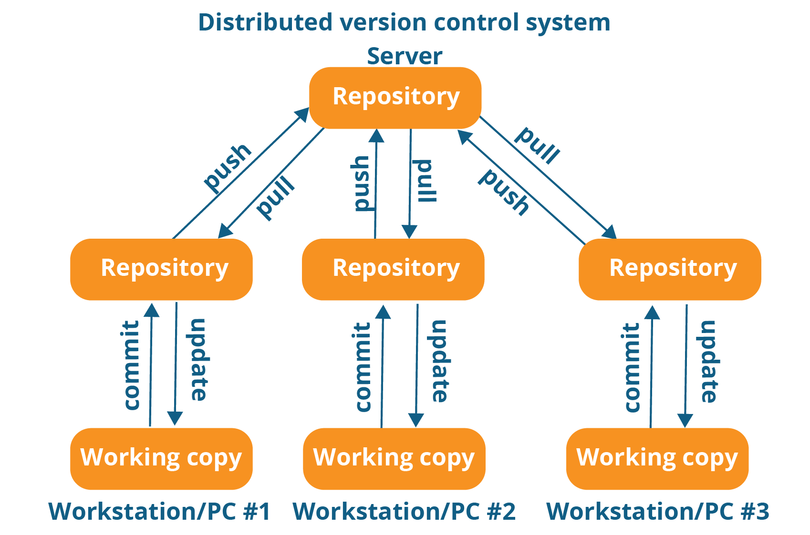

Slide 4
Git Installation
Git on Windows
Install visual studio code
Install git
Create a repo in github
Connect to github
Git on Linux
sudo apt-get update
sudo apt-get install git

Slide 5
Github setup
Create a repo
Git config
Initialize
Add
Commit
Pull
Push

Slide 6
Git Areas
Working Area
Staging Area
Commit Area

Slide 7
Git Command
git init
Creates a new repository.
git config
git config --global user.name “Your Name”
git config --global user.email “yourmail@yourdomain.com”
Sets the author name and email address respectively.
git clone
git clone https://github.com/myrep/mycode.git
Copy of a repository from an existing URL.

Slide 8
Git Command
git status
Displays the state of the working directory and the staging area.
You can see changes that are in the staging, those that are not staged and are not tracked by Git.
git add
git add file.txt
Adds a file (file.txt) to the staging area.
git add .
git add *
Add all files to the staging area before commit

Slide 9
Git Command
git restore
git restore file.txt
git restore .
Un-stage or even discard uncommitted local changes
git commit
git commit -m “commit message”
Records the file permanently in the version history.
git show
Displays the metadata and content changes of the commit.
git log
Shows the commit logs
git log
git log –oneline
git log –name-only

Slide 10
Git Command
git rm
git rm file.txt
git rm –f file.txt
git rm –cached file.txt
Deletes the file from your working directory and stages the deletion.
git push
This command sends the committed changes of the master branch to your remote repository.
git push [variable name] master
git push [variable name] [branch]
git push origin master

Slide 11
Git Command
git pull
Fetches and merges changes on the remote server to your working directory.
git branch
Lists all the local branches in the current repository.
git branch develop_branch
Creates a new branch.
git branch -d develop_branch
Deletes the feature branch.
git push --set-upstream origin feature/algo

Slide 12
Git Command
git checkout
git checkout branch_name
Switch from one branch to another.
git checkout –b branch_name
Create a new branch and switch to the new branch.
git merge
git merge branch_name
Merges the specified branch’s history into the current branch.

Slide 13
Git revert and reset
git revert
It is used for undoing changes to a repository's commit history
git revert HEAD
git reset
It is used to undo local changes to the state of a Git repo
git reset --hard f414f31
git reset --soft HEAD@{1}
git stash

Slide 14
.gitignore
Git can specify which files or parts of your project should be ignored by Git using a .gitignore file.
Git will not track files and folders specified in .gitignore.
The .gitignore file itself is tracked by Git.
Examples of ignored file
log files
temporary files
hidden files
personal files

Slide 15
Git Fork
Forking is a git clone operation executed on a server copy of a projects repo
A fork is a copy of a repository that you manage.
Forks let you make changes to a project without affecting the original repository
Syncing a fork
Sync a fork of a repository to keep it up-to-date with the upstream repository

