Slide 1
Kubernates

Slide 2
Docker Orchestration tools
Docker Swarm - Docker's own tool
Kubernetes – Google (Most popular)
Mesos – Apache
Kubernetes is supported on all public cloud service providers like
GCP
Azure
AWS

Slide 3
What is Kubernetes
Kubernetes (K8s) is an open-source system:
Automating Deployment
Scaling
Management of containerized applications.
Large, rapidly growing ecosystem. Kubernetes services, support, and tools are widely available
Kubernetes was originally developed and designed by engineers at Google

Slide 4
Kubernetes
Kubernetes -> K8s
Kubernetes originates from Greek, meaning pilot

Slide 5
Features
With Kubernetes:
Orchestrate containers across multiple hosts.
Make better use of hardware to maximize resources needed to run your enterprise apps.
Control and automate application deployments and updates.
Mount and add storage to run stateful apps.
Scale containerized applications and their resources on the fly.
Declaratively manage services, which guarantees the deployed applications are always running the way you intended them to run.
Health-check and self-heal your apps with auto-placement, auto-restart, auto-replication, and autoscaling.

Slide 6
Kubernetes Components
A Kubernetes cluster consists of a set of worker machines, called nodes (at least one worker node)
The worker node(s) host the Pods
The control plane manages the worker nodes and the Pods in the cluster.

Slide 7
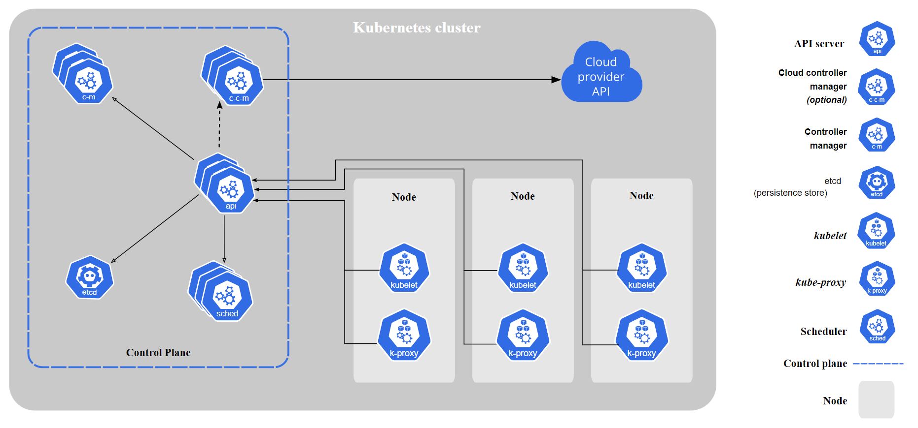

Slide 8
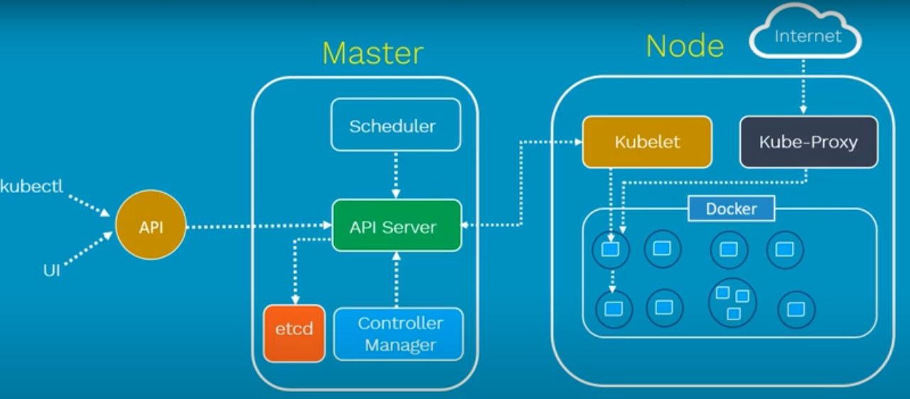

Slide 9
Control Plane Components
Api Server
Exposes the Kubernetes API. The API server is the front end for the Kubernetes control plane.
etcd
Consistent and highly-available key value store used as Kubernetes' backing store for all cluster data.
kube-scheduler
Control plane component that watches for newly created Pods with no assigned node, and selects a node for them to run on.
kube-controller-manager
Runs controller processes.

Slide 10
Node Components
Kubelet
An agent that runs on each node in the cluster.
It makes sure that containers are running in a Pod.
kube-proxy
kube-proxy is a network proxy that runs on each node in your cluster.
Container runtime
The container runtime is the software that is responsible for running containers.
docker

Slide 11
Setup Kubernetes
Many ways to setup Kuberenetes.
Locally setup on laptops or virtual machines
Minikube
Kubeadmin
Minikube: A single instance of kubernetes in an All-in-one setup
Kubeadmin: Is a tool used to configure kubernetes in a multi-node setup
AWS EKS
Azure AKS
GKE (Google Kubernetes Engine)

Slide 12
Miniqube setup
Minikube Tutorial: –
https://kubernetes.io/docs/tutorials/hello-minikube/
install and set up the kubectl tool: –
https://kubernetes.io/docs/tasks/tools/
Install Minikube: –
https://minikube.sigs.k8s.io/docs/start/

Slide 13
Installation
Following installation required to kubernates in your local
minikube
Kubectl
You can use kubectl from minikube
Docker Desktop
minikube status

Slide 14
Work with minikube
minikube start
Start your cluster
minikube kubectl -- get po –A
minikube can download the appropriate version of kubectl and you should be able to use it like this
alias kubectl="minikube kubectl --“
alias kl="minikube kubectl --“

Slide 15
Manage minikube cluster
minikube pause
Pause Kubernetes without impacting deployed applications
minikube unpause
Unpause a paused instance
minikube stop
Halt the cluster
minikube delete --all
Delete all of the minikube clusters
minikube update-context

