Slide 1
POD

Slide 2
POD
Pods are the smallest deployable units to create and manage in Kubernetes.
It is a collection of one or more containers, with shared storage and network resources.
A Pod contains one or more application containers which are relatively tightly coupled.
Each Pod is meant to run a single instance of a given application
Single container Pod.
The Pod as a wrapper around a single container.
Kubernetes manages Pods rather than managing the containers directly.

Slide 3
Pod
Pods contain multiple containers.
A Pod can encapsulate multiple co-located containers that are tightly coupled and need to share resources.
The Pod wraps the containers, storage resources, and an ephemeral network identity together as a single unit.
The containers in a Pod are automatically co-located and co-scheduled on the same physical or virtual machine in the cluster.
The containers can share resources and dependencies, communicate with one another, and coordinate when and how they are terminated.

Slide 4
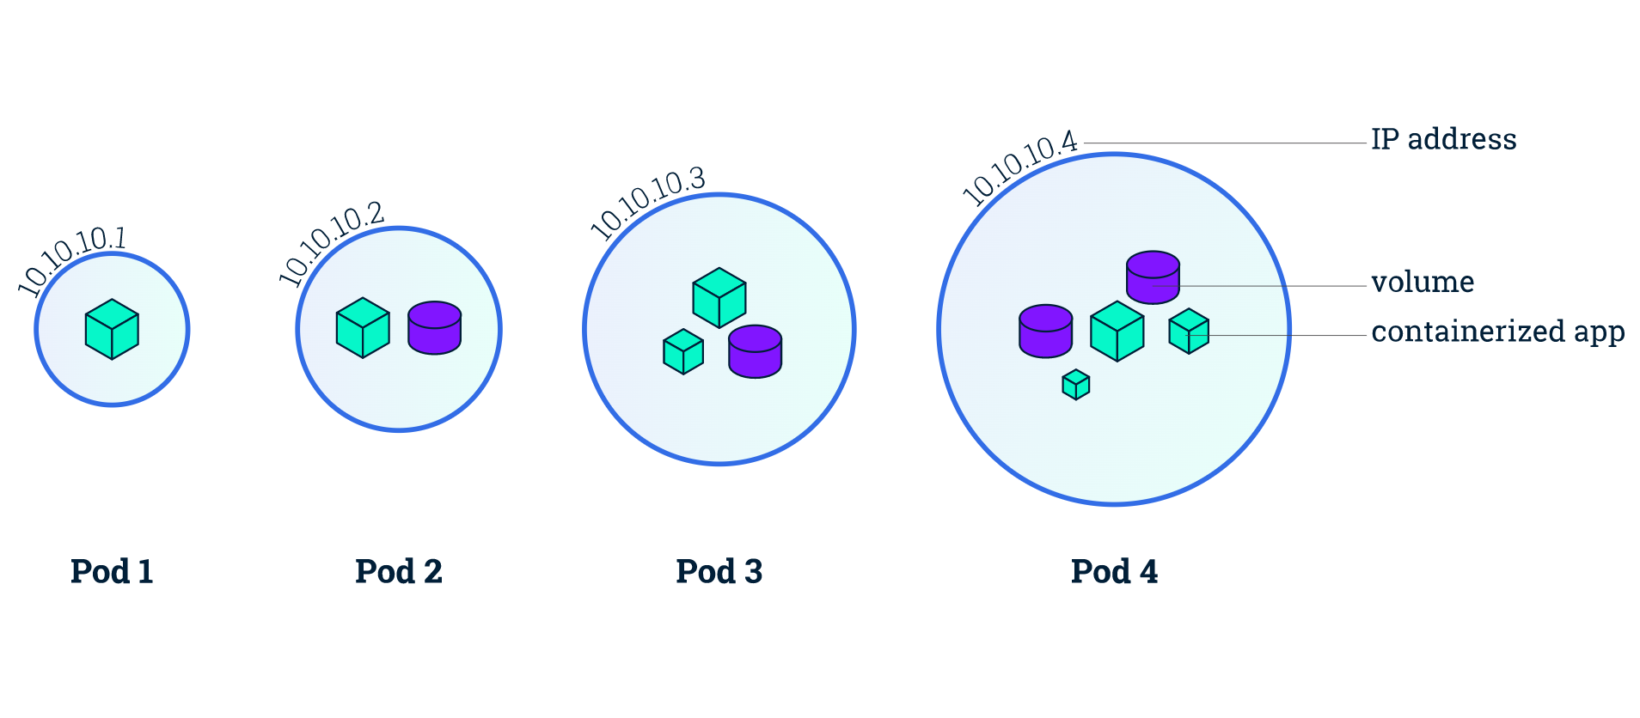

Slide 5
Create a Pod using kubectl run https://jamesdefabia.github.io/docs/user-guide/kubectl/kubectl_run/
Start a single instance of nginx.
kubectl run nginx --image=nginx
Start a single instance of nginx and let the container expose port 80 .
kubectl run mynginx --image=nginx --port=80

Slide 6
List the pod
List all pods in ps output format
kubectl get pods
List all pods in ps output format with more information
kubectl get pods -o wide

Slide 7
Create a pod using yaml https://kubernetes.io/docs/concepts/workloads/pods/
apiVersion: v1
kind: Pod
metadata:
name: nginx
spec:
containers:
- name: mynginx
image: nginx
ports:
- containerPort: 80
kubectl apply -f simple-pod.yaml

Slide 8
Demo
Use Visual Studio Code

