Slide 1
Service

Slide 2
Kubernetes Service
Service defines a logical set of Pods and a policy by which to access them.
Service is used to expose an application deployed on a set of pods using a single endpoint
Types:
NodePort
ClusterIP - default
LoadBalancer
ExternalName

Slide 3
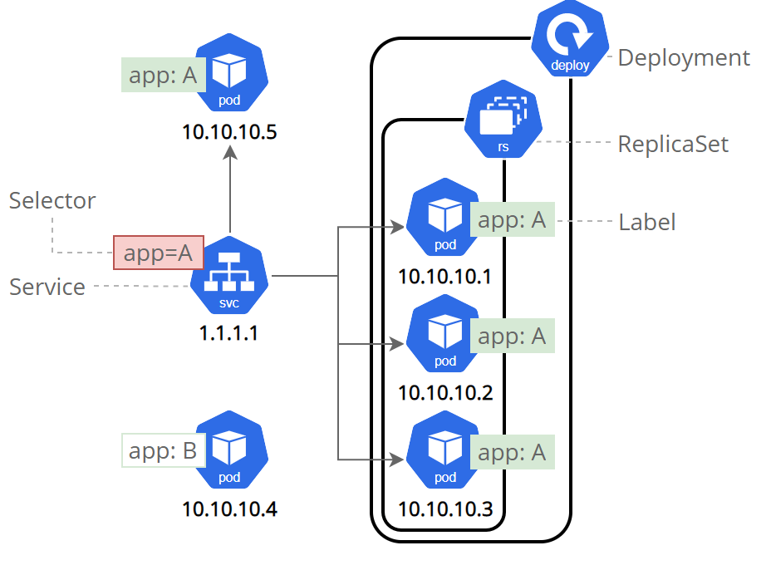

Slide 4
Why Services?
In Kubernetes, each Pod gets its own internal IP address, but Pods are ephemeral
Pods are frequently created and destroyed, and their IP addresses changed.
When old Pod dies and new one gets started in its place it gets a new IP address.
So we can’t rely on Pod IP addresses as it changes.
With the Service we have a solution of a stable or static IP address that stays even when the Pod is destroyed.

Slide 5
Publishing Services - ServiceTypes
ServiceTypes allow you to specify the kind of Service
ClusterIP: Default
Exposes the Service on a cluster-internal IP.
Choosing this value makes the Service only reachable from within the cluster.
NodePort:
Exposes the Service on each Node's IP at a static port.
Static Port Range: 30000 ~ 32767
LoadBalancer:
Exposes the Service externally using a cloud provider's load balancer.
ExternalName:
Maps the Service to the contents of the externalName field
Ex: apps.example.com

Slide 6
Service Commands
Kubctl get services
Kubectl get svc
Kubectl describe svc svc-name
Kubectl delete svc svc-name

