Slide 1
What is Infrastructure as Code

Slide 2
Traditional Infrastructure
Traditional data centers consist of various pieces of hardware ex: Servers, Storage, Network etc.
This server is typically installed on the premises, and provides all employees using the hardware, access to the business’s stored data and applications.
Additional hardware and upgrades required in order to scale up.
Mandatory software upgrades also required.

Slide 3
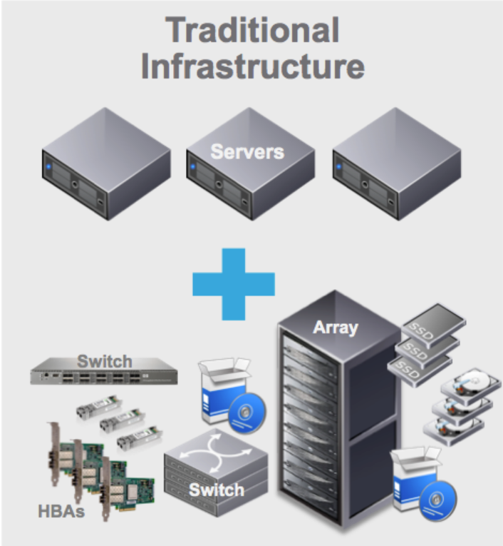

Slide 4
Cloud Computing vs Traditional IT infrastructure
Virtual hosting solution.
All servers, software and networks are hosted in the cloud
Instead investing money into purchasing physical servers in-house, you can rent the data storage space from CSP on a more cost effective pay-per-use basis.

Slide 5
Cloud Computing vs Traditional IT infrastructure benefits
Resilience and Elasticity
Traditional IT systems are not so resilient and cannot guarantee a consistently high level of server performance
The infra hosted in the cloud are evenly distributed across all the servers, which are connected to work as one.
If one server fails, no data is lost and downtime is avoided.
Flexibility and Scalability
Cloud offers flexibility and scalability in comparison to traditional data centres.
The on-demand virtual space of cloud computing has unlimited storage space and more server resources.
Cloud servers can scale up or down depending on the level of traffic your website receives

Slide 6
Automation
APIs and SDKs provided by CSP
Running Costs
Cloud computing is more cost effective than traditional IT infrastructure
Security

Slide 7
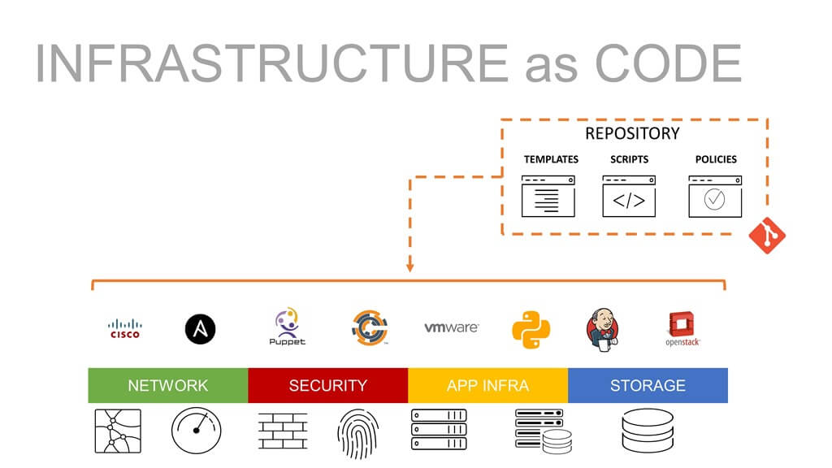
Introduction to IAC
Infrastructure as Code (IaC) is a process to managing and provisioning of infrastructure through code instead of through manual processes.
With IaC, configuration files are created that contain your infrastructure specifications, which makes it easier to edit and distribute configurations.

Slide 8
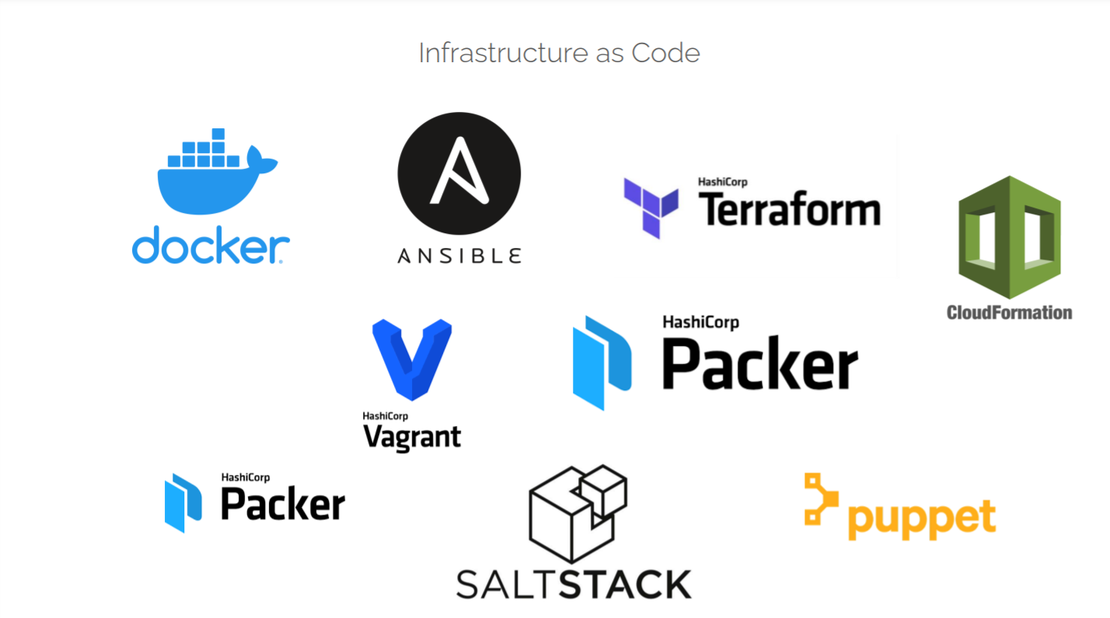

Slide 9
Types Of IaC tools
Configuration Management
Chef
Puppet
Ansible
SaltStack
Server Templating
Docker
Packer
Infrastructure Provisioning
Terraform
CloudFormation
Google Cloud Deployment Manager
Azure Resource Manager

Slide 10
Terraform (by HashiCorp)
Terraform is an open-source infrastructure as code software tool created by HashiCorp
Most popular IAC tool
Single binary, easy installation
Supports 100s of providers. All popular CSP, network infra, monitoring and data management cloud providers tools
https://registry.terraform.io/browse/providers

Slide 11
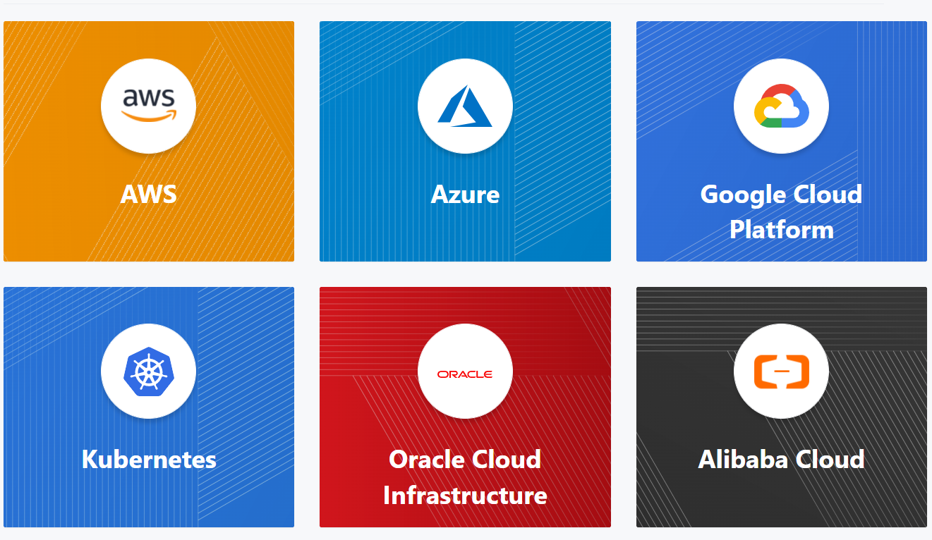

Slide 12
Terraform Installation
Installation
configuration for aws

