Slide 1
Introduction to Structures:
Definition and Initialization of Structures, Accessing structure members, Structure pointers Nested Structures, Array of Structures, Structures and Functions, Unions, typedef, Enumerated Data types.

Slide 2
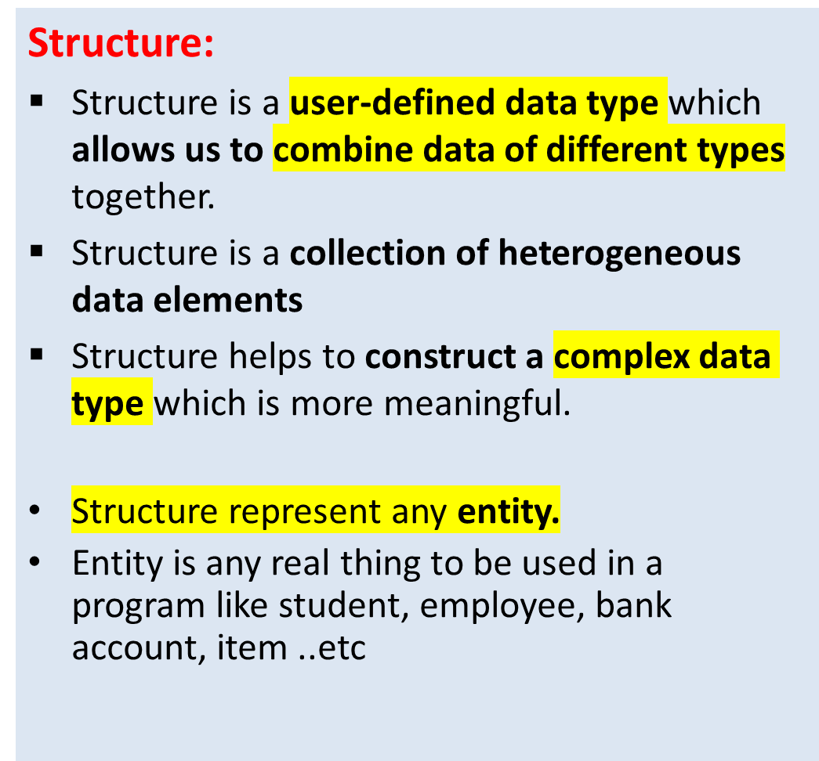
Structures
Example:
If Student is an entity, its properties are
  Roll number
  Name
  Cgpa
If Employee is an entity, its properties are
  Name
  Designation
  Salery ..etc

Slide 3
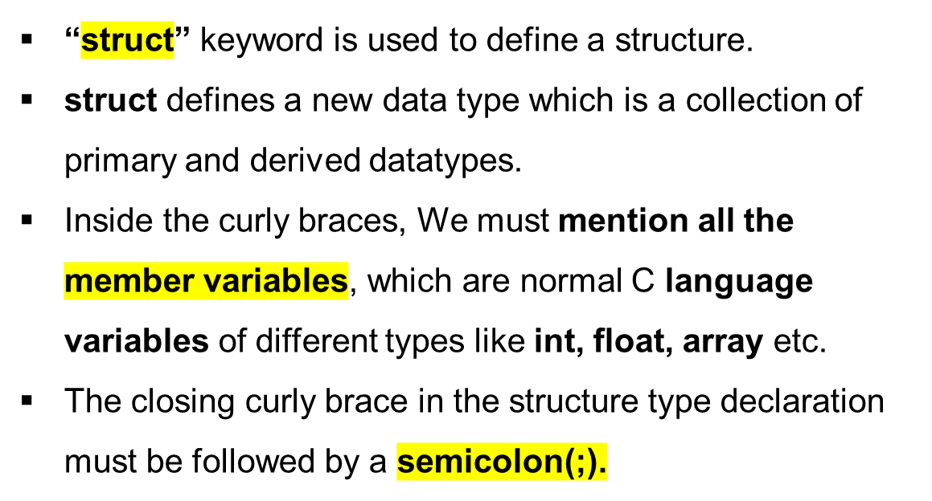
Defining a Structure
Defining a structure
Syntax:
  struct structure_name
  {
  datatype 1 variable 1;
  datatype2 variable 2;
  datatype3 variable 3;
  ...
  };

Slide 4
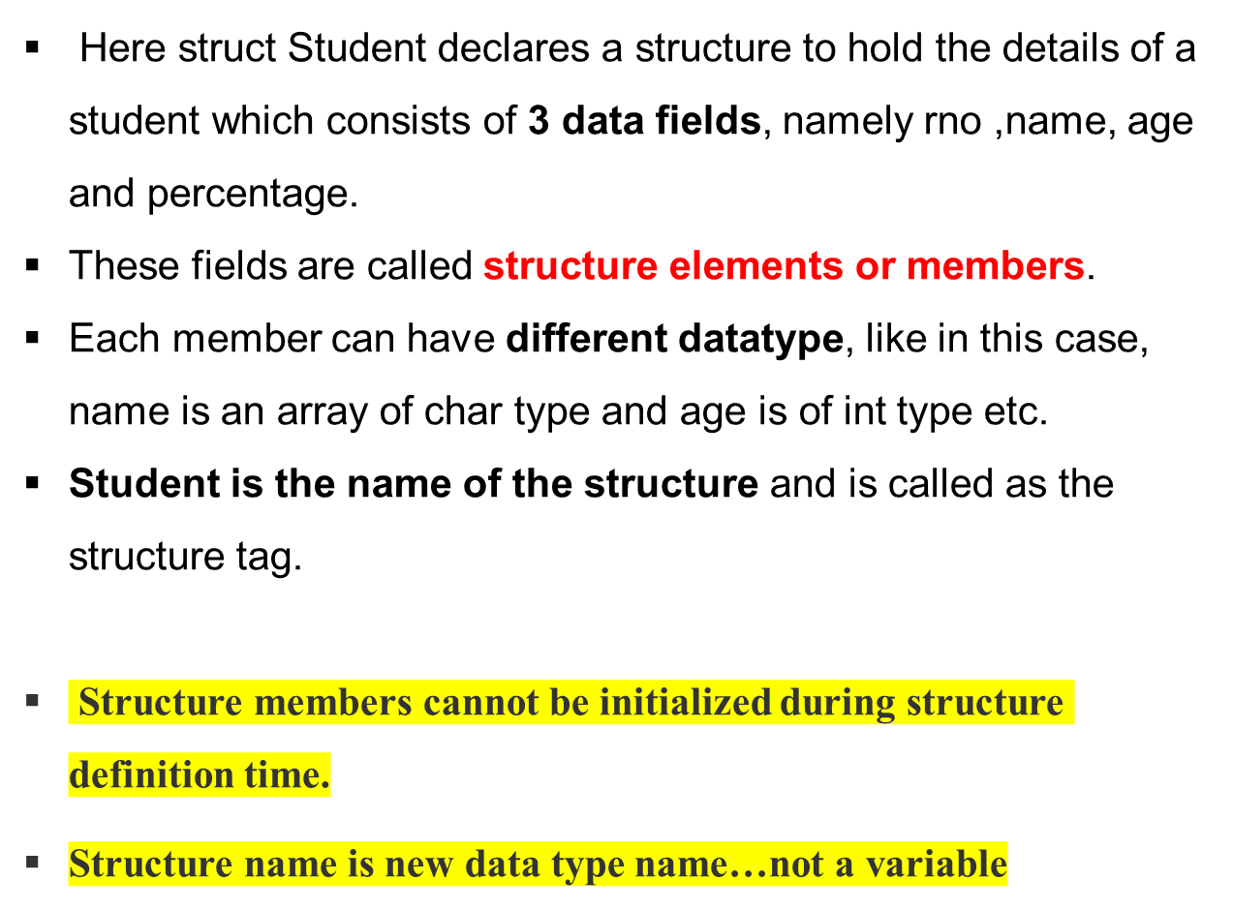
Defining Structure
Ex.
struct student
{
int rno;
char name[20];
float percentage;
};
rno, name and percentage are structure memembers

Slide 5
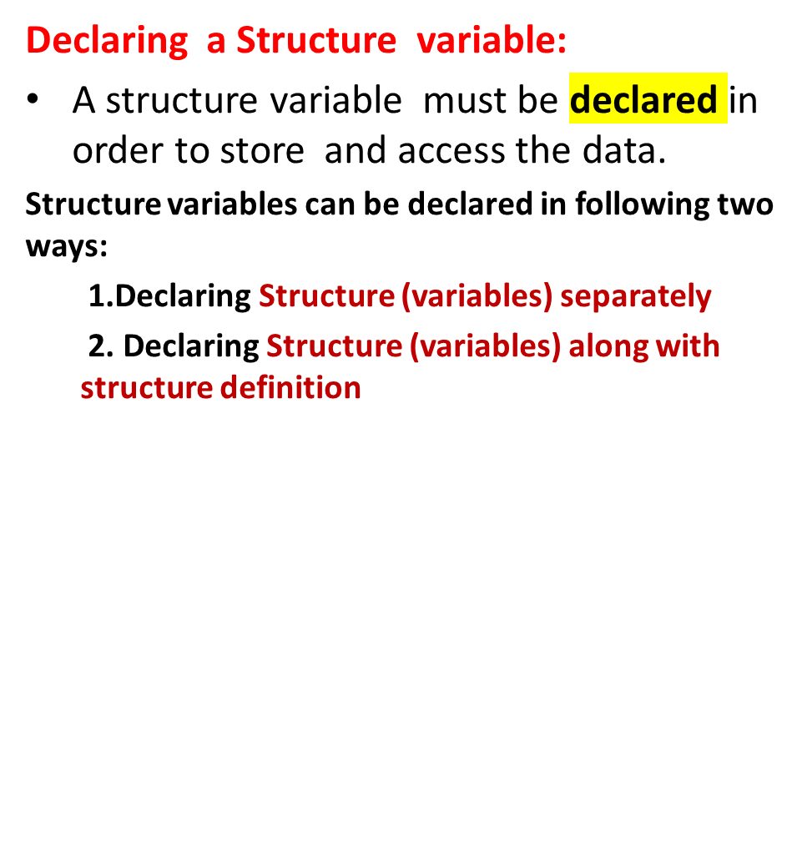
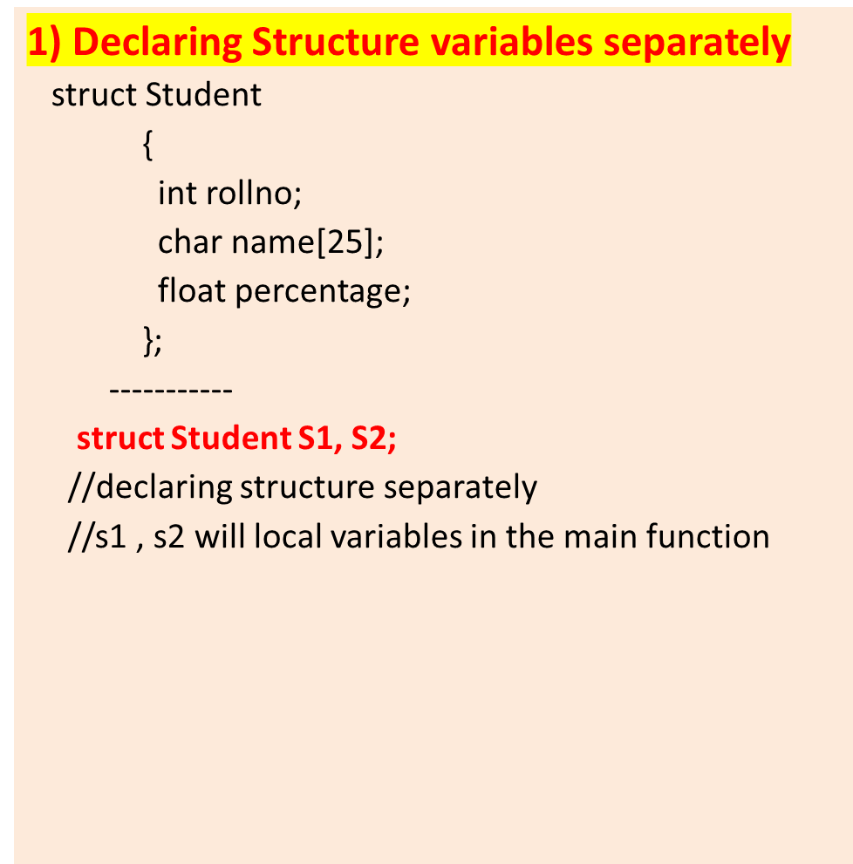
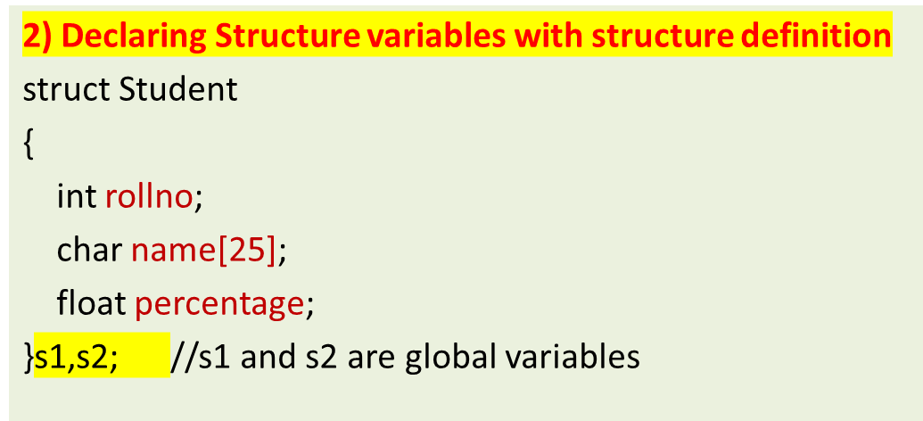
Structure Variable Declaration

Slide 6
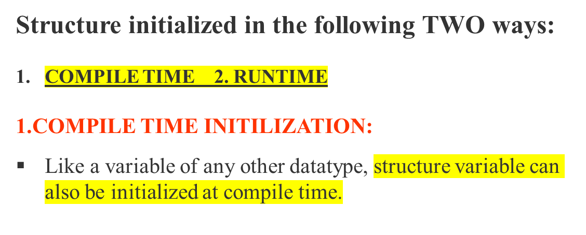
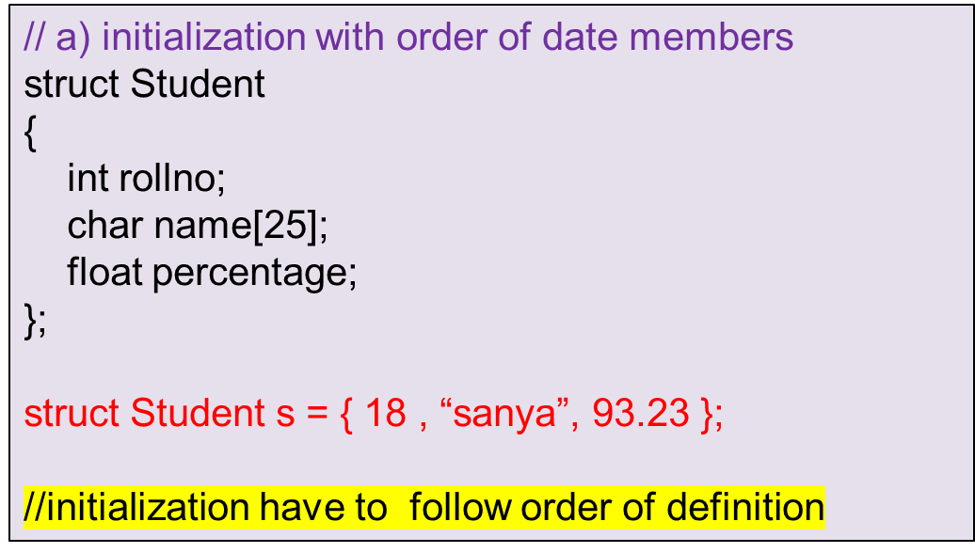
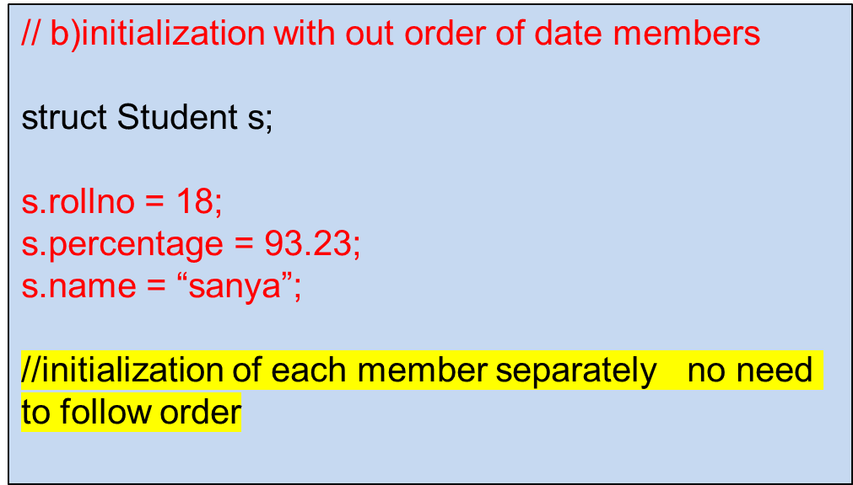
Structure Initialization

Slide 7
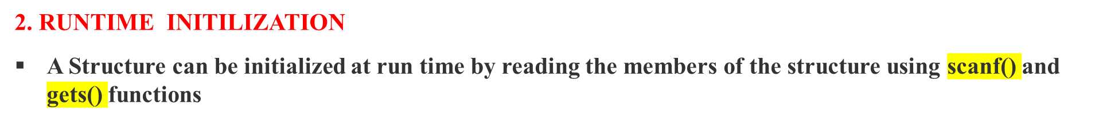
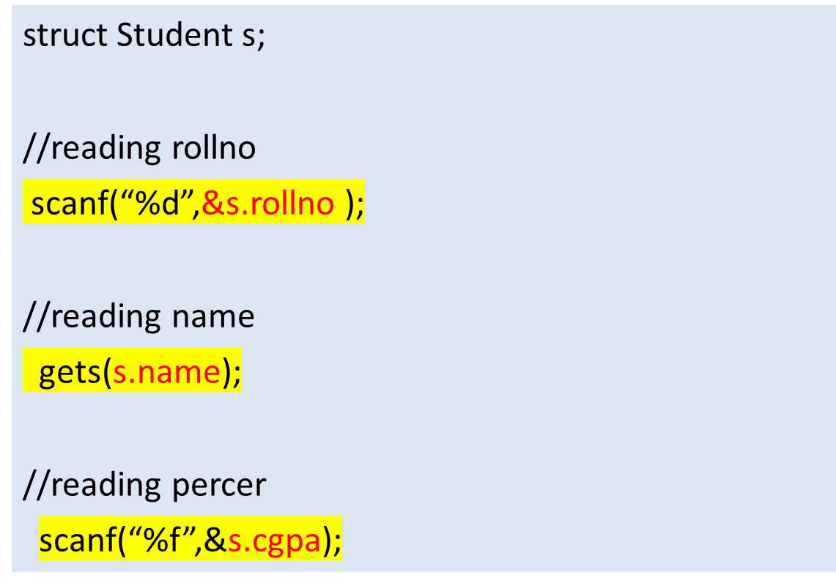
Structure Initialization
Ex.
#include<stdio.h>
#include<string.h>
struct Student
{
int rollno;
char name[25];
float cgpa;
};

Slide 8
Structures
Q) Write a C Program create a student structure with rno, name and cgpa. Read and display the data members of the same
  INPUT:
  Enter Rollno: 856
  Name: Sachin
  cgpa: 9.35
  OUTPUT:
  Rollno is : 856
  Name is : Sachin
  cgpa is : 9.35
    LOGIC:
    Create a structure with data members
    Declare structure variable
    Initialize the structure members
    Display them

Slide 9
Q) Write a C Program create a student structure with rno, name and cgpa. Read and display the data members of the same
#include <stdio.h>
struct Student {
int rno;
char name[100];
float cgpa;
};
int main()
{
struct Student s1;
printf("Enter student rno: ");
scanf("%d", &s1.rno);
printf("Enter student name: ");
getchar();
gets(s1.name);
printf("Enter student CGPA: ");
scanf("%f", &s1.cgpa);
// Display the entered information
printf("Student rno: %d\n", s1.rno);
printf("Student name: %s\n", s1.name);
printf("Student CGPA: %.2f\n", s1cgpa);
return 0;
}

Slide 10
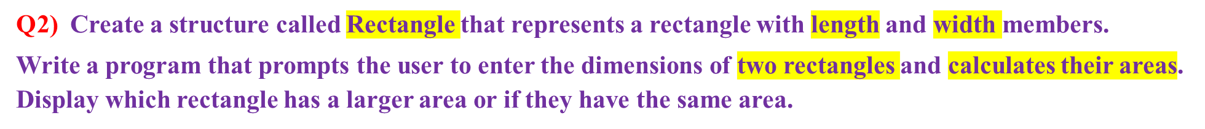
Structures
Logic:
Define a structure called Rectangle with length and width as members.
Prompt the user to enter the dimensions of two rectangles.
calculate the areas of both rectangles ..as area = length * width.
Compare the areas of the two rectangles
If the area of the first rectangle is greater, display “the first rectangle has a larger area”.
If the area of the second rectangle is greater, display “second rectangle has a larger area”
If both rectangles have the same area, display they have equal areas.
Input:
Enter length and width of RECT-1: 5.2 3.7
Enter length and width of RECT-2: 4.8 6.1
Output:
The RECT-2 has a larger area.

Slide 11
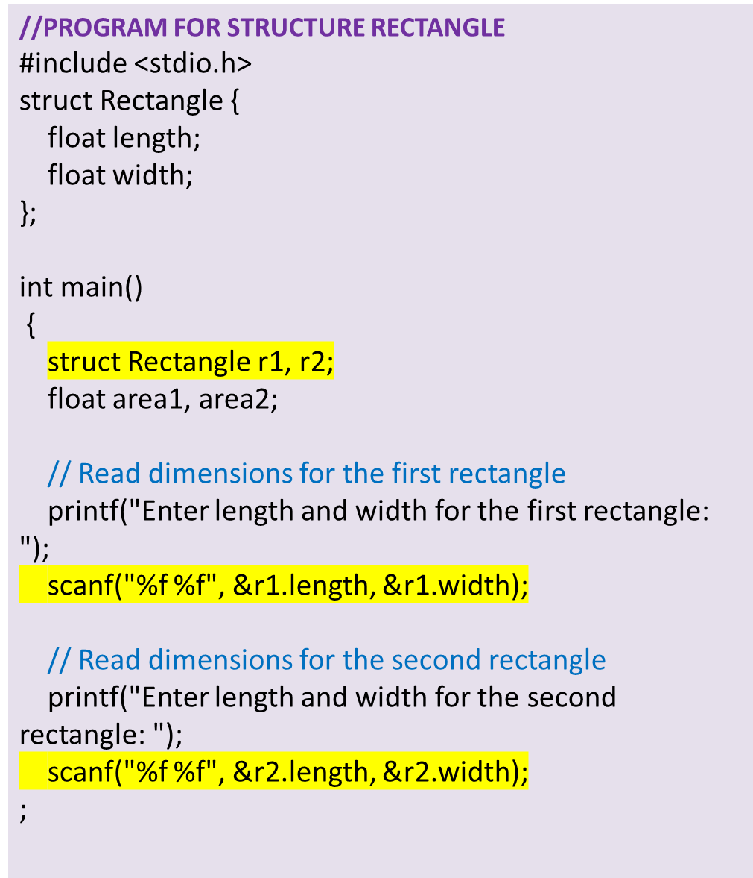
// Calculate areas
area1 = r1.length * r1.width;
area2 = r2.length * r2.width
// Compare areas and display the result
if (area1 > area2) {
printf(“RECT-1 has a larger area.\n");
} else if (area2 > area1) {
printf(“RECT-2 has a larger area.\n");
} else
{
printf("Both rectangles have equal areas.\n");
}
return 0;
}
OUTPUT:
Enter length and width for the first rectangle: 5.2 3.7
Enter length and width for the second rectangle: 4.8 6.1
The second rectangle has a larger area.

Slide 12
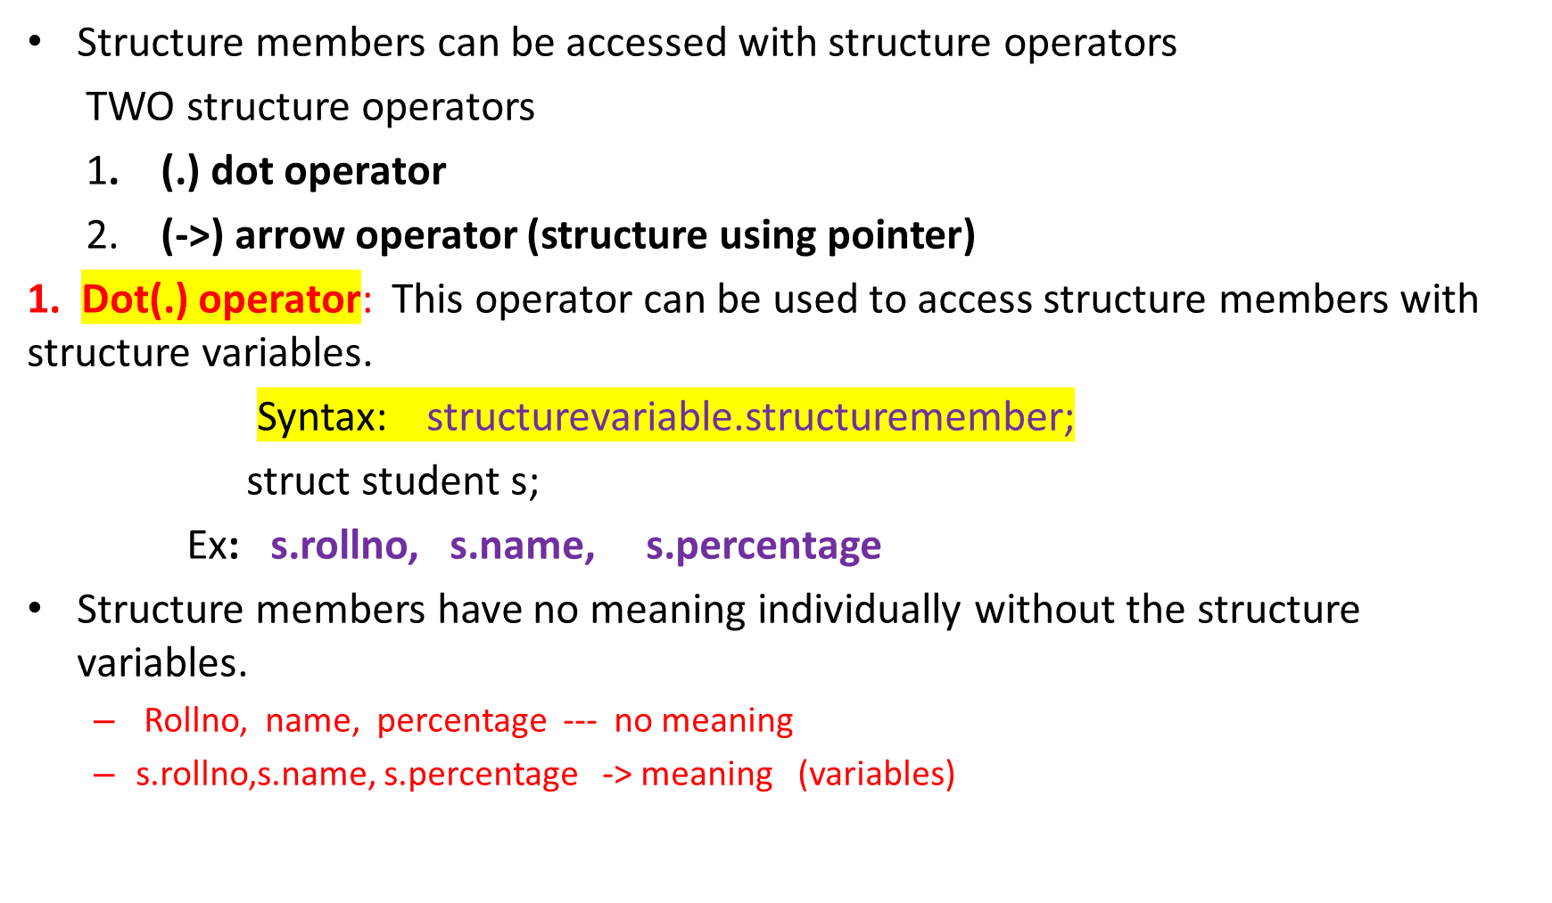
Accessing structure members

Slide 13
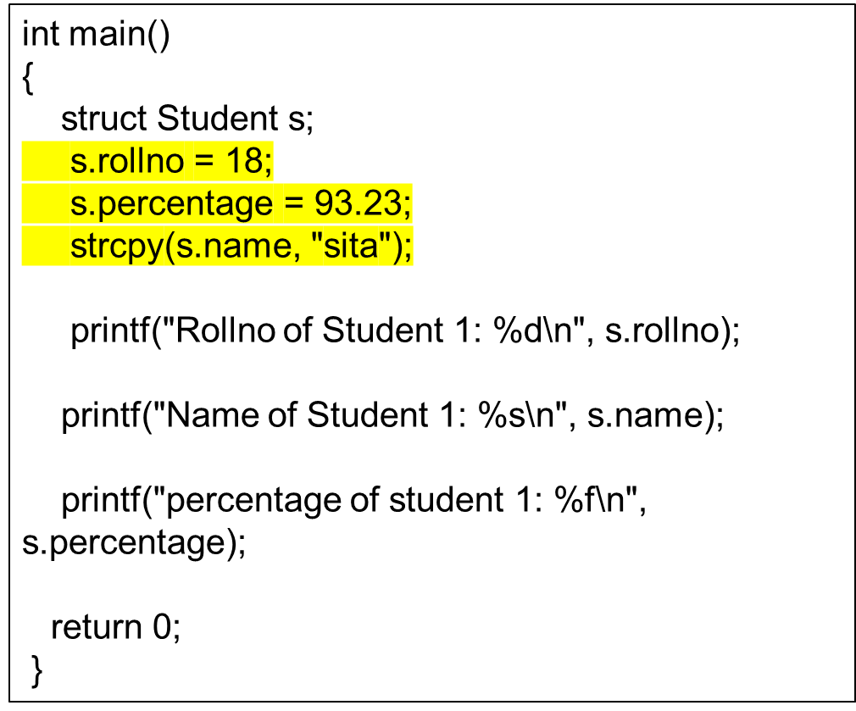
Accessing structure members using .(dot) operator
// C program to access structure members using dot(.) operator
#include<stdio.h>
#include<string.h>
struct Student
{
int rollno ;
char name[25];
float percentage;
};

Slide 14
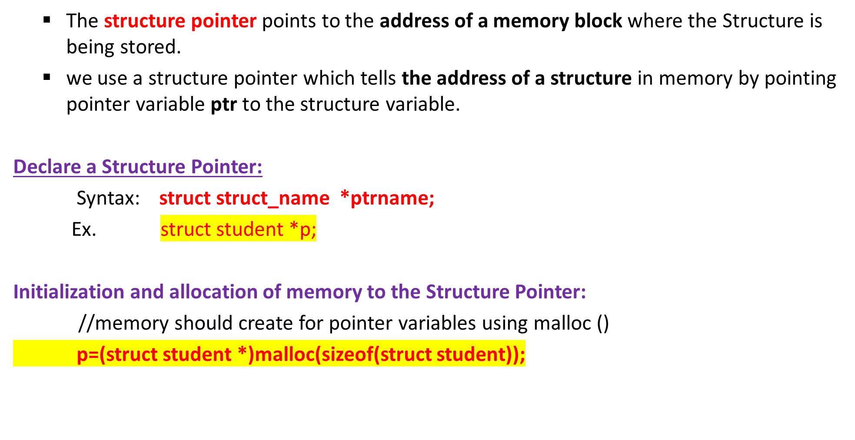
Structure Pointer /pointer structure

Slide 15
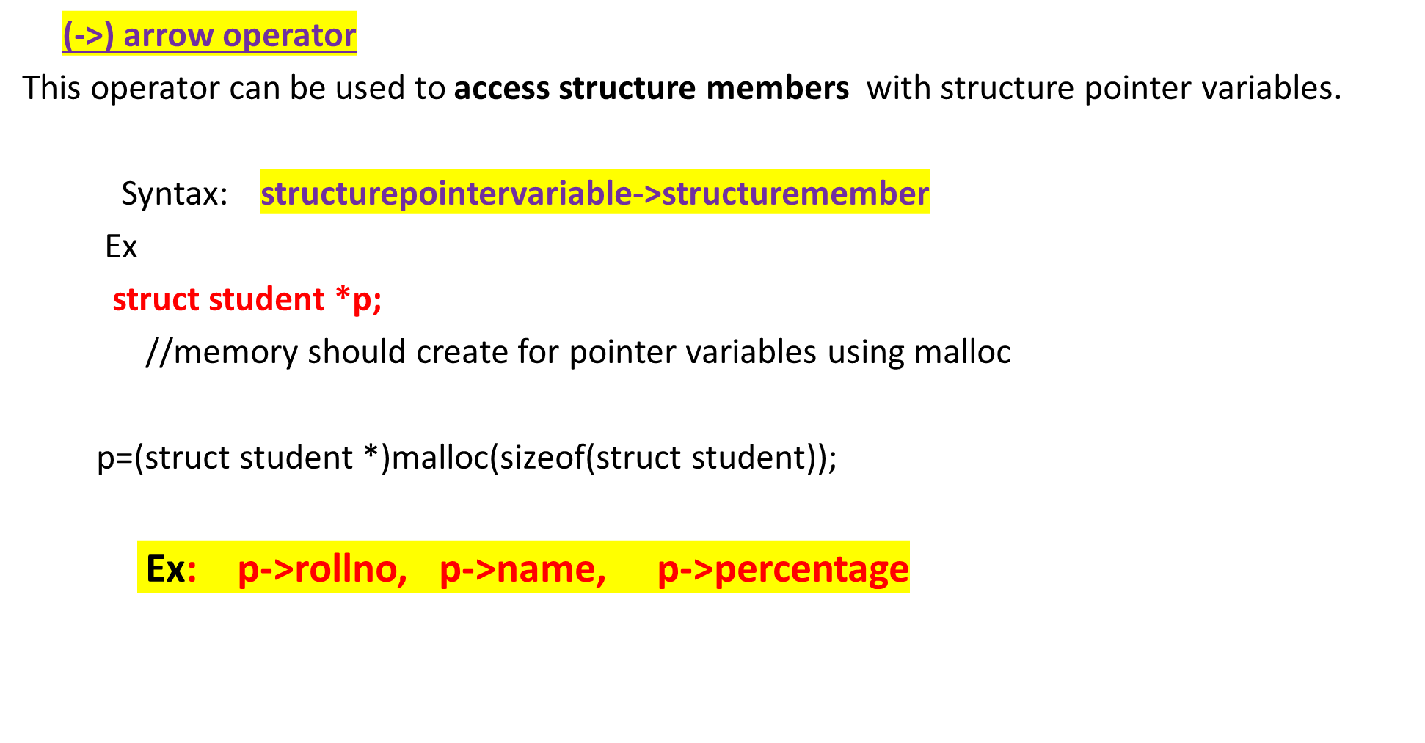
Accessing structure pointer members using -> operator

Slide 16
Accessing structure members using pointer
void main()
{
struct Emp *p;
p=(struct Emp *)malloc(sizeof(struct Emp));
p->eno = 3518;
p->sal = 85000.50;
strcpy(p->name, “samarth");
printf(" Emp number : %d\n", p->eno);
printf("Name : %s\n", p->name);
printf(“Salary : %f\n", p->sal);
}
//Using Arrow operator
#include<stdio.h>
#include<string.h>
struct Emp
{
int eno;
char ename[25];
float sal;
};

Slide 17
Structure pointer
Q) Write a C Program create a student structure pointer with name, rno and cgpa. Read and display the data members of the same
  INPUT:
  Name: Sachin
  Enter rno: 856
  cgpa: 9.35
  OUTPUT:
  Name is : Sachin
  Rollno is : 856
  cgpa is : 9.35
    LOGIC:
    Create a structure with data members
    Declare structure pointer variable
    Initialize the structure members
    Display them

Slide 18
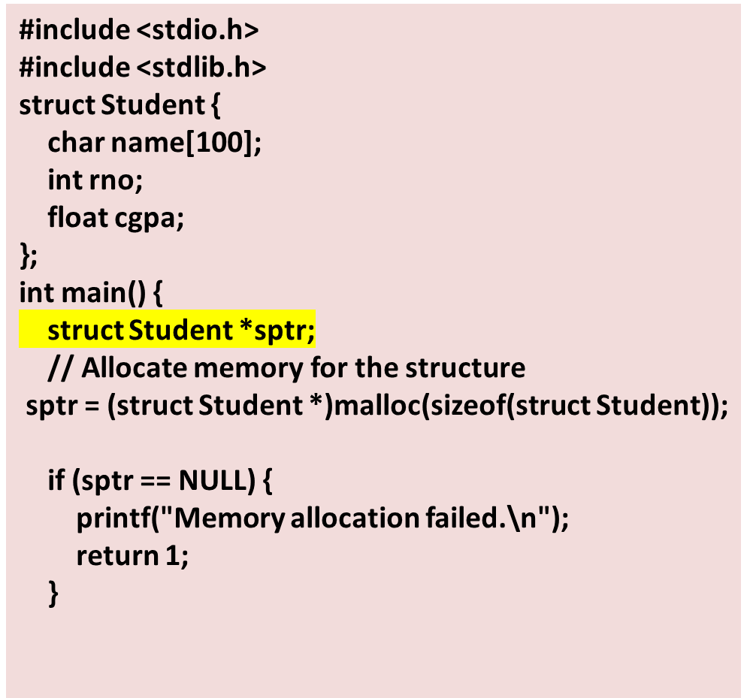
Q) Write a C Program create a student structure pointer with name, age and marks. Read and display the data members of the same
// Read information using the pointer
printf("Enter student name: ")
scanf (" %s", & sptr ->name);
printf("Enter student rno: ");
scanf("%d", &(sptr ->rno));
printf("Enter student marks: ");
scanf("%f", &(sptr ->cgpa));
// Display the entered information
printf("Student name: %s", sptr->name);
printf("Student age: %d\n", sptr->rno);
printf("Student marks: %.2f\n", sptr->cgpa);
// Free the allocated memory
free(sptr);
return 0;
}

Slide 19
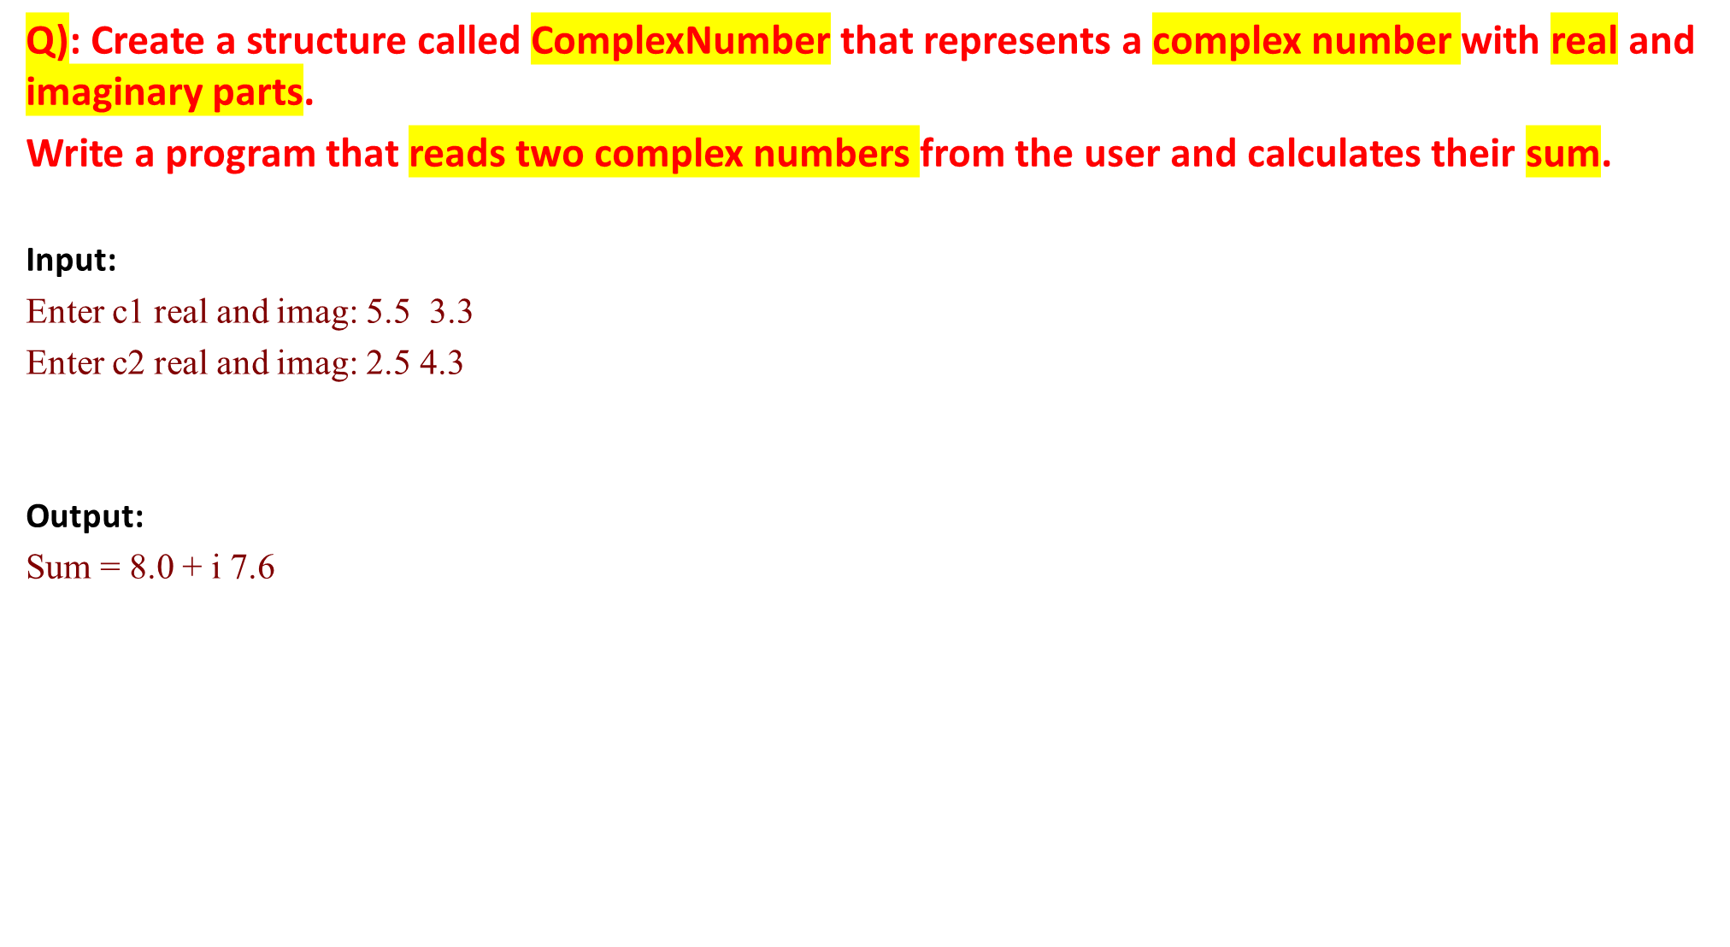
Logic
  Define a structure called Complex with real and imaginary parts as members.
  Prompt the user to enter the real and imaginary parts of two complex numbers.
  Read the real and imaginary parts for each complex number.
  Calculate the sum of the two complex numbers by adding their corresponding real and imaginary parts.
  Display the sum of the two complex numbers.

Slide 20
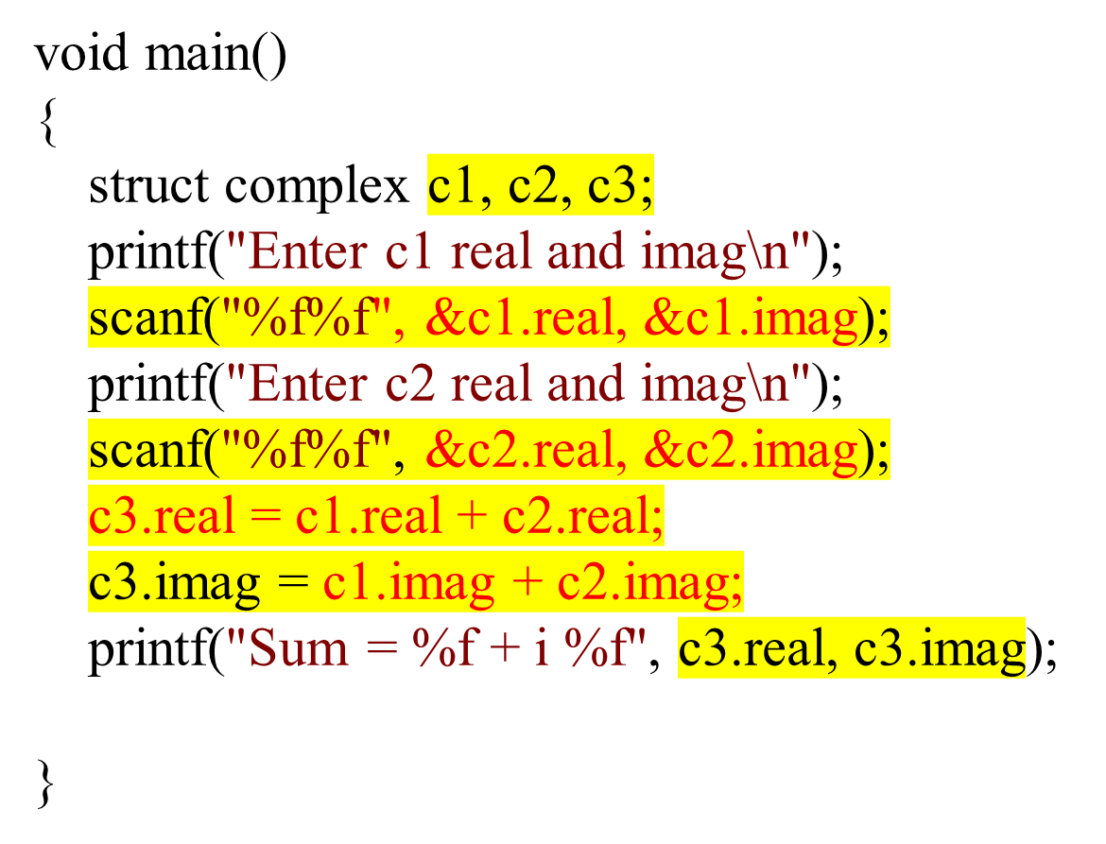
//addition of 2 complex numbers using structures
#include <stdio.h>
struct complex
{
float real;
float imag;
};

Slide 21
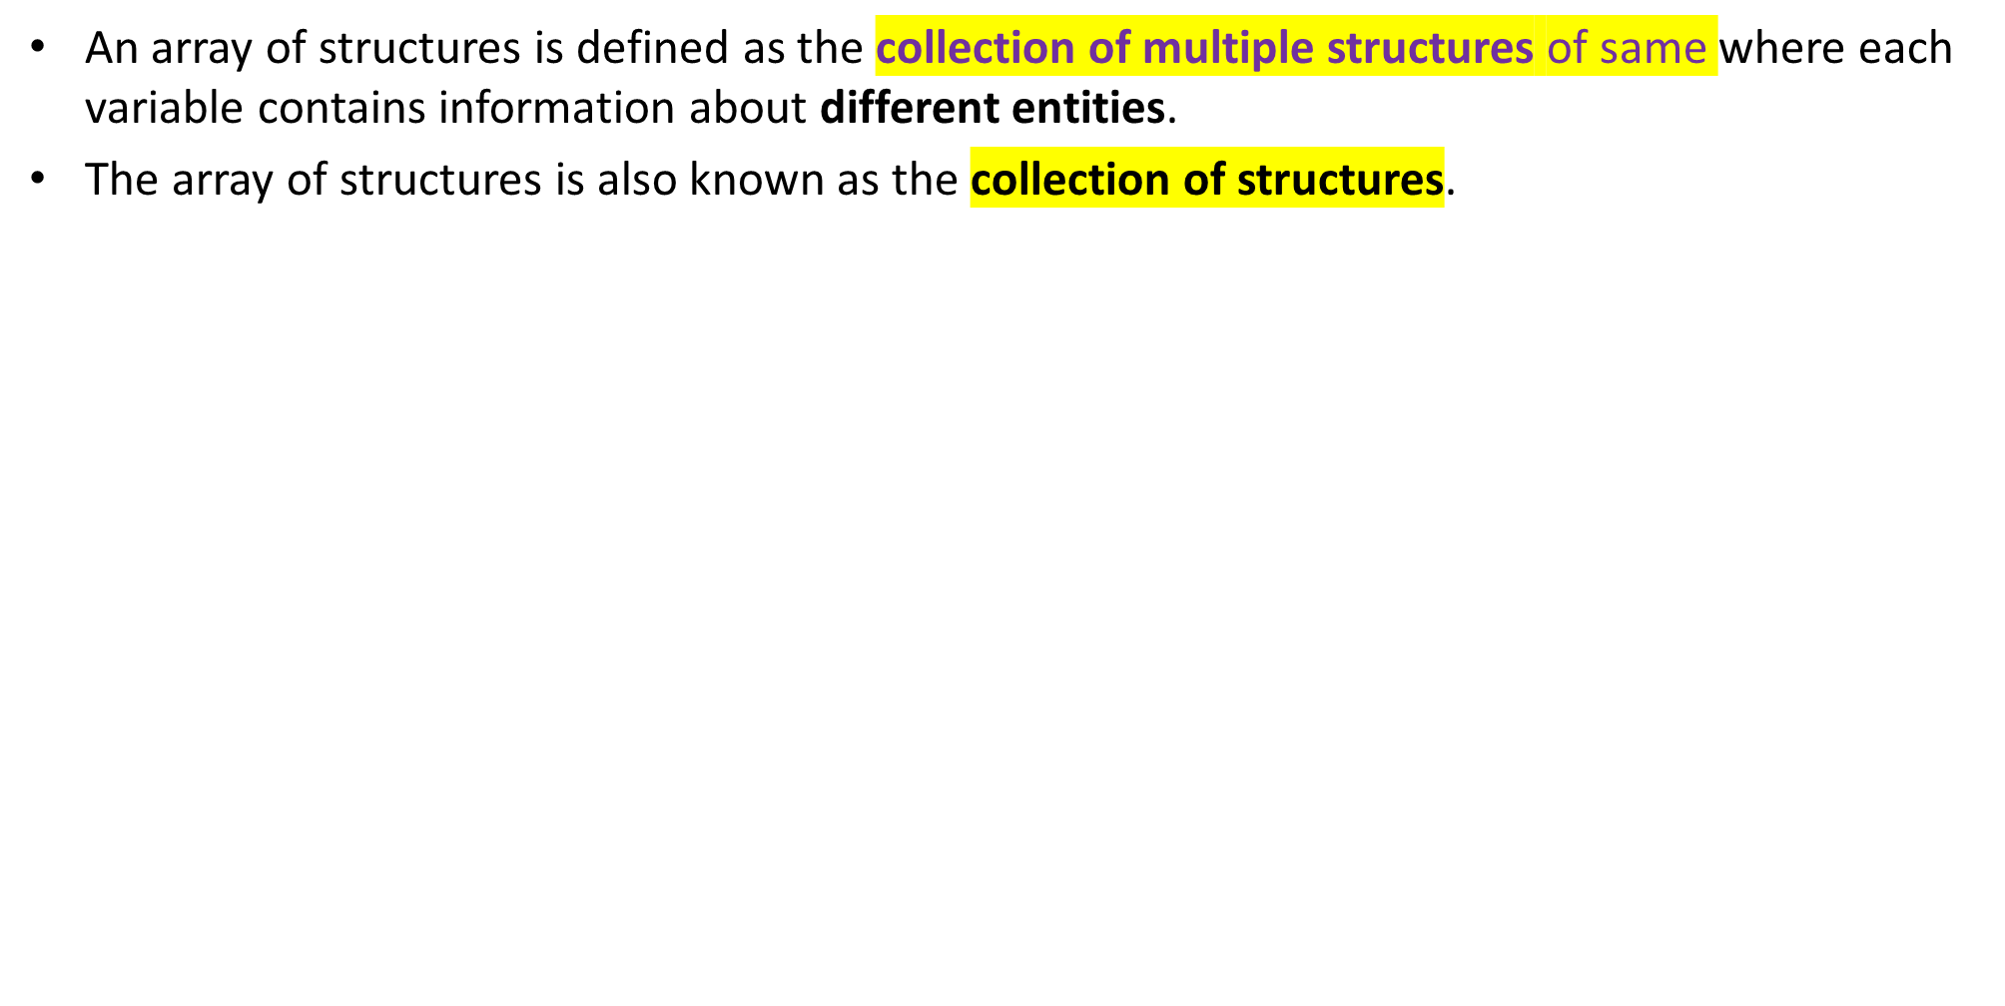
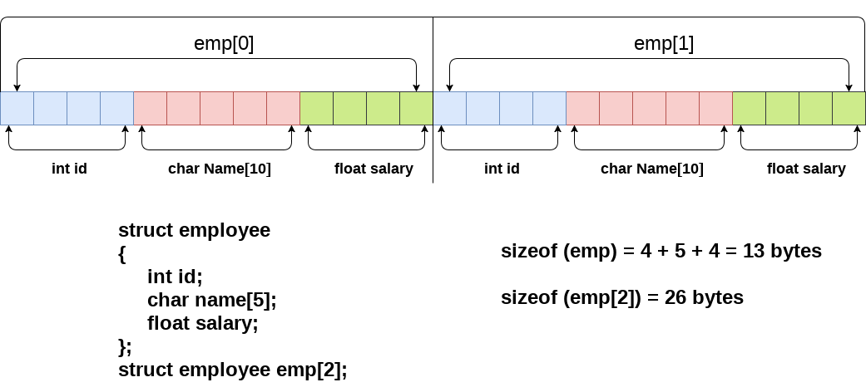
Array of structures

Slide 22
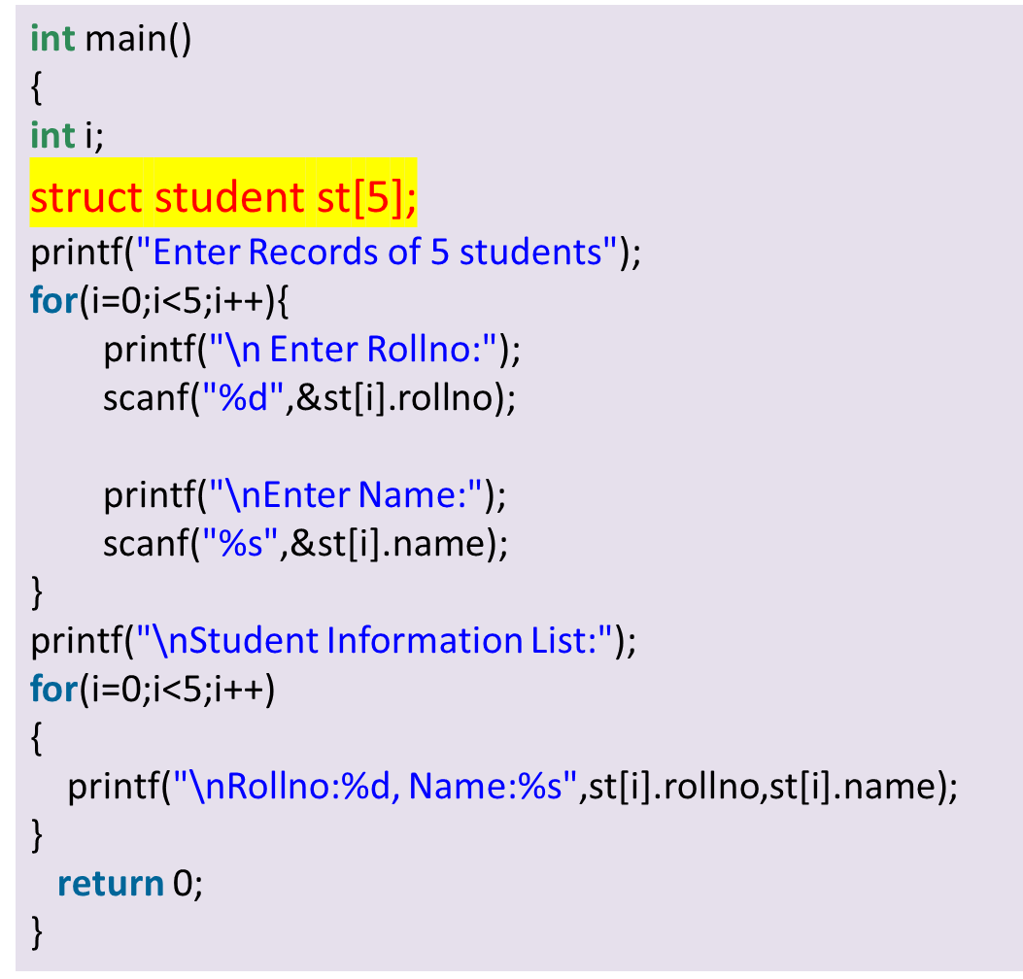
Array of structures
Index -- 0 emp[0].id, emp[0].name, emp[0].salary
index -- 1 emp[1].id, emp[1].name, emp[1].salary
index -- i emp[i].id, emp[i].name, emp[i].salary
//an array of structures that stores information of 5 students and prints it.
#include<stdio.h>
#include <string>
struct student{
int rollno;
char name[10];
};

Slide 23
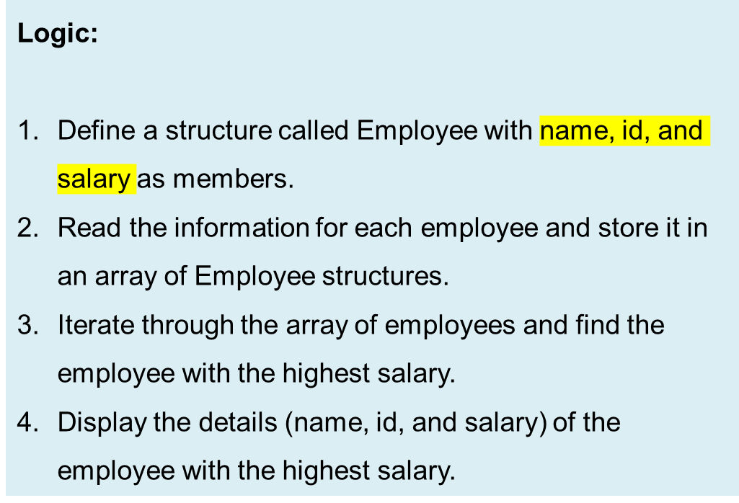
Array of structures
Input:
Enter name, ID, and salary for employee 1: John 1234 50000
Enter name, ID, and salary for employee 2: Mary 5678 45000
Enter name, ID, and salary for employee 3: Peter 4321 55000
Enter name, ID, and salary for employee 4: Lisa 9876 48000
Enter name, ID, and salary for employee 5: David 2468 52000.
Output:
Employee with the highest salary:
Name: Peter
ID: 4321
Salary: 55000.00
.

Slide 24
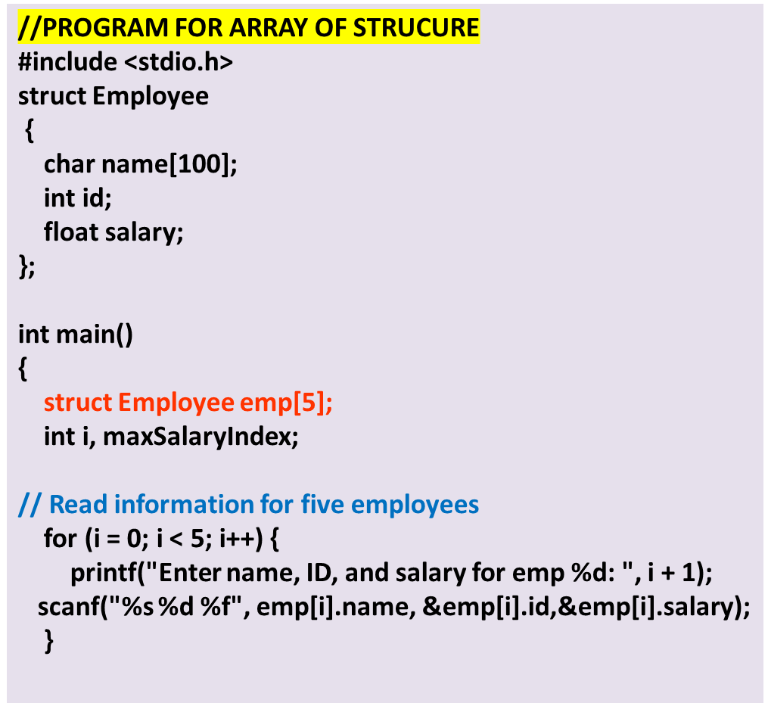
// Find the employee with the highest salary
maxSalaryIndex = 0;
for (i = 1; i < 5; i++) {
if (emp[i].salary > emp[maxSalaryIndex].salary)
{
maxSalaryIndex = i;
}
}
// Display the employee with the highest salary
printf("\n Employee with the highest salary:\n");
printf("Name: %s\n", emp[maxSalaryIndex].name);
printf("ID: %d\n", emp[maxSalaryIndex].id);
printf("Salary: %.2f\n", emp[maxSalaryIndex].salary);
return 0;
}
Enter name, ID, and salary for employee 1: John 1234 50000
Enter name, ID, and salary for employee 2: Mary 5678 45000
Enter name, ID, and salary for employee 3: Peter 4321 55000
Enter name, ID, and salary for employee 4: Lisa 9876 48000
Enter name, ID, and salary for employee 5: David 2468 52000
Employee with the highest salary:
Name: Peter
ID: 4321
Salary: 55000.00

Slide 25
Array of structures
Question 2:Consider the following structure representing a product's information:
struct Product {
char name[50];
float price;
int quantity;
};
Write a C program that takes input from the user to store information about 10 products in an array of structures. Afterward, calculate and display the total value of all the products (price * quantity) in the array
Logic:
Define the structure struct Product with members for name, price, and quantity.
Declare an array products of struct Product type to store information about the products.
Use a loop to take input from the user for the name, price, and quantity of each product.
After input, iterate through the array to calculate the total value of all products (price * quantity).
Print the total value of all products.
Input: The program prompts the user to enter the name, price, and quantity for 10 products.
Output: The program calculates and displays the total value of all the products (price * quantity).

Slide 26
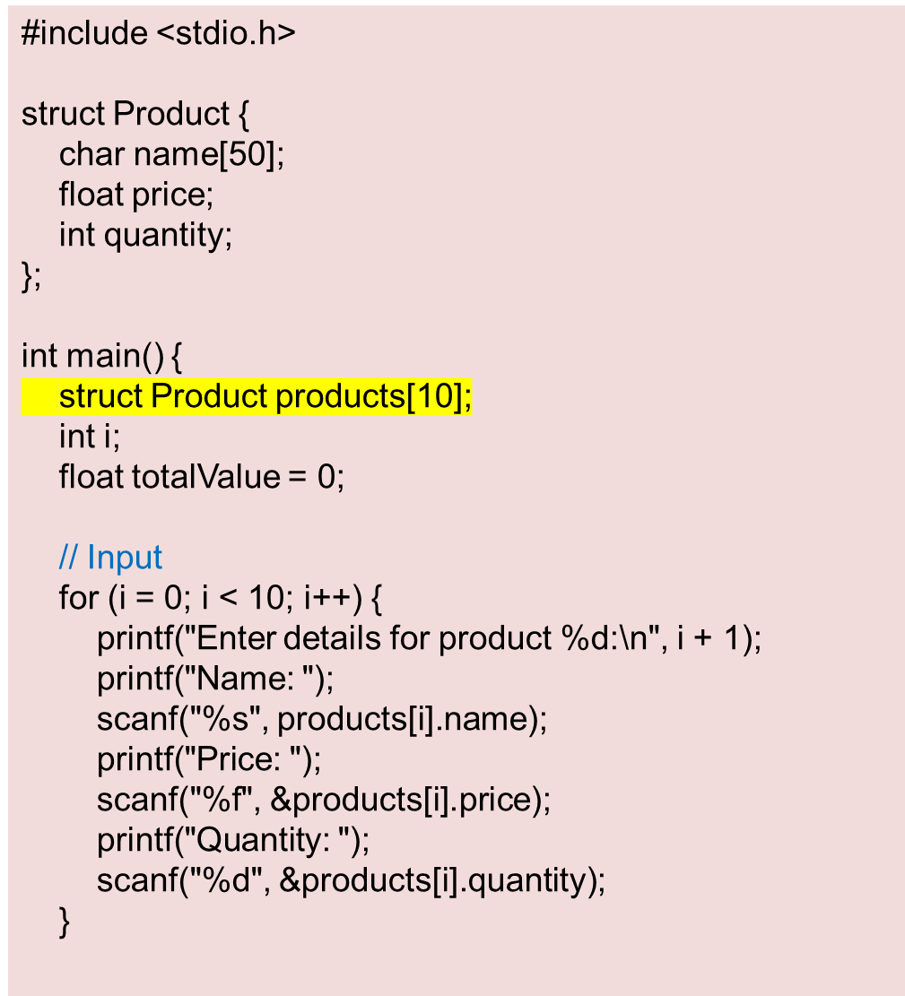
// Calculate total value
for (i = 0; i < 10; i++) {
totalValue += products[i].price * products[i].quantity;
}
// Output
printf("\nTotal value of all products: $%.2f\n", totalValue);
return 0;
}

Slide 27


Nested Structures
When a, it is called nested structure. structure contains another structure
i.e. One structure defined inside other structure as a structure member.
Example:
struct Person
{
char name[50];
int age;
struct Address
  {
  char street[50];
  char city[50];
  char state[20];
  int zipCode;
  };
};
The Person structure includes an Address structure as one of its members. This nesting allows us to store information about a person along with their address.
Syntax:
struct name_1
{
member_1;
member_2;
.
member_n;
struct name_2
{
member_1;
member_2;
.
member_n;
}var1;
} var2;
Outer Structure
Inner strucure

Slide 28
Nested Structures
The structure can be nested in the following ways.
By Embedded structure - define a structure inside the structure
By separate structure - create two structures, but the dependent structure should be used inside the main structure as a member
//nesting by embedding
struct employee
{
char name[20];
struct address
{
char city[20];
int pin;
char phone[14];
};
};
// nesting by separate strucure
struct address
{
char city[20];
int pin;
char phone[14];
};
struct employee
{
char name[20];
struct address add;
};

Slide 29
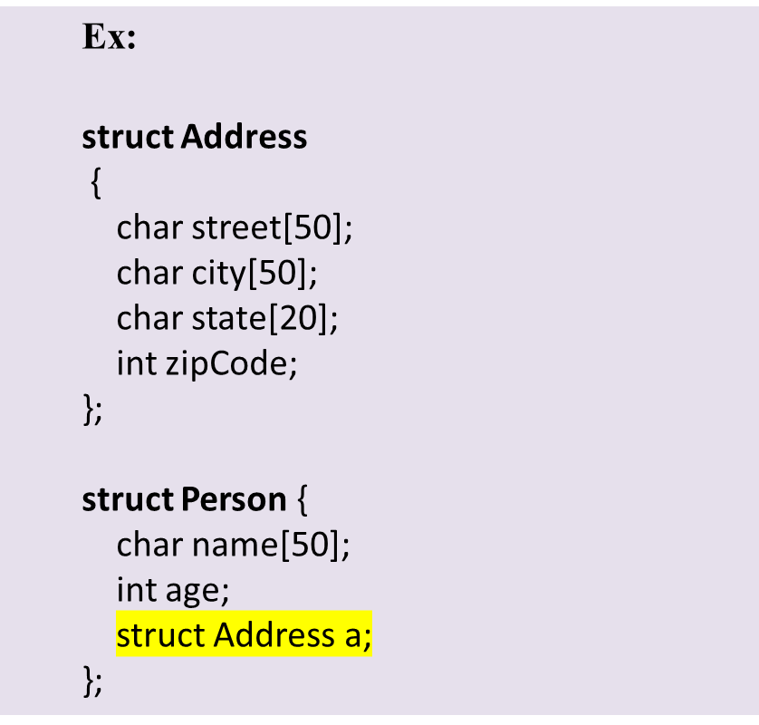
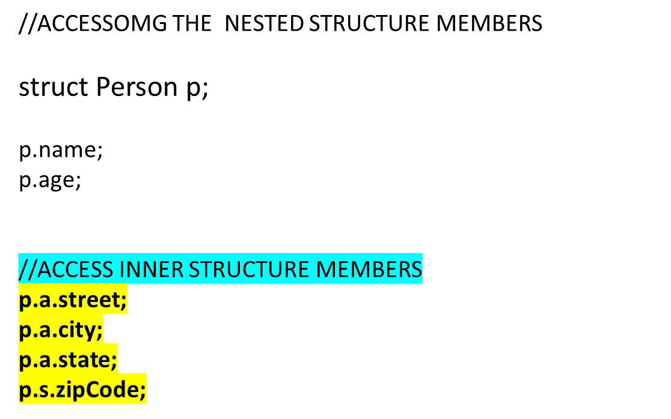
ACCESSING THE NESTED STRUCTURE MEMBERS

Slide 30
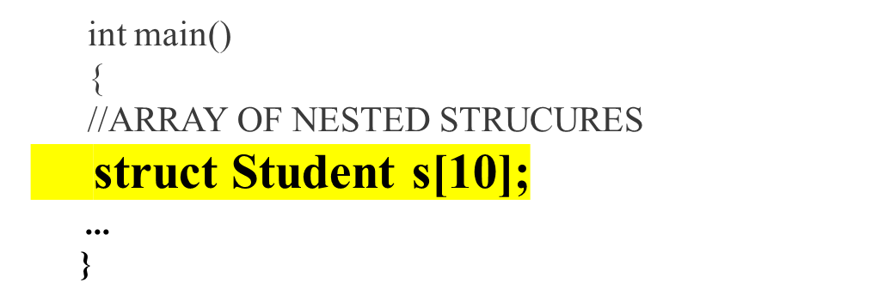
Array of Nested structures
A collection of similar nested structures is called as Array of Nested of Structure.
  struct Date
  {
  int day;
  int month;
  int year;
  };
  struct Student //nested structure
  {
  int rollno;
  char name[20];
  struct Date d;
  float percentage;
  };

Slide 31
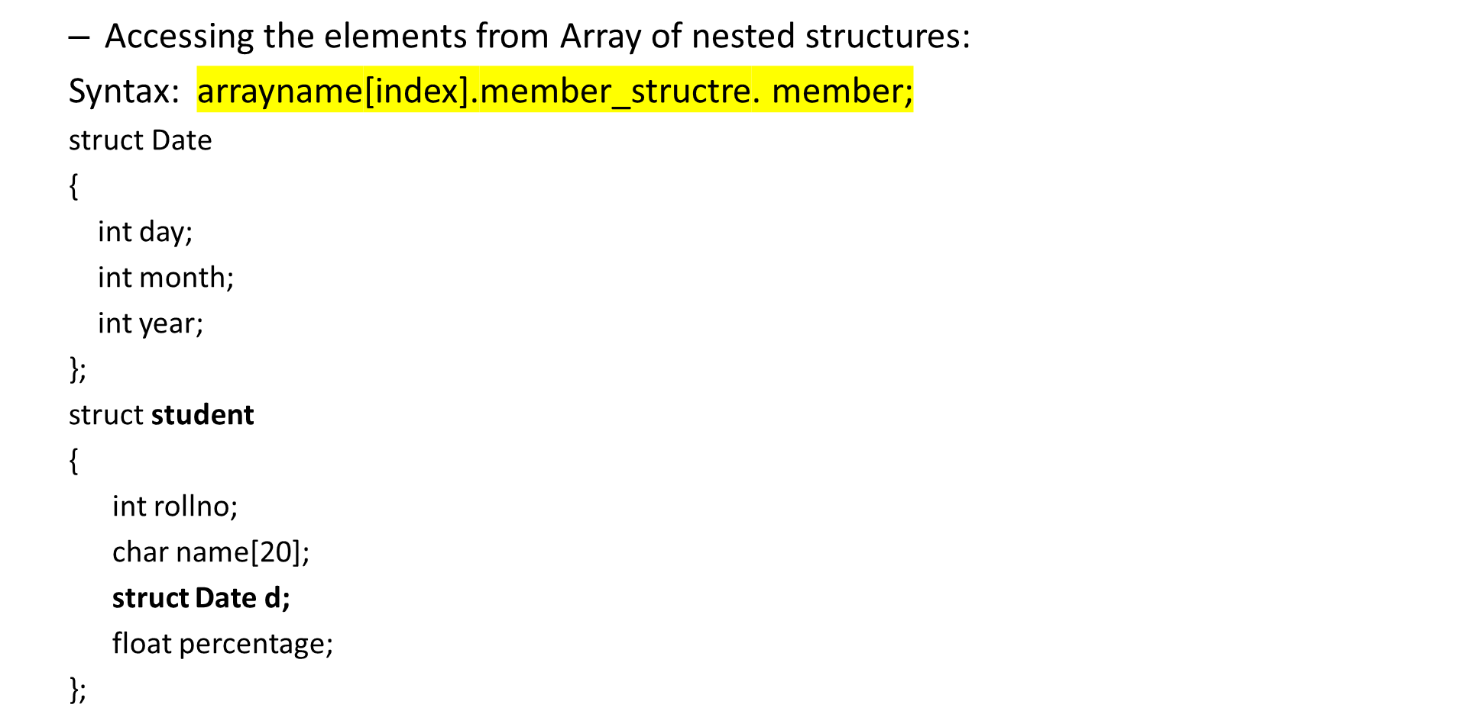
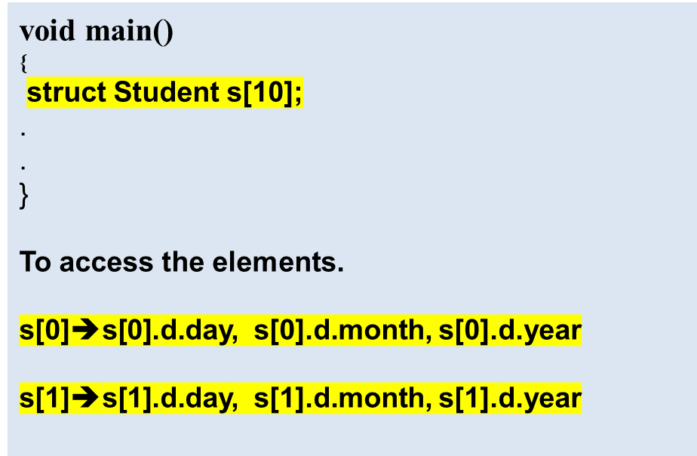
Array of Nested structures

Slide 32
Q) Write a C program that allows the user to input details about a student's course enrollment and displays the student's information. The program should use nested structures to store the data.
INPUT:
  Enter Roll Number: 101
  Enter Name: John Doe
  Enter Course Code: CS101
  Enter Course Name: Introduction to Computer Science
  Enter Credits: 3
OUTPUT:
  Student Details:
  Roll Number: 101
  Name: John Doe
  Course Code: CS101
  Course Name: Introduction to Computer Science
  Credits: 3
LOGIC
Start by defining the necessary structures
Declare the function display() that takes a struct
Student as input and prints the student's details:
  Inside the function, print the student’s details
In the main function:
  Declare a variable student to store the student's information.
  Read the details.
  Call t display() passing the student structure as an argument to print the student's details

Slide 33
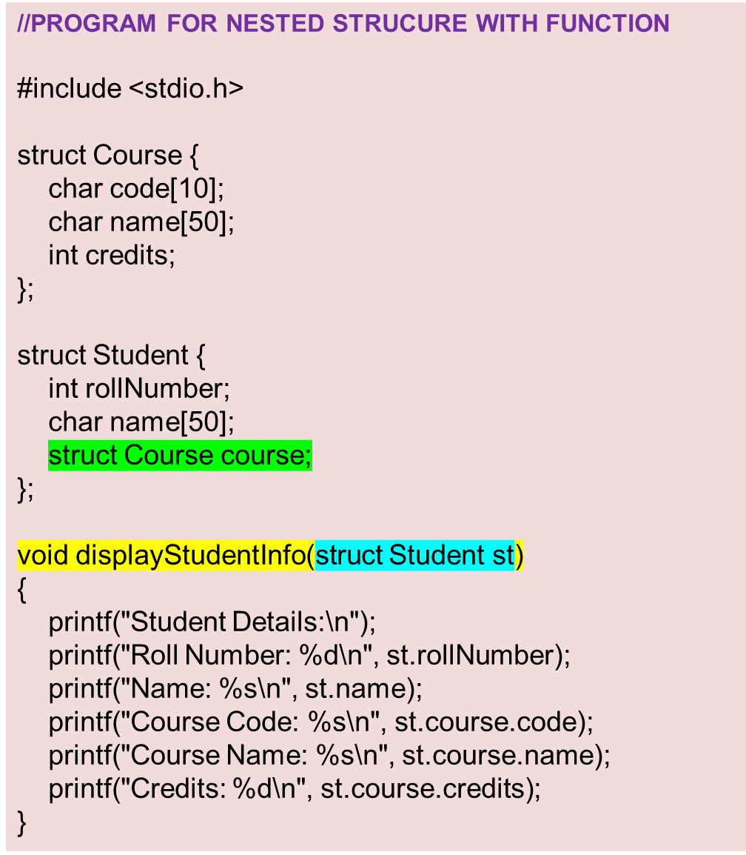
int main() {
struct Student student;
// Input
printf("Enter Roll Number: ");
scanf("%d", &student.rollNumber);
printf("Enter Name: ");
scanf("%s", student.name);
printf("Enter Course Code: ");
scanf("%s", student.course.code);
printf("Enter Course Name: ");
scanf("%s", student.course.name);
printf("Enter Credits: ");
scanf("%d", &student.course.credits);
// Output
displayStudentInfo(student);
return 0;
}

Slide 34
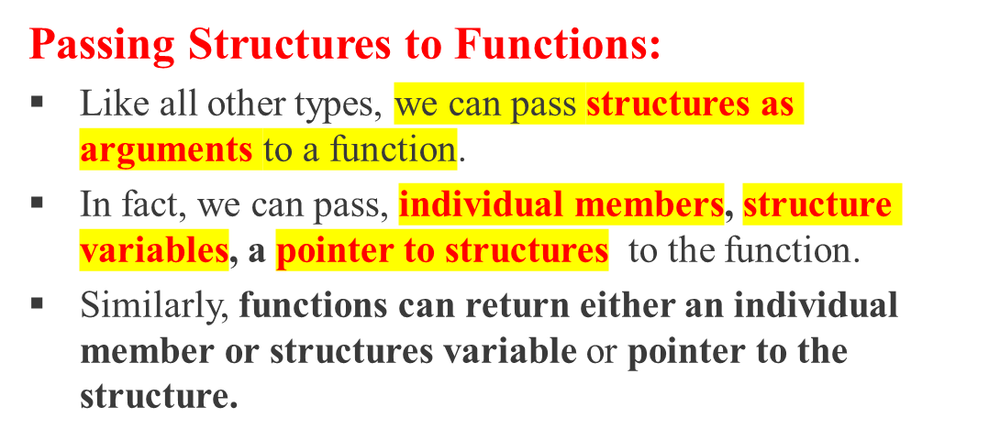
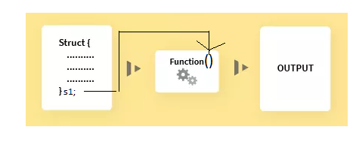
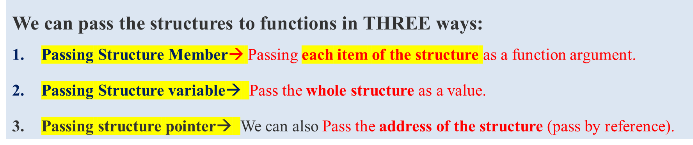
Structures and Functions

Slide 35
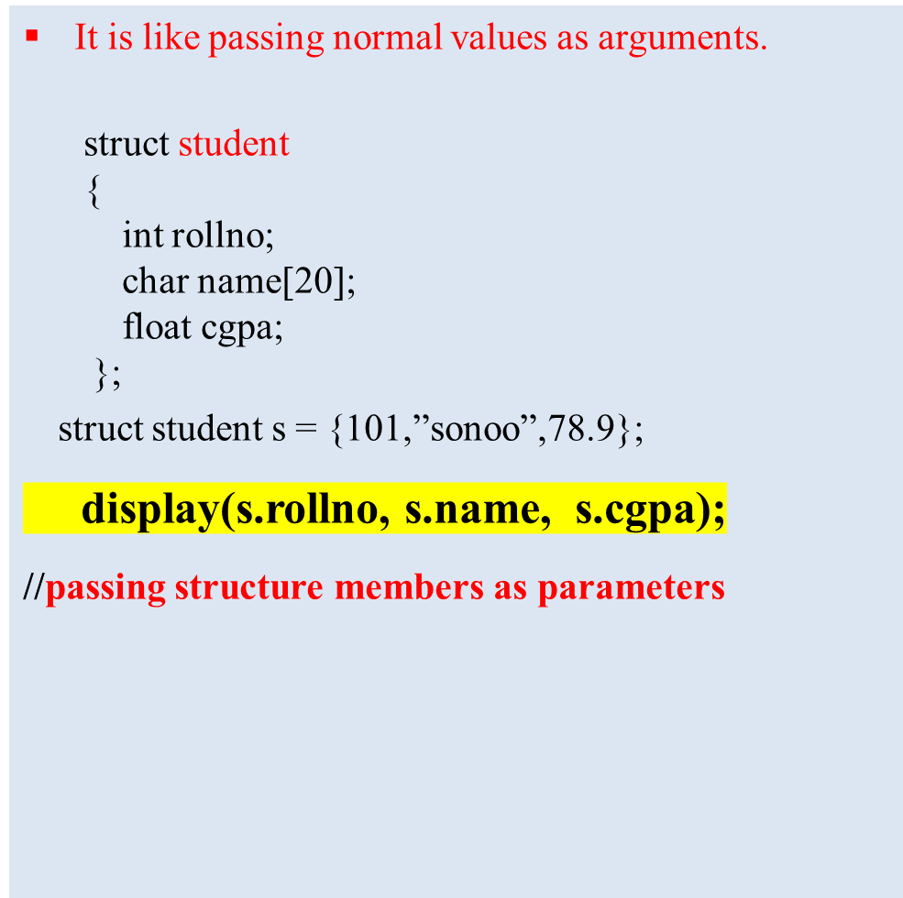
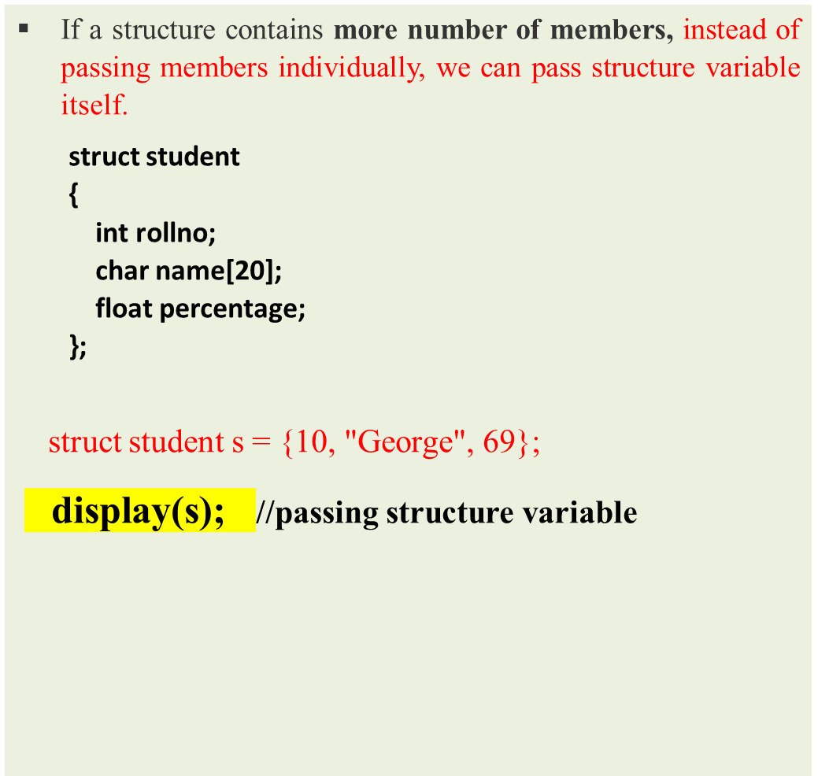
1. Pass structure members as arguments to the function.
2. Passing Structure Variable as Argument to a Function

Slide 36
Q) Write a C program that calculates the area of a rectangle. The program should define a structure called Rectangle with two integer members: length and width.
Implement a function called calculateArea() that takes the length and width as arguments and Display the calculated area as the output.
Input:
No input is required from the user.
Output:
The program should display the calculated area of the rectangle.
Logic:
Define a structure called Rectangle with length and width.
Implement calculateArea()that takes length and width as arguments and returns the area.
In the main function, create a Rectangle structure variable.
Initialize the members
Call calculateArea(), passing the length and width of the rectangle.
Display the calculated area as the output.

Slide 37
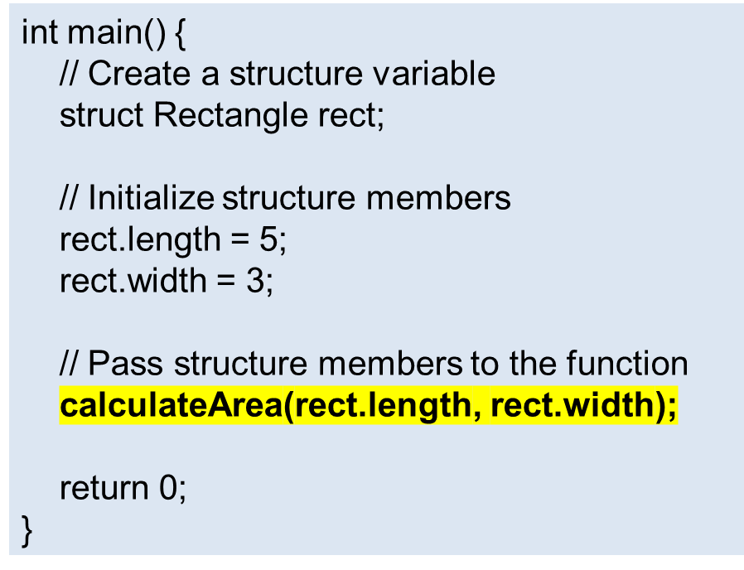
Q) Write a C program that calculates the area of a rectangle. The program should define a structure called Rectangle with two integer members: length and width.
Implement a function called calculateArea that takes the length and width as arguments and Display the calculated area as the output.
#include <stdio.h>
// Define a structure
struct Rectangle {
int length;
int width;
};
// Function that takes structure members as arguments
void calculateArea(int length, int width)
{
int area = length * width;
printf("The area of the rectangle is: %d\n", area);
}

Slide 38
Q) Write a C program that calculates the area of a rectangle. The program should define a structure called Rectangle with two integer members: length and width.
Implement a function called calculateArea() that takes rectangle structure as argument and Display the calculated area as the output.
Logic:
Define a structure called Rectangle
Implement calculateArea() that takes the length and width as arguments and returns the calculated area.
In the main function, create a Rectangle structure variable.
Initialize the members of the Rectangle structure variable.
Call the calculateArea(), passing the rectangle structure.
Display the calculated area as the output.
Input:
No input is required from the user.
Output:
The program should display the calculated area of the rectangle.

Slide 39
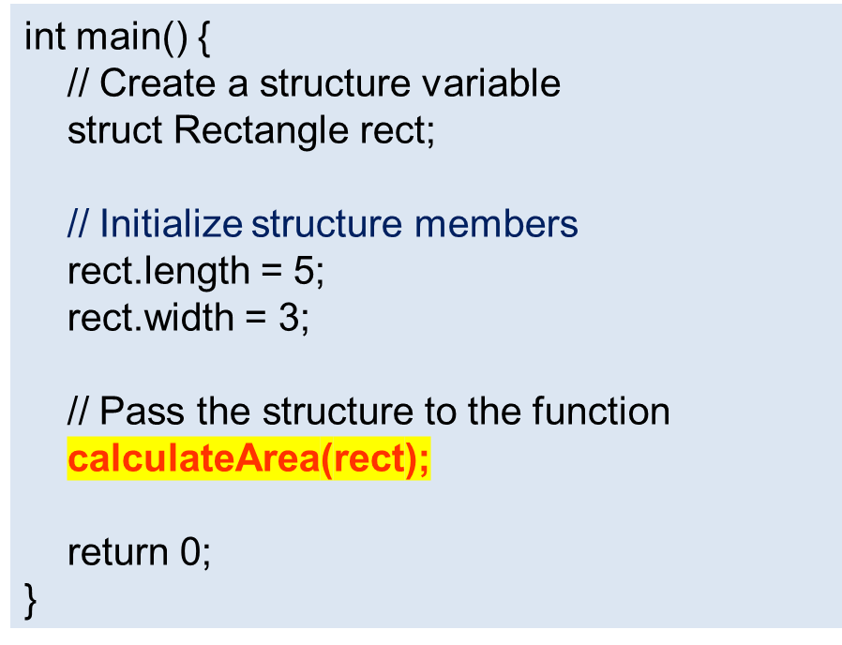
Q) Write a C program that calculates the area of a rectangle. The program should define a structure called Rectangle with two integer members: length and width.
Implement a function called calculateArea that takes the length and width as arguments and Display the calculated area as the output.
#include <stdio.h>
// Define a structure
struct Rectangle {
int length;
int width;
};
// Function that takes a structure as an argument
void calculateArea(struct Rectangle rect)
{
int area = rect.length * rect.width;
printf("The area of the rectangle is: %d\n", area);
}

Slide 40
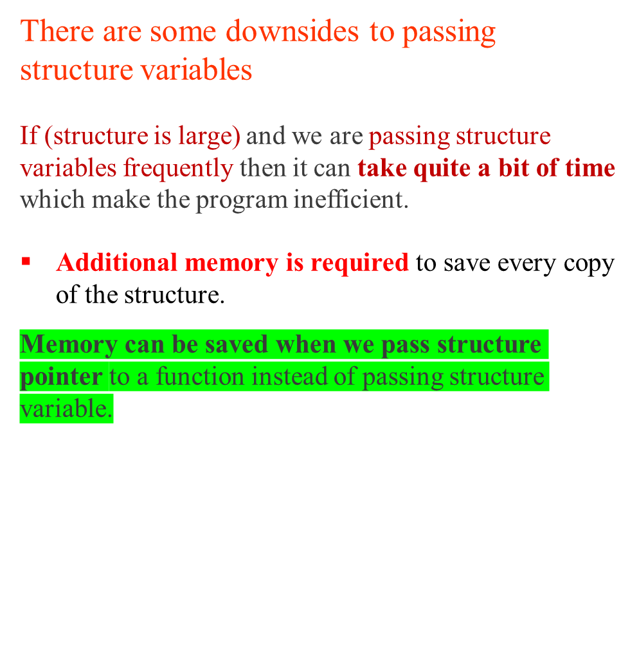
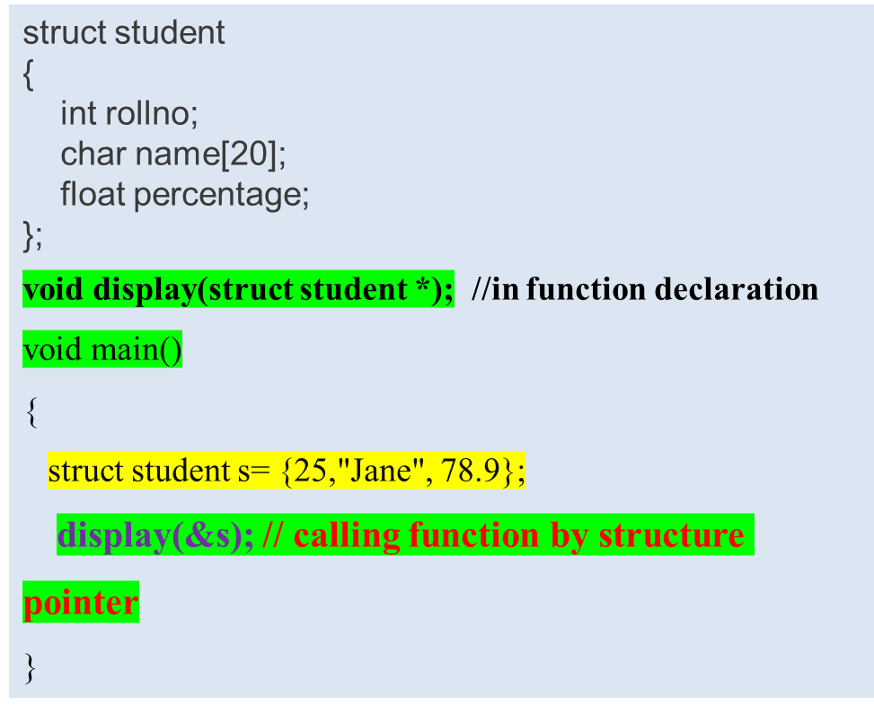
3.Passing Structure Pointers as Argument to a Function

Slide 41
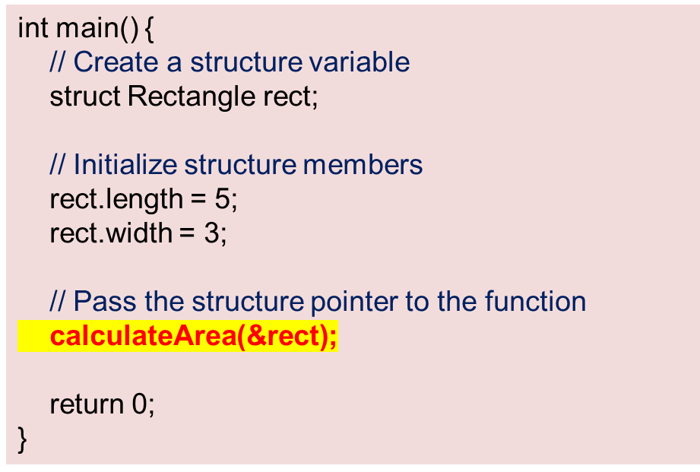
3.Passing Structure Pointers as Argument to a Function
// PROGRAM TO CALL FUNCITON BY STR.POINTER
#include <stdio.h>
// Define a structure
struct Rectangle {
int length;
int width;
};
// Function that takes structure pointers as arguments
void calculateArea(struct Rectangle* rect)
{
int area = rect->length * rect->width;
printf("The area of the rectangle is: %d\n", area);
}

Slide 42
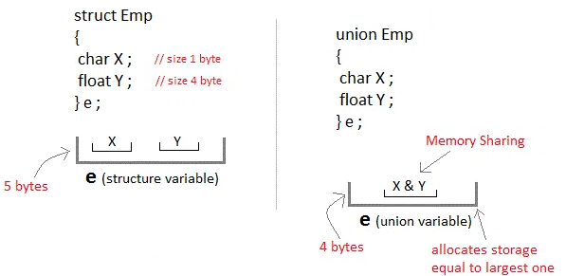
Unions
A union is a user defined data type contains different data members.
These members will share the same memory location.
Unions are conceptually like structures. The only differences is in terms of storage.
In structure each member has its own storage location, whereas all members of union uses A SINGLE SHARED MEMORY LOCATION which is equal to THE SIZE OF ITS LARGEST DATA MEMBER

Slide 43
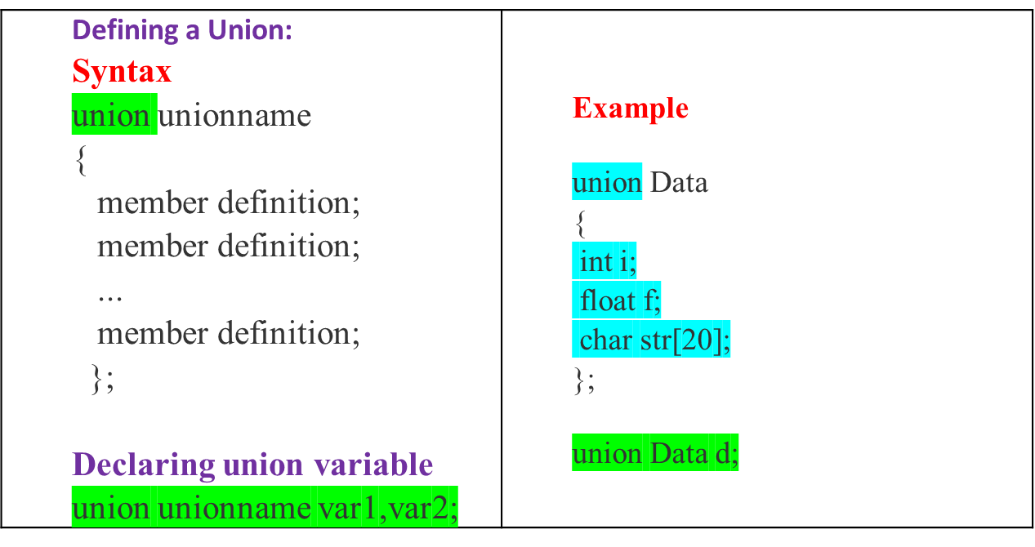
Defining Union
To define a union, you must use the keyword “union“
In the above example
Now, a variable of Data can store an integer, a floating-point number, or a string of characters.
It means a single variable, i.e., same memory location, can be used to store multiple types of data.

Slide 44
Structure vs Union
difference ?
Structure
Union
1
3
1
3
struct
{
char name[20];
int age;
float cgpa;
};
struct student std1;
std1
union
{
char name[20];
int age;
float cgpa;
};
union student stud1;
student
student
stud1
name
(20 bytes)
(20 bytes)
age
(2 bytes)
2
cgpa
(4 bytes)
20 bytes
2
26 bytes
Notes:
Title + Image + Text

Slide 45
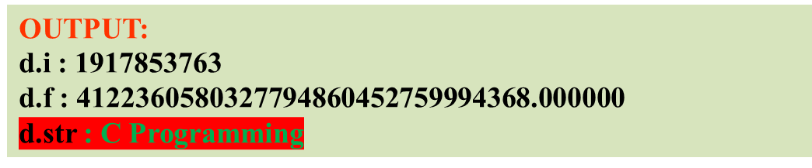
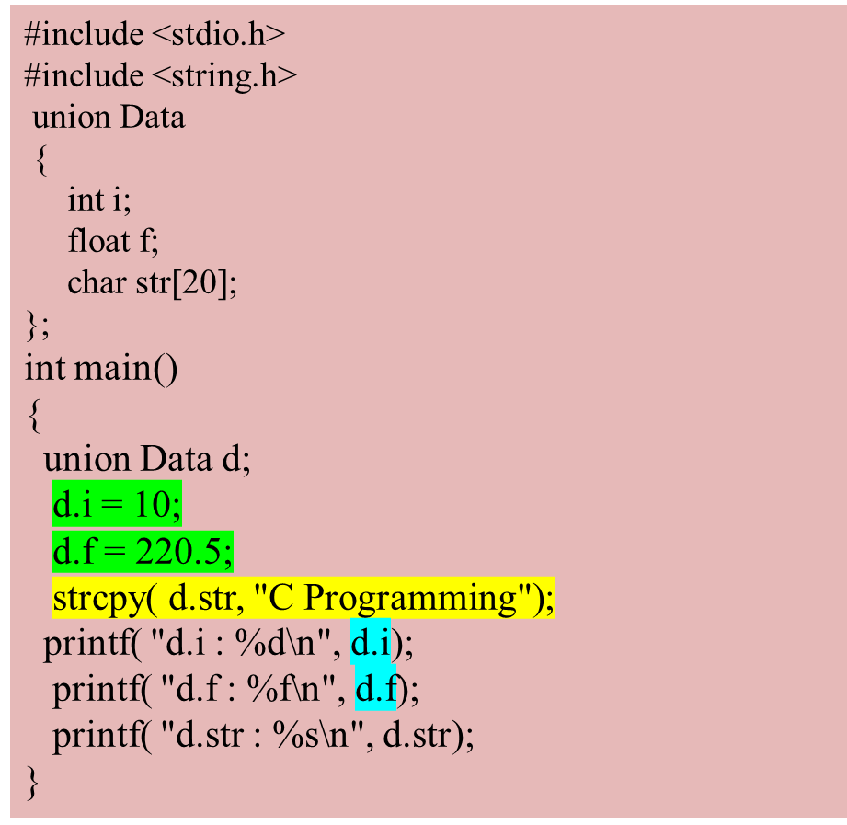

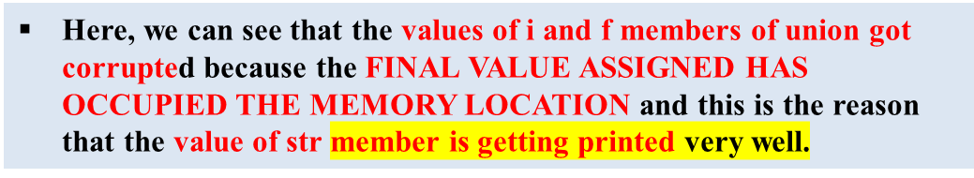
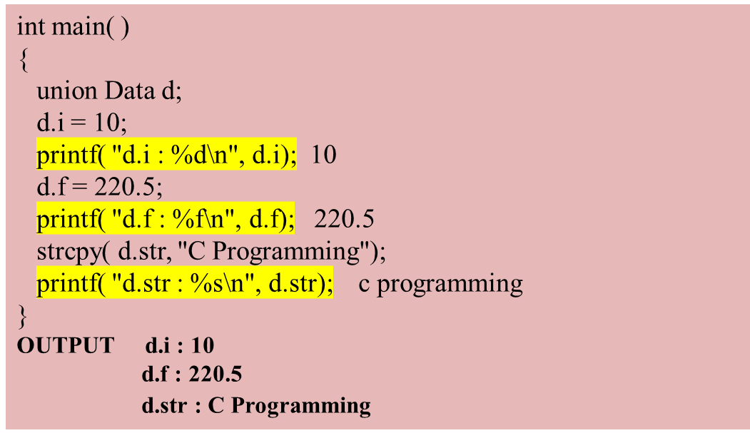
Accessing and displaying Union Members
To access any member of a union, we use the member access operator dot (.)

Slide 46
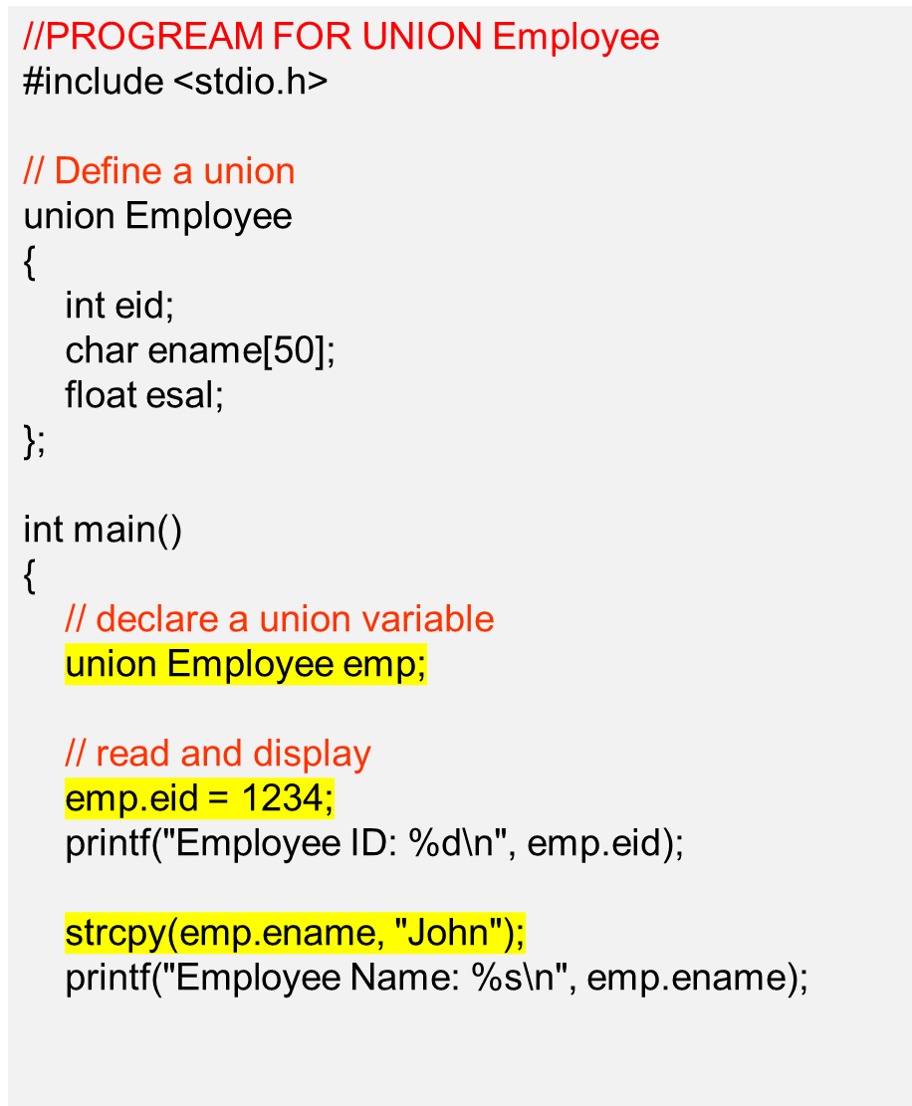
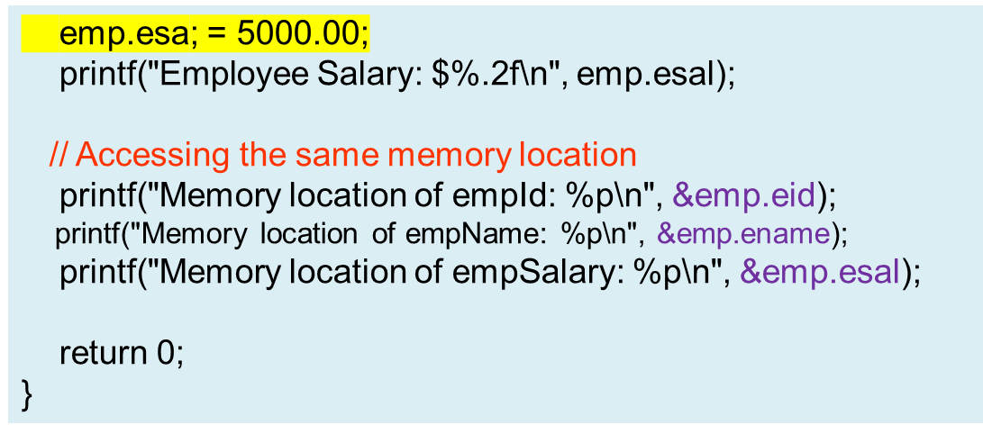

Union Example Program

Slide 47

LOGIC
Define a union shape with radius, length and width
Define a Function calclulateArea() based on the shape type.
Create a Shape union variable representing a circle and rectangle
Call calculateArea(circle, 1) for circle
Call calculateArea(square, 0) for square
Input:
No input is required from the user.
Output:
The program should display the calculated area for each shape.
Area of the Circle: 38.48
Area of the Rectangle: 24

Slide 48



Slide 49

Differences between structures and Unions

Slide 50


User Defined Datatypes- typedef and enum
User Defined Datatypes are the new datatypes created by the user.
There are 2 types of user defined datatypes
1. typedef (type definition)
2. enum (enumeration)

Slide 51


typedef – example programs

Slide 52

Creating a structure using typedef statement

Slide 53
// program to create a type alias for structure
#include <stdio.h> // Define a struct typedef struct { int x; int y; } Point; int main() { // Declare a variable using the struct type alias Point p1 = {5, 10}; // Access and display the struct members printf("Point coordinates: (%d, %d)\n", p1.x, p1.y); return 0; }

Slide 54

Enumeration(Enum): Enumerated datatype

Slide 55

OUTPUT: Today is day number 3
Tomorrow is day number 4

Slide 56



Why Structure Padding required?
The processor does not read 1 byte at a time. It reads 1 word at a time.
What does the 1 word mean?
If we have a 32-bit processor, then the processor reads 4 bytes at a time, which means that 1 word is equal to 4 bytes.
  1 word = 4 bytes
[If we have a 64-bit processor, then the processor reads 8 bytes at a time, which means that 1 word is equal to 8 bytes.
  1 word = 8 bytes ]
  If 1 word = 4 bytes then a, b in 1st word , c is
  stored in 2 words
struct student
{
char a; // 1 byte
char b; // 1 byte
int c; // 4 bytes
}
The contiguous memory will be allocated to the structure members.
First, the memory will be allocated to the 'a' variable, then 'b' variable, and then 'c' variable.

Slide 57

Structure occupies the contiguous block of memory as shown in the above diagram, i.e., 1 byte for char a, 1 byte for char b, and 4 bytes for int c,
How is structure padding done?
In order to achieve the structure padding, an empty row is created on the left, and the two bytes which are occupied by the 'c' variable on the left are shifted to the right.
Now the variable can be accessed within a single cycle.
we will face the problem when we access the int c variable as 2 CPU cycles are required to access the value of the 'c' variable.

Slide 58

It is mechanism which avoids allocation of extra memory.
Packing a structure can be achieved using compiler-specific directives or attributes.
#pragma pack(1) directive to avoid the structure padding
If we do not use this directive, then the output of the above program would be 8 bytes.
But the actual size of the structure members is 5 bytes, so 3 bytes are wasted.
To avoid the wastage of memory, we use the #pragma pack(1) directive to provide the 1-byte packaging.

Slide 59


So we use the bit fields to save the memory. In the bit field, we can explicitly give the width or the range to the data member in terms of bytes.
dataype data_member : maximum_width_bits
struct dob
{
unsigned int date: 5;
unsigned int month: 4;
unsigned int year: 12;
};
we can have a maximum 31 value in the day variable which can be represented using 5 bits.
we need only 12 values as the maximum in the month section can be represented in 4 bits
Year: 12 bits
whole memory occupied by the struct variable : 3 Bytes

Slide 60
#include <stdio.h>
// Define a structure with bit fields
struct Student
{
unsigned int age : 6; // 6 bits for age
unsigned int isMale : 1; // 1 bit for gender (0 or 1)
unsigned int grade : 3; // 3 bits for grade (0-7))
};
int main()
{
struct Student student1;
student1.age = 20;
student1.isMale = 1;
student1.grade = 5;
printf("Student Age: %u\n", student1.age);
printf("Is Male? : %d\n", student1.isMale);
printf("Grade: %u\n", student1.grade);
return 0;
}
In this example, we define a structure Student with three-bit fields: age, isMale, and grade. Each bit field is assigned a specific number of bits to store the respective information.
Bit fields are usually packed together to minimize memory usage, but the exact memory layout can be influenced by the architecture, compiler, and compiler settings.
In this case, the sum of the bit widths is 6 + 1 + 3 = 10 bits. However, most systems use bytes (8 bits) as the fundamental memory unit. Therefore, you'll typically see this structure occupy 2 bytes, with the compiler aligning the structure to the nearest byte boundary.

Slide 61
To compile a program using GCC in Windows, you can follow these steps:
1. Install GCC:
If you haven't already, you need to install GCC on your Windows machine. One way to do this is by installing the MinGW-w64 (Minimalist GNU for Windows) distribution, which provides a development environment with GCC.
You can download it from the MinGW-w64 website (https://mingw-w64.org/doku.php) and follow the installation instructions.
2. Open a command prompt: Press Win + R to open the Run dialog, type "cmd", and press Enter. This will open a command prompt window.
3. Navigate to the directory: Use the cd command to navigate to the directory where your source code file is located.
  Ex. cd desktop
4. Compile the program: Once you are in the correct directory, use the gcc command
gcc my_program.c -o my_program.exe
GCC will compile your source code file and generate an executable file with the specified name
5. Run the program: To run the compiled program, simply type the name of the executable file and press Enter. For example:
my_program.exe

