Slide 1
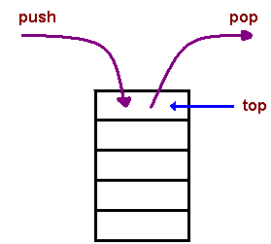
Stacks
Stack is a linear Data structure that stores and retrieves the elements by using a principle LIFO(Last-In First-Out ).
i.e. The elements in stack are inserted or removed according to Last-In First-Out (LIFO) principle.
LIFO Principle- Lastly Inserted elements will be removed first.
Ex. IN OUT
E4,E3,E2,E1 → STACK → E4,E3,E2,E1
Stack will have only one end, it is called as top of stack
Elements can be added and removed from the stack only at the top end.
push()→ inserting an element into stack is called as push.
pop()→ deleting an element into stack is called as pop
E4
E3
E2
E1
A stack

Slide 2
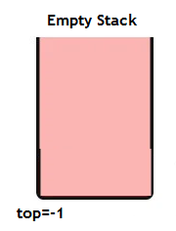
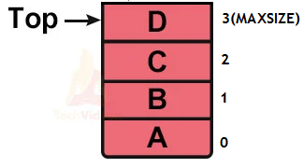
Stacks
An Empty stack: A stack with out any elements.
In Empty stack top points to -1
i.e. top=-1
If(top==-1)
{
printf(“stack is empty”);
}
Full Stack: A stack with full of elements.
In Full stack top points to MAXSIZE
i.e. top=-1
if(top==MAXSIZE)
{
printf(“stack is FULL”);
}

Slide 3
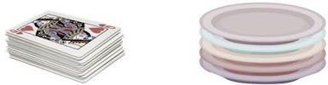
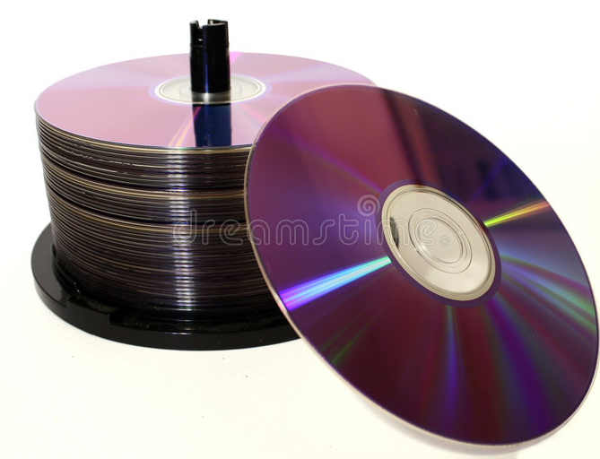

Stacks
Examples of a stack:
A deck of cards
a pile of plates
A stack of books
A CD case

Slide 4
Stack- Operations
Basic Operations:
push()→ inserting an element into stack is called as push.
pop()→ deleting an element into stack is called as pop
Other operations:
isEmpty(): It determines whether the stack is empty or not.
isFull(): It determines whether the stack is full or not.'
peek(): It returns the element at the given position.
count(): It returns the total number of elements available in a stack.
4
3
2
1
A stack

Slide 5
Stack-Operation – push()
push() – INSERTING ELEMENT
The process of inserting an element into stack is known as a Push Operation.
An element can be inserted into stack using push operation.
Push operation involves a series of steps −
Step 1 − Checks if the stack is full.
If the stack is full, produces an error and exit.
if(top==Maxsize-1)
print “Stack is overflow”
Step 2 − If the stack is not full, increments top to point next empty space.
top=top+1
Step 3 − Add data element to the stack location, where top is pointing.
stack[top]=item
Step 4: stop

Slide 6
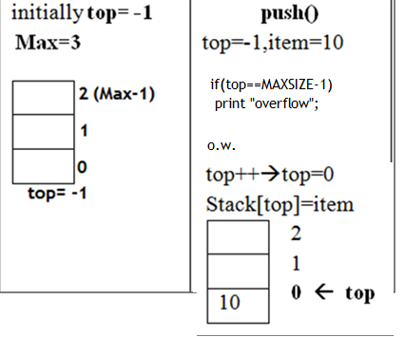
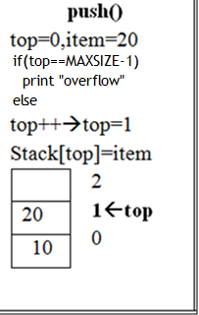
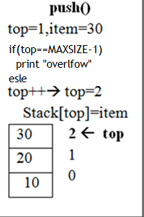
Stack-Operation push()

Slide 7
Stack-Operation – push()
//Implementation of push with item as a parameter
void push (int item) //push with item as a parameter
{
if (top == MAXSIZE-1 )
{
printf("\n Stack is full"); //checking for Overflow
}
else
{
top = top +1; //decrement top by 1
stack[top] = item; //insert the item at top position
}
}

Slide 8
Stack-Operation – push()
void push () //Implementation of push with out parameter
{
int num;
if (top == (MAXSIZE - 1)) //check for stack overflow
{
printf ("Stack is Full\n"); //stack overflow
}
else
{
printf ("Enter the element to be pushed\n");
scanf ("%d", &num); //read item
top = top + 1; //increment top
st[stop] = num; //insert item
}
}

Slide 9
Stack-Operation – pop()
pop() – REMOVING/ACCESSING AN ELEMENT
The process of REMOVING an element from stack is known as a pop Operation.
An element can be removed from stack using pop operation.
Pop operation involves a series of steps −
Step 1 − Checks if the stack is empty.( underflow)
If the stack is empty, produces an error and exit.
if(top==--1)
print “Stack is empty”;
Step 2 − If the stack is not empty, access data element from the stack location, where top is pointing.
item= st[top] ;
Step 3 −decrements top by 1
top=top-1
Step 4: return item;

Slide 10
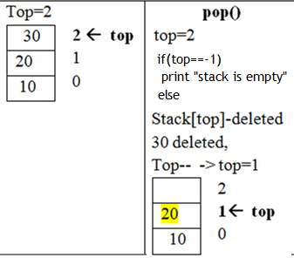
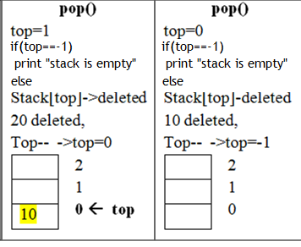
Stack-Operation pop()

Slide 11
Stack-Operation – pop()
int pop ()
{
if(top == -1) //check for underflow
{
printf(“Stack is empty");
return 0;
}
else
{
int item;
item = st[top]; //get the item i.e. removing an item from stack
top--;
return item;
}
}

Slide 12
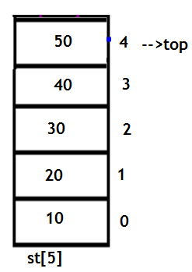
Implementation of Stack using Arrays
The stack is implemented by using the array.
All the operations regarding the stack are performed using arrays.
Declaration of stack:
datatype stackname[MAXSIZE];
EX> int st[5];
flaot st[15];
Operations performed:
push(item);
pop()

Slide 13
Implementation of Stack using Arrays
#include<stdio.h>
#define MAXSIZE 10
void push(int item);
int pop();
void display();
int st[MAXSIZE ];
int main()
{
push(10); //inserts 10
push(20); //inserts 20
push(30) //inserts 30
push(40); //inserts 40
printf(“After pushing the stack is \n”);
display();
pop(); //removes 40
pop(); //removes 30
pop(); //removes 10
printf(“After poping the stack is \n”);
display();
return 0;
}
//definition of push()
void push(int item)
{
if(top==MAX-1) //check for overflow
{
printf("STACK is full. Insertion not possible\n");
}
else
{
top=top+1;
stack[top]=item;
}
}

Slide 14
Implementation of Stack using Arrays
int pop()
{
if(top==-1) //check for underflow
{
printf("Stack is empty\n");
return 0;
}
else
{
item=stack[top];
top--;
return(item);
}
}
void display()
{
int i;
if(top!=-1)
{
printf("The elements of STACK \n");
for(i=top; i>=0; i--)
printf("%d\n",stack[i]);
}
else
printf("The STACK is empty\n");
}
The elements of STACK
After pushing the stack is
40
30
20
10
After poping the stack is
10

Slide 15
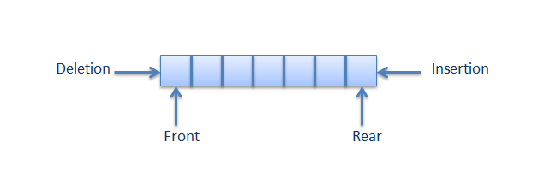
Queue
Queue is a linear Data structure which stores and retrieves the elements by following the property First-In First-Out (FIFO).
i.e. The elements can be inserted or removed according to the First-in first-out (FIFO) principle.
Queue will have two ends, called as front-end and rear-end.
Elements can be added to queue at rear index and removed from the queue at the front index.
At the initial stage of queue front=-1 and rear=-1

Slide 16
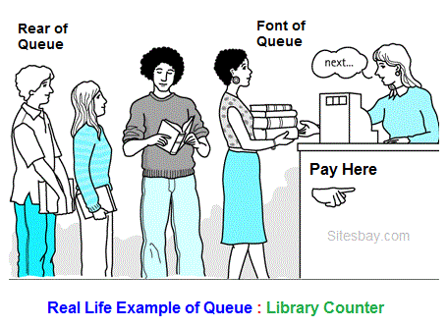


Queue

Slide 17
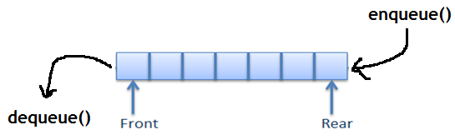
Queue operations
Basic operations :
enqueue()- An element can be inserted into queue using enqueue() operation.
dequeue() -An element is removed from queue using dequeue() operation.
Other Operations:
isEmpty (): The isEmpty() function is used to check if the Queue is empty or not.
isFull (): The isFull() function is used to check if the Queue is full or not.
peek() - This function helps to see the data at the front of the queue

Slide 18
Queue operations
Enqueue() - ALGORITHM
rear index is incremented by 1 in enqueue() operation.
Each enqueue() operation increases the size of queue by 1.
When rear be MAX, queue is full, then it is said to be an Overflow condition.
The following steps should be taken to enqueue (insert) data into a queue(alg)
Step 1 − Check if the queue is full.
if(rear==MAXSIZE-1)
print “queue is full”;
Step 2 − If the queue is full, produce overflow and exit.
Step 3 − If the queue is not full, increment rear pointer to point the next empty space.
rear=rear+1;
Step 4 − Add data element to the queue location, where the rear is pointing.
queue[rear]=item;
Step 5 − return success.

Slide 19
Queue operations
//implementation of enqueue
int enqueue(int item) // with item as a parameter
{
if(rear==MAXSIZE-1) //check for overflow
{
printf(“queue is full \n”);
return 0;
else
{
if(front==-1) //if empty stack increment front
{
front++;
}
rear = rear + 1; //increment rear
queue[rear] = item; //insert item
return 1;
}

Slide 20
Queue operations
//implementation of emqueue() with out parameter
void enqueue()
{
if(rear==MAXSIZE-1) //check for overflow
{
printf(“queue is fulll”);
}
else
{
int item;
scanf(“%d”,&item) // read item
if(front==-1) //if empty stack increment front
{
front++;
}
rear = rear + 1; //increment rear
queue[rear] = item; //insert item
}
}

Slide 21
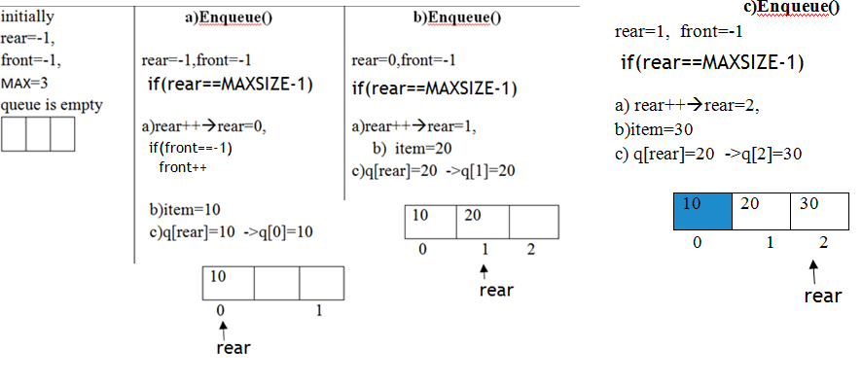
Queue operations

Slide 22
Queue operations
dequeue()
An element is removed from queue using dequeue() operation.
Front index is incremented by 1 in dequeue() operation.
Each dequeue() operation decreases the size of the queue by 1.
When rear==-1 or front >rear, the queue is empty, then it is said to be an Underflow condition
Algorithm ford equeue() to remove an element from queue.
Step 1. Check for underflow
if (rear==-1 || front>rear) or if(front==-1 || front>rear)
print “Queue is empty”; //underflow condition
Step 2: If the queue is not empty, access the data where front is pointing
itme=queue[front] ;
Step 3 : Increment front pointer to point to the next available data element.
front = front+ 1;
Step 4. stop

Slide 23
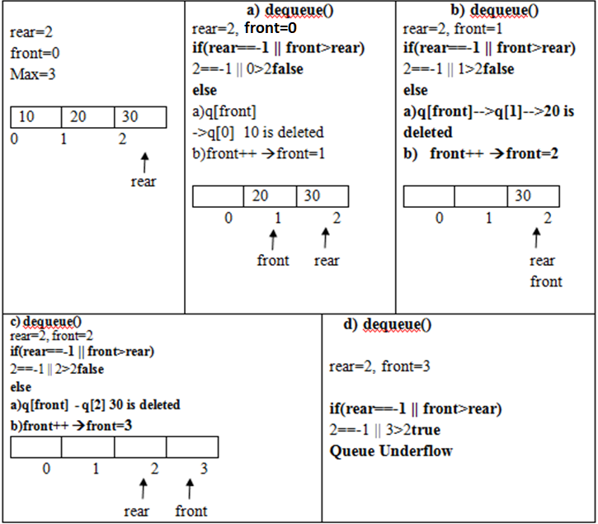
Queue operations

Slide 24
Queue operations
//implementation of dequeue()
void dequeue ()
{
if( rear==-1 || front>rear) //check for queue underflow
{
printf(" Deletion not possible QUEUE is empy"); }
else
{
int item;
item=queue[front]; //delete item
printf("The deleted element is %d\n“,item);
front++; //increment front
}
}

Slide 25
Implementation of Queue using Arrays
#define MAXSIZE 10
void enqueue(int item);
int dequeue();
void display();
int q[MAXSIZE ];
int main()
{
enqueue (10);
enqueue (20);
enqueue (30)
enqueue(40);
printf(“After inserting the queue is \n”);
display();
dequeue();
dequeue();
dequeue();
printf(“After removing the queue is \n”);
display();
return 0;
}
int enqueue(int item)
{
if(rear==MAXSIZE-1
{
printf(“queue is full \n”);
return 0;
else
{
if(front==-1)
{
front++;
}
rear = rear + 1; //increment rear
queue[rear] = item; //insert item
return 1;
}

Slide 26
Implementation of Queue using Arrays
void dequeue ()
{
if( rear==-1 || front>rear)
{
printf(" Deletion not possible QUEUE is empy"); }
else
{
int item
item=queue[front]; //delete item
printf("The deleted element is %d\n“,item);
front++; //increment front
}
}
void display()
{
int i;
if( rear==-1 || front>rear)
printf("The QUEUE is empty\n");
else
{
printf("\n The elements of QUEUE\n");
for(i=front; i<=rear; i++)
printf("%d\n",queue[i]);
}
}
The elements of queue
After inserting the queue is
10
20
30
40
After deleting the queue is
40

Slide 27
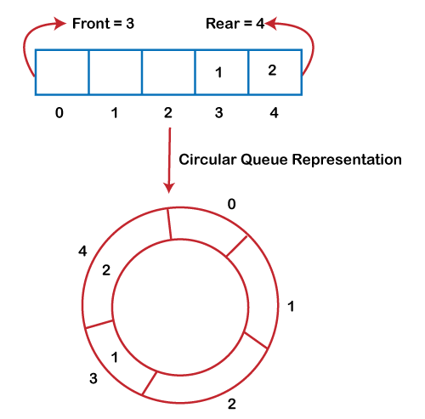
Circular Queue
Circular Queue
There was one limitation in the array implementation of Queue.
If the rear reaches to the end position of the Queue then there might be possibility that some vacant spaces are left in the beginning which cannot be utilized.
So, to overcome such limitations, the concept of the circular queue was introduced.

Slide 28
Circular Queue
Operations on Circular Queue
The following are the operations that can be performed on a circular queue:
Front: It is used to get the front element from the Queue.
Rear: It is used to get the rear element from the Queue.
enQueue(value): This function is used to insert the new value in the Queue. The new element is always inserted from the rear end.
deQueue(): This function deletes an element from the Queue. The deletion in a Queue always takes place from the front end.

Slide 29
Applications of Queue
Queues are widely used as waiting lists for a single shared resource like printer, CPU, disk.
Queue are used to maintain the play list in media players in order to add or remove the songs from the play-list.
Queues are used in operating systems for handling interrupts.
Handling website traffic
Routers and switches in networking
Queues are used in asynchronous transfer of data (where data is not being transferred at the same rate between two processes) for eg. pipes, file IO, sockets.

Slide 30
Application of Stacks:
Stack is used for Evaluating expression with operands and operations.
Ex. A+B
Expression Conversion: An expression can be represented in infix prefix or postfix notation.
Infix to Postfix→ a+b → ab+
Infix to Prefix → a+b → +ab
Expressions
Infix ->a+b Prefix -> +ab Postfix -> ab+
Backtracking And Parenthesis Matching: Stacks are used for Stacks help in reversing any set of data or strings.
Syntax Parsing.
Function calls implementation →Used in Recursions;

Slide 31
Representation of Expressions and Evaluation
An Expression can have constants , variable and symbols that can be operators or parentheses.
Expression Evaluation: All the components of expression must be arranged according to a set of rules and must be parsed/evaluated according to grammar
Expression Representations:
3 notations :
1) Infix
2 ) Prefix and
3) Postfix
1) Infix Notation
Expressions are usually represented in Infix notation, in which each operator is written between two operands.
Operators are written in-between their operands
Syntax: <operand> <operator> <operand>
Ex. 2 + 3 → 2,3 are operands + operator
A – B
(P * 2)
(2+3) *4 An operand can also be an expression
(p+q) * (r + s) → (p+q) and (r+s) are the operands.
Note: we use only binary operators in expression evaluation

Slide 32
Representation of Expressions and Evaluation
Infix Expression Evaluation:
An expression in Infix form will be evaluated according to precedence and associativity of operators.
Operator Precedence(Order of operation ):
1.Paranthesis () {} []
2. Exponents ^ (right to left)
3. Multiplication and division (left to right)
4. Addition and subtraction (left to right)
Ex. 4 + 6 * 2 → 4 + 12 → 16 Precedence * then +
(4 + 6) * 2 → 24 * 2→ 48 Precedence () then *
2 * 6 / 2 -3 =? Which operation Performed first? * and / have same precedence
Here we need Operation Associativity.
Operators Associativity is used when two operators of same precedence appear in an expression. Associativity can be either Left to Right (Left Associativity) or Right to Left(Right Associativity).
2 * 6 / 2 -3 → 12/2 -3 → 6 -3 →3 * has highest associativity because * came first from left
100 / 10 * 10 → 10 * 10 → 100 / has highest associativity because / came first from left

Slide 33
Expression Evaluation
2) Prefix Notation:
It is not easy to parse and evaluate an Infix expression with an ambiguity.
To reduce the ambiguity , mathematicians invented parenthesis free and can be parsed with out ambiguity.
In prefix notation operator can be placed before operands.
<operator> <operand> <operand>
Infix Prefix
A + B +AB
A+B*C +A*BC //Two operands are A,B and C
In infix notation operand B associated with two operators which makes ambiguity and needs operator precedence and associativity rules. or use parathesis.
Prefix does not require operator precedence and associativity rules

Slide 34
Representation of Expressions and Evaluation
3) Postfix Notation:
In Postfix notation operator can be placed after operands.
<operand> <operand> <operator>
Infix Prefix Postfix
A + B +AB AB+
A+B*C +A*BC ABC*+

Slide 35
Algorithms for conversions:
The conversion is done at the time of evaluating the expression by a compiler as one need not worry about the precedence or associativity of the operators.
1) Infix to Postfix Conversion 2) Infix to Prefix conversion
1) Infix to Postfix Conversion:
To convert infix expression to postfix expression, we will use the stack data structure.
ALG:
The following steps are required for conversion
Scan the infix expression from left to right,
When we will get any operand, simply add them to the postfix form(output)
For the operator and parenthesis, push them in the stack by maintaining the precedence of them.

Slide 36
Infix to Postfix Conversion:
Ex. Infix ➔ a + b * C
incoming char | stack | postfix form (output) | observation
a | Empty | a | a is added to output
+ | + | a | + pushed to stack
b | + | ab | b is added to output
* | * + | ab | * has higher precedence than +
c | * + | abc | c is added to output
End of exp |  | abc*+ | Pop and add to output

Slide 37
Infix to Postfix Conversion:
Rules for the conversion from infix to postfix expression
If (stack == empty or contains a left parenthesis on top), then push the incoming operator on to the stack.
If the incoming symbol is '(', push it on to the stack.
If the incoming symbol is ')', pop the stack and output(print) the operators until the left parenthesis is found.
If( incoming operator > the top of the stack) then → push it on the stack.
If (incoming operator < the top of the stack) then → pop and print the top of the stack. Then test the incoming operator against the new top of the stack.
If ( incoming operator ==the top of the stack )→ use the associativity rules. If the associativity is from left to right then pop and print the top of the stack then push the incoming operator. If the associativity is from right to left then push the incoming operator.
At the end of the expression, pop and print all the operators of the stack..

Slide 38
Algorithms for conversions: Infix to Prefix
2.Infix to Prefix Conversion:
To convert infix expression to prefix expression, we will use the stack data structure.
ALG:
The following steps are required for conversion
First, reverse the infix expression
Scan the infix expression from left to right,
Whenever the operands arrives, simply add them to the postfix form(output).
For the operator and parenthesis, push them in the stack by maintaining the precedence of them.

Slide 39
Infix to Prefix Conversion:
incoming char | stack | prefix form (output) | observation
c | Empty | c | c is added to output
* | * | c | * pushed to stack
b | * | cb | b is added to output
+ | + | cb* | + has lower precedence than * then pop and print.
a | + | cb*a | a is added to output
End of exp |  | cb*a+ | Pop and add to output
 |  | +a*bc | Reverserof output
Ex. Infix➔
a + b * c reverse→ c * b + a
→ output(prefix): + a * bc

Slide 40
Infix to Prefix Conversion:
Rules for the conversion from infix to prefix expression
If (stack == empty or contains a right parenthesis on top), then push the incoming operator on to the stack.
If the incoming symbol is '(', then pop all the operators from the stack till it finds ) opening bracket in the stack
If the operator is ')', then push it into the stack.
If( incoming operator > the top of the stack) then → push it on the stack.
If (incoming operator < the top of the stack) then → pop and print the top of the stack. Then test the incoming operator against the new top of the stack.
If ( incoming operator ==the top of the stack )→ push the incoming operator into the stack.
At the end of the expression, pop and print all the operators of the stack..

Slide 41
Postfix Expression Evaluation
A postfix expression is a collection of operators and operands in which the operator is placed after the operands.
That means, in a postfix expression the operator follows the operands.
Syntax: <operand> <operand> <operator>
Evaluating a postfix expression using Stack:
ALG:
Step1: Read all the symbols one by one from left to right in the given Postfix Expression
Step 2: If (symbol==operand) then → push it on to the Stack.
Step 3: If (symbol== operator) (+ , - , * , / etc.,) then
a) pop out the top most two contents from the stack
b) apply the operator on them ,
c) then push result back on to the Stack.
Step 4: Perform a pop operation and display the popped value as final result.

Slide 42
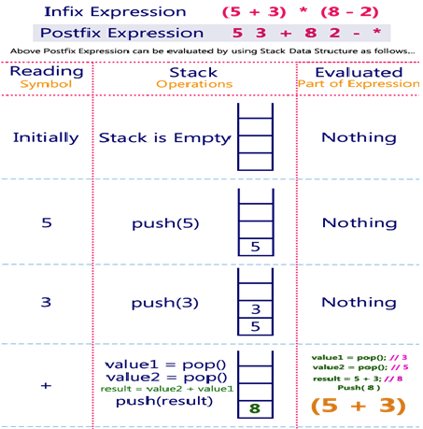
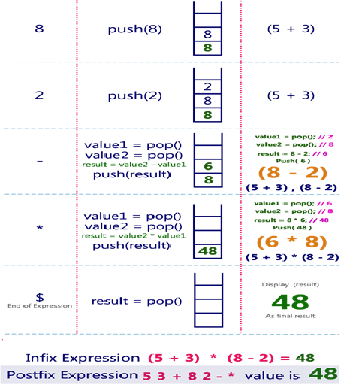
Example

Slide 43
//Impl. of postfix ex evaluation
#include<stdio.h>
#include<string.h>
#define size 10
int stack[size],top=-1;
void push(int e);
int pop();
int main()
{
char pe[30];
int i,v,op1,op2; //index,value, operand
printf("Enter postfix expression\n");
gets(pe);
for(i=0;pe[i]!='\0';i++)//read expression
{
if(isalpha(pe[i]))
{
printf("ener the vlaue of %c",pe[i]);
scanf("%d",&v);
push(v);
}
else if(isdigit(pe[i]))
{ push(pe[i]-'0'); //encoding scheme, ASCII, EX
//ASCII of 3 is 51 ascii of 0 is 48--> 51 - 48=3
}
else{
op2=pop();
op1=pop();
switch(pe[i])
{
case '+': push(op1+op2);break;
case '-': push(op1-op2);break;
case '*': push(op1*op2);break;
case '/': push(op1/op2);break;
case '%': push(op1%op2);break;
case '^': push(op1^op2);break;
defaulat: printf("\n invalid operation");
} } }
printf("the result is %d",stack[top]);
}
void push(int e)
{
if(top==size-1)
printf("\n stack is full");
else
stack[++top]=e;
}
int pop()
{
if(top==-1)
printf("\n stack is empyt");
else
return stack[top--];
}

Slide 44
Parenthesis Checker
The parenthesis is represented by the brackets shown below:
( )
Where, ( → Opening bracket
) → Closing bracket
These parentheses are used to represent the mathematical representation.
The balanced parenthesis means that when the opening parenthesis is equal to the closing parenthesis, then it is a balanced parenthesis.
Example 1: ( 2+5 ) * 4
In the above expression, there is one opening and one closing parenthesis means that both opening and closing brackets are equal; therefore, the above expression is a balanced parenthesis.
Example 2: 2 * ( ( 4/2 ) + 5 )
The above expression has two opening and two closing brackets which means that the above expression is a balanced parenthesis.
Example 3: 2 * ( ( 4/2 ) + 5
The above expression has two opening brackets and one closing bracket, which means that both opening and closing brackets are not equal; therefore, the above expression is unbalanced.

Slide 45
Parenthesis Checker
Algorithm to check balanced parenthesis
We will check the balanced parenthesis by using a variable.
The variable is used to determine the balance factor. Let's consider the variable 'x'. The algorithm to check the balanced parenthesis is given below:
ALG:
Step 1: Set x equal to 0.
Step 2: Scan the expression from left to right.
For each opening bracket "(", increment x by 1.
For each closing bracket ")", decrement x by 1.
This step will continue scanning until x<0.
Step 3: If x is equal to 0, then
"Expression is balanced.“
else
"Expression is unbalanced."

Slide 46
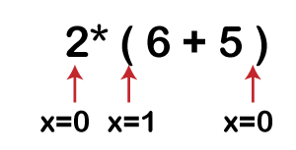
Parenthesis Checker
Let's understand the above algorithm through an example.
Suppose expression is 2 * ( 6 + 5 )
Solution: First, the x variable is initialized by 0.
The scanning starts from the variable '2', when it encounters '(' then the 'x' variable gets incremented by 1 and when the x reaches to the last symbol of the expression, i.e., ')' then the 'x' variable gets decremented by 1 and it's final value becomes 0.
We have learnt in the above algorithm that if x is equal to 0 means the expression is balanced; therefore, the above expression is a balanced expression
Parenthesis Checker Program

Slide 47
Parenthesis Checker using Stack Data Structure
Follow the steps mentioned below to implement the idea:
Declare a character stack temp.
Now traverse the string exp.
If( character == ( ( or { or [ ) → push it to stack.
If( character == ) or } or ] ) → pop from stack and if the popped character is the matching starting bracket, then fine else brackets are Not Balanced.
After complete traversal, if there is some starting bracket left in stack then Not balanced , else Balanced.

Slide 48
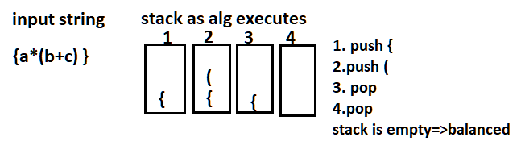
Parenthesis Checker using Stack Data Structure
Example:

