Slide 1
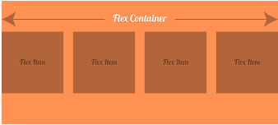
Layout with Flexbox
Flexbox is a layout mode in CSS that provides a flexible way to distribute space and align content within a container.
Used to make the elements behave predictably when they are used with different screen sizes and different display devices.
The CSS3 flexbox contains flex containers and flex items.
Flex container: specifies the properties of the parent.
display: flex or inline-flex.
Flex items: specify properties of the children.
There may be one or more flex items inside a flex container.

Slide 2
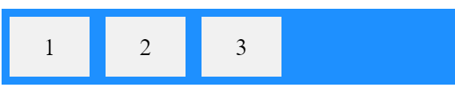
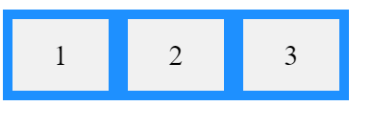
Creating flex display: flex /inline-flex.
A flex box can be created as.
display: flex and display: inline-flex
When you apply display: flex or display: inline-flex to an element, that element becomes a flex container, and its child elements become flex items.
display: flex creates a block-level flex container.
display:inline-flex creates an inline-level flex container
.flex-container {
display: flex;
background-color: DodgerBlue;
}
.flex-container {
display: inline-flex;
background-color: DodgerBlue;
}

Slide 3
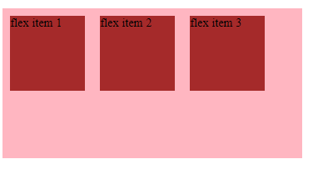
Layout with Flexbox- creating a flex
<html>
<head>
<style>
.flex-container {
display: flex;
width: 400px;
height: 150px;
background-color: lightpink;
}
.flex-item {
background-color:gray;
width: 100px;
height: 80px;
margin: 10px;
padding: 20px;
font-size:20pt;
}
</style>
</head>
<body>
<div class="flex-container">
<div class="flex-item">Flex Item 1</div>
<div class="flex-item">Flex Item 2</div>
<div class="flex-item">Flex Item 3</div>
</div>
</body>
</html>

Slide 4
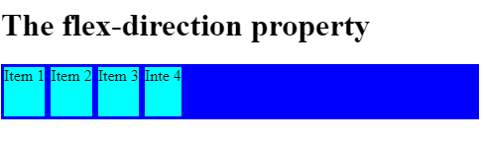

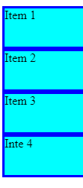
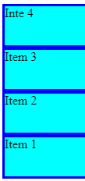
CSS flex-direction Property -
The flex-direction property specifies the direction of the flexible items.
CSS Syntax:
flex-direction: row
Property Values:
flex-direction:row;
Value | Description
row | Default value. The flexible items are displayed horizontally, as a row
column | The flexible items are displayed vertically, as a column
column-reverse | Same as column, but in reverse order
row-reverse | Same as row, but in reverse order
flex-direction:row-reverse;
flex-direction:column;
flex-direction:column-revrse;

Slide 5
CSS flex-direction Property -row
The flex-direction property specifies the direction of the flexible items.
<div class="container">
<div class="item">Item 1</div>
<div class="item">Item 2</div>
<div class="item">Item 3 </div>
<div class="item">Inte 4</div>
</div>
</div>
</body>
</html>
<html>
<head>
<style>
.container{
display: flex;
flex-direction:row;
background-color: blue;
}
.item{
background-color: aqua;
margin: 3px;
height: 50px;
}
</style>
</head>
<body>
<h1>The flex-direction property</h1>

Slide 6
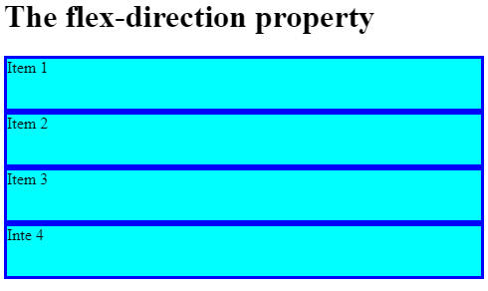
CSS flex-direction Property column
The flex-direction property specifies the direction of the flexible items.
<div class="container">
<div class="item">Item 1</div>
<div class="item">Item 2</div>
<div class="item">Item 3 </div>
<div class="item">Inte 4</div>
</div>
</div>
</body>
</html>
<html>
<head>
<style>
.container{
display: flex;
flex-direction:column;
background-color: blue;
}
.item{
background-color: aqua;
margin: 3px;
height: 50px;
}
</style>
</head>
<body>
<h1>The flex-direction property</h1>

Slide 7
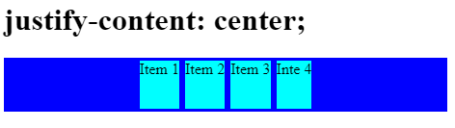
display: justify-content.
justify-content is a CSS property that is used to align and distribute flex items along the main axis of the flex container.
</style>
</head>
<body>
<div class="container">
<div class="flex-item">Item 1</div>
<div class="flex-item">Item 2</div>
<div class="flex-item">Item 3</div>
</div>
</body>
</html>
<html>
<head>
<style>
.container {
display: flex;
justify-content: center;
background-color:dodgerblue;
}
.item{
background-color: aqua;
margin: 3px;
height: 50px;
}

Slide 8



display: justify-content.
Property Values
Value | Description
flex-start | Default value. Items are positioned at the beginning of the container
flex-end | Items are positioned at the end of the container
center | Items are positioned in the center of the container
space-between | Items will have space between them
space-around | Items will have space before, between, and after them
space-evenly | Items will have equal space around them
flex-start
flex-end
center

Slide 9
CSS flex-grow Property
The flex-grow property specifies how much the item will grow relative to the rest of the flexible items inside the same container.
<body>
<h1> flex-grow: 0; </h1>
<div class="container">
<div class="flex-item" style = "flex-grow: 0;"> flex-item 1 </div>
<div class="flex-item" style = "flex-grow: 0;"> flex-item 2 </div>
<div class="flex-item" style = "flex-grow: 0;"> flex-item 3 </div>
</div>
<h1> flex-grow: 1; </h1>
<div class="container">
<div class="flex-item" style = "flex-grow: 1;"> flex-item 1 </div>
<div class="flex-item" style = "flex-grow: 1;"> flex-item 2 </div>
<div class="flex-item" style = "flex-grow: 1;"> flex-item 3 </div>
</div> </div>
</body>
</html>
<html>
<head>
<style>
.container {
display: flex;
background-color: green;
}
.flex-item {
background-color: lightgreen;
text-align: center;
font-size: 25px;
width: 100px;
height: 100px;
padding-top: 20px;
margin: 5px;
}
</style> </head>

Slide 10
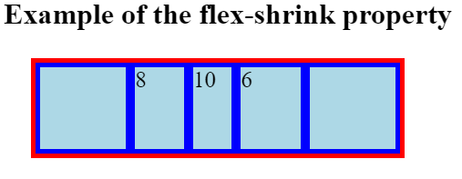
CSS flex-shrink Property
The flex-shrink property specifies how the item will shrink relative to the rest of the flexible items inside the same container.
</style>
</head>
<body> <h1> Example of the flex-shrink property </h1>
<div class="container">
<div class = "flex-item"></div>
<div class = "flex-item"></div>
<div class = "flex-item" style = "flex-shrink: 5;"> 5 </div>
<div class = "flex-item" style = "flex-shrink: initial;"> initial </div>
<div class = "flex-item" style = "flex-shrink: inherit;"> inherit </div>
</div>
<div class="container">
<div class = "flex-item"></div>
<div class = "flex-item" style = "flex-shrink: 8;"> 8 </div>
<div class = "flex-item" style = "flex-shrink: 10;"> 10 </div>
<div class = "flex-item" style = "flex-shrink: 6;"> 6 </div>
<div class = "flex-item"></div>
</div></body></html>
<html>
<head>
<style>
.container {
width: 400px;
height: 100px;
border: 5px solid red;
display: flex;
background-color: blue;
margin: 30px;
}
.flex-item{
background-color: lightblue;
font-size: 25px;
margin: 5px;
flex-grow: 1;
flex-shrink: 1;
flex-basis: 100px;
}

Slide 11
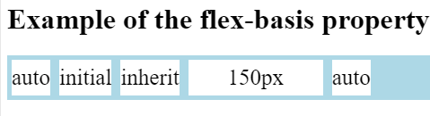
CSS flex-basis Property
The flex-basis property specifies the initial length of a flexible item.
<body>
<h1> Example of the flex-basis property </h1>
<div class = "container">
<div class = "flex-item" style = "flex-basis: auto;"> auto </div>
<div class = "flex-item" style = "flex-basis: initial;"> initial </div>
<div class = "flex-item" style = "flex-basis: inherit;"> inherit </div>
<div class = "flex-item" style = "flex-basis: 150px;"> 150px </div>
<div class = "flex-item" style = "flex-basis: auto"> auto </div>
</div>
</body>
</html>
<!DOCTYPE html>
<html>
<head>
<style>
.container {
display: flex;
background-color: lightblue;
}
.flex-item {
background-color: white;
text-align: center;
line-height: 40px;
font-size: 25px;
margin: 5px;
}
</style>
</head>

Slide 12
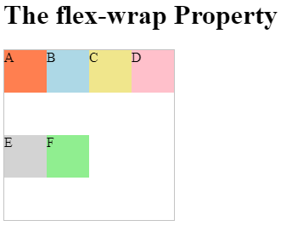
CSS flex-wrap Property
The flex-wrap property specifies whether the flexible items should wrap or not.
<h1>The flex-wrap Property</h1>
<div id="main">
<div style="background-color:coral;">A</div>
<div style="background-color:lightblue;">B</div>
<div style="background-color:khaki;">C</div>
<div style="background-color:pink;">D</div>
<div style="background-color:lightgrey;">E</div>
<div style="background-color:lightgreen;">F</div>
</div>
</body>
</html>
<!DOCTYPE html>
<html>
<head>
<style>
#main {
width: 200px;
height: 200px;
border: 1px solid #c3c3c3;
display: flex;
flex-wrap: wrap;
}
#main div {
width: 50px;
height: 50px;
}
</style>
</head>
<body>

Slide 13
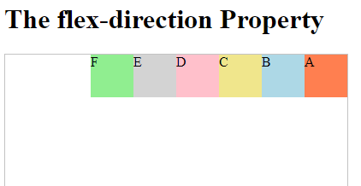
CSS flex-direction Property
The flex-direction property specifies the direction of the flexible items.
<div id="main">
<div style="background-color:coral;">A</div>
<div style="background-color:lightblue;">B</div>
<div style="background-color:khaki;">C</div>
<div style="background-color:pink;">D</div>
<div style="background-color:lightgrey;">E</div>
<div style="background-color:lightgreen;">F</div>
</div>
</body>
</html>
<html>
<head>
<style>
#main {
width: 400px;
height: 400px;
border: 1px solid #c3c3c3;
display: flex;
flex-direction: row-reverse;
}
#main div {
width: 50px;
height: 50px;
}
</style>
</head>
<body>
<h1>The flex-direction Property</h1>

Slide 14
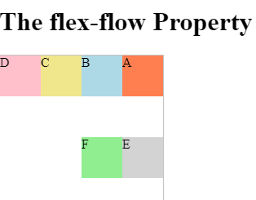
CSS flex-flow Property
This CSS property is shorthand for flex-direction and flex-wrap properties.
<h1>The flex-flow Property</h1>
<div id="main">
<div style="background-color:coral;">A</div>
<div style="background-color:lightblue;">B</div>
<div style="background-color:khaki;">C</div>
<div style="background-color:pink;">D</div>
<div style="background-color:lightgrey;">E</div>
<div style="background-color:lightgreen;">F</div>
</div>
</body>
</html>
<!DOCTYPE html>
<html>
<head>
<style>
#main {
width: 200px;
height: 200px;
border: 1px solid #c3c3c3;
display: flex;
flex-flow: row-reverse wrap;
}
#main div {
width: 50px;
height: 50px;
}
</style>
</head>
<body>

Slide 15
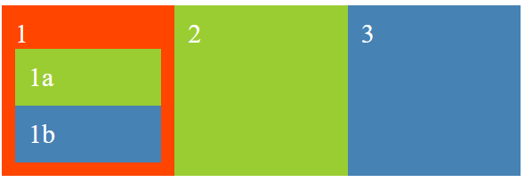
Nested Flexboxes
Flex items within a flex container can be laid out either horizontally or vertically, but not both.
If you want to lay out items in both dimensions, you'll need to nest a flex container inside another one.
.container div {
font-size: 5vw;
padding: .5em;
color: white;
flex: 1;
}
</style>
<div class="container">
<div class="red">1
<div class="green">1a</div>
<div class="blue">1b</div>
</div>
<div class="green">2</div>
<div class="blue">3</div>
</div>
<!doctype html>
<title>Example</title>
<style>
.container {
display: flex;
}
.red {
background: orangered;
display: flex;
flex-direction: column;
}
.green {
background: yellowgreen;
}
.blue {
background: steelblue;
}

