Slide 1
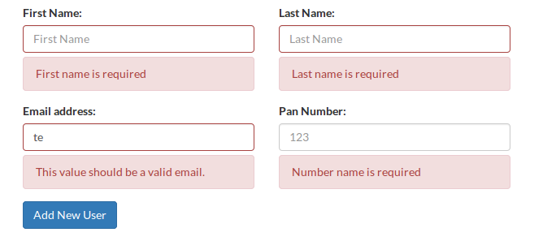
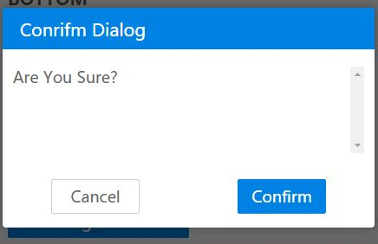
Introduction to Java-script
JavaScript is most often used for client side validation.(i.e. form data)
JavaScript is an object based scripting language designed to add interactivity (ex. pop-up alert, menu, windows, etc) to HTML pages
A JavaScript is usually embedded directly into HTML pages.
A JavaScript consists of lines of executable computer code.
JavaScript is an interpreted language (means that scripts execute without preliminary compilation)

Slide 2
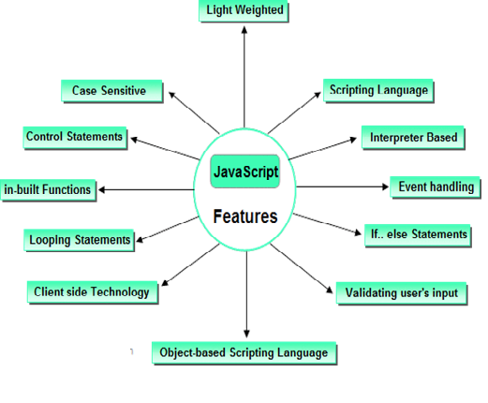
Features of JavaScript
Used to validate form data at client side.
Adds functionality to a webpage
It is light weight programming language , because Java script is return with very simple syntax.
It is interpreted language , because script code can be executed without preliminary compilation.
It Handle events like onSubmit, onLoad, onClick, onMouseOver & etc .
An important part of JavaScript is the ability to create new functions within scripts.

Slide 3
Creating a java-script
Html <script> tag is used to script code inside the html page.
< script > JavaScript statements... </ script >
A document can have multiple script tags, and each can enclose any number of JavaScript statements
The script is containing 2 attributes . They are
language attribute:-
It represents name of scripting language such as JavaScript, VbScript.
<script language=javaScript>
type attribute: - It indicates MIME (multi purpose internet mail extension) type of scripting code. It sets to an alpha-numeric MIME type of code.
<script type=text/javaScript>

Slide 4
Location of script or placing the script:
- Script code can be placed in both head & body section of html page.
Script in head section Script in body section
<html>
<head>
<script type="text/javascript“>
….. Script code here
<script>
</head>
<body>
</body>
</html>
<html>
<body>
<script type="text/javascript“>
….. Script code here
<script>
</body>
</html>

Slide 5
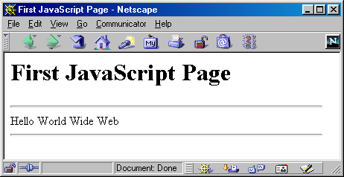
A Simple Script
<html>
<head><title>First JavaScript Page</title></head>
<body>
<h1>First JavaScript Page</h1>
<script type="text/javascript">
document.write("<hr>");
document.write("Hello World Wide Web");
document.write("<hr>");
</script>
</body>
</html>

Slide 6
Creating external script
To run same script on several pages without having to write the script on each page.
To simplify this, write external script & save .js extension. To use external script specify .js file in src attribute of script tag.
<html>
<head><title>First JavaScript Program</title></head>
<body>
<script type="text/javascript"
src="your_source_file.js"></script>
</body>
</html>
Inside your_source_file.js
document.write("<hr>");
document.write("Hello World Wide Web");
document.write("<hr>");
Use the src attribute to include JavaScript codes from an external file.
The included code is inserted in place.

Slide 7
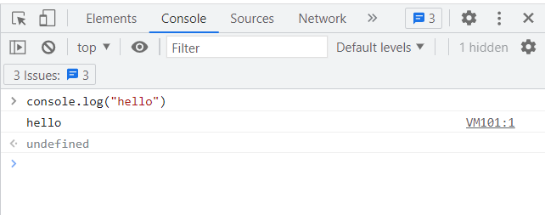
JavaScript code in the Dev Console
To run JavaScript code in the Dev Console, you can follow these steps:
Open the Dev Tools by pressing the F12 key (or Ctrl+Shift+I on Windows or Command+Option+I on Mac).
Click on the "Console" tab to view the console.
Type your JavaScript code directly into the console prompt and press Enter to run it.
For example:
Type console.log("Hello, world!"); into the console prompt and press Enter
Output : "Hello, world!" to the console.

Slide 8
Declaring variable
Variable is a memory location where data can be stored.
In java script variables with any type of data are declared by using the keyword var.
All keywords are small letters only.
var a; a=20;
var str; str= “Sunil”;
var c; c=‟a‟;
var d; d=30.7;
But the keyword is not mandatory when declare of the variable.
During the script, we can change value of variable as well as type of value of variable.
Ex: a=20;
a=30.7;

Slide 9
Declaring variable - JavaScript syntax rules:
JavaScript is case sensitive language.
In this upper case lower case letters are differentiated (not same).
Ex: - a=20;
A=20;
The variable name "a" is different from the variable named "A"
Ex: - myf( ) // correct
myF( ) // incorrect
“ ; ” is optional in general JavaScript.
Ex: - a=20 // valid
b=30 // valid
A=10; b=40; // valid
However, it is required when you put multiple statements in the same line.
JavaScript ignore white space. In java script white space, tab space & empty lines are not preserved.
To display special symbols we use \.

Slide 10
JavaScript Data Types
JavaScript provides different data types to hold different types of values. There are two types of data types in JavaScript.
Primitive data type
Non-primitive (reference) data type
JavaScript is a dynamic type language, means you don't need to specify type of the variable because it is dynamically used by JavaScript engine.
You need to use var here to specify the data type.
It can hold any type of values such as numbers, strings etc. For example:
var a=40; //holding number
var b="Rahul"; //holding string

Slide 11
JavaScript primitive data types
There are five types of primitive data types in JavaScript. They are as follows:
Data Type | Description
String | represents sequence of characters e.g. "hello"
Number | represents numeric values e.g. 100
Boolean | represents boolean value either false or true
Undefined | represents undefined value
Null | represents null i.e. no value at all
// Strings: let color = "Yellow"; let lastName = "Johnson";
// Numbers: let length = 16; let weight = 7.5;
// Booleans let x = true; let y = false;

Slide 12
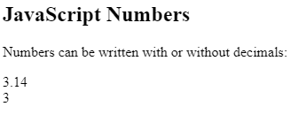
JavaScript primitive data types
JavaScript has only one type of number.
Numbers can be written with or without decimals.
<!DOCTYPE html>
<html>
<body>
<h2>JavaScript Numbers</h2>
<p>Numbers can be written with or without decimals:</p>
<p id="demo"></p>
<script>
let x = 3.14;
let y = 3;
document.getElementById("demo").innerHTML = x + "<br>" + y;
</script>
</body>
</html>

Slide 13
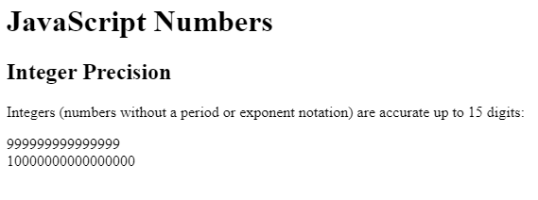
JavaScript primitive data types
Integer Precision
Integers (numbers without a period or exponent notation) are accurate up to 15 digits.
<!DOCTYPE html>
<html>
<body>
<h1>JavaScript Numbers</h1>
<h2>Integer Precision</h2>
<p>Integers (numbers without a period or exponent notation) are accurate up to 15 digits:</p>
<p id="demo"></p>
<script>
let x = 999999999999999;
let y = 9999999999999999;
document.getElementById("demo").innerHTML = x + "<br>" + y;
</script>
</body>
</html>

Slide 14
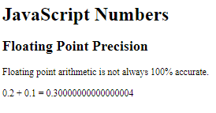
JavaScript primitive data types
Floating Precision
<!DOCTYPE html>
<html>
<body>
<h1>JavaScript Numbers</h1>
<h2>Floating Point Precision</h2>
<p>Floating point arithmetic is not always 100% accurate.</p>
<p id="demo"></p> <script>
let x = 0.2 + 0.1;
document.getElementById("demo").innerHTML = "0.2 + 0.1 = " + x;
</script>
</body>
</html>

Slide 15
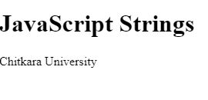
JavaScript Data Types
A JavaScript string is zero or more characters written inside quotes.
<!DOCTYPE html>
<html>
<body>
<h1>JavaScript Strings</h1>
<p id="demo"></p>
<script>
let text = "Chitkara University"; // String written inside quotes
document.getElementById("demo").innerHTML = text;
</script>
</body>
</html>

Slide 16
JavaScript non-primitive data types
Data Type | Description
Object | represents instance through which we can access members
Array | represents group of similar values
// Object: const person = {firstName:"John", lastName:"Doe"};
// Array object: const cars = ["Saab", "Volvo", "BMW"]

Slide 17
JavaScript Operators
JavaScript operators are symbols that are used to perform operations on operands
There are following types of operators in JavaScript.
Arithmetic Operators
Comparison (Relational) Operators
Bitwise Operators
Logical Operators
Assignment Operators
Special Operators

Slide 18
JavaScript Operators- Arithmetic operators
Arithmetic operators are used to perform arithmetic operations on the operands.
The following operators are known as JavaScript arithmetic operators.
Operator | Description | Example
+ | Addition | 10+20 = 30
- | Subtraction | 20-10 = 10
* | Multiplication | 10*20 = 200
/ | Division | 20/10 = 2
% | Modulus (Remainder) | 20%10 = 0
++ | Increment | var a=10; a++; Now a = 11
-- | Decrement | var a=10; a--; Now a = 9
<-- JS arithmetic operations -->
<html>
<head>
<script>
let a = 100;
let b = 50;
let x = a + b;
let y = a * b;
document.writeln("Addtion"+x);
document.writeln("<br>Multiplicaiton"+y);
</script>
</head>
<body>
</body>
</html>

Slide 19
JavaScript Operators
Relational operators compares the two operands.
The bitwise operators perform bitwise operations on operands.
Operator | Description | Example
== | Is equal to | 10==20 = false
=== | Identical (equal and of same type) | 10==20 = false
!= | Not equal to | 10!=20 = true
!== | Not Identical | 20!==20 = false
> | Greater than | 20>10 = true
>= | Greater than or equal to | 20>=10 = true
< | Less than | 20<10 = false
<= | Less than or equal to | 20<=10 = false
Operator | Description | Example
& | Bitwise AND | (10==20 & 20==33) = false
| | Bitwise OR | (10==20 | 20==33) = false
^ | Bitwise XOR | (10==20 ^ 20==33) = false
~ | Bitwise NOT | (~10) = -10
<< | Bitwise Left Shift | (10<<2) = 40
>> | Bitwise Right Shift | (10>>2) = 2
>>> | Bitwise Right Shift with Zero | (10>>>2) = 2

Slide 20
JavaScript Operators
JavaScript Logical Operators
JavaScript Assignment Operators
Operator | Description | Example
&& | Logical AND | (10==20 && 20==33) = false
|| | Logical OR | (10==20 || 20==33) = false
! | Logical Not | !(10==20) = true
Operator | Description | Example
= | Assign | 10+10 = 20
+= | Add and assign | var a=10; a+=20; Now a = 30
-= | Subtract and assign | var a=20; a-=10; Now a = 10
*= | Multiply and assign | var a=10; a*=20; Now a = 200
/= | Divide and assign | var a=10; a/=2; Now a = 5
%= | Modulus and assign | var a=10; a%=2; Now a = 0

Slide 21
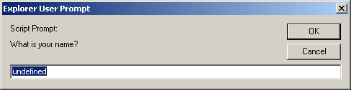
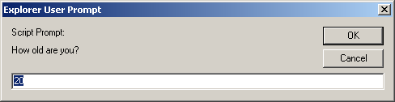
How to get input and displays output:
prompt() →used to take input in a java script code
<script type="text/javascript">
prompt("What is your name?");
prompt("How old are you?","20");
</script>
<html>
<head>
<script>
let a=prompt("Enter your name");
document.writeln(a);
</script>
</head>
<body>
</body>
</html>

Slide 22
prompt()
var num=parseInt(prompt(“Enter a number”));
<html>
<head>
<script>
let a=parseInt(prompt("Ener number1"));
let b=parseInt(prompt("Ener number2"));
document.writeln(a+b);
</script>
</head>
<body>
</body>
</html>
If the user click the "OK" button, prompt() returns the value in the input as a string.
If the user click the "Cancel" button, prompt() returns null.
To covert the string input to number we use parseInt()

Slide 23
JavaScript Display Possibilities
Writing into the HTML output using document.write().
Writing into an alert box, using window.alert().
Writing into an confirm box using window.confirm()
Writing into an HTML element, using innerHTML
document.write() provides user the functionality to write multiple expressions (HTML or JavaScript) directly to a document.
This method overwrites HTML code in a document, if any and does not appends arguments to a new line.
document.write("Hello World!");
document.write("<h2>Hello World!</h2><p>Have a nice day!</p>");

Slide 24
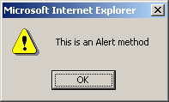
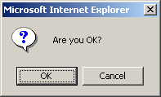
JavaScript Display Possibilities- alert() and confirm()
A alert() and confirm() is used to take input in a java script code
alert(" This is an Alert method");
Display a message in a dialog box.
The dialog box will block the browser.
alert() box
var answer = confirm("Are you sure?");
Display a message in a dialog box with two buttons: "OK" or "Cancel".
confirm() returns true if the user click "OK". Otherwise, it returns false.
confirm() box

Slide 25
JavaScript Display Possibilities- alert() and confirm()
Writing into an HTML element, using innerHTML :
To access an HTML element, JavaScript can use the document.getElementById(id) method.
The id attribute defines the HTML element.
The innerHTML property defines the HTML content:
Using console.log()
For debugging purposes, you can call the console.log() method in the browser to display data
<!– console.log() --> <html> <body> <script> console.log(5 + 6); </script> </body> </html>
<!– innerHTML - -> <html> <body> <h1>My First Web Page</h1> <p>My First Paragraph</p> <p id="demo"></p> <script> document.getElementById("demo").innerHTML = 5 + 6; </script> </body> </html>

Slide 26
Conditional Statements
To perform different actions for different decisions, we can use conditional statements in your code to do this.
In JavaScript we have the following conditional statements:
If Statement
If else statement
if else if statement
Switch statement
1. If statement
It evaluates the content only if expression is true.
if (condition) { // block of code to be executed if the condition is true }
<html>
<body>
<script>
var age=20;
if(a>10){
document.write("value of a is greater than 10");
}
</script>
</body>
</html>

Slide 27
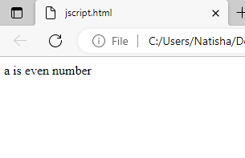
Conditional Statements- If...else Statement
2) If...else Statement
It evaluates the content whether condition is true of false
Use the else statement to specify a block of code to be executed if the condition is false.
<!– JS program to find the ever or odd -->
<html>
<head>
</head>
<script>
var a=20;
if(a%2==0){
document.write("a is even number");
}
else{
document.write("a is odd number");
}
</script>
<body>
</body>
</html>
if (condition) { //code to be executed if the condition is true } else { //code to be executed if the condition is false }

Slide 28
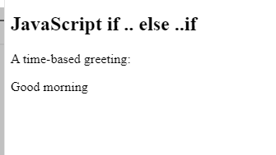
Conditional Statements- else if statement
Use the else if statement to specify a new condition if the first condition is false.
<html>
<body>
<h2>JavaScript if .. else</h2>
<p>A time-based greeting:</p>
<p id="demo"></p>
<script>
const time = new Date().getHours();
let greeting;
if (time < 10)
{
greeting = "Good morning";
} else if (time < 20) {
greeting = "Good day";
} else {
greeting = "Good evening";
}
document.getElementById("demo").innerHTML = greeting;
</script>
</body>
</html>
if (condition1) { // code to be executed if condition1 is true } else if (condition2) { // code to be executed if the condition1 is false and condition2 is true } else { // code to be executed if the condition1 is false and condition2 is false }

Slide 29
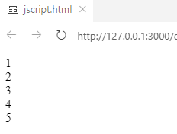
Loops
Loops can execute a block of code a number of times.
<html>
<body>
<script>
for (i=1; i<=5; i++)
{
document.write(i + "<br/>")
}
</script>
</body>
</html>
There are four types of loops in JavaScript.
for loop
while loop
do-while loop
for-in loop
JavaScript For loop:
The JavaScript for loop iterates the elements for the fixed number of times.
for (initialization; condition; increment)
{
code to be executed
}

Slide 30
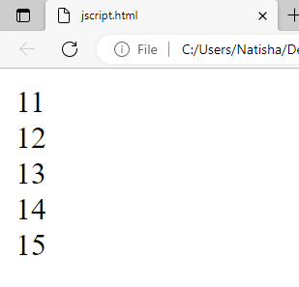
Loops - while
2) JavaScript while loop
The JavaScript while loop iterates the elements for the infinite number of times.
It should be used if number of iteration is not known.
<!DOCTYPE html>
<html>
<body>
<script>
var i=11;
while (i<=15)
{
document.write(i + "<br/>");
i++;
}
</script>
</body>
</html>
while (condition)
{
code to be executed
}

Slide 31
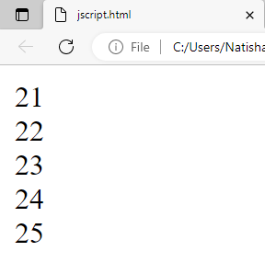
Loops – do while
3) JavaScript do while loop
The JavaScript do while loop iterates the elements for the infinite number of times like while loop.
But, code is executed at least once whether condition is true or false
<!DOCTYPE html>
<html>
<body>
<script>
var i=21;
do{
document.write(i + "<br/>");
i++;
}while (i<=25);
</script>
</body>
</html>
do{
code to be executed
}while (condition);

Slide 32
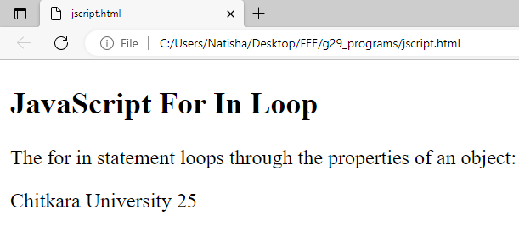
Loops – for in loop
The For In Loop
The JavaScript for in statement loops through the properties of an Object:
<!DOCTYPE html>
<html>
<body>
<h2>JavaScript For In Loop</h2>
<p>The for in statement loops through the properties of an object:</p>
<p id="demo"></p>
<script>
const person = {fname:"Chitkara", lname:"University", age:25};
let txt = "";
for (let x in person) {
txt += person[x] + " ";
}
document.getElementById("demo").innerHTML = txt;
</script>
</body>
</html>
for (key in object) { // code block to be executed }

Slide 33
JavaScript variable Scope
Scope determines the accessibility (visibility) of variables.
JavaScript has 3 types of scope:
Block scope
Function scope
Global scope
1. Block Scope
Variables declared inside a { } block cannot be accessed from outside the block:
{ let x = 2; } // x can NOT be used here
{ var x = 2; } // x CAN be used her
Variables declared with the var keyword can NOT have block scope.

Slide 34
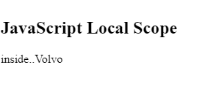
JavaScript variable Scope
2. Function scope/Local Scope
Variables declared within a JavaScript function, become LOCAL to the function.
<!DOCTYPE html>
<html>
<body>
<h2>JavaScript Local Scope</h2>
<p id="demo1"></p>
<p id="demo2"></p>
<script>
myFunction();
function myFunction() {
let carName = "Volvo";
document.getElementById("demo1").innerHTML ="inside.."+carName;
}
document.getElementById("demo2").innerHTML ="outside"+carName;
</script>
</body>
</html>
// code here can NOT use carName function myFunction() { let carName = "Volvo"; // code here CAN use carName } // code here can NOT use carNam

Slide 35

JavaScript variable Scope
3.Global JavaScript Variables
A variable declared outside a function, becomes GLOBAL
<!DOCTYPE html>
<html>
<body>
<h2>JavaScript Scope</h2>
<p id="demo"></p>
<script>
let carName = "Volvo";
myFunction();
function myFunction() {
document.getElementById("demo").innerHTML = "I can display " + carName;
}
</script>
</body>
</html>

Slide 36
JavaScript Functions
A JavaScript function is a block of code designed to perform a particular task.
function functionName([arg1, arg2, ...argN])
{
//code to be executed
}
Generally we can place script containing function head section of web page.
Ex: -
<HTML>
<HEAD>
<TITLE> Function direct call</TITLE>
<script language="JavaScript">
function add(x,y)
{
z=x+y
return z
}
</script>
</HEAD>
<BODY>
<script>
var r=add(30,60)
document.write("addition is :"+r);
</script>
</BODY>
</HTML>

Slide 37
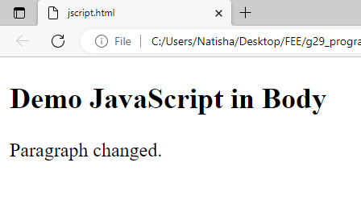
JavaScript Functions
JavaScript in <body>
A JavaScript function is placed in the <body> section of an HTML page.
<!DOCTYPE html>
<html>
<body>
<h2>Demo JavaScript in Body</h2>
<p id="demo">A Paragraph.</p>
<script>
function disp()
{
document.getElementById("demo").innerHTML = "Paragraph changed.";
}
disp()
</script
</body>
</html>

Slide 38
Invoking a JavaScript Function
The code inside a function is not executed when the function is defined.
The code inside a function is executed when the function is invoked.
Function call
Events handlers
<HTML>
<HEAD>
<TITLE> Function direct call</TITLE>
<script>
function add(x,y) //function definition
{
z=x+y
return z
}
</script>
</HEAD>
<BODY>
<script>
var r=add(30,60) //function call
document.write("addition is :"+r);
</script>
</BODY>
</HTML>
Invoking a function by function call:
Ex>
function f1()
{
--
}
f1();

Slide 39
JavaScript functions
2. Events handlers to call the function dynamically.
To add dynamical effects, java script provide a list of events that call function dynamically.
<HTML>
<HEAD>
<TITLE> Function dynamically</TITLE>
<script language="JavaScript">
function add( )
{
x=20;
y=30;
z=x+y;
document.write("addition is :"+z);
}
</script>
</HEAD>
<BODY> to call function:
<input type="button“ value="clickhere" onclick="add( )">
</script>
</BODY>
</HTML>
O/P: - to call function: addition is :90

