Slide 1
Java Script Objects
A “JavaScript” object is an entity having state and behavior (properties and method).
For example: car, pen, bike, chair, glass, keyboard, monitor etc.
It is an object-based language.(All OOP concepts except inheritance).
JavaScript is template based not class based. Here, we don't create class to get the object. But, we direct create objects.
Types of Objects:
Built-in Objects
User-Defined Objects

Slide 2
Java Script Objects - Built-in Objects
1. JavaScript Native Objects/ Built-in Objects
JavaScript Number Object
JavaScript Boolean Object
JavaScript String Object
JavaScript Date Object
JavaScript Math Object
JavaScript Array Object

Slide 3
Java Script Objects – Number
The JavaScript number object represent a numeric value.
The Number object is a fundamental wrapper object that represents and manages number
Integers, decimal, or float point numbers, among many other types of numbers, are all represented as number objects.
Values of various kinds can be turned into numbers using the Number() method.
var n=new Number(value);
<html>
<body>
<script>
var x=102;//integer value
var y=102.7;//floating point value
var z=13e4;//exponent value, output: 130000
var n=new Number(16);//integer value by number object
document.write(x+" "+y+" "+z+" "+n);
</script>
</body>
</html>

Slide 4
Java Script Objects – Number
Methods | Description
isFinite() | It determines whether the given value is a finite number.
isInteger() | It determines whether the given value is an integer.
parseFloat() | It converts the given string into a floating point number.
parseInt() | It converts the given string into an integer number.
toExponential() | It returns the string that represents exponential notation of the given number.
toFixed() | It returns the string that represents a number with exact digits after a decimal point.
toPrecision() | It returns the string representing a number of specified precision.
toString() | It returns the given number in the form of string.
Constant | Description
MIN_VALUE | returns the largest minimum value.
MAX_VALUE | returns the largest maximum value.
POSITIVE_INFINITY | returns positive infinity, overflow value.
NEGATIVE_INFINITY | returns negative infinity, overflow value.
NaN | represents "Not a Number" valu

Slide 5
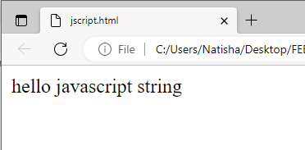
Java Script Objects – String
The JavaScript string is an object that represents a sequence of characters.
There are 2 ways to create string in JavaScript
By string literal
By string object (using new keyword)
2) By string object (using new keyword)
The syntax of creating string object using new keyword is given below:
var str=new String("string literal");
<!DOCTYPE html>
<html>
<body>
<script>
var str=new String("hello javascript string");
document.write(str);
</script>
</body>
</html>
1) By string literal
The string literal is created using double quotes.
var str = “Hello”
<html>
<body>
<script>
var str="This is string literal";
document.write(str);
</script>
</body>
</html>

Slide 6
JavaScript String Methods
Methods | Description
charAt() | Return char value present at the specified index.
concat() | Return combination of two or more strings.
indexOf() | Return position of a char value present in the given string.
replace() | string with the specified replacement.
substr() | It is used to fetch the part of the given string on the basis of the specified starting position and length.
substring() | It is used to fetch the part of the given string on the basis of the specified index.
slice() | It is used to fetch the part of the given string
toLowerCase() | It converts the given string into lowercase letter.
toUpperCase() | It converts the given string into uppercase letter.
toString() | Returns a string representing the particular object.
split() | It splits a string into substring array, then returns that newly created array.
trim() | It trims the white space from the left and right side of the string.

Slide 7
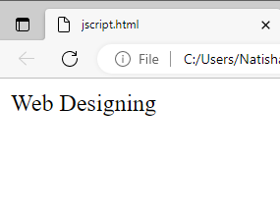
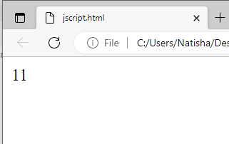
String Methods
concat(str) method:
The JavaScript String concat(str) method concatenates or joins two strings.
JavaScript String indexOf(str) Method
The JavaScript String indexOf(str) method returns the index position of the given string
<html>
<body>
<script>
var s1="Web ";
var s2="Designing";
var s3=s1.concat(s2);
document.write(s3);
</script>
</body>
</html>
<!DOCTYPE html>
<html>
<body>
<script>
var s1="javascript for web";
var n=s1.indexOf("for");
document.write(n);
</script>
</body>
</html>

Slide 8
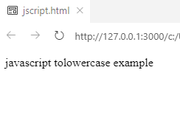
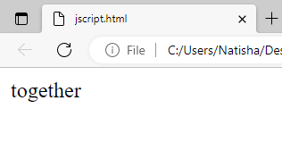
String Methods
JavaScript String toLowerCase() Method
The JavaScript String toLowerCase() method returns the given string in lowercase letters
7) JavaScript String slice(beginIndex, endIndex) Method
The JavaScript String slice(beginIndex, endIndex) method returns the parts of string from given beginIndex to endIndex.
In slice() method, beginIndex is inclusive and endIndex is exclusive.
<html>
<body>
<script>
var s1="JavaScript toLowerCase Example";
var s2=s1.toLowerCase();
document.write(s2);
</script>
</body>
</html>
<!DOCTYPE html>
<html>
<body>
<script>
var s1="We are together";
var s2=s1.slice(6,15);
document.write(s2);
</script>
</body>
</html>

Slide 9
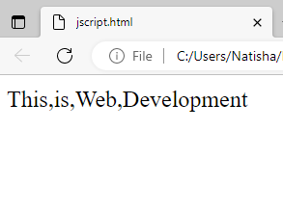
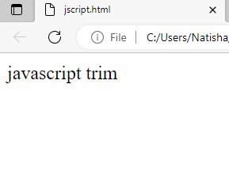
String Methods
JavaScript String split() Method
splits the given string.
7) JavaScript String trim() Method:
trim() eliminates the spaces in the string
<html>
<body>
<script>
var str="This is Web Development";
document.write(str.split(" "));
//ocument.write(s2);
</script>
</body>
</html
<html>
<body>
<script>
var s1=" javascript trim ";
var s2=s1.trim();
document.write(s2);
</script>
</body>
</html>

Slide 10
Java Script Boolean Object
Boolean
JavaScript Boolean is an object that represents value in two states: true or false.
You can create the JavaScript Boolean object by Boolean() constructor
Boolean b=new Boolean(value);
<script>
document.write(10<20);//true
document.write(10<5);//false
</script>

Slide 11
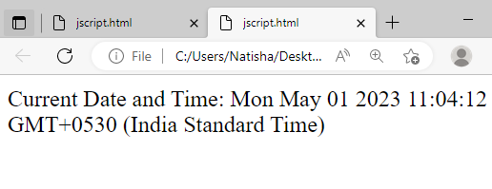
Java Script Objects - Date
Date:
The JavaScript date object can be used to get year, month and day.
You can display a timer on the webpage by the help of JavaScript date object.
<html>
<body>
Current Date and Time:
<span id="txt"></span>
<script>
var today=new Date();
document.getElementById('txt').innerHTML=today;
</script>
</body>
</html>
Constructor:
4 variant of Date constructor to create date object.
Date()
Date(milliseconds)
Date(dateString)
Date(year, month, day, hours, minutes, seconds, milliseconds)

Slide 12
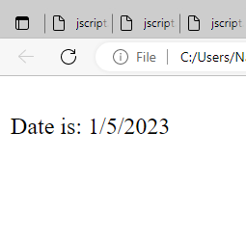
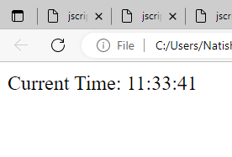
Java Script Objects -Date
Methods | Description
getDate() | It returns the integer value between 1 and 31
getDay() | It returns the integer value between 0 and 6
getFullYears() | represents the year on the basis of local time
getMonth() | It returns the integer value between 0 and 11 that represents the month
JavaScript Current Time Example
<html>
<body>
Current Time: <span id="txt"></span>
<script>
var today=new Date();
var h=today.getHours();
var m=today.getMinutes();
var s=today.getSeconds();
document.getElementById('txt').innerHTML=h+":"+m+":"+s;
</script>
</body>
</html>
<!DOCTYPE html>
<html>
<script>
var date=new Date();
var day=date.getDate();
var month=date.getMonth()+1;
var year=date.getFullYear();
document.write("<br>Date is: "+day+"/"+ month+"/"+year);
</script>
</body>
</html>

Slide 13
Java Script Objects – Math Object
The JavaScript math object provides several constants and methods to perform mathematical operation.
let num1 = 16;
let sq = Math.sqrt(num1);
let num2 = 3.14;
let rounded = Math.round(num2);
// Generate a random number between 0 and 1
let random = Math.random();
// Calculate the maximum of two numbers
let num4 = 20;
let max = Math.max(num1, num4);
// Calculate the minimum of two numbers
let num5 = -5;
let min = Math.min(num2, num5);
The square root of 16 is 4
3.14 rounded to the nearest integer is 3
A random number between 0 and 1 is 0.9191471923452968
The maximum of 16 and 20 is 20
The minimum of 3.14 and -5 is -5

Slide 14
Java Script Objects
2. User-Defined Objects
The new operator is used to create an instance of an object.
To create an object, the new operator is followed by the constructor method
Syntax
var objectname=new Object();
var emp=new Object();
The Object() Constructor
A constructor is a function that creates and initializes an object.
JavaScript provides a special constructor function called Object() to build the object
Creating and assigning properties to the object
var emp=new Object();
emp.id=101;
emp.name=“Naveen Kumar";
emp.salary=50000.50;
document.write(“emp name is : " + emp.name + "<br>");
document.write(“salary is : " + emp.salay+ "<br>");

Slide 15
Java Script Objects
create a user defined object using object literal notation
create an object with a User-Defined object using a constructor
// creating an object using object literal notation
const person = {
firstName: “naveen",
lastName: “reddy",
age: 30,
occupation: "Developer"
};
// accessing object properties using dot notation
console.log(person.firstName);
console.log(person.age);
//const creates "constant" array that cannot be reassigned another
function book(title, author) //constructor
{
this.title = title;
this.author = author;
}
//creating array as object using constructor
var myBook = new book("JAVA", “Naveen");
document.write("Book title is : " + myBook.title );
document.write("Book author is : " + myBook.author );

Slide 16
Java Script Objects- Defining Methods for an Object
Defining Methods in constructor
Adding the method as a property
<html>
<head>
</head>
<body><h3>To add a method to a JavaScript object.</h3>
<script>
function Calculator(){
//adding the another method
Calculator.prototype.add = function (a,b)
{
var result = a+b;
document. Writeln("sum is:"+result)
}
}
var calc = new Calculator();
calc.add(10,20);
</script>
</body>
</html>
<html><head></head>
<body>
<h3>To add a method to a JavaScript object.</h3>
<p id="method-to-obj"></p>
<script>
function Car(name, model, year, color) {
this.Name = name;
this.Model = model;
this.Year = year;
this.Color = color;
}
var car1 = new Car("Maruti", "Vitara Brezza", "2016", "Red");
car1.prop = function() //added as property
{
document.writeln(""+this.Name+" has launched in"+this.Year);
}
car1.prop();
</script>
</body>
</html>

Slide 17
JavaScript Arrays
JavaScript array is an object that represents a collection of similar type of elements.
3 ways to construct array in JavaScript
By array literal
By creating instance of Array directly (using new keyword)
By using an Array constructor (using new keyword)
<!–- CREATING AN ARRAYA AND ACCESSING THE ELEMENTS-->
<html>
<body>
<script>
var emp=["Shivam","Vansh","Sameer"];
for (i=0;i<emp.length;i++){
document.write(emp[i] + "<br/>");
}
</script>
</body>
</html>
1) JavaScript array literal:
var arrayname=[value1,value2.....valueN];
Ex1.
var cars = ["Saaboo","Volvo","BMW"]; (or) const cars = ["Saaboo","Volvo","BMW"];
Ex2.
var cars = []; cars[0]= "Saab"; cars[1]= "Volvo"; cars[2]= "BMW";

Slide 18
JavaScript Array directly (new keyword)
Creating an array using new keyword:
Creating an array using constructor
create instance of array by passing arguments in constructor so that no need to provide value explicitly.
var arr=new Array();
<html>
<body>
<script>
var i;
var emp = new Array();
emp[0] = “kiran";
emp[1] = “Uday";
emp[2] = “Ram";
for (i=0;i<emp.length;i++)
{
document.write(emp[i] + "<br>");
}
</script>
</body>
</html>
<html>
<body>
<script>
var emp=new Array(“vansh",“shiva",“sneha");
for (i=0;i<emp.length;i++)
{
document.write(emp[i] + "<br>");
}
</script>
</body>
</html>

Slide 19
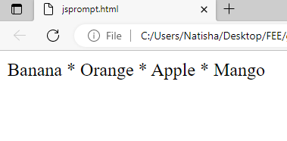
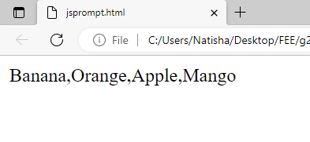
JavaScript Array Methods
toString() method
converts an array to a string of (comma separated) array values.
Join():
Joins all array elements into a string.
Also, can specify the separator
<html>
<body>
<h2>JavaScript Array Methods</h2>
<h2>toString()</h2>
<p>The toString() method returns an array as a comma separated string:</p>
<p id="demo"></p>
<script>
const fruits = ["Banana", "Orange", "Apple", "Mango"];
document.getElementById("demo").innerHTML = fruits.toString();
</script>
</body>
</html>
<html>
<body>
<p id="demo"></p>
<script>
const fruits = ["Banana", "Orange", "Apple", "Mango"];
document.getElementById("demo").innerHTML = fruits.join(" * ");
</script>
</body>
</html>

Slide 20
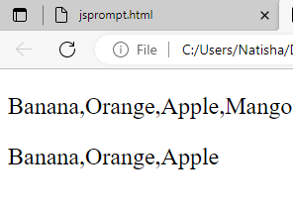
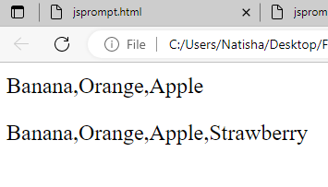
JavaScript Array Methods
pop()
removes the last element from an array:
push():
adds a new element to an array (at the end)
<html>
<body>
<p id="demo1"></p>
<p id="demo2"></p>
<script>
const fruits = ["Banana", "Orange", "Apple", "Mango"];
document.getElementById("demo1").innerHTML = fruits;
fruits.pop();
document.getElementById("demo2").innerHTML = fruits;
</script>
</body>
</html>
<html>
<body>
<p id="demo1"></p>
<p id="demo2"></p>
<script>
const fruits = ["Banana", "Orange", "Apple"];
document.getElementById("demo1").innerHTML = fruits;
fruits.push("Strawberry");
document.getElementById("demo2").innerHTML = fruits;
</script>
</body>
</html>

Slide 21
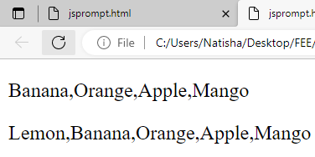
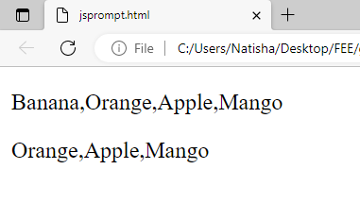
JavaScript Array Methods
shift()
removes the first array element and "shifts" all other elements to a lower index
unshift():
adds a new element to an array (at the beginning), and "unshifts" older elements:
<html>
<body>
<p id="demo1"></p>
<p id="demo2"></p>
<script>
const fruits = ["Banana", "Orange", "Apple", "Mango"];
document.getElementById("demo1").innerHTML = fruits;
fruits.shift();
document.getElementById("demo2").innerHTML = fruits;
</script>
</body>
</html>
<html>
<body>
<p id="demo1"></p>
<p id="demo2"></p>
<script>
const fruits = ["Banana", "Orange", "Apple", "Mango"];
document.getElementById("demo1").innerHTML = fruits;
fruits.unshift("Lemon");
document.getElementById("demo2").innerHTML = fruits;
</script>
</body>
</html>

Slide 22
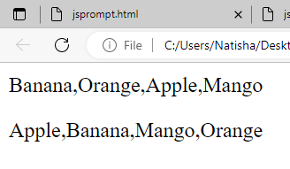
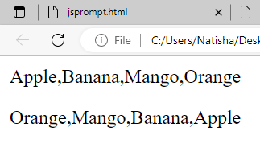
JavaScript Array Methods
sort()
sorts an array alphabetically
reverse():
Reverse the elements of the array
<html>
<body>
<p id="demo1"></p>
<p id="demo2"></p>
<script>
const fruits = ["Banana", "Orange", "Apple", "Mango"];
document.getElementById("demo1").innerHTML = fruits;
fruits.sort();
document.getElementById("demo2").innerHTML = fruits;
</script>
</body>
</html>
<html> <body>
<p id="demo1"></p>
<p id="demo2"></p>
<script>
// Create and display an array:
const fruits = ["Banana", "Orange", "Apple", "Mango"];
// First sort the array
fruits.sort();
document.getElementById("demo1").innerHTML = fruits;
fruits.reverse();
document.getElementById("demo2").innerHTML = fruits;
</script>
</body>
</html>

Slide 23
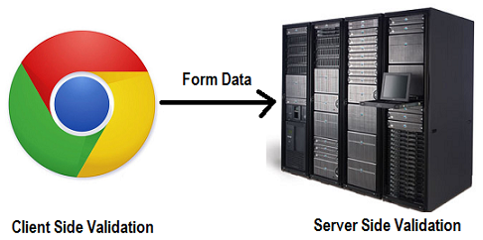
FORM VALIDATION
Validations can be performed on the server side or on the client side ( web browser)
Client side validation is an initial check and an important feature of good user experience
by catching and requiring corrections to invalid data before it is sent to the server to be rejected there,
the delay caused by a round trip to the server for server-side validation is avoided.
Server-side validation is necessary to check data sent to the server, ensuring incorrect or malicious data is rejected.

Slide 24
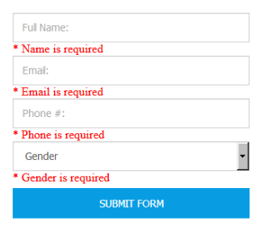
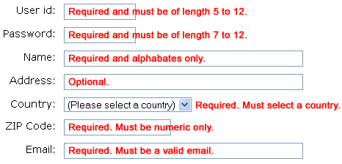
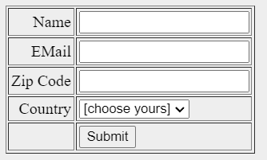
FORM VALIDATION
JavaScript provides a way to validate form's data on the client's computer before sending it to the web server.
Form validation generally performs two functions.
1) Basic Validation − First of all, the form must be checked to make sure all the mandatory fields are filled in.
It would require just a loop through each field in the form and check for data.
2) Data Format Validation − Secondly, the data that is entered must be checked for correct form and value.
Your code must include appropriate logic to test correctness of data.

Slide 25
FORM VALIDATION- name and password validation
Validate the name and password fields
The name can’t be empty and password can’t be less than 6 characters long.
<body>
<form name="myform" action="page2.html" onsubmit="return validateform()" >
Enter username:
<input type="text" id="username" name="username">
<span id="unameError"></span><br>
Enter password <label for="password">Password:</label>
<input type="password" id="password" name="password">
<span id="pwdError"></span><br>
<input type="submit" value="Submit">
</form>
<script>
function validate() {
var username =document.getElementById("username").value;
var password =document.getElementById("password").value;
if (username.length < 6) {
document.getElementById("unameError").innerHTML="Username must be at least 6 chars";
return false;
}
if(password.length < 8) {
document.getElementById(“pwdError").innerHTML=“Password must be at least 8 chars";
return false;
}
return true;
}
</script>

Slide 26
FORM VALIDATION- number validation
Number validation
<!DOCTYPE html>
<html>
<body>
<h1>Number Validation Example</h1>
<form onsubmit="return validate()">
Enter a Number
<input type="text" id="number" name="number">
<span id="numError"></span><br>
<input type="submit" value="Submit">
</form>
<script>
function validate() {
var number = document.getElementById("number").value;
if(isNaN(number))
{
document.getElementById(" numError ").innerHTML="Enter Numeric value only";
return false;
}
return true;
}
</script>
</body>
</html>
isNaN() tests if the number is the value NaN

Slide 27
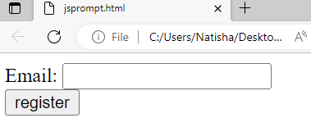
FORM VALIDATION- email validation
JavaScript email validation:
</script>
<body>
<form name="myform" action="valid.html" onsubmit="return validate();">
Email: <input type="text" name="email"><br/>
<input type="submit" value="register">
</form>
</body>
</html>
We can validate the email by the help of JavaScript.
email id must contain the @ and . character
There must be at least one character before and after the @.
There must be at least two characters after . (dot).
<html> <body> <script>
function validate()
{
var x=document.myform.email.value;
var atpos=x.indexOf("@");
var dotpos=x.lastIndexOf(".");
if (atpos<1 || dotpos<atpos+2 || dotpos+2>=x.length)
{
alert("Please enter a valid e-mail address \n atpostion:"+atpos+"\n dotposition:"+dotpos);
return false;
}
}
atpos<1: checks to see there is at least one character before the "@" symbol.
dotpos<atpos+2: checks if the "." symbol appears before the second character after the "@" symbol. This is to ensure that there is at least one character between the "@" symbol and the "." symbol.
dotpos+2>=x.length: This is to ensure that there is at least one character after the "." symbol in the domain name.

Slide 28
JavaScript Retype Password Validation
JavaScript Retype Password Validation
</script>
</head>
<body> <form name="f1" onsubmit="return matchpass()">
Password:<input type="password" name="password" /><br/>
Re-enter Password:<input type="password" name="password2"/><br/>
<input type="submit">
</form>
</body>
</html>
<html>
<head>
<script type="text/javascript">
function matchpass()
{
var firstpwd=document.f1.password.value;
var secondpwd=document.f1.password2.value;
if(firstpwd==secondpwd){
return true;
}
else{
alert("password must be same!");
return false;
}
}

Slide 29
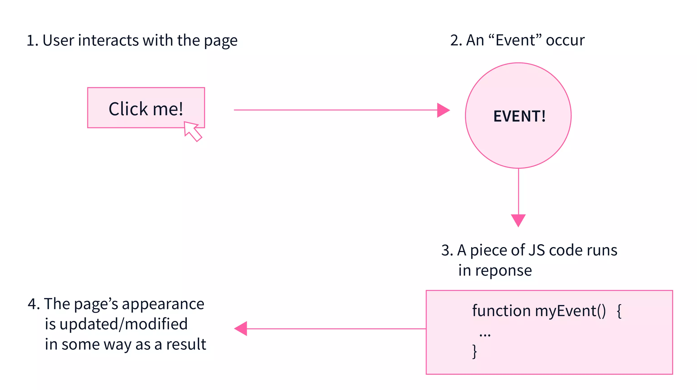
JavaScript Events
An event is action performed by user in the browser.
In html, there are various events which represents that some activity is performed by the user or by the browser.
When javascript code is included in HTML, js react over these events and allow the execution. This process of reacting over the events is called Event Handling. Thus, js handles the HTML events via Event Handlers.
For example, when a user clicks on the button, add js code, which will execute the task to be performed on the event.

Slide 30
Types of Events
Types of Events:
Mouse events:
Keyboard events:
Form events:
Window/Document events
Mouse Events
click | onclick
mouseover | onmouseover
mouseout | onmouseout
mousedown | onmousedown
mouseup | onmouseup
mousemove | onmousemove
Window/Document events
load | onload
unload | onunload
resize | onresize
Form Events
focus | onfocus
submit | onsubmit
blur | onblur
change | onchange
Key Events
event | Evenhandler
keydown | onkeydown
keypress | onkeypress
keyup | onkeyup

Slide 31
Onclick event
In the following example, an onclick attribute (with code), is added to a <button> element:
Ex2.
<html>
<body> <button onclick="document.getElementById('demo').innerHTML=Date()">The time is?</button> <p id="demo"></p> </body>
</html>
Ex.1:
<html>
<head> Javascript Events </head>
<body>
<script>
function clickevent()
{
document.write("This is Onclick event");
}
</script>
<form>
<input type="button" onclick="clickevent()" value="Who's this?"/>
</form>
</body>
</html>

Slide 32
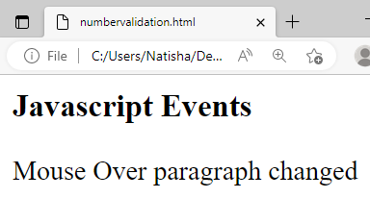
mouse event- onmuseover
Occurs when the cursor of the mouse comes over the element
<html>
<head>
<h1> Javascript Events </h1>
</head>
<body>
<script> function mouseoverevent()
{
document.getElementById("p1").innerText="Mouse Over paragraph changed"
}
</script>
<p id="p1" onmouseover="mouseoverevent()"> Keep cursor over me</p>
</body>
</html>

Slide 33
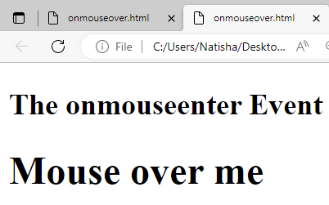
mouse event- onmouseenter, onmouseleave
The onmouseenter event occurs when the mouse pointer enters an element.
The onmouseenter event is often used together with the onmouseleave event, which occurs when the mouse pointer leaves an element.
<html>
<body>
<h2>The onmouseenter onmouseleave Events</h2>
element.</p>
<h1 id="demo" onmouseenter="mouseEnter()" onmouseleave="mouseLeave()">Mouse over me</h1>
<script>
function mouseEnter() {
document.getElementById("demo").style.color = "red";
}
function mouseLeave() {
document.getElementById("demo").style.color = "black";
}
</script>
</body>
</html>

Slide 34
mouse event- onmouseenter, onmouseleave
The onmouseenter event occurs when the mouse pointer enters an element.
The onmouseenter event is often used together with the onmouseleave event, which occurs when the mouse pointer leaves an element.
<html>
<head>
<title>onmouseover Example</title>
<script>
function changeImage() {
document.getElementById("my-image").src = "flower2.jpg";
}
function restoreImage() {
document.getElementById("my-image").src = "flower1.jpg";
}
</script>
</head>
<body>
<img id="my-image" src="flower1.jpg" onmouseover="changeImage()" onmouseout="restoreImage()">
</body>
</html>

Slide 35
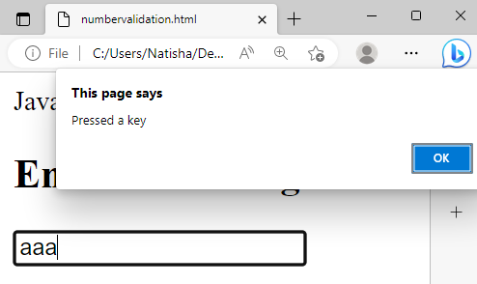
mouse event- Keydown Event
Keydown Event
<html>
<head> Javascript Events</head>
<body>
<h2> Enter something here</h2>
<input type="text" id="input1" onkeydown="keydownevent()"/>
<script>
function keydownevent()
{
document.getElementById("input1");
alert("Pressed a key");
}
</script>
</body>
</html>

Slide 36
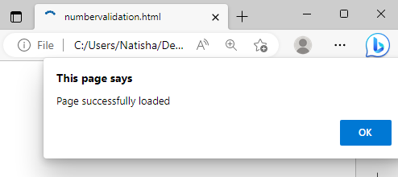
mouse event- Load Event
Load event: onload is most often used within the <body> element to execute a script once a web page has completely loaded all content
<html>
<head>Javascript Events</head>
</br>
<body onload="window.alert('Page successfully loaded');">
<script>
document.write("The page is loaded successfully");
</script>
</body>
</html>

Slide 37
mouse event- resize Event
The onresize event occurs when the browser window has been resized.
<html>
<body onresize="myFunction()"
<p>Try to resize the browser window to display the windows height and width.</p>
<p id="demo"></p>
<script>
function myFunction() {
var w = window.outerWidth;
var h = window.outerHeight;
var txt = "Window size: width=" + w + ", height=" + h;
document.getElementById("demo").innerHTML = txt;
}
</script>
</body>
</html>

Slide 38
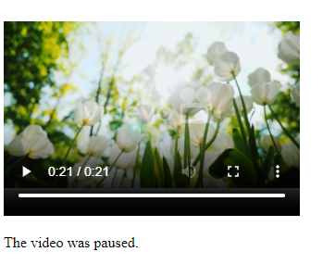
Onplay and onpause events
The onplay event occurs when an audio/video is started.
The onpause event occurs when an audio/video is pause.
function myFunction2() {
document.getElementById("demo").innerHTML = "The video is playing.";
}
</script>
</body>
</html>
<html>
<body>
<h1>HTML DOM Events</h1>
<h2>The onpause Event</h2>
<p>Assign an "onpause" event to a video element.</p>
<p>Play and pause the video.</p>
<video width="320" height="240" controls onpause="myFunction()"
onplay="myFunction2()">
<source src="flower.mp4" type="video/mp4">
</video>
<p id="demo"></p>
<script>
function myFunction() {
document.getElementById("demo").innerHTML = "The video was paused.";
}

Slide 39
JavaScript addEventListener()
The addEventListener() method is used to attach an event handler to a particular element.
It does not override the existing event handlers.
Syntax:
element.addEventListener(event, function);
<html>
<body>
<p> Example of the addEventListener() method. </p>
<p> Click the following button to see the effect. </p>
<button id = "btn"> Click me </button>
<p id = "para"></p>
<script>
document.getElementById("btn").addEventListener("click", fun);
function fun() {
document.getElementById("para").innerHTML = "Hello World" + "<br>" + "Welcome to the Webdevelopment";
}
</script>
</body>
</html>

