Slide 1
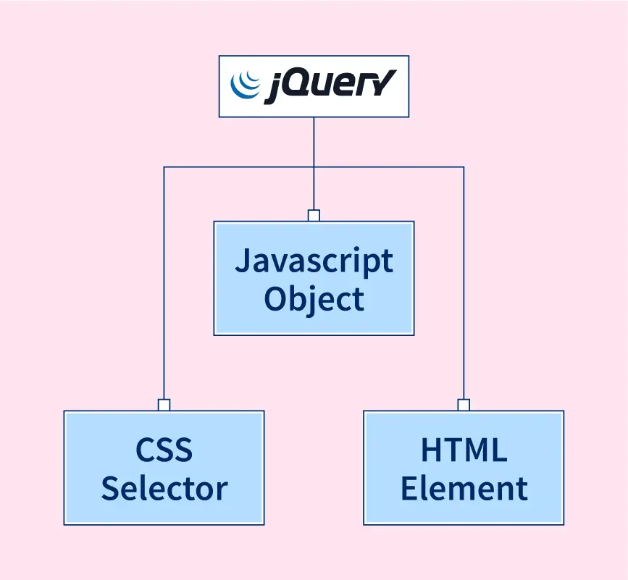
jQuery introduction
jQuery is a lightweight, "write less, do more", JavaScript library.
The purpose of jQuery is to make it much easier to use JavaScript on your website.
jQuery takes a lot of common tasks that require many lines of JavaScript code to accomplish, and wraps them into methods that you can call with a single line of code.
jQuery also simplifies a lot of the complicated things from JavaScript, like AJAX calls and DOM manipulation.
The jQuery library contains the following features:
HTML/DOM manipulation
CSS manipulation
HTML event methods
Effects and animations
AJAX
Utilities

Slide 2
jQuery introduction
Adding jQuery to Your Web Pages
There are several ways to start using jQuery on your web site.
1) Download the jQuery library from jquery.com:
The jQuery library is a single JavaScript file, and you reference it with the HTML <script> tag (notice that the <script> tag should be inside the <head> section):
(or)
2) Include jQuery from a CDN, like Google:
If you don't want to download and host jQuery yourself, you can include it from a CDN (Content Delivery Network).
<head>
<script src="jquery-3.6.4.min.js"></script>
</head>
<head>
<script src="https://ajax.googleapis.com/ajax/libs/jquery/3.6.4/jquery.min.js"></script>
</head>

Slide 3
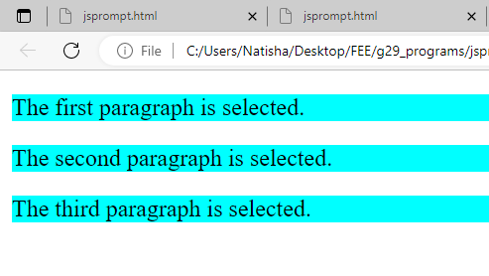
jQuery introduction - $( document ).ready()
$(document).ready() and $()
A page can't be manipulated safely until the document is "ready.“
The code inserted between $(document).ready() is executed only once when page is ready for JavaScript code to execute.
In place of $(document).ready(), we can use shorthand notation $() only.
Ex. Changes the background-color of all <p> tag or paragraph to cyan.
<html>
<head>
<title>First jQuery Example</title>
<script type="text/javascript" src="https://code.jquery.com/jquery-3.6.0.min.js">
</script>
<script>
$(document).ready(function() {
$("p").css("background-color", "cyan");
});
</script>
</head>
<body>
<p>The first paragraph is selected.</p>
<p>The second paragraph is selected.</p>
<p>The third paragraph is selected.</p>
</body>
</html>

Slide 4
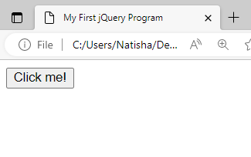
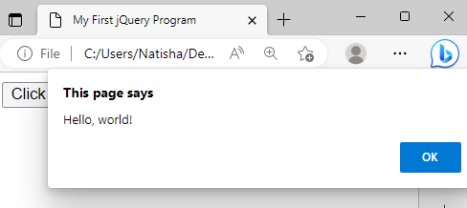
jQuery introduction - $( document ).ready()
we use jQuery to add a click event listener to the button that displays an alert message when clicked.
The $(document).ready() function ensures that the code inside it will only run once the document has finished loading, so that the button element exists and can be selected by its ID.
<html>
<head>
<title>My First jQuery Program</title>
<script src="https://code.jquery.com/jquery-3.6.0.min.js"></script>
</head>
<body>
<button id="myButton">Click me!</button>
<script>
$(document).ready(function() {
$("#myButton").click(function() {
alert("Hello, world!");
});
});
</script>
</body>
</html>

Slide 5
jQuery Selectors
jQuery Selectors
Used to select and manipulate HTML elements.
jQuery selectors are used to "find" (or select) HTML elements based on their name, id, classes, types, attributes, values of attributes and much more.
All selectors in jQuery start with the dollar sign and parentheses: $().
jQuery Selectors:
Element selector: selects all elements with the specified tag name.
For example, $("p") selects all <p> elements.
Class selector: selects all elements with the specified class. For example, $(".my-class") selects all elements with the class my-class.
ID selector: selects the element with the specified ID.
For ex, $("#my-id") selects the element with the ID my-id.
Attribute selector: selects all elements that have the specified attribute.
For example, $("input[type='text']") selects all <input> elements with a type attribute of text.

Slide 6
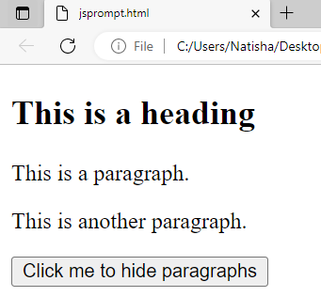
jQuery Selectors
1) The element Selector:
The jQuery element selector selects elements based on the element name.
We can select all <p> elements on a page like this:
$("p" ) .
<html>
<head>
<script src="https://code.jquery.com/jquery-3.6.0.min.js"></script>
<script>
$(document).ready(function(){
$("button").click(function(){
$("p").hide(); //element selector
});
});
</script>
</head>
<body>
<h2>This is a heading</h2>
<p>This is a paragraph.</p>
<p>This is another paragraph.</p>
<button>Click me to hide paragraphs</button>
</body> </html>
Ex.
When a user clicks on a button, all <p> elements will be hidden

Slide 7
jQuery Selectors
2) The #id Selector:
The jQuery #id selector uses the id attribute of an HTML tag to find the specific element.
To find an element with a specific id, write a hash character, followed by the id of the HTML element:
$("#test") .
Ex.
When a user clicks on a button, all <p> elements will be hidden:
<html>
<head>
<script src="https://ajax.googleapis.com/ajax/libs/jquery/3.6.4/jquery.min.js"></script>
<script>
$(document).ready(function(){
$("button").click(function(){
$(“#test").hide(); //id selector
});
});
</script>
</head>
<body>
<h2>This is a heading</h2>
<p>This is a paragraph.</p>
<p id="test">This is another paragraph.</p>
<button>Click me to hide paragraphs</button>
</body> </html>

Slide 8
jQuery Selectors
3) The .class Selector
The jQuery .class selector finds elements with a specific class.
To find elements with a specific class, write a period character, followed by the name of the class:
$(“.test") .
Example
When a user clicks on a button, all <p> elements will be hidden:
<html>
<head>
<script src="https://ajax.googleapis.com/ajax/libs/jquery/3.6.4/jquery.min.js"></script>
<script>
$(document).ready(function(){
$("button").click(function(){
$(“.test").hide();
});
});
</script>
</head>
<body>
<h2 class="test">This is a heading</h2>
<p class="test">This is a paragraph.</p>
<p>This is another paragraph.</p>
<button>Click me to hide paragraphs</button>
</body> </html>

Slide 9
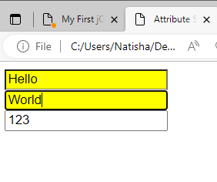
jQuery Selectors
3) Attribute selector
It selects all elements that have the specified attribute.
For example, $("input[type='text']") selects all <input> elements with a type attribute of text.
$("input[type='text’]”) .
select all <input> elements with a type attribute of "text", and apply a CSS style
<!DOCTYPE html>
<html>
<head>
<title>Attribute Selector Example</title>
<script src="https://code.jquery.com/jquery-3.6.0.min.js"></script>
</head>
<body>
<input type="text" value="Hello">
<input type="text" value="World">
<input type="number" value="123">
<script>
$(document).ready(function() {
$("input[type='text']").css("background-color", "yellow");
});
</script>
</body>
</html>

Slide 10
jQuery Events
Events are the actions that can be detected by your web application.
They are used to create dynamic web pages.
An event shows the exact moment when something happens.
These are some examples of events.
A mouse click
An HTML form submission
A web page loading
A keystroke on the keyboard
Scrolling of the web page etc.
Syntax for event methods:
Most of the DOM events have an equivalent jQuery method.
To assign a click events to all paragraph on a page, do this:
$("p").click ();
The next step defines what should happen when the event fires. You must pass a function to the event.
$("p").click(function(){
// action goes here!!
});
Mouse Events | Keyboard Events | Form Events | Document/Window Events
click | keypress | submit | load
dblclick | keydown | change | resize
mouseenter | keyup | focus | scroll
mouseleave |  | blur | unload

Slide 11
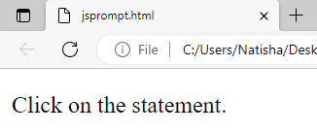
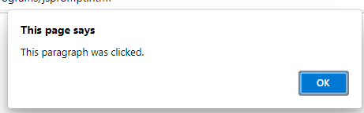
jQuery Events- jQuery click( )
1) jQuery click Event:
When we click on an element, the click event occurs and once the click event occurs it execute the click () method or attaches a function to run.
Syntax:
$(selector).click()
It is used to trigger the click event for the selected elements.
$(selector).click(function)
<html>
<head>
<script src="https://ajax.googleapis.com/ajax/libs/jquery/1.11.2/jquery.min.js"></script>
<script>
$(document).ready(function(){
$("p").click(function(){
alert("This paragraph was clicked.");
});
});
</script>
</head>
<body>
<p>Click on the statement.</p>
</body>
</html>

Slide 12
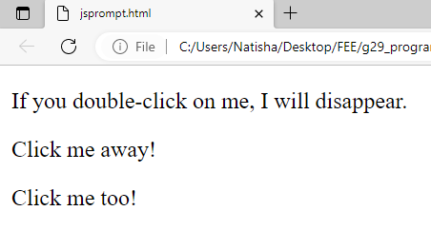
jQuery Events- dblclick()
2) dblclick() event
The dblclick() method attaches an event handler function to an HTML element.
The function is executed when the user double-clicks on the HTML element
<!DOCTYPE html>
<html>
<head>
<script src="https://ajax.googleapis.com/ajax/libs/jquery/3.6.4/jquery.min.js"></script>
<script>
$(document).ready(function(){
$("p").dblclick(function(){
$(this).hide();
});
});
</script>
</head>
<body> <p>If you double-click on me, I will disappear.</p>
<p>Click me away!</p>
<p>Click me too!</p> </body>
</html>

Slide 13
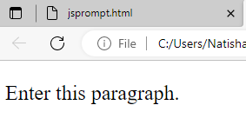
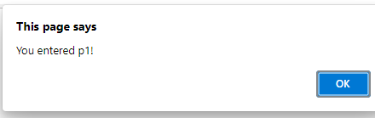
jQuery Events - mouseenter() event
3) mouseenter() event:
The mouseenter() method attaches an event handler function to an HTML element.
The function is executed when the mouse pointer enters the HTML element.
<!DOCTYPE html>
<html>
<head>
<script src="https://ajax.googleapis.com/ajax/libs/jquery/3.6.4/jquery.min.js"></script>
<script>
$(document).ready(function(){
$("#p1").mouseenter(function(){
alert("You entered p1!");
});
});
</script>
</head>
<body>
<p id="p1">Enter this paragraph.</p>
</body>
</html>

Slide 14
jQuery Events - Keydown event
4) keydown() event:
This event is triggered when a key on the keyboard is pressed down.
To handle a keydown event using jQuery, you can use the .keydown() method.
<!DOCTYPE html>
<html>
<head>
<title>Keydown Event Example</title>
<script src="https://code.jquery.com/jquery-3.6.0.min.js"></script>
</head>
<body>
<input type="text" id="myInput">
<script>
$(document).ready(function() {
$("#myInput").keydown(function(){
alert("Enter key pressed!");
});
});
</script>
</body>
</html>
The keydown event to detect when the Enter key is pressed and display an alert:

Slide 15
jQuery Objects
The jQuery object is a collection of DOM elements and behaves like a special array.
Everything in jQuery is an object.
When we create a new element or select an existing element the jQuery returns those elements in a collection.
The syntax of creating jQuery empty object:
var obj = { };
or
The syntax of creating an object using properties
var obj = { property1:value1, property2:value2... propertyN:valueN } ;
or
The syntax of creating an object using selector
var obj = $( "selector" );
Parameters:
property – It specifies the property for the object to assign.
value – It specifies the value to set for the specific property of the object. The property and value are separated by the colon(:) and each property-value pair is separated by the comma(,).
selector – It specifies the element to select to return the object. it can be a single element or multiple elements.
Return value:
The return value of the object is the object if selector element found, else return an empty object if selector element not found.

Slide 16
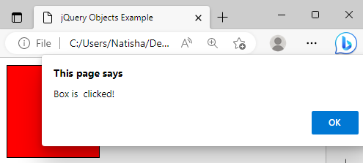
jQuery Objects
The JQuery object can be created as..
var $obj = $(selector);
<script>
$(document).ready(function() {
var $box = $("#box"); // create a jQuery object for the div
$box.css("background-color", "red"); // set its background color to red
$box.click(function() {
alert("Box is clicked!");
}); // attach a click event handler to the div
});
</script>
</body>
</html>
<!DOCTYPE html>
<html>
<head>
<title>jQuery Objects Example</title>
<script src="https://code.jquery.com/jquery-3.6.0.min.js"></script>
<style>
div {
width: 100px;
height: 100px;
border: 1px solid black;
}
</style>
</head>
<body>
<div id="box"></div>

Slide 17
jQuery Objects
var headings = $("h3");
creates a jQuery object that contains all <h3> elements in the HTML document
</style>
</head>
<body>
<h3> This is an Example for jQuery object: </h3>
<h3 id = "h3" > This is a example heading. </h3>
<p > This is a paragraph example. </p>
<button onclick="obj()"> click here to create and display jQuery object </button>
<div id = "div1"> </div>
<div id = "div2"> </div>
<script>
function obj()
{
var headings = $("h3");
// disply the number of h3 tags on the page.
$("#div1").text("The no.of h3 are:"+headings.length);
// Selecting only the first h1 element on the page
$("#div2").text("The first h3 heading is:" +$("h3")[0]);
}
</script>
</body></html>
<html lang = "en">
<head>
<script src = "https://code.jquery.com/jquery-3.5.0.js"></script>
<title > This is an example for jQuery object </title>
<style>
#h3
{
width : 150px;
height : 100px;
border : 2px solid red;
font-size : 20px;
}

Slide 18
jQuery Objects
Example of object with some properties
<body>
<h3> This is an Example for jQuery object: </h3>
<p id = "p1"> </p>
<button onclick = "checkRes()" > Click here to create and display the object and its properties. </button>
<p id = "p2"> </p>
<script>
var obj = { Sub1: "JavaScript", Sub2: "CSS", Sub3: "jQuery", Sub4: "Java" };
function checkRes()
{
$("#p2" ).text( "The object properties are : " +obj.Sub1+ " " +obj.Sub2+ " " +obj.Sub3+ " " +obj.Sub4);
}
</script>
</body>
</html>
<!doctype html>
<html lang = "en">
<head>
<meta charset = "utf-8">
<script src = "https://code.jquery.com/jquery-3.5.0.js"></script>
<title > This is an example for jQuery object </title>
<style>
#p1 {
color : blue;
}
#p2 {
color : red;
background-color : yellow;
}
</style>
</head>

Slide 19
jQuery Objects
Example of object with some properties
<div id="myDiv"></div> <script>
var options = {
backgroundColor: "green",
position: "absolute",
top: "150px",
left: "150px"
};
$("#myDiv").css(options);
options.backgroundColor = "red";
options.top = "200px";
$("#myDiv").css(options);
</script>
</body>
</html>
<!DOCTYPE html>
<html>
<head>
<meta charset="UTF-8">
<title>jQuery Object with Properties Example</title>
<script src="https://code.jquery.com/jquery-3.6.0.min.js"></script>
<style>
#myDiv {
width: 100px;
height: 100px;
border: 1px solid black;
}
</style>
</head>
<body>

