Slide 1
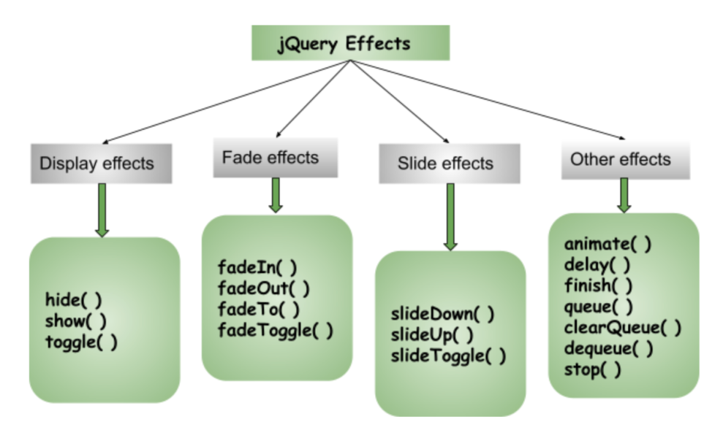
jQuery Effects
Effects are methods that allow you to animate or manipulate elements in various ways, such as changing their visibility, opacity, height, width, and position
Categories:
Display Effects
hide(), show()
Fading Effects
fadeIn(), fadeout(),fadeToggle()
Sliding Effects
slodeDown(), slideUp(), slideToggle()
Other Effects
Animate(), delay(), finish()..

Slide 2
jQuery hide() and show()
With jQuery, you can hide and show HTML elements with the hide() and show() methods:
jQuery hide():
used to hide the selected elements.
Syntax:
$(selector).hide();
$(selector).hide(speed, callback);
$(selector).hide(speed, easing, callback);
jQuery show():
Used to show the selected elements.
Syntax:
$(selector).show();
$(selector).show(speed, callback);
$(selector).show(speed, easing, callback);
<html><head>
<script src="https://ajax.googleapis.com/ajax/libs/jquery/3.6.4/jquery.min.js"></script>
<script>
$(document).ready(function(){
$("#hide").click(function(){
$("p").hide();
});
$("#show").click(function(){
$("p").show();
});
});
</script>
</head>
<body>
<p>If you click on the "Hide" button, I will disappear.</p>
<button id="hide">Hide</button>
<button id="show">Show</button>
</body>
</html>

Slide 3
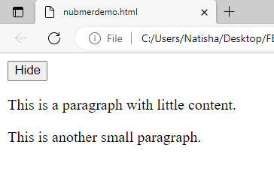
jQuery hide() and show()
The optional speed parameter specifies the speed of the hiding/showing, and can take the following values: "slow", "fast", or milliseconds.
The optional callback parameter is a function to be executed after the hide() or show() method completes
$(selector).hide(speed,callback);
$(selector).show(speed,callback);
<html><head>
<script src="https://ajax.googleapis.com/ajax/libs/jquery/3.6.4/jquery.min.js"></script>
<script>
$(document).ready(function(){
$("#hide").click(function(){
$("p").hide(1000);
});
$("#show").click(function(){
$("p").show();
});
});
</script>
</head>
<body>
<p>If you click on the "Hide" button, I will disappear.</p>
<button id="hide">Hide</button>
<button id="show">Show</button>
</body>
</html>

Slide 4
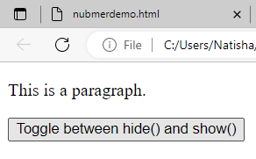
jQuery toggle() Method
toggle()
toggles between hide() and show() for the selected elements.
This method checks the selected elements for visibility. show() is run if an element is hidden. hide() is run if an element is visible - This creates a toggle effect.
<!DOCTYPE html>
<html>
<head>
<script src="https://ajax.googleapis.com/ajax/libs/jquery/3.6.4/jquery.min.js"></script>
<script>
$(document).ready(function(){
$("button").click(function(){
$("p").toggle();
});
});
</script>
</head>
<body> <p>This is a paragraph.</p> <button>Toggle between hide() and show()</button> </body>
</html>

Slide 5
jQuery Effects - Fading
With jQuery you can fade elements in and out of visibility
jQuery fadeIn() Method
It is used to fade in a hidden element.
Syntax:
$(selector).fadeIn(speed);
The optional speed parameter specifies the duration of the effect.
It can take the following values: "slow", "fast", or milliseconds.
</script>
</head>
<body> <p>Demonstrate fadeIn() with different parameters.</p> <button>Click to fade in boxes</button><br><br> <div id="div1" style="width:80px;height:80px;display:none;background-color:red;"></div><br>
<div id="div2" style="width:80px;height:80px;display:none;background-color:green;"></div><br>
<div id="div3" style="width:80px;height:80px;display:none;background-color:blue;"></div>
</body>
</html>
<html> <head> <script src="https://ajax.googleapis.com/ajax/libs/jquery/3.6.4/jquery.min.js"></script> <script>
$(document).ready(function(){
$("button").click(function(){
$("#div1").fadeIn();
$("#div2").fadeIn("slow");
$("#div3").fadeIn(3000);
});
});

Slide 6
jQuery Effects - Fading
fadeOut()
It is used to fade out the element.
Syntax:
$(selector).fadeOut();
$(selector).fadeOut(speed);
</script>
</head>
<body>
<p>See the fadeOut() method example with different parameters.</p>
<button>Click to fade out boxes</button><br><br>
<div id="div1" style="width:80px;height:80px;background-color:red;"></div><br>
<div id="div2" style="width:80px;height:80px;background-color:green;"></div><br>
<div id="div3" style="width:80px;height:80px;background-color:blue;"></div>
</body>
</html>
<html> <head> <script src="https://ajax.googleapis...></script>
<script>
$(document).ready(function(){
$("button").click(function(){
$("#div1").fadeOut();
$("#div2").fadeOut("slow");
$("#div3").fadeOut(3000);
});
});

Slide 7
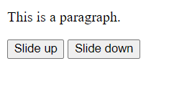
jQuery Effects - Sliding
The jQuery slide methods slide elements up and down.
jQuery slideDown() Method
It is used to slide down an element.
The slideDown() method slides-down (shows) the selected elements.
Syntax:
$(selector).slideDown(speed);
jQuery slideUp() Method
It is used to slide up an element.
The slideUp() method slides-up the selected elements.
$(selector).slideUp(speed);
<html>
<head>
<script src="https://ajax.googleapis.com/ajax/libs/jquery/3.6.4/jquery.min.js"></script>
<script>
$(document).ready(function(){
$(".btn1").click(function(){
$("p").slideUp(1000);
});
$(".btn2").click(function(){
$("p").slideDown(1000);
});
});
</script></head>
<body> <p>This is a paragraph.</p> <button class="btn1">Slide up</button>
<button class="btn2">Slide down</button> </body>
</html>

Slide 8

jQuery Effects - animate()
The jQuery animate() method provides you a way to create custom animations.
It allows us to change the CSS properties of an element over a specified period of time.
The syntax for animate() function : $(selector).animate({styles}, speed, easing, callback)
params →defines the CSS properties to be animated.
speed → specifies the duration of the effect. It can be set as "slow" , "fast" or milliseconds.
The callback→ optional and it is a function which is executed after the animation completes.
<!-- Simple Moving box animation-->
<html>
<head>
<script src="https://code.jquery.com/jquery-3.6.0.min.js"></script>
<script>
$(document).ready(function(){
$("button").click(function(){
$("div").animate({left: '450px'});
});
});
</script>
</head>
<body>
<button>Start Animation</button>
<div style="background:red;height:100px;width:100px;position:absolute;"></div>
</body>
</html>

Slide 9
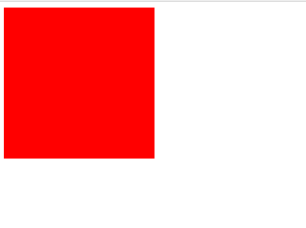

jQuery animate() method using multiple properties
You can use multiple properties to animate at the same time
Animating Width and Height:
<script>
$(document).ready(function(){
$("#element").click(function(){
$(this).animate({
width: '200px',
height: '200px'
}, 1000);
});
});
</script>
</head>
<body>
<div id="element"></div>
</body>
</html>
<html>
<head>
<script src="https://code.jquery.com/jquery-3.6.0.min.js"></script>
<style>
#element {
width: 100px;
height: 100px;
background-color: red;
}
</style>

Slide 10


jQuery animate() method using multiple properties
You can use multiple properties to animate at the same time
Animating Opacity:
</script>
</head>
<body>
<button>Start Animation</button>
<div style="background:#125f21;height:100px;width:100px;position:absolute;"></div>
</body>
</html>
<html>
<head>
<script src="https://code.jquery.com/jquery-3.6.0.min.js">
</script>
<script>
$(document).ready(function(){
$("button").click(function(){
$("div").animate({
left: '250px',
opacity: '0.5',
height: '150px',
width: '150px'
});
});
});

Slide 11
jQuery animate() - Uses Queue Functionality
By default, jQuery comes with queue functionality for animations.
This means that if you write multiple animate() calls after each other, jQuery creates an "internal" queue with these method calls. Then it runs the animate calls ONE by ONE.
div.animate({width: '300px', opacity: '0.8'}, "slow");
div.animate({height: '100px', opacity: '0.4'}, "slow");
div.animate({width: '100px', opacity: '0.8'}, "slow");
});
});
</script>
</head>
<body>
<button>Start Animation</button>
<div style="background:red;height:100px;width:100px;position:absolute;"></div>
</body>
</html>
<!DOCTYPE html>
<html>
<head>
<script src="https://code.jquery.com/jquery-3.6.0.min.js">
</script>
<script>
$(document).ready(function(){
$("button").click(function(){
var div = $("div");
div.animate({height: '300px', opacity: '0.4'}, "slow");

