Slide 1
jQuery & CSS - jQuery Style Methods
jQuery provides several style-related methods that allow you to manipulate and change the appearance of HTML elements.
Method | Description
.css(propertyName, value) | Sets the value of a CSS property for the selected elements.
.addClass(className) | Adds one or more CSS classes to the selected elements.
.height(value) | Gets or sets the height of the selected elements.
.before(content) | Inserts content before the selected elements.
Method | Description
.css(propertyName) | return value of a CSS property for the selected element.
.removeClass(className) | Removes one or more CSS classes from the selected elements.
.width(value) | Gets or sets the width of the selected elements.
.after(content) | Inserts content after the selected elements.

Slide 2
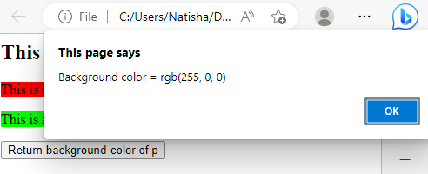
jQuery Style Methods- jQuery - .css() return method
jQuery - css() Method:
It sets or returns one or more style properties for the selected elements.
Return a CSS Property:
To return the value of a specified CSS property, use the following syntax:
css("propertyname");
The following example will return the background-color value of the FIRST matched element
<html><head>
<script src="https://code.jquery.com/jquery-3.6.0.min.js">
</script>
<script>
$(document).ready(function(){
$("button").click(function(){
alert("Background color = " +
$("p").css("background-color") );
});
});
</script> </head>
<body><h2>This is a heading</h2> <p style="background-color:#ff0000">This is a paragraph.</p>
<p style="background-color:#00ff00">This is a paragraph.</p> <button>Return background-color of p</button> </body>
</html>

Slide 3
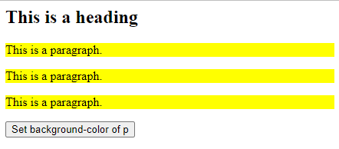
jQuery Style Methods- .css() set method
Set a CSS Property
To set a specified CSS property, use the following syntax:
css("propertyname","value");
The following example will set the background-color value for ALL matched elements:
Ex:
$("p").css("background-color", "yellow");
<html>
<head>
<script src="https://code.jquery.com/jquery-3.6.0.min.js"></script>
</head>
<body>
<h2>This is a heading</h2>
<p style="background-color:#ff0000">This is a paragraph.</p>
<p style="background-color:#00ff00">This is a paragraph.</p>
<p>This is a paragraph.</p>
<button>Set background-color of p</button>
<script>
$(document).ready(function(){
$("button").click(function(){
$("p").css("background-color", "yellow");
})
});
</script>
</body>
</html>

Slide 4
jQuery Style Methods
Set Multiple CSS Properties
To set multiple CSS properties, use the following syntax:
css({"propertyname":"value","propertyname":"value",...});
The following example will set a background-color and a font-size for ALL matched elements:
Ex
$("p").css({"background-color": "yellow", "font-size": "200%"});
<html> <head>
<script src="https://code.jquery.com/jquery-3.6.0.min.js"></script>
<script>
$(document).ready(function(){
$("button").click(function(){
$("p").css({"background-color": "yellow", "font-size": "200%"});
});
});
</script>
</head>
<body> <h2>This is a heading</h2>
<p style="background-color:#ff0000">This is a paragraph.</p>
<p style="background-color:#00ff00">This is a paragraph.</p>
<p>This is a paragraph.</p>
<button>Set multiple styles for p</button>
</body>
</html>

Slide 5
jQuery height( ) and width( ) Methods
jQuery height() Method:
sets or returns the height of the selected elements.
$(selector).height() → returns height
When it is used to return height, it returns the height of the FIRST matched element.
$(selector).height(value) → sets the height
When it is used to set height, it sets the height of ALL matched elements.
jQuery width() Method:
The width() method sets or returns the width of the selected elements.
$(selector).width() → returns width
When it is used to return width, it returns the width of the FIRST matched element.
$(selector).width(value) → sets the widths
When it is used to set width, it sets the width of ALL matched elements.
<html> <head>
<script <script src="https://code.jquery.com/jquery-3.6.0.min.js"></script>
<script>
$(document).ready(function(){
$("button").click(function(){
alert("Height and width of div " + $("div").height()+ " "+$("div").width());
});
});
</script>
</head>
<body> <div style="height:100px;width:200px;border:1px solid blue;"></div><br>
<button>Display the height of div</button>
</body>
</html>

Slide 6
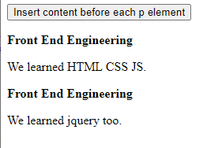
jQuery before() method
jQuery before() method
It is used to insert the specified content before the selected elements.
It adds the content specified by the parameter, before each element in the set of matched elements
Syntax:
$(selector).before(content, function(index))
<!DOCTYPE html>
<html>
<head>
<script src="https://code.jquery.com/jquery-3.6.0.min.js"></script>
<script>
$(document).ready(function(){
$("button").click(function(){
$("p").before("<p><b>Front End Engineering</b></p>");
});
});
</script>
</head>
<body>
<button>Insert content before each p element</button>
<p>We learned HTML CSS JS.</p>
<p>We learned jquery too.</p>
</body>
</html>
Content It is a mandatory parameter. It specifies the content to insert.
Function (index) It specifies a function that returns the content which is used to insert.
Index: It provides the index position of the element in the set.

Slide 7
jQuery after() Method
jQuery after() Method
It is used to insert the specified content after the selected elements.
It adds the content specified by the parameter, after each element in the set of matched elements
Syntax:
$(selector).after(content, function(index))
<!DOCTYPE html>
<html>
<head>
<script src="https://code.jquery.com/jquery-3.6.0.min.js"></script>
<script>
$(document).ready(function(){
$("button").click(function(){
$("p").after("<p><b>Front End Engineering</b></p>");
});
});
</script>
</head>
<body>
<button>Insert content before each p element</button>
<p>We learned HTML CSS JS.</p>
<p>We learned jquery too.</p>
</body>
</html>
Content It is a mandatory parameter. It specifies the content to insert.
Function (index) It specifies a function that returns the content which is used to insert.
Index: It provides the index position of the element in the set.

Slide 8
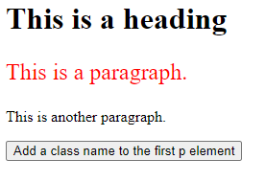
jQuery addClass() Method
addClass() method
It adds one or more class names to the selected elements.
It does not remove existing class attributes, it only adds one or more class names to the class attribute.
To add more than one class, separate the class names with spaces
Syntax
$(selector).addClass(classname,function(index,currentclass))
<html> <head>
<script <script src="https://code.jquery.com/jquery-3.6.0.min.js"></script>
<script>
$(document).ready(function(){
$("button").click(function(){
$("p:first").addClass("intro");
});
});
</script>
<style>
.intro {
font-size: 150%; color: red;
}
</style> </head>
<body> <h1>This is a heading</h1> <p>This is a paragraph.</p>
<p>This is another paragraph.</p> <button>Add a class name to the first p element</button> </body></html>

Slide 9
jQuery removeClass() Method
removeClass() method
removes one or more class names from the selected elements.
If no parameter is specified, this method will remove ALL class names from the selected elements.
Syntax
$(selector).removeClass(classname,function(index,currentclass))
</script>
<style>
.intro {
font-size: 120%;
color: red;
}
</style>
</head>
<body>
<h1>This is a heading</h1>
<p class="intro">This is a paragraph.</p>
<p class="intro">This is another paragraph.</p>
<button>Remove the "intro" class from all p elements</button>
</body>
</html>
<html>
<head>
<script src="https://code.jquery.com/jquery-3.6.0.min.js"></script>
<script>
$(document).ready(function(){
$("button").click(function(){
$("p").removeClass("intro");
});
});

Slide 10
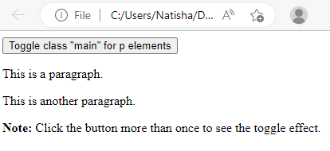
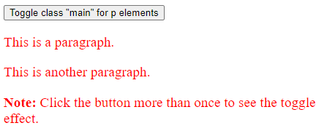
jQuery toggleClass() Method
toggleClass() method
toggles between adding and removing one or more class names from the selected elements.
This method checks each element for the specified class names.
The class names are added if missing, and removed if already set - This creates a toggle effect.
<html><head>
<script src="https://code.jquery.com/jquery-3.6.0.min.js"></script>
<script>
$(document).ready(function(){
$("button").click(function(){
$("p").toggleClass("main");
});
});
</script><style>
.main {
font-size: 120%; color: red;
}
</style> </head>
<body> <button>Toggle class "main" for p elements</button> <p>This is a paragraph.</p>
<p>This is another paragraph.</p>
<p><b>Note:</b> Click the button more than once to see the toggle effect.</p> </body></html>

Slide 11
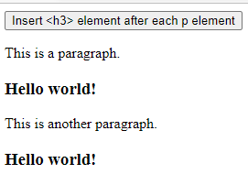
jQuery insertAfter() Method
jQuery insertAfter() Method
The insertAfter() method inserts HTML elements after the selected elements.
$(content).insertAfter(selector)
<!DOCTYPE html>
<html>
<head>
<script src="https://code.jquery.com/jquery-3.6.0.min.js"></script>
<script>
$(document).ready(function(){
$("button").click(function(){
$("<h3>Hello world!</h3>").insertAfter("p");
});
});
</script>
</head>
<body>
<button>Insert &lth3&gt element after each p element</button>
<p>This is a paragraph.</p>
<p>This is another paragraph.</p>
</body>
</html>

Slide 12
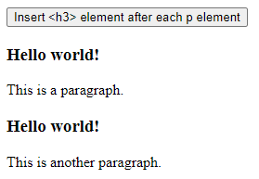
jQuery insertBefore() Method
jQuery insertBefore() Method
The insertAfter() method inserts HTML elements after the selected elements.
$(content).insertBefore(selector)
<!DOCTYPE html>
<html>
<head>
<script src="https://code.jquery.com/jquery-3.6.0.min.js"></script>
<script>
$(document).ready(function(){
$("button").click(function(){
$("<h3>Hello world!</h3>").insertBefore("p");
});
});
</script>
</head>
<body>
<button>Insert &lth3&gt element after each p element</button>
<p>This is a paragraph.</p>
<p>This is another paragraph.</p>
</body>
</html>

Slide 13
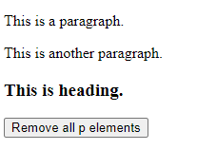
jQuery remove() Method
jQuery remove() Method
The remove() method removes the selected elements, including all text and child nodes.
This method also removes data and events of the selected elements.
To remove the elements without removing data and events, use the detach() method instead.
To remove only the content from the selected elements, use the empty() method.
$(selector).remove(selector)
<html>
<head>
<script src="https://code.jquery.com/jquery-3.6.0.min.js"></script>
<script>
$(document).ready(function(){
$("button").click(function(){
$("p").remove();
});
});
</script>
</head>
<body>
<p>This is a paragraph.</p>
<p>This is another paragraph.</p>
<h3>This is heading.</h3>
<button>Remove all p elements</button> </body>
</html>

Slide 14
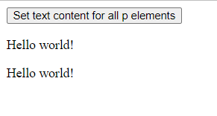
jQuery text() Method
jQuery text() Method
sets or returns the text content of the selected elements.
When this method is used to return content, it returns the text content of all matched elements (HTML markup will be removed).
When this method is used to set content, it overwrites the content of ALL matched elements.
$(selector).text()
<!DOCTYPE html>
<html>
<head>
<script src="https://code.jquery.com/jquery-3.6.0.min.js"></script>
<script>
$(document).ready(function(){
$("button").click(function(){
$("p").text("Hello world!");
});
});
</script></head>
<body> <button>Set text content for all p elements</button> <p>This is a paragraph.</p>
<p>This is another paragraph.</p> </body>
</html>

