Slide 1
DOM and jQuery
The DOM (Document Object Model)
It is a programming interface for HTML documents.
Represents the document(page) as set of objects; that way, programming languages can interact with the page.
Why DOM is required?
The JS can not understand the HTML document directly. So, a corresponding document is created(DOM).
DOM is basically the representation of the same HTML document but in a different format with the use of objects.
Javascript interprets DOM easily
i.e <h1> →DOM→ h1 object
JS can access each of the objects (h1, p, etc) by using different functions
HTML represents Elements
------------------------------------------------
<html> element
<h3> element
DOM represents Objects
------------------------------------------------
document object
h3 object
JavaScript use Objects, methods, properties for adding programming
------------------------------------------------
document.getElementById()
h3

Slide 2

The DOM as a Tree Structure
When a web page is loaded, the browser creates a Document Object Model of the page.
The DOM model is constructed as a tree of Objects:
<html>
<head>
<title> My title</title>
</head>
<body>
<a href=“abc.html> My link</a>
<h1> My Header</h1>
</body>
</html>
Html document
DOM Tree

Slide 3
The document keyword
DOM is a standard object model and programming interface for HTML.
It defines:
The HTML elements as objects
The properties of all HTML elements
The methods to access all HTML elements
The events for all HTML elements
i.e The HTML DOM is a standard for how to get, change, add, or delete HTML elements.
The document object represents the web page.
To access any element in an HTML page, always start with accessing the document object.
Below are some examples of how you can use the document object to access and manipulate HTML.
1) Finding HTML Elements (Selecgting an HTML Element)
Method | Description
document.getElementById(id) | Find an element by element id
document.getElementsByTagName(name) | Find elements by tag name
document.getElementsByClassName(name) | Find elements by class name

Slide 4
The document keyword
2) Changing HTML Elements (Modifying HTML Elements)
Property | Description
element.innerHTML = new html content | Change the inner HTML of an element
element.attribute = new value | Change the attribute value of an HTML element
element.style.property = new style | Change the style of an HTML element
Method | Description
element.setAttribute(attribute, value) | Change the attribute value of an HTML element
3) Adding and Deleting Elements
Method | Description
document.createElement(element) | Create an HTML element
document.removeChild(element) | Remove an HTML element
document.appendChild(element) | Add an HTML element
document.replaceChild(new, old) | Replace an HTML element
document.write(text) | Write into the HTML output stream

Slide 5
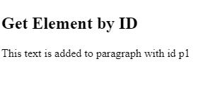
Selecting Elements
1) Finding HTML Element by Id:
getElementById() method is used to find an element by its ID
The easiest way to find an HTML element in the DOM, is by using the element id
var el = document.getElementById("intro");
If the element is found, the method will return the element as an object (el).
If the element is not found, el will contain null.
The below example to find the <p> element with id=“p1"
<!DOCTYPE html>
<html>
<body> <h2>Get Element by ID</h2> <p id="p1"> </p> <script>
document.getElementById("p1").innerHTML ="This text is added to paragraph with id p1";
</script> </body>
</html>

Slide 6
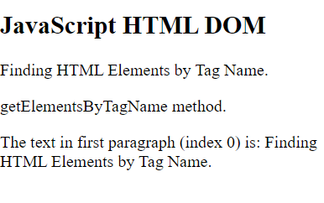
Selecting Elements
2) Finding HTML Element by Tag Name
getElementsByTagName("p");
find an HTML element in the DOM, is by using the Tag Name
var x = document.getElementsByTagName("p");
If the element is found, the method will return the element as an object (in x).
If the element is not found, x will contain null.
<!DOCTYPE html>
<html>
<body>
<h2>JavaScript HTML DOM</h2>
<p>Finding HTML Elements by Tag Name.</p>
<p>getElementsByTagName method.</p>
<p id="demo"></p>
<script>
const element = document.getElementsByTagName("p");
document.getElementById("demo").innerHTML = 'The text in first paragraph (index 0) is: ' + element[0].innerHTML;
</script>
</body>
</html>

Slide 7
Modify Elements (changing HTML Content)
i) Changing HTML Content using innerHTML
The easiest way to modify the content of an HTML element is by using the innerHTML property.
To change the content of an HTML element, use this syntax:
document.getElementById(“id”).innerHTML = new HTML
Changing Text of element using innerText
To change only the text content of an HTML element, we can use innerText
document.getElementById(“id”).innerText=“new text”
<html> <body> <p id="p1">Paragraph1</p>
<p id="p2">Paragraph2</p> <script> document.getElementById("p1").innerHTML="New text!";
document.getElementById("p2").innerText="New text!"; </script> </body> </html>

Slide 8
Modify Elements (changing HTML Content)
2) Changing the Value of an Attribute
getElementById(id).attribute
To change the value of an HTML attribute, use this syntax:
document.getElementById(id).attribute = new value
<!–-changing attribute value-- >
<html>
<head>
<script src="https://code.jquery.com/jquery-3.6.0.min.js"></script>
</head>
<body>
<img id="myImage" src="flower1.jpg">
<button>Click here Change floer</button>
<script>
$(document).ready(function(){
$("button").click(function(){
document.getElementById("myImage").src="flower2.jpg";
})
})
</script>
</body>
</html>

Slide 9
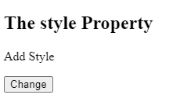
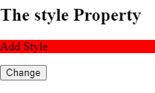
Style an element
Changing HTML Style (Changing CSS)
The HTML DOM allows JavaScript to change the style of HTML elements.
The style property sets the values of an element's style attribute.
Syntax:
document.getElementById(id).style.property = new style
Ex. element.style.backgroundColor = "red";
<!-- Adding style (JS)-->
<html>
<body>
<h1 id="myH1">The Element Object</h1>
<h2>The style Property</h2>
<p id="p1">Add Style</p>
<button onclick="myFunction()">Change</button>
<script>
function myFunction() {
document.getElementById("p1").style.backgroundColor = "red";
}
</script>
</body>
</html>

Slide 10
Creating and insert elements
createElement() and appendElement():
The createElement() method creates a new node (element).
The appendChild() method appends a node (element) as the last child of an element.
<script>
function myFunction()
{
// Create an "li" node:
const node = document.createElement("li");
// Create a text node:
const textnode = document.createTextNode("Water");
// Append the text node to the "li" node:
node.appendChild(textnode);
// Append the "li" node to the list:
document.getElementById("myList").appendChild(node);
}
</script> </body>
</html>
<html>
<body>
<h1>Creating and appending Element</h1>
<ul id="myList">
<li>Coffee</li>
<li>Tea</li>
</ul>
<p>Click "Append" to append an item to the end of the list:</p>
<button onclick="myFunction()">Append</button>

Slide 11
Create a New Element Using jQuery
Create a New Element Using jQuery
Like most jQuery operations, creating an element starts with the dollar function, $( ).
syntax: $(“element")
Ex. $("<a>")
var newimg = $("<img>");
Set Attributes on a New Element:
$("<img>", { src: “flower1.jpg});
<html>
<head>
<script src="https://code.jquery.com/jquery-3.6.0.min.js"></script>
<script>
$(document).ready(function() {
// Create a new <div> element
var newDiv = $("<div>");
// Set some properties for the new element
newDiv.text("This is a new element created using jQuery");
newDiv.css("background-color", "yellow");
// Append the new element to the body of the document
$("body").append(newDiv);
});
</script>
</head>
<body>
<h1>Example Program: Create Element Using jQuery</h1>
</body>
</html>

Slide 12
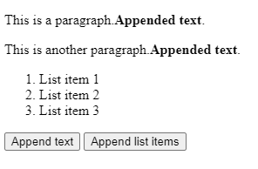
jQuery append() Method
The jQuery append() method inserts content AT THE END of the selected HTML elements.
<p>This is a paragraph.</p>
<p>This is another paragraph.</p> <ol>
<li>List item 1</li>
<li>List item 2</li>
<li>List item 3</li>
</ol> <button id="btn1">Append text</button>
<button id="btn2">Append list items</button> </body>
</html>
<html><head>
<script src="https://code.jquery.com/jquery-3.6.0.min.js"></script>
<script>
$(document).ready(function(){
$("#btn1").click(function(){
$("p").append("<b>Appended text</b>.");
});
$("#btn2").click(function(){
$("ol").append("<li>Appended item</li>");
});
});
</script>
</head>
<body>

Slide 13
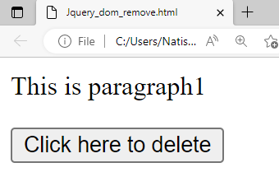
HTML DOM Element remove()
The remove() method removes an element
(or node) from the document.
<!--removing element -->
<html lang="en">
<head>
<script src="https://code.jquery.com/jquery-3.6.0.min.js"></script>
</head>
<body>
<p id="p1">This is paragraph1</p>
<button> Click here to delete</button>
<script>
$(document).ready(function(){
$("button").click(function(){
document.getElementById("p1").remove();
})
})
</script>
</body>
</html>

Slide 14
jQuery - Remove an Element
The jQuery remove() method removes the selected element(s) and its child elements.
<!DOCTYPE html>
<html>
<head>
<script src="https://ajax.googleapis.com/ajax/libs/jquery/3.6.4/jquery.min.js"></script>
<script>
$(document).ready(function(){
$("button").click(function(){
$("#div1").remove();
});
});
</script>
</head>
<body>
<div id="div1" style="height:100px;width:300px;border:1px solid black;background-color:yellow;">
This is some text in the div.
<p>This is a paragraph in the div.</p>
<p>This is another paragraph in the div.</p>
</div>
<br>
<button>Remove div element</button>
</body>
</html>

Slide 15
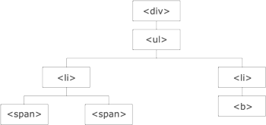
Traversing the DOM
DOM traversing refers to the process of navigating through the Document Object Model (DOM) tree structure to access and manipulate elements.
Start with one selection and move through that selection until you reach the elements you desire.
There are several methods and properties available for traversing the DOM.
The <div> element is parent of <ul>, and an ancestor of everything inside of it
The <ul> is the parent of both <li> elements, and a child of <div>
<li> element is the parent of <span>, child of <ul> and a descendant of <div>
The <span> element is a child of the left <li> and a descendant of <ul> and <div>
The two <li> elements are siblings (they share the same parent)

Slide 16
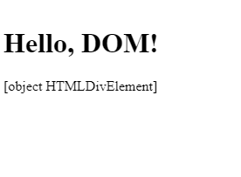
Traversing the DOM
1) parentNode: This property returns the parent node of the current node.
Ex.
var parent = element.parentNode;
<!DOCTYPE html>
<html>
<head>
<title>parentNode Example</title>
</head>
<body>
<div>
<h1 id="myElement">Hello, DOM!</h1>
</div>
<script>
var element = document.getElementById("myElement");
var parent = element.parentNode;
document.writeln(parent);
</script>
</body>
</html>

Slide 17
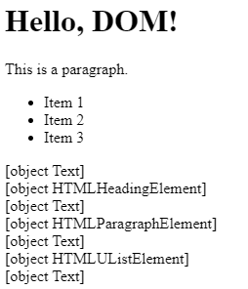
Traversing the DOM
2) childNodes: This property returns a collection of all child nodes of the current node.
Ex.
var children = element.childNodes;
<script>
var element = document.getElementById("myElement");
var children = element.childNodes;
for (var i = 0; i < children.length; i++) {
document.writeln(children[i]+"<br>");
}
</script>
</body>
</html>
<html>
<head>
<title>childNodes Example</title>
</head>
<body>
<div id="myElement">
<h1>Hello, DOM!</h1>
<p>This is a paragraph.</p>
<ul>
<li>Item 1</li>
<li>Item 2</li>
<li>Item 3</li>
</ul>
</div>

Slide 18
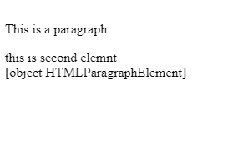
Traversing the DOM
3) firstChild: This property returns first child of the current node.
Ex.
var children = element. firstChild;
<!DOCTYPE html>
<html>
<head>
<title>firstChild Example</title>
</head>
<body>
<div id="myElement"><p>This is a paragraph.</p>
<span>this is second element</span>
</div>
<script>
var element = document.getElementById("myElement");
var firstChild = element.firstChild;
document.writeln(firstChild);
</script>
</body>
</html

Slide 19
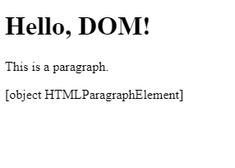
Traversing the DOM
4) latChild: This property returns last child of the current node.
Ex.
var children = element. latChild;
<!DOCTYPE html>
<html>
<head>
<title>lastChild Example</title>
</head>
<body>
<div id="myElement">
<h1>Hello, DOM!</h1>
<p/>This is a paragraph.
</div>
<script>
var ele=document.getElementById("myElement");
var lastChild = ele.lastChild;
document.writeln(lastChild);
</script>
</body>
</html>

Slide 20
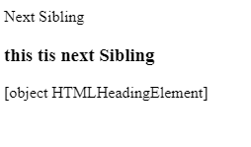
Traversing the DOM
5) nextSibling:: This property returns the next sibling node of the current node.
Ex.
var nextSibling = element.nextSibling;;
<html>
<body>
<p id="myElement"/>Next Sibling
<h3> this tis next Sibling</h3>
<script>
var ele=document.getElementById("myElement");
var nextSibling = ele.nextSibling;
document.writeln(nextSibling);
</script>
</body></html>

Slide 21
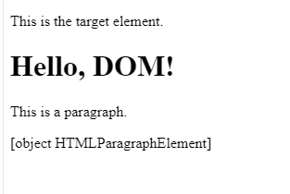
Traversing the DOM
6)previousSibling: This property returns the previous sibling node of the current node.
Ex.
var prevSibling = element.previousSibling;
<html>
<body>
<p>This is the target element.</p> (don’t use space)
<div id="myElement">
<h1>Hello, DOM!</h1>
<p>This is a paragraph.</p>
</div>
<script>
var ele = document.getElementById("myElement");
var prevSibling = ele.previousSibling;
document.writeln(prevSibling);
</script>
</body>
</html>

Slide 22
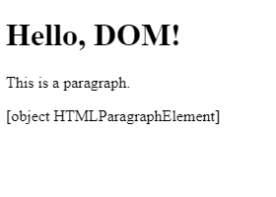
Traversing the DOM
7) querySelector: This method returns the first element that matches a specified CSS selector within the current node
Ex.
var matchingEl= element.querySelector(selector);
<html>
<body>
<div id="myElement">
<h1>Hello, DOM!</h1>
<p class="myClass">This is a paragraph.</p>
</div>
<script>
var ele = document.getElementById("myElement");
var matchingEl = ele.querySelector(".myClass");
document.writeln(matchingEl);
</script>
</body>
</html>

Slide 23
Traversing the DOM
8) querySelectorAll: This method returns a collection of all elements that match a specified CSS selector within the current node.
i.e. returns the matching elements
Ex.
var me = element.querySelectorAll(selector);
<script>
var ele= document.getElementById("myElement");
var me = ele.querySelectorAll("li");
for (var i = 0; i < me.length; i++) {
document.writeln(me[i]);
}
</script>
</body>
</html>
(me=matching elements)
<html> <body>
<div id="myElement">
<h1>Hello, DOM!</h1>
<p class="myClass">This is a paragraph.</p>
<ul>
<li>Item 1</li>
<li>Item 2</li>
<li>Item 3</li>
</ul>
</div>

Slide 24
Traversing the DOM- jQuery Traversing Methods
Traversing the DOM:
jQuery provides a variety of methods that allow us to traverse the DOM.
The largest category of traversal methods are tree-traversal
parent() → gives parent element of specified selector
Syntax:
$(selector).parent();
parents()→ it gives all ancestor elements of the specified selector.
Syntax:
$(selector).parents();
)
parentsUntil()→ it gives all ancestor elements between specified selector and arguments.
Syntax:
$(selector).parentsUntil(selector, filter element)
offsetParent()→it gives the first positioned parent element of specified selector.
Syntax:
$(selector).offsetParent();
closest()→it gives the first ancestor of the specified selector.
Syntax:
$(selector).closest(selector);
$(selector).closest(element);

Slide 25

Traversing the DOM- jQuery Traversing Methods
jQuery parent() Method:
It returns the direct parent element of the selected element.
DOM tree: This method only traverse a single level up the DOM tree.
// Change the background color of the parent element
parentElement.css("background-color", "yellow");
});
});
</script>
<style>
#parent {
background-color: lightblue;
padding: 20px;
}
</style>
</head>
<body>
<div id="parent">
<button id="child">Click me</button>
</div>
</body>
</html>
<html>
<head>
<title>jQuery parent() Method Example</title>
<script src="https://code.jquery.com/jquery-3.6.0.min.js"></script>
<script>
$(document).ready(function() {
// Add a click event handler to the button
$("#child").click(function() {
// Get the parent element of the button
var parentElement = $(this).parent();

Slide 26
Traversing the DOM- jQuery Traversing Methods
Descendants:
children() →gives the children of each selected elements, optionally filtered by a selector.
Syntax:
$(selector).children(); .
find()→
it gives descendant elements of specified elements, filtered by a selector, jQuery object, or element.
Syntax:
$(selector).find('selector to find');
siblings()→ it gives all siblings of the specified selector.
Syntax:
$(selector).siblings(); .
next()→ it gives the next sibling element of the specified selector.
$(selector).next(); .
prev()→it gives the previous sibling element of the specified selector.
Syntax:
$(selector).prev(selector);
$(selector).prev()
Siblings:
prevAll() → it gives all previous sibling elements of the specified selector.
Syntax:
$(selector).prevAll(selector, filter element)

Slide 27
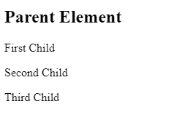
jQuery children() Method
jQuery children() Method:
The children() method returns all direct children of the selected element.
// Use the children() to select all direct child paragraphs
var childElements= parentElement.children('p');
// Add a CSS class to the child elements
childElements.addClass('highlight’);
});
</script>
</head>
<body>
<div id="parent">
<h2>Parent Element</h2>
<p>First Child</p>
<p>Second Child</p>
<p>Third Child</p>
</div>
</body>
</html>
<html>
<head>
<style>
.highlight {
background-color: yellow;
}
</style>
<script src="https://code.jquery.com/jquery-3.6.0.min.js"></script>
<script>
$(document).ready(function() {
// Select the parent element
var parentElement = $('#parent');

Slide 28
jQuery siblings() Method
jQuery siblings() Method:
returns all siblings() of the selected element.
$(document).ready(function() {
// Select an element
var element = $('#target');
// Use the siblings() to select all sibling elements
var sib = element.siblings();
// Add a CSS class to the sibling elements
sib.addClass('highlight');
});
</script>
</head>
<body>
<h2>Parent Element</h2>
<p>Sibling 1</p>
<p id="target">Target Element</p>
<p>Sibling 2</p>
</body>
</html>
<html>
<head>
<title>jQuery siblings() Method Example</title>
<style>
.highlight
{
color: red;
}
</style>
<script src="https://code.jquery.com/jquery-3.6.0.min.js"></script>
<script>

Slide 29
Traversing the DOM- jQuery Traversing Methods
Filtering
first() → it gives the first element of the specified selector.
Syntax:
$(selector).first();
last() → it gives the last element of the specified selector.
Syntax:
$(selector).last();
filter()→it remove/detect an elements that are matched with specified selector.
Syntax:
$(selector).filter(selector)
has()→ it gives all elements that have one or more elements within, that are matched with specified selector.
Syntax:
$(selector).has(selector);
slice() →it selects a subset of specified selector based on its argument index or by start and stop value.
Syntax:
$(selector).slice(start, end );

Slide 30
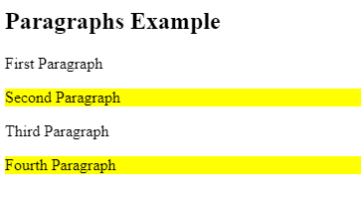
jQuery filter() Method
jQuery filter() Method:
It is used to narrow down the set of matched elements based on a specific criteria
</head>
<body>
<h2>Paragraphs Example</h2>
<p>First Paragraph</p>
<p class="special">Second Paragraph</p>
<p>Third Paragraph</p>
<p class="special">Fourth Paragraph</p>
</body>
</html>
<html> <head>
<style>
.highlight {
background-color: yellow;
}
</style>
<script src="https://code.jquery.com/jquery-3.6.0.min.js"></script>
<script>
$(document).ready(function() {
// Select all paragraphs
var para = $('p');
// Use filter() to select paragraphs with a class special
var fe = para.filter('.special'); // Add a CSS class to the filtered elements
fe.addClass('highlight');
}); </script>

Slide 31
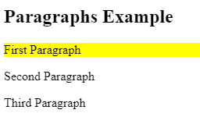
jQuery first() Method
jQuery first() Method:
it gives the first element of the specified selector.
first() method on $('p') to select the first p element and store it in the first Paragraph variable.
// Add a CSS class to the first paragraph
fp.addClass('highlight');
});
</script>
</head>
<body>
<h2>Paragraphs Example</h2>
<p>First Paragraph</p>
<p>Second Paragraph</p>
<p>Third Paragraph</p>
</body>
</html>
<html>
<head>
<title>jQuery first() Method Example</title>
<style>
.highlight {
background-color: yellow;
}
</style>
<script src="https://code.jquery.com/jquery-3.6.0.min.js"></script>
<script>
$(document).ready(function() {
// Select the first paragraph
var fp = $('p').first()

Slide 32
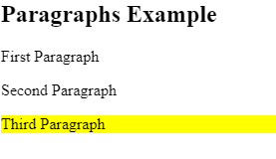
jQuery last() Method
jQuery last() Method:
it gives the last element of the specified selector.
last() method on $('p') to select the last p element and store it in the last Paragraph variable.
// Add a CSS class to the last paragraph
lp.addClass('highlight');
});
</script>
</head>
<body>
<h2>Paragraphs Example</h2>
<p>First Paragraph</p>
<p>Second Paragraph</p>
<p>Third Paragraph</p>
</body>
</html>
<html>
<head>
<title>jQuery last() Method Example</title>
<style>
.highlight {
background-color: yellow;
}
</style>
<script src="https://code.jquery.com/jquery-3.6.0.min.js"></script>
<script>
$(document).ready(function() {
// Select the last paragraph
var lp = $('p').last();

