Slide 1



FRONT END ENGINEERING
- Ch.Naveen Kumar Reddy,

Slide 2
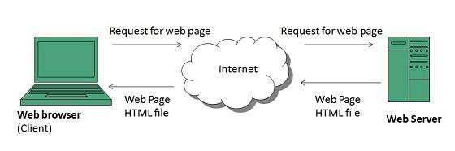
Web Application
What can we do on web?
We rely on different websites/web apps for different tasks.
  Submitting online application
  Banking transactions
  Purchasing of goods
  Watching movies .etc
A web page contain texts, images, graphics, sounds animations etc.
Web pages are developed in HTML

Slide 3
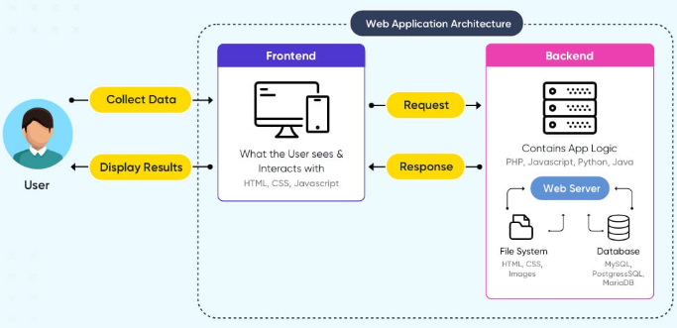
Web Application Architecture

Slide 4
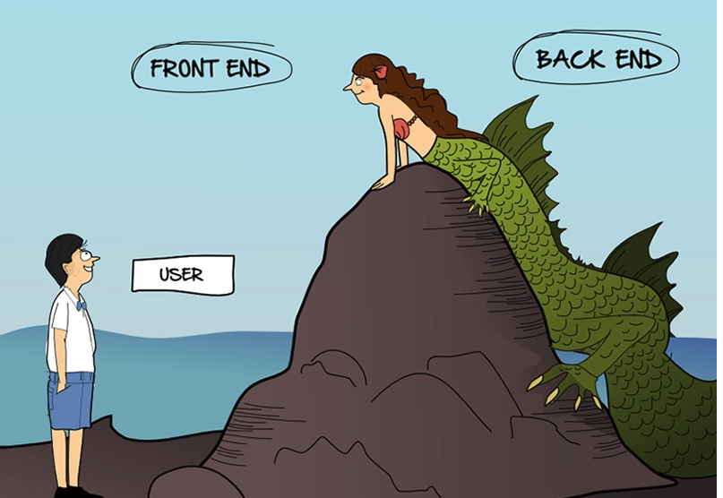

Slide 5
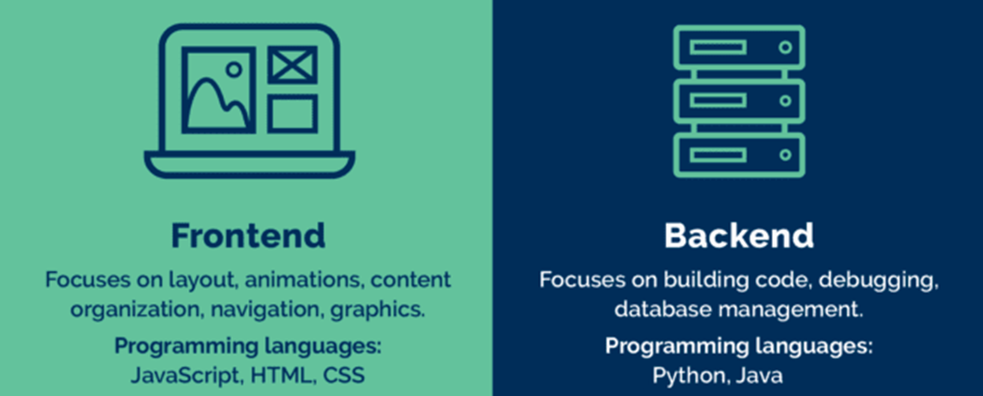
Front end vs. back end
Front end development is programming which focuses on the visual elements used to see on client side
Back-end ensure the website performs correctly, focusing on organization of data, logic, application programming interface (APIs)

Slide 6


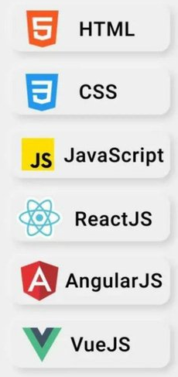


Slide 7
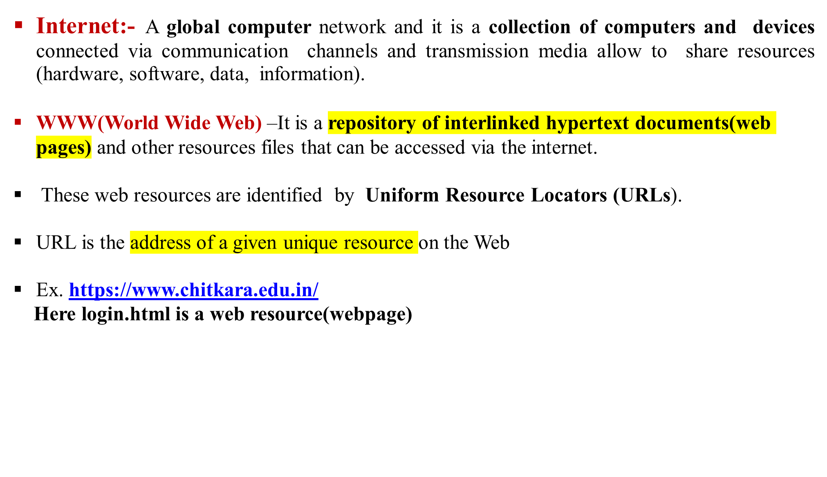
Internet and Web(WWW)

Slide 8
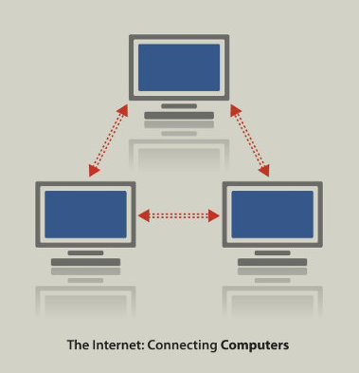
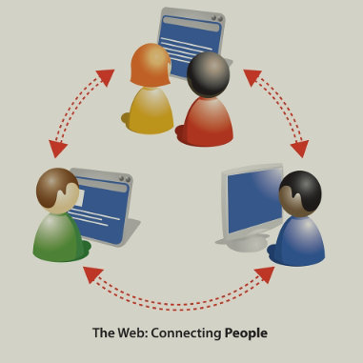
Difference between Internet and World Wide Web
Internet | WWW
 | It is a repository of Common resoucres
Nature of Internet is hardware. | Nature of www is software.
Internet consists of computers, routers, cables, bridges, servers, cellular towers, satellites etc | www consists of information like text, images, audio, video
Internet works on the basis of Internet Protocol (IP) | WWW works on the basis of Hyper Text Transfer Protocol (HTTP)
Computing devices are identified by IP Addresses | Information pieces are identified by Uniform Resource Locator (URL)
It is a network of network
Network connecting
computers
Connects
users/ resources
over internet

Slide 9
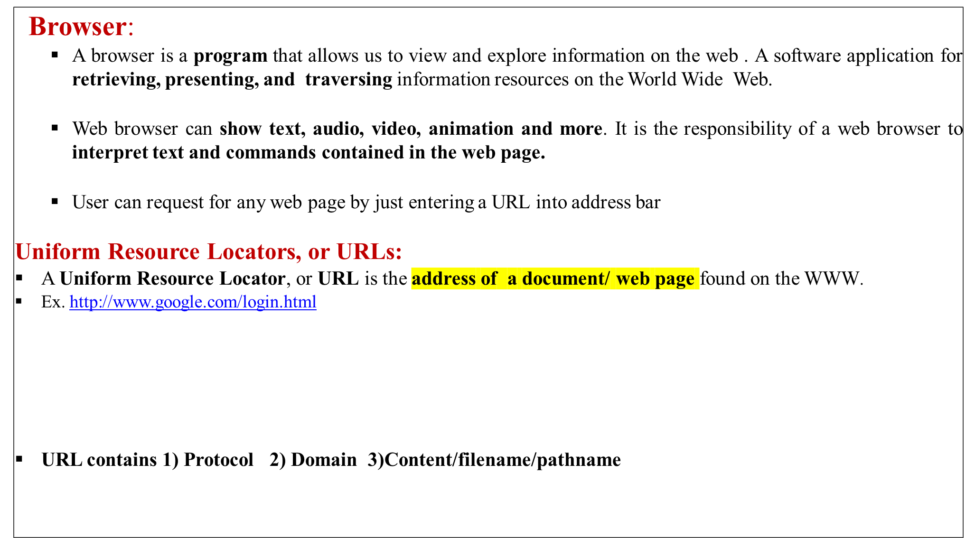

Domain Name

Slide 10
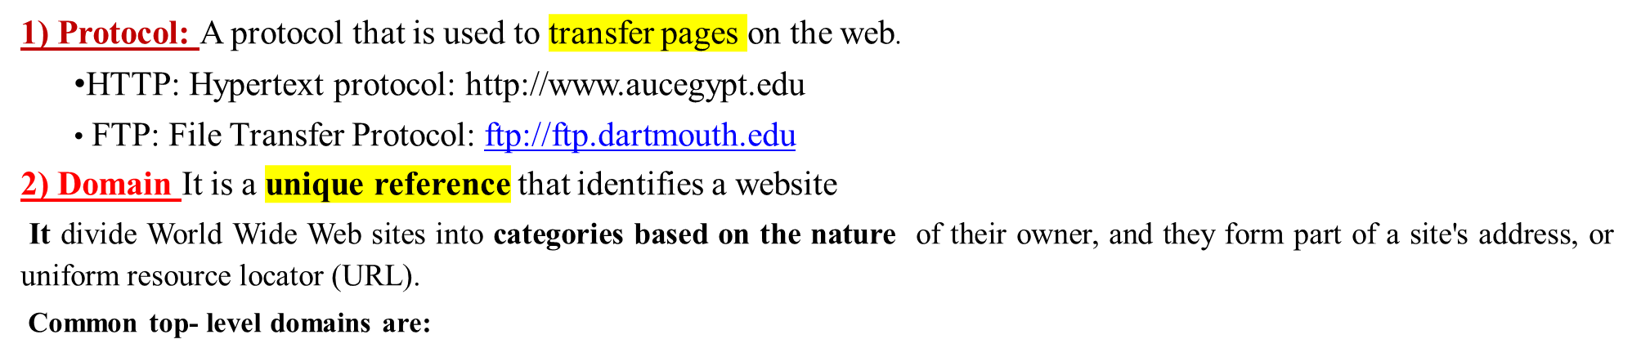
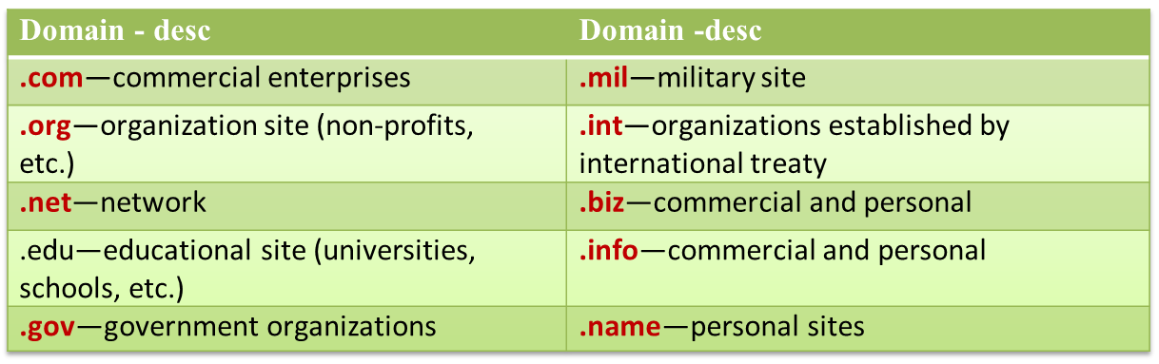
Each country linked to the Web has a two- letter top- level domain,
for example .fr is France, .ie is Ireland.
3) File name or path name: The name of the document file requested.

Slide 11
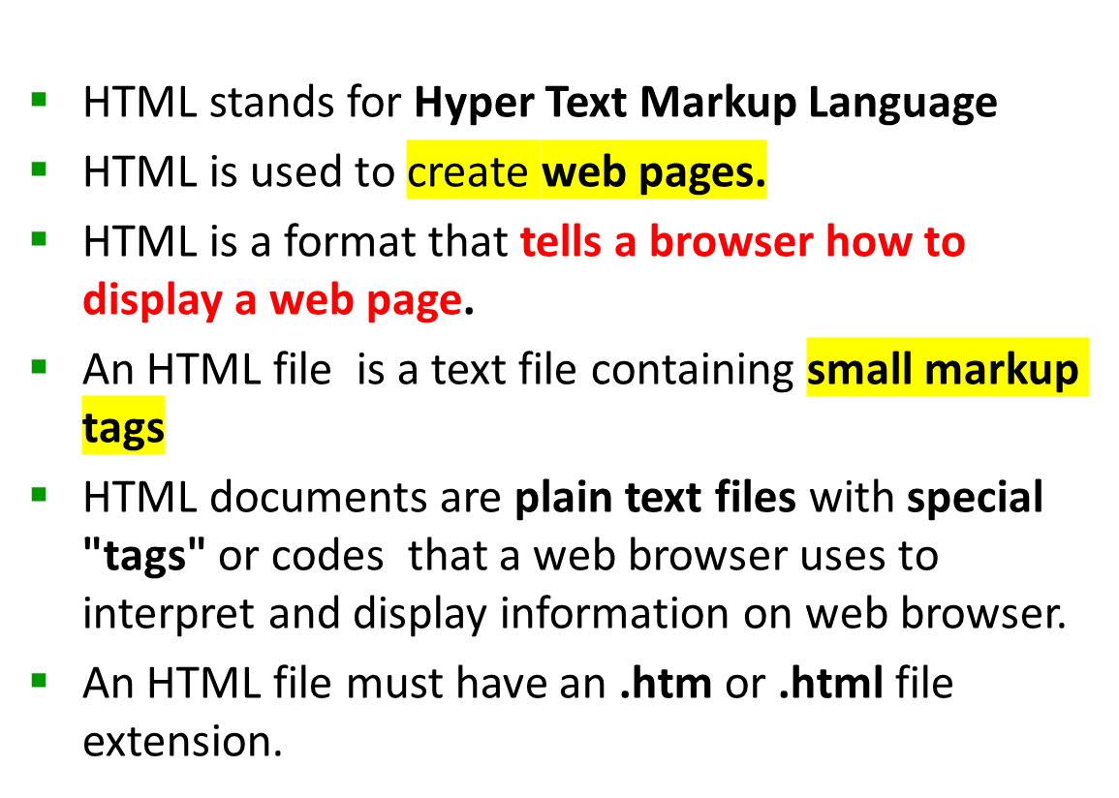
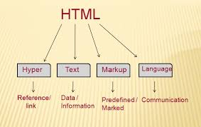
HTML

Slide 12
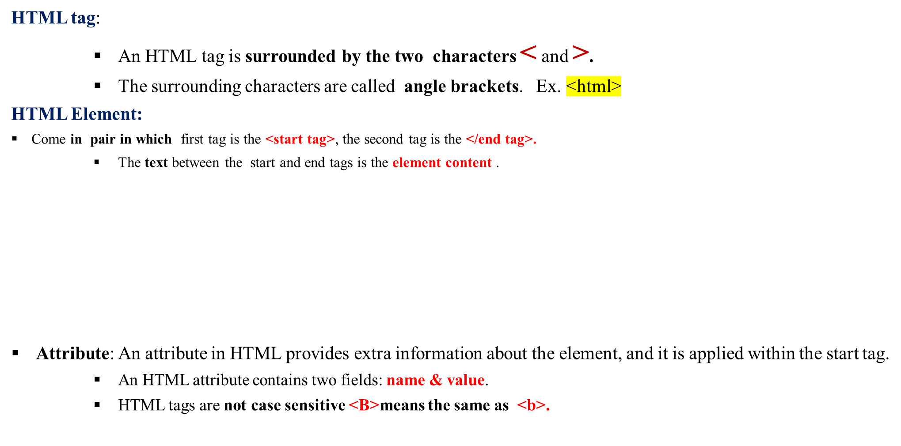
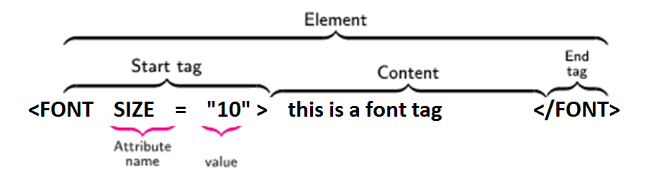
Anatomy of an HTML element or HTML Tags/Element structure:-

Slide 13
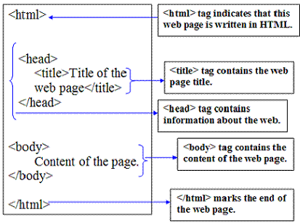
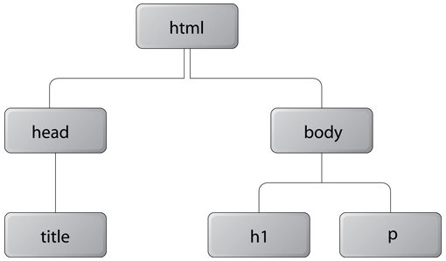
Basic structure of an HTML document
Fig.Tree Structure of HTML Doc

Slide 14
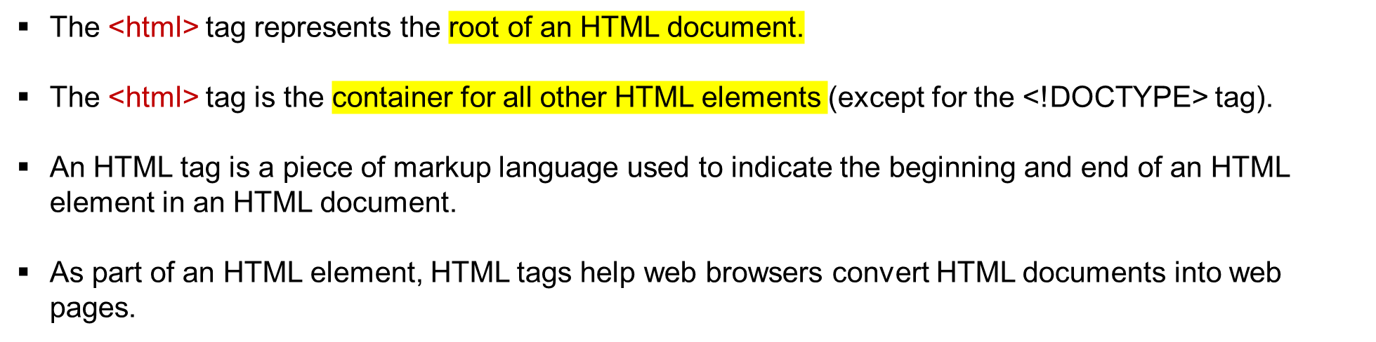

HTML <html> Tag

Slide 15
Program for Displaying Welcome
<html>
<head>
</head>
<body bgcolor="cyan">
welcome to web world
</body>
</html>

Slide 16
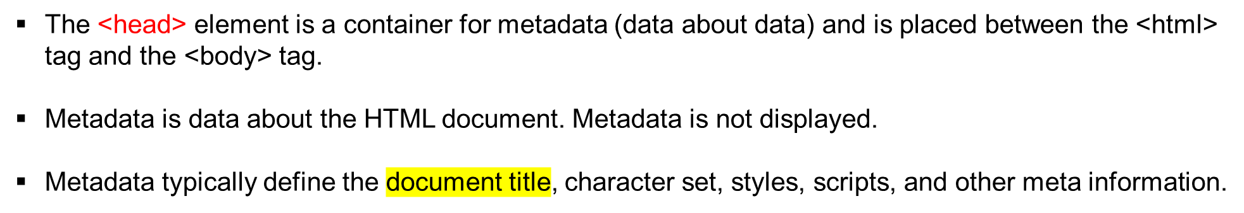
<head> Tag
<head>
<title>Title of the document</title>
</head>
<head>
<style>
h1 {color:red;}
p {color:blue;}
</style>
</head>

Slide 17
HTML <body> Tag
The <body> tag defines the document's body.
The <body> element contains all the contents of an HTML document, such as headings, paragraphs, images, hyperlinks, tables, lists, etc.
There can only be one <body> element in an HTML document.
<html>
<head>
<title>Title of the document</title>
</head>
<body>
<h1>This is a heading</h1>
<p>This is a paragraph.</p>
</body>
</html>

Slide 18
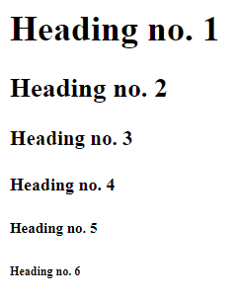
<h1> is the largest heading tag and
<h6 > is the smallest one
<h1>Heading no. 1</h1>
<h2>Heading no. 2</h2>
<h3>Heading no. 3</h3>
<h4>Heading no. 4</h4>
<h5>Heading no. 5</h5>
<h6>Heading no. 6</h6>

Slide 19
Displaying Texts and like breaks
Tag | Description
<p> | This tag represents a paragraph.
<h1> to <h6> | Defines header 1 to header 6
<br> | Inserts a single line break
<hr> | Defines a horizontal rule
<!--> | Defines a comment
<p> - Paragraph Tag
The <p> tag defines a paragraph. Browsers automatically add some space (margin) before and after each <p> element..
<p>This is a paragraph</p>
<br> Line Breaks:-
The <br> tag is used when we want to start a new line, but don't want to start a new paragraph.
This Code | output
<p>This <br> is a para<br> graph with line breaks</p> | This is a para graph with line breaks
<hr> The element is used for horizontal rules that act as dividers between sections

Slide 20
HTML Text Formatting Elements
HTML Formatting is a process of formatting text for better look and feel.
Element name | Description
<b> | Bold Text
<strong> | This is a logical tag, which tells the browser that the text is important.
<i> | used to make text italic.
<em> | used to display content in italic.
<mark> | This tag is used to highlight text.
<u> | used to underline text written between it.
<strike> | This tag is used to draw a strikethrough on a section of text
<sup> | -Superscript text
<sub> | Subscript text
<del> | This tag is used to display the deleted content.
<ins> | This tag displays the content which is added
<big> | This tag is used to increase the font size by one conventional unit.
<small> | This tag is used to decrease the font size by one unit from base font size.

Slide 21
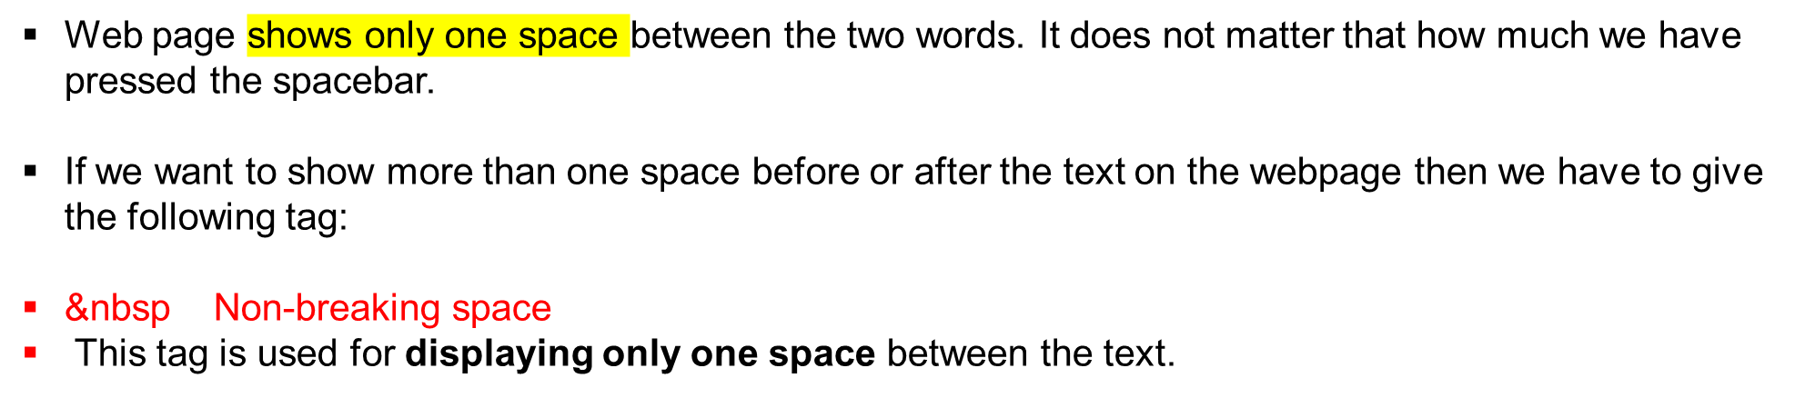
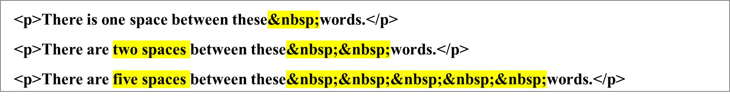
Adding the spaces between text:
There is one space between these words.
There are two spaces between these words.
There are five spaces between these words.

Slide 22
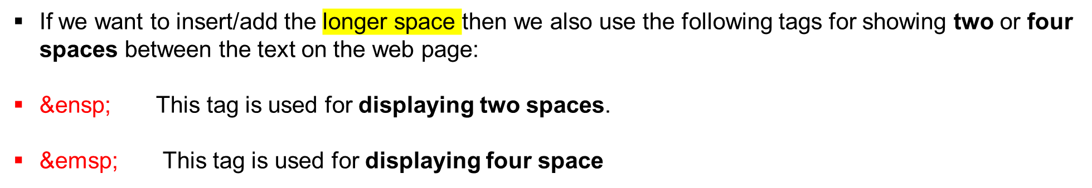
Adding the spaces between text:
We can also add the <pre> tag, which displays the text on the web page as same as entered in the Html document.
<pre> Any text or paragraph </pre>

Slide 23
Some Useful HTML Character Entities
symbol | Description | Entity Name | Entity Number
 | non-breaking space | &nbsp; | &#160;
< | less than | &lt; | &#60;
> | greater than | &gt; | &#62;
& | ampersand | &amp; | &#38;
" | double quotation mark | &quot; | &#34;
' | single quotation mark (apostrophe) | &apos; | &#39;
¢ | cent | &cent; | &#162;
£ | pound | &pound; | &#163;
¥ | yen | &yen; | &#165;
€ | euro | &euro; | &#8364;
© | copyright | &copy; | &#169;
® | registered trademark | &reg; | &#174;

Slide 24
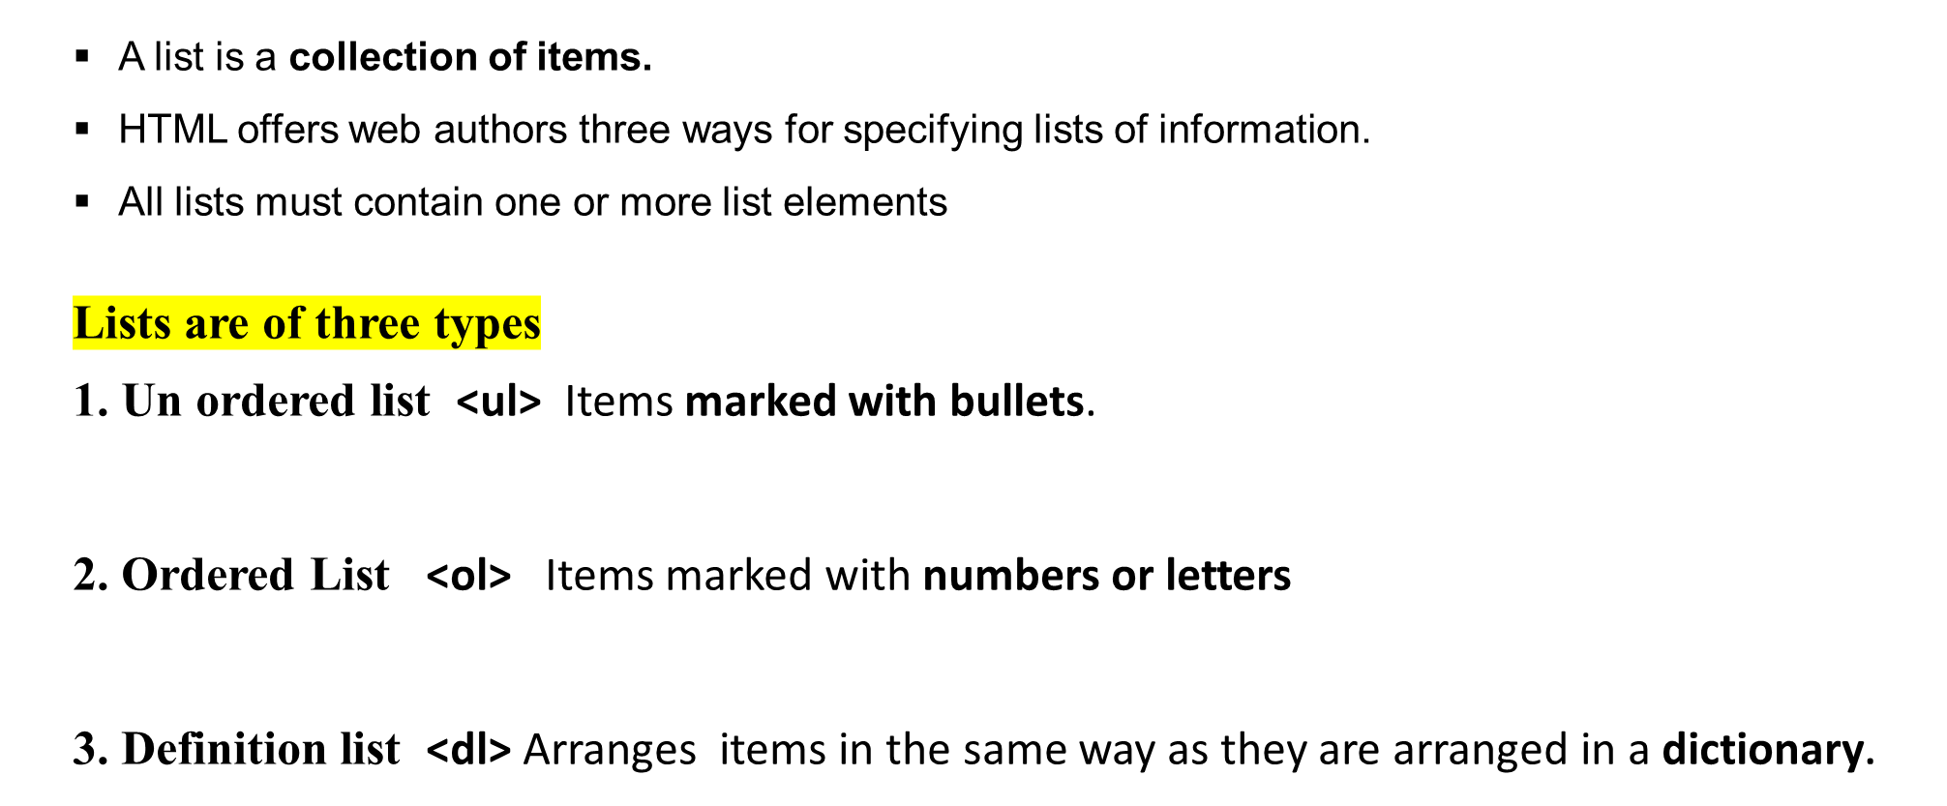
LISTS
html
css
javascript
Coffee
Tea
Milk
Coffee
  - black hot drink
Milk
  - white cold drink

Slide 25
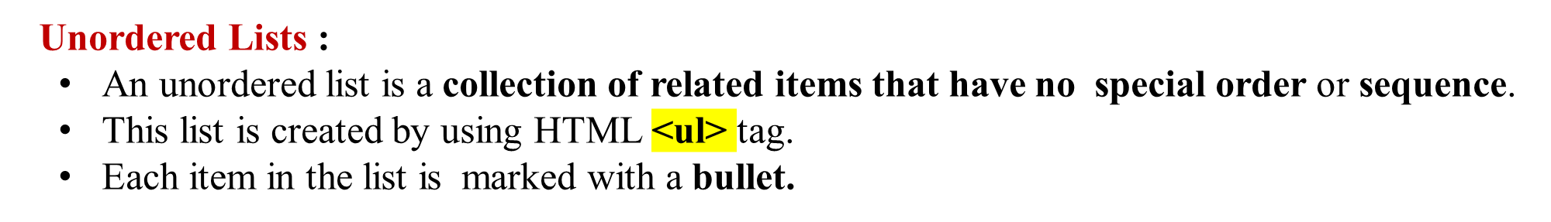
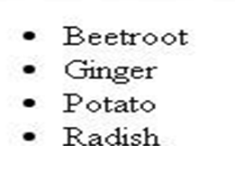
LISTS
Example
<html>
<head>
<title>HTML Unordered List</title>
</head>
<body>
<ul> <li>Beetroot</li>
<li>Ginger</li>
<li>Potato</li>
<li>Radish</li>
</ul>
</body>
</html>

Slide 26
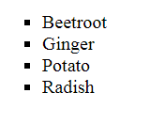
UNORDERD LISTS WITH “TYPE” ATTRIBUTE
The type Attribute
we can use type attribute for <ul> tag to specify the type of bullet we like. By default, it is a disc.
Following are the possible options −
  <ul type = "square"> <ul type = "disc"> <ul type = "circle">
Example
<html>
<head> <title>HTML Unordered List</title> </head>
<body>
<ul type = "square">
  <li>Beetroot</li>
  <li>Ginger</li>
  <li>Potato</li>
  <li>Radish</li>
</ul>
</body>
</html>

Slide 27
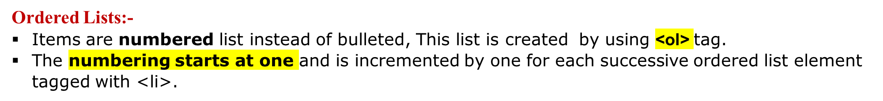
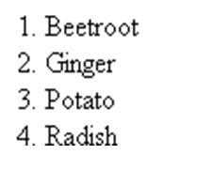
ORDERED LISTS
Example
<!DOCTYPE html>
<html>
<head>
<title>HTML Ordered List</title>
</head>
<body>
<ol>
<li>Beetroot</li>
<li>Ginger</li>
<li>Potato</li>
<li>Radish</li>
</ol>
</body>
</html>

Slide 28
ORDERED LISTS WITH TYPE ATTRIBURE
The type Attribute:
we can use type attribute for <ol> tag to specify the type of numbering we like. By default, it is a number. Following are the possible options.
  <ol type = "1"> - Default-Case Numerals.
  <ol type = "I"> - Upper-Case Numerals.
  <ol type = "i"> - Lower-Case Numerals.
  <ol type = "A"> - Upper-Case Letters.
  <ol type = "a"> - Lower-Case Letters.
<html>
<head> <title>HTML Ordered List</title> </head> <body>
<ol type = "1">
  <li>Beetroot</li>
  <li>Ginger</li>
  <li>Potato</li>
  <li>Radish</li>
</ol>
</body>
</html>

Slide 29
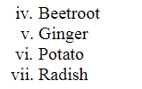
ORDERED LISTS WITH “START” ATTRIBURE
The start Attribute
we can use start attribute for <ol> tag to specify the starting point of numbering we need. Following are the possible options −
  <ol type = "1" start = "4"> - Numerals starts with 4.
  <ol type = "I" start = "4"> - Numerals starts with IV.
  <ol type = "i" start = "4"> - Numerals starts with iv.
  <ol type = "a" start = "4"> - Letters starts with d.
  <ol type = "A" start = "4"> - Letters starts with D.
<html>
<head> <title>HTML Ordered List</title> </head>
<body>
<ol type = "i" start = "4">
  <li>Beetroot</li>
  <li>Ginger</li>
  <li>Potato</li>
  <li>Radish</li>
</ol>
</body>
</html>

Slide 30
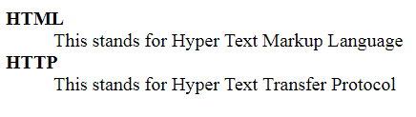
DEFINITIN LISTS
Definition Lists:
HTML supports a list style which is called definition lists where entries are listed like in a dictionary or encyclopedia.
The definition list is the ideal way to present a glossary, list of terms, or other name/value list.
Definition List makes use of following three tags.
1). <dl> - Defines the start of the list
</dl> - Defines the end of the list
2). <dt> - A term
. <dd> - Term definition
<html>
<head>
<title>HTML Definition List</title>
</head>
<body>
<dl>
<dt>HTML</dt>
<dd>This stands for Hyper Text Markup Language</dd>
<dt>HTTP</dt>
<dd>This stands for Hyper Text Transfer Protocol</dd>
</dl>
</body>
</html>

Slide 31
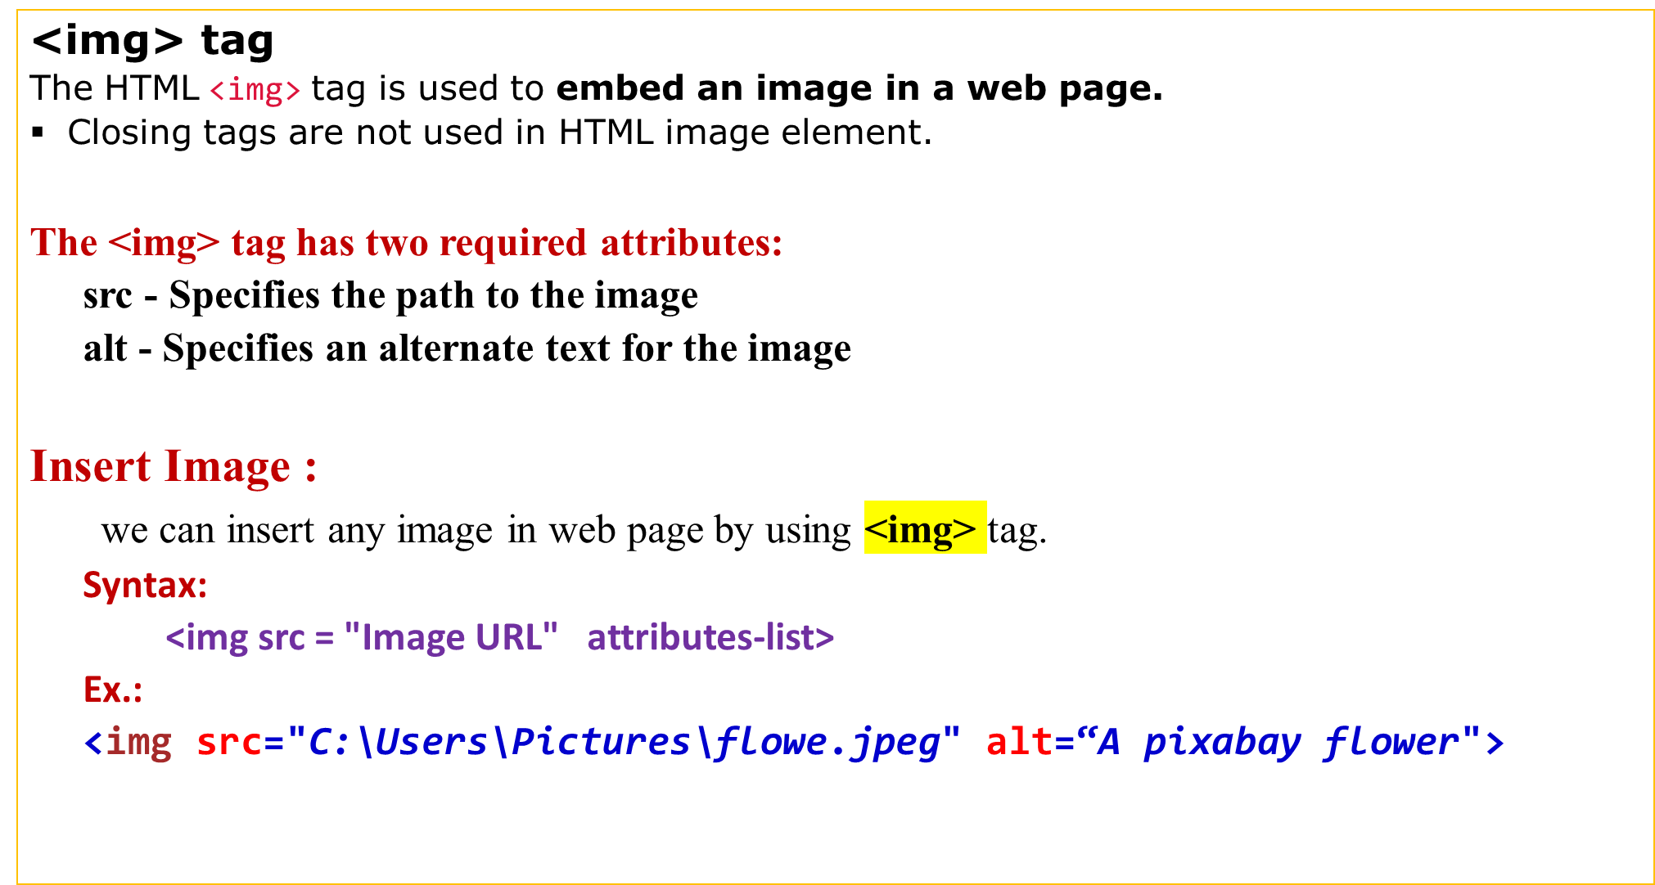
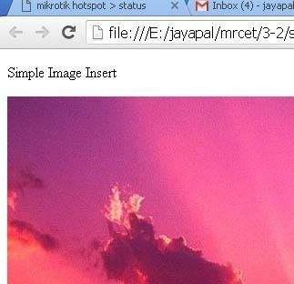
IMAGES

Slide 32

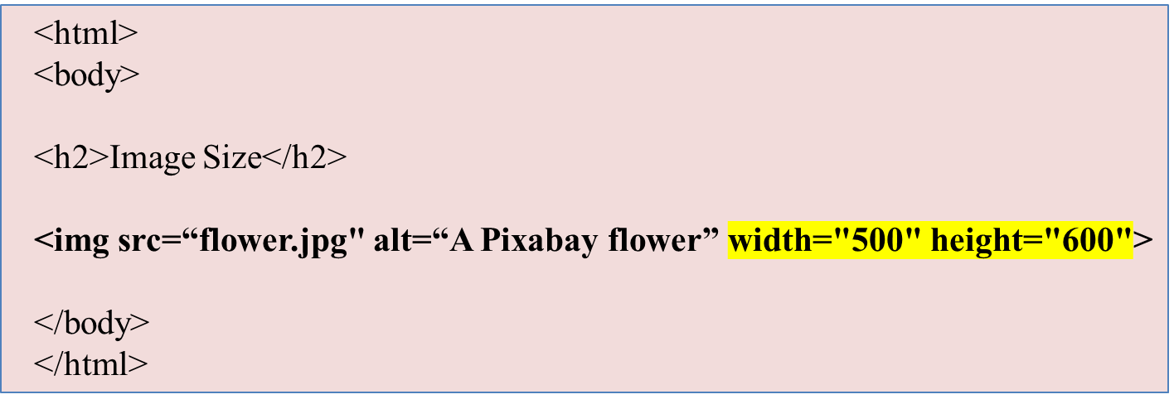
IMAGES:
Set Image Width/Height
<img src = "/html/images/test.png" alt = "Test Image" width = "150" height = "100"/>

Slide 33
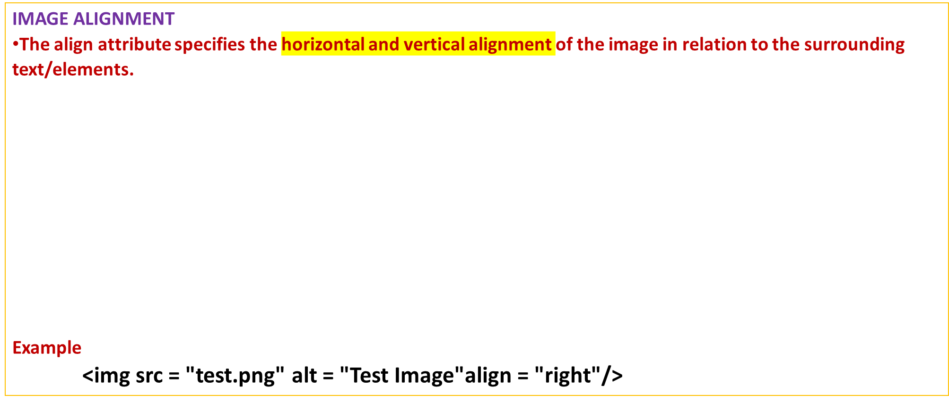
IMAGES
Value | Description
left | Align the image to the left
right | Align the image to the right
top | Align the image on the top
bottom | Align the image on the bottom
Middle | Align the image on the middle

Slide 34
IMAGES:
SET IMAGE BORDER:
The <img> border attribute is used to specify the border width around the image.
The default value of <img> border attribute is 0.
It is not supported by HTML 5. Use CSS instead of this attribute
<img src = "test.png" alt = "Test Image" border = "3"/>

Slide 35
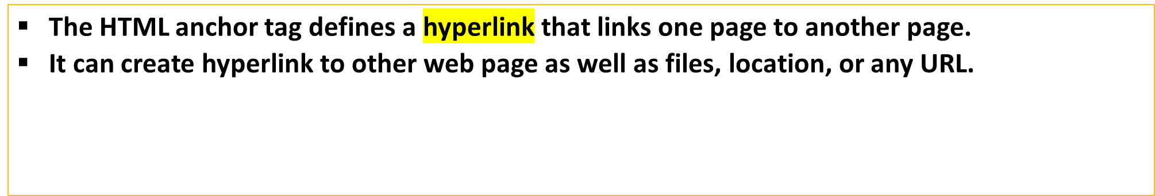
Anchor tag <a>
syntax
<a href = “url"> Link Text </a>
Ex>
<a href = “www.goolge.com"> Click Here </a>
<a href = “home.html"> Home page</a>

Slide 36
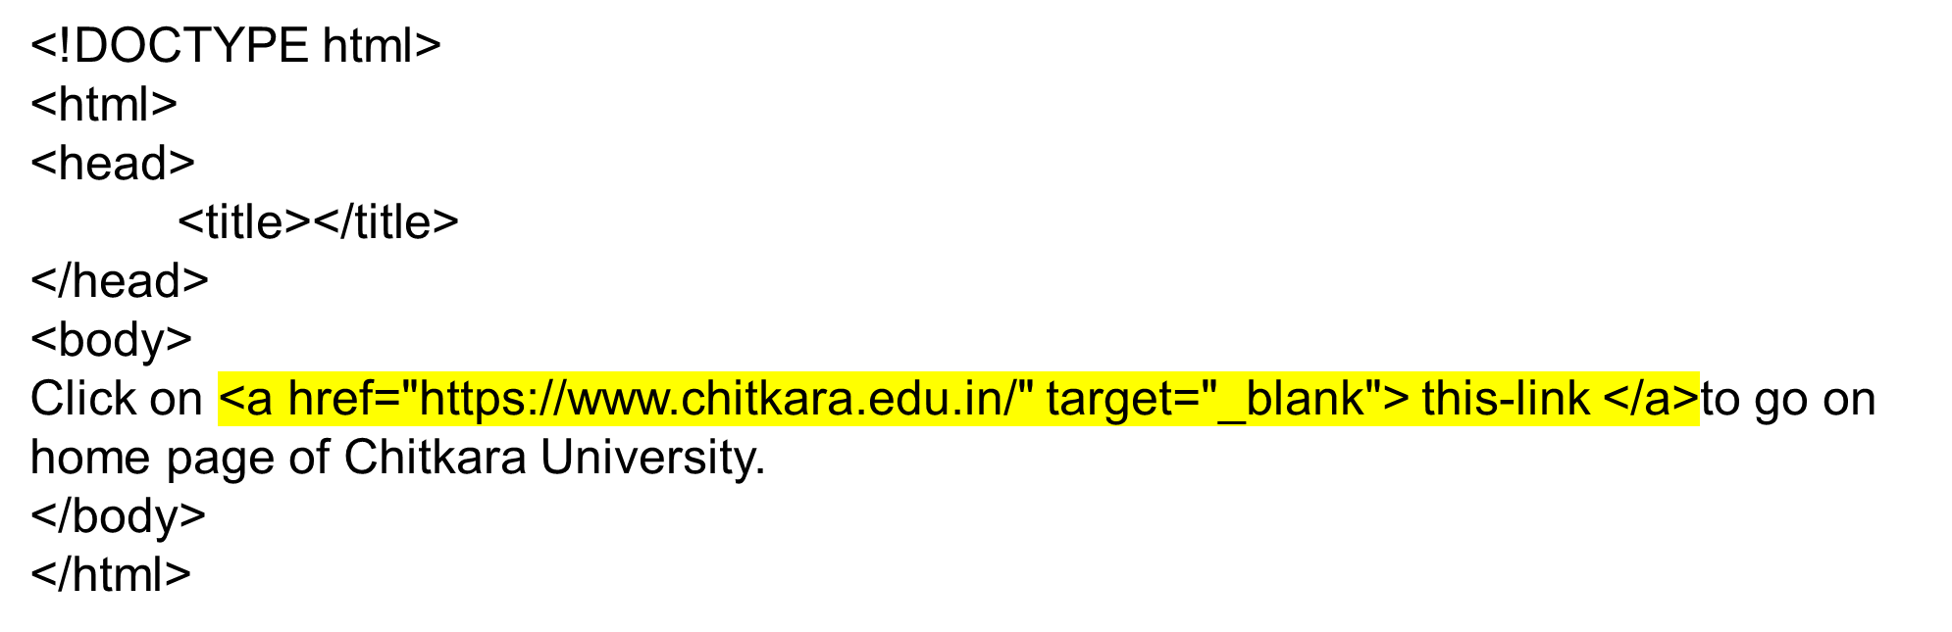
Program to create a Hyperlink

