Slide 1

Tables
HTML table tag is used to display data in tabular form (row * column)
A table is created using the following tags.
<table> element, with the help of <tr> , <td>, and <th> elements.
<html>
<head> <title>HTML Tables</title> </head>
<body>
<table border="1">
<tr> <td>Jill</td> <td>Smith</td> <td>50</td> </tr> <tr> <td>Eve</td> <td>Jackson</td> <td>94</td> </tr>
</table>
</body>
</html>
Tag | Description
<table> | It defines a table.
<tr> | It defines a row in a table.
<th> | It defines a header cell in a table.
<td> | It defines a cell – table data in a table.
<caption> | It defines the table caption.

Slide 2
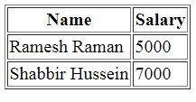
Tables
Table Heading
Table heading can be defined using <th> tag. This tag will be put to replace <td> tag.
<html>
<head>
<title>HTML Table Header</title>
</head>
<body>
<table border = "1">
<tr>
<th>Name</th>
<th>Salary</th>
</tr>
<tr>
<td>Ramesh Raman</td>
<td>5000</td>
</tr>
<tr>
<td>Shabbir Hussein</td>
<td>7000</td>
</tr>
</table>
</body>
</html>

Slide 3
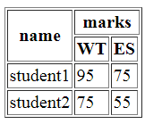
Tables - Colspan and Rowspan Attributes:
We can use colspan attribute if we want to merge two or more columns into a single column.
Similar way we will use rowspan if we want to merge two or more rows.
<html>
<head>
<title>HTML Table Colspan/Rowspan</title>
</head>
<body>
<table border = "1">
<tr>
<th rowspan = "2">name</th>
<th colspan = “3">marks</th>
</tr>
<tr>
<th>WT</th>
<th>ES</th>
</tr>
<tr>
<td>student1</td>
<td>95</td>
<td>75</td>
</tr>
<tr>
<td >student2</td>
<td>75</td>
<td>55</td>
</tr>
</table> </body> </html>

Slide 4
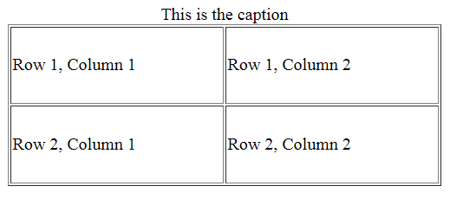
Tables- Height and Width attributes
We can set a table width and height using width and height attributes.
Specify table width or height in terms of pixels or in terms of percentage of available screen area.
Table Caption
The caption tag will serve as a title or explanation for the table and it shows up at the top of the table. This tag is deprecated in newer version of HTML/XHTML
<html>
<head>
<title>HTML Table Width/Height</title>
</head>
<body>
<table border = "1" width = "400" height = "150">
<caption>This is the caption</caption>
<tr>
<td>Row 1, Column 1</td>
<td>Row 1, Column 2</td>
</tr>
<tr>
<td>Row 2, Column 1</td>
<td>Row 2, Column 2</td>
</tr>
</table>
</body>
</html>

Slide 5
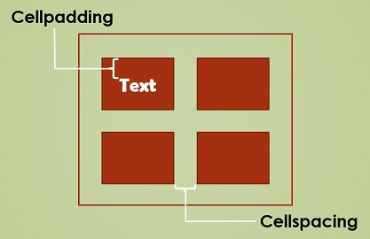
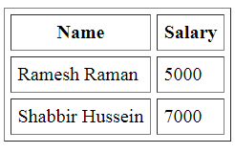
Tables : Cellpadding and Cell-spacing Attributes
cellpadding and cellspacing which are used to adjust the white space in table cells.
The cellspacing attribute defines space between table cells.
cellpadding represents the distance between cell borders and the content within a cell.
<html>
<head>
<title>HTML Table Cellpadding</title>
</head>
<body>
<table border = "1" cellpadding = "5" cellspacing = "5">
<tr>
<th>Name</th>
<th>Salary</th>
</tr>
<tr>
<td>Ramesh Raman</td>
<td>5000</td>
</tr>
<tr>
<td>Shabbir Hussein</td>
<td>7000</td>
</tr>
</table>
</body>
</html>

Slide 6
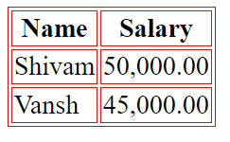
Tables – bordercolor
we can also set border color also using bordercolor attribute.
<html>
<head>
<title>HTML Tables</title> </head>
<body>
<table border="1"bordercolor="red" >
<tr>
<th>Name</th>
<th>Salary</th>
</tr>
<tr>
<td>Shivam</td>
<td>50,000.00</td>
</tr>
<tr>
<td>Vansh</td>
<td>45,000.00</td>
</tr>
</table>
</body>
</html>

Slide 7
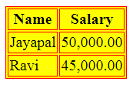
Tables – Backgrounds
Tables Backgrounds
bgcolor attribute − we can set background color for whole table or just for one cell.
background attribute − we can set background image for whole table or just for one cell.
<html>
<head>
<title>HTML Tables</title> </head>
<body>
<table border="1"bgcolor="yellow">
<tr>
<th>Name</th>
<th>Salary</th>
</tr>
<tr>
<td>Jayapal</td>
<td>50,000.00</td>
</tr>
<tr>
<td>Ravi</td>
<td>45,000.00</td>
</tr>
</table>
</body>
</html>

Slide 8
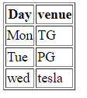
Tables – table body <tbody>
HTML <tbody> tag is used to group the table rows (<tr>) together, which indicates that this is body part of a table (<table>).
The <tbody> tag must be a child of <table> element.
The <tbody> is used along with <thead> and <tfoot> which shows the different part of the table that are table head, table body, and table footer, however, it does not affect the layout of the table.
<!DOCTYPE html>
<html>
<h1>The thead, tbody, and tfoot elements</h1>
<table border="1">
<thead>
<tr>
<th>Day</th>
<th>venue</th>
</tr>
</thead>
<tbody>
<tr>
<td>Mon</td>
<td>TG</td>
</tr>
<tr>
<td>Tue</td>
<td>PG</td>
</tr>
</tbody>
<tfoot>
<tr>
<td>wed</td>
<td>tesla</td>
</tr>
</tfoot>
</table>
</body>
</html>

