Slide 1
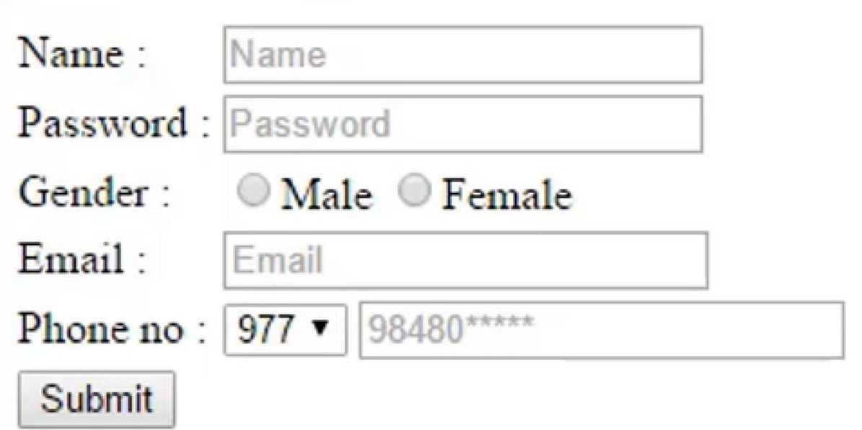
FORMS:
An HTML form is a section of a document which contains controls such as
text fields,
password fields,
checkboxes,
radio buttons,
submit button,
menus etc.
An HTML form facilitates the user to enter data that is to be sent to the server for processing such as name, email address, password, phone number, etc. .
There are various form elements available like text fields, text area fields, drop-down menus, radio buttons, checkboxes, etc.

Slide 2
HTML Form Tags:
<form>
The HTML <form> element defines a form that is used to collect user input:
<form action="server url" method="get|post">
//input controls e.g. textfield, textarea, radiobutton, button
</form>
Sr.No | Attribute & Description
1 | action : Backend script ready to process your passed data.
2 | method: It to be used to upload data. The most frequaently used are GET and POST methods.
3 | target : Specify the target window or frame where the result of the script will be displayed. It takes values like _blank, _self, _parent etc.

Slide 3
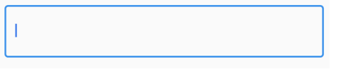






FORMS:
<input> - It defines an input control.
The <input> element can be displayed in several ways, depending on the type attribute.
Type | Description
<input type="text"> | Defines a one-line text input field
<input type="password"> | Defines a password field
<input type="checkbox"> | Defines a checkbox
<input type="button"> | Defines a clickable button (mostly used with a JavaScript to activate a script)
<input type=“file"> | Defines a file-select field and a "Browse" button (for file uploads)
<input type="radio"> | Defines a radio button (for selecting one of many choices)
<input type="submit"> | Defines a submit button (for submitting the form)

Slide 4
FORMS:
HTML Form Controls
There are different types of form controls that you can use to collect data using HTML form −
Text field
Password Field
Text Area
Checkbox
Radio Box
Select Box
File Select boxes
Buttons

Slide 5
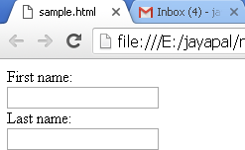
FORMS:
Text field (or) Single-line text input control
This control is used for items that require only one line of user input, such as search boxes or names. They are created using HTML <input> tag.
<html>
<head>
<title>Text Input Control</title>
</head>
<body>
<form >
First name: <input type = "text" name = "first_name" />
<br>
Last name: <input type = "text" name = "last_name" />
</form>
</body>
</html>
Sr.No | Attribute & Description
type | Indicates the type of input control and for text input.
name | Used to give a name to the control
value | This can be used to provide an initial value
size | Allows to specify the width of the text-input control in terms of characters.
maxlength | Allows to specify the maximum number of characters a user can enter into the text box.

Slide 6

FORMS:
2. Password Field
This is also a single-line text input but it masks the character as soon as a user enters it.
They are also created using HTML <input>tag but type attribute is set to password.
<html>
<head> <title>Password Input Control</title> </head>
<body>
<form >
User ID : <input type = "text" name = "user_id" />
<br> Password:
<input type = "password" name = "password" />
</form>
</body>
</html>

Slide 7
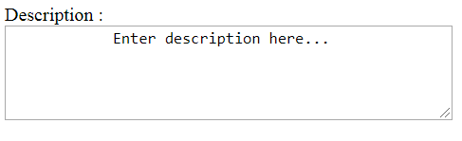
FORMS:
3. Text Area (or) Multiple-Line Text Input Control
This is used when the user is required to give details that may be longer than a single sentence.
Multi-line input controls are created using HTML <textarea> tag.
<html>
<head>
<title>Multiple-Line Input Control</title>
</head>
<body>
<form>
Description :<br>
<textarea rows = "5" cols = "50" name = "description">
Enter description here...
</textarea>
</form>
</body>
</html>

Slide 8
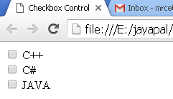
FORMS:
4. Checkbox Control
Checkboxes are used when more than one option is required to be selected. They are also created using HTML <input> tag but type attribute is set to checkbox.
<html> <head> <title>Checkbox Control</title> </head>
<body>
<form>
<input type="checkbox" name="C++" value="on"> C++
<br>
<input type="checkbox" name="C#" value="on"> C#
<br>
<input type="checkbox" name="JAVA" value="on"> JAVA
</form>
</body> </html>

Slide 9
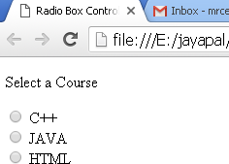
FORMS:
5. Radio Button Control
Radio buttons are used when out of many options, just one option is required to be selected. They are also created using HTML <input> tag but type attribute is set to radio
<html>
<head>
<tit le>Radio Box Control
</title> </head>
<body> <p>Select a Course</p>
<form>
<input type="radio" name="subject" value="C++"> C++
<br>
<input type="radio" name="subject" value="JAVA"> JA VA
<br>
<input type="radio" name="subject" value="HTML"> HTML
</form> </body> </html>

Slide 10
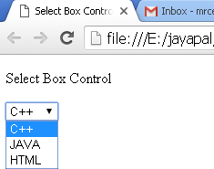
FORMS:
6. Select Box Controls
A select box, also called drop down box which provides option to list down various options in the form of drop down list, from where a user can select one or more options
<html>
<head>
<title>Select Box Control</title>
</head>
<body>
<form>
<select name="dropdown">
<option value="C++" selected>C++</option>
<option value="JAVA">JA VA</option>
<option value="HTML">HTML</option>
</select>
</form>
</body>
</html>

Slide 11
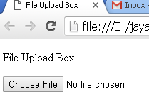
FORMS:
7. File Select boxes
If we want to allow a user to upload a file to web site, we will need to use a file upload box, also known as a file select box. This is also created using the <input > element but type attribute is set to file.
<html>
<head>
<title>File Upload Box</title>
</head>
<body>
<p>File Upload Box</p>
<form>
<input type="file" name="fileupload" >
</form>
</body>
</html>

Slide 12
FORMS:
8. Buttons
There are various ways in HTML to create clickable buttons.
we can also create a clickable button using <input> tag by setting its type attribute to button. The type attribute can take the following values:
Sr.No | Type & Description
submit | This creates a button that automatically submits a form.
reset | This creates a button that automatically resets form controls to their initial values.
button | This creates a button that is used to trigger a client-side script when the user clicks that button.
image | This creates a clickable button but we can use an image as background of the button.
<html>
<head>
<title>File Upload Box</title>
</head>
<body>
<form>
<input type="submit" name="submit" value="Submit" />
<input type="reset" name="reset" value="Reset" />
<input type="button" name="ok" value="OK" />
<input type="image" name="imagebutton" src="test1.png" />
</form>
</body>
</html>

Slide 13
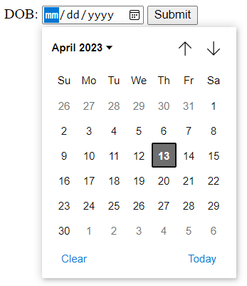
Displaying date picker
9. HTML <input type="date">
The <input type="date"> defines a date picker.
The resulting value includes the year, month, and day.attribute
<html>
<body>
<h1>Show a Date Control</h1>
<form>
DOB: <input type="date" id="birthday" name="birthday">
<input type="submit">
</form>
</body>
</html>

Slide 14
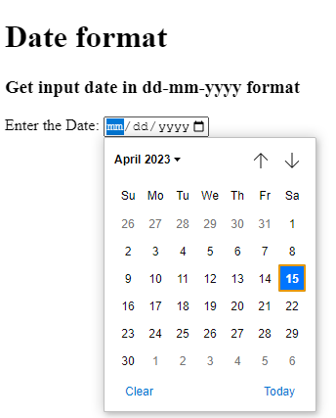
Displaying date picker with dd/mm/yyyy format and ranges
10. HTML <input type="date">
To set and get the input type date in dd-mm-yyyy format we will use attribute
placeholder="dd-mm-yyyy“.
We can also mention the start and end dates for the date picker with min and max attributes.
<html>
<body>
<h1>Date format</h1>
<h3> Get input date in
dd-mm-yyyy format </h3>
<label for="start"> Enter the Date: </label>
<input type="date" name="start"
placeholder="dd-mm-yyyy"
min="1997-01-01" max="2030-12-31">
</body>
</html>

Slide 15
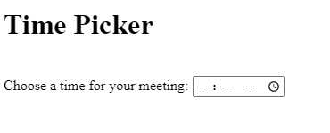
Displaying time picker
11. HTML <input type=“time">
The <input type="date"> defines a date picker.
placeholder="dd-mm-yyyy“.
We can also mention the start and end dates for the date picker with min and max attributes.
<html>
<body>
<label for="appt">Choose a time for your meeting:</label>
<input type="time" id="appt" name="appt"
min="09:00" max="18:00" required>
<small>Office hours are 9am to 6pm</small>
</body>
</html>

Slide 16
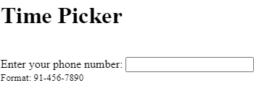
Telephone number
12. <input type="tel">
The <input type=“tel"> defines a telephone number.
<html>
<body>
<label for="appt">Choose a time for your meeting:</label>
<input type="time" id="appt" name="appt"
min="09:00" max="18:00" required>
<small>Office hours are 9am to 6pm</small>
</body>
</html>

