Slide 1
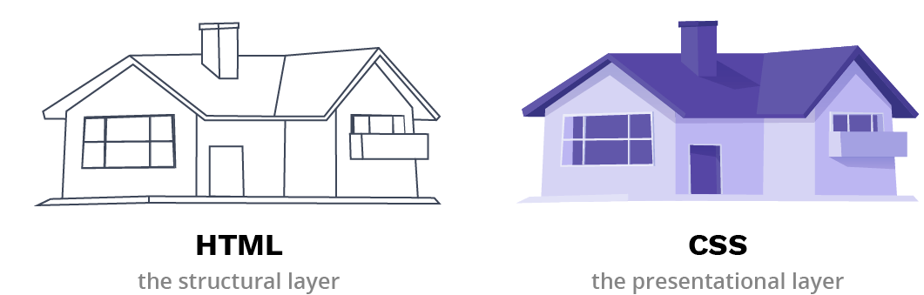
CSS- Cascading Style Sheets
A style sheet is a document that contains style information about one or more documents written in markup language and used to control the styles such as fonts, colors, size, spacing, margins etc.
CSS stands for Cascading Style Sheets is a style sheet language that describes the style of an HTML document.
Describes the appearance, layout, and presentation of information on a web page
Describes how information is to be displayed, not what is being displayed

Slide 2
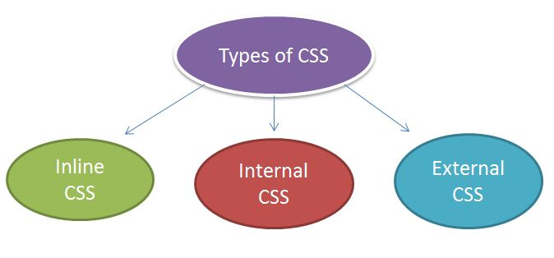
CSS- Cascading Style Sheets
CSS adds the styles to the HTML document
3 WAYS TO ADD CSS TO HTML:
-------------------------------------------------------------------------------------------------------------------------------------------------
THREE TYPES OF CSS
Style
Document
Content
CSS can be added to HTML elements in 3 ways:
1.Inline - by using the style attribute in HTML elements
Applied to only one element
2. Internal - by using a <style> element in the <head> section
Applied to entire web page
3. External - by using an external .CSS file

Slide 3
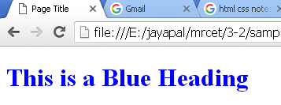
CSS- Cascading Style Sheets
1. Inline CSS
Inline CSS is used to apply CSS on a single line or element.
An inline CSS uses the style attribute of an HTML element.
<h1 style="color:blue;">This is a Blue Heading</h1>
This example sets the text color of the < h1> element to blue:
<html>
<body>
<h1 style="color:blue;">This is a Blue Heading</h1>
</body>
</html>
Inline style

Slide 4
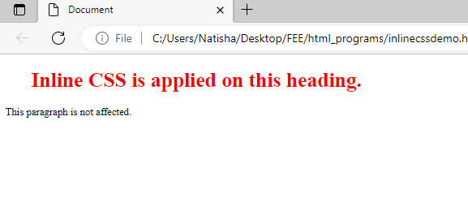
CSS- Cascading Style Sheets
Inline CSS
Style is applicable to only one tag
<html>
<body>
<h1 style="color:red;margin-left:40px;">Inline CSS is applied on this heading.</h1>
<p>This paragraph is not affected.</p>
</body>
</html>

Slide 5
CSS- Cascading Style Sheets
2. Internal CSS: An internal CSS is used to define a style for a single HTML page.
The internal style is defined inside the <style> element, inside the <head> section.
<html>
<head>
<style>
body {background-color: blue;}
h1 {color: blue;}
p{color: red;}
</style>
</head>
<body>
<h1>This is a heading</h1>
<p>This is a paragraph.</p>
</body>
</html>
<head>
<head>
Home.html
<style>
---------------
----------------
</style>

Slide 6
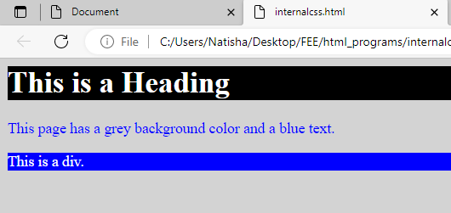
2. Internal CSS
<html>
<head>
<style>
body {
background-color: lightgrey;
color: blue;
}
h1 {
background-color: black;
color: white;
}
div {
background-color: blue;
color: white;
}
</style>
</head>
<body>
<h1>This is a Heading</h1>
<p>This page has a grey background color and a blue text.</p>
<div>This is a div.</div>
</body>
</html>
2. Internal CSS:

Slide 7
CSS SELECTORS
A CSS selector selects the HTML element(s) you want to style.
There are several different types of selectors in CSS.
Element Selector(element name)
Id Selector(#)
Class Selector(.)
Universal Selector(*)
Group Selector(h1,p,.)
<!– EEMENT SELECTOR-->
<html>
<head>
<style>
p{
text-align: center;
color: blue;
}
</style>
</head>
<body>
<p>This style will be applied on every paragraph.</p>
<p >here also applie</p>
<p>And me!</p>
</body>
</html>
1) CSS Element Selector
The element selector selects the HTML element by name.
The style is applicable to the tags that are same .

Slide 8
CSS SELECTORS
2) CSS Id Selector(#)
The id selector selects the id attribute of an HTML element to select a specific element.
An id is always unique within the page so it is chosen to select a single, unique element.
It is written with the hash character (#), followed by the id of the element.
<html>
<head>
<style>
#para1 {
text-align: center;
color: blue;
}
</style>
</head>
<body>
<p id="para1">applicable to this element only</p>
<p>This paragraph will not be affected.</p>
</body>
</html>

Slide 9
CSS SELECTORS
3) CSS Class Selector
The class selector selects HTML elements with a specific class attribute.
It is used with a period character . (full stop symbol) followed by the class name.
A class name should not be started with a number.
CSS Class Selector for specific element
If you want to specify that only one specific HTML element should be affected, then you should use the element name with class selector.
<html>
<head>
<style>
p.center {
text-align: center;
color: blue;
}
</style>
</head>
<body>
<h1 class="center">This heading is not affected</h1>
<p class="center">This is blue and center-aligned.</p>
</body>
</html
<html>
<head>
<style>
.center {
text-align: center;
color: blue;
}
</style>
</head>
<body>
<h1 class="center">This heading is blue and center-aligned.</h1>
<p class="center">This paragraph is blue and center-aligned.</p>
</body>
</html>

Slide 10
CSS SELECTORS
4) CSS Universal Selector (*)
It selects all the elements on the pages.
<html>
<head>
<style>
* {
color: green;
font-size: 20px;
}
</style>
</head>
<body>
<h2>This is heading</h2>
<p>This style will be applied on every paragraph.</p>
<p id="para1">Me too!</p>
<p>And me!</p>
</body>
</html>

Slide 11
CSS SELECTORS
5) CSS Group Selector:
The grouping selector is used to select all the elements with the same style definitions.
Grouping selector is used to minimize the code. Commas are used to separate each selector in grouping.
<html>
<head>
<style>
h1, h2, p {
text-align: center;
color: blue;
}
</style>
</head>
<body>
<h1>Hello..This is heading one /h1>
<h2>Hello this is heading two </h2>
<p>This is a paragraph.</p>
</body>
</html>

Slide 12
CSS- Cascading Style Sheets
3. External CSS:-
An external style sheet is used to define the style for many HTML pages.
With an external style sheet, we can change the look of an entire web site, by changing one file
An External style sheet is written in separate file with extension .css and referenced in multiple HTML documents
To use an external style sheet, add a <link> in the <head> section of the HTML page:
<
<link>
-------------
---------------
Home.html
<link>
-------------
---------------
Mystyle.css
login.html
<link>
-------------
---------------
Syntax to Link external CSS file:
<link rel="stylesheet" type="text/css" href="mystyle.css">
dept.html

Slide 13
CSS- Cascading Style Sheets
An external style sheet can be written in any text editor, and must be saved with a .css extension.
The external .css file should not contain any HTML tags.
body
{background-color:lightblue;
}
h1{
color:navy;
margin-left:20px;
}
<html>
<head>
<link rel="stylesheet" type="text/css" href="mystyle.css">
</head>
<body>
<h1>This is a heading</h1>
<p>This is a paragraph.</p>
</body>
</html>
"mystyle.css“
“home.html“
Attributes of <link> tag:
The “rel” attribute is compulsory and it is used to specify the relationship between the current file and the linked file.
The “href” → it is compulsory used to specify the file location.
The “type” →attribute is optional, it is used to define the type of content that we are linking.

Slide 14
CSS Properties
CSS Fonts:
color: The CSS color property defines the text color to be used.
h1 { color: red; } //specify color name
h2 { color: #9000A1; } //specify by hexadecimal value
p { color:rgb(0, 220, 98); } //by RGB color combinations
font-family: The CSS font-family property defines the font to be used.
font-size property defines the text size to be used.
font-size: 30px; or font-size: 200%;
font-style: The CSS font-family property defines the font to be used.
font-style: italic
border: defines a border around an HTML element.
border-style {border-style: none;} {border-style: dotted;}
border-color border-color: red;
border-width border-width: 1px;
padding: defines a padding (space) between the text and the border.
{ padding-top: 50px; padding-right: 100px; padding-bottom: 150px; }
margin: defines a margin (space) outside the border.
{ margin-top: 50px; margin-bottom: 50px; margin-right: 100px; }
h1
{ color: blue;
font-family: verdana;
}
p {
color: red;
font-family: courier;
font-size: 160%;
}
h1{ color: blue;
font-family:'Courier New';
}
p { color: red;
font-size: 200%;
border: 2px solid powderblue;
padding: 30p x;
margin: 50p x; }

Slide 15
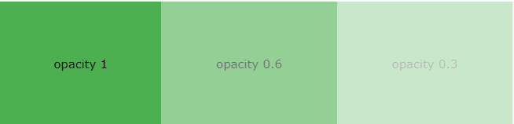

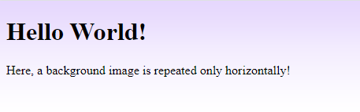
CSS Background
CSS background property is used to define the background effects on element.
CSS background properties: 5 BG properties
background-color
background-color: lightblue;
Opacity / Transparency
div { background-color: green; opacity: 0.3; }
2 . background-image:
specifies an image to use as the background of an element
By default, the image is repeated so it covers the entire element.
body {
background-image: url("paper.gif");
}
3. . background-repeat: repeats the background image horizontally and vertically.
body { background-image: url("gradient_bg.png");
background-repeat: repeat-x; }

Slide 16
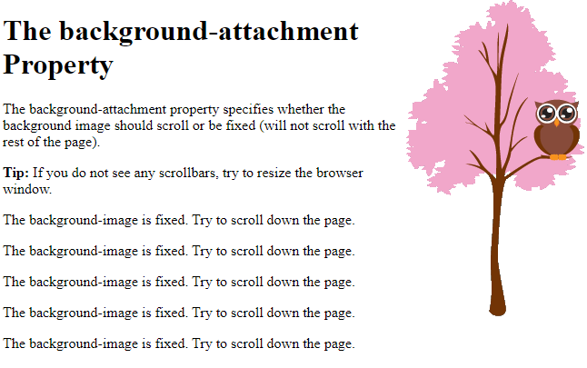
CSS Background
CSS background property is used to define the background effects on element.
3. background-attachment → specifies whether the background image should scroll or be fixed
body {
background-image: url("img_tree.png");
background-repeat: no-repeat;
background-position: right top;
margin-right: 200px;
background-attachment: fixed;
}
3. background-position → specifies initial position of the background image
center
top
bottom
left
right

Slide 17
CSS- Multiple Classes
Multiple classes can be applied to a single HTML element by adding each class name to the class attribute, separated by a space.
<style>
.para1 {
font-size: larger;
margin-bottom: 35px;
background-color: lightgreen;
}
.para2 {
color: red;
}
</style>
<body>
<p class="para1"> only one style is applied </p>
<p class=“para1 para2">Two classes styles are applied
</p>
</body>
<style>
.class_1{
/* some styles */
}
.class_2{
/* some styles */
}
</style>
Here two classes are defined
<tag_name class="class_1 class_2">
Here the two class style are applied to tag

Slide 18
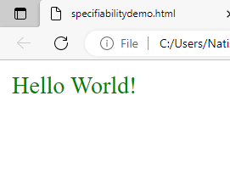
SPECIFICITY IN CSS
Specificity in CSS is decides which styles to apply when multiple styles are defined for the same element
i.e. if there are two or more CSS styles applied to the same element, then the selector with the highest specificity value will be applied to that HTML element.
[DIFFERENT SELECTRS are id selector(#), class selector(.), element selector, etc.]
<html>
<head>
<style>
.test {color: green;} /*class selector*/
p {color: red;} /*element selector */
</style>
</head>
<body>
<p class="test">Hello World!</p>
<!- - here the class selector is applied -- >
</body>
</html>

Slide 19
SPECIFICITY FOR DIFFETENT SELECTORS
//ID SELECTOR IS GIVEN HIGHER PRIORITY in [ID, CLASS, ELEMENT]
Ex1:
<html>
<head>
<style>
#demo {color: blue;} /* id selector */
.test {color: green;} /* class selector */
p {color: red;} /* element selector*/
</style>
</head>
<body>
<p id="demo" class="test">Hello World!</p>
</body>
</html>
//INLINE STYLE IS GIVEN THE HIGHEST PRIORITY IN [ID ,CLASS, ELEMENT, INLINE}
Ex 2.
<html>
<head>
<style>
#demo {color: blue;} /* id selector */
.test {color: green;} /* class selector */
p {color: red;} /* element selector*/
</style>
</head>
<body>
<p id="demo" class="test" style="color: pink;">Inline style</p>
<! - - inline selector is appled-->
</body>
</html>
Here we have added an inline style for the "p" element.
The text will now be pink, because the inline style is given the highest priority
Here ID selector is given higher priority, so Hello World will be displayed in Blue

Slide 20
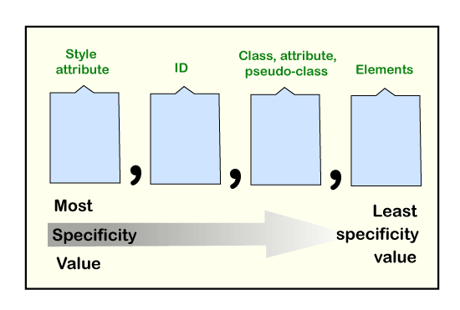
Specificity hierarchy
Each selector has a place in the hierarchy.
FOUR categories define the selector's specificity level:
PRIORITY 1: INLINE STYLES (highest priority)
Example: <h1 style="color: pink;">
PROORITY 2: ID SELECTOR (#)
- Example: #navbar
PROIRITY 3: CLASS SELECTOS, pseudo-classes, attribute selectors -
Example: .test, :hover, [href]
PRIORITY 4 ELEMENT SELECTOR and pseudo-elements -
Example: h1, ::before
INLINE
Id SELCEROT
CLASS SELCEROT
ELEMENT SELCEROT

Slide 21
CSS Pseudo-classes
A pseudo-class is used to define a special state of an element.
For example, it can be used to:
Style an element when a user mouses over it
Style visited and unvisited links differently
Style an element when it gets focus
/* unvisited link */ a:link { color: #FF0000; } /* visited link */ a:visited { color: #00FF00; } /* mouse over link */ a:hover { color: #FF00FF; } /* selected link */ a:active { color: #0000FF; }
selector:pseudo-class { property: value; }

Slide 22
Specificity rules
Equal specificity: the latest rule wins - If the same rule is written twice, then the latest(last) rule will be applied.
h1 {background-color: yellow;} h1 {background-color: red;} /* highest priority */
The specificity of class selector is greater than the element selectors
<style>
.intro {background-color: yellow;}
h1 {background-color: red;}
</style>
<body>
<h1 class="intro">This is a heading</h1>
</body>
The specificity of ID selectors is higher than attribute selectors
div#a {background-color: green;} /* highest priority */
#a {background-color: yellow;}
div[id=a] {background-color: blue;}
The universal selector (*) and inherited values have a specificity of 0 - The universal selector (*) and inherited values are ignored!

Slide 23
CSS Combinators
A combinator is something that explains the relationship between the selectors.
<div> <!-- Descendant selector-- >
<p>Para 1 in the div. It is descendant of div </p>
<p>Para 2 in the div. It is descendant of div </p>
<section> <p>Para3 in the div. it is descendant</p> </section>
</div>
FOUR DIFFERENT COMBINATORS IN CSS:
1. Descendant selector (space)
div p → <p> is descendant of <div>
2. child selector (>)
div > p --> <p> is child of <div>
3. adjacent sibling selector (+)
div + p ---> <p> is adjacent sibling of <div>
4. general sibling selector (~)
div ~ p --> <p> is general sibling selector
<div> <!-- child selector -->
<p>Para 1 in the div. it is child of div</p> → CHILD OF DIV
<p>Para 2 in the div. it is child of div </p> → CHILD OF DIV
<section> <p>Para 3 in the div. but not a child</p> </section>
</div>
<div> <!-- adjacent sibling selector -->
<p>Paragraph 1 in the div.</p>
<p>Paragraph 2 in the div.</p>
</div>
<p>Para 3. After a div. it is adjacent sibling</p> → ADJUSENT SIBLING
<div> <p>Paragraph 2.</p> </div> <!-- general sibling selector -->
<p>Paragraph 3.</p> → GENERAL SIBLING
<code>Some code.</code>
<p>Paragraph 4.</p> → GENERAL SIBLINE

Slide 24
CSS Combinators
1.DESCENDANT SELECTOR(SPACE)
The descendant selector matches all elements that are descendants of a specified element.
The example selects all <p> elements inside <div> elements:
<!– DESCENDANT SELECTOR -- >
<html>
<head>
<style>
div p /* p is descendant of div*/
{
background-color: yellow;
}
</style>
</head>
<body>
<div>
<p>Paragraph 1 in the div.</p>
<p>Paragraph 2 in the div.</p>
<section><p>Paragraph 3 in the div.</p></section>
</div>
</body>
</html?

Slide 25
CSS Combinators
2. Child Selector (>)
The child selector selects all elements that are the children of a specified element.
The example selects all <p> elements that are children of a <div> element:
Example
div > p
{ background-color: yellow; }
<style>
div > p /* p is child of div*/
{
background-color: yellow;
}
</style>
.
.
<div>
<p>Paragraph 1 in the div.</p>
<p>Paragraph 2 in the div.</p>
<section> <!-- not Child but Descendant -->
<p>Paragraph 3 in the div (inside a section element).</p>
</section>
<p>Paragraph 4 in the div.</p>
</div>

Slide 26
CSS Combinators
3. Adjacent Sibling Selector (+)
→used to select an element that is directly after another specific element.
Sibling elements must have the same parent element, and "adjacent" means "immediately following".
..
<div>
<p>Paragraph 1 in the div.</p>
<p>Paragraph 2 in the div.</p>
</div>
<p>Paragraph 3. After a div.</p>
<p>Paragraph 4. After a div.</p>
<div>
<p>Paragraph 5 in the div.</p>
<p>Paragraph 6 in the div.</p>
</div>
<p>Paragraph 7. After a div.</p>
<p>Paragraph 8. After a div.</p>
<p>Paragraph 1 in the div.</p>
<p>Paragraph 2 in the div.</p>
<section> <!-- not Child but Descendant -->
<p>Paragraph 3 in the div (inside a section element).</p>
</section>
<p>Paragraph 4 in the div.</p>
</div>
<style>
div + p /* p is adjacent sibling of div*/
{
background-color: yellow;
}
</style>

Slide 27
CSS chaining Selectors
Chaining selectors is a technique in CSS where multiple selectors are combined to apply styles to elements that meet all the specified criteria.
Chaining selectors uses the combinators.
.container > p /* chaining selector */
{
font-size: 24px;
}
<div class="container">
<p>Paragraph 1</p>
<p>Paragraph 2</p>
</div>
Ex.
.container > p ,
Applies on the p element that is a direct child of an element with class "container".
It applies a font size of 24px to the p element.

Slide 28
CSS chaining Selectors
.container p + ul li,
Applies style on the
<li> elements that are direct children of a <ul>
<uL> element that is adjacent sibling of <p> element
<P> that is a descendant of an element with class = "container".
It applies a red color to these li elements.
.container p + ul li
{
color: red;
}
<div class="container">
<h1>Title</h1>
<p>Paragraph 1</p>
<p>Paragraph 2</p>
<ul>
<li>List item 1</li>
<li>List item 2</li>
</ul>
</div>

Slide 29
CSS chaining Selectors
Chaining selectors can also be used with classes, IDs, and attribute selectors to target specific elements with a particular set of properties.
.container .special
{
font-weight: bold;
color: blue;
}
<div class="container">
<h1>Title</h1>
<p>Paragraph 1</p>
<p class="special">Paragraph 2</p>
</div>
.container .special
we first specify the parent element with a class of "container", then we specify the child element with a class of "special“
The style is applied on Paragraph2

Slide 30
Nested Elements in css
In CSS, nested elements refer to the use of selectors that are nested within other selectors to target specific elements within the HTML document.
Selectors can be nested using the parent-child relationship.
For example, you can target all <li> elements that are children of a ul element using the following selector:
ul li
<ul>
<li>Item 1</li>
<li>Item 2</li>
<li>
Item 3
<ul>
<li>Subitem 1</li>
<li>Subitem 2</li>
</ul>
</li>
</ul>
ul li ul li {
color: blue;
}

