Slide 1
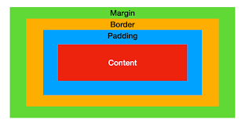
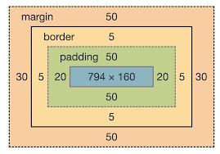
CSS Box Model
In CSS, the term "box model" is used when talking about design and layout.
The CSS box model is essentially a box that wraps around every HTML element.
It consists of: margins, borders, padding, and the actual content. The image below illustrates the box model:
Content - The content of the box, where text and images appear
Padding - Clears an area around the content. The padding is transparent
Border - A border that goes around the padding and content
Margin - Clears an area outside the border. The margin is transparent

Slide 2
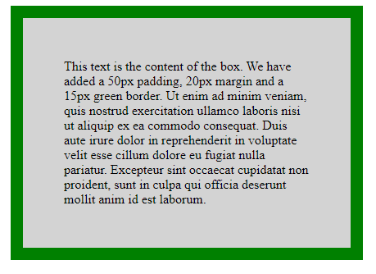
Demonstration of the box model
<!– box model -->
<html>
<head>
<style>
div
{
background-color: lightgrey;
width: 300px;
border: 15px solid green;
padding: 50px;
margin: 20px;
}
</style>
</head>
<body>
<h2>Demonstrating the Box Model</h2>
<div>
This text is the content of the box. We have added a 50px padding, 20px margin and a 15px green border.
This text is the content of the box. We have added a 50px padding, 20px margin and a 15px green border.
This text is the content of the box. We have added a 50px padding, 20px margin and a 15px green border.
</div>
</body>
</html>

Slide 3
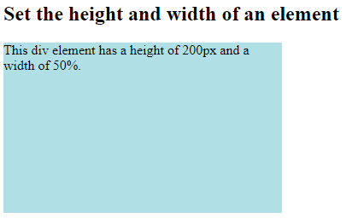
CSS Height, Width and Max-width
The CSS height and width properties are used to set the height and width of an element.
The CSS max-width property is used to set the maximum width of an element.
This element has a height of 50 pixels and a width of 100%.
div {
height: 200px;
width: 50%;
background-color: aqua;
max-width: fit-content;
}
<body>
<h2>Set the height and width of an element</h2>
<div>This div element has a height of 200px and a width of 50%.</div>
</body>

Slide 4
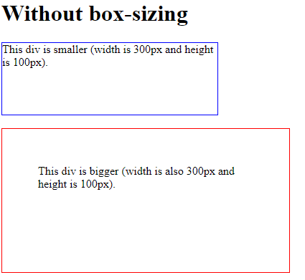
CSS Box Sizing
The CSS box-sizing property allows us to include the padding and border in an element's total width and height.
Without the CSS box-sizing Property:
By default, the width and height of an element is calculated like this:
width + padding + border = actual width of an element
height + padding + border = actual height of an element
.div1 {
width: 300px;
height: 100px;
border: 1px solid blue;
}
.div2 {
width: 300px;
height: 100px;
padding: 50px;
border: 1px solid red;
}

Slide 5
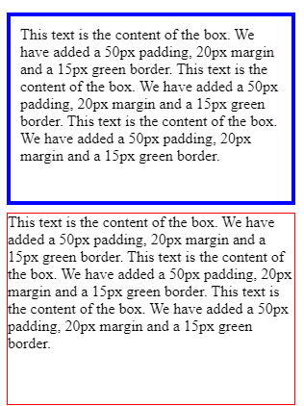
With the CSS box-sizing Property
The box-sizing property allows us to include the padding and border in an element's total width and height.
If you set box-sizing: border-box; on an element, padding and border are included in the width and height:
.div1 {
width: 300px;
height: 200px;
border: 1px solid blue;
padding: 10px;
border-width: 3pt;
box-sizing: border-box;
}
.div2 {
width: 300px;
height: 200px;
margin-top: inherit;
border: 1px solid red;
box-sizing: border-box;
}

Slide 6
Border Radius
The CSS box model includes the border radius property, which allows you to specify the curvature of the corners of an element's border.
Specify the value for this property in several ways, including:
A single value → sets the same radius for all four corners of the border.
Two values → set different radii for the top and bottom corners and the left and right corners.
Four values → set different radii for each individual corner of the border.
SINGLE VALUE
For example, to set a border radius of 10 pixels for all corners of an element's border, you would use the following CSS code:
TWO VALUES
To set different radii for the top and bottom corners, and the left and right corners, you would use two values like this:
border-radius: 10px 20px;
border-radius: 10px;
FOUR VALUES
This would set a radius of 10 pixels for the top and bottom corners, and a radius of 20 pixels for the left and right corners.
border-radius: 10px 20px 30px 40px;

Slide 7
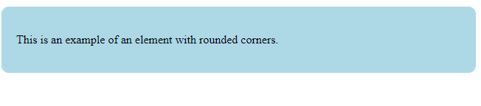
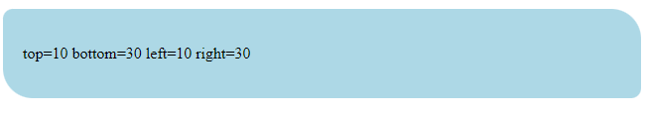
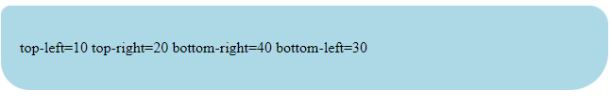
<!– box model with border radius-->
<html>
<head>
<title>Border Radius Example</title>
<style>
.box {
background-color: lightblue;
padding: 20px;
border-radius: 10px;
}
</style>
</head>
<body>
<div class="box">
<p>This is an example of an element with rounded corners.</p>
</div>
</body>
</html>
.box1 {
background-color: lightblue;
padding: 20px;
border-radius: 10px 30px;
/*top=10 bottom=30 left=10 right=30*/
}
.box3 {
background-color: lightblue;
padding: 20px;
border-radius: 10px 20px 40px 30px;
}

Slide 8
Padding
In CSS, the padding property is used to add space between an element's content and its border.
The padding property can be applied to any HTML element, including text, images, and containers.
The padding property can be set in several ways:
padding: value; sets the same padding value for all four sides of the element.
padding: vertical horizontal; sets the padding value for the top and bottom, and left and right sides of the element separately.
padding: top right bottom left; sets the padding value for each side of the element separately.
Ex.
padding: 10px;
→ add 10 pixels of padding to the top, bottom, left, and right sides of the element.
Ex.
padding: 10px 20px
add 10 pixels of padding to the top and bottom,
20 pixels of padding to the left and right.
Ex.
padding: 10px 20px 30px 40px
→add 10 pixels of padding to the top,
20 pixels of padding to the right,
30 pixels of padding to the bottom
40 pixels of padding to the left

Slide 9


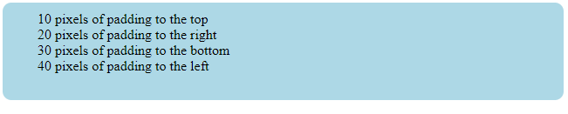
<!-- box model with padding-->
<html>
<head>
<style>
.box3
{
background-color: lightblue;
padding: 20px;
border-radius: 10px;
}
</style>
</head>
<body>
<div class="box3">
padding 20px for all sides
i.e. top, bottom, left and right
</div>
</body>
</html>
.box3
{
background-color: lightblue;
padding: 10px 20px;
border-radius: 10px;
}
.box3
{ background-color: lightblue;
padding: 10px 20px 30px 40px;
border-radius: 10px;
}

Slide 10
Margins
In CSS, the margin property is used to add space between an element's border and the adjacent elements
The margin property can be applied to any HTML element, including text, images, and containers.
The margin property can be set in several ways:
margin: value; sets the same margin value for all four sides of the element
margin: vertical horizontal; sets the margin value for the top and bottom, and left and right sides of the element separately..
margin: top right bottom left; sets the margin value for each side of the element separately.
For example,
margin: 10px;
→ add 10 pixels of margin to the top, bottom, left, and right sides of the element.
For example,
margin: 10px 20px;
add 10 pixels to the top and bottom,
20 pixels to the left and right.
For example,
margin: 10px 20px 30px 40px;
add 10 pixels of margin to the top,
20 pixels of margin to the right,
30 pixels of margin to the bottom, and
40 pixels of margin to the left.

Slide 11
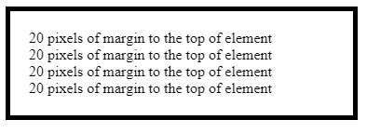
<!-- box model with margin->
<html>
<head>
<style>
.box {
border: 5px solid black;
padding: 20px;
margin: 20px;
}
</style>
</head>
<body>
<div class="box">
20 pixels of margin to the top, bottom, left and righ of element<br>
</div>
</body>
</html>

Slide 12
auto margin
The auto value for the margin property can be used to horizontally center an element within its parent container.
Here's an example of how to use margin: auto to center an element horizontally:
In this example, we have defined a <div> element with a class of "box".
margin: auto;
.box {
background-color: lightblue;
padding: 20px;
margin: auto;
width: 50%;
}
<!– auto margin demo->
<html>
<head>
<title>Auto Margin Example</title>
<style>
</style>
</head>
<body>
<div class="box">
<p>This is an example of an element centered using auto margins.</p>
</div>
</body>
</html>

Slide 13
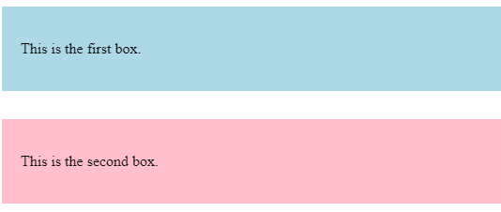
Margin collapse
In CSS, margin collapse is a behavior where adjacent margins between two elements collapse into a single margin.
This can affect the layout of elements in unexpected ways
Ex. Here two <div>elements with different background colors, padding, and margins.
The first <div> has a margin-bottom of 20 pixels,
second <div>element has a margin-top of 30 pixels.
<html>
<head> <style>
.box1 {
background-color: lightblue;
margin-bottom: 20px;
padding: 20px;
}
.box2 {
background-color: pink;
margin-top: 30px;
padding: 20px;
}
</style>
</head>
<body>
<div class="box1">
<p>This is the first box.</p>
</div>
<div class="box2">
<p>This is the second box.</p>
</div> </body>
</html>

Slide 14
Margin collapse
<html>
<head> <style>
.box1 {
background-color: lightblue;
margin-bottom: 20px;
padding: 20px;
}
.box2 {
background-color: pink;
margin-top: 30px;
padding: 20px;
}
</style>
</head>
<body>
<div class="box1">
<p>This is the first box.</p>
</div>
<div class="box2">
<p>This is the second box.</p>
</div> </body>
</html>
Here the margin between the two boxes is not the sum (20px + 30px = 50px), but instead is the max value of the two margins (30px).
This is because the margins have collapsed into a single margin between the two boxes.
Margin collapse can occur in other situations as well, such as between siblings, or between a parent and its first or last child element.
To prevent margin collapse, you can use techniques such as setting a padding value on the parent element, or using a border or outline property.

Slide 15
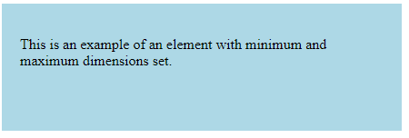
Minimum and Maximum Height and Width
In CSS, the min-height, max-height, min-width, and max-width properties can be used to set minimum and maximum dimensions for an element in the box model.
We have set the min-height property to 100px and the max-height property to 300px.
We have also set the min-width property to 200px and the max-width property to 400px.
<html>
<head>
<title>Minimum and Maximum Dimensions Example</title>
<style>
.box {
background-color: lightblue;
padding: 20px;
min-height: 100px;
max-height: 300px;
min-width: 200px;
max-width: 400px;
}
</style>
</head>
<body>
<div class="box">
<p>This is an example of an element with minimum and maximum dimensions set.</p>
</div> </body>
</html>

Slide 16
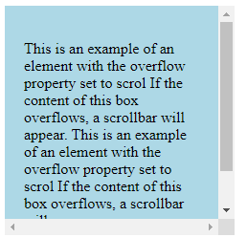
Overflow
In CSS, the overflow property is used to control what happens when the content of an element overflows its allocated space within the box model.
Here are some possible values for the overflow property:
scroll: Content that overflows is clipped, and a scrollbar is added to allow scrolling to see the rest of the content.
<!DOCTYPE html>
<html>
<head>
<title>Overflow Example</title>
<style>
.box {
background-color: lightblue;
padding: 20px;
width: 200px;
height: 200px;
overflow: scroll;
}
</style>
</head>
<body> <div class="box">
<p>This is an example of an element with the overflow property set to scroll. If the content of this box overflows, a scrollbar will appear.</p>
</div>
</body>
</html>

Slide 17
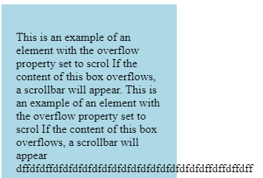
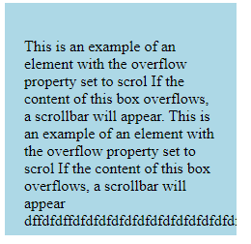
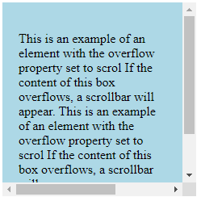
Overflow
visible: This is the default value. Content overflows outside the box model and can overlap other elements.
overflow:visible:
hidden: Content that overflows is clipped and not visible outside the box model.
overflow: hidden;
auto: Content that overflows is clipped and a scrollbar is added only if necessary.
overflow: auto;

Slide 18
Resetting Defaults
/* CSS Reset */
html, body, div, span, applet, object, iframe,
h1, h2, h3, h4, h5, h6, p, blockquote, pre,
a, abbr, acronym, address, big, cite, code,
del, dfn, em, img, ins, kbd, q, s, samp,
small, strike, strong, sub, sup, tt, var,
b, u, i, center,
dl, dt, dd, ol, ul, li,
fieldset, form, label, legend,
table, caption, tbody, tfoot, thead, tr, th, td {
margin: 0;
padding: 0;
border: 0;
font-size: 100%;
font: inherit;
vertical-align: baseline;
}
Resetting defaults in CSS can be achieved by using a CSS reset stylesheet.
A CSS reset stylesheet is a set of CSS rules that are designed to reset or override the default styles applied by browsers to HTML elements.
Here's an example of a simple CSS reset stylesheet:
/* HTML5 display-role reset for older browsers */
article, aside, details, figcaption, figure,
footer, header, hgroup, menu, nav, section {
display: block;
}
body { /* Body styles */
line-height: 1;
}
a {/* Links */
color: #000;
text-decoration: none;
}
a:hover {
text-decoration: underline;
}

Slide 19
Visibility
The visibility property in CSS is used to control the visibility of an element.
The visibility property can have the following values:
visible: The element is visible.
hidden: The element is hidden, but still takes up space.
collapse: Only for table elements. The row or column is removed from the table layout and the space is made available for other content.
<!DOCTYPE html>
<html>
<head>
<title>Visibility Example</title>
<style>
.box {
background-color: lightblue;
padding: 20px;
width: 200px;
height: 200px;
visibility: hidden;
}
</style>
</head>
<body>
<div class="box">
<p>This is an example of an element with the visibility property set to hidden. The element is hidden, but still takes up space.</p>
</div>
</body>
</html>

Slide 20
Visibility
In this example we set the visibility property to hidden.
When you view this code in a web browser, you will see a box with light blue background color and 20 pixels of padding, but there will be no content visible inside the box.
This is because the visibility property has been set to hidden, which hides the content of the element but still takes up space.
<!DOCTYPE html>
<html>
<head>
<title>Visibility Example</title>
<style>
.box {
background-color: lightblue;
padding: 20px;
width: 200px;
height: 200px;
visibility: hidden;
}
</style>
</head>
<body>
<div class="box">
<p>This is an example of an element with the visibility property set to hidden. The element is hidden, but still takes up space.</p>
</div>
</body>
</html>

