Slide 1
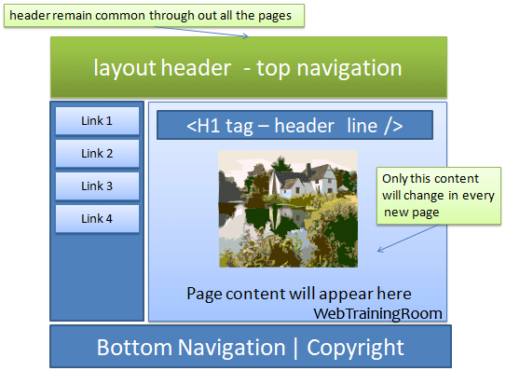
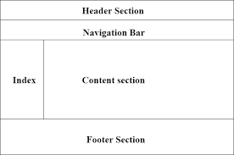
Basic Layout
The HTML Layouts specifies the arrangement of components on an HTML web page

Slide 2
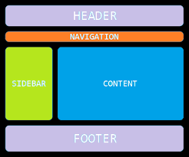
Basic Layout
HTML Layout Elements:
<header> - Defines a header for a document
<nav> - Defines a set of navigation links
<section> - Defines a section in a document
<footer> - Defines a footer for a document
<article> - Defines an independent, self-contained content
<aside> - Defines content aside from the content (like a sidebar)
<details> - Defines additional details that the user can open and close on demand
<summary> - Defines a heading for the <details> element

Slide 3

Basic Layout
<header> - Defines a header for a document or a section
The <header> element is used to create header section of web pages. The header contains the introductory content, heading element, logo or icon for the webpage, and authorship information.
<!DOCTYPE html>
<html>
<head>
<title>First Webpage</title>
</head>
<body>
<header style="background-color: #303030; height: 80px;width:
100%">
<h1 style="font-size: 30px; color: white;text-align: center; padding-top: 15px;">
Welcome to MyFirstWebpage</h1>
</header>
</body>
</html>

Slide 4
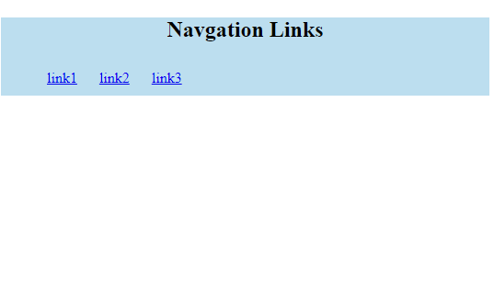
Basic Layout
HTML <nav>
The <nav> elements is a container for the main block of navigation links.
It can contain links for the same page or for other pages.
<html>
<body>
<nav style="background-color:#bcdeef;">
<h1 style="text-align: center;">Navgation Links</h1>
<ul>
<li style="display: inline-block; padding: 10px;">
<a href="#">link1</a>
</li>
<li style="display: inline-block; padding: 10px;">
<a href="#">link2</a>
</li>
<li style="display: inline-block; padding: 10px;">
<a href="#">link3</a>
</li>
</ul>
</nav>
</body>
</html

Slide 5
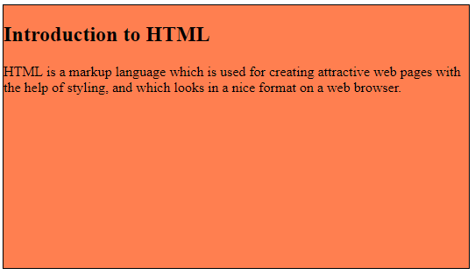
Basic Layout
HTML <section>
HTML <section> elements represent a separate section of a web page which contains related element grouped together.
It can contain: text, images, tables, videos, etc
<!DOCTYPE html>
<html>
<head>
<title>Page Section</title>
</head>
<body>
<section style="background-color:#ff7f50; height:300px;width: 100%; border: 1px solid black;">
<h2>Introduction to HTML</h2>
<p>HTML is a markup language which is used for creating attractive web pages with the help of styling, and which looks in a nice format on a web browser.</p>
</section>
</body>
</html>

Slide 6

Basic Layout
HTML <footer>
HTML <footer> element defines the footer for that document or web page.
It mostly contains information about author, copyright, other links, etc.
<!DOCTYPE html>
<!DOCTYPE html>
<html>
<head>
<title>Footer Section</title>
</head>
<body>
<footer style="background-color:#f0f8ff; width: 100%; text-align: center;">
<h3>Footer Example</h3>
<p>© Copyright 2022-2023. </p>
</footer>
</body>
</html>

Slide 7

Basic Layout
HTML <aside>
HTML <aside> define aside content related to primary content. The <aside> content must be related to the primary content. It can function as side bar for the main content of web page.
<!DOCTYPE html>
<html>
<head>
<title>Aside Example</title>
</head>
<body>
<aside style="background-color:#e6e6fa">
<h2>Sidebar information</h2>
<p>This conatins information which will represent like a side bar for a webpage</p>
</aside>
</body>
</html>

Slide 8
Flow of HTML
In HTML, the flow refers to the way elements are positioned and arranged on a web page.
The flow of element → the order in which they appear in the HTML document and the type of positioning applied to them.
The default flow → normal flow, and it follows a top-to-bottom, left-to-right order.
In this flow, ELEMENTS ARE POSITIONED ONE AFTER ANOTHER, starting from the top-left corner to bottom- right as necessary.
HTML elements can be positioned in following ways:
Static: Elements are positioned in the normal flow of the page.
Relative: Elements are positioned relative to their normal position in the flow. They can be moved up, down, left, or right using the top, bottom, left, and right properties.
Absolute: Elements are positioned relative to their nearest positioned ancestor.
Z-index: The z-index property specifies the stack order of an element.

Slide 9
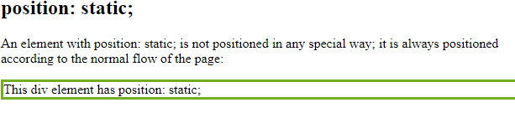
Flow of HTML- static flow
i). position: static;
HTML elements are positioned static by default.
Static positioned elements are not affected by the top, bottom, left, and right properties.
An element with position: static; is not positioned in any special way; it is always positioned according to the normal flow of the page:
This <div> element has position: static
<html>
<head>
<style>
div.static {
position: static;
border: 3px solid #73AD21;
}
</style>
</head>
<body>
<h2>position: static;</h2>
<p>An element with position: static; is not positioned in any special way; it is always positioned according to the normal flow of the page:</p>
<div class="static">
This div element has position: static;
</div>
</body>
</html>

Slide 10
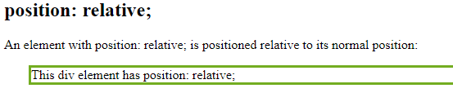
Flow of HTML- static flow
ii). position: relative;
positioned relative to its normal position.
We can set relative positions top, right, bottom, and left
These properties of a relatively-positioned element will cause it to be adjusted away from its normal position.
<html>
<head>
<style>
div.relative {
position: relative;
left: 30px;
border: 3px solid #73AD21;
}
</style>
</head>
<body>
<h2>position: relative;</h2>
<p>An element with position: relative; is positioned relative to its normal position:</p>
<div class="relative">
This div element has position: relative;
</div>
</body>
</html>

Slide 11
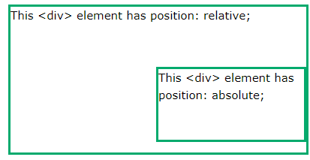
Flow of HTML
iii). position: absolute;
An element with position: absolute; is positioned relative to the nearest positioned ancestor.
However; if an absolute positioned element has no positioned ancestors, it uses the document body, and moves along with page scrolling.
Absolute positioned elements are removed from the normal flow, and can overlap elements.
<html>
<head>
<style>
div.relative {
position: relative; width: 400px;
height: 200px; border: 3px solid #73AD21;
}
div.absolute {
position: absolute; top: 80px; right: 0; width: 200px;
height: 100px; border: 3px solid #73AD21;
}
</style>
</head>
<body>
<h2>position: absolute;</h2>
<div class="relative">This div element has position: relative;
<div class="absolute">This div element has position: absolute;</div>
</div>
</body>
</html>

Slide 12

Flow of HTML
iv). The z-index Property
When elements are positioned, they can overlap other elements.
The z-index property specifies the stack order of an element (which element should be placed in front of, or behind, the others).
An element can have a positive or negative stack order.
<html>
<head>
<style>
img {
position: absolute;
left: 0px;
top: 0px;
z-index: -1;
}
</style>
</head>
<body>
<h1>This is a heading</h1>
<img src="img_tree.png">
<p>Because the image has a z-index of -1, it will be placed behind the text.</p>
</body>
</html>

Slide 13
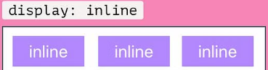
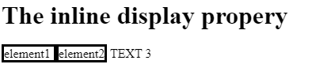
INLINE DISPLAY -- display: inline
Inline display in HTML refers to a way of displaying an element on a web page, where the element is displayed on the same line as its adjacent content.
Displays an element as an inline element (like <span>). Any height and width properties will have no effect
To set an element to display inline in HTML, you can use the CSS "display" property and set its value to "inline"
display:inline
<html>
<head>
<style>
.in {
display: inline;
border-style: solid;
}
</style>
</head>
<body>
<h1>The inline display propery</h1>
<p class="in">element1 </h2>
<p class="in">element2</p> TEXT 3
</div>
</body>
</html>

Slide 14
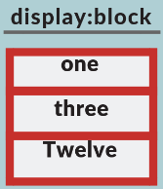
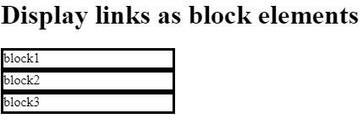
BLOCK DISPLAY -- display: block
A block-level display always starts on a new line and takes up the full width available (stretches out to the left and right as far as it can).
<html>
<head>
<style>
div{
display:block;
height: 20px;
width: 200px;
border-style: solid;
}
</style>
</head>
<body>
<h1>Display links as block elements</h1>
<div>block1</div>
<div>block2</div>
<div>block3</div>
</body>
</html>
Examples of block-level elements:
<div>
<h1> - <h6>
<p>
<form>
<header>
<footer>
<section>

Slide 15
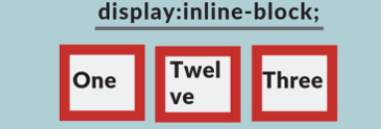
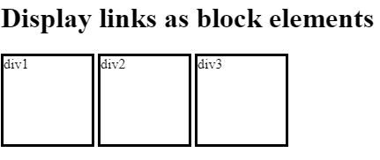
INLIE-BLOCK DISPLAY- display: inline-block
Element is displayed as an inline-level element, with a width, height, margin, and padding like a block-level element
<html>
<head>
<style>
div {
display: inline-block;
height:100px;
width:100px;
border-style:solid;
}
</style>
</head>
<body>
<h1>Display links as block elements</h1>
<div> div1
</div>
<div>div2</div>
<div>div3</div>
</body>
</html>

Slide 16
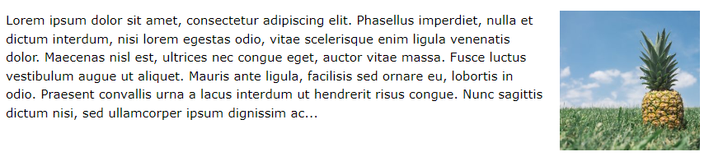
CSS Layout - float and clear
The CSS float property specifies how an element should float.
The float Property
The float property is used for positioning and formatting content
e.g. let an image float left to the text in a container.
FLAOT PROPERY VAUES :
left - The element floats to the left of its container
right - The element floats to the right of its container
none - The element does not float . This is default
inherit - The element inherits the float value of its parent
float: right;

Slide 17

Float right
<html>
<head>
<style>
img {
float: right;
}
</style>
</head>
<body>
<h2>Float Right</h2>
<p><img src="flower1.jpg" alt=“Flower"
style="width:170px;height:170px;margin-left:15px;">
some textdffdffdafdffdafdasffdsafdsfdsfadsffdsfdffdfsdfdfsdfd
Dfdfsdfsdffasdfdsfsdfsdfsdfsdfsdfsdfdffdsfdsafsdafdasfsdfads
Fads dfdasfdsfsdfdf</p>
</body>
</html>

Slide 18
CSS Layout - clear
The CSS float property specifies how an element should float.
The float Property
The float property is used for positioning and formatting content
e.g. let an image float left to the text in a container.
FLAOT PROPERY VAUES :
left - The element floats to the left of its container
right - The element floats to the right of its container
none - The element does not float . This is default
inherit - The element inherits the float value of its parent
float: right;

Slide 19
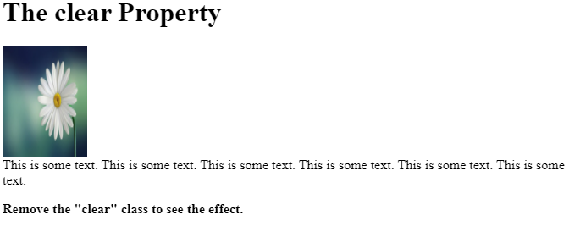
CSS Layout - float and clear
The clear property controls the flow next to floated elements.
The clear property specifies what should happen with the element that is next to a floating element.
<html>
<head>
<style>
img {
float: left;
}
p.clear {
clear: left;
}
</style>
</head>
<body>
<h1>The clear Property</h1>
<img src=“flower1.jpeg" width="100" height="132">
<p class="clear">
This is some text. This is some text. This is some text. This is some text. This is some text. This is some text.</p>
<p><strong>Remove the "clear" class to see the effect.</strong></p>
</body>
</html>

