Slide 1
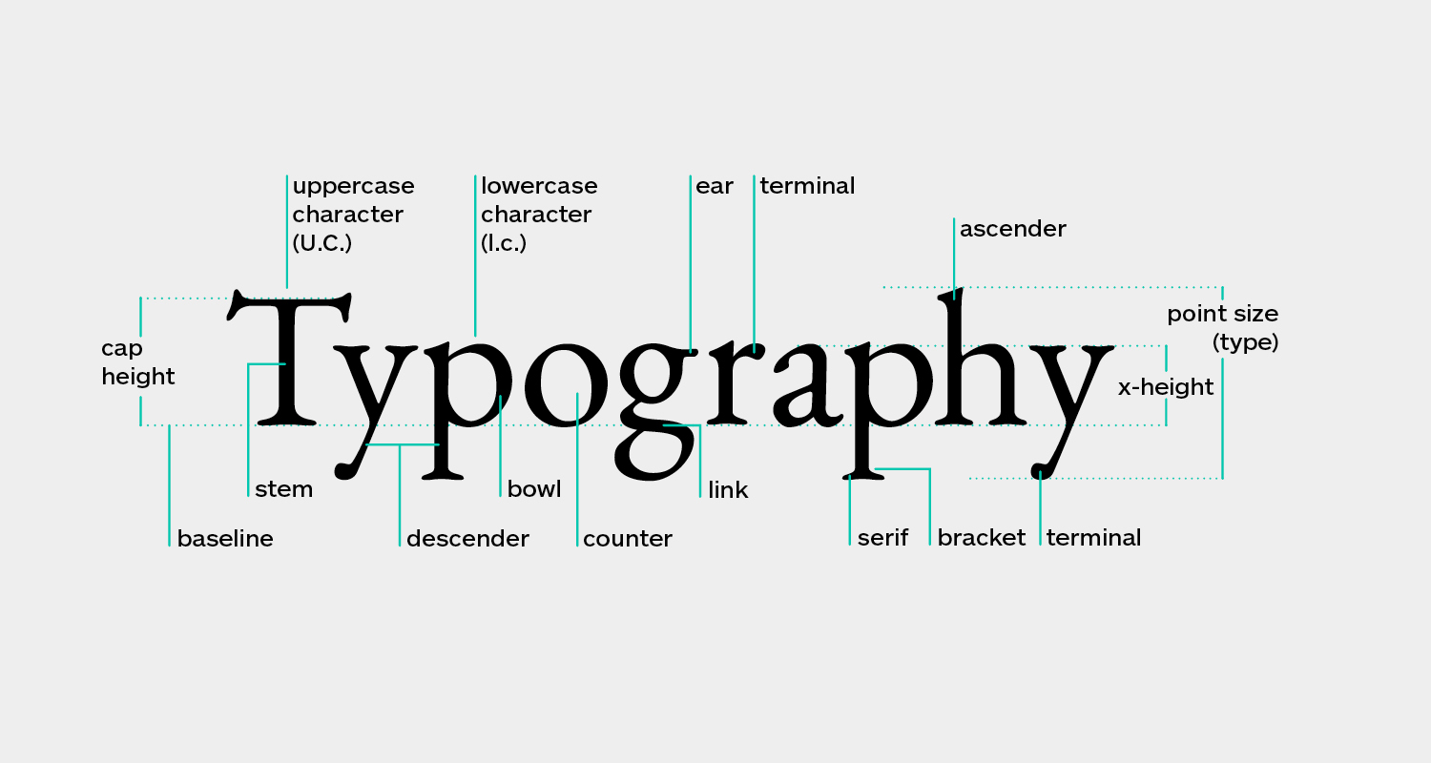
Typography
Typography →arrangement of text to make written language legible, readable and appealing when displayed.
The arrangement of type involves selecting typefaces, point sizes, line lengths, line-spacing, and letter-spacing, as well as adjusting the space between pairs of letters.

Slide 2
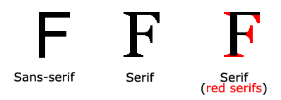

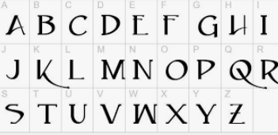
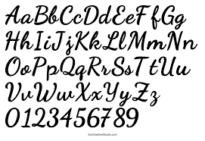
CSS Fonts
In CSS there are FIVE generic font families:
Serif fonts have a small stroke at the edges of each letter. They create a sense of formality and elegance.
2) Sans-serif fonts have clean lines (no small strokes attached). They create a modern and minimalistic look.
3) Monospace fonts - here all the letters have the same fixed width. They create a mechanical look.
4) Cursive fonts imitate human handwriting.
5)Fantasy fonts are decorative/playful fonts.

Slide 3
CSS Fonts
Generic Font Family | Examples of Font Names
Serif | Times New Roman Georgia Garamond
Sans-serif | Arial Verdana Helvetica
Monospace | Courier New Lucida Console Monaco
Cursive | Brush Script MT Lucida Handwriting
Fantasy | Copperplate Papyrus

Slide 4
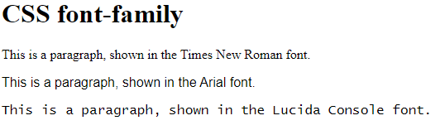
CSS Fonts font-family
The CSS font-family Property
In CSS, we use the font-family property to specify the font of a text.
.p1 {
font-family: "Times New Roman", Times, serif;
}
.p2 {
font-family: Arial, Helvetica, sans-serif;
}
.p3 {
font-family: "Lucida Console", "Courier New", monospace;
}
</style>
“Arial" is a sans-serif font-family name
"Helvetica" is a similar sans-serif font used as a fallback option in case "Arial" is not available on a particular system;
"Sans-serif" is a generic font family that includes all sans-serif fonts.

Slide 5
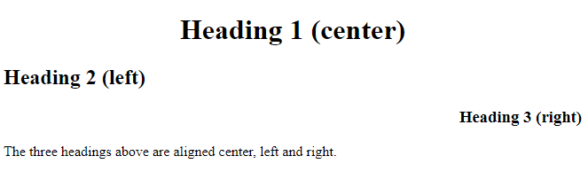
Text Alignment
<html>
<head>
<style>
h1 {
text-align: center;
}
h2 {
text-align: left;
}
h3 {
text-align: right;
}
</style>
</head>
<body>
<h1>Heading 1 (center)</h1>
<h2>Heading 2 (left)</h2>
<h3>Heading 3 (right)</h3>
<p>The three headings above are aligned center, left and right.</p>
</body>
</html>
The text-align property is used to set the horizontal alignment of a text.
A text can be left or right aligned, centered, or justified.

Slide 6
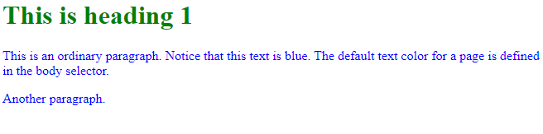
Text Color
<html>
<head>
<style>
body {
color: blue;
}
h1 {
color: green;
}
</style>
</head>
<body>
<h1>This is heading 1</h1>
<p>This is an ordinary paragraph. Notice that this text is blue. The default text color for a page is defined in the body selector.</p>
<p>Another paragraph.</p>
</body>
</html>
The color property is used to set the color of the text. The color is specified by:
a color name - like "red"
a HEX value - like "#ff0000"
an RGB value - like "rgb(255,0,0)"

Slide 7
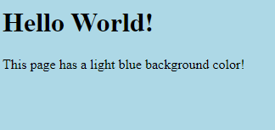
CSS Backgrounds :background-color
<!DOCTYPE html>
<html>
<head>
<style>
body {
background-color: lightblue;
}
</style>
</head>
<body>
<h1>Hello World!</h1>
<p>This page has a light blue background color!</p>
</body>
</html>
CSS background-color
The background-color property specifies the background color of an element.
With CSS, a color is most often specified by:
a valid color name - like "red"
a HEX value - like "#ff0000"
an RGB value - like "rgb(255,0,0)"

Slide 8
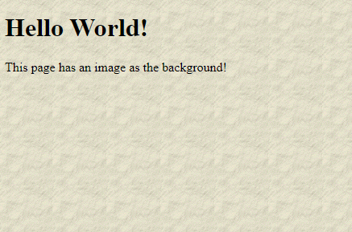
CSS Background Image
<!DOCTYPE html>
<html>
<head>
<style>
body {
background-image: url("paper.gif");
}
</style>
</head>
<body>
<h1>Hello World!</h1>
<p>This page has an image as the background!</p>
</body>
</html>
The background-image property specifies an image to use as the background of an element.
By default, the image is repeated so it covers the entire element.

Slide 9
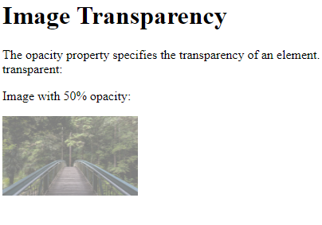
CSS Opacity / Transparency
<html>
<head>
<style>
img {
opacity: 0.5;
}
</style>
</head>
<body>
<h1>Image Transparency</h1>
<p>The opacity property specifies the transparency of an element. The lower the value, the more transparent:</p>
<p>Image with 50% opacity:</p>
<img src="img_forest.jpg" alt="Forest" width="170" height="100">
</body>
</html>
The opacity property specifies the opacity/transparency of an element.
The opacity property can take a value from 0.0 - 1.0. The lower the value, the more transparent:

Slide 10
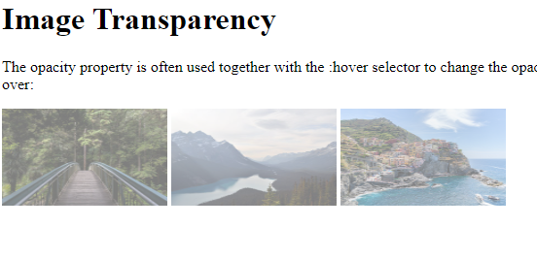
Transparent Hover Effect
<html>
<head>
<style>
img {
opacity: 0.5;
}
img:hover {
opacity: 1.0;
}
</style>
</head>
<body>
<h1>Image Transparency</h1>
<p>The opacity property is often used together with the :hover selector to change the opacity on mouse-over:</p>
<img src="img_forest.jpg" alt="Forest" width="170" height="100">
<img src="img_mountains.jpg" alt="Mountains" width="170" height="100">
<img src="img_5terre.jpg" alt="Italy" width="170" height="100">
</body>
</html>
The opacity property is often used together with the :hover selector to change the opacity on mouse-over:

Slide 11
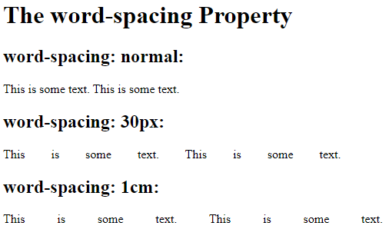
Word Spacing
<html>
<head>
<style>
p.a {
word-spacing: normal;
}
p.b {
word-spacing: 30px;
}
p.c {
word-spacing: 1cm;
}
</style>
</head>
<body>
<h1>The word-spacing Property</h1>
<h2>word-spacing: normal:</h2>
<p class="a">This is some text. This is some text.</p>
<h2>word-spacing: 30px:</h2>
<p class="b">This is some text. This is some text.</p>
<h2>word-spacing: 1cm:</h2>
<p class="c">This is some text. This is some text.</p>
</body>
</html>
The word-spacing property increases or decreases the white space between words.

Slide 12
LETTER-SPACING
<html>
<head>
<style>
h1 {
letter-spacing: 3px;
}
h2 {
letter-spacing: 2px;
}
h3 {
letter-spacing: -1px;
}
</style>
</head>
<body>
<h1>This is heading 1</h1>
<h2>This is heading 2</h2>
<h3>This is heading 3</h3>
</body>
The letter-spacing property increases or decreases the space between characters in a text.

Slide 13
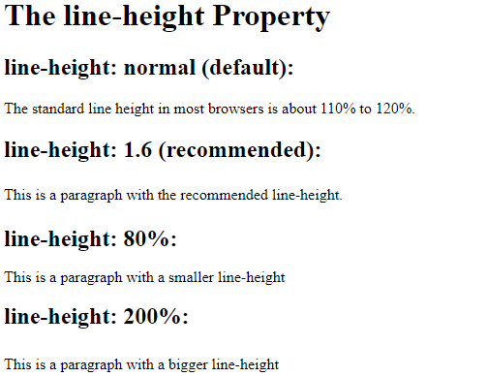
CSS line-height Property
<html>
<head>
<style>
div.a {
line-height: normal;
}
div.b {
line-height: 1.6;
}
div.c {
line-height: 80%;
}
div.d {
line-height: 200%;
}
</style>
</head>
The line-height property specifies the height of a line.
<body>
<h2>line-height: normal (default):</h2>
<div class="a">
The standard line height in most browsers is about 110% to 120%.</div>
<h2>line-height: 1.6 (recommended):</h2>
<div class="b">This is a paragraph with the recommended line-height.<br>
</div>
<h2>line-height: 80%:</h2>
<div class="c">This is a paragraph with a smaller line-height</div>
<h2>line-height: 200%:</h2>
<div class="d">This is a paragraph with a bigger line-height</div>
</body>
</html>

Slide 14
CSS @font-face Rule
<html>
<head>
<style>
@font-face {
font-family: myFirstFont;
src: url(sansation_light.woff);
}
div {
font-family: myFirstFont;
}
</style>
</head>
<body>
<h1>The @font-face Rule</h1>
<div>With CSS, websites can finally use fonts other than the pre selected "web-safe" fonts.</div>
</body>
</html>
With the @font-face rule, web designers do not have to use one of the "web-safe" fonts anymore.
In the @font-face rule you must first define a name for the font (e.g. myFirstFont), and then point to the font file.
To use the font for an HTML element, refer to the name of the font (myFirstFont) through the font-family property:

Slide 15
Linking Fonts
<html>
<head>
<style>
@font-face {
font-family: myFirstFont;
src: url(sansation_light.woff);
}
* {
font-family: myFirstFont;
}
</style>
</head>
<body>
<h1>The @font-face Rule</h1>
<div>
With CSS, websites can use fonts other than the pre-selected "web-safe" fonts.
</div>
</body>
</html>
The CSS @font-face used to link external fonts
Web fonts allow Web designers to use fonts that are not installed on the user's computer.

Slide 16
CSS @font-face Rule
<html>
<head>
<style>
@font-face {
font-family: myFirstFont;
src: url(sansation_light.woff);
}
div {
font-family: myFirstFont;
}
</style>
</head>
<body>
<h1>The @font-face Rule</h1>
<div>With CSS, websites can finally use fonts other than the pre selected "web-safe" fonts.</div>
</body>
</html>
With the @font-face rule, web designers do not have to use one of the "web-safe" fonts anymore.
In the @font-face rule you must first define a name for the font (e.g. myFirstFont), and then point to the font file.
To use the font for an HTML element, refer to the name of the font (myFirstFont) through the font-family property:

