Slide 1
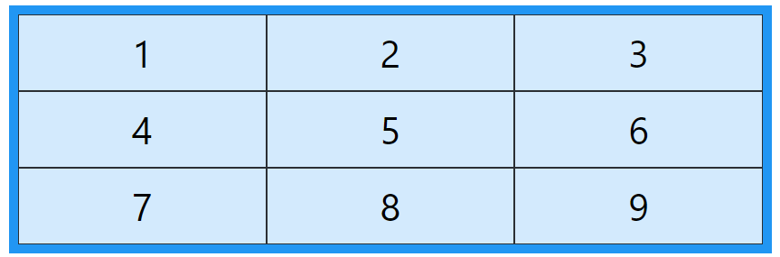

CSS Grid
A grid can be defined as an intersecting set of horizontal lines and vertical lines.
CSS Grid layout divides a page into major regions.
CSS grid is a two-dimensional layout system that allows you to create rows and columns.
You can define the grid using the grid-template-columns and grid-template-rows properties.
These properties allow you to specify the size and number of columns and rows in your grid

Slide 2
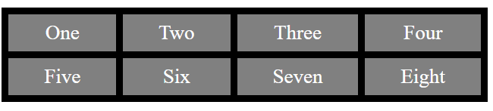
Grid Container
We can define the grid container by setting the display property to grid or inline-grid on an element.
Ex. a grid container with four rows and four columns, where the size of the rows and columns is determined automatically by the content within them.
</head>
<body>
<div class="main">
<div>One</div>
<div>Two</div>
<div>Three</div>
<div>Four</div>
<div>Five</div>
<div>Six</div>
<div>Seven</div>
<div>Eight</div>
</div>
</body>
</html>
<html> <head> <style>
.main {
display: grid;
grid: auto auto / auto auto auto auto;
grid-gap: 10px;
background-color: black;
padding: 10px;
}
div{
background-color: grey;
text-align: center;
color: white;
padding: 10px 10px;
font-size: 30px;
} </style>

Slide 3
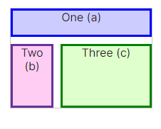
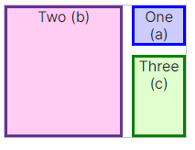
CSS “grid-template Property”
The grid-template CSS property is a shorthand property for defining grid columns, grid rows, and grid areas.
The grid-template property is a shorthand property for the following properties:
1) grid-template-areas - used to specify the grid layout by using the named items.
2) grid-template-rows - used to specify the row size.
3) grid-template-columns - used to specify the size of the columns.
1) grid-template-areas
The grid-template-areas CSS property specifies named grid areas, establishing the cells in the grid and assigning them names.
grid-template-areas:
"a a a"
"b c c"
"b c c";
grid-template-areas: "b b a“
"b b c"
"b b c";

Slide 4
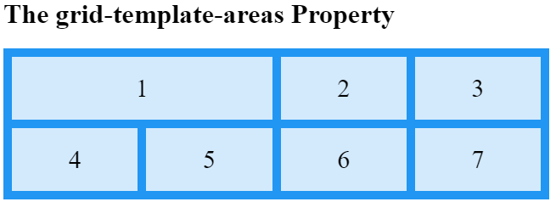
CSS “grid-template Property”
<html>
<head>
<style>
.item1 {
grid-area: myArea;
}
.grid-container {
display: grid;
grid-template-areas: ' myArea myArea . . ';
grid-gap: 10px;
background-color: #2196F3;
padding: 10px;
}
div {
background-color: cyan
text-align: center;
padding: 20px 0;
font-size: 30px;
}
</style>
</head>
<body>
<h1>The grid-template-areas Property</h1>
<div class="grid-container">
<div class="item1">1</div>
<div class="item2">2</div>
<div class="item3">3</div>
<div class="item4">4</div>
<div class="item5">5</div>
<div class="item6">6</div>
<div class="item7">7</div>
</div>
</body>
</html>

Slide 5
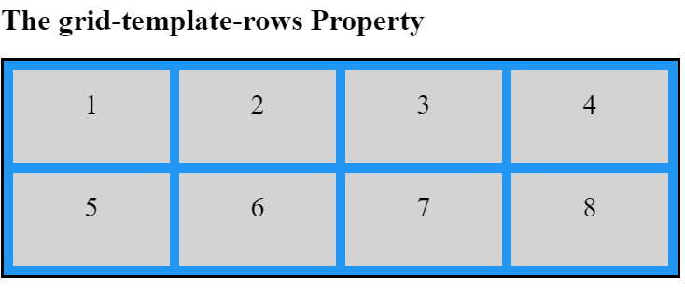
CSS grid-template-columns Property
The grid-template-columns property specifies the number (and the widths) of columns in a grid layout.
Ex. Given below sets up a grid container with four equally sized columns, where each column's width will be determined automatically based on its content.
<body>
<h1>The grid-template-rows Property</h1>
<div class="grid-container">
<div class="item">1</div>
<div class="item">2</div>
<div class="item">3</div>
<div class="item">4</div>
<div class="item">5</div>
<div class="item">6</div>
<div class="item">7</div>
<div class="item">8</div>
</div> </body>
</html>
<html><head> <style>
.grid-container {
display: grid;
grid-template-columns: auto auto auto auto;
grid-gap: 10px;
background-color: #2196F3;
padding: 10px;}
.item{
background-color: lightgrey;
text-align: center;
padding: 20px 10px;
font-size: 30px;
} </style></head>

Slide 6
CSS grid-template-rows Property
The grid-template-rows property specifies the number (and the heights) of the rows in a grid layout.
Ex. Given below sets up a grid container with two rows, both with a fixed height of 100 pixels
<body>
<h1>The grid-template-rows Property</h1>
<div class="grid-container">
<div class="item">1</div>
<div class="item">2</div>
<div class="item">3</div>
<div class="item">4</div>
<div class="item">5</div>
<div class="item">6</div>
<div class="item">7</div>
<div class="item">8</div>
</div> </body>
</html>
<html>
<head> <style>
.grid-container {
display: grid;
grid-template-columns: auto auto auto auto;
grid-template-rows: 100px 100px;
grid-gap: 10px;
background-color: #2196F3;
padding: 10px;}
.item{
background-color: lightgrey;
text-align: center;
padding: 20px 10px;
font-size: 30px;
} </style></head>

Slide 7
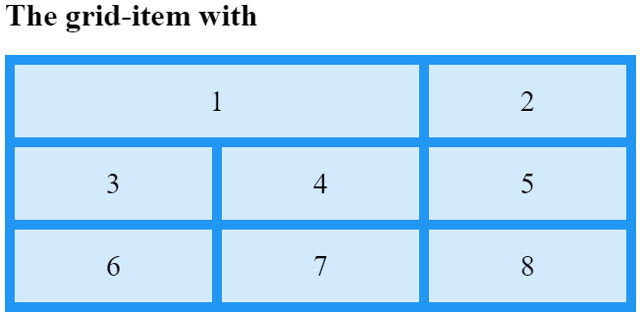
CSS Grid Item
A grid container contains grid items.
By default, a container has one grid item for each column, in each row, but you can style the grid items so that they will span multiple columns and/or rows.
grid-column: 1 / 2 → grid item will start at the first column and end at the 2nd column, spanning a total of TWO columns.
.item1 {
grid-column: 1 / 2;
}
</style>
</head>
<body>
<h1>The grid-item with </h1>
<div class="grid-container">
<div class="item1">1</div>
<div>2</div>
<div>3</div>
<div>4</div>
<div>5</div>
<div>6</div>
<div>7</div>
<div>8</div>
</div>
</body>
</html>
<html><head> <style>
.grid-container {
display: grid;
grid-template-columns: auto auto auto auto;
grid-template-rows: 100px 100px;
grid-gap: 10px;
background-color: #2196F3;
padding: 10px;}
.div{
background-color: lightgrey;
text-align: center;
padding: 20px 10px;
font-size: 30px;
} </style></head>

Slide 8
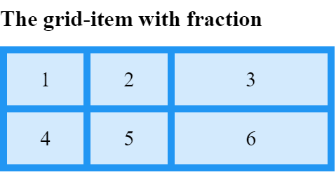
CSS fraction (fr)
With CSS Grid Layout, we get a new flexible unit: the Fr unit.
Fr is a fractional unit and 1fr is for 1 part of the available space.
<body>
<h1>The grid-item with fraction</h1>
<div class="grid-container">
<div >1</div>
<div>2</div>
<div>3</div>
<div>4</div>
<div>5</div>
<div>6</div>
</div>
</body>
</html>
<html>
<head>
<style>
.grid-container {
display: grid;
grid-template-columns: 1fr 1fr 2fr;
gap: 10px;
background-color: #2196F3;
padding: 10px;
}
div {
background-color: rgba(255, 255, 255, 0.8);
text-align: center;
padding: 20px 0;
font-size: 30px;
} </style></head>

Slide 9
CSS repeat()
repeat() is a notation that you can use with the grid-template-columns and grid-template-rows properties to make your rules more concise and easier to understand when creating a large amount of columns or rows.
<body>
<h1>The grid-item with fraction</h1>
<div class="grid-container">
<div >1</div>
<div>2</div>
<div>3</div>
<div>4</div>
<div>5</div>
<div>6</div>
</div>
</body>
</html>
<html>
<head>
<style>
.grid-container {
display: grid;
grid-template-columns: repeat(3, 1fr);
grid-template-rows: repeat(2,80px);
background-color: #2196F3;
padding: 10px;
}
div {
background-color: rgba(255, 255, 255, 0.8);
text-align: center;
padding: 20px 0;
font-size: 30px;
} </style></head>

Slide 10

minmax()
The minmax() CSS function defines a size range greater than or equal to min and less than or equal to max.
<body>
<div class="grid-container">
<div class="grid-item">Item 1</div>
<div class="grid-item">Item 2</div>
<div class="grid-item">Item 3</div>
</div>
</body>
</html>
<html>
<head>
<style>
.grid-container {
display: grid;
grid-template-columns: minmax(100px, 1fr) minmax(200px, 2fr) minmax(150px, 1fr);
grid-gap: 10px;
}
.grid-item {
background-color: lightblue;
border: 1px solid gray;
padding: 10px;
text-align: center;
}
</style> </head>

Slide 11
CSS grid-gap Property
The grid-gap property defines the size of the gap between the rows and columns in a grid layout, and is a shorthand property for the following properties
grid-row-gap ;grid-column-gap
<body>
<div class="grid-container">
<div class="grid-item">Item 1</div>
<div class="grid-item">Item 2</div>
<div class="grid-item">Item 3</div>
<div class="grid-item">Item 4</div>
<div class="grid-item">Item 5</div>
<div class="grid-item">Item 6</div>
</div>
</body>
</html>
<html>
<head>
<title>minmax() example</title>
<style>
.grid-container {
display: grid;
grid-template-columns:auto auto auto;
grid-gap: 10px;
}
.grid-item {
background-color: lightblue;
border: 1px solid gray;
padding: 10px;
text-align: center;
}
</style> </head>

