Slide 1
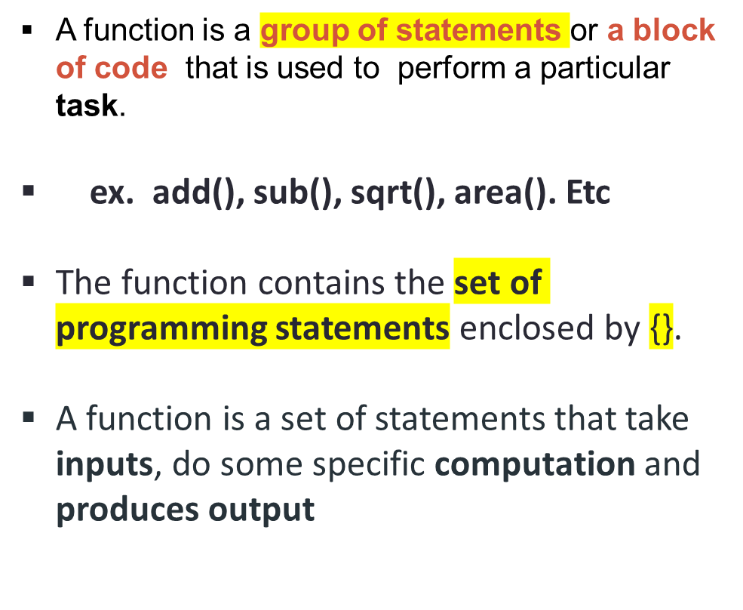
FUNCTIONS
ex. add(p1,p2… )
{
statements;
--
}
------------------------------------------------------------------
Ex. add(2,3)
--------- --------------------------------------------------------
input→ 2,3
computation→ addition
result → return 5
--------------------------------------------------------------------

Slide 2
BENEFITS OF FUNCTIONS
Modularity: We can divide a large program into more separate functions.
  Ex. we need to create a program to create a circle and color it.
  We can create two functions to solve this problem:
      create a circle function
      create a color function
  Dividing a complex problem into smaller chunks makes our program easy to understand
Code Reusability: We can call a function any number of times in a program and from any place in a program
ex. add(a,b)
called any number of times with different input
add(3,4)
add(5,6)…etc
3. Debugging becomes easy: Errors in the functions can be easily detected and rectified.
4. Easy Modification: Modifying a program becomes easier by using function.

Slide 3
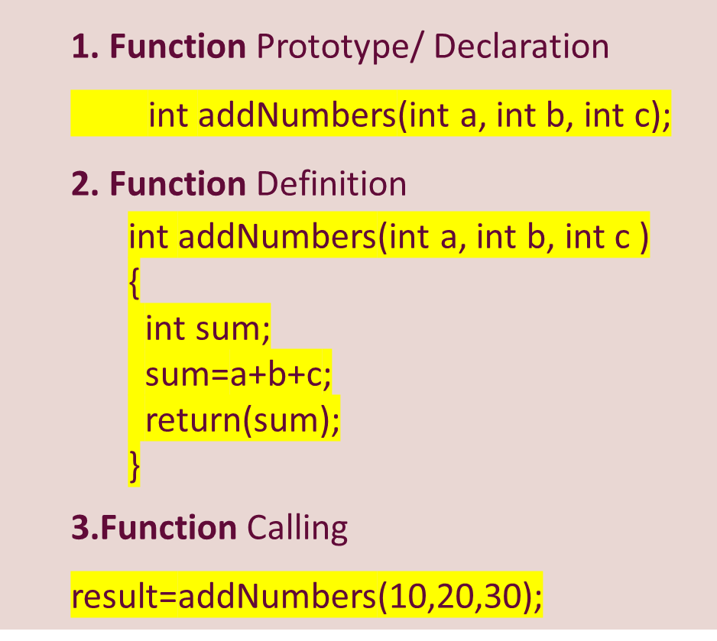
FUNCTION PROTOTYPING
The functions are written by the programmer to achieve specific work.
A function can have
  Declaration
  Definition
  Function call

Slide 4
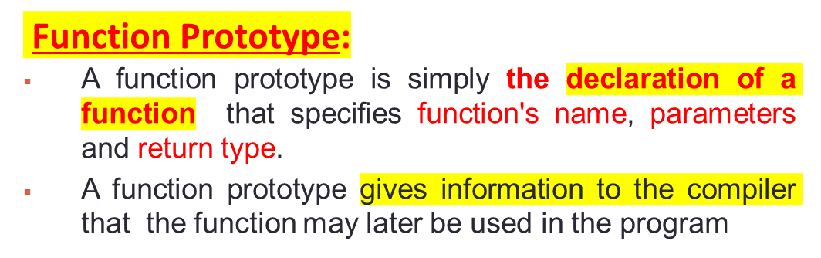
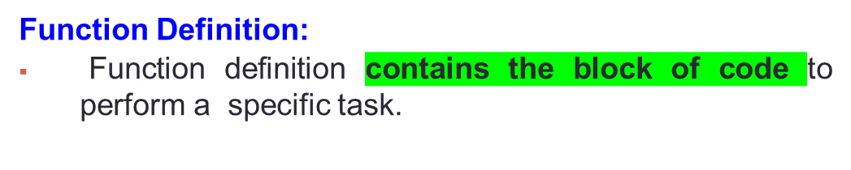
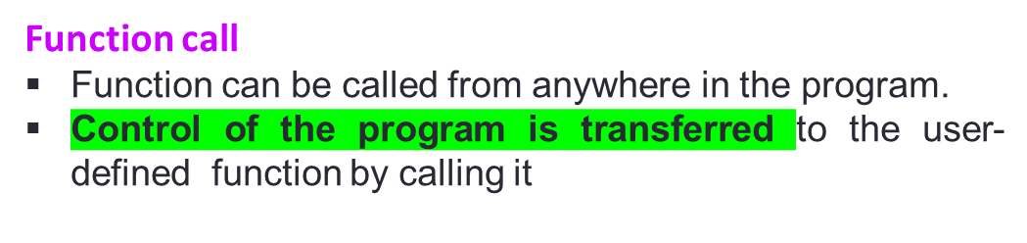
FUNCTION PROTOTYPING
Syntax:
return_type function_name(parameter list);
Ex. int addNumbers(int a, int b, int c);
return_type function_name(parameter list )
{
body of the function;
....
}
int addNumbers(int a, int b, int c )
{
int sum;
sum=a+b+c;
return(sum);
}
Syntax:
function_name(argument_list);
Ex.
int result;
result=addNumbers(10,20,30);

Slide 5
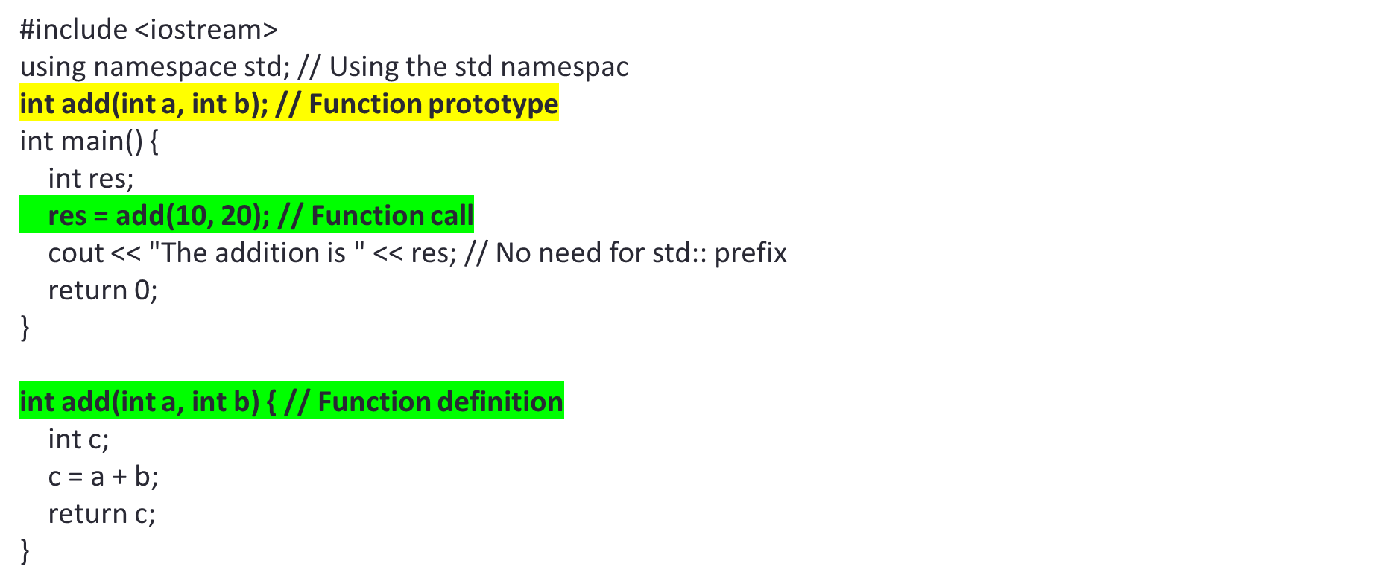
C++ PROGRAM TO CREATE A FUNCTION add()

Slide 6
Create a C++ program to calculate the area of the square using the function.
INPUT:
Enter the length of the side in meters: 10
OUTPUT:
The area of the square: 100.00
    LOGIC:
    Read a length of a side
    Define a area_sqare() function
    Call area_sqare() function

Slide 7
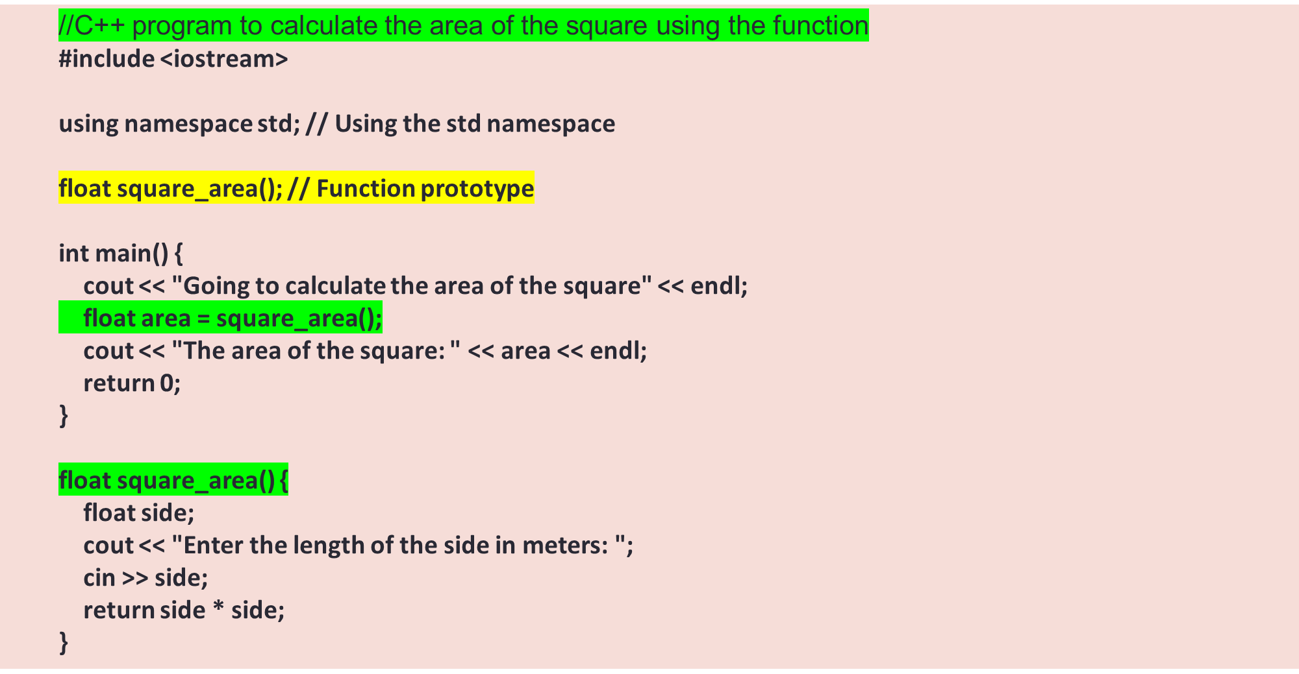

Slide 8
FUNCTIONS
→ Create a C++ program to calculate the SIMPLE INTEREST using the function.
Simple Interest = (p * t * r) / 100
here, p = Principal,
t = Time Period or year.
r = Rate of Interest.
INPUT:
Enter the P T R
OUTPUT:
The SI is : ……
    LOGIC:
    read p,t,r
    Defien simp_interest() function
    Call simp_interst() function

Slide 9
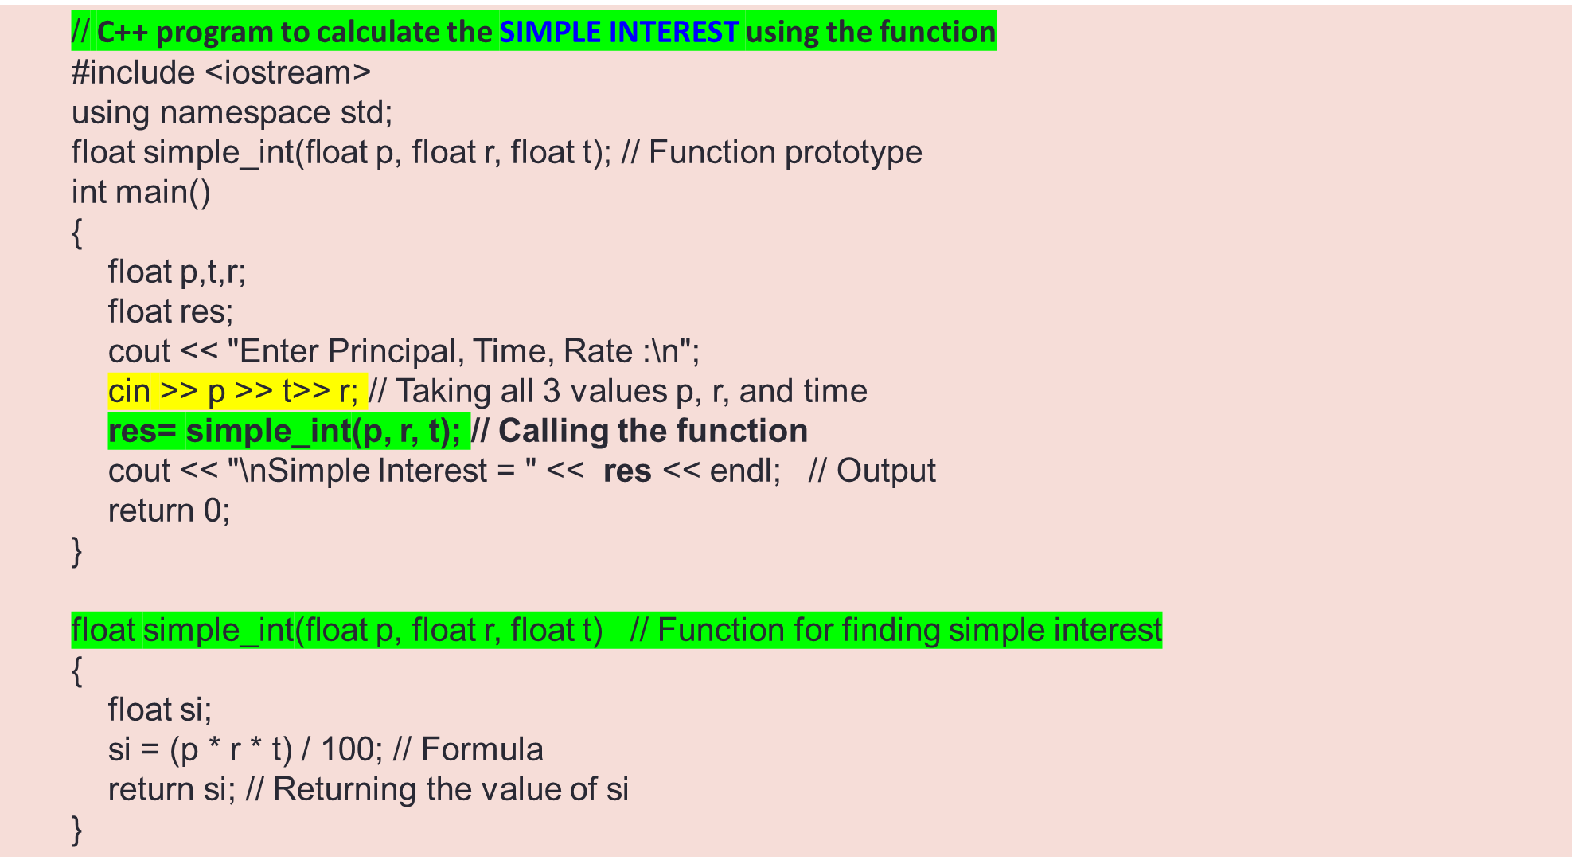

Slide 10
FUNCTIONS
Q) write a c++ program to check the given number is PRIME OR NOT using
function.
--------------------------------------------------------------------
INPUT: 5
OUTPUT: Given number is prime
-----------------------------------------------------------------------
isPrime(){
  int count=0
  for(i=1;i<=n;i++)
  {
  if(n%i==0)
  count++;
  }
  retrun count;
}
    LOGIC:
    read a number
    define a function isprime()
    call the function isprime()

Slide 11
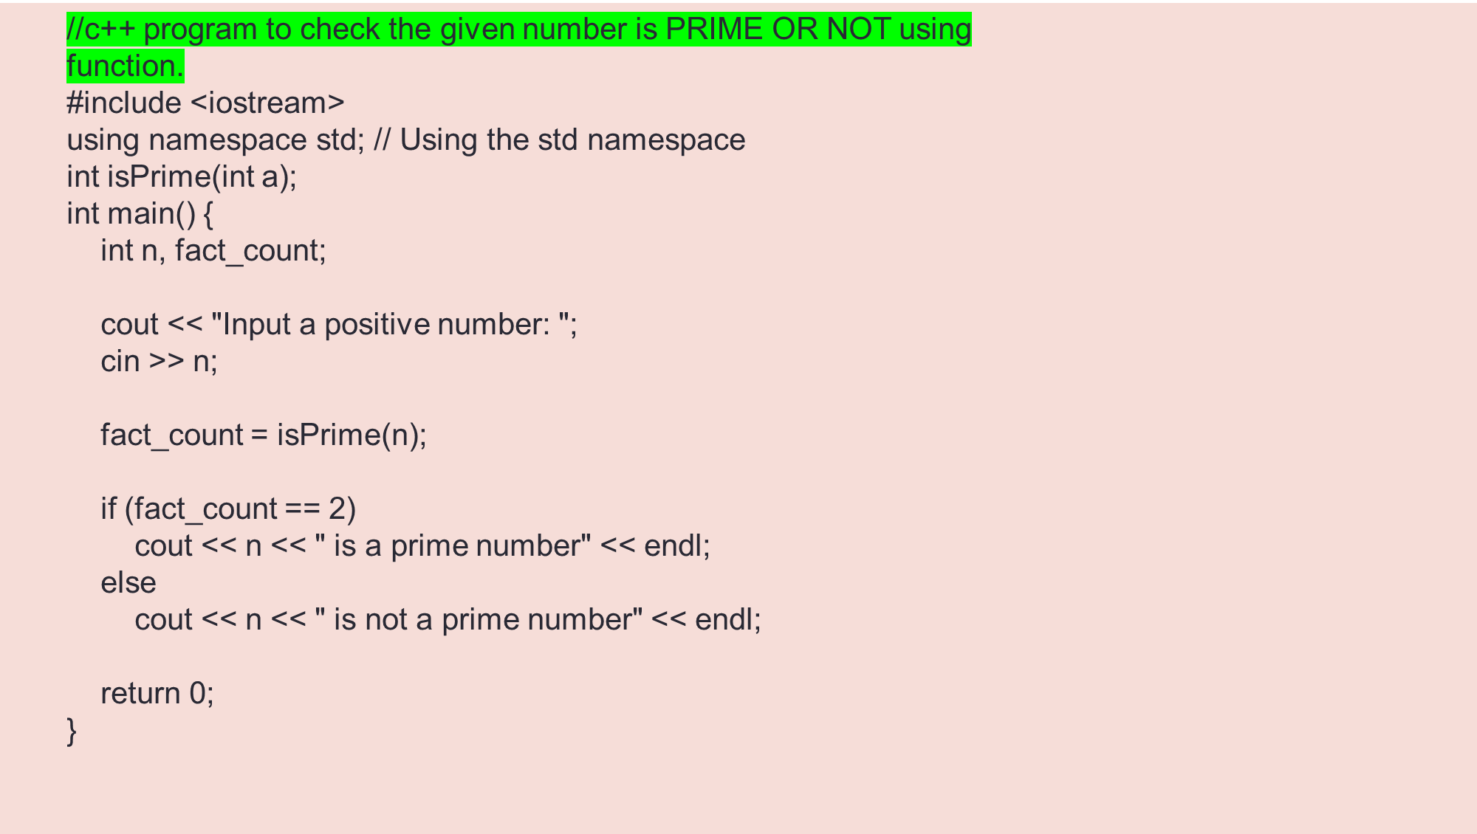
  int isPrime(int n) {
  int i, count = 0;
  for (i = 1; i <= n; i++) {
  if (n % i == 0)
  count++;
  }
  return count;
  }

Slide 12
FUNCTIONS
Q) Create a C++ program that manages an employee payroll system using function;
-----------------------------------------------------------------------
INPUT:
Enter employee name: Shivansh
Enter employee ID: 12345
Enter hourly wage: Rs.1500
Enter hours worked: 40
Logic:
Input employee details: Name, ID, hourly wage, and hours worked.
Calculate the salary by multiplying the hourly wage by the hours worked.
Display the employee's name, ID, and salary.
OUTPUT:
Employee Information:
Name: John Doe
Employee ID: 12345
Salary: Rs.60000

Slide 13
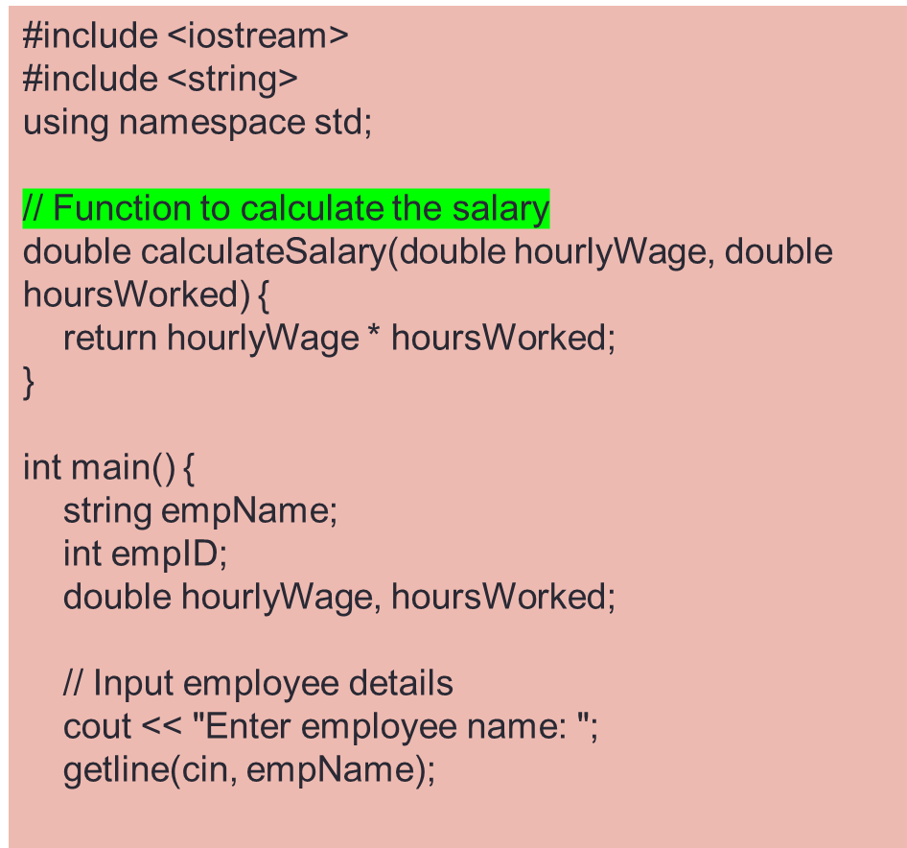
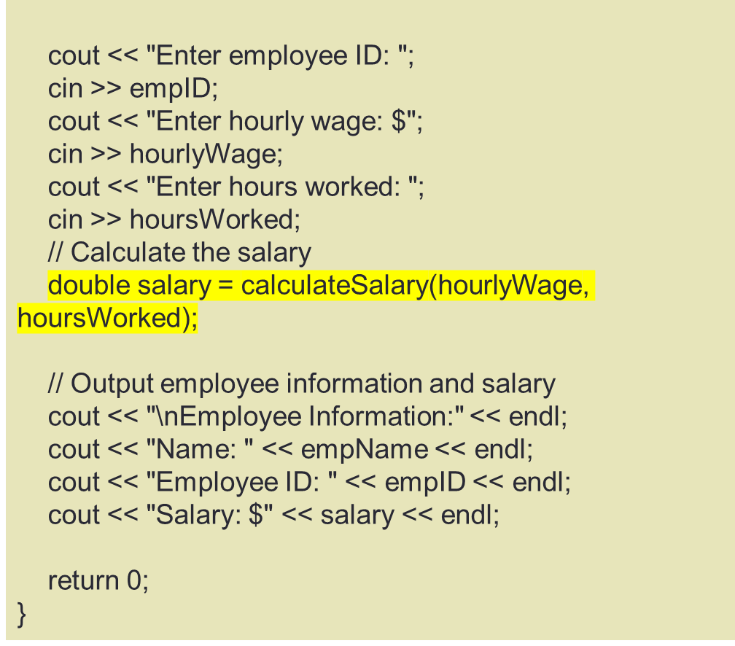
C++ PROGRAM THAT MANAGES AN EMPLOYEE PAYROLL SYSTEM

Slide 14
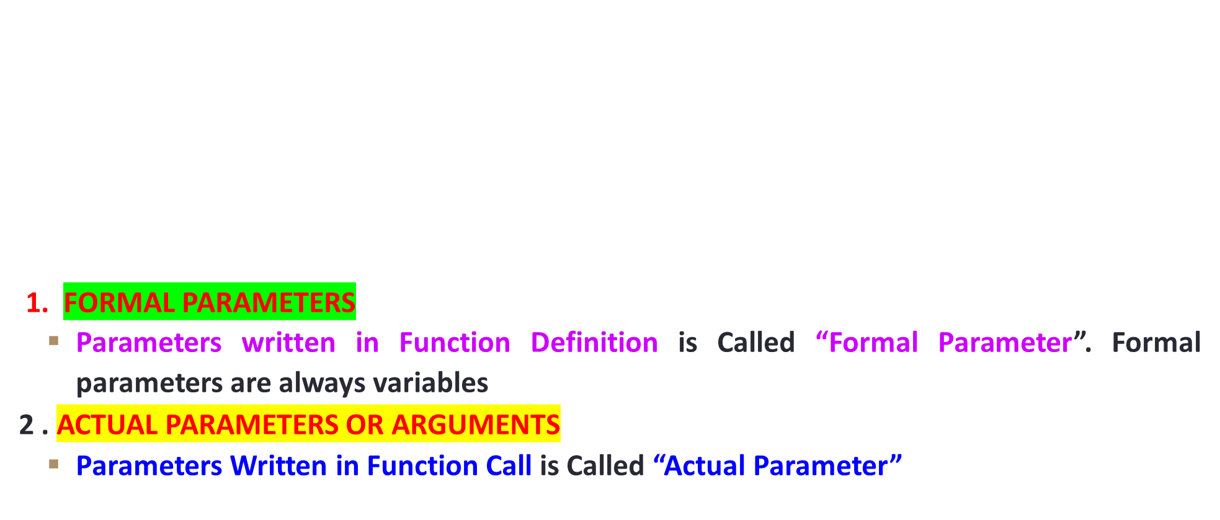
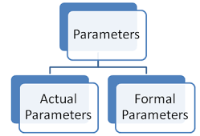
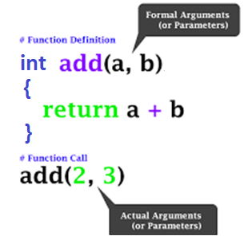
TYPES OF PARAMETERS

Slide 15
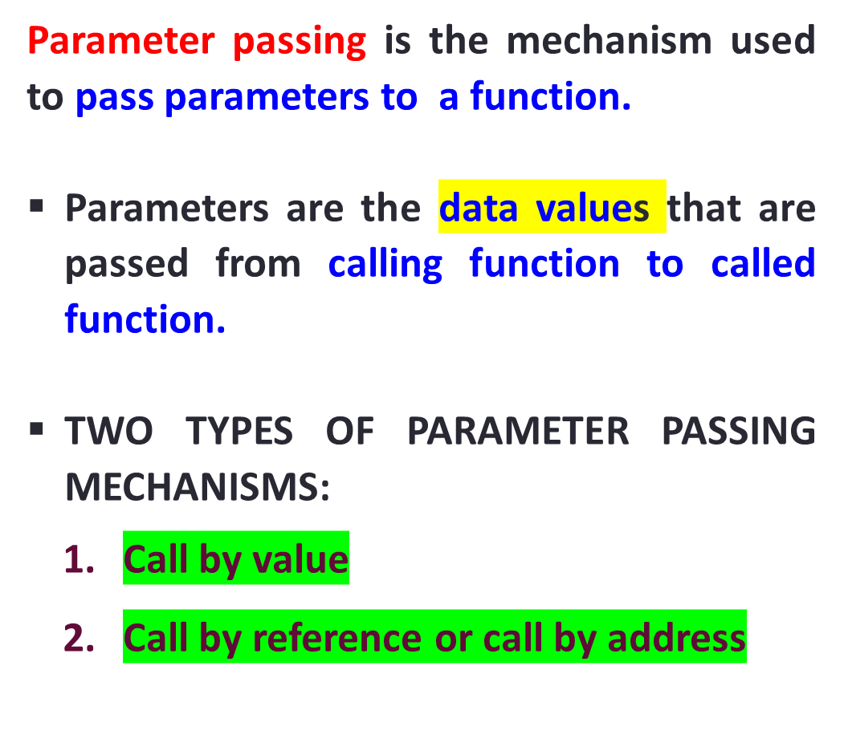
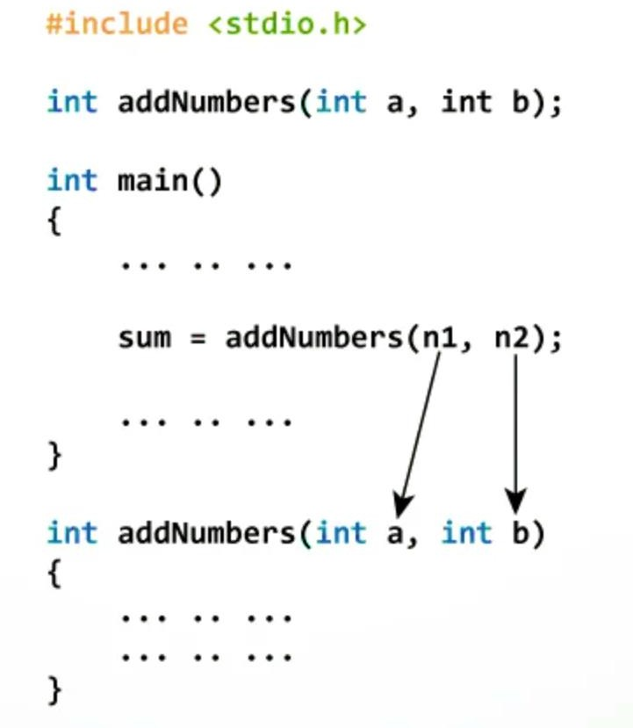
PARAMETER PASSING IN C++

Slide 16
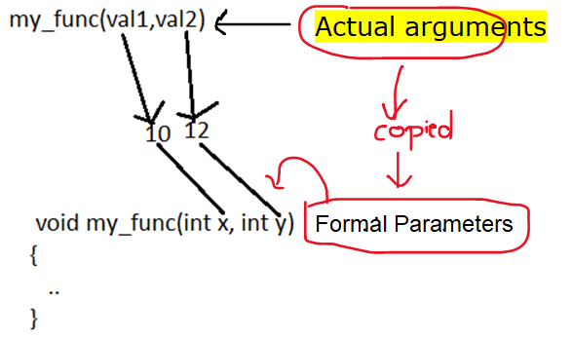
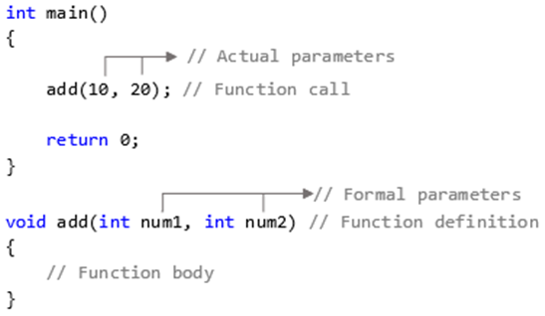


1.CALL BY VALUE
In CALL BY VALUE, function copies the actual value of an argument → formal parameter of the function
i.e. in which values of the actual arguments are copied into the corresponding formal arguments of the called function

Slide 17
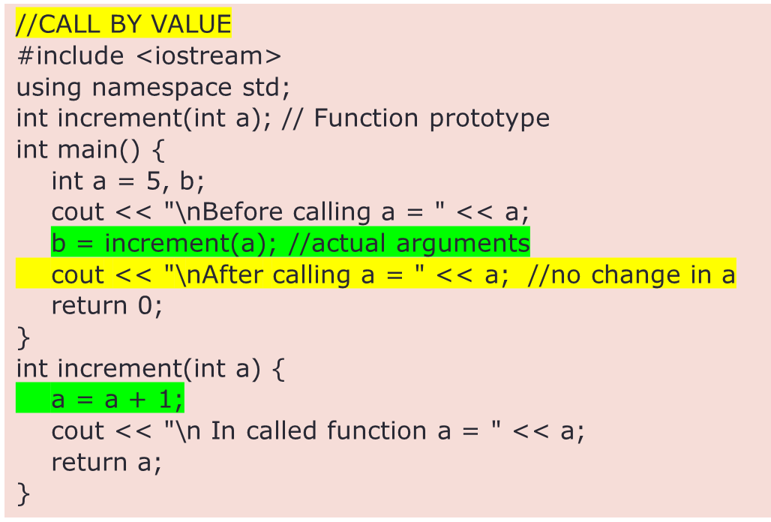
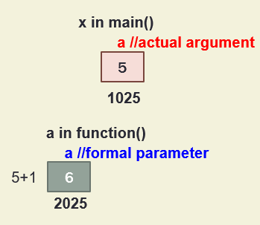
PARAMETER PASSING IN C – CALL BY VALUE
Changes made in the FORMAL ARGUMENTS in the function definition does not reflect on the values of the ACTUAL ARGUMENTS
Before calling a = 5
In called function a = 6
After calling a = 5

Slide 18
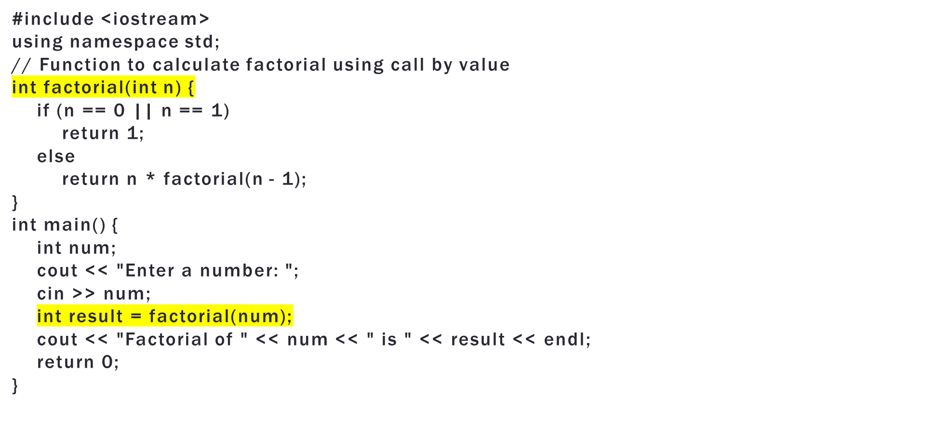
WAT TO CALCULATE FACTORIAL USING CALL BY VALUE

Slide 19
Q) Write a C++ program to check a given number is PALINDROME OR NOT using function.
INPUT: 151
OUTPUT: Given number is palindrome number
-------------------------------------------------------------------------------------------------------------
Palindrome number:- If the Reverse of a number is equal to the same number then the number is called a palindrome number.
Example:-
123 = 321 So, 123 is not a palindrome number.
5225 = 5225 So, 5225 is a palindrome number.
    LOGIC:
    Take a number
    Find the reverse of the number
    If reverse and the actual number is the same then it a palindrome number
    Else it is not a palindrome number

Slide 20
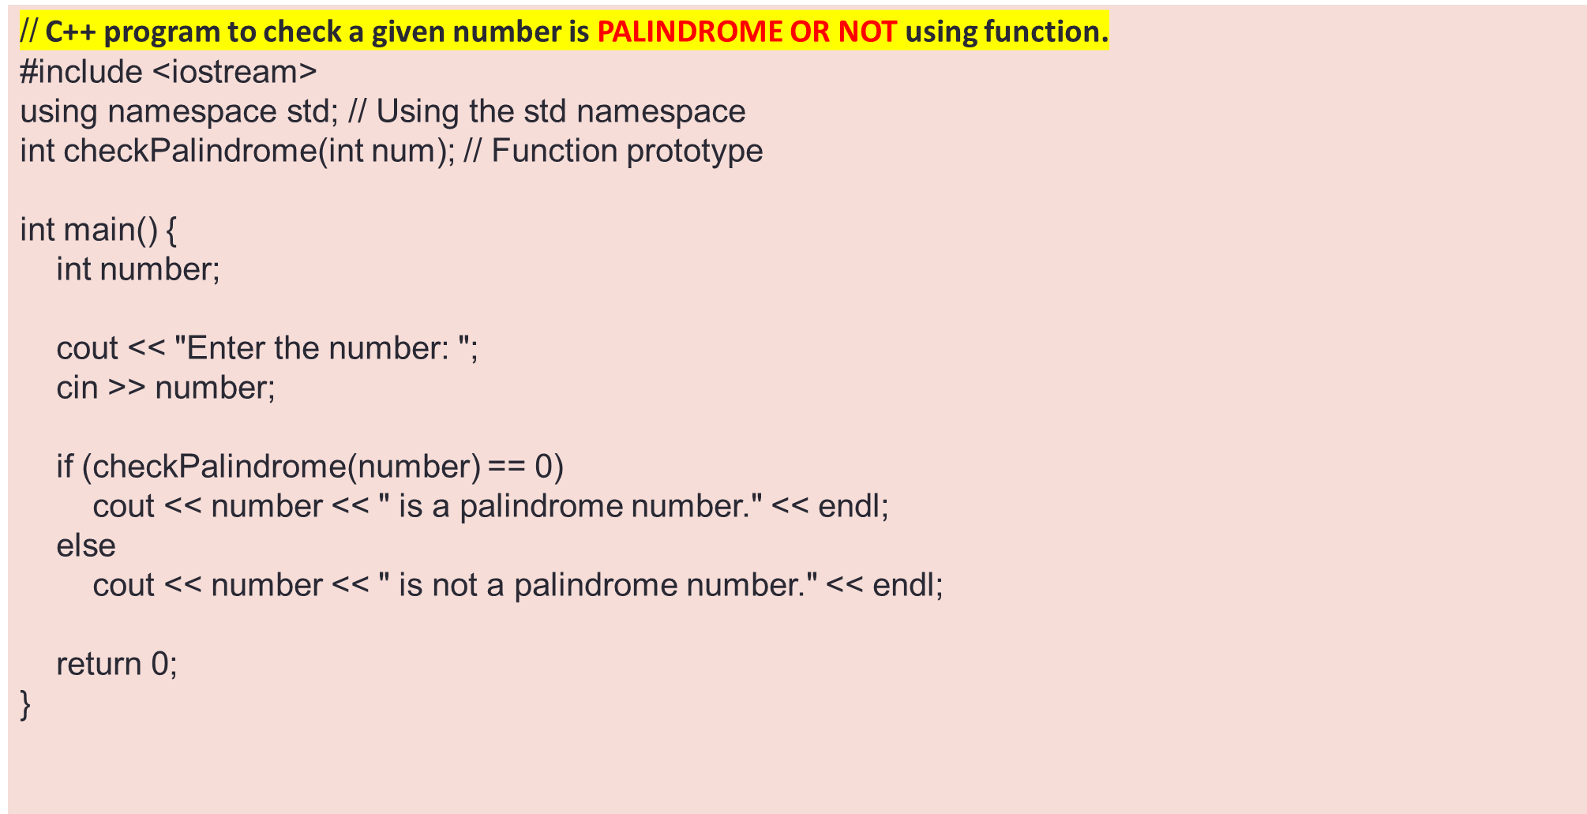
int checkPalindrome(int num) {
int temp, rem, rev = 0;
temp = num;
while (num != 0) {
rem = num % 10;
rev = rev * 10 + rem;
num = num / 10;
}
if (rev == temp)
return 0;
else
return 1;
}

Slide 21
Q) Write a C++ program to check a given number is ARMSTRONG OR NOT using function.
INPUT: 153
OUTPUT: Given number is Armstrong number
A positive integer is called Armstrong number of order n if, abcd…. = a^{n} + b^{n} + c^{n} + d^{n} + …
A 3 digit Number is said to be Armstrong number if sum cubes of individual digits is same as the given number
Ex. 153
=1*1*1 +5*5*5+3*3*3=153
    LOGIC:
    read a number
    define a function isArmstrong()
    call the function isArmstrong ()

Slide 22
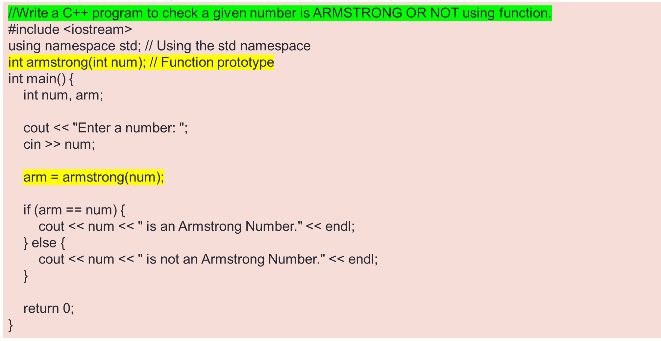
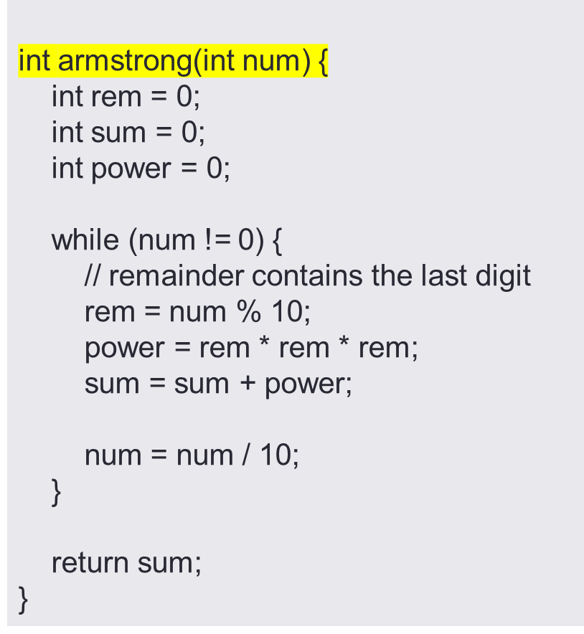

Slide 23
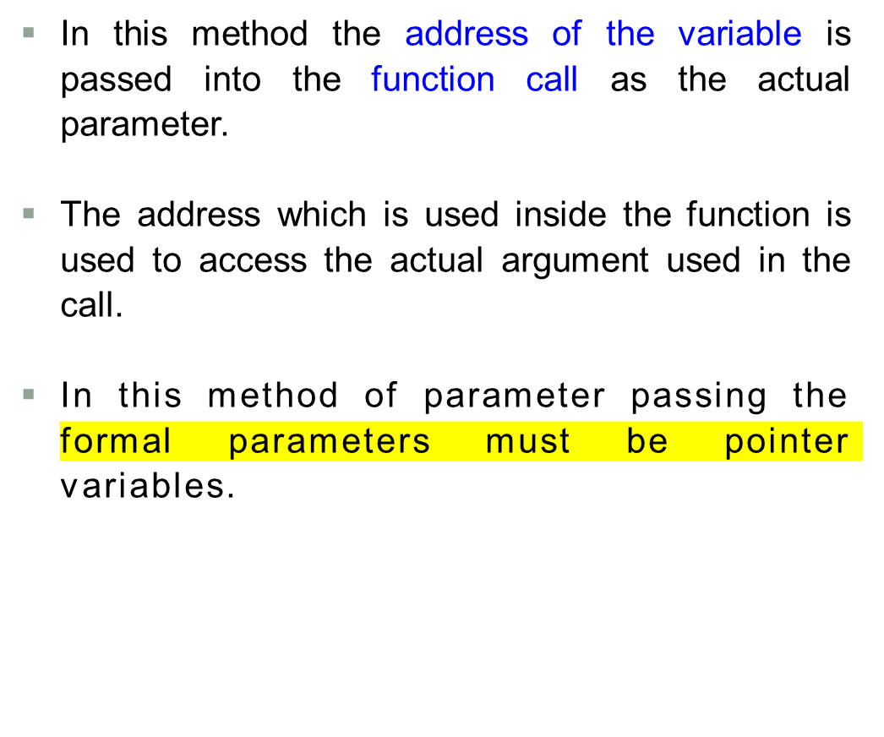
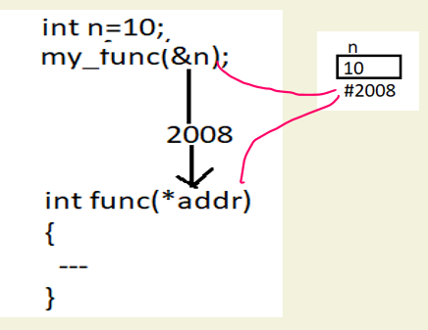
2. CALL BY REFERENCE:

Slide 24
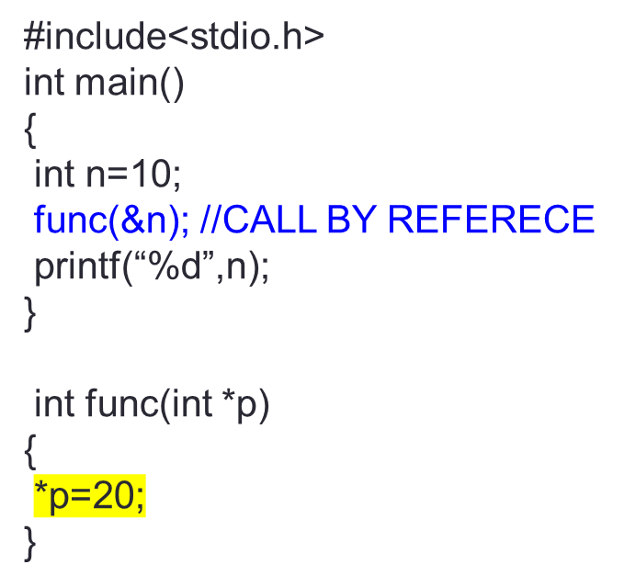
2. CALL BY REFERENCE:
The address which is used inside the function is used to access the actual argument used in the call.
The changes made on the formal parameters effects the value of actual parameters
n
10 20
1008
p
1008
2016

Slide 25

2. CALL BY REFERENCE:
Q) Create a C++ program for Swapping two numbers using call by reference
INPUT: Enter n1= 35 n2= 45
OUTPUT: After swapping n1=45 n2=35
    LOGIC:
    Read two numbers
    Define a function swap()
    Call swap() using address
    Print the numbers after swappin

Slide 26
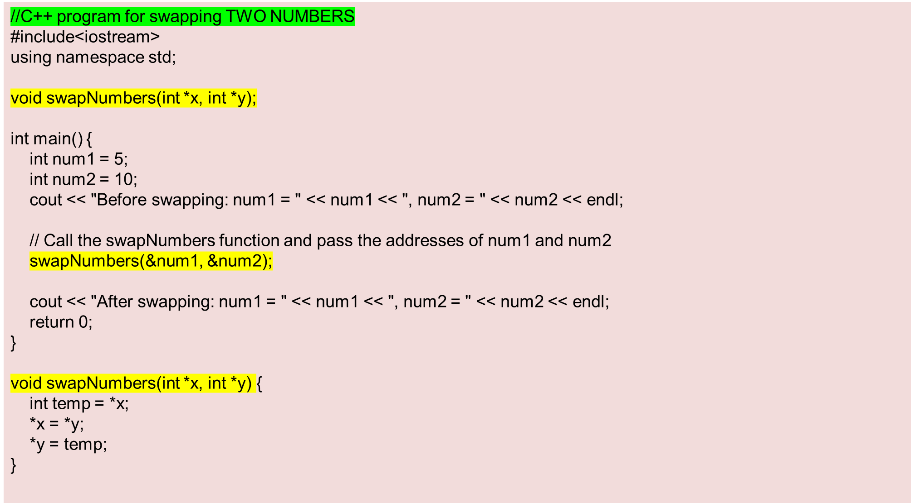
Notes:
Title + Image + Text

Slide 27
WAP for CYCLIC-SWAP that takes 3 numbers and swap them in cyclic order.
  Input:
  3 numbers
  Output:
  print numbers in cyclic order
  Example -
  Input-
  Enter a, b and c respectively:
  1
  2
  3
Output
Value before swapping:
  a = 3
  b = 1
  c = 2
Value after swapping:
  a = 2
  b = 3
  c = 1
LOGIC:
temp = *n2;
*n2 = *n1;
*n1 = *n3;
*n3 = temp;
}

Slide 28
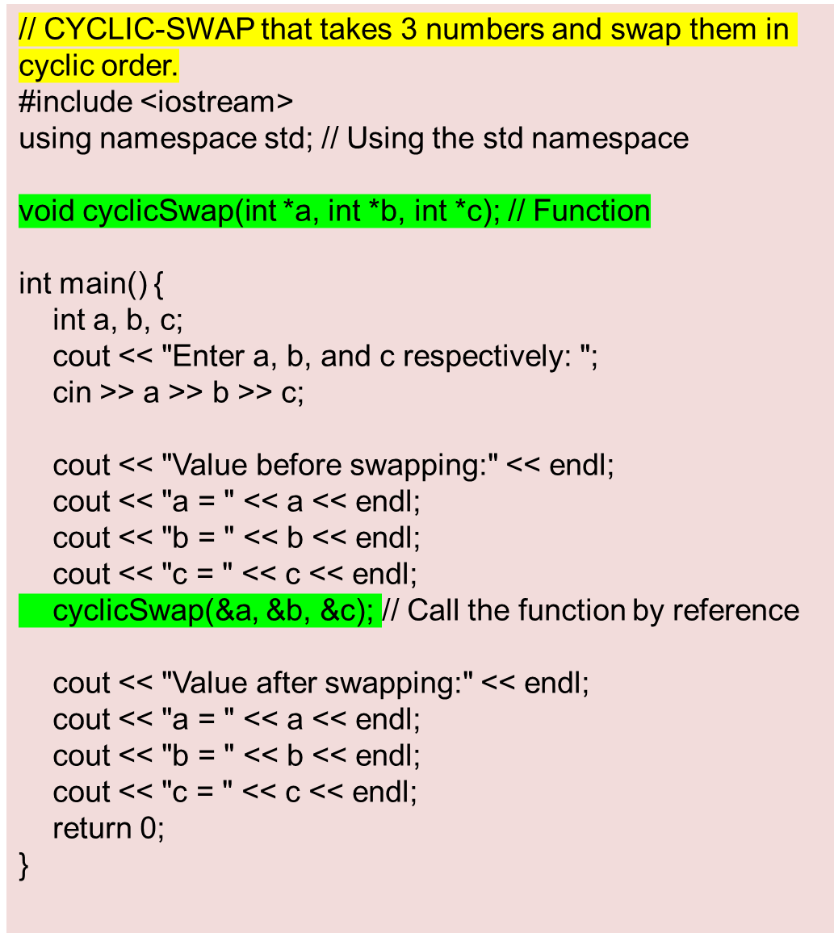
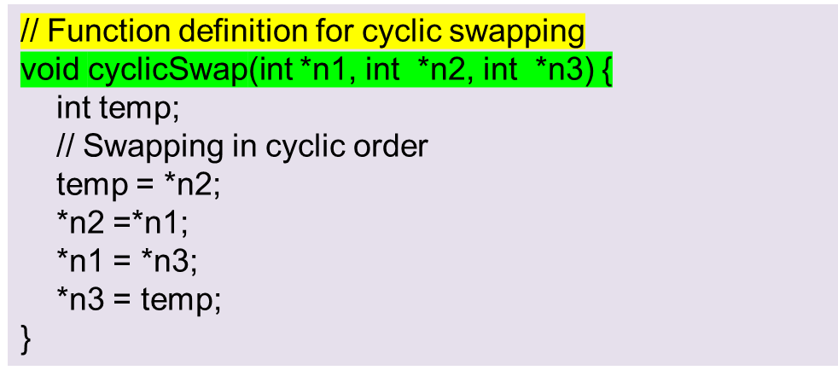
Notes:
Title + Image + Text

Slide 29
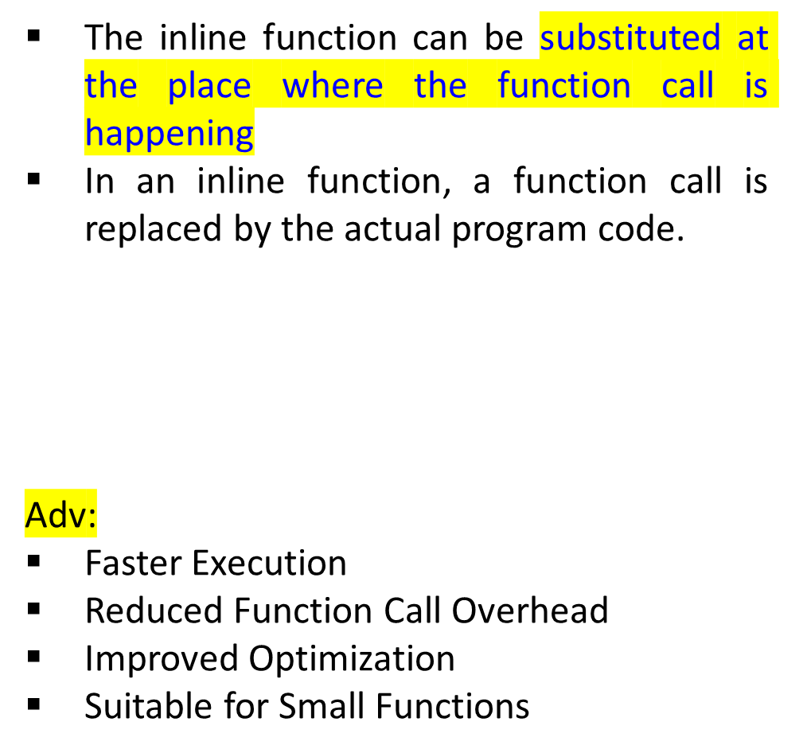
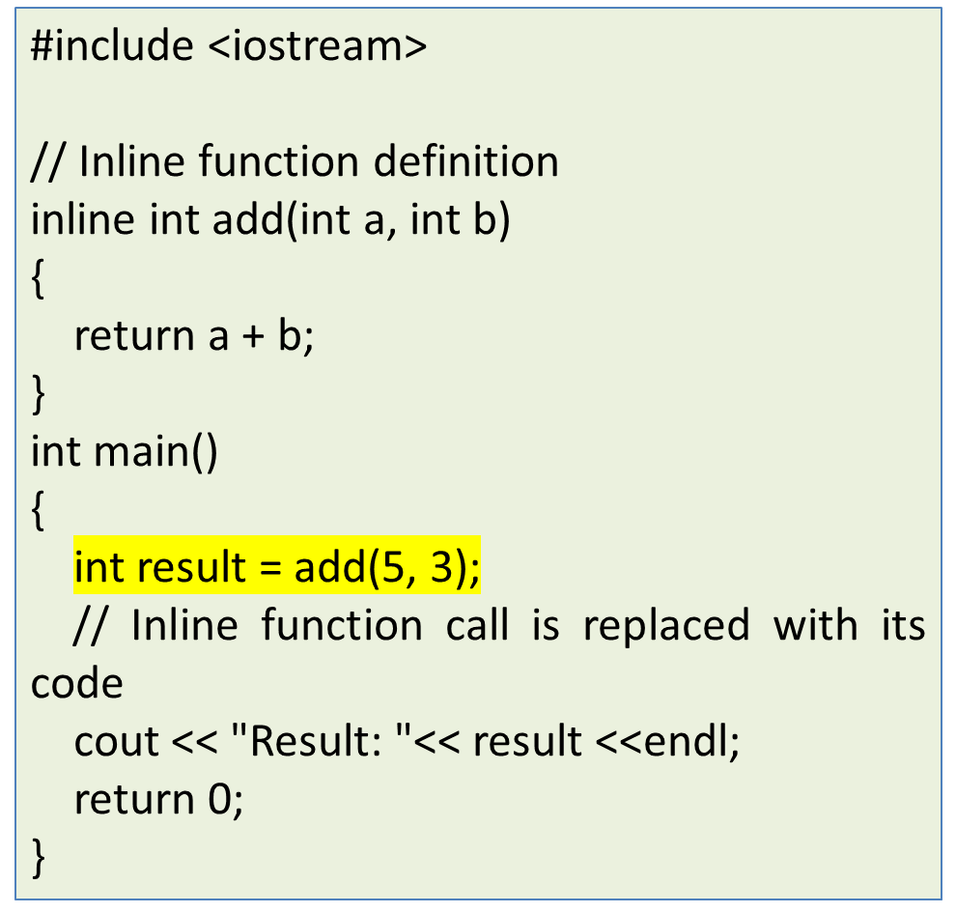
Inline functions
inline return_type function_name(parameters)
{
// Function code here
}
Notes:
Title + Image + Text

Slide 30
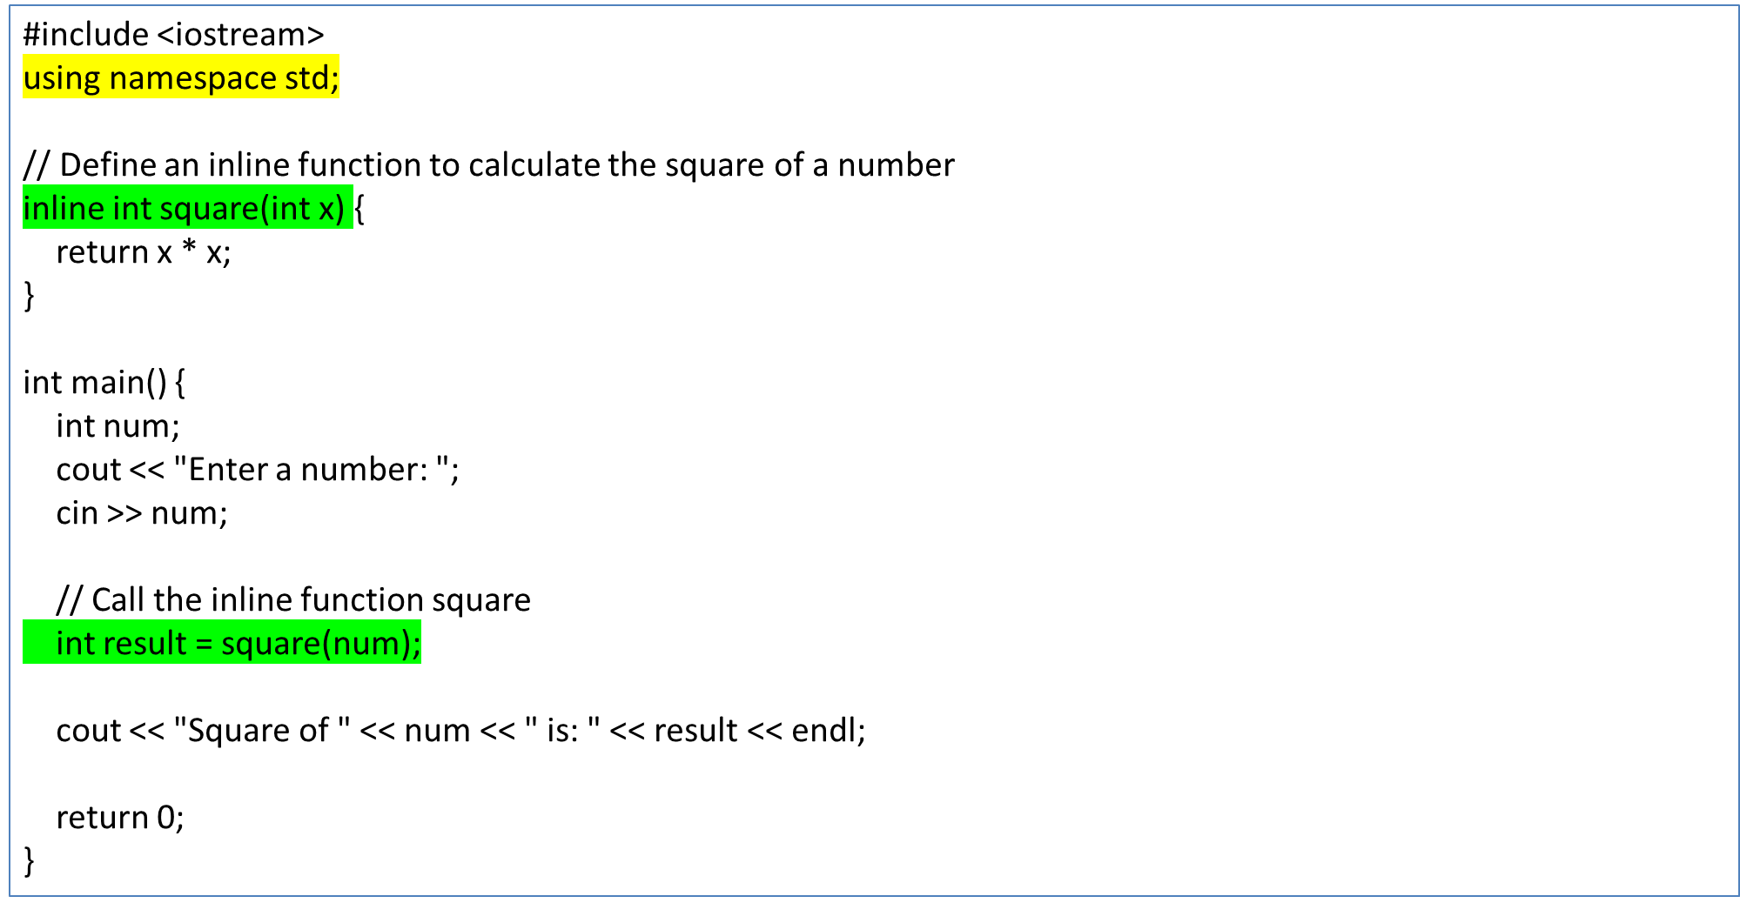
Q) WAP an inline function to calculate the square of a number
Notes:
Title + Image + Text

Slide 31
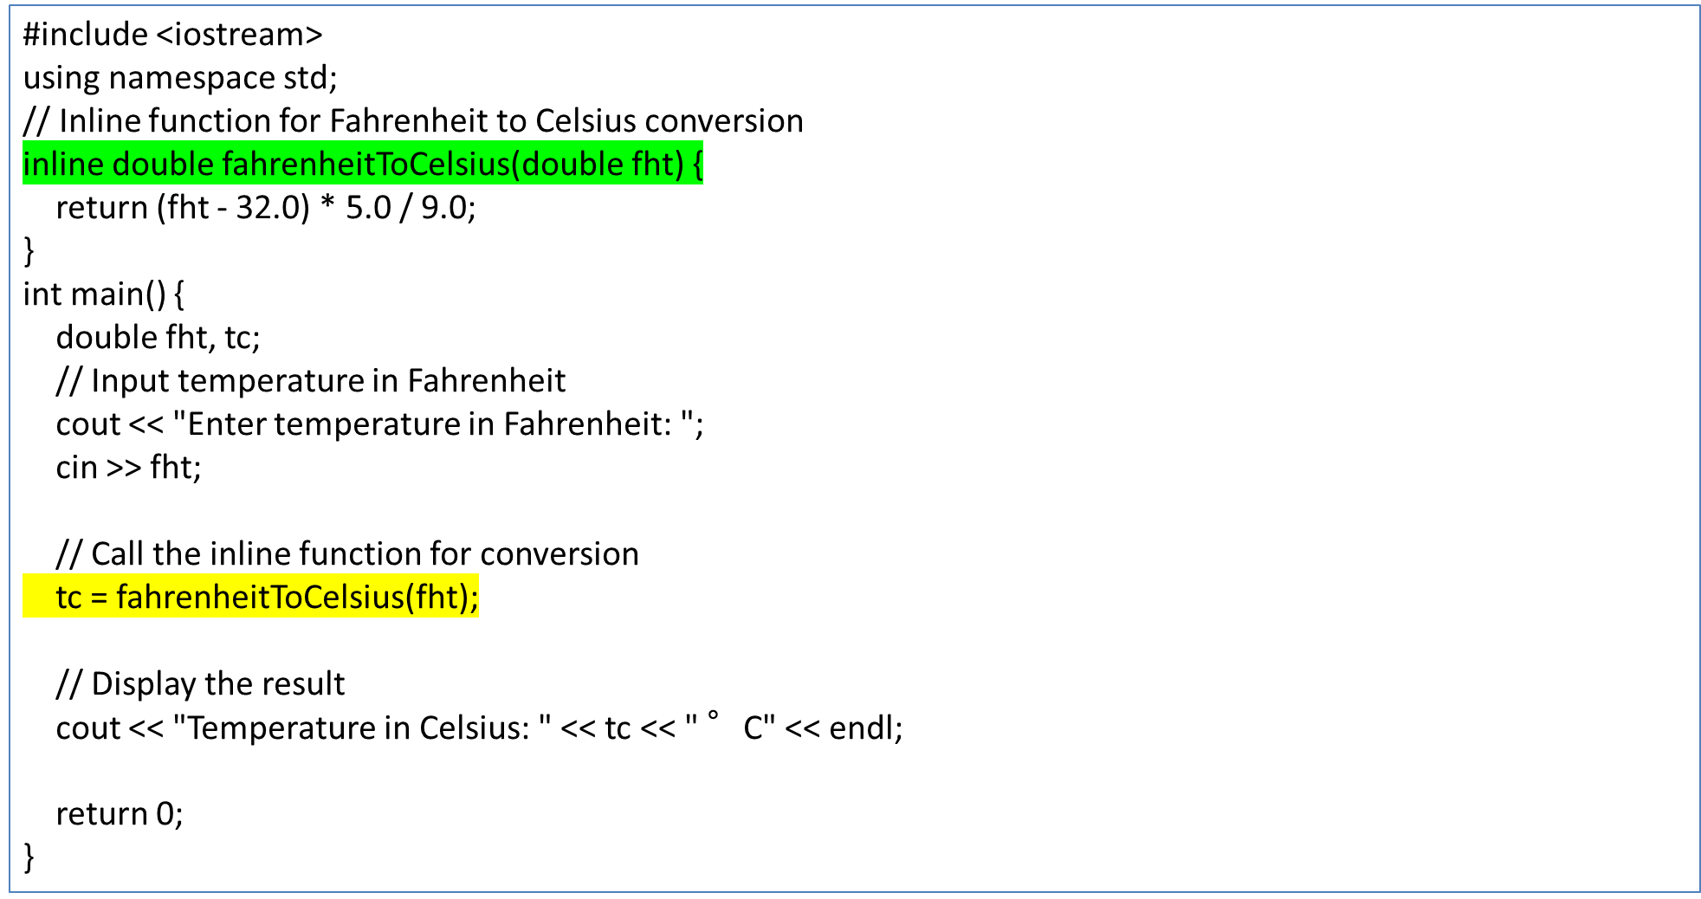
Q) WAP for inline function for temperature conversion from Fahrenheit to Celsius
Notes:
Title + Image + Text

Slide 32
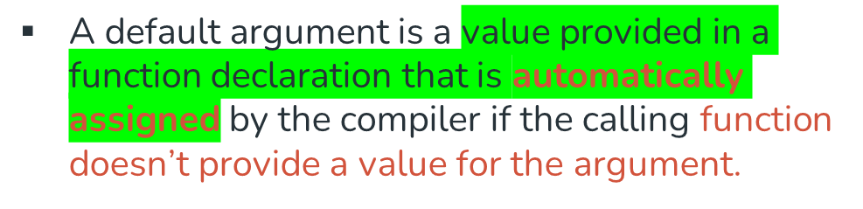
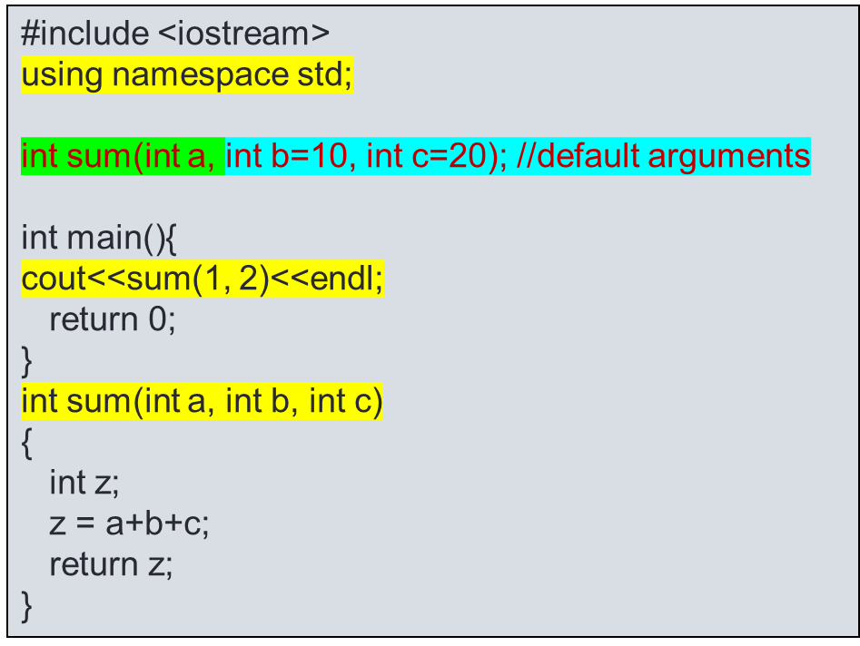
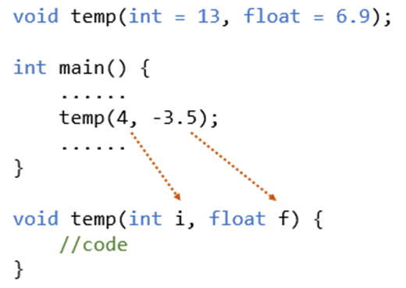
DEFAULT ARGUMENTS

Slide 33
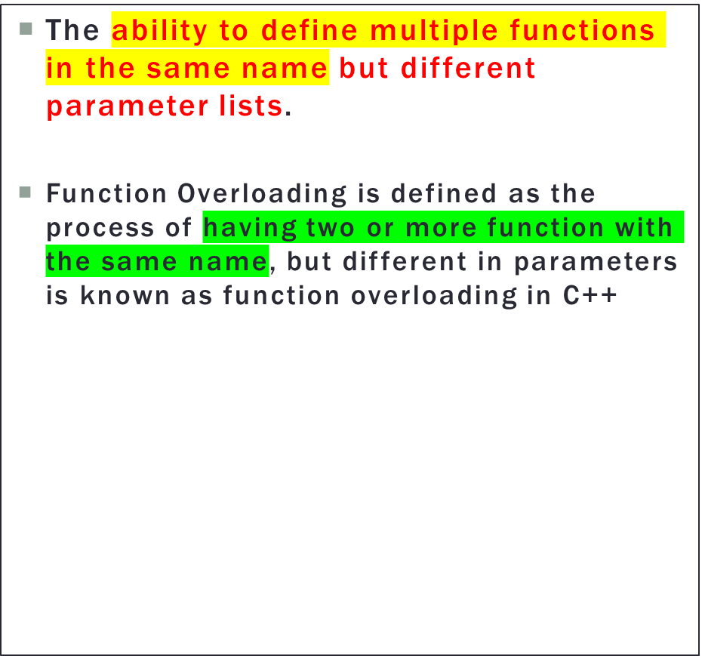
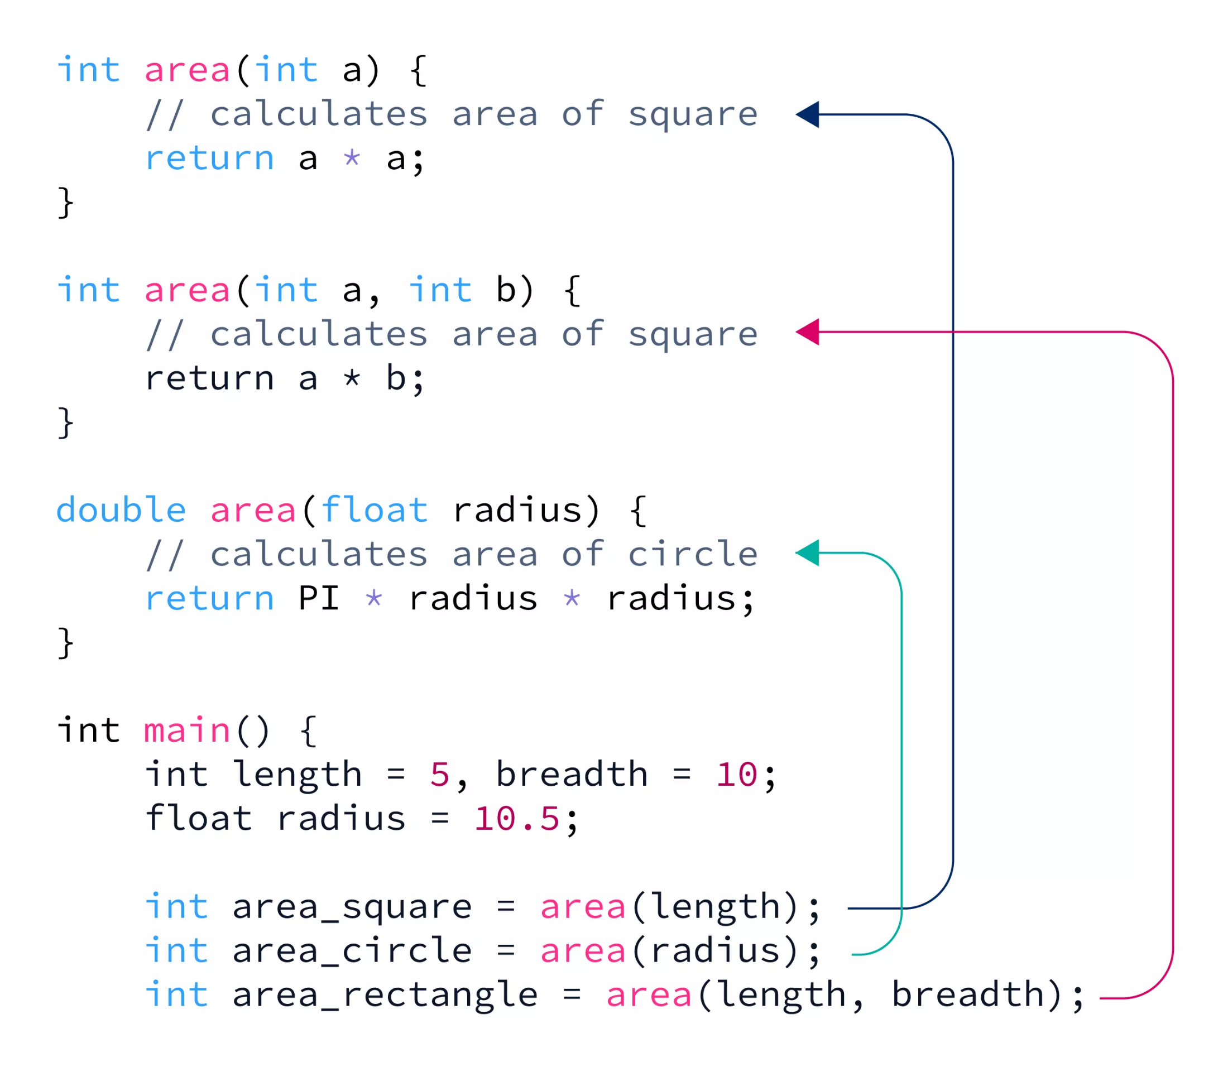



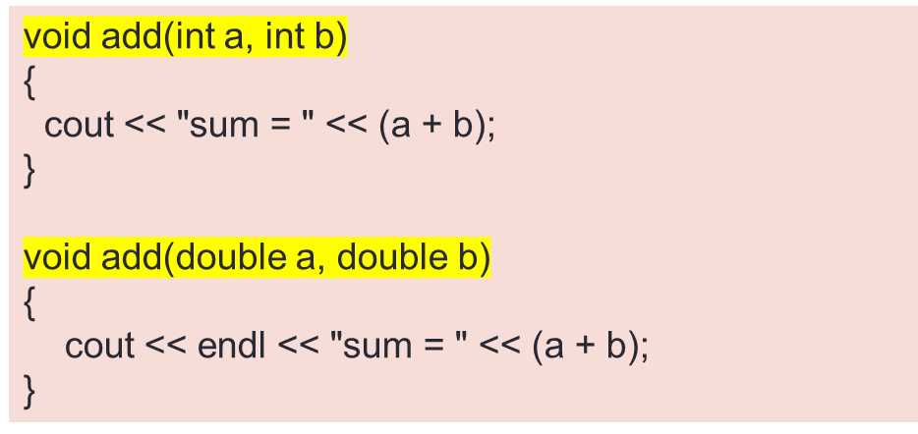
FUNCTION OVERLOADING IN C++

Slide 34
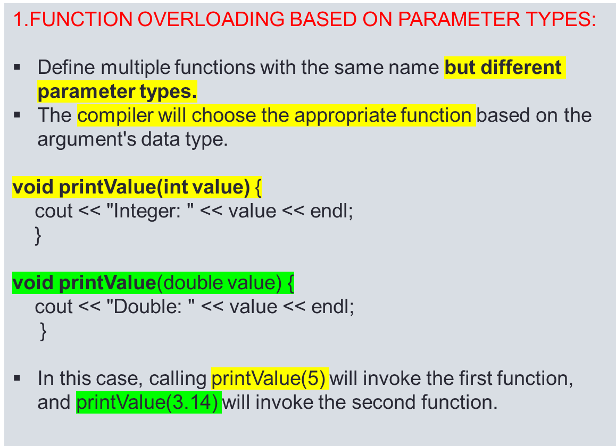
FUNCTION OVERLOADING IN C++
Function overloading in C++ can be based on various factors.
The type of parameters,
The sequence of parameters,
The number of parameters

Slide 35
WRITE A PROGRAM FOR FUNCTION OVERLOADIN BASED ON TYPE OF PARAMETERS
#include <iostream>
void add(int a, int b) {
std::cout << "sum = " << (a + b);
}
void add(double a, double b) {
std::cout << std::endl << "sum = " << (a + b);
}
int main() {
add(10, 2);
add(5.3, 6.2);
return 0;
}

Slide 36
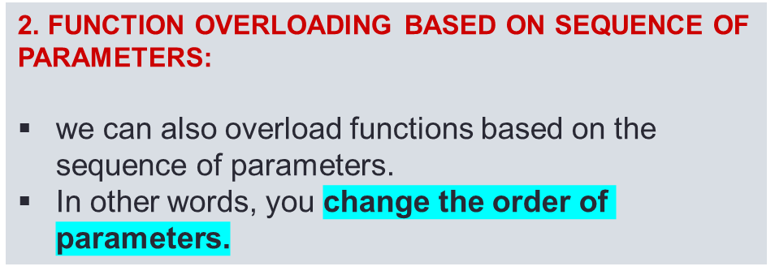
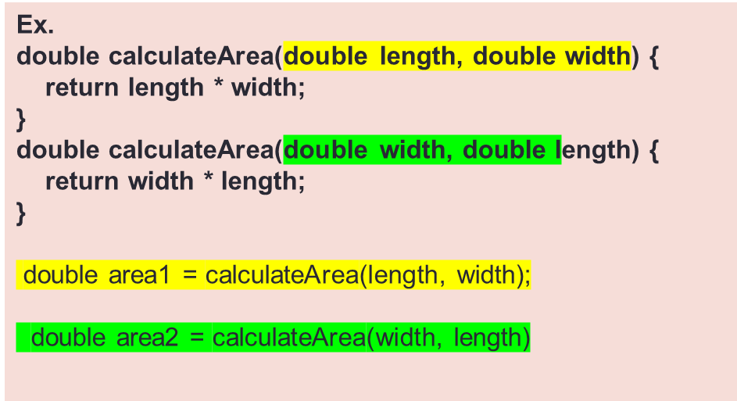
FUNCTION OVERLOADING IN C++
#include <iostream>
void print(int a, double b)
{
cout << "int: " << a << ", double: " << b << endl;
}
void print(double b, int a) {
cout << "double: " << b << ", int: " << a << endl;
}
int main() {
int x = 5;
double y = 3.14;
print(x, y); // Calls the first print function
print(y, x); // Calls the second print function
return 0;
}

Slide 37
FUNCTION OVERLOADING IN C++
3.Function Overloading Based on Number of Parameters:
You can define multiple functions with the same name but a different number of parameters
int multiply(int a, int b) {
return a * b;
}
int multiply(int a, int b, int c) {
return a * b * c;
}

Slide 38
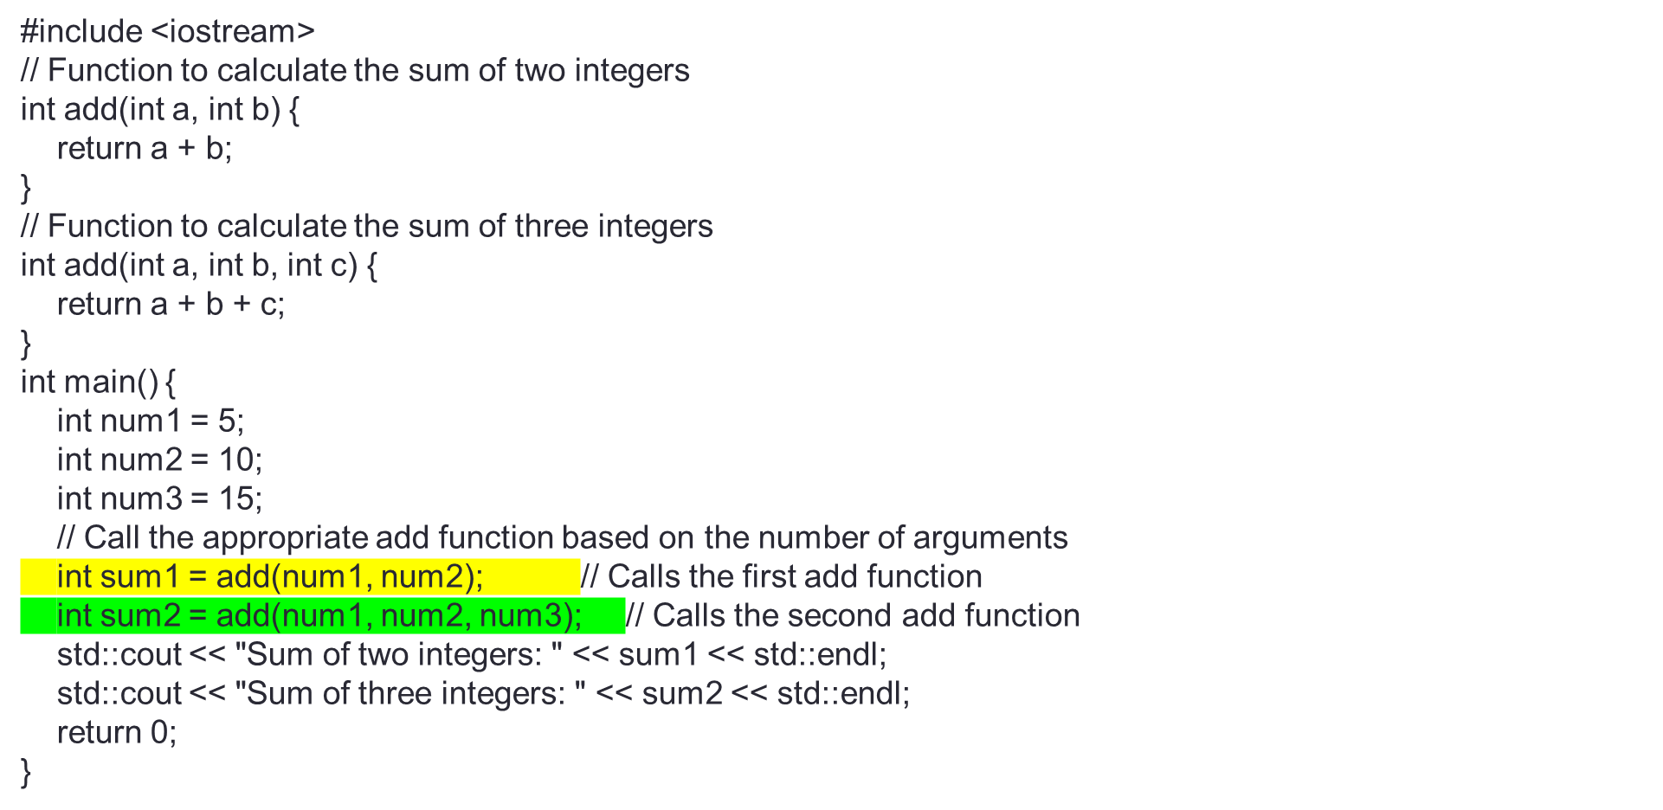
FUNCTION OVERLOADING BASED ON NUMBER OF PARAMETERS

Slide 39
Scenario:
Sarah is developing a financial application that calculates loan interest with different rates and compounding frequencies. She uses function overloading to create calculateInterest functions.
Question:
Explain function overloading in this context and how Sarah uses it.
Describe the purpose of these calculateInterest functions and how they differ based on their parameters.
If Sarah needs to support variable compounding frequencies (e.g., monthly), how can she extend her functions using function overloading efficiently?
Input:
double principal = 1000.0;
double annualRate = 0.05;
int years = 5;
int compoundingFrequency = 12; // Monthly compounding
Ourput:
Simple Interest: 50
Compound Interest (Annual): 276.504
Compound Interest (Monthly): 282.037

Slide 40
#include <iostream>
#include <cmath>
class LoanCalculator {
public:
// Calculate simple interest
double calculateInterest(double principal, double rate) {
return principal * rate;
}
// Calculate compound interest with annual compounding
double calculateInterest(double principal, double rate, int years) {
return principal * pow(1 + rate, years) - principal;
}
// Calculate compound interest with custom compounding frequency
double calculateInterest(double principal, double rate, int years, int compoundingFrequency) {
double effectiveRate = rate / compoundingFrequency;
return principal * pow(1 + effectiveRate, years * compoundingFrequency) - principal;
}
};
int main() {
LoanCalculator calculator;
double principal = 1000.0;
double annualRate = 0.05;
int years = 5;
int compoundingFrequency = 12; // Monthly compounding
double simpleInterest = calculator.calculateInterest(principal, annualRate);
double compoundInterestAnnual = calculator.calculateInterest(principal, annualRate, years);
double compoundInterestMonthly = calculator.calculateInterest(principal, annualRate, years, compoundingFrequency);
std::cout << "Simple Interest: " << simpleInterest << std::endl;
std::cout << "Compound Interest (Annual): " << compoundInterestAnnual << std::endl;
std::cout << "Compound Interest (Monthly): " << compoundInterestMonthly << std::endl;
return 0;
}

Slide 41
Scenario:
Sophie is designing a data validation library. She wants to create functions that validate different data types, including integers, floating-point numbers, and email addresses. How can Sophie use function overloading to create a concise and versatile set of validation functions?
Input 1: Validating an Integer
Input: validateData(42)
Expected Output: true
Explanation: The input is a valid integer, so the validateData(int value) function should return true.
Input 2: Validating a Floating-Point Number
Input: validateData(3.14159)
Expected Output: true
Explanation: The input is a valid floating-point number, so the validateData(double value) function should return true.

Slide 42
#include <iostream>
#include <string>
class DataValidator {
public:
// Validate integers
bool validateData(int value) {
return true; // Simplified validation logic
}
// Validate floating-point numbers
bool validateData(double value) {
return true; // Simplified validation logic
}
// Validate email addresses
bool validateData(std::string email) {
// Simplified email validation logic
// Check if 'email' matches a valid email pattern
// Return true if valid, false otherwise
return email.find('@') != std::string::npos;
}
};
int main() {
DataValidator validator;
int intValue = 42;
double doubleValue = 3.14159;
std::string emailAddress = "example@example.com";
bool isIntValid = validator.validateData(intValue);
bool isDoubleValid = validator.validateData(doubleValue);
bool isEmailValid = validator.validateData(emailAddress);
std::cout << "Integer is valid: " << isIntValid << std::endl;
std::cout << "Double is valid: " << isDoubleValid << std::endl;
std::cout << "Email is valid: " << isEmailValid << std::endl;
return 0;
}

