Slide 1
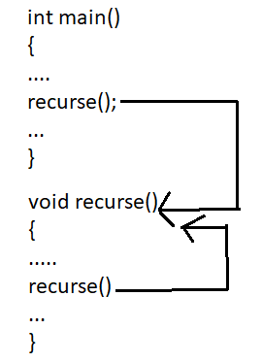
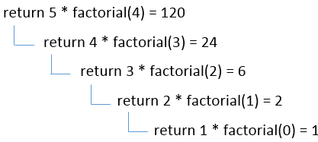
RECURSION IN C++
The process of calling a function itself is called as Recursion
Any function which calls itself is called recursive function, and such function calls are called recursive calls.
Recursion continues until some base condition is met to prevent it.

Slide 2

Base case in Recursion
Base case stops the recursion at one point
5!= 5 * 4 * 3 * 2 * 1= 5 * 4!
4!= 4 * 3!
3!= 3 * 2!
2! = 2 * 1!
1! = 1 * 0! ( factorial of 0 is 1) <-- BASE Case
If base case not there in recursion it continues to execute until memory is full
5! ->
4!->
3->
2->
1->
0->
-1->
-2->
.
.
Memory full
Hence base case is mandatory
<-- BASE Case

Slide 3
RECURSION IN C++
Create a C++ program to calculate the factorial of given number using the recursion.
INPUT:
Enter the number for factorial: 5
OUTPUT:
The factorial of given number is: 120
LOGIC:
Read a;
Declare a recursive function fact()
Define fact() to recursively call fact()
Call fact() in main

Slide 4
Example -RECURSION:
//C++ program to calculate the factorial of given number using the recursion.
#include <iostream>
using namespace std; // Using the std namespace
int fact(int n); // Function declaration
int main() {
int n;
cout << "Enter the number: ";
cin >> n;
int f = fact(n);
cout << "Factorial = " << f << endl;
return 0;
}
int fact(int n) // Function definition for finding factorial
{
if (n == 0 ) //base case
return 1;
else
return n * fact(n - 1);
}

Slide 5
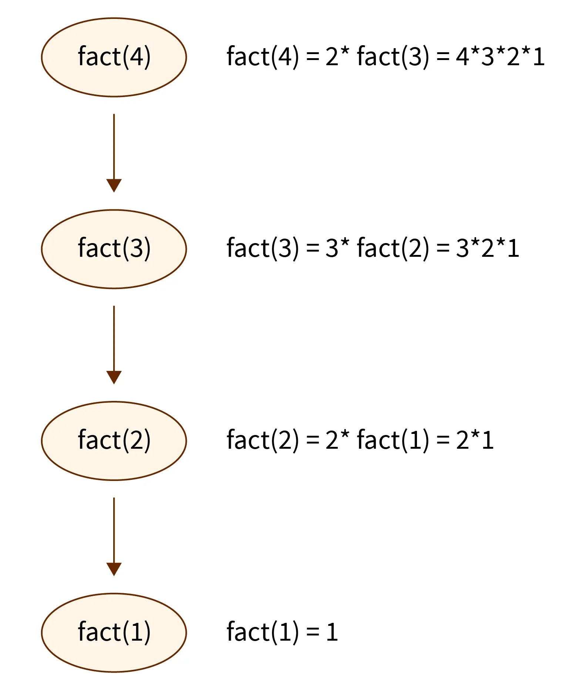
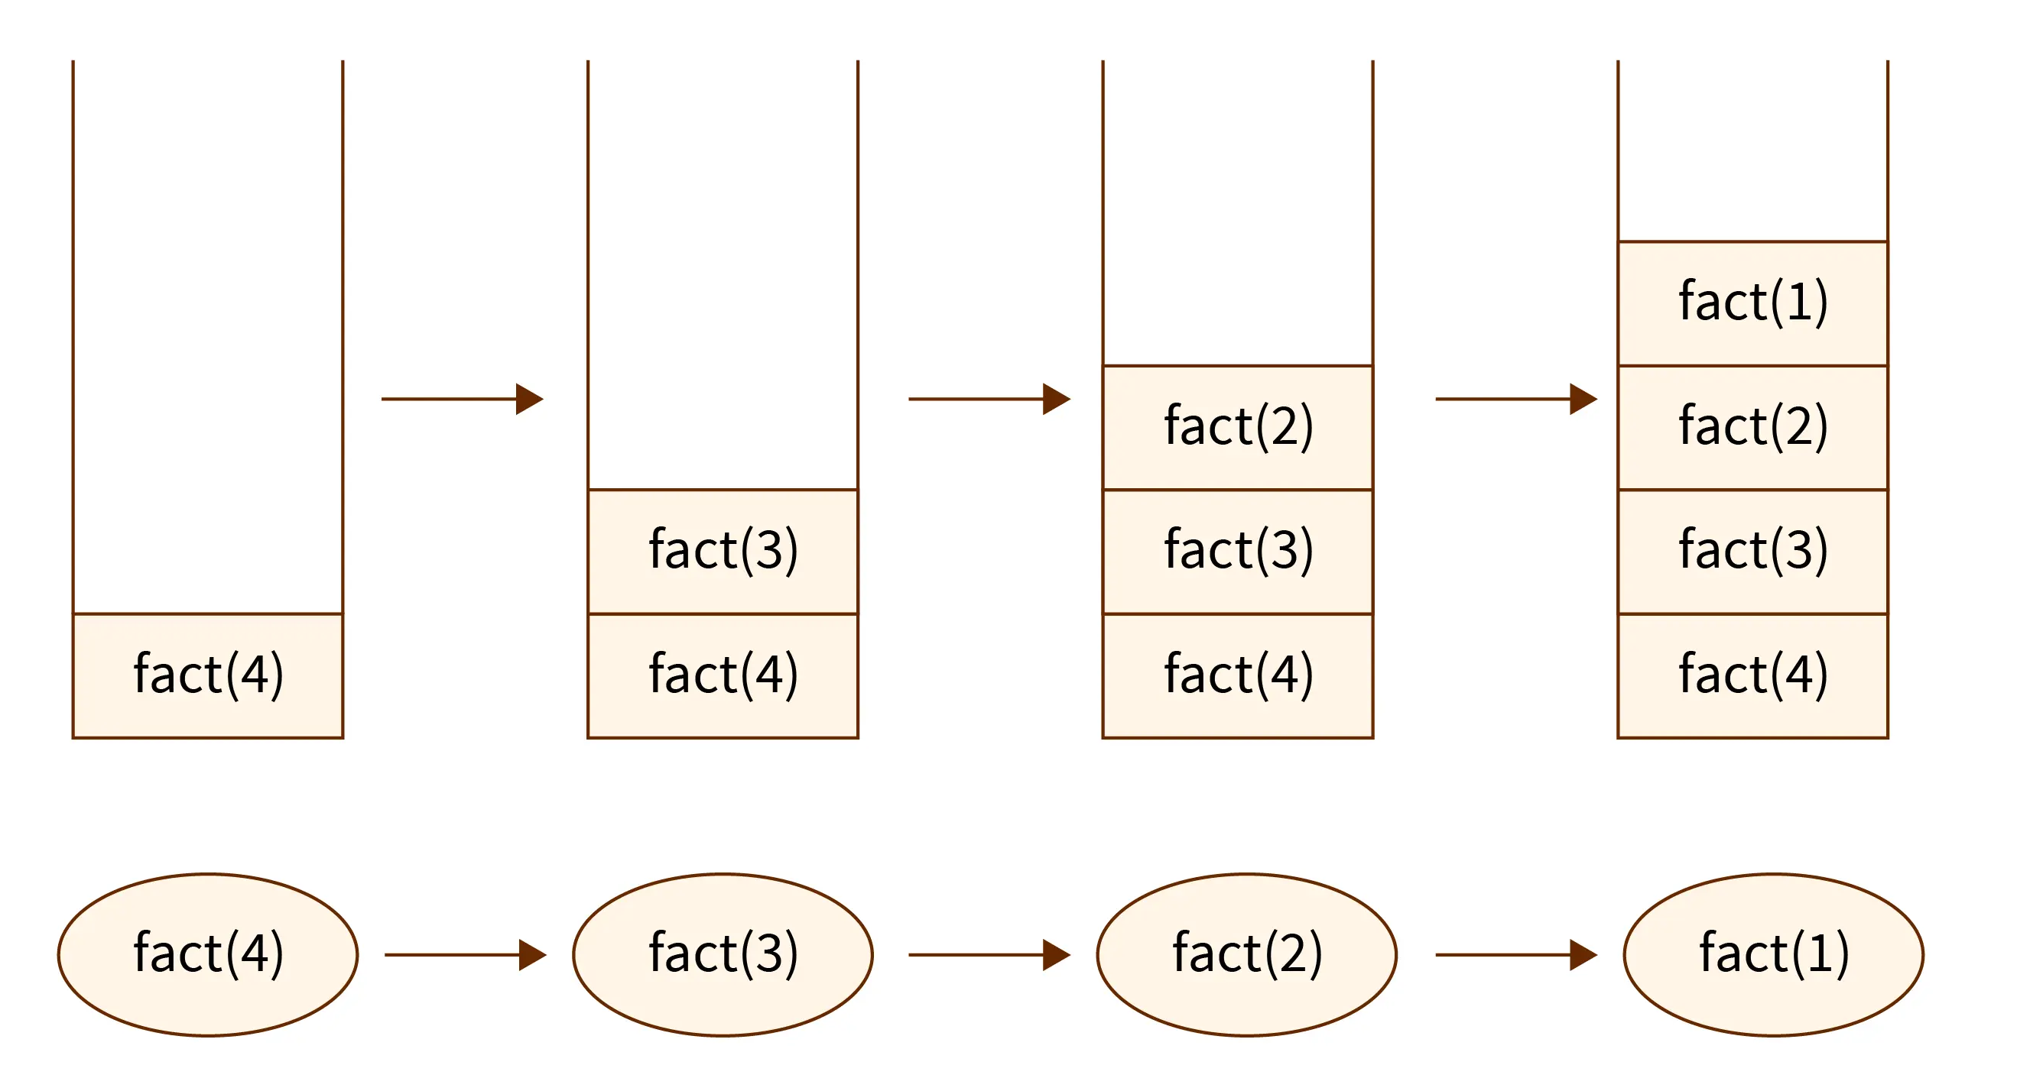
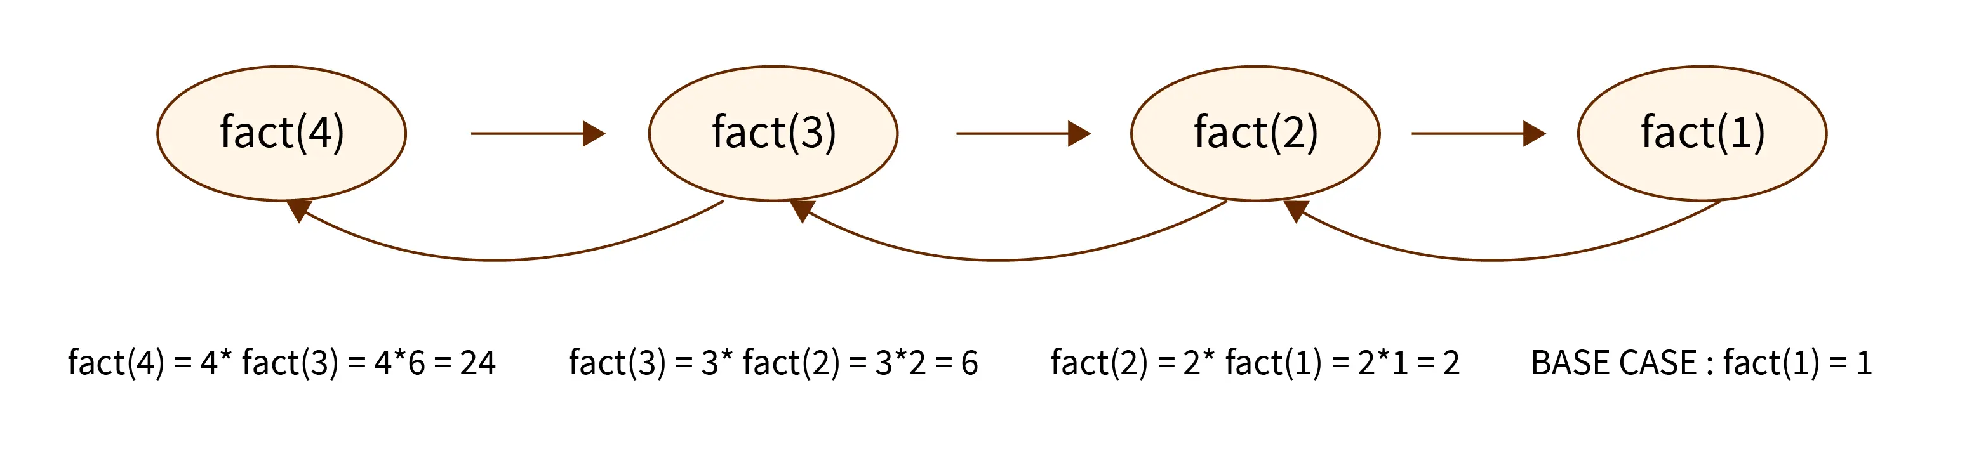
Order of Execution of recursion / Call stack
Recursion in C++ uses an internal stack to store information about the execution of the function,
Each function call gets pushed onto the stack one after another
push
Base case
push
push
push
pop
pop
pop
pop

Slide 6
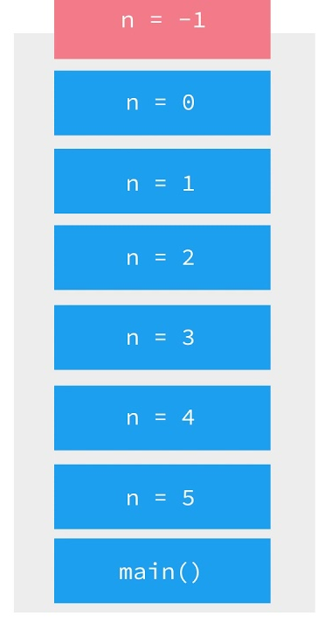
Stack overflow
If a recursive function calls itself so many times infinitely then the space needed to store the variables and with each call is more than stack. It is called as stack overflow
A recursion with out base case can make the stack overflow
int print(n )
{
return print(n-1);
}
Stack overflow

Slide 7
RECURSION
Q)Create a C++ program to calculate the sum of n Natural Numbers using the recursion.
INPUT:
Enter n : 3
OUTPUT:
The sum of Natural Numbers : 6
LOGIC:
Read a;
Declare a recursive function sum()
Define sum() to recursively call sum()
Call sum() in main()

Slide 8
Example -RECURSION:
//C++ program to calculate the sum of n-natural numbers
#include<iostream>
using namespace std;
int sum_num(int n);
int main()
{
int n;
cout<<"Enter a value \n";
cin>>n;
int res=sum_num(n);
cout<<"The sume of"<<n<<"numbers is "<<res<<endl;
return 0;
}
int sum_num(int n)
{
if(n<=0) //base case
return 0;
else
return n+sum_num(n-1);
}

Slide 9
RECURSION
Create a C++ program to calculate the FIBONACCI SERIES using the recursion.
INPUT:
Enter n : 6
OUTPUT:
The Fibonacci series is : 0 1 1 2 3 5
LOGIC:
Read n;
Declare a recursive function fib(int n, int n1, int n2)
Define fib(int n, int n1, int n2) to recursively call fib(int n-1, int n1, int n2)
Call fib(n - 2, 0, 1) in main()

Slide 10
Example -RECURSION:
#include<iostream>
using namespace std;
void fib(int n, int n1, int n2) {
if (n > 0) {
int n3 = n1 + n2;
n1 = n2;
n2 = n3;
cout << n3 << " ";
fib(n - 1, n1, n2);
}
}
int main() {
int n;
cout << "Enter the number of elements: ";
cin >> n;
if (n < 2)
{
cout << "Fibonacci Series: 0";
} else {
cout << "Fibonacci Series: 0 1 ";
fib(n - 2, 0, 1); // n-2 because 2 numbers are already printed
}
return 0;
}

Slide 11
RECURSION- ADVANTAGES
Recursive functions are very useful to solve many mathematical problems, such as calculating the factorial of a number, generating Fibonacci series, etc
To solve such problems which are naturally recursive.
Reduce unnecessary calling of function.
Extremely useful when applying the same solution.
Recursion reduce the length of code.
It is very useful in solving the data structure problem
Disadvantages of recursion
Recursive functions are generally slower than non-recursive function.
It may require a lot of memory space to hold intermediate results on the system stacks.
Hard to analyze or understand the code.
It is not more efficient in terms of space and time complexity

Slide 12
RECURSION
Q) Write a c+ program to find the sum of the digits of a number using recursion
Input:
Enter a number: 12345
Output:
Sum of digits of 12345 is 15

Slide 13
Example -RECURSION:
//c+ program to find the sum of the digits of a number using recursion
#include <iostream>
using namespace std;
// Function to find the sum of the digits of a number using recursion
int sumOfDigits(int num) {
if (num == 0) {
return 0;
}
return (num % 10) + sumOfDigits(num / 10);
}
int main() {
int num;
cout << "Enter a number: ";
cin >> num;
int result = sumOfDigits(num);
cout << "Sum of digits of " << num << " is " << result << endl;
return 0;
}

Slide 14
RECURSION
Q) Write a c++ program to reverse an array using recursion
Input:
Enter the size of array: 5
Enter the elements of array: 1 2 3 4 5
Output:
Original array: 1 2 3 4 5
Reversed array: 5 4 3 2 1

Slide 15
//c++ program to reverse an array using recursion
#include <iostream>
using namespace std;
void reverseArray(int arr[], int start, int end)
{
if (start >= end) {
return; // Base case: Array is reversed
}
// Swap the first and last elements
int temp = arr[start];
arr[start] = arr[end];
arr[end] = temp;
// Recursively reverse the subarray
reverseArray(arr, start + 1, end - 1);
}
// Function to print an array
void printArray(int arr[], int size) {
for (int i = 0; i < size; i++) {
cout << arr[i] << " ";
}
cout << endl;
}
int main() {
int arr[] = {1, 2, 3, 4, 5};
int size = sizeof(arr) / sizeof(arr[0]);
cout << "Original Array: ";
printArray(arr, size);
reverseArray(arr, 0, size - 1);
cout << "Reversed Array: ";
printArray(arr, size);
return 0;
}

Slide 16
DIRECT & INDIRECT RECURSION
Direct Recursion:
Direct recursion occurs when a function calls itself directly.
Indirect Recursion:
Indirect recursion occurs when multiple functions call each other in a circular manner.
#include <iostream>
void countdown(int n) {
if (n > 0) {
std::cout << n << " ";
countdown(n - 1); // Direct recursive call
}
}
int main() {
int n = 10;
countdown(n);
return 0;
}
#include <iostream>
void functionA(int n);
void functionB(int n) {
if (n > 0) {
std::cout << n << " ";
functionA(n - 1);
}
}
void functionA(int n) {
if (n > 0) {
std::cout << n << " ";
functionB(n - 1); //indirect call
}
}
int main() {
int n = 5000; // A large value
functionA(n);
return 0;
}

Slide 17
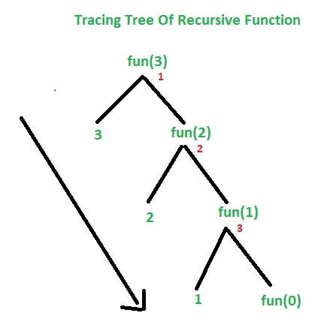
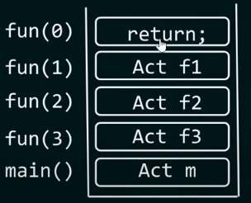

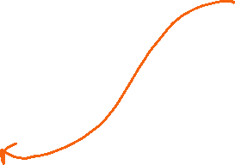
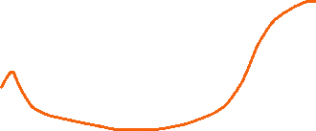
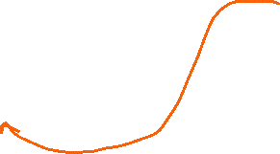



Tail and Non-tail Recursive Functions
Tail-recursive Function:
A recursive function is said to be in a tail-recursive form if the recursive call is the last operation performed in the function before returning a result.
print
void fun(int n)
{
if (n < =0)
return ;
else
{
cout<<n;
fun(n-1); //last operation
}
}
output: 3 2 1
print
print

Slide 18
Car speed analyzer
Problem Statement:
You are developing a simulation program for a car engine.
One crucial aspect of this simulation is tracking and displaying the speed of the car over time.
The speed can vary as the car accelerates or decelerates based on user input and road conditions.
You want to implement a function that calculates the speed of the car at a specific time interval, taking into account acceleration and deceleration.
Test Case 1: Acceleration Scenario
Initial Speed :10.0
Acceleration 2.0
Deceleration : 0.0
Time Elapsed 5.0 seconds
Expected Result:
The car starts with an initial speed of 10.0 m/s and accelerates at a rate of 2.0 m/s for 5.0 seconds.
The expected speed at the end of this time interval should be 20.0 m/s.

Slide 19
Car speed analyzer
#include <iostream>
using namespace std;
double calculateSpeed(double initialSpeed, double acceleration, double deceleration, double timeElapsed)
{
if (timeElapsed <= 0) { // Base case: If timeElapsed is less than or equal to 0, return the initial speed.
return initialSpeed;
}
// Calculate the new speed as initial speed + acceleration * timeElapsed - deceleration * timeElapsed.
double newSpeed = initialSpeed + (acceleration - deceleration) * timeElapsed;
// Recursive case: Call the function with the updated parameters.
return calculateSpeed(newSpeed, acceleration, deceleration, timeElapsed - 1.0);
}
int main() {
double initialSpeed, acceleration, deceleration, timeElapsed;
cout << "Enter initial speed "; cin >> initialSpeed;
cout << "Enter acceleration : "; cin >> acceleration;
cout << "Enter deceleration "; cin >> deceleration;
cout << "Enter time elapsed "; cin >> timeElapsed;
double speed = calculateSpeed(initialSpeed, acceleration, deceleration, timeElapsed);
cout << "The car's speed after " << timeElapsed << " seconds is " << speed << " m/s." << endl;
return 0;
}

Slide 20
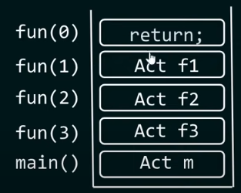




Tail and Non-tail Recursive Functions
Non-Tail Recursion:
In non-tail recursion, the recursive call is not the last operation in the function.
The function performs additional operations after the recursive call before returning a result.
int print(int n) {
if(n==0)
return;
print(n-1); //not last operation
cout<<n;
}
int main() {
print(3)
return 0;
}
Print 1
Print 2
Print 3
Output: 1 2 3

Slide 21
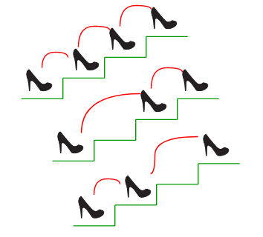
Climbing Stairs Problem
Problem Statement:
You are climbing a staircase. It takes n steps to reach the top.
Each time you can either climb 1 or 2 steps.
In how many distinct ways can you climb to the top?
1step + 1 step + 1 step
Example 1:
Input: n = 2
Output: 2
Explanation: There are two ways to climb to the top.
1 step + 1 step 2.
2 steps
Example 2:
Input: n = 3 Output: 3
Explanation: There are three ways to climb to the top. 1.
1. 1step + 1 step + 1 step
2. 1 step + 2 steps
3. 2 steps + 1 step
2 steps + 1 step
1 step + 2 steps
The value of n is 3. There are 3 ways to reach the top

Slide 22
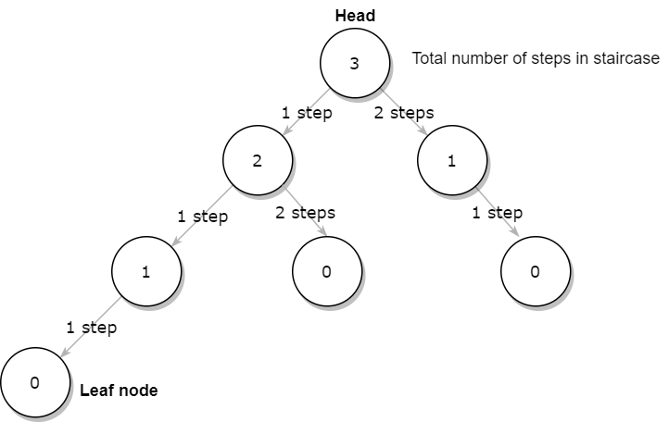






Climbing Stairs Problem
#include <iostream>
using namespace std;
int climbStairs(int n) {
if (n < 0)
return 0;
if (n == 0)
return 1;
// Recursive case
int ans = climbStairs(n - 1) + climbStairs(n - 2);
return ans;
}
int main() {
int n;
cout << "Enter the number of stairs: ";
cin >> n;
int ways = climbStairs(n);
cout << "Number of ways to climb " << n << " stairs: " << ways << endl;
return 0;
}

Slide 23
Say Digit Problem
You are working on a coding project where you need to implement a C++ function called "printDigitsInWords" that takes a three-digit number as input and prints its individual digits in words using recursion.
The goal is to convert each digit of the number into its word representation.
Test Case 1:
Input: 123
Expected Output: "One Two Three"
Test Case 2:
Input: 456
Expected Output: "Four Five Six"

Slide 24
Say Digit Problem
// say digit recursion
#include<iostream>
using namespace std;
void sayDigit(int n,string arr[]){
if(n==0)
return;
int digit = n%10;
n = n/10;
sayDigit(n,arr);
cout<<arr[digit]<<" ";
}
int main()
{
int n;
cout<<"Enter a number \n";
cin>>n;
string arr[10] = {"zero","one","two","three","four","five","six","seven","eight","nine"};
sayDigit(n,arr);
return 0;
}

Slide 25
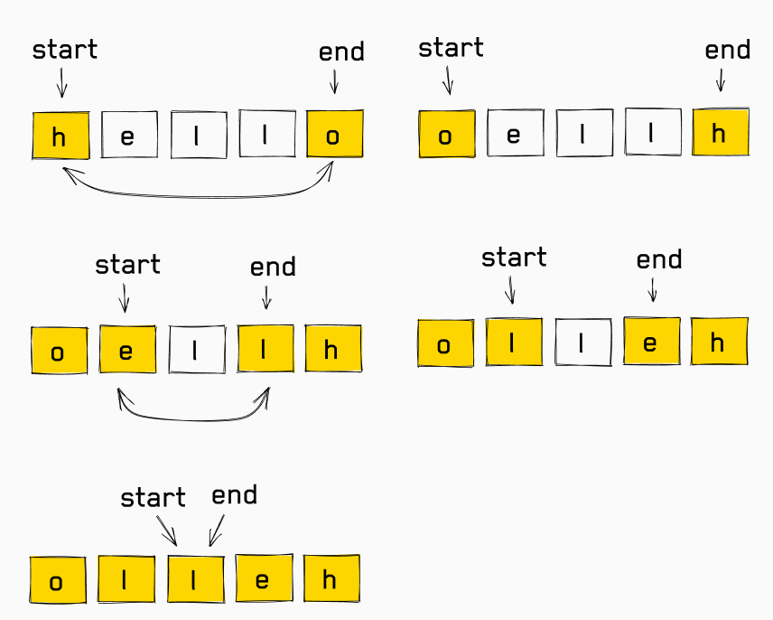
i
j
Reverse String using Recursion:
Imagine you are developing a text processing application, and one of the essential tasks is to reverse strings.
Your team is working on implementing a C++ function called "reverseString" that takes a string as input and returns the reversed version of the string.
Test Case 1:
Input: “ABCDE"
Expected Output: “EDCBA"
Test Case 2:
Input: “NAVEEN”
Expected Output: “NEEVAN"
logic:
string s=“hello”
int i=0,j=s.length()-1;
while(i<j)
{
swap(s[i],s[j]);
i++;
j--;
}

Slide 26


Reverse a string using recursion
// C++ program to reverse a string
#include<iostream>
using namespace std;
void reverseStr(string& str)
{
if(i>j)
return;
swap(str[i],str[j]);
i++;
j--;
reverseStr(str,I,j);
}
}
int main()
{ string str;
cout<<"Enter a string\n";
getline(cin,str);
reverseStr(str, 0, str.length()-1);
cout << str;
return 0;
}
a b c d e, 0, 4
e b c d a, 1, 3
e d c b a, 2, 2
Base case
e d c b a , 3, 2

Slide 27
i
j
Goal Frequency Counter:
Problem Statement:
You are developing a program that tracks the performance of a sports team over the course of a season.
You have an array that stores the number of goals scored by the team in each game.
The coach wants to analyze the team's performance by finding out how many times they scored a specific number of goals in various matches during the season
Test Case 1:
Array of goal counts: [2, 3, 2, 1, 2, 4, 2, 0]
Specific number of goals to count: 2
Expected result: The team scored 4 times with 2 goals.
Test Case 2:
Array of goal counts: [1, 1, 1, 1, 1, 1, 1, 1]
Specific number of goals to count: 0
Expected result: The team scored 0 times with 0 goals.

Slide 28
Goal Frequency Counter:
#include <iostream>
using namespace std;
int goalcounter(int goals[], int size, int specGoal) {
if (size == 0) { // Base case:
return 0;
}
// Recursive case:
if (goals[0] == specGoal)
{
// If the first element equals the specific goals, add 1 and continue with the rest of the array.
return 1 + goalcounter(goals + 1, size - 1, specGoal);
} else {
// If not equal, continue with the rest of the array.
return goalcounter(goals + 1, size - 1, specGoal);
}
}
int main() {
int size;
cout << "Enter the total matches played: ";
cin >> size;
int goals[size];
cout << "Enter the goals in each math:" << endl;
for (int i = 0; i < size; i++) {
cin >> goals[i];
}
int specGoal;
cout << "Enter the specificGoals to find the frequency of: ";
cin >>specGoal;
int count = goalcounter(goals, size, specGoal);
cout << "The team scored " << count << " times with " << specGoal << " goals." << endl;
return 0;
}

