Slide 1
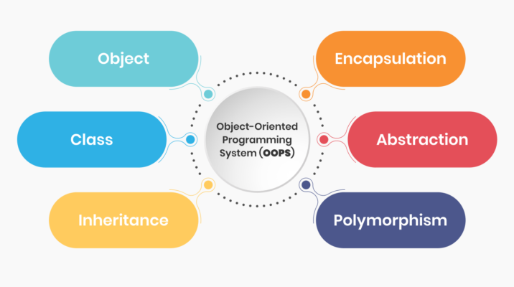
OOPs Paradigm and its features
Class and Objects
Encapsulation
Inheritance
Polymorphism
Data abstraction
Dynamic binding
Message passing

Slide 2
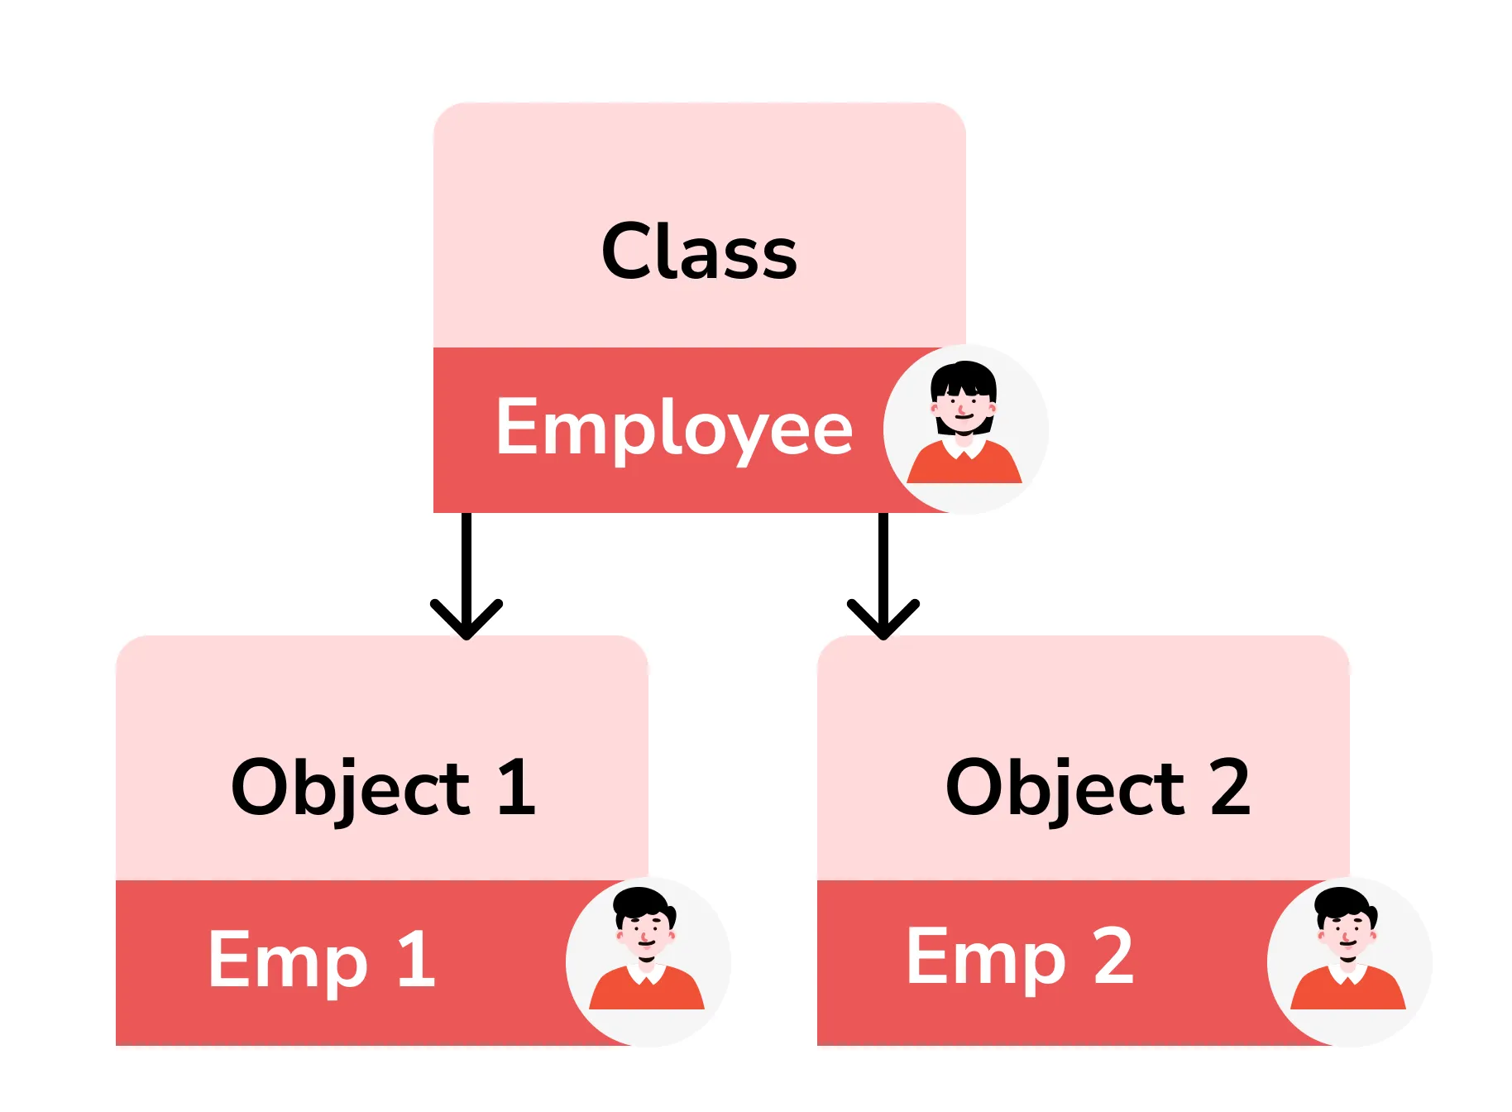
Classes And Objects
Class:
Template for declaring and creating objects
Does not contain any value
Bind data as well as methods together as a single unit
Logical Entity
Object:
Object is an instance of a class.
Memory space is assigned to them.
Each object has its own value
Objects are like a variable of the class
Physical Entity

Slide 3
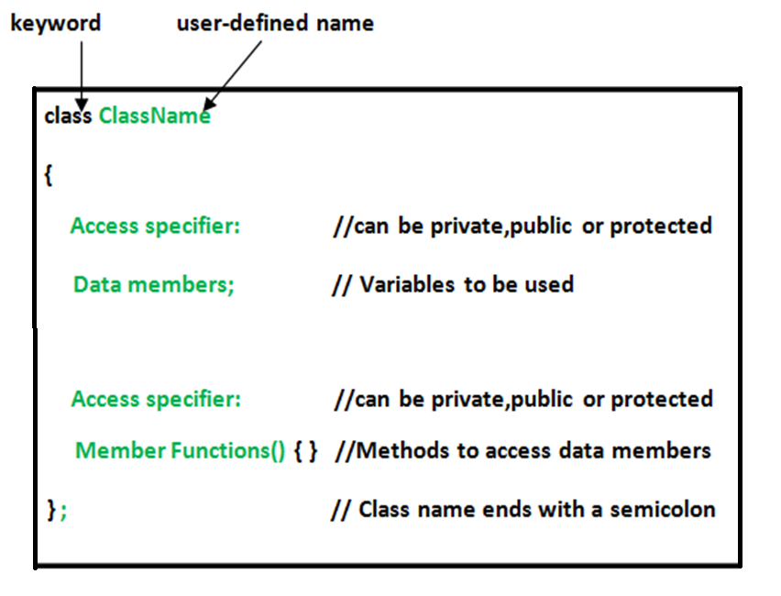
Specifying class

Slide 4
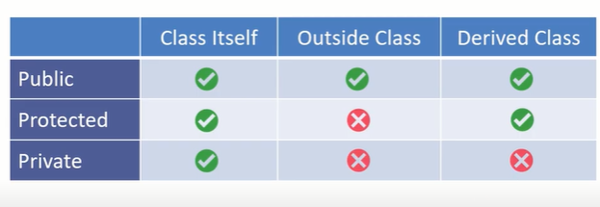
Access Control
TYPES OF ACCESS SPECIFIERS
private
public
protected
Access specifier or access modifiers are the labels that specify type of access given to members of a class.
These are used for data hiding.
These are also called as visibility modes.
public - members are accessible from outside the class.
private - members cannot be accessed (or viewed) from outside the class.
protected - members cannot be accessed from outside the class, however, they can be accessed in inherited classes.
Note: If the access specifier is not specified in the class the default access specifier is private.

Slide 5
Creating a class
//creating a class Student
class Student
{
public:
int rno;
string name;
public:
void read()
{
cout<<”Enter roll number and name”:
cin>>rno>>name;
}
void disp()
{
cout<<”Roll number:”<<rno<<endl; cout<<”Name” <<name<<endl;
}
};
//creating an object for a student class
int main()
{
// Create an object of the student class
Student std;
// Call the display function to show student details
std.read();
std.disp();
return 0;
}

Slide 6
Object Creation
Instance of a class is called as object.
To create an object , specify the class name, followed by the object name.
Syntax:
Class_name object name;
Ex. Student std;
To access the class attributes use the dot (.) on the object:
Object-name.function-name(actual arguments);
Ex:
std.get_data();
std.put_data();
int main()
{
// Create an object of the Employee class
Student std;
// Assign values to the object's member variables
std.name = “Sachin";
std.rno = 101;
// Call the display function to show employee details
std.get_data();
std.put_data();
return 0;
}

Slide 7
Q) Create a class for employee and display info using object
int main() {
// Create an object of the Employee class
Employee emp;
// Assign values to the object's member variables
emp.name = “Sachin";
emp.eid = 101;
emp.salary = 850000.0;
// Call the display function to show employee details
emp.display();
return 0;
}
//creating class
class Employee
{
//data members
public:
int eid;
string name;
double sal;
//methods
public:
void display() {
cout<<“name=“<<name<<endl;
cout<<“empno=“<<eid<<endl;
cout<<“emp sal=“<<sal<<endl;
}
};

Slide 8
Student Grade System
Problem Statement:
You are tasked with developing a C++ program to manage student records.
The program should allow users to input data for multiple students, including their name, roll number, and marks in different subjects.
Users should also be able to calculate and display the average marks for each student.
Test Case 1:
Input data for two students and calculate their average marks.
Student 1:
Name: Sachin
Roll Number: 101
Math Marks: 90
Science Marks: 85
Literature Marks: 92
Student 2:
Name: Virat
Roll Number: 102
Math Marks: 78
Science Marks: 88
Literature Marks: 76
Expected output
Name: Sachin
Roll Number: 101
Math Marks: 90
Science Marks: 85
Literature Marks: 92
Average Marks: 89
Name: Virat
Roll Number: 102
Math Marks: 78
Science Marks: 88
Literature Marks: 76
Average Marks: 80

Slide 9
//Student Grade System
#include <iostream>
#include <string>
using namespace std;
class Student
{
public:
string name; int rno, m1,m2,m3;
public:
void inputDetails() {
cout << "Enter Student's Name: ";
cin.ignore(); // Ignore any previous newline character
getline(cin, name);
cout << "Enter Roll Number: "; cin >> rollNumber;
cout << "Enter Marks: "; cin >> m1>>m2>>m3;
}
void dispDetails() {
cout << "Student's Name: " << name << endl;
cout << "Roll Number: " << rollNumber << endl;
}
void calcAvg() {
float avg=(float)(m1+m2+m3)/3;
cout<<"The avg="<<avg<<endl;
if(avg>=90) cout<<"o grade\n";
else if(avg>=80) cout<<" A+ grade \n";
else if(avg>=70) cout<<" A grade \n";
else if(avg>=60) cout<<" B grade \n";
else if(avg>=50) cout<<" C grade \n";
else cout<<" Fail \n";
}
};
int main() {
Student s1,s2;
s1.inputDetails();
s1. dispDetails();
s1. dispAvg() ;
s2.inputDetails();
s2. dispDetails();
s2. dispAvg() ;
return 0;
}

Slide 10
Banking System Transactions
You are tasked with creating a C++ program to manage bank accounts.
Design a class called BankAccount with member variables for the account number, account holder's name, and account bal.
→ Implement methods to deposit and withdraw money, and a function to display the account details
Test Case 1:
Input:
Account Number: 12345
Account Holder's Name: John Doe
Account bal: Rs10000.00
Deposit: Rs 5000
Withdraw: Rs 2000
Output:
Deposited Rs 5000 into the account.
Withdrawn Rs 2000 from the account.
Final Account Details:
Account Number: 12345
Account Holder's Name: John Doe
Account bal: Rs 13000.00

Slide 11
//Banking System
#include <iostream>
#include <string>
using namespace std;
class BankAccount {
private:
string accno;
string name;
double bal;
public:
void read()
{
cout<<”Enter acc number and name”:
cin>>accno>>name;
}
void deposit() {
int amt;
cout<<“Enter amount to doposit \n”;
if (amt> 0) {
bal += amt;
cout << "Deposit of Rs." << amount << " successful." << endl;
disp();
}
void withdraw()
{
int amt;
cout<<“Enter amount to withdraw \n”;
if (amt > 0 && amt <= bal) {
bal -= amount;
cout << "Withdrawal of Rs" << amount << " successful." << endl;
} else
{
cout << "Insufficient bal for withdrawal." << endl; }
disp();
}
void disp() {
cout << "\nAccount Details:" << endl;
cout << "Account Number: " << accno << endl;
cout << "Account Holder's Name: " << accountHolderName << endl;
cout << "bal: Rs." << bal << endl;
}
};
int main()
{
BankAccount acc; // Create an object of the BankAccount class
acc.read();
acc.disp();
acc.deposit(1000);
acc.withdraw(500);
return 0;
}

Slide 12
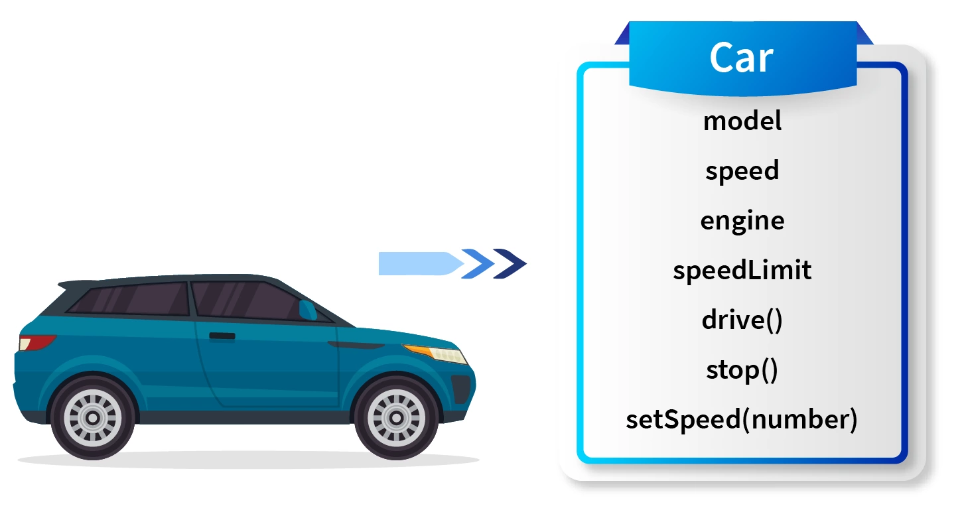
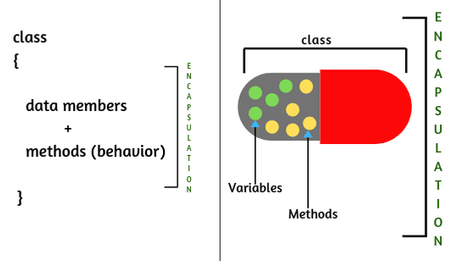
OOPs Paradigm - Encapsulation
Encapsulation: concept of bundling data (attributes) and the methods (functions) into a single unit called a class
Wrapping of data and functions together as a single unit is known as encapsulation.
Example: Car
In a car we have so many functionalities like drive(), stop(), setSpeed(number) etc. which helps us to control the car while driving,
Properties of a car like model, speed, engine, speedLimit etc. which gives us the various information about the car.

Slide 13
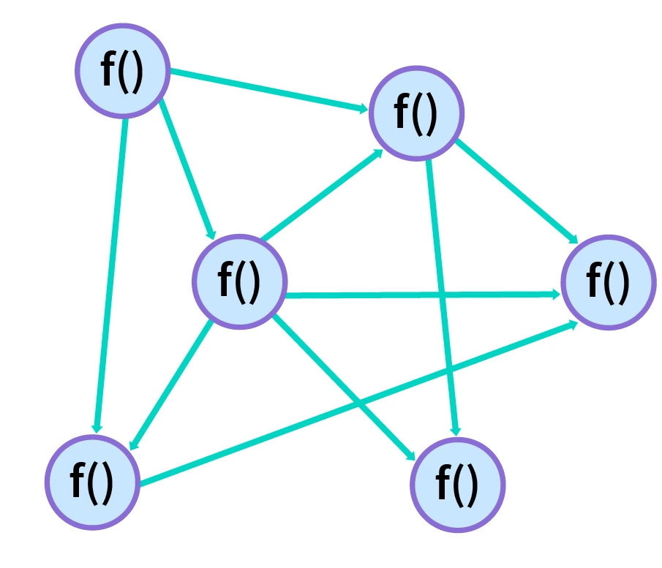
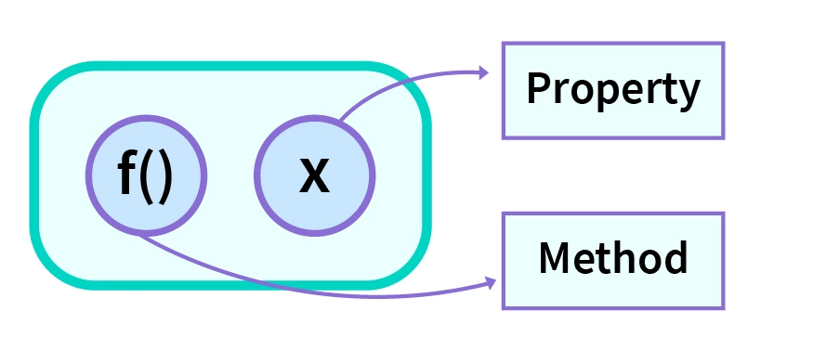
Why do we Need Encapsulation?
If we have all the member functions and data members of the program interdependent throughout the program, it becomes very difficult to use.
If we make changes in one function then there are high chances that other functions which depend on it will start to show the bugs.
This style of coding makes it very complex to use and make changes
if we wrapped data members and related member functions together then it becomes easy to access and modify them.
It reduces the complexity of code and all the related things come in a single unit.

Slide 14
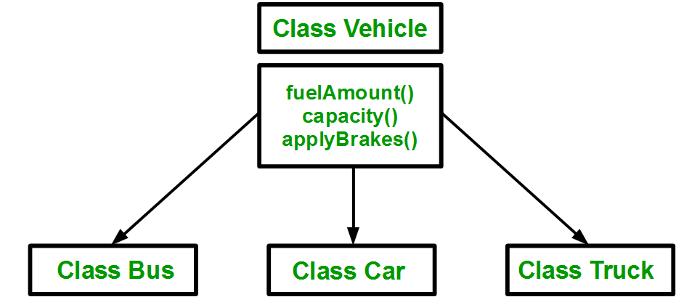
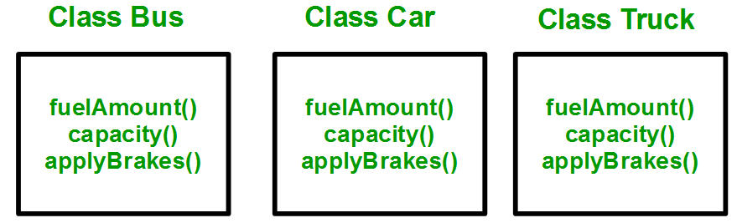
OOPs Paradigm - Inheritance
Inheritance:
Acquiring the properties and behaviors (attributes and methods) from another class, establishing a hierarchical relationship between classes.
The class that is inherited from is called the base class or parent class.
Inheritance is the most promising concept of OOP, which helps realize the goal of constructing software from reusable parts, rather than hand coding every system from scratch

Slide 15
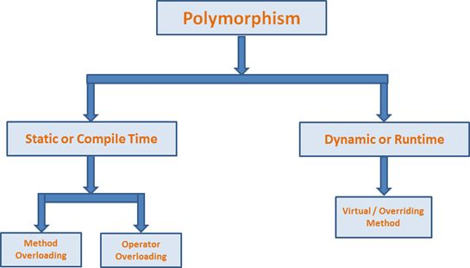
OOPs Paradigm -Polymorphism
Polymorphism comes from the Greek words “poly” and “morphism”.
“poly” means many and “morphism” means form i.e.. many forms.
Polymorphism means the ability to take more than one form.
For example, an operation have different behavior in different instances.
Different ways to achieving polymorphism in C++ program:
1) Function overloading
2) Operator overloading
3) Virtual Functions

Slide 16

Data abstraction
Abstraction refers to the act of representing essential features without including the back ground details or explanation.
Class use the concept of data abstraction so they are called Abstract Data Type (ADT)
Advantages of Abstraction
Helps to hide complexities from the user
It improves security just by showing essential details.
User only focuses on what the object does instead of how it does.
We can update the internal implementation by keeping the same interface so users will not have to adjust.
For example, disk brakes and drum brakes have different internal working but both of them are accessed with a similar interface.

Slide 17
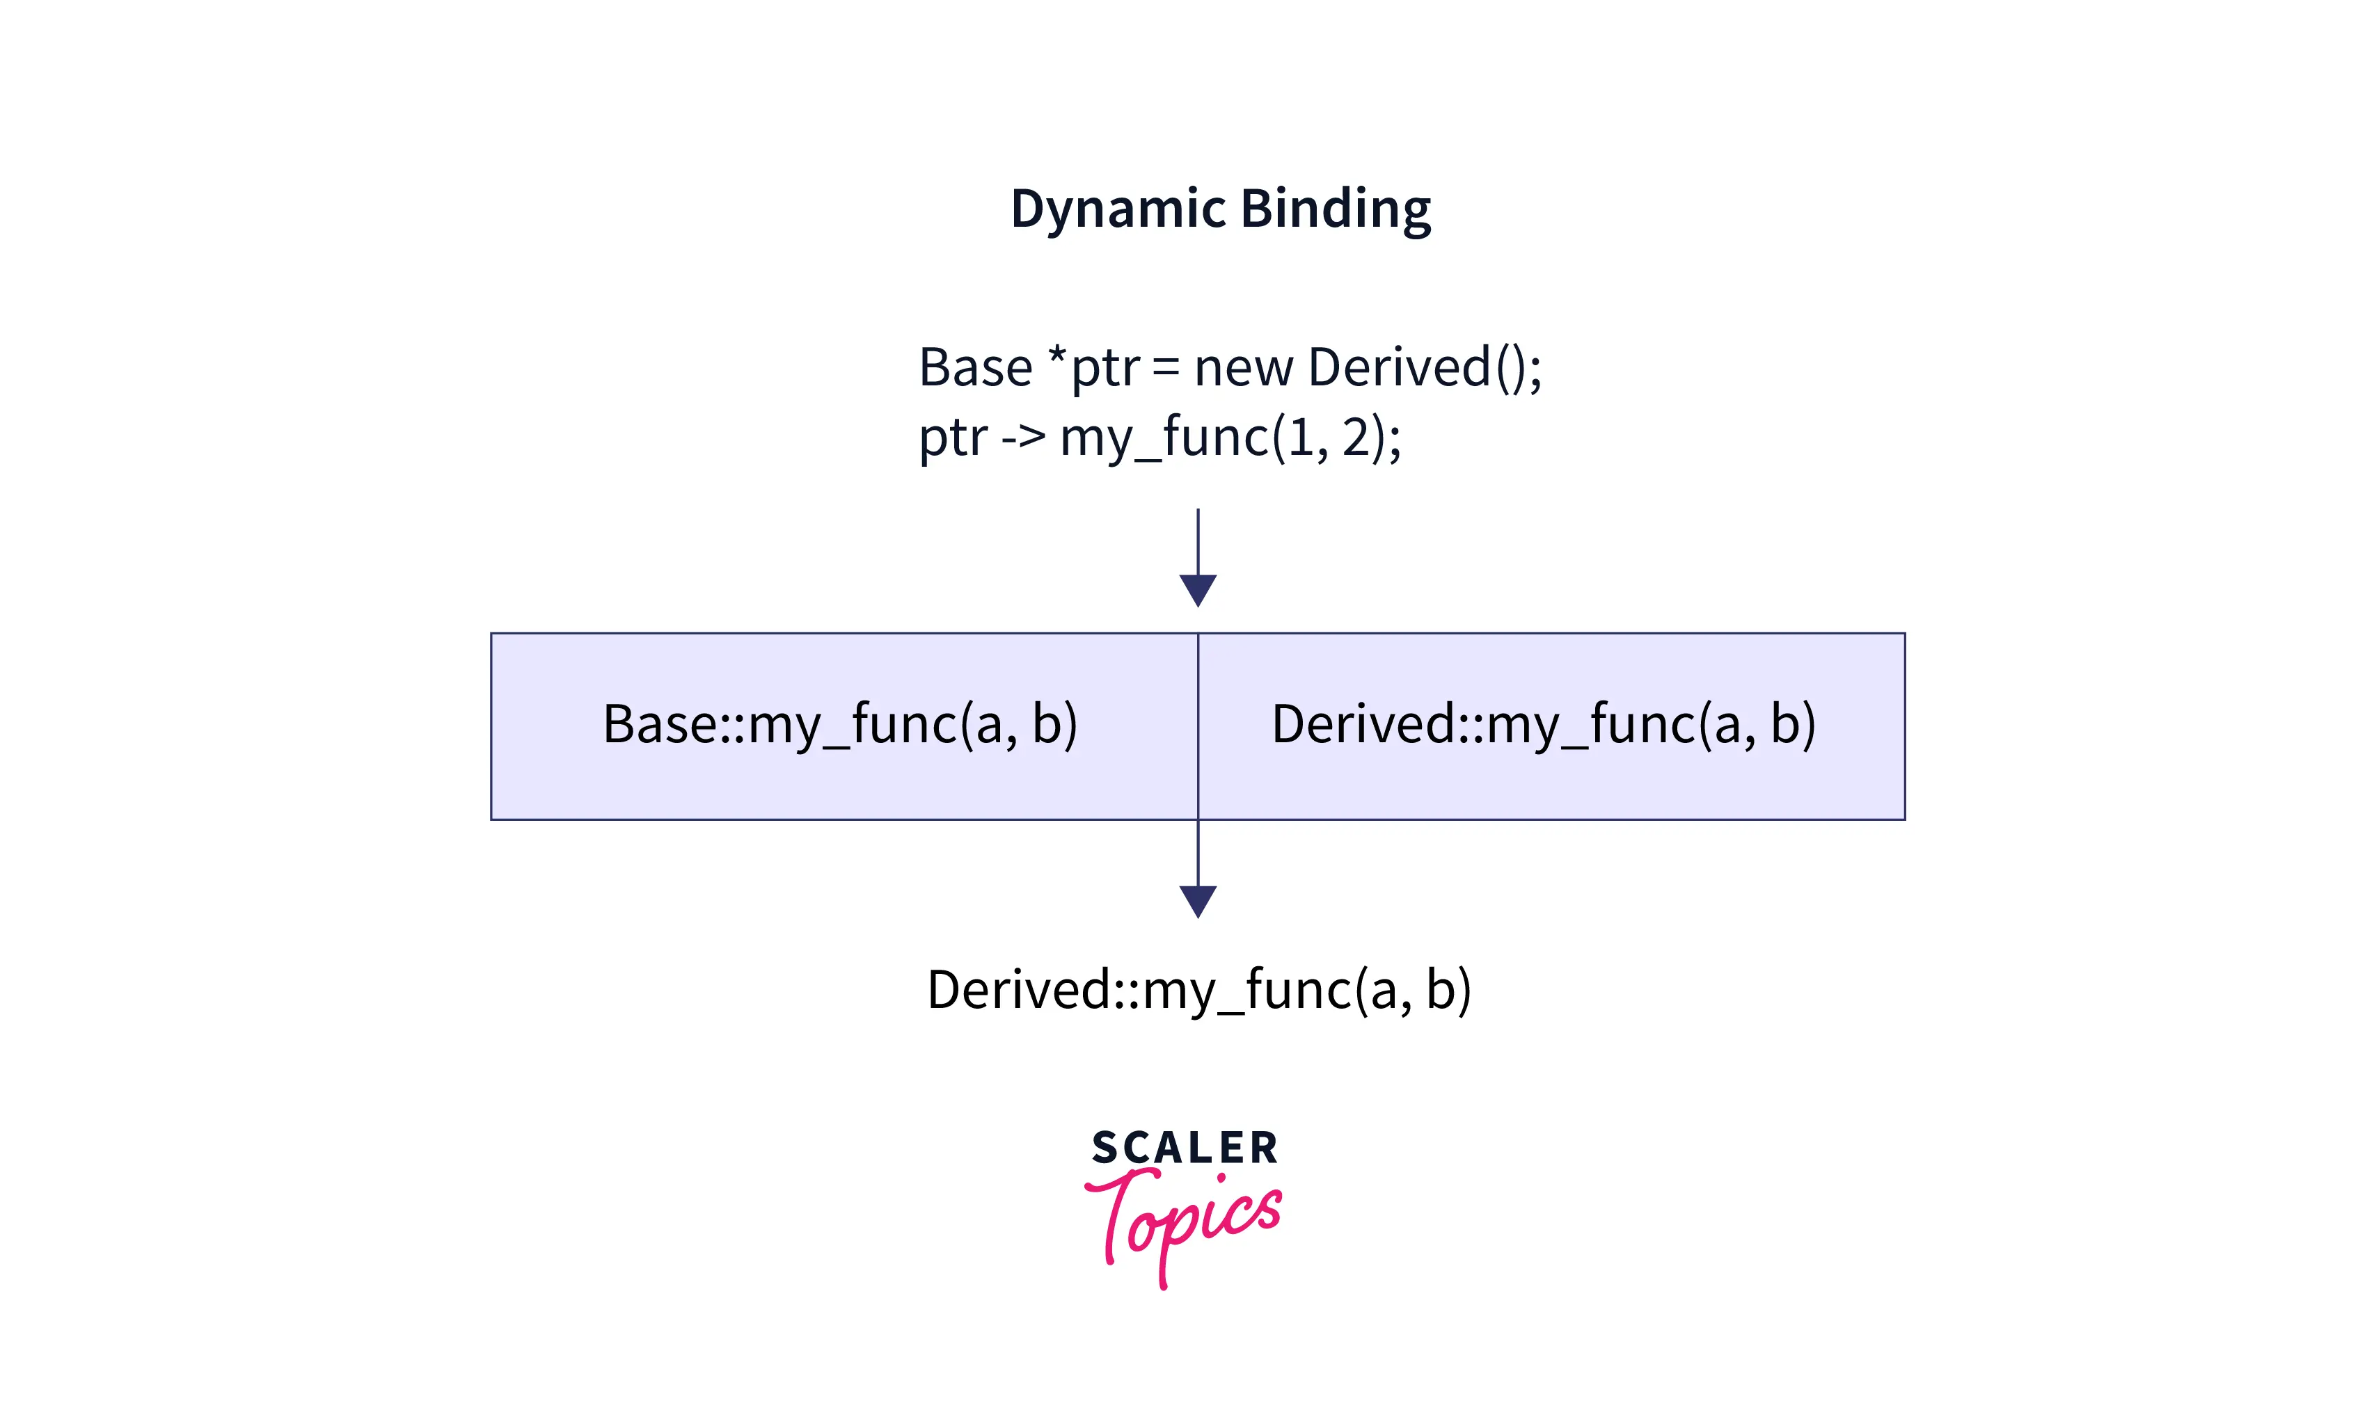
OOPs Paradigm - Dynamic binding:
Binding refers to linking of procedure call to the code to be executed in response to the call.
Dynamic binding(or late binding) means the code associated with a given procedure call in not known until the time of call at run time.
It is executed using virtual functions in C++.
A virtual function is a member function in the base class & overridden (re-defined) by its derived class(es).
While declaring in the base class, we use the keyword virtual to distinguish it.
#include<iostream>
using namespace std;
// Base Class Definition.
class base {
public:
virtual void show()
{
………function body
}
};
// Derived Class Definition.
a class derived: public base {
public:
void show()
{
………function body
}
};

Slide 18
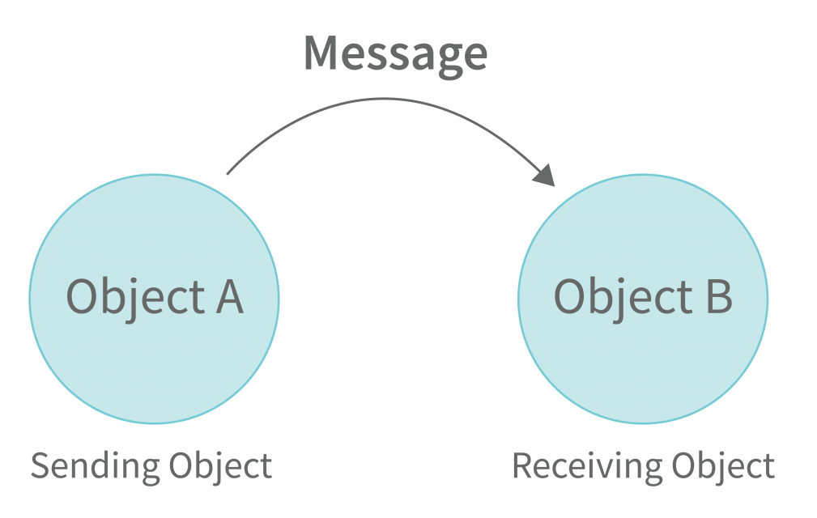
OOPs Paradigm -Message passing
Message passing in C++ is the method of communication between two or more objects
A message is a form of request that is made to an object to perform a function specific to the object to which the request was made.
Objects communicates with each other by sending and receiving information .
A message for an object is a request for execution of a procedure and therefore invoke the method that is called for an object and generates result

Slide 19
Advantages of OOP
Reusability: In OOP programs functions and modules that are written by a user can be reused by other users without any modification.
Inheritance: Through this we can eliminate redundant code and extend the use of existing classes.
Data Hiding: The programmer can hide the data and functions in a class from other classes. It helps the programmer to build the secure programs.
Reduced complexity of a problem: The given problem can be viewed as a collection of different objects. Each object is responsible for a specific task. The problem is solved by interfacing the objects. This technique reduces the complexity of the program design.
Easy to Maintain and Upgrade: OOP makes it easy to maintain and modify existing code as new objects can be created with small differences to existing ones. Software complexity can be easily managed.
Message Passing: The technique of message communication between objects makes the interface with external systems easier.

Slide 20
Car Rental System:
Problem Statement:
You're developing a car rental application.
Create a Car class with member variables for make, model, and rental price per day.
Implement a method to calculate the total rental cost for a specified number of days.
→ Create an object for a car, specify the number of rental days, and calculate the total cost.
Test Case 1:
Car details:
Make: Toyota
Model: Camry
Rental Price per Day: Rs 1000.00
Number of Rental Days: 5
Total Rental Cost: Rs.5000
Test Case 2:
Car details:
Make: Honda
Model: Civic
Rental Price per Day: Rs1500.00
Number of Rental Days: 3
Total Rental Cost: Rs.45000

Slide 21
// Car Rental System
#include <iostream>
class Car
{
private:
string make;
string model;
double rentalPricePerDay;
int numRentalDays;
public:
void setCarDetails() {
cout << "Enter the car make: "; cin >> make;
cout << "Enter the car model: "; cin >> model;
cout << "Enter the rental price per day: Rs";
cin >> rentalPricePerDay;
}
void setRentalDays() {
cout << "Enter the number of rental days: ";
cin >> numRentalDays;
}
double calculateRentalCost() {
if (numRentalDays < 1) {
cout << "Invalid number of rental days.”<< endl;
return 0.0;
}
return rentalPricePerDay * numRentalDays;
}
void displayCarDetails() {
cout << "Car Details:" << endl;
cout << "Make: " << make << endl;
cout << "Model: " << model << endl;
cout << "Rental Price per Day: $" << rentalPricePerDay << endl;
cout << "Number of Rental Days: " << numRentalDays << endl;
}
};
int main() {
Car car;
car.setCarDetails();
car.setRentalDays();
double totalCost = car.calculateRentalCost();
cout << "Total Rental Cost: Rs" << totalCost << endl;
car.displayCarDetails();
return 0;
}

Slide 22
Accessing class members
Accessing a data member depends on the access control
public data member can be easily accessed from anywhere
private or protected→ cannot access directly.
create special public member functions to access, private and protected data members.
These are called Accessors and Mutator methods or getter and setter functions.
class MyClass { public: // Public access specifier int x; // Public attribute private: // Private access specifier int y; // Private attribute }; int main() { MyClass myObj; myObj.x = 25; // Allowed (public) myObj.y = 50; // Not allowed (private) return 0; }

Slide 23
Accessing Private Data Members
To access, use and initialize the private data member use getter() and setter() functions
setter() → set the value to a private data member
getter() → return the value of the private data member to be used.
Both getter and setter must be defined public.
Accessing Protected Data Members
Accessible inside the subclass of the current class,
For non-subclass we will have to follow the steps same as to access private data member
class Student
{
private: // private data member
int rollno;
public:
int getRollno()
{
return rollno;
} setRollno
void (int i)
{
rollno=i;
}
};
int main()
{
Student s;
s.rollono=1; //Compile time error
cout<< s.rollno; //Compile time error
s.setRollno(1);
cout<< s.getRollno();
}

Slide 24
Member Functions(methods) of Classes in C++
Member functions are the functions, which are declared/ defined in class definition and works on the data members of the class.
Definition of Member Function ca be
inside class (or)
outside the definition of class.
If function definition is inside class, then no need to declare , directly define the function.
If function definition is outside class then we must declare the function inside class and then define it outside.
Here we have to use the scope resolution :: operator along with class name along with function name.
// Definition of method inside class
class Cube
{
public:
int side;
int getVolume()
{
return side*side*side; //returns volume of cube
}
};
// Definition of method outside class
class Cube
{
public:
int side;
int getVolume();
}
// member function defined outside class definition
int Cube :: getVolume() {
return side*side*side;
}

Slide 25
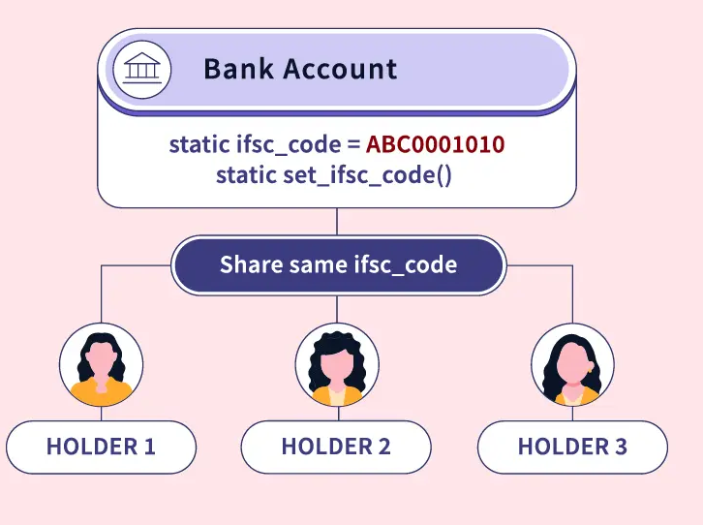
Static Data Members
Static data members in C++ are used to store values common to the entire class
A static data member is available globally for all the objects of the same class.
A static data member maintains its single copy that is shared by all the objects of the class
class BankAccount
{
public:
string name;
string accno;
static string ifscCode;
void displayIfsc() {
//code to disp ifsc code
}
};
string BankAccount::ifscCode = "ABCB0001234";
int main() {
BankAccount acc1;
BankAccount acc2;
acc1.displayIfsc (); //prints same IFSC code
acc2.displayIfsc (); //prints same IFSC code
// acc1 and acc2 use same copy of ifsc code
return 0;
}

Slide 26
//static data member
#include<iostream>
using namespace std;
class BankAccount
{
public:
string name; int accno;
static string ifscode; //static data memeber
void setDetails() {
cout<<"Enter the name of acc holder and acc no \n";
cin>>name>>accno;
}
void getDetails() {
cout<<"\n The Account details :\n";
cout<<"Name = "<<name<<" acc no= "<<accno<<" IFSC Code: "<<ifscode;
}
};
string BankAccount::ifscode="ABC123789";
int main()
{
BankAccount acc1,acc2;
acc1.setDetails(); acc2.setDetails();
acc1.getDetails();acc2.getDetails(); return 0;
}
IFSCcode
ABC123789
acc1
acc2

Slide 27
Static Member functions in C++
work for the class as whole rather than for a particular object of a class.
Created using static keyword .
Called by using class name with scope resolution :: operator.
Can be called using the object and the direct member access . operator.
class X
{
public:
static void fun()
{
// statement
}
};
int main()
{
X::fun(); // calling member function directly with class name
}
static data_type data_member_name;
class A{
static int x;
};

Slide 28
Static Data Members with Member Functions
#include<iostream>
using namespace std;
class Myclass {
private:
static int count; // Static data member to count instances
public:
void increment() {
count++;
}
static int getCount() { // Static member function to get the count
return count;
}
};
// Initialize the static count to 0
int Myclass::count = 0;
int main() {
Myclass m1,m2,m3;
m1.increment();m2.increment();m3.increment();
// Get and display the count using the static member function
int totalCount = Myclass::getCount(); //calling static member function using class
cout << "Number of instances created: " << totalCount << endl;
return 0;
}

Slide 29
Tracking Software Users
Problem Statement:
You are developing a software licensing system that tracks the number of users or instances of your software currently running.
Each time a new user starts the software, it should increment the count of active users, and when a user closes the software, it should decrement the count.
Your task is to create a UserTracker class that manages this count using static member functions and a static data member.
Test Cases:
Test Case 1:
User 1 (Sachin) starts the software.
User 2 (Viraat) starts the software.
User 3 (Rohith) starts the software.
User 1, User 2, and User 3 details are displayed.
Total active users are displayed as 3.
Test Case 2:
User 1 (Sachin) starts the software.
User 2 (Viraat) starts the software.
User 3 (Rohith) starts the software.
User 1 (Sachin) stops the software.
User 1, User 2, and User 3 details are displayed.
Total active users are displayed as 2.
LOGIC:
Define a class UserTracker with:
A static data member userCount to track active users.
Member functions to start() and stop() user activity.
A read() method to set the user's name.
A display() method to show user details.
Initialize the static data member userCount to 0.
In the main function:
Create UserTracker objects.
Set user names with read() and start user activity with start().
Display user details with display().
Get and display the total active users with getTotalUsers().

Slide 30
//TRACKING SOFTWARE USERS
#include<iostream>
using namespace std;
class UserTracker
{ public:
static int ucount;//static data member
string uname;
public:
void start(){
ucount++;
}
void stop() {
ucount--;
}
static void getAllUsers() { //static member funtion
cout<<" The no of users are :"<<ucount<<endl;
}
void setter() {
cout<<"Enter user name:\n";cin>>uname;
}
void getter() {
cout<<"User stared s.w. "<<uname<<endl;
}
};
int UserTracker::ucount=0;
int main(){
UserTracker u1,u2,u3;
u1.setter();u2.setter();u3.setter();
u1.start();u2.start();u3.start();
u1.getter();u2.getter();u3.getter();
UserTracker::getAllUsers();
return 0;
}

Slide 31
Const Member functions in C++
Const keyword makes variables constant, that means once defined, there values can't be changed.
When used with member function, such member functions can never modify the object or its related data members.
data cannot be updated in a Constant member function.
// C++ program to demonstrate that data cannot be updated
// in a Constant member function.
#include <iostream>
using namespace std;
class Demo {
int x;
public:
void set_data(int a) { x = a; }// non const member function
// data can be updated
int get_data() const
{
++x; //Error while attempting to modify the data
return x;
}
};
int main()
{
Demo d;
d.set_data(10);
cout << d.get_data();
return 0;
}
// basic syntax of const Member Function
void fun() const
{
// statement
}

Slide 32
Library catalog System
You are designing a read-only database for a library catalog.
Each book has a unique ISBN, title, and author.
Create a Book class with the following:
Private data members: ISBN, title, and author.
Read book details
Create Constant member functions to retrieve book details.
LOGIC:
Define a Book Class:
Create a class named Book with private member variables for ISBN, title, and author.
Implement a rea() to initialize a book with ISBN, title, and author.
Create a const disp() method to display the book's information.
Main Function:
In the main function, create instances of the Book
Set the book information using read()
Use the disp method to display the information of each book.
Testcase 1:
Book 1 ISBN: 978-1234567890
Book 1 Title: Introduction to Programming
Book 1 Author: John Smith
Book 2 ISBN: 978-0987654321
Book 2 Title: Data Structures and Algorithms
Book 2 Author: Jane Doe

Slide 33
//Library catalog System
#include <iostream>
using namespace std;
class Book {
private:
string ISBN;
string title;
string author;
public:
void read(const string& isbn, const string& bookTitle, const string& bookAuthor)
{
ISBN = isbn;
title = bookTitle;
author = bookAuthor;
}
void disp() const {
//ISBN="4343434"; cannot change
cout << "ISBN: " << ISBN << endl;
cout << "Title: " << title << endl;
cout << "Author: " << author << endl;
}
};
int main() {
Book book1, book2;
book1.read("978-1234567890", “C++", “BJarne");
book2.read("978-0987654321", “ Let us C", “Dennis");
cout << "Book 1 Details:" << endl;
book1.disp();
cout << "\nBook 2 Details:" << endl;
book2.disp();
return 0;
}

Slide 34
Constant objects
const object cannot be modified
invoke only const member functions.
created by prefixing the const keyword
Any attempt to change the data member of const objects results in a compile-time error.
#include <iostream>
#include <string>
using namespace std;
class Book {
public:
const string title = "The Catcher in the Rye";
void display() const {
cout << "Title: " << title << endl;
}
};
int main() {
// Create a constant Book object
const Book myBook;
myBook.display();
// Attempt to modify the constant Book object (will result in a compilation error)
// myBook.title = "New Title"; // Error: 'title' is read-only in a const object
return 0;
}
// Create a constant Book object
const Book myBook;

Slide 35
Immutable Geographical Coordinates
Problem Statement:
You are building a Geographic Mapping Application and need to represent geographical coordinates (latitude and longitude).
Create a class GeoCoordinates to store these coordinates and ensure that they remain constant once set.
Provide constant methods to access and display the coordinates.
Testcase 1:
Input:
We create an immutable GeoCoordinates object with latitude 37.7749 and longitude -122.4194 during object initialization.
Output:
Geographical Coordinates:
Latitude: 37.774900
Longitude: -122.419400
Accessing Coordinates Using Constant Methods:
Latitude: 37.774900
Longitude: -122.419400
LOGIC:
Create GeoCoordinates class
Define private constant member variables latitude and longitude, which are initialized to specific values (37.7749 and -122.4194).
The class provides two constant member functions getLatitude and getLongitude that allow you to access the latitude and longitude values, respectively.
Create a constant GeoCoordinates object named coordinates
Since the member variables of coordinates are constant, their values cannot be changed after initialization.
The getLatitude and getLongitude methods of the coordinates object are used to access and display the latitude and longitude values.

Slide 36
//Immutable Geographical Coordinates
#include <iostream>
#include <iomanip>
using namespace std;
class GeoCoordinates {
private:
const double latitude=37.7749;
const double longitude=-122.4194;
public:
double getLatitude() const {
return latitude;
}
double getLongitude() const {
return longitude;
}
};
int main() {
const GeoCoordinates coordinates;
cout << "Accessing Coordinates Using Constant Methods:" << endl;
cout << "Latitude: " << coordinates.getLatitude() << endl;
cout << "Longitude: " << coordinates.getLongitude() << endl;
return 0;
}

Slide 37
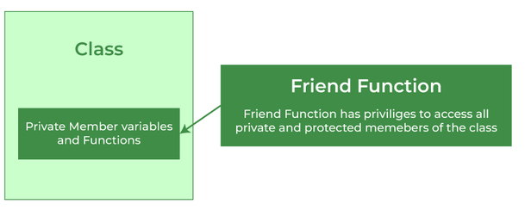
Friend functions in C++
Actually, not class member function.
Made to give private access to non-class functions.
We can declare a friend function as...
A global function
A member function of another class
//making a global function as friend
class MyClass
{
int i;
public:
friend void fun(MyClass); // global function as friend
};
void fun(MyClass obj) //global function
{
obj.i=10; // access to private data member
cout << obj.i;
}
int main()
{
MyClass obj;
fun(obj); //Can be called directly
}

Slide 38
Friend functions in C++
//Friend Funtion
#include <iostream>
using namespace std;
class Box {
private:
double length;
double width;
double height;
public:
// Member function to set the dimensions of the box
void setDimensions(double l, double w, double h) {
length = l;
width = w;
height = h;
}
// Declare the friend function
friend double calculateVolume(const Box& box);
};
// Define the friend function to calculate the volume
double calculateVolume(Box b) {
return b.length * b.width * b.height;
}
int main()
{
Box myBox;
myBox.setDimensions(3.0, 4.0, 5.0);
double volume = calculateVolume(myBox);
cout << "Volume of the box: " << volume << " cubic units" ;
return 0;
}

Slide 39
Banking System- Fund Transfer
Problem Statement:
You are a software developer working on a banking system.
The code provided allows users to input details for two bank accounts (Account 1 and Account 2) and perform operations like deposit, withdrawal, and fund transfer between these accounts.
Account details include the account number and initial balance.
Your task is to use the friend function to tranfer balance from one account to another account.
Test Case: Comprehensive Banking Operations
User inputs for Account 1:
Account Number: 101
Initial Balance: Rs. 10000.00
User inputs for Account 2:
Account Number: 102
Initial Balance: Rs. 15000.00
User deposits Rs. 2000.0 into Account 1.
User withdraws Rs. 1000.0 from Account 2.
User transfers Rs. 3000.0 from Account 1 to Account 2.
Enter acc1 details
Enter acc no
101
Enter initial balance
1000.0
Enter acc2 details
Enter acc no
102
Enter initial balance
500.0
Initial Balances:
Account 1: Rs1000.00
Account 2: Rs500.00
Deposited Rs2000.00 into Account 101
Withdrawn Rs1000.00 from Account 102
Transferred Rs 3000.00 from Account 101 to Account 102
Final Balances:
Account 1: Rs14000.00
Account 2: Rs7000.00

Slide 40
//Banking System- Fund Transfer
#include <iostream>
#include <iomanip>
using namespace std;
class BankAccount {
private: int accno; double balance;
public:
void setDetails() {
cout<<"Enter acc no \n"; cin>>accno;
cout<<"Enter initial balance \n"; cin>>balance;
}
void deposit(double amount) {
balance += amount;
cout << "Deposited Rs" << amount << " into Account " << accno << endl;
}
void withdraw(double amount) {
if (balance >= amount) {
balance -= amount;
cout << "Withdrawn Rs." <<amount << " from Account " << accno << endl;
} }
double getBalance() const {
return balance;
}
friend void transferFunds(BankAccount& from, BankAccount& to, double amount);
};
void transferFunds(BankAccount& from, BankAccount& to, double amount) {
if (from.balance >= amount) {
from.balance -= amount;
to.balance += amount;
cout << "Transferred Rs." << amount << " from Account " << from.accno << " to Account " << to.accno << endl;
} }
int main() {
BankAccount account1;
BankAccount account2;
cout<<"Enter acc1 details \n";
account1.setDetails();
cout<<"Enter acc2 details \n";
account2.setDetails();
cout << "Initial Balances:" << endl;
cout << "Account 1: Rs" << account1.getBalance() ;
cout << "Account 2: Rs" << account2.getBalance() << endl;
account1.deposit(200.0);
account2.withdraw(100.0);
transferFunds(account1, account2, 300.0);
cout << "Final Balances:" << endl;
cout << "Account 1: Rs" << account1.getBalance() << endl;
cout << "Account 2: Rs" << account2.getBalance() << endl;
return 0;
}

Slide 41
Library Management System Using Friend
Problem Statement:
Suppose you are designing a Library Management System in C++.
You have a Book class with private attributes like title, author, and isAvailable.
You want to implement a friend function that allows the library staff to mark a book as available or not. Write a C++ program that demonstrates this scenario.
Test Case 1: Book Availability
Input:
Title: "The Great Gatsby"
Author: "F. Scott Fitzgerald"
Availability: true (initially)
Output:
Book Title: The Great Gatsby Author: F. Scott Fitzgerald This book is available.
Logic:
Book Class:
Define a Book class with private attributes title, author, and isAvailable.
Friend Function:
Declare a friend function markBookAvailability to toggle book availability.
Main Function:
Create a Book object.
Use read to set book details.
Display details.
Update availability with markBookAvailability.
Display availability.

Slide 42
// Library Management System using friend function
#include <iostream>
#include <string>
using namespace std;
class Book {
public:
string title;
string author;
bool isAvailable;
public:
friend void markBookAvailability(Book& book, bool available);
void read(const string& t, const string& a) {
title = t;
author = a;
isAvailable = true; // Assuming the book is initially available
}
void displayBookDetails() {
cout << "Book Title: " << title << endl;
cout << "Author: " << author << endl;
}
};
void markBookAvailability(Book& book, bool available) {
book.isAvailable = available;
}
int main() {
Book myBook;
myBook.read("The Great Gatsby", "F. Scott Fitzgerald");
myBook.displayBookDetails();
markBookAvailability(myBook, true);
if (myBook.isAvailable)
{
cout << "This book is available." << endl;
} else
{
cout << "This book is not available." << endl;
}
return 0;
}

Slide 43
Friend class
we can also make function of some other class as friend, or we can also make an entire class as friend class
Friend Functions is a reason, why C++ is not called as a pure Object Oriented language.
Because it violates the concept of Encapsulation
class A
{
void fun();
};
class B
{
private:
int i;
public:
void getdata(); // Member function of class B
// making function of class Other as friend here
friend void A::fun();
// making the complete class as friend
friend class A;
};

Slide 44
Bank Account Balance Inquiry
Problem Statement:
You are designing a banking application in C++.
You have a BankAccount class representing a user's bank account,
You have to create a BankEmployee class to handle balance inquiries without exposing the account's private data publicly
Input:
Enter account holder name: Alice
Enter initial balance: Rs.5000
Expected Output:
Balance inquiry from Bank employee
Account holder: Alice
Current balance: Rs.5000
LOGIC:
Define two classes: BankEmployee and BankAccount.
Declare BankEmployee as a friend class of BankAccount for access to private members.
In the BankAccount class, implement functions:
setAccountHolder: Read and store the account holder's name.
setBalance: Read and store the initial balance.
In the BankEmployee class, implement a function:
inquireBalance: Display account holder's name and balance.
In the main function:
Create instances of BankAccount and BankEmployee.
Use functions to set account details and inquire about the balance

Slide 45
Bank Account Balance Inquiry
#include <iostream>
#include <string>
class BankAccount; // Forward declaration
class BankEmployee {
public:
void inquireBalance(BankAccount& account);
};
class BankAccount {
private:
std::string accountHolder;
double balance;
public:
void setAccountHolder() {
cout << "Enter account holder name: ";
cin >> accountHolder;
}
void setBalance() {
cout << "Enter initial balance: Rs.";
cin >> balance;
}
friend class BankEmployee; // Friend class declaration
};
void BankEmployee::inquireBalance(BankAccount& account)
{
cout<<"Balance inquiry from Bank employee \n";
cout << "Account holder: " << account.accountHolder << endl;
cout << "Current balance: Rs." << account.balance << endl;
}
int main() {
BankAccount account;
BankEmployee bankEmployee;
account.setAccountHolder();
account.setBalance();
bankEmployee.inquireBalance(account);
return 0;
}

Slide 46
CarMilageTracker
Problem Statement:
You are developing an application to track car information and mileage.
The application has two classes, Car and CarOwner.
The Car class stores car details and mileage, while the CarOwner class allows the owner to update the car's mileage.
Create a scenario where a car owner uses the program to track their car's mileage.
LOGIC;
Create a Car class with private members for make, model, and mileage.
Create a read method in the Car class to read the make and model from the user.
Create a displayInfo method in the Car class to display the car's make, model, and mileage.
Create a CarOwner class.
Create a driveCar method in the CarOwner class to update the car's mileage.
In the main function:
Create a Car object.
Create a CarOwner object.
Read the car's make and model using the read method.
Display the car's details and initial mileage using the displayInfo method.
Update the car's mileage using the driveCar method.
Display the updated mileage using the displayInfo method.
Input:
Enter car make: Honda
Enter car model: Accord
Output (Initial Mileage):
Car Make: Honda
Car Model: Accord
Mileage: 0 miles
Output (After Driving 150 miles):
Car Make: Honda
Car Model: Accord
Mileage: 150 miles

Slide 47
//CarMilageTracker
#include <iostream>
using namespace std;
class CarOwner; // Forward declaration
class Car {
private:
string make; string model; int mileage;
public:
void read() {
cout << "Enter car make: "; cin >> make;
cout << "Enter car model: "; cin >> model;
}
void displayInfo() const {
cout << "Car Make: " << make << endl;
cout << "Car Model: " << model << endl;
cout << "Mileage: " << mileage << " miles" << endl;
}
friend class CarOwner; // CarOwner class is a friend
};
class CarOwner {
public:
void driveCar(Car& car, int miles) {
car.mileage += miles;
}
};
int main() {
Car car;
CarOwner owner;
car.read(); // Read car make and model from the user
car.displayInfo(); // Display initial mileage
owner.driveCar(car, 100); // Owner drives the car
car.displayInfo(); // Display updated mileage
return 0;
}

Slide 48
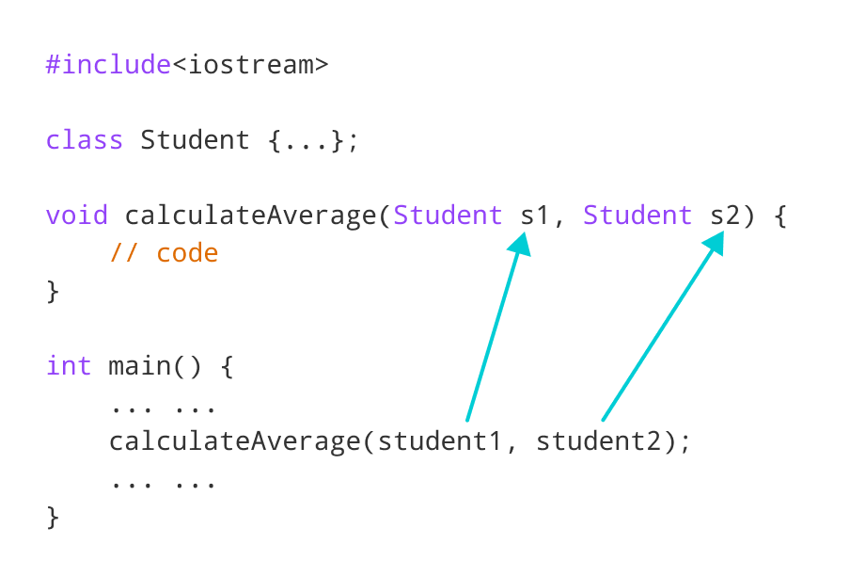
Passing and Returning Objects in C++
In C++ we can pass class’s objects as arguments and also return them from a function the same way we pass and return other variables
Passing an Object as argument
To pass an object as an argument we write object name as the argument while calling the function the same way we do it for other variables.
Here, we have passed two Student objects student1 and student2 as arguments to the calculateAverage() function.
Syntax:
function_name(object_name);

Slide 49
// C++ program to calculate the average marks of two students
#include <iostream>
using namespace std;
class Student {
public:
double marks;
// initialize marks
void read() {
cin>>marks;
}
void disp() {
cout<<marks;
}
};
// function that has objects as parameters
void calculateAverage(Student s1, Student s2) {
// calculate the average of marks of s1 and s2
double average = (s1.marks + s2.marks) / 2;
cout << "Average Marks = " << average << endl;
}
int main() {
Student s1, s2;
s1. read(); s2.read();
// pass the objects as arguments
calculateAverage(student1, student2);
return 0;
}

Slide 50
Employee bonus system
Problem Statement:
You are tasked with building a software system to manage employee bonus.
→ You have designed an Employee class with attributes such as eid, name, and salary.
→ You need to implement a function calculateBonus() that takes an Employee object and a bonus percentage as arguments.
The function should calculate the bonus amount and update the employee's salary accordingly.
Employee Information After Bonus:
Input:
----------
Employee ID: 101
Name: Sachin
Output:
-----------
Salary After Bonus: Rs. 5500.00
LOGIC
Create Employee class with the specified attributes.
Develop the calculateBonus() that takes an Employee object and a bonus percentage as arguments, calculates the bonus
In main(), create an Employee object and input their details (eid, name, and current salary) from the user.
Prompt the user to enter a bonus percentage and call the calculateBonus() to calculate and apply the bonus.
Display the employee's information, including their updated salary after the bonus.

Slide 51
//EMPLOYEE BONUS SYSTEM
#include <iostream>
using namespace std;
class Employee {
public:
int eid;
string name;
double salary;
// Function to read employee information
void read()
{
cout << "Enter Employee ID: "; cin >> eid;
cin.ignore(); // Clear the input buffer
cout << "Enter Employee Name: "; getline(cin, name);
cout << "Enter Employee Salary: Rs"; cin >> salary;
}
// Function to display employee information
void displayEmployee()
{
cout << "Employee ID: " << eid << endl;
cout << "Name: " << name << endl;
cout << "Salary: $" << salary << endl;
}
};
// Function to calculate and apply a bonus to an employee passed as an argument (by value)
void applyBonus(Employee emp, double bonusPercentage)
{
double bonusAmount = (bonusPercentage / 100.0) * emp.salary;
emp.salary = emp.salary+bonusAmount;
cout<<"After bonus salary is "<<emp.salary;
int main()
{
// Create an Employee object and read employee information
Employee employee1;
employee1.read();
// Calculate and apply a bonus using a function
double bonusPercentage;
cout << "Enter Bonus Percentage: ";
cin >> bonusPercentage;
applyBonus(employee1, bonusPercentage);
return 0;
}

Slide 52
How do pass objects to functions?
Passing objects to functions.
Pass by value
Pass by reference
Pass by pointer
1) Pass by value
This creates a shallow local copy of the object in the function scope.
Things you modify here won’t be reflected in the object passed to it.
For example:
…
void fun(Test t);
…
Test t;
fun(t); //Calling function by passing object t

Slide 53
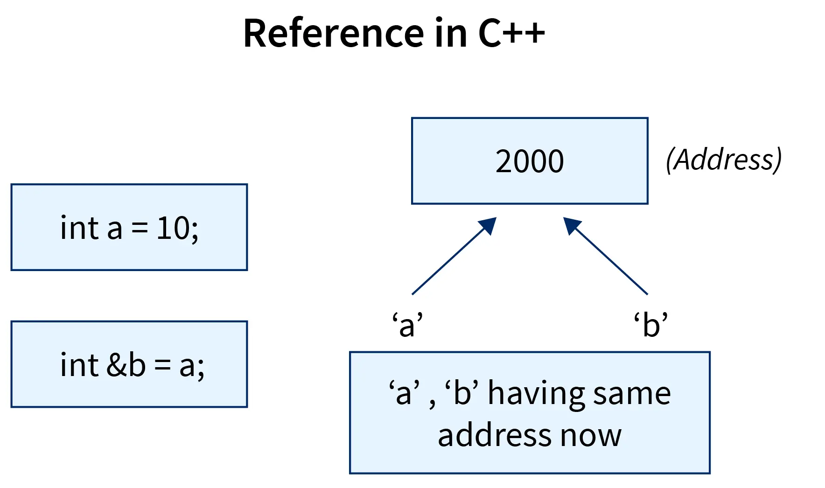
How do pass objects to functions?
2) Passing object as reference
This passes a reference to the object to the function.
Things you modify here will be reflected in the object passed to it.
No copy of the object is created.
class person
{
int age;
public:
void readage() {
cout<<“ener age \n”; cin>>age;
}
};
void changeAge(person &p) //reference of object person
{
int newage; cout<<“enter new age \n”;
cin>>newage;
p.age=newage;
}
int main() {
person p;
p.readage();
changeAge(p); //calling function object
return 0;
}
Reference variable points to the address of the original variable and any changes made to the reference variable will be reflected in the original variable.

Slide 54
EMPLOYEE PERFORMANCE EVALUATION SYSTEM
Problem Statement:
Imagine you are tasked with building an employee performance evaluation system.
You have an Employee class with attributes such as eid, name, and rating.
You need to implement a function evaluateEmployee() that takes an Employee object as an argument and returns a performance assessment.
Employee ID: 101
Name: Alice Johnson
Performance Rating: 92
Performance Assessment: Excellent
Employee ID: 102
Name: Bob Smith
Performance Rating: 75
Performance Assessment: Good
Employee ID: 103
Name: Charlie Brown
Performance Rating: 45
Performance Assessment: Needs Improvement
LOGIC
Create Employee class.
Implement evaluateEmployee(Employee &e) function by taking Employee e object referenc
Create object for Employee class.
Call evaluateEmployee() by passing Employee object

Slide 55
//Employee Evaluation:
#include <iostream>
using namespace std;
class Employee {
public:
int eid; string name; int rating;
// Function to read employee information from the user.
void read() {
cout << "Enter Employee ID: "; cin >> eid;
cout << "Enter Employee Name: ";
cin.ignore(); // Clear the input buffer
getline(cin, name);
cout << "Enter Performance Rating: "; cin >> rating;
}
// Function to display employee information.
void disp() {
cout << "\nEmployee Information:" << endl;
cout << "Employee ID: " << eid << endl;
cout << "Name: " << name << endl;
cout << "Performance Rating: " << rating ;
}
};
// Evaluate an employee's performance
string evaluateEmployee(Employee& emp) {
if (emp.rating >= 90) {
return "Excellent";
} else if (emp.rating >= 70) {
return "Good";
} else if (emp.rating >= 50) {
return "Satisfactory";
} else
{
return "Needs Improvement";
}
}
int main() {
Employee emp1;
emp1.read();
string assessment = evaluateEmployee(emp1);
emp1.disp();
cout << "Performance Assessment: " << assessment << endl;
return 0;
}

Slide 56
How do pass objects to functions?
3) Pass object as pointer
This passes a pointer to the object to the function.
This is useful if you want the function to have only the address of this object in the pointer.
We can also pass a NULL pointer to this function where the pointer doesn't point to a valid object.
No copy of the object is created.
For example:
class Person{
public:
int age; string name;
void read() {
cout<<“Enter name and age \n”; cin>>name>>age;
}
};
void changeAge(Person *p) //pointer of object Person
{
int newage; cout<<“enter new age \n”;
cin>>newage;
p->age=newage; cout<<“new age=“<<p->age;
}
int main() {
Person p;
p.read();
// Create a pointer to person
Person* ptr = &p;
changeage(ptr); //calling function object pointer
return 0;
}
void fun(Test *t);
//Calling
Test t;
fun(&t);

Slide 57
Inventory System
Problem Statement:
You are the owner of a craft store specializing in unique handmade items.
To efficiently manage your inventory, you've created an Item class with essential attributes like itemID, itemName, and quantityInStock.
→ Now, you're looking to implement a streamlined inventory restocking process.
Create a function called restockItem() that takes a pointer to an Item object and a quantity to restock.
→ This function will update the quantity in stock for the item and provide you with the updated item information.
Before Restocking:
Item ID: 1
Item Name: Liril Soap
Quantity in Stock: 20
After Restocking:
Item ID: 1
Item Name: Artisan Soap
Quantity in Stock: 30
LOGIC:
Create an Item class
Define a function restockItem() by passing pointer the Item object.
Create the Item object i.e Item itm;
Create a pointer to the Item object Item *p=&itm:
Call restockItem() by passing this pointer

Slide 58
//INVENTORY SYSTEM (using passing object pointer)
#include <iostream>
#include <string>
using namespace std;
class Item {
public:
int itemID;
string itemName;
int quantity;
void read() {
cout << "Enter Item ID: "; cin >> itemID;
cout << "Enter Item Name: "; cin>>itemName;
cout << "Enter Quantity in Stock: "; cin >> quantity;
}
void disp(){
cout << "Item ID: " << itemID << endl;
cout << "Item Name: " << itemName << endl;
cout << "Quantity in Stock: " << quantityI << endl;
}
};
void restockItem(Item* itemPtr) //passing object pointer
{
int newstock;
cout << "Enter Quantity to Restock: ";
cin >> newstock;
itemPtr->quantityI= itemPtr->quantity +newstock;
}
int main()
{
Item itm1;
itm1.read();
restockItem(&itm1);
cout << "\n Item Information After Restocking:";
itm1.disp();
return 0;
}

Slide 59
Function returning object
Returning an Object from a function:
An object can be returned by a function using the return keyword.
Test fun( Test t)
{
Test x; ….
return x;//returning object x of type Test
}
class Point {
public: int x,y;
void read() {
cout<<"Enter the x and y coordinate values \n";
cin>>x>>y;
}
Point addPoint(Point p)
{
Point temp;
temp.x = x + p.x;
temp.y = y + p.y;
return temp; //returning temp object of type Point
}
void display() {
cout<<"(x, y) = ("<< x <<","<< y << ") \n";
}
};
int main()
{ Point p1,p2,p3;p1.read();p2.read();
p3=p1.addPoint(p2);
cout<<"New point created is :";
p3.display(); return 0;
}

Slide 60
//ADDING TWO COMPLEX NUMBERS
#include <iostream>
class Complex
{
public:
double real, imag;
void read() {
cout << "Enter the real part: "; cin >> real;
cout << "Enter the imaginary part: "; cin >> imag;
}
Complex add( Complex& other)
{
Complex result;
result.real = this->real + other.real;
result.imag = this->imag + other.imag;
return result; //returning object
}
};
int main() {
Complex c1, c2;
cout << "Enter values for Complex Number 1:" ;
c1.read();
cout << "Enter values for Complex Number 2:" ;
c2.read();
Complex sum = c1.add(c2);
cout << "Sum: (" << sum.real << ", " << sum.imag << "i)“;
return 0;
}

Slide 61
//STRING CONCATENATION
#include <iostream>
#include <string>
class StringConcat
{
public:
string concatStrings(string& str1, string& str2)
{
return str1 + str2; //returning object
}
};
int main()
{
StringConcaten con;
string str1 = “Chitkara "; string str2 = “University!";
string result = con.concatStrings(str1, str2);
cout << "Concatenated String: " << result;
return 0;
}

