Slide 1
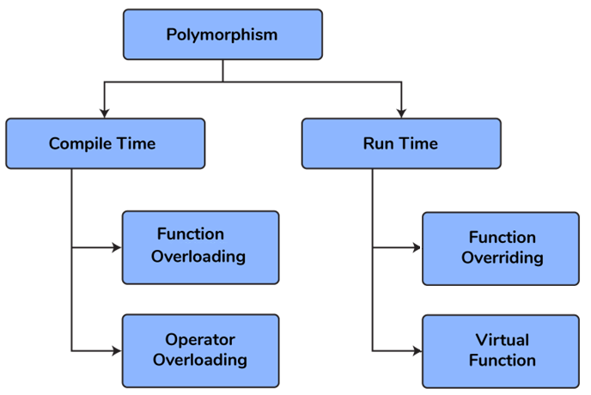
Polymorphism
Polymorphism comes from the Greek words “poly” and “morphism”.
“poly” means many and “morphism” means form i.e.. many forms.
Polymorphism means the ability to take more than one form.
For example, an operation have different behavior in different instances.
Different ways to achieving polymorphism in C++ program:
I) Compile Time (static)
Function Overloading, Operator Overloading
II) Runtime (Dynamic)
Function Overriding/ Virtual Functions

Slide 2
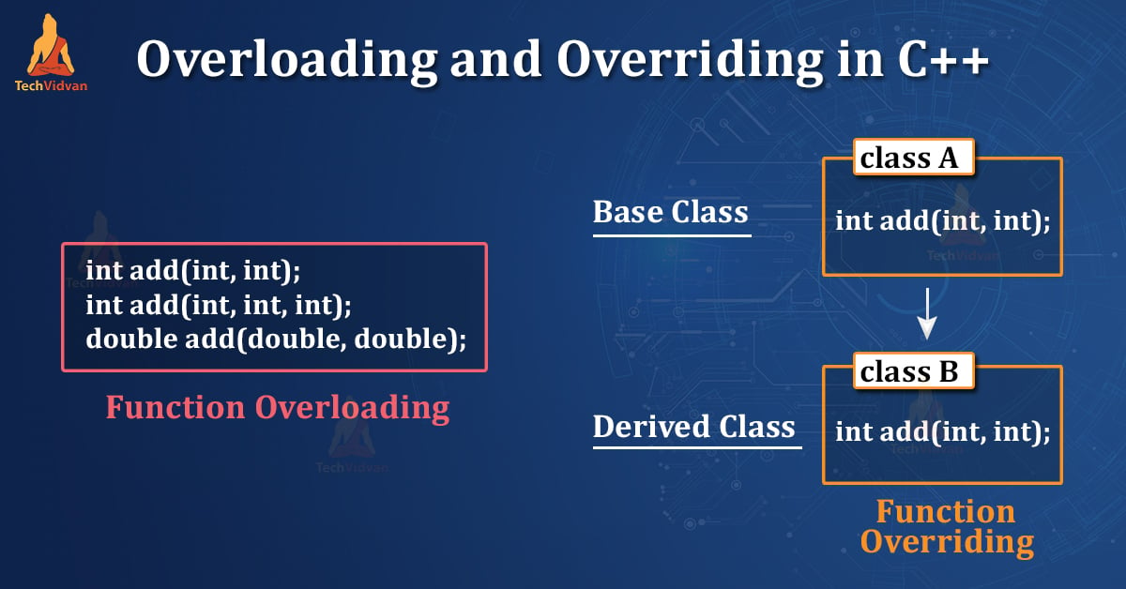
Function overlong vs Function Overriding
Class A
Two or more functions can have the same name , the number and/or type of parameters are different
When a member function of a base class is redefined in its derived class with the same parameters and return type, it is called FUNCTION OVERRIDING

Slide 3
Function Overriding
When a member function of a base class is redefined in its derived class with the same parameters and return type, it is called FUNCTION OVERRIDING
Requirements for Overriding a Function
Inheritance should be there.
Function overriding cannot be done within a class.
For this we require a derived class and a base class.
Function that is redefined must have exactly the same declaration in both base and derived class, that means same name, same return type and same parameter list.
class Base
{ public:
void show() {
cout << "Base class";
}
};
class Derived : public Base
{ public:
void show() { //overriding show() in derived
cout << "Derived Class";
}
};
int main()
{ Base b;
b.show(); //calling show() of Base
Derived d;
d.show(); // calling show() of Derived
return 0; }
Base
show( ){ ..}
Derived
show( ) { ..} //overriding

Slide 4
// Polymorphic Animal Sounds- function overriding
class Animal { //base class
public:
// Virtual function to be overridden by derived classes
virtual void makeSound() {
std::cout << "Animal makes a generic sound." << std::endl;
}
};
class Dog : public Animal { // Derived class 1
public:
// Override the makeSound function from the base class
void makeSound() {
std::cout << "Dog barks: Woof! Woof!" << std::endl;
}
};
class Cat : public Animal { // Derived class 2
public:
// Override the makeSound function from the base class
void makeSound() {
std::cout << "Cat says: Meow!" << std::endl;
}
};
int main()
{
// Create objects of base and derived classes
Animal genericAnimal;
Dog myDog;
Cat myCat;
// Call the makeSound function on each object
std::cout << "Generic Animal: ";
genericAnimal.makeSound();
std::cout << "My Dog: ";
myDog.makeSound();
std::cout << "My Cat: ";
myCat.makeSound();
return 0;
}

Slide 5
“Transport Management System“ – using function overriding
You're developing a C++ transportation management system, where vehicles are represented in a class hierarchy derived from a base class Vehicle. Users interact with the system to start vehicle engines.
How would you design a user interface for users to select and start engines of specific vehicles, like cars and bicycles? Explain the execution flow when a user starts a car's engine, considering function overriding.
Describe modifications to integrate a new vehicle type, handle invalid user input, and customize output for each vehicle type.
Input:
User selects a vehicle type (e.g., car, bicycle) to start the engine.
Output:
Generic Vehicle: Starting the engine of a generic vehicle.
My Car: Starting the engine of a car.
My Bicycle: Pedaling a bicycle.

Slide 6
class Vehicle {
public:
// Virtual function to be overridden by derived classes
virtual void start() const {
std::cout << "Starting the engine of a generic vehicle." << std::endl;
}
};
// Derived class 1
class Car : public Vehicle {
public:
// Override the start function from the base class
void start() { //overriding
std::cout << "Starting the engine of a car." << std::endl;
}
};
// Derived class 2
class Bicycle : public Vehicle {
public:
// Override the start function from the base class
void start() { //overriding
std::cout << "Pedaling a bicycle." << std::endl;
}
};
int main() {
// Create objects of base and derived classes
Vehicle genericVehicle;
Car myCar;
Bicycle myBicycle;
// Call the start function on each object
std::cout << "Generic Vehicle: ";
genericVehicle.start();
std::cout << "My Car: ";
myCar.start();
std::cout << "My Bicycle: ";
myBicycle.start();
return 0;
}

Slide 7
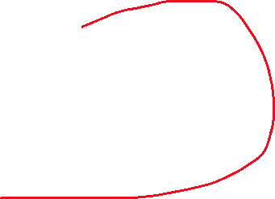

Function Overriding
Different cases of calling functions in overriding:
Case1: Calling Base class function with Base class object and Derived class function with Derived object.
Case 2: Calling Base class Function using Derived Class Object
Case 3: Calling Overriding function using pointer of Base type that points to an object of Derived class
Base b; b.show()
Derived d; d.show();
// Case1: Calling Base class function with Base class object and Derived class function with Derived object.
class Base
{ public:
void show() {
cout << "Base class";
}
};
class Derived : public Base
{ public:
void show() { //overriding show() in derived
cout << "Derived Class";
}
};
int main()
{ Base b; // Base class object
b.show(); //calling show() of Base
Derived d; //derived class object
d.show(); // calling show() of Derived
return 0; }
Base
show( ){ ..}
Derived
show( ) { ..} //overriding

Slide 8

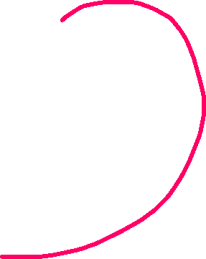
Case 2: Calling Base class Function using Derived Class Objects
// calling base class function using derived class by ::
class Base
{
public: void show() {
cout << "Base class";
}
};
class Derived : public Base
{
public: void show() { //overriding show() in derived
cout << "Derived Class";
}
};
int main()
{ Derived d1,d2;
d1.show(); // calling show( ) of Derived
d2.A::show() //calling show( ) of Base
return 0; }
Output: Derived Class
Base class
Base
show( ){ ..}
Derived
show( ) { ..} //overriding
Derived d1,d2;
d1.show();
d2.A::show();

Slide 9
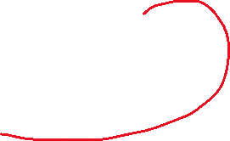
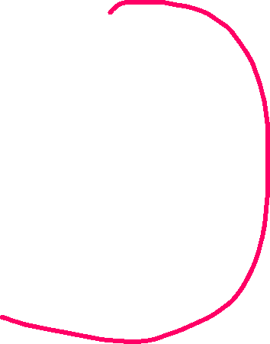
Case3: Calling Base class Function using Base pointer that holds Derived Class Object
/* Calling Overriding function using pointer
of Base type that points to an object of Derived class */
class Base {
public: void show( ){
cout << "Base Function" << endl;
}
};
class Derived : public Base {
public: void show( ){
cout << "Derived Function" << endl;
}
};
int main()
{
Derived d; // creating derived class object
d.show(); //calls derived class show()
Base *ptr=&d; //ptr of Base type points to Derived
ptr->show(); //call base class show()
return 0;
}
Base
show( ){ ..}
Derived
show( ) { ..} //overriding
Derived d;
d.show();
Base *ptr=&d; //ptr of Base type points to Derived
ptr->show();

Slide 10
Static vs. Dynamic Binding
Binding:
The determination of which method in the class
hierarchy is to be invoked for a particular object.
Static (Early) Binding occurs at compile time:
When the compiler can determine which method in the class hierarchy to use for a particular object.
Dynamic (Late) Binding occurs at run time:
When the determination of which method in the class hierarchy to use for a particular object occurs during program execution.
Static (Early) Binding
Time t1;
ExtTime et2;
t1.setTime(12, 30, 00); // static binding
et1.setExtTime(13, 45, 30); // static binding
t1.printTime( ); // static binding – Time’s printTime( )
et1.printTime(); // static binding – ExtTime’s printTime( )
Dynamic (Late) Binding occurs at run time:
Compiler cannot determine binding of object to method.
Binding is determined dynamically at runtime.
To indicate that a method is to be bound dynamically, the base class must use the reserved word virtual
When a method is defined as virtual, all overriding methods from that point on down the hierarchy are virtual, even if not explicitly defined to be so

Slide 11
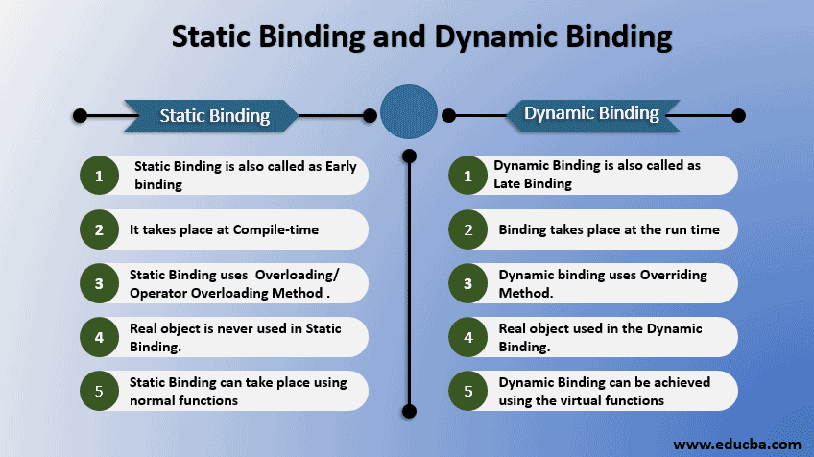








Slide 12
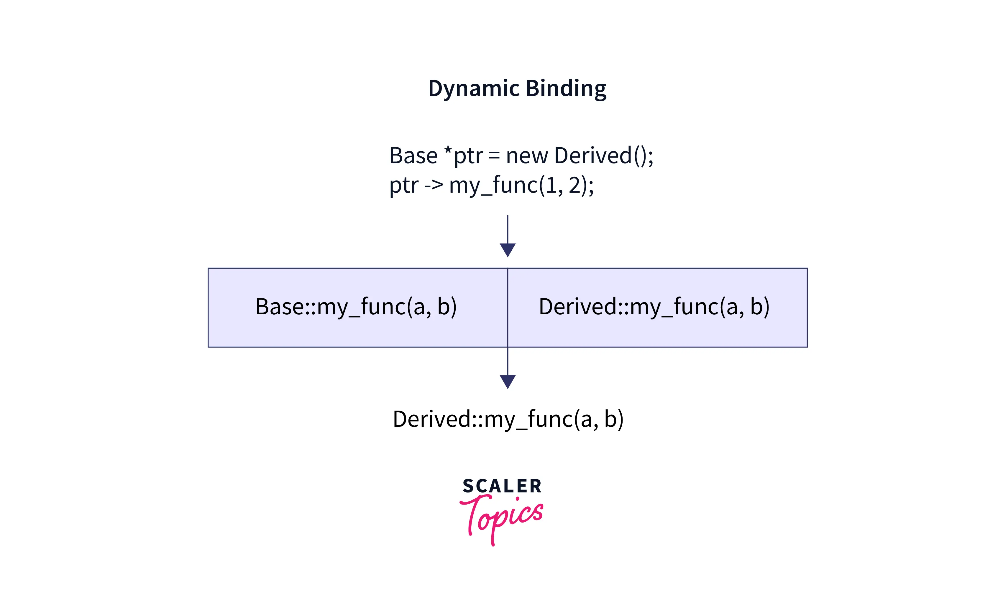
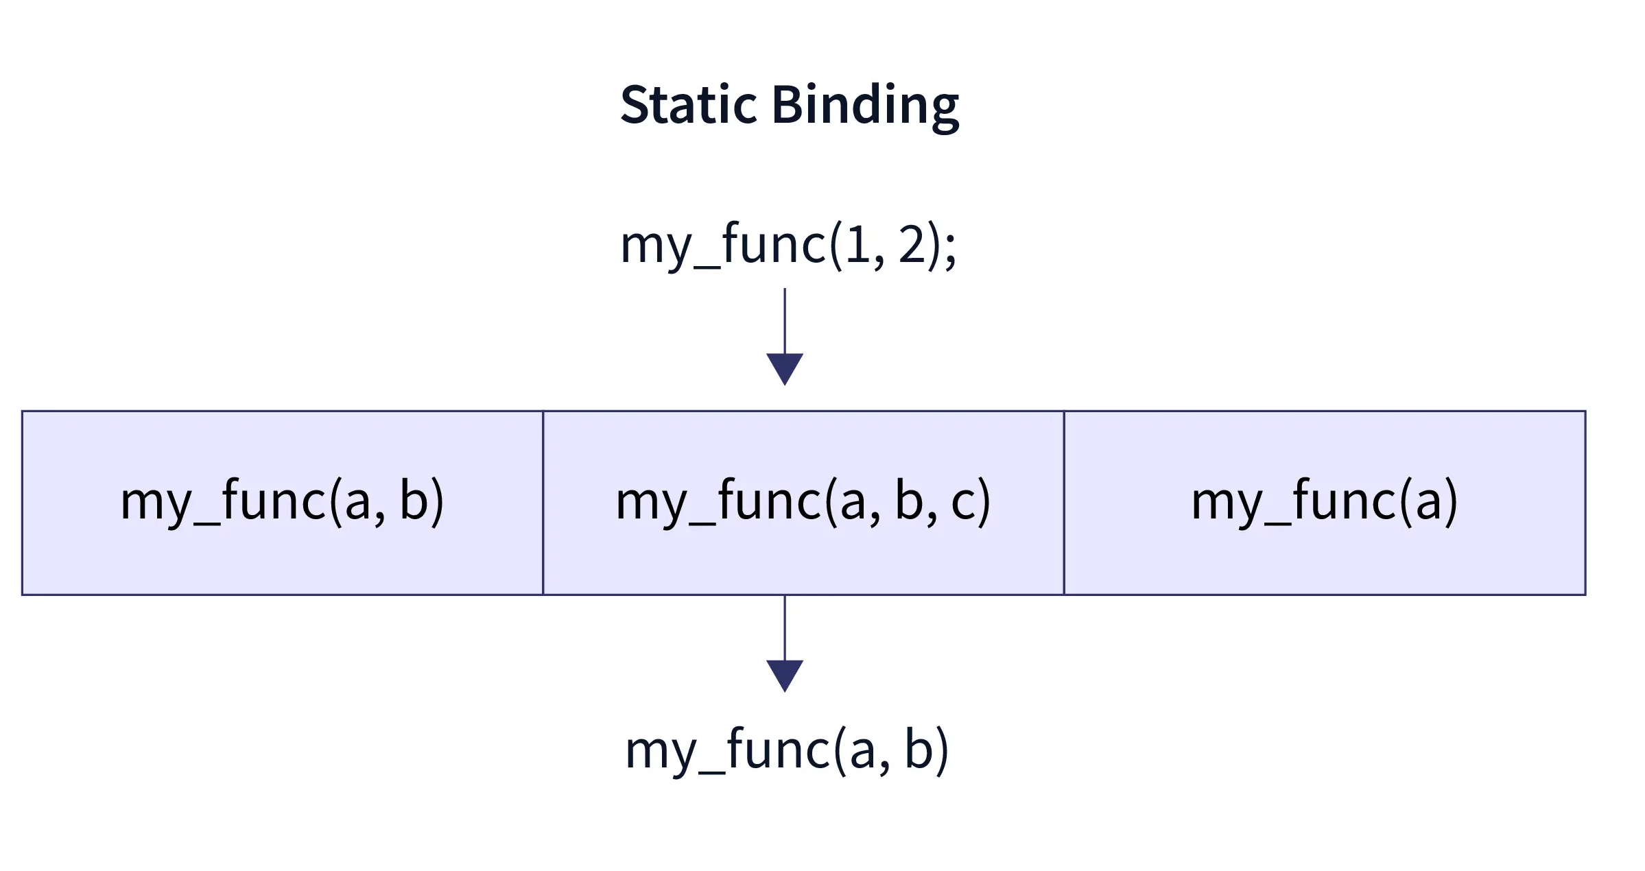



Binding at compile time is known as static binding.
Binding at runtime is known as dynamic binding.
Calls if my_func() is non- virtual
Calls if my_func() is virtual
There are instances in our program when the compiler cannot get all the information at compile time to resolve a function call. These function calls are linked at runtime .Such a process of binding is called dynamic binding. Since everything is postponed till runtime, it is also known as run-time binding or late binding.
It is executed using virtual functions in C++. A virtual function is a member function in the base class & overridden (re-defined) by its derived class(es)
Static binding ensures linking the function call and its function definition at compile-time only.
It is also why it is synonymous with compile-time binding or early binding.

Slide 13


Virtual Function
A member function of a base class and is RE-DEFINED in a derived class.
Refer to a derived class object using a pointer to the base class, and call a virtual function for that object and execute the derived class’s version of the method.
Virtual functions ensure that the correct function is called for an object, regardless of the type of reference (or pointer) used for the function call.
They are mainly used to achieve Runtime polymorphism.
Functions are declared with a virtual keyword in a base class
The resolving of a function call is done at runtime
Base{
virtual void print(){}
} as it is virtual
cals
Derived{
void print(){}
}
calls
Base *ptr;
Derived d;
ptr=&d;
prt->print()
// calls derived class print
ptr
Derived d

Slide 14

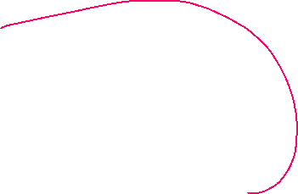
Virtual Function
class Base {
public:
virtual void print() { //virtual function
cout << "print base class\n";
}
void show() { cout << "show base class \n"; } //non virtual function
};
class Derived : public base {
public: void print() { cout << "print derived class\n"; }
void show() { cout << "show derived class\n"; }
};
int main()
{ Base* ptr; Derived d;
ptr = &d;
ptr->print(); //Virtual function, binded at runtime
ptr->show(); // Non-virtual function, binded at compile time
return 0;
}
Output:
print derived class
show base class

Slide 15
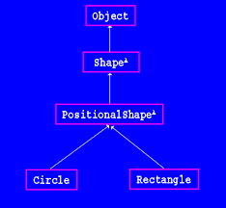
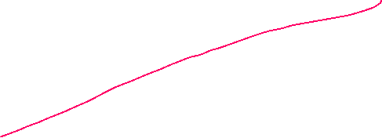
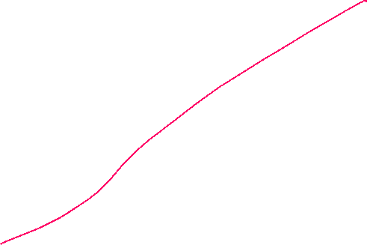
//VIRTUAL FUNCTIONS
#include <iostream>
using namespace std;
class Shape {
public:
virtual void draw() {
cout << "Drawing a Shape" << endl;
}
};
class Circle : public Shape {
public:
void draw() {
cout << "Drawing a Circle" << endl;
}
};
class Rectangle : public Shape {
public:
void draw() {
cout << "Drawing a Rectangle" << endl;
}
};
int main()
{
Shape* shape1 = new Circle();
Shape* shape2 = new Rectangle();
shape1->draw();
shape2->draw();
delete shape1;
delete shape2;
return 0;
}

Slide 16
Virtual Functions in Payroll System
You are developing a payroll system for a company that employs various types of employees, including full-time, part-time, and contract workers.
Each type of employee has a different method for calculating their pay.
You've used virtual functions to handle pay calculations for different employee types.
Implement this using virtual functions in the payroll system benefits code organization and maintenance.
OUTPUT:
Payroll Information:
Employee Name: Virat
Pay: Rs 55000.00
---------------------------
Employee Name: Rohith
Pay: Rs.6600.00
---------------------------
Employee Name: Shubhman
Pay: Rs.33000.00
---------------------------

Slide 17
//CREATING payroll system using VIRTUAL FUNCTION
#include<iostream>
using namespace std;
class Emp
{
public:
string name;float sal;
virtual void read(){ } //virtual function
virtual void pay(){ } //virtual function
};
class FullTimeEmp:public Emp
{public:
void read()
{
cout<<"Enter Full time emp details: name and sal"; cin>>name>>sal;
}
void pay()
{ cout<<"name=:"<<name<<"sal="<<sal;
}
};
class PartTimeEmp:public Emp
{
public: float hrs,rate;
void read(){
cout<<"Enter part time emp details: name and sal"; cin>>name>>sal;
cout<<"Enter hrs worked and age";
cin>>hrs>>rate;
}
void pay()
{ sal=hrs*rate;
cout<<"name=:"<<name<<"sal="<<sal;}
};
int main()
{
Emp *ft=new FullTimeEmp();
Emp *pt=new PartTimeEmp();
ft->read(); ft->pay(); //calls fulltime emp read() and pay()
pt->read(); pt->pay(); //calls parttime emp read() and pay()
return 0;
}

Slide 18
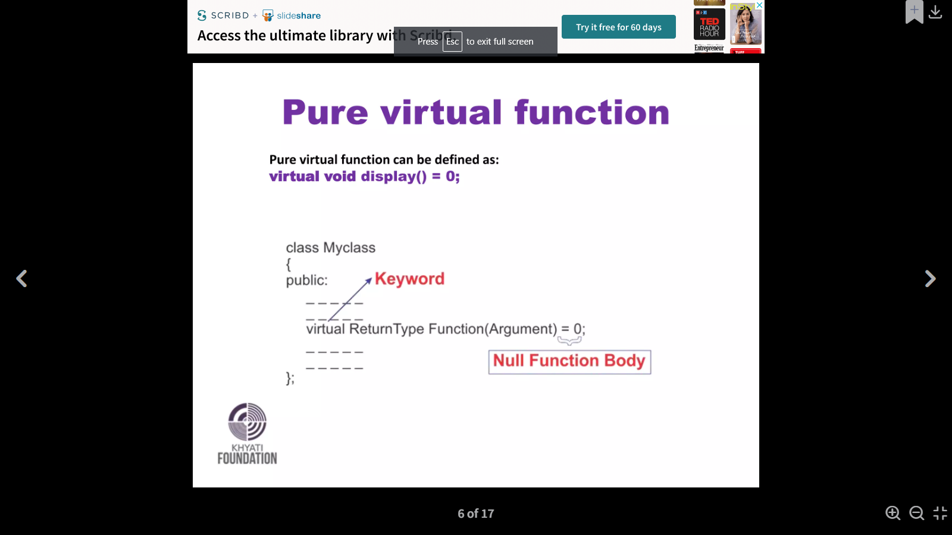

Pure Virtual Functions and Abstract Classes in C++
PURE VIRTUAL FUNCTION:
A pure virtual function is a virtual function with out any implementation.
When a function has no definition such function is known as “do-nothing” function.
A pure virtual function is declared by assigning a zero (0) in its declaration.
ABSTRACT CLASS
Any class with one or more pure virtual functions is called as Abastract class.
We can’t create the object for Abstract class.
The main objective of it is to provide traits(behavior) to the derived classes .
Used for achieving Runtime polymorphism.
class Test
{
// Data members of class
public:
// Pure Virtual Function
virtual void show() = 0;
/* Other members */
};

Slide 19
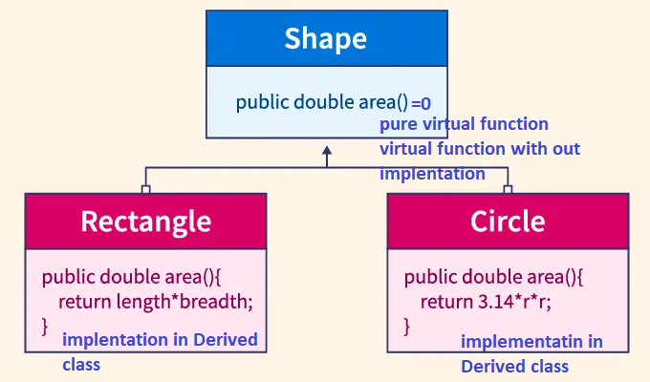



Abstract Classes in C++
Abstract class contains at least one pure virtual function, which cannot be instantiated. Such classes are mainly used for Upcasting, which means that its derived classes can use its interface.
class Shape {
public:
virtual double area() const = 0;
};
class Circle : public Shape {
public: double radius;
Circle(double r) : radius(r) {}
double area() {
return 3.14159 * radius * radius;
}
};
class Rectangle : public Shape {
public: double length; double width;
Rectangle(double l, double w) : length(l), width(w) {}
double area() {
return length * width;
}
};
int main() {
Circle circle(5.0); Rectangle rectangle(4.0, 6.0);
cout << "Circle Area: " << circle.area();
cout << "Rectangle Area: " << rectangle.area(); return 0;
}

Slide 20
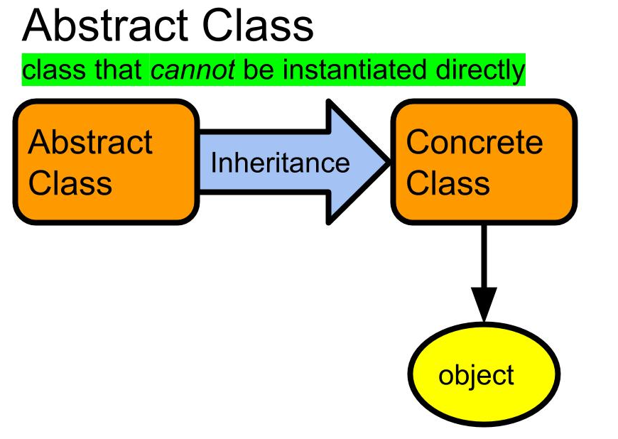
//CRETATING ABSTRACT CLASS
#include <iostream>
using namespace std;
class Abstract
{
int a, b;
public:
virtual void readData()=0;//pure virtual function
virtual void printData()=0; //pure virtual function
};
class Derived : public Abstract {
public:
Void readData()
{
cout << " Enter a and b: ";
cin>>a>>b;
}
void printData()
{
cout << "Derived a = " << a << endl
Cout << "Derived b = " << b << endl;
}
};
int main()
{
// Abstract a;
// Cannot create an instance of Abstract Class
Derived d;
d. readData(10, 20);
cout << Data in derived class" << endl;
d.printData();
}

Slide 21
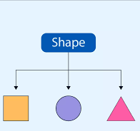
Shape drawing Application using Abstract class
Consider a scenario where you are developing a shape drawing application.
Extend the existing code to create an abstract class Shape with attributes color .
Derive classes like Circle and Square from the abstract class, implementing functions to draw each shape on the screen
INPUT AND OUTPUT:
Drawing Shapes:
Enter the radius and color of the circle
5
Red
Drawing a Red circle with radius 5
Enter side length and color of the square:
8
Blue
Drawing a Blue square with side length 8

Slide 22
//CREATING ABSTRACT CLASS WITH PURE VIRTUAL FUNCTIONS
#include <iostream>
using namespace std;
class Shape //abstract class .i.e. having atleast one pure virtual function
{ public: string color;
virtual void readDimension()=0; //pure virtual function.
virtual void draw()=0; //pure virtual function
};
class Circle:public Shape
{ public: int r;
void readDimension()
{
cout<<"Enter the radius and color of the circle \n";
cin>>r>>color;
}
void draw()
{
cout<<"Drawing a "<<color<<" circle with radius="<<r<<endl;
}
};
class Square:public Shape
{ public: int s;
void readDimension()
{
cout<<"Enter side and color of the square \n";
cin>>s>>color;
}
void draw()
{
cout<<"Draiwng a "<<color<<" square with
side="<<s<<endl;}
};
int main()
{ //Abstract a; can't create obj for abstract class
Circle c;
c.readDimension();
c.draw();
Square s; s.readDimension();
s.draw();
return 0;
}

Slide 23
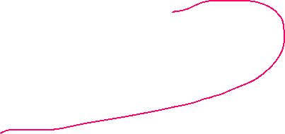

//pointers and references of abstract class type.
#include <iostream>
using namespace std;
class Base {
public:
virtual void show() = 0;
};
class Derived : public Base {
public:
void show() {
cout << "In Derived \n";
}
};
int main( )
{
Base* bp = new Derived();
bp->show();
return 0;
}
Output: In Derived
Base
virtual void show() = 0;
Derived
void show()
bp
Derived obj
bp->draw()

Slide 24
int main()
{
Animal* animals[2]; //creating 2 pointers of Abstract class
Dog myDog; //Creating Dog object
Cat myCat; //Crating Cat object
animals[0] = &myDog;
animals[1] = &myCat;
animals[0]->makeSound(); //Woof! Woof!
animals[1]->makeSound();// Meow!
return 0;
}
//combining the two statements from two classes
Output:
Woof! Woof!
Meow!
//pointers and references of abstract class type.
class Animal {
public:
virtual void makeSound() const = 0;
};
class Dog : public Animal {
public:
void makeSound() const override
{
cout << "Woof! Woof!\n";
}
}
};
class Cat : public Animal
{
public:
void makeSound() const override
{
cout << "Meow!\n";
}
};

Slide 25
// Abstract class with constructors
class Shape {
public:
// Constructor in the abstract class
Shape(int x, int y) : x(x), y(y) {}
virtual void draw() const = 0; //pure virtual function
void move(int newX, int newY) {
x = newX; y = newY;
cout << "Shape moved to x=" << newX << " y=" << newY ;
}
protected: int x, y;
};
class Circle : public Shape {
public:
Circle(int x, int y, int radius) : Shape(x, y), radius(radius) {}
void draw()
{
cout << "Drawing a circle at x=" << x << " y=" << y << " with
radius=" << radius;
}
private: int radius;
};
int main()
{
Circle circle(5, 10, 8);
// Calling methods on the object
circle.draw();
// Calls the draw method in the Circle class
circle.move(8, 15);
// Calls the move method in the Shape class
return 0;
}

Slide 26
// Abstract class BankAccount
class BankAccount { //abstract class
public:
// Constructor with initial balance
BankAccount(double initialBalance) : balance(initialBalance) {}
// Abstract methods for deposit and withdrawal
virtual void deposit(double amount) = 0;
virtual void withdraw(double amount) = 0;
double getBalance() const { return balance; }
protected: double balance;
};
// Concrete subclass SavingsAccount
class SavingsAccount : public BankAccount { //savings account
public:
SavingsAccount(double initialBalance, double interestRate)
: BankAccount(initialBalance), interestRate(interestRate) {}
void deposit(double amt) {
if (amt > 0) {
balance += amt;
cout << "Deposited: Rs." << amt;
} else {
cout << "Invalid deposit amount.";
}
}
void withdraw(double amt) override {
if (amount > 0 && balance >= amt) {
bal -= amt;
cout << "Withdrawn: Rs." << amt;
} else {
cout << "Invalid withdrawal amount or insufficient bal.";
}
}
void calculateInterest() {
double interest = bal * rate / 100;
bal += interest;
cout << "Interest calculated and added: Rs." << interest;
}
private: double rate;
};
int main()
{
SavingsAccount sa(1000, 5);
sa.deposit(500); sa.withdraw(200); sa.calculateInterest();
cout << "Final Balance: Rs." << sa.getBalance();
return 0;
}

Slide 27
//creating abstract class
class Shape //abstract class
{
protected:
int width, height;
public:
void set_values (int a, int b)
{
width = a; height = b;
}
virtual int area() = 0;
};
class Rectangle: public p
{
public:
int area (void)
{
return (width * height);
}
};
class Triangle: public p
{
public:
int area (void)
{
return (width * height / 2);
}
};
int main ()
{
Rectangle rect;
Triangle trgl;
p *ptr1 = &rect;
p *ptr2 = &trgl;
ptr1->set_values (4, 5);
ptr2 ->set_values (4, 5);
cout << ptr1 -> area() ;
cout << ptr2 -> area();
return 0;
}
output: 2010

Slide 28
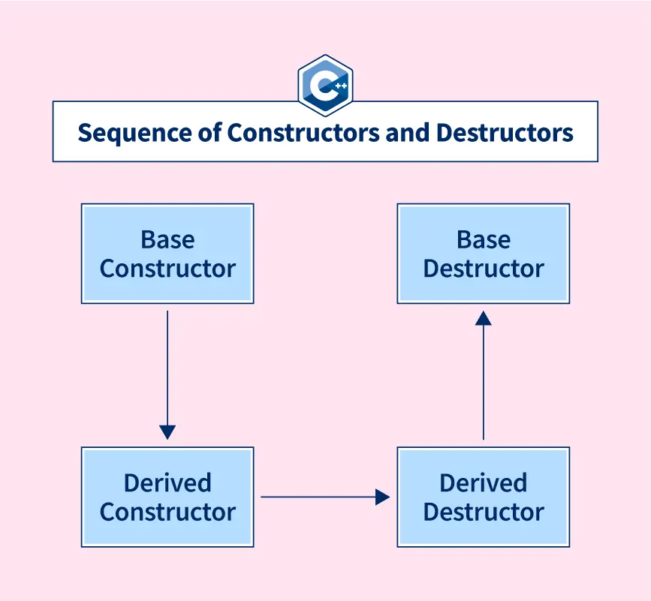
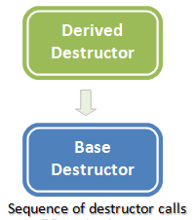
Virtual Destructor in C++
Destructor call sequence
First derived class will be destroyed and then base class

Slide 29
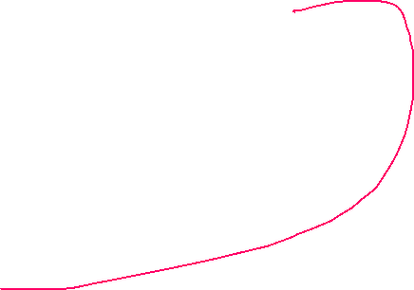
Virtual Destructor in C++
// CPP program without virtual destructor
// causing undefined behavior
class base {
public:
base(){ cout << "Constructing base\n"; }
~base() { cout<< "Destructing base\n"; }
};
class derived: public base {
public:
derived() { cout << "Constructing derived\n"; }
~derived() { cout << "Destructing derived\n"; }
};
int main()
{ derived *d = new derived();
base *b = d;
delete b; //deletes memory for base class object only
return 0;
}
A destructor in C++ is a member function of a class used to free the space occupied by or delete an object of the class that goes out of scope.
Deleting a derived class object using a pointer of base class type that has a non-virtual destructor results in undefined behavior.
To correct this situation, the base class should be defined with a virtual destructor.
A virtual destructor is used to free up the memory space allocated by the derived class object or instance while deleting instances of the derived class using a base class pointer object.
Calls base class
destructor
Output
Constructing base
Constructing derived
Destructing base //what about Destructing derived?

Slide 30

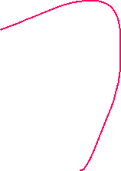
Virtual Destructor in C++
// A program with virtual destructor
class base {
public:
base() { cout << "Constructing base\n"; }
virtual ~base() { cout << "Destructing base\n"; } //VIRTUAL DESTRUCTOR
};
class derived : public base {
public:
derived() { cout << "Constructing derived\n"; }
~derived() { cout << "Destructing derived\n"; }
};
int main()
{
derived *d = new derived(); //creating derived object refereeing with ptr
base *b = d;
delete b; //deleting the pointer of base holding derived object
return 0;
}
Making base class destructor virtual guarantees that the object of derived class is destructed properly, i.e., both base class and derived class destructors are called.
Improper Destruction of objects:
Parent Destroyed but Child Not destroyed
Proper Destruction of objects:
Child destroyed then Parent destroyed
Calls base class
destructor
Calls derived class
destructor
Constructing base
Constructing derived
Destructing derived
Destructing base

Slide 31
Resource Management in a Base and Derived Class – virtual destructor
Suppose you are developing a software system that involves handling different types of shapes.
You have a base class called Shape with a virtual destructor, and you also have a derived class called Circle that inherits from Shape.
Both classes manage some dynamically allocated resources, such as memory for storing shape data.
Implement this with a virtual destructor and explain what happens when the delete shapePtr; statement is executed in the main function. Discuss the role of the virtual destructor in this scenario and how it contributes to proper resource cleanup.
OUTPUT:
Constructing Shape
Constructing Circle
Destructing Circle
Destructing Shape

Slide 32
//virtual destructor
class Shape {
public:
Shape() {
data = new int[10];
cout << "Shape constructor\n";
}
virtual ~Shape() { //virtual destructor
delete[] data;
cout << "Shape destructor\n";
}
private: int* data;
};
class Circle : public Shape {
public:
Circle() {
radius = 5.0;
cout << "Circle constructor\n";
}
~Circle() override {
cout << "Circle destructor\n";
}
private: double radius;
};
int main()
{
Shape* shapePtr = new Circle();
delete shapePtr;
return 0;
}

