Slide 1
Exception handling in c++
Error:
Errors are the problems that occur in the program due to an illegal operation performed by the user or by the fault of a programmer, which halts the normal flow of the program.
Errors are also termed as bugs or faults.
There are mainly two types of errors in programming
a. Compile Time Errors
b. Run-Time Errors
a) Compile Time Errors:
Compile Time Errors are those errors that are caught during compilation time.
Some of the most common compile-time errors are syntax errors, library references, incorrect import of library functions and methods, uneven bracket pair(s), etc.
b. Run-Time Errors
Run-Time Errors are those errors that cannot be caught during compilation time.
int main()
{
int a = 5;
// Dividing the number a by zero, so the program will compile easily
// but run time error will be generated.
cout << a / 0;
return 0;
}

Slide 2
Exception handling in c++
Exception:
An exception is run time error that arises during the execution of a program
Exceptions are runtime anomalies or unusual conditions that a program may encounter while executing
Anomalies might include conditions such ass division by zero, accessing an array outside of its bounds, opening a file which does not exist or running out of memory or disk space
Exception Handling in C++ is a process to handle runtime errors.
Exception handling in C++ built up on three keywords:
try
throw
Catch
Ex.
//Exception: Dividing a number by 0
int main()
{
int a,b,c; cout>>a>>b; //Read as a=10 ,b=20
c=a/b; // Dividing the number a by zero,
// Arithmetic Exception
cout << c;
return 0;
}
int main()
{
int arr[] = {1, 2, 3, 4, 5};
cout << "arr[10] is " << arr[10] << endl;
// Accessing an element outside the array bounds (arr[10])
// Array Index out of bounds exception
return 0;
}

Slide 3
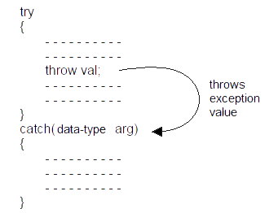
Exception handling
Exception Handling Mechanism:
try
{
// code
throw exception;
}
catch(exception e)
{
// code for handling exception
}
try allows to define a block of code to be tested for errors. i.e. includes error causing code
throw - throws an exception when a problem is detected.
catch allows to define a block of code to be executed if an error occurs in the try block

Slide 4
Exception handling
Exception Handling Mechanism:
try
{
// code
throw exception;
}
catch(exception e)
{
// code for handling exception
}
try allows to define a block of code to be tested for errors. i.e. includes error causing code
throw - throws an exception when a problem is detected.
catch allows to define a block of code to be executed if an error occurs in the try block
#include <iostream>
using namespace std;
int main ()
{
float x,y,z;
cout<<"Enter x value \n"; cin>>x;
cout<<"Enter y value \n"; cin>>y;
try {
if(y==0)
{ throw y;
}
z=x/y;
cout<<" Result is "<<z;
}
catch (int y)
{
cout <<" Exception: Divide by zero:"<<y << endl;
}
return 0;
}

Slide 5
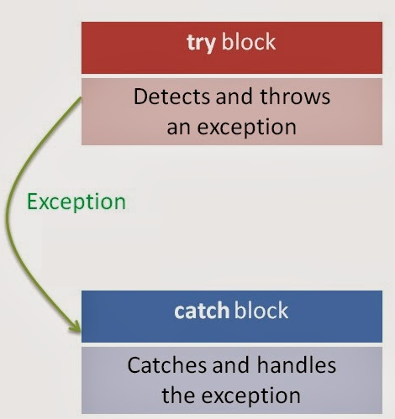
Exception handling
THROWING MECHANISM:
An exception is said to be thrown at the place where some error or abnormal condition is detected.
When an exception is detected, it can be thown by using throw statement in any one of the following forms
throw(exception);
throw exception;
throw;

Slide 6
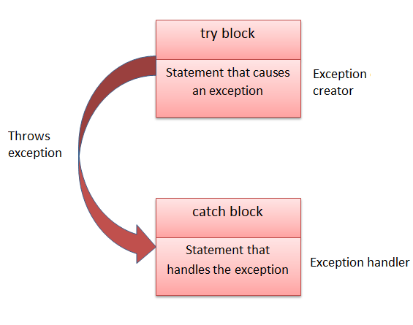
Exception handling
CATCHING MECHANISM:
The catch block following the try block catches any exception
The catch statement allows you to define a block of code to be executed, if an error occurs in the try block.
try {
// protected code
}
catch(data_type arg)
{
// code to handle any exception
}

Slide 7
//PROGRAM FOR ARRAY DIVIDE BY ZERO EXCEPTION
#include <iostream>
using namespace std;
int main ()
{
float x,y,z;
cout<<"Enter x value \n"; cin>>x;
cout<<"Enter y value \n"; cin>>y;
try {
if(y==0)
{ throw y;
}
z=x/y;
cout<<" Result is "<<z;
}
catch (int y)
{
cout <<" Exception: Divide by zero:"<<y << endl;
}
return 0;
}

Slide 8
//PROGRAM FOR ARRAY INDEX OUT OF BOUNDS EXCEPTION
#include <iostream>
using namespace std;
int main() {
int arr[] = {1, 2, 3, 4, 5 };
try {
// Accessing and printing the first element (arr[0])
cout << "arr[0] is " << arr[0] << endl;
int index;
cout << "Enter the index: ";
cin >> index;
// Accessing the element at the user-provided index
if (index < 0 || index >= sizeof(arr) / sizeof(arr[0])) {
throw index;
}
cout << "arr[" << index << "] is " << arr[index] << endl;
// This line will not be executed if the index is out of bounds
}
catch (int ex) {
cerr << "Exception:Index out of Bounds: " << ex << endl;
}
return 0;
}

Slide 9
//PROGRAM FOR FILE NOT FOUND EXCEPTION
#include <iostream>
#include <fstream>
using namespace std;
int main() {
try {
ifstream file("myfile1.txt");
if (!file.is_open()) {
throw "Unable to open the file";
}
// File processing code...
cout<<"File open \n";
}
catch (const char* msg) {
cerr << "Exception: " << msg << endl;
}
return 0;
}

Slide 10
Handling Multiple catch blocks
Multiple catch statements:
try
{
//try block
}
catch(data_type1 arg)
{
//catch block1
}
catch(data_type2 arg)
{
//catch block2
}
………………
……………..
catch(data_typeN arg)
{
//catch blockN
}
int main()
{ int x; cout<<" Enter x as 0 , 1 -1 \n"; cin>>x;
try
{
if(x==1) throw x; //throwing integer exception
if(x==0) throw 'x’; //throwing char exception
if(x==-1) throw 1.0; //throwing double exception
}
catch(char c) {
cout<<"caught a character"<<endl;
}
catch(int m){
cout<<"caught an integer"<<endl;
}
catch(double d)
{
cout<<"caught a double"<<endl;
}
return 0;
}
When an exception is thrown, the exception handler are searched in order fore an appropriate match.

Slide 11
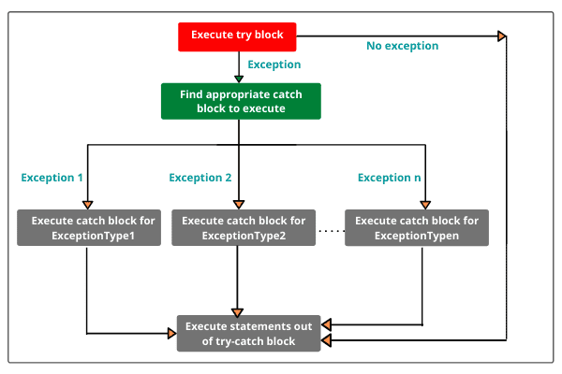
Handling Multiple catch blocks
Multiple catch statements:
try
{
//try block
}
catch(data_type1 arg)
{
//catch block1
}
catch(data_type2 arg)
{
//catch block2
}
………………
……………..
catch(data_typeN arg)
{
//catch blockN
}

Slide 12
Exception handling
Catch All Exceptions:
For all possible types of exceptions , we may not be able to design independent catch handlers to Catch them.
In such circumstances, we can force one catch statement to catch all exceptions instead of a Certain type alone.
int main()
{ int x; cout<<" Enter x as 0 , 1 -1 \n"; cin>>x;
try
{
if(x==1) throw x; //thowing integer exception
if(x==0) throw 'x’; //thowing char exception
if(x==-1) throw 1.0; //thowing double exception
}
catch(…) // catches all exceptins
{
cout<<"caught Exception"<<endl;
}
try
{
//try block
}
catch(…)
{
………
}

Slide 13
Exception handling
Re-throwing an Exception:
It is possible to pass exception caught by a catch block again to another exception handler.
This is known as Re-throwing.
int main()
{
cout<< "Main start...."<<endl;
try
{
myHandler();
}
catch(const char*)
{
cout <<"Caught exception inside Main\n";
}
cout << "Main end";
return 0;
}
#include <iostream>
using namespace std;
void myHandler()
{
try
{
throw "hello";
}
catch (const char*)
{
cout <<"Caught exception inside MyHandler\n";
throw; //rethrow char* out of function
}
}

Slide 14
Exception handling
Specifying Exceptions:
Specification of exception restrict functions to throw some specified exceptions only with the use of throw(exception list) in the the header of the function.
void test(int x) throw(int,float,char)
{
switch(x)
{
case 1:throw x; break;
case 2:throw 'x’; break;
case 3:throw double(x); break;
case 4:throw float(x); break;
}
}
int main()
{
try
{ test(4); //test(4) leads to abnormal termination
}
catch(int i) { cout <<"Caught int type exception\n"; }
catch(float f) { cout <<"Caught float type exception\n"; }
catch(char c) { cout <<"Caught char type exception\n"; }
catch(double i) { cout <<"Caught Double type exception\n"; }
return 0;
}
General form
type function_name(argument list) throw(exceptions -list)
{
….
try
{
statements
}
}

Slide 15
C++ User-Defined Exceptions
Creating user defined Exceptions:
The new exception can be defined by overriding and inheriting exception class functionality.
All exceptions are derived from std::exception class located in <exception> library file
This class has a virtual member function what() that returns a null-terminated character sequence (of type char *) and that can be overwritten in derived classes to contain some sort of description of the exception
#include <iostream>
#include <exception>
using namespace std;
class MyException : public exception{
public:
const char * what() const throw()
{
return “User defined Exception \n";
}
};
int main()
{
MyException e;
try
{
throw e;
}
catch(exception& e)
{
cout << e.what();
}
}

Slide 16
User input Validation
You are developing a program that takes user input for the age of a person.
Implement a user-defined exception class, InvalidAgeException, to handle the case where the entered age is less than 0 or greater than 150.
In your program, throw this exception when invalid input is detected
INPUT
Enter the age: 25
OUTPUT:
Entered age: 25
INPUT
Enter the age: -5
OUTPUT:
Exception caught: InvalidAgeException: Age must be between 0 and 150.

Slide 17
//InvalidAgeException
#include <iostream>
#include <stdexcept>
// User-defined exception class for invalid age
class InvalidAgeException : public exception
{
public:
const char* what() const throw(){
return "InvalidAgeException: Age must be between 0 and 150.";
}
};
// Function to get user input for age
int getAge()
{
int age;
cout << "Enter the age: ";
cin >> age;
// Check for validity
if (age < 0 || age > 150) {
throw InvalidAgeException();
}
return age;
}
int main()
{
try {
int userAge = getAge();
// If age is valid, display it
cout << "Entered age: " << userAge << endl;
}
catch (const exception& e)
{
cerr << "Exception caught: " << e.what() << endl;
}
return 0;
}

Slide 18
InsufficientFundsException:
You are developing a banking application, and you want to implement a user-defined exception class, InsufficientFundsException.
This exception should be thrown when a user attempts to withdraw more money from their account than the available balance.
Implement this scenario in your program.
INPUT
Enter the amount to withdraw: 500
OUTPUT:
sWithdrawal successful. Remaining balance: 500
INPUT
Enter the amount to withdraw: 1500
OUTPUT:
Exception caught: InsufficientFundsException: Not enough funds for the withdrawal.

Slide 19
// User-defined exception class for insufficient funds
#include <iostream>
#include <stdexcept>
class InsufficientFundsException : public sexception {
public:
const char* what() const {
return "InsufficientFundsException: Not enough funds ";
}
};
// Class representing a bank account
class BankAccount {
private:
double balance;
public:
BankAccount(double initialBalance) : balance(initialBalance) {}
// Function to withdraw money from the account
void withdraw(double amount) {
if (amount > balance) {
throw InsufficientFundsException();
}
balance -= amount;
cout << "Withdrawal successful. Remaining balance: " << balance ;
}
};
int main() {
try {
// Create a bank account with an initial balance
BankAccount account(1000.0);
// Attempt to withdraw an amount
double amt;
cout << "Enter the amount to withdraw: ";
cin >> amt;
account.withdraw(amt);
}
catch (const exception& e)
{
cerr << "Exception caught: " << e.what() << endl;
}
return 0;
}

Slide 20
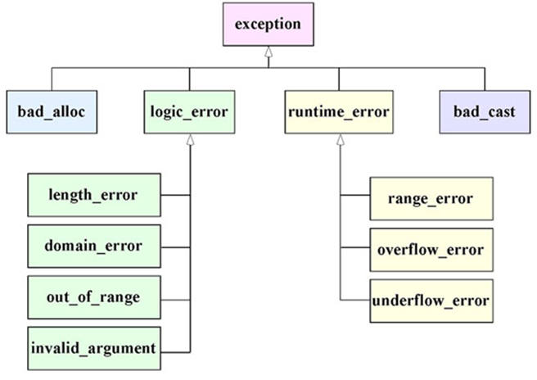
Standard Exceptions in C++
C++ provides a list of standard exceptions defined in <stdexcept> class.
exception | description
bad_alloc | thrown by new on allocation failure
bad_cast | thrown by dynamic_cast when it fails in a dynamic cast
logic_error | error related to the internal logic of the program
runtime_error | error detected during runtime

Slide 21
//USING STANDARD EXCEPTION out_of_range
#include <iostream>
#include <stdexcept>
using namespace std;
int main()
{ const int arraySize = 5;
int numbers[arraySize] = {1, 2, 3, 4, 5};
try
{
// Access an element at an index
int index;
cout << "Enter an index to access: ";
cin >> index;
if (index < 0 || index >= arraySize) {
throw out_of_range("Index out of bounds");
}
cout << "Value at index " << index << ": " << numbers[index];
}
catch (const out_of_range& e)
{
cerr << "Exception caught: " << e.what() << endl;
}
return 0;
}
Enter an index to access: 10
Exception caught: Index out of bounds

Slide 22
//using standard exception runtime_erro()
#include <iostream>
#include <stdexcept>
using namespace std;
int main() {
try {
int number;
cout << "Enter a number: ";
cin >> number;
if (cin.fail()) //checks input was not an integer.
{
throw runtime_error("Error: Invalid input. Please enter a numeric value.");
}
cout << "You entered: " << number << endl;
}
catch (const exception& e)
{
cerr << e.what() << endl;
}
return 0;
}
OUPUT:
Enter a number: abc
Error: Invalid input. Please enter a numeric value.

Slide 23
//using standard exception bad_alloc
#include <iostream>
#include <stdexcept>
using namespace std;
int main() {
try {
// Attempt to allocate a large array
int* myArray = new int[1000000000000000];
// Use the allocated memory (this won't be reached in case of failure)
delete[] myArray;
}
catch (const bad_alloc& e)
{
cerr << "Error: Failed to allocate memory - " << e.what() << endl;
}
return 0;
}
OUTPUT:
Error: Failed to allocate memory

Slide 24
//using standard exception bad_cast
#include <iostream> #include <typeinfo> #include<exception>
using namespace std;
class Base {
public:
virtual ~Base() {}
};
class Derived : public Base {
public:
void derivedFunction() {
std::cout << "Derived function\n";
}
};
int main() {
try {
Base baseObj;
Derived derivedObj;
// Attempt to cast a Base reference to a Derived reference
Base& baseRef = baseObj;
Derived& derivedRef = dynamic_cast<Derived&>(baseRef);
// If successful, call a function specific to Derived class
derivedRef.derivedFunction();
}
catch (const bad_cast& bc)
{
cerr << "Caught bad_cast: Can't cast base to derived " << bc.what() << '\n';
}
return 0;
}

