Slide 1
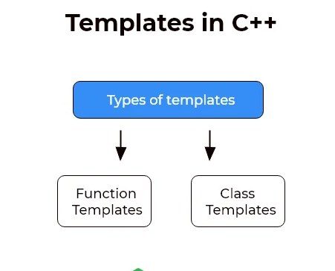
Templates / Generic programming
Template enable us to define generic functions and classes those work on more than one data type at once.
Parameters used during its definition is of generic type and can be replaced later by actual parameter. This is called Generic programming.
Advantages:
Code reusability
Flexibility of program

Slide 2
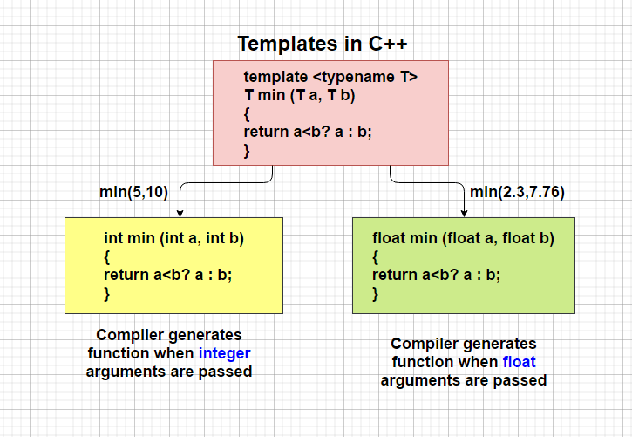
Templates / Generic programming
1. Function Templates
Instead of writing different functions for the different data types, we can define common function.
int max(int a,int b);
max(float a,float b);
max(char a,char b);
Instead of writing three different functions we can write Template
T max(T a,T b); // T is called generic data type
template < class T> or <typename T>
T func_name(T param)
{
// body of function.
}

Slide 3
Function Templates
//CREATING FUNCTION TEMPLATES
#include <iostream>
using namespace std;
// One function works for all data types.
template <typename T>
T myMax(T x, T y)
{
return (x > y) ? x : y;
}
int main()
{
// Call myMax for int
cout << myMax<int>(3, 7) << endl;
// call myMax for double
cout << myMax<double>(3.0, 7.0) << endl;
// call myMax for char
cout << myMax<char>('g', 'e') << endl;
return 0;
}
Compiler internally generates and
adds below code
int myMax(int x, int y)
{
return (x > y) ? x : y;
}
Compiler internally generates and
adds below code
double myMax(double x, double y)
{
return (x > y) ? x : y;
}
Compiler internally generates and
adds below code
int myMax(int x, int y)
{
return (x > y) ? x : y;
}

Slide 4
//Swapping two values using function templates
#include <iostream>
template <typename T> //or teplate<class T>
void swapValues(T &a, T &b)
{
T temp = a;
a = b;
b = temp;
}
int main()
{
int x = 5, y = 10;
cout << "Before swap: x = " << x << ", y = " << y << endl;
swapValues(x, y); // Swap integers
cout << "After swap: x = " << x << ", y = " << y << endl;
double a = 3.14, b = 2.71;
cout << "Before swap: a = " << a << ", b = " << b << endl;
swapValues(a, b); // Swap doubles
cout << "After swap: a = " << a << ", b = " << b << endl;
return 0;
}

Slide 5
Function Templates with Multiple Parameters
We can use more than one generic type in the template function by using the comma to separate the list
#include <iostream>
template <typename T1, typename T2>
T1 add(T1 a, T2 b) {
return a + b;
}
int main()
{
// Adding two integers
int sum_int = add(5, 10);
cout << "Sum of integers: " << sum_int;
// E Adding an integer and a double
double sum_double = add(3.14, 2);
cout << "Sum of double and integer: " << sum_double;
// Adding two doubles
double result = add(2.71, 3.14);
std::cout << "Sum of doubles: " << result << std::endl;
return 0;
}
template<class T1, class T2,.....>
return_type function_name (arguments of type T1, T2....)
{
// body of function.
}
#include <iostream>
using namespace std;
template<class X,class Y>
void fun(X a,Y b)
{
std::cout << "Value of a is : " <<a<< std::endl;
std::cout << "Value of b is : " <<b<< std::endl;
}
int main()
{
fun(15,12.3);
return 0;
}

Slide 6
Class Templates
A class template is similar to a function template, but it is used to create generic classes.
Create a single class that can work with the various data types
Class Template Declaration
template<class T>
class class-name
{
private:
T var;
... .. ...
public:
T functionName(T arg);
... .. ...
}
Creating a Class Template Object
Once we've declared and defined a class template, we can create its objects.
className<dataType> classObject;
className<int> classObject;
className<float> classObject;
className<string> classObject;

Slide 7
// creating class template
#include <iostream>
using namespace std;
// Class template
template <class T>
class Number {
private:
// Variable of type T
T num;
public:
Number(T n) : num(n) {} // constructor
T getNum()
{
return num;
}
};
int main() {
// create object with int type
Number<int> numInt(7);
// create object with double type
Number<double> numDouble(7.7);
cout << "int Number = " << numInt.getNum() << endl;
cout << "double Number = " << numDouble.getNum() << endl;
return 0;
}

Slide 8
//Simple Calculator Using Class Templates
#include <iostream>
using namespace std;
template <class T>
class Calculator
{
private:
T num1, num2;
public:
Calculator(T n1, T n2) {
num1 = n1;
num2 = n2;
}
void displayResult() {
cout << "Numbers: " << num1 << " and " << num2 << "." << endl;
cout << num1 << " + " << num2 << " = " << add() << endl;
cout << num1 << " - " << num2 << " = " << subtract() << endl;
cout << num1 << " * " << num2 << " = " << multiply() << endl;
cout << num1 << " / " << num2 << " = " << divide() << endl;
}
T add() { return num1 + num2; }
T subtract() { return num1 - num2; }
T multiply() { return num1 * num2; }
T divide() { return num1 / num2; }
};
int main()
{
Calculator<int> intCalc(2, 1);
Calculator<float> floatCalc(2.4, 1.2);
cout << "Int results:" << endl;
intCalc.displayResult();
cout << endl
<< "Float results:" << endl;
floatCalc.displayResult();
return 0;
}

Slide 9
Class Templates with multiple parameters
We can use more than one generic data type in a class template, and each generic data type is separated by the comma
template<class T1, class T2>
class A
{
T1 a; T2 b;
public:
A(T1 x,T2 y)
{
a = x; b = y;
}
void display()
{
cout << "Values of a and b are : " << a<<" ,"<<b<<endl;
}
};
int main()
{
A<int,float> d(5, 6.5);
d.display();
return 0;
}
Class Template Declaration
template<class T1, class T2, …>
class class-name
{
private:
T1 var1; T2 var2;
... .. ...
public:
T1 functionName(T1 arg);
... .. ...
}

Slide 10
Sensor Data Processor
In a data processing application, the scenario involves the utilization of a Pair class template to represent timestamp-sensor reading pairs.
The Pair class is designed to accommodate an integer as the first element for timestamps and a double as the second element for sensor readings.
This template includes functions to set and retrieve both the timestamp and the sensor reading. In the application, instances of the Pair class are created to store specific data points,
Input:
The program creates two instances of the Pair class template:
dataPoint1 with a timestamp of 10 seconds and a sensor reading of 20
dataPoint2 with a timestamp of 15 seconds and a sensor reading of 30.2.
OUTPUT:
Data Point 1 - Timestamp: 10 seconds, Sensor Reading: 20
Data Point 2 - Timestamp: 15 seconds, Sensor Reading: 30.2

Slide 11
//SensorDataProcessor
#include<iostream>
using namespace std;
template <typename T1, typename T2>
class Pair
{
public:
Pair(T1 first, T2 second) : first_(first), second_(second) {}
T1 getFirst() const {
return first_;
}
T2 getSecond() const {
return second_;
}
void display() const {
scout << "(" << first_ << ", " << second_ << ")" << sendl;
}
private:
T1 first_;
T2 second_;
};
int main() {
// Pair of integers
Pair<int, int> dataPoint1(10, 20);
cout << "Data Point 1 - ";
dataPoint1.display();
// Pair of int and doubles
Pair<int, double> dataPoint2(10, 3.14);
cout << "Data Point 2 - ";
dataPoint2.display();
return 0;
}

Slide 12
Class Templates with multiple parameters: Non-type Template Arguments
The template can contain multiple arguments, and we can also use the non-type arguments.
void display()
{
for(int i=0;i<size;i++)
{
cout << arr[i] << " ";
}
}
};
int main()
{
A<int,10> t1;
t1.insert();
t1.display();
return 0;
}
Ex
template<class T, int size>
class A
{
public:
T arr[size];
void insert()
{ cout<<“Enter the elements \n”;
for (int i=0;j<size;i++)
{
cin>>arr[i];
}
}

Slide 13
// Class template for a generic stack
template <typename T, int MaxSize>
class SimpleStack {
private:
T stack[MaxSize];
int top;
public:
// Constructor
SimpleStack() { top=0;}
void push(T item) {// Push an element onto the stack
if (top < MaxSize) {
stack[top] = item;
top++;
cout<<"Element insertd \n";
}
}
void pop() { // Pop an element from the stack
if (top > 0){
top--;
cout<<"Element popped \n";
}
}
};
int main() {
// Creating a stack of integers with a maximum size of 3
SimpleStack<int, 3> intStack;
int a,b,c;
cout<<"Enter 3 integer elements of stack \n";
// Pushing elements onto the stack
cout<<"Enter integer element1:"; cin>>a; intStack.push(a);
cout<<"Enter integer element2:"; cin>>b; intStack.push(b);
cout<<"Enter integer element3:"; cin>>c; intStack.push(c);
// Popping an element
intStack.pop();
// Creating a stack of float with a maximum size of 3
SimpleStack<float, 3> floatStack;
float x,y,z;
// Pushing elements onto the stack
cout<<"Enter float element1:"; cin>>x; floatStack.push(x);
cout<<"Enter float element2:"; cin>>y; floatStack.push(y);
cout<<"Enter float8 element3:"; cin>>z; floatStack.push(z);
// Popping an element
floatStack.pop();
return 0;
}

Slide 14
Template Function Overloading
A template function overloaded in two ways:
Overloading with explicit function
Overloaded itself
1. Overloading with explicit function
When a function template is overloaded with a non-template function, the function name remains the same but the function’s arguments are unlike.
// overloading of template function with non-template function
#include <bits/stdc++.h>
using namespace std;
template <class T>
void display(T t1) //template function
{
cout << "Displaying Template: "
<< t1 << "\n";
}
void display(int t1) //non-template function
{
cout << "Explicitly display: "
<< t1 << "\n";
}
int main()
{
display(200);
display(12.40);
display('G');
return 0;
}

Slide 15
Template Function Overloading:
2. Template function Overloaded itself :
If the function template is with the ordinary template, the name of the function remains the same but the number of parameters differs.
#include <iostream> template <class X>
void func(X a) //template function with one param { // Function code; cout <<”Inside f(X a) \n”; } template <class X, class Y> //template with two params
void func(X a, Y b) //overloading function template func() { // Function code; cout <<”Inside f(X a, Y b) \n”; } int main() { func(10); // calls func(X a) func(10, 20); // calls func(X a, Y b) return 0; }

Slide 16
Geometry Calculator: Area Calculation for Rectangles and Circles
Suppose you are developing a geometry calculator library, and you have implemented a template function calculateArea that can compute the area of rectangles and circles.
Your colleague is using your library to calculate areas for a construction project.
They have provided the dimensions for a rectangle and the radius for a circle.
Write a C++ program that takes user input for the rectangle's length and width, as well as the circle's radius, and uses your calculateArea function to output the respective areas.
INPUT:
Enter the length of the rectangle: 7.2
Enter the width of the rectangle: 4.5
Enter the radius of the circle: 3.0
OUTPUT:
Calculating area of a rectangle: Area of the rectangle: 32.4
Calculating area of a circle: Area of the circle: 28.2743

Slide 17
#include <iostream>
// Template function for calculating the area of a rectangle
template <typename T>
T calculateArea(T length, T width)
{ cout << "Calculating area of a rectangle: ";
return length * width;
}
// Template function for calculating the area of a circle
template <typename T>
T calculateArea(T radius)
{
constexpr double pi = 3.14159265358979323846;
std::cout << "Calculating area of a circle: ";
return pi * radius * radius;
}
int main() {
// Calculate the area of a rectangle
double rect = calculateArea(5.0, 3.0);
cout << "Area of the rectangle: " << rect;
// Calculate the area of a circle
float circle = calculateArea(2.5f);
cout << "Area of the circle: " << circle;
return 0;
}

