Slide 1
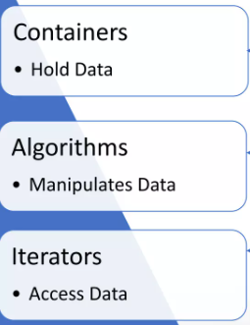
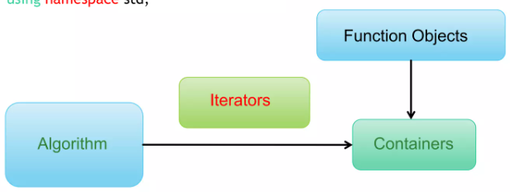
Standard Template Library(STL)
The Standard Template Library provides a set of well structured generic C++ components that work together in a seamless way.
Components of STL
A collection of template classes & functions
Enables generic programming in C++.
It is commonly used for efficiently programming data structures, algorithms, and functions.
Some built-in data structures include arrays, vectors, stacks, queues, etc

Slide 2
STL Features: Containers, Iterators, & Algorithms
Containers- A container is a holder object that stores other objects as elements.
Sequential: vector, deque, list
Associative: set, multiset, map, multimap
Adapters: stack, queue, priority queue
Iterators: Are generalization of the concept pointers , that they point to elements in the container
Input, output, forward, bidirectional, & random access
Each container declares a trait for the type of iterator it provides
Algorithms: Procedures that are applied to containers to process their data
Ex. Search an element, sort() an element
Mutating, non-mutating, sorting, & numeric

Slide 3
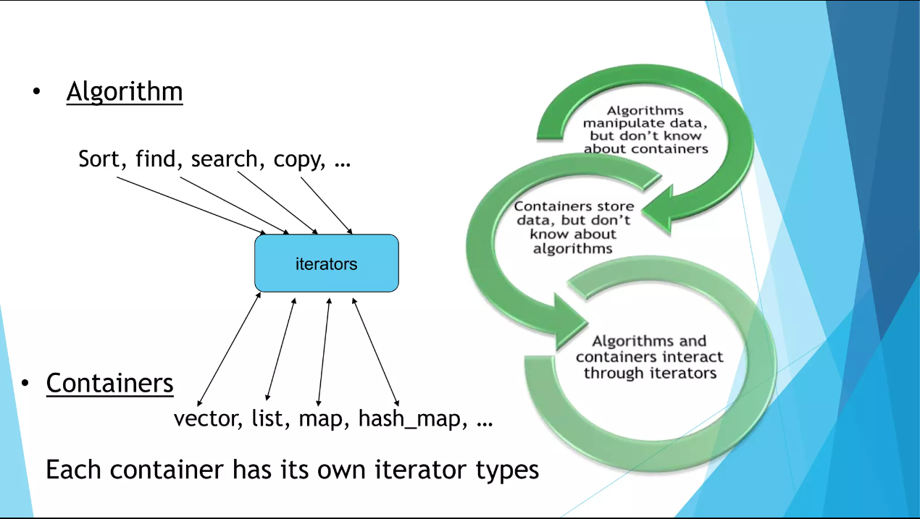
Standard Template Library(STL)

Slide 4
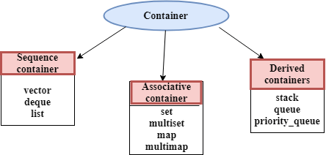
Types of Containers
Adaptive Containers
Stores data by position in linear order.
Implement data structures that can be accessed sequentially via their position.
A special type of container that adapts other containers to give a different interface with restricted functionality
Associative container is an ordered (sorted) container that provides a fast lookup of objects based on the keys.
A value is stored corresponding to each key.

Slide 5
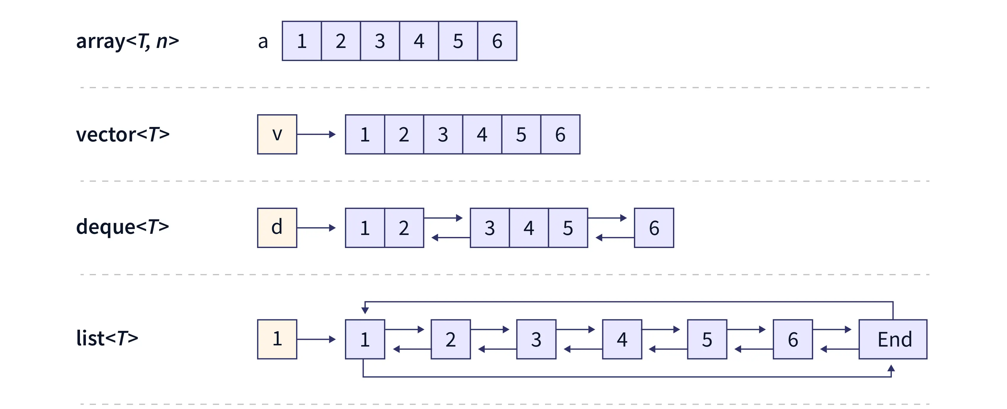
Sequential Containers
A Sequential Container in C++ is an ordered collection of the same type of data in which each element is stored in a specific position.
The position of an element depends on the place and time of insertion of that element.
Sequential containers are also called sequence containers.

Slide 6


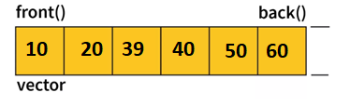
Sequential Container - Vector
A vector is a dynamic array, means size automatically changes when appending elements.
Difference between vector and array
An array follows static approach, i.e size is fixed
Vector is dynamic i.e it automatically resizes
To use vectors, we need to include the #include <vector> header file in our program.
C++ Vector Declaration
Syntax:
vector<T> vector_name;
Ex.
Vector declaration with out size:
vector<int> num;
vector can grow dynamically so it is not necessary to define size
Vector decleratino with size:
vector<int> grades(10);.

Slide 7
Vector Declaration and Initialization in C++
VECTOR DECLARATION AND INITIALIZATION:
vector<int> myVector; //with out size
myVector = {1, 2, 3, 4, 5}; //initialization
vector<int> myVector(10);
// Creates a vector with size 5
myVector = {1, 2, 3, 4, 5}; //initialization
ACCESSING ELEMENT OF THE VECTOR:
To access the element of the vector, use index:
myVector[i].
Starting index=0 and ending index myVector.size()
#include <iostream>
#include <vector>
using namespace std;
int main() {
// Declaration of a vector of integers
vector<int> myVector;
// Initialization of the vector with values
myVector = {1, 2, 3, 4, 5};
// Displaying the elements of the vector
cout << "Vector elements: ";
for (int i = 0; i < myVector.size(); ++i) {
cout << myVector[i] << " ";
}
return 0;
}

Slide 8
Vector Declaration and Initialization in C++
C++ VECTOR INITIALIZATION
// Initializer list
vector<int> vector1 = {1, 2, 3, 4, 5};
// Uniform initialization
vector<int> vector2 {1, 2, 3, 4, 5};
vector<int> vector3(5, 12);
Here, 5 is the size of the vector and 12 is the value.
This code creates an int vector with size 5 and initializes the vector with the value of 12. So, the vector is equivalent to
vector<int> vector3 = {12, 12, 12, 12, 12};
#include <vector>
int main() {
vector<int> vector1 = {1, 2, 3, 4, 5};
// Uniform initialization
vector<int> vector2 {1, 2, 3, 4, 5};
vector<int> vector3(5, 12);
cout << "Vector1 elements: ";
for (int i = 0; i < vector1.size(); ++i) {
cout << vector1[i] << " "; }
cout << " \n Vector2 elements: ";
for (int i = 0; i < vector2.size(); ++i) {
cout << vector2[i] << " ";
}
cout << " \n Vector3 elements: ";
for (int i = 0; i < vector3.size(); ++i) {
cout << vector3[i] << " "; }
return 0;
}

Slide 9
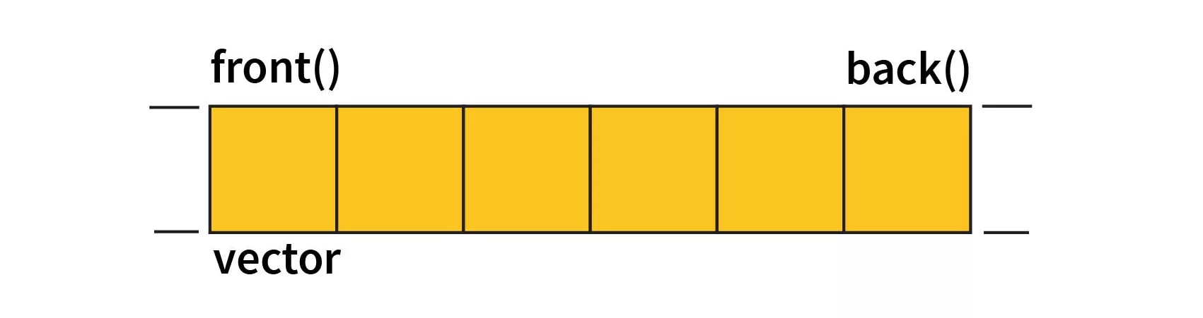
Methods of Vector class- push_back() and pop_back()
Adding Elements to a Vector
push_back(value):
Adds an element to the end of the vector.
myVector.push_back(6); // Vector becomes {1, 2, 3, 4, 5, 6}
Deleting Element from a Vector
pop_back():
Removes the last element from the vector.
myVector.pop_back(); // Vector becomes {1, 2, 3, 4, 5}
size():
Returns the number of elements in the vector.
vector<int> myVector = {1, 2, 3, 4, 5};
int size = myVector.size(); // size is 5
using namespace std;
int main() {
vector<int> myVector;
myVector.push_back(10); //Pushing elements into the vector
myVector.push_back(20);
myVector.push_back(30);
// Displaying the vector after push_back()
cout << "Vector after push_back(): ";
for (int i = 0; i < myVector.size(); ++i)
{
cout << myVector[i] << " ";
}
cout << endl;
// Popping the last element from the vector
myVector.pop_back();
// Displaying the vector after pop_back()
cout << "Vector after pop_back(): ";
for (int i = 0; i < myVector.size(); ++i) {
cout << myVector[i] << " ";
}
cout << endl;
return 0;
}
push_back(70)
10 20 30 40 50 60
pop_back( )

Slide 10
Methods of Vector class
Accessing Front and Back Elements
front():
Accesses the first element of the vector.
int firstElement = myVector.front();
// firstElement
back():
Accesses the last element of the vector.
int lastElement = myVector.back();
// lastElement i
Checking if a Vector is Empty
empty():
Returns true if the vector is empty, false otherwise.
bool isEmpty = myVector.empty();
vector<int> numbers = {1, 2, 3};
if (numbers.empty()) {
// Vector is empty
} else {
// Vector is not empty }
int main() {
// Declaration of a vector of integers
vector<int> myVector;
// Check if the vector is initially empty
if (myVector.empty()) {
cout << "Vector is initially empty." << endl;
}
// Pushing elements to the back of the vector
myVector.push_back(1);
myVector.push_back(2);
myVector.push_back(3);
// Displaying the front and back elements of the vector
cout << "Front element: " << myVector.front() << endl;
cout << "Back element: " << myVector.back() << endl;
// Popping the last element from the vector
myVector.pop_back();
if (!myVector.empty()) {
cout << "Front element after pop_back(): " << myVector.front() ;
cout << "Back element after pop_back(): " << myVector.back() l;
} else {
cout << "Vector is empty after pop_back()." << endl;
}
return 0;
}

Slide 11
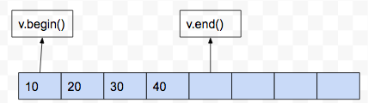
Iterators of Vector
Iterating a vector means traversing every element present in the vector until a condition is met. C
begin():
Used to point the first element of the vector
iterator it =v.begin();
end():
Returns an iterator referring to the past-last-element in the vector container.
iterator it=v.end()
#include <iostream>
#include <vector>
using namespace std;
int main() {
// Declare and initialize a vector
vector<int> v = {1, 2, 3, 4, 5};
// Creating iterate to iterate over the vector
vector<int>::iterator it
cout << "Iterating over the vector : ";
for (it = v.begin(); it != v.end(); ++it)
{
cout << *it << " ";
}
cout << endl;
return 0;
}

Slide 12
Iterators of Vector
INSERTING AND ERASING ELEMENTS IN A VECTOR
insert() Function
Use insert() to add elements at a specific position in the vector.
vector<int> numbers = {1, 2, 3};
numbers.insert(numbers.begin() + 1, 4); // Inserts 4 at index 1
Takes an iterator as the first argument.
erase() Function
Use erase() to remove elements by position or by a range.
vector<int> numbers = {1, 2, 3, 4, 5};
numbers.erase(numbers.begin() + 2); // Erases element
Example
vector< string> names = {"Alice", "Bob", "Charlie"};
names.insert(names.begin() + 1, "David"); // Inserts "David" at index 1
names.erase(names.begin() + 2); // Erases element at index 2 ("Bob")
int main() {
vector< string> names = {"Alice", "Bob", "Charlie"};
cout << "Original Vector: ";
for (const string& name : names) {
cout << name << " ";
}
cout << endl;
// Inserting an element at a specific position
names.insert(names.begin() + 1, "David");
// Display the vector after inserting an element
cout << "After Inserting 'David' at Index 1: ";
for (const string& name : names) {
cout << name << " ";
}
cout << endl;
// Erasing an element by position
names.erase(names.begin() + 2);
// Display the vector after erasing an element
cout << "After Erasing Element at Index 2: ";
for (const string& name : names) {
cout << name << " ";
}
cout << endl;
return 0;
}

Slide 13
sort()
sort()
Sorts elements in a range, commonly used with containers like vectors or arrays.
Header:
Include <algorithm>.
Ex:
vector<int> myVector = {3, 1, 4, 1, 5, 9, 2, 6, 5, 3, 5};
sort(myVector.begin(), myVector.end());
#include <iostream>
#include <vector>
#include <algorithm>
int main()
{
// Create a vector of integers
vector<int> myVector = {3, 1, 4, 1, 5, 9, 2, 6, 5, 3, 5};
// Sort the vector
sort(myVector.begin(), myVector.end());
// Display the sorted vector
cout << "Sorted Vector: ";
for (const auto &element : myVector) {
cout << element << " ";
}
cout << std::endl;
return 0;
}

Slide 14
find()
find()
find() is a C++ Standard Template Library (STL) algorithm used for searching a specified value in a given range.
Syntax:
#include <algorithm>
iterator find(first, last, value);
Parameters:
first: Iterator pointing to the beginning of the range.
last: Iterator pointing to the end of the range.
value: Value to be searched for in the range.
auto it = find(myVector.begin(), myVector.end(), target);
Return Value:
Returns an iterator pointing to the first occurrence of the specified value in the range. If the value is not found, it returns the iterator last.
#include <iostream>
#include <algorithm>
#include <vector>
using namespace std;
int main() {
// Create a vector of integers
vector<int> myVector = {1, 3, 5, 7, 9, 11, 13, 15};
// Element to search for
int target = 7;
// Use std::find to search for the element
auto it = find(myVector.begin(), myVector.end(), target);
// Check if the element was found
if (it != myVector.end())
{
cout << "Element " << target << " found at index " << distance(myVector.begin(), it) << endl;
} else {
cout << "Element " << target << " not found in the vector" << endl;
}
return 0;
}

Slide 15


Lists
Lists are one of the sequence containers available in C++ STL that store elements in a non-contiguous manner.
It permits iteration in both directions.
Insert and remove operations anywhere inside the sequence are completed in constant time.
List containers are constructed as doubly-linked lists, which allow each of the elements, they contain to be stored in non-continuous memory locations
List Syntax
list <data_type> list_name; //cretes an empty list
list<int> l;
list<int> l1 = { 10, 20, 30 };
Initialization of list
list<int> new_list{1,2,3,4};
or
list<int> new_list = {1,2,3,4};

Slide 16
Lists
Creating and Displaying List:
list <data_type> list_name; //cretes an empty list
list<int> l;
list<int> l1 = { 10, 20, 30 };
Initialization of list
list<int> new_list{1,2,3,4};
or
list<int> new_list = {1,2,3,4};
begin():
Used to point the first element of the list
iterator it =l.begin();
end():
Returns an iterator referring to the past-last-element in the list container.
iterator it=l.end()
#include <iostream>
#include <list>
using namespace std;
int main() {
// Create a list of integers
list<int> myList = {10, 20, 30, 40, 50};
// Display the elements of the list using an iterator
cout << "Elements of the list: ";
for (auto it = myList.begin(); it != myList.end(); ++it)
{
cout << *it << " ";
}
// Alternatively,
// for (const auto& element : myList) {
// cout << element << " ";
// }
cout << endl;
return 0;
}

Slide 17
Lists – adding elements
Adding Elements to a List:
1. push_back() Operation
Appends an element to the end of the list.
Syntax:
myList.push_back(value);
Example:
myList.push_back(42);
2. push_front() Operation
Inserts an element at the beginning of the list.
Syntax:
myList.push_front(value);
Example:
myList.push_front(10);
#include <list>
int main() {
list<int> myList; // Create an empty list of integers
myList.push_back(10); //adding element at end of the lise
myList.push_back(20);
myList.push_back(30);
cout << "List after push_back operations: ";
for (const auto& element : myList) {
cout << element << " "; }
myList.push_front(5);// add element at beginning of the list
myList.push_front(15);
cout << "List after push_front operations: ";
for (auto& element : myList) {
cout << element << " ";
}
cout << endl;
return 0;
}

Slide 18
Lists- removing elements
Removing Elements from a List
1. pop_back Operation: Removes the last element from the end of the list.
Syntax:
myList.pop_back();
Example:
myList.pop_back();
2. pop_front Operation : Removes the first element from the beginning of the list.
Syntax:
myList.pop_front();
Example:
myList.pop_front();
int main()
{
list<int> myList = {10, 20, 30, 40, 50};
cout << "Original List: ";
for (auto& element : myList) {
cout << element << " ";
} cout << endl;
myList.pop_back(); // Remove the last element
cout << "List after pop_back: ";
for (const auto& element : myList) {
cout << element << " "; } cout << endl;
myList.pop_front(); // Remove the first element
cout << "List after pop_front: ";
for (const auto& element : myList) {
cout << element << " ";
}
cout << endl;
return 0;
}

Slide 19
Lists – erase()
erase()
Removes elements from a specified range or position.
i) Erasing at specified location
Syntax:
myList.erase(iterator);
Example:
auto it = myList.begin();
myList.erase(it);
ii) Erasing a range elemens:
myList.erase(startIterator, endIterator);
#include <iostream>
#include <list>
int main() {
list<int> myList = {10, 20, 30, 40, 50};
cout << "Original List: ";
for (const auto& element : myList) {
cout << element << " "; }
// Erase a range of elements, e.g., elements at index 2 to 5
auto startIterator = next(myList.begin(), 2);
auto endIterator = next(myList.begin(), 6);
myList.erase(startIterator, endIterator);
}
cout << endl;
return 0;
}

Slide 20
Merge - Lists
Merging two lists:
merge()
Used to merge two sorted lists into one.
Syntax:
list1.merge(list2);
Example:
list<int> list1 = {10, 20, 30};
list<int> list2 = {15, 25, 35};
list1.merge(list2);
Result: list1 is now {10, 15, 20, 25, 30, 35}
#include <iostream>
#include <list>
int main()
{
list<int> list1 = {10, 20, 30};
list<int> list2 = {15, 25, 35};
list1.merge(list2);
for (const auto& element : list1) {
cout << element << " ";
}
return 0;
}

Slide 21
Lists –insert()
insert()
Inserts an element at a specific position in the list.
Syntax:
auto position = myList.begin();
// Iterator pointing to the desired position
myList.insert(position, value);
Example:
list<int> myList = {10, 20, 40};
auto position = next(myList.begin());
// Iterator pointing to the second element
myList.insert(position, 30);
Result: myList is now {10, 20, 30, 40}
int main() {
list<int> myList = {1, 2, 3, 4, 5};
cout << "Original List: ";
for (int num : myList) {
cout << num << " ";
}
// Insert an element at the beginning of the list
myList.insert(myList.begin(), 10);
cout << "List after insertion at the beginning: ";
for (int num : myList) {
cout << num << " ";
}
// Insert an element at a specified index
auto it = next(myList.begin(), 2);
myList.insert(it, 10);
cout << "List after insertion at the index : ";
for (int num : myList) {
std::cout << num << " ";
} return 0; }

Slide 22
Lists –insert()
sort() Function
Sorts the elements of a list in ascending order by default.
Syntax:
myList.sort();
Example:
list<int> myList = {30, 10, 20};
myList.sort();
Result: myList is now {10, 20, 30}
#include <iostream>
#include <list>
int main() {
list<int> myList = {30, 10, 50, 20, 40};
// Sorting the list
myList.sort();
// Displaying sorted elements
cout << "Sorted list: ";
for (const auto& element : myList) {
cout << element << " ";
}
cout << std::endl;
return 0;
}

Slide 23
Removing duplicate elements
Removing Consecutive Duplicates
unique()
Removes consecutive duplicates, retaining only the first occurrence of each unique element.
Syntax:
myList.unique();
Example:
list<int> myList = {1, 2, 2, 3, 3, 4, 4, 5};
myList.unique();
Result: myList is now {1, 2, 3, 4, 5}.
int main()
{
list<int> myList = {1, 2, 3, 2, 4, 5, 1, 6, 7, 3};
cout << "Original List: ";
for (const auto& element : myList)
cout << element << " ";
myList.sort(); // Sort the list to bring duplicates together
myList.unique(); // Remove consecutive duplicates
cout << "List after removing duplicates: ";
for (const auto& element : myList) {
cout << element << " ";
}
cout << "\n";
return 0;
}

Slide 24
Task Scheduler
In a Task Scheduler for a dynamic system, frequent sorting of tasks upon addition hampers performance.
How would you optimize the scheduler for efficient task addition and execution, considering dynamic priorities? Further, how would you modify the code to ensure tasks with the same priority are executed in the order they were added while maintaining performance improvements? This assesses your ability to optimize code and manage execution order in real-world scenarios.
Input:
Add Task: "TaskA" with Priority: 3
Add Task: "TaskB" with Priority: 1
Add Task: "TaskC" with Priority: 2
Task List:
Task: TaskA | Priority: 3
Task: TaskC | Priority: 2
Task: TaskB | Priority: 1
Executing Highest Priority Task:
Executing task: TaskA (Priority: 3)
After Execution:
Task List:
Task: TaskC | Priority: 2
Task: TaskB | Priority: 1

Slide 25
#include <iostream> #include <list> #include <algorithm>
struct Task {
std::string name; int priority;
};
// Comparison function for sorting tasks in priority
bool compareTasks(const Task& a, const Task& b) {
return a.priority > b.priority;
}
class TaskScheduler {
private:
std::list<Task> taskList;
public:
void addTask(const std::string& name, int priority) {
Task newTask = {name, priority};
taskList.push_back(newTask);
taskList.sort(compareTasks);
}
void executeHighestPriorityTask() {
if (!taskList.empty()) {
Task highestPriorityTask = taskList.front();
std::cout << "Executing task: " << highestPriorityTask.name << " (Priority: " << highestPriorityTask.priority << ")\n";
taskList.pop_front();
} else {
std::cout << "No tasks in the scheduler.\n";
}
}
void displayTaskList() {
std::cout << "Task List:\n";
for (const auto& task : taskList) {
std::cout << "Task: " << task.name << " | Priority: " << task.priority << "\n";
}
}
};
int main() {
TaskScheduler sc;
// Sample Input
sc.addTask("TaskA", 3);
sc.displayTaskList();
sc.addTask("TaskB", 1);
sc.displayTaskList();
sc.addTask("TaskC", 2);
sc.displayTaskList();
// Execute Highest Priority Task
sc.executeHighestPriorityTask();
sc.displayTaskList();
return 0;
}

Slide 26
Contact Management System
You are tasked with implementing a search feature in the Contact Management System.
Implement a program that uses a list to store contact information (name, phone number, email, etc.).
Include functionalities like adding a new contact, updating contact details, and displaying the contact list. give me input , output and logic for this
OUTPUT:
Contact List:
Name: Rahul Sharma | Phone: +123456789 | Email: rahul.sharma@email.com
Name: Priya Patel | Phone: +987654321 | Email: priya.patel@email.com
Contact updated successfully.
Contact List:
Name: Rahul Sharma | Phone: +999888777 | Email: rahul.sharma.updated@email.com
Name: Priya Patel | Phone: +987654321 | Email: priya.patel@email.com

Slide 27
#include <iostream> #include <list> #include <string>
struct Contact { // Define a structure to represent a contact
string name; string phno;
string email;
};
class ContactManager { // Class to manage contacts
private:
list<Contact> contactList; // List to store contact information
public:
void addContact(string& name, string& phno, string& email) {
Contact newContact = {name, phno, email};
contactList.push_back(newContact);
}
// Method to update contact details
void updateContact(string& name, string& new_phno, string& newEmail) {
// Iterate through the list to find and update the contact
for (auto& contact : contactList) {
if (contact.name == name) {
contact. phno = new_phno;
contact.email = newEmail;
cout << "Contact updated successfully.\n";
return;
}
} cout << "Contact not found.\n";
}
// Method to display the list of contacts
void displayContactList() {
cout << "Contact List:\n";
// Iterate through the list and print contact details
for (const auto& contact : contactList) {
cout << "Name: " << contact.name << " | Phone: " << contact.phno << " | Email: " << contact.email << "\n";
}
}
};
int main() {
ContactManager cm;
// Sample Input with Indian names
cm.addContact("Rahul Sharma", "+123456789", "rahul.sharma@email.com");
cm.addContact("Priya Patel", "+987654321", "priya.patel@email.com");
cm.displayContactList();
// Update Contact
cm.updateContact("Rahul Sharma", "+999888777", "rahul.sharma.updated@email.com");
cm.displayContactList();
return 0;
}

Slide 28

Deque
Deque:
Deque (Double-ended queue) is a versatile data structure that allows insertion and deletion from both ends.
A dynamic array-like container that allows fast insertion and deletion at both ends.
Key Characteristics
Random Access: Supports constant-time access to elements.
Dynamic Sizing: Can grow or shrink dynamically.
Declaring a deque
#include <deque>
deque<int> myDeque;
Initializing a deque
deque<int> myDeque = {1, 2, 3, 4, 5};
#include <iostream>
#include <deque>
int main() {
// Creating an empty deque of integers
deque<int> myDeque;
// Initializing a deque with some values
deque<int> dq = {1, 2, 3, 4, 5};
// Display the elements in the initialized deque
cout << "Initialized Deque: ";
for (int num : dq) {
cout << num << " ";
}
cout << endl;
return 0;
}

Slide 29
Deque
Adding elements:
push_back(element):
Adds an element to the end.
push_front(element):
Adds an element to the front.
Removing Elements
pop_back():
Removes the last element.
pop_front():
Removes the first element.
#include <iostream>
#include <deque>
int main() {
deque<int> dq;
// Insertion at the back
dq.push_back(10);
dq.push_front(20);
dq.push_back(30);
// Insertion at the front
myDeque.push_front(50);
cout << "Deque elements: ";
for (int num : dq) { cout << num << " "; }
// Deletion from the front
myDeque.pop_front();
// Deletion from the back
myDeque.pop_back();
cout << "Deque elements: ";
for (int num : dq) { cout << num << " "; }
return 0;
}

Slide 30
Deque
Accessing Elements
// Access front and back
int frontElement = myDeque.front();
int backElement = myDeque.back();
int thirdElement = myDeque.at(2);
// Random access
int thirdElement = myDeque[2];
Iterating Through Deque
for (auto it = myDeque.begin(); it != myDeque.end(); ++it)
{
// Access each element using *it
}
// Or use range-based for loop
for (const auto& element : myDeque) {
// Access each element directly
}

Slide 31
Deque – inert()
Insert()
1) Inserts an element at the specified iterator position.
Syntax1: insert(iterator, element):
Ex:
auto it = dq.begin() + 2;
dq.insert(it, 42);
2) Inserts multiple copies of an element at the specified iterator position.
Syntax2: insert(iterator, count, element):
Ex:
auto it = dq.begin() + 2;
dq.insert(it, 3, 42); // Inserts three copies of 42 at position 2
insert(iterator, start_iterator, end_iterator)
3) Inserts elements from another range into the deque at the specified iterator position.
auto it = dq.begin() + 2;
vector<int> v = {1, 2, 3};
myDeque.insert(it, v.begin(), v.end());
#include <iostream> #include <deque>
int main() {
deque<int> dq = {1, 2, 3, 4, 5};
for (auto& element : dq) {
cout << element << " "; }
auto it = dq.begin() + 2;
dq.insert(it, 42); // Inserting a single element
cout << "Deque after inserting 42 at position 2: ";
for (auto& element : dq) {
cout << element << " "; }
it = dq.begin() + 4;
dq.insert(it, 3, 99); // Inserts three copies of 99 at position 4
for (const auto& element : dq) {
cout << element << " "; }
it = dq.begin() + 1;
vector<int> v = {7, 8, 9};
dq.insert(it, v.begin(), v.end());
for (auto& element : dq) {
cout << element << " ";
}
return 0; }

Slide 32
//creating a deque with custom objects
#include <iostream> #include <deque>
#include <string> using namespace std;
class Person {
public:
string name; int age;
// Constructor
Person(const string& n, int a) : name(n), age(a) { }
};
int main()
{
deque<Person> pq; // Create a deque of Person object
//adding data to deque of person
pq.push_back({"Aarav", 28});
pq.push_back({"Priya", 35});
pq.push_front({"Arjun", 22});
cout << “People in the deque:" << endl;
for ( auto& p : pq) {
cout << "Name: " << p.name << ", Age: " << p.age;
}
// Access front and back persons
cout << "\n Front Person:";
cout << "Name: " << pq.front().name << ", Age: " << pq.front().age;
cout << "\nBack Person:" << endl;
cout << "Name: " << pq.back().name << ", Age: " <<
pq.back().age << endl;
// Remove a person from the back
cout << "\nRemoving a person from the back...“;
pq.pop_back();
// Display updated deque
cout << "\nUpdated deque:" << std::endl;
for (auto& p : pq) {
cout << "Name: " << p.name << ", Age: " << p.age ;
}
return 0;
}

