Slide 1
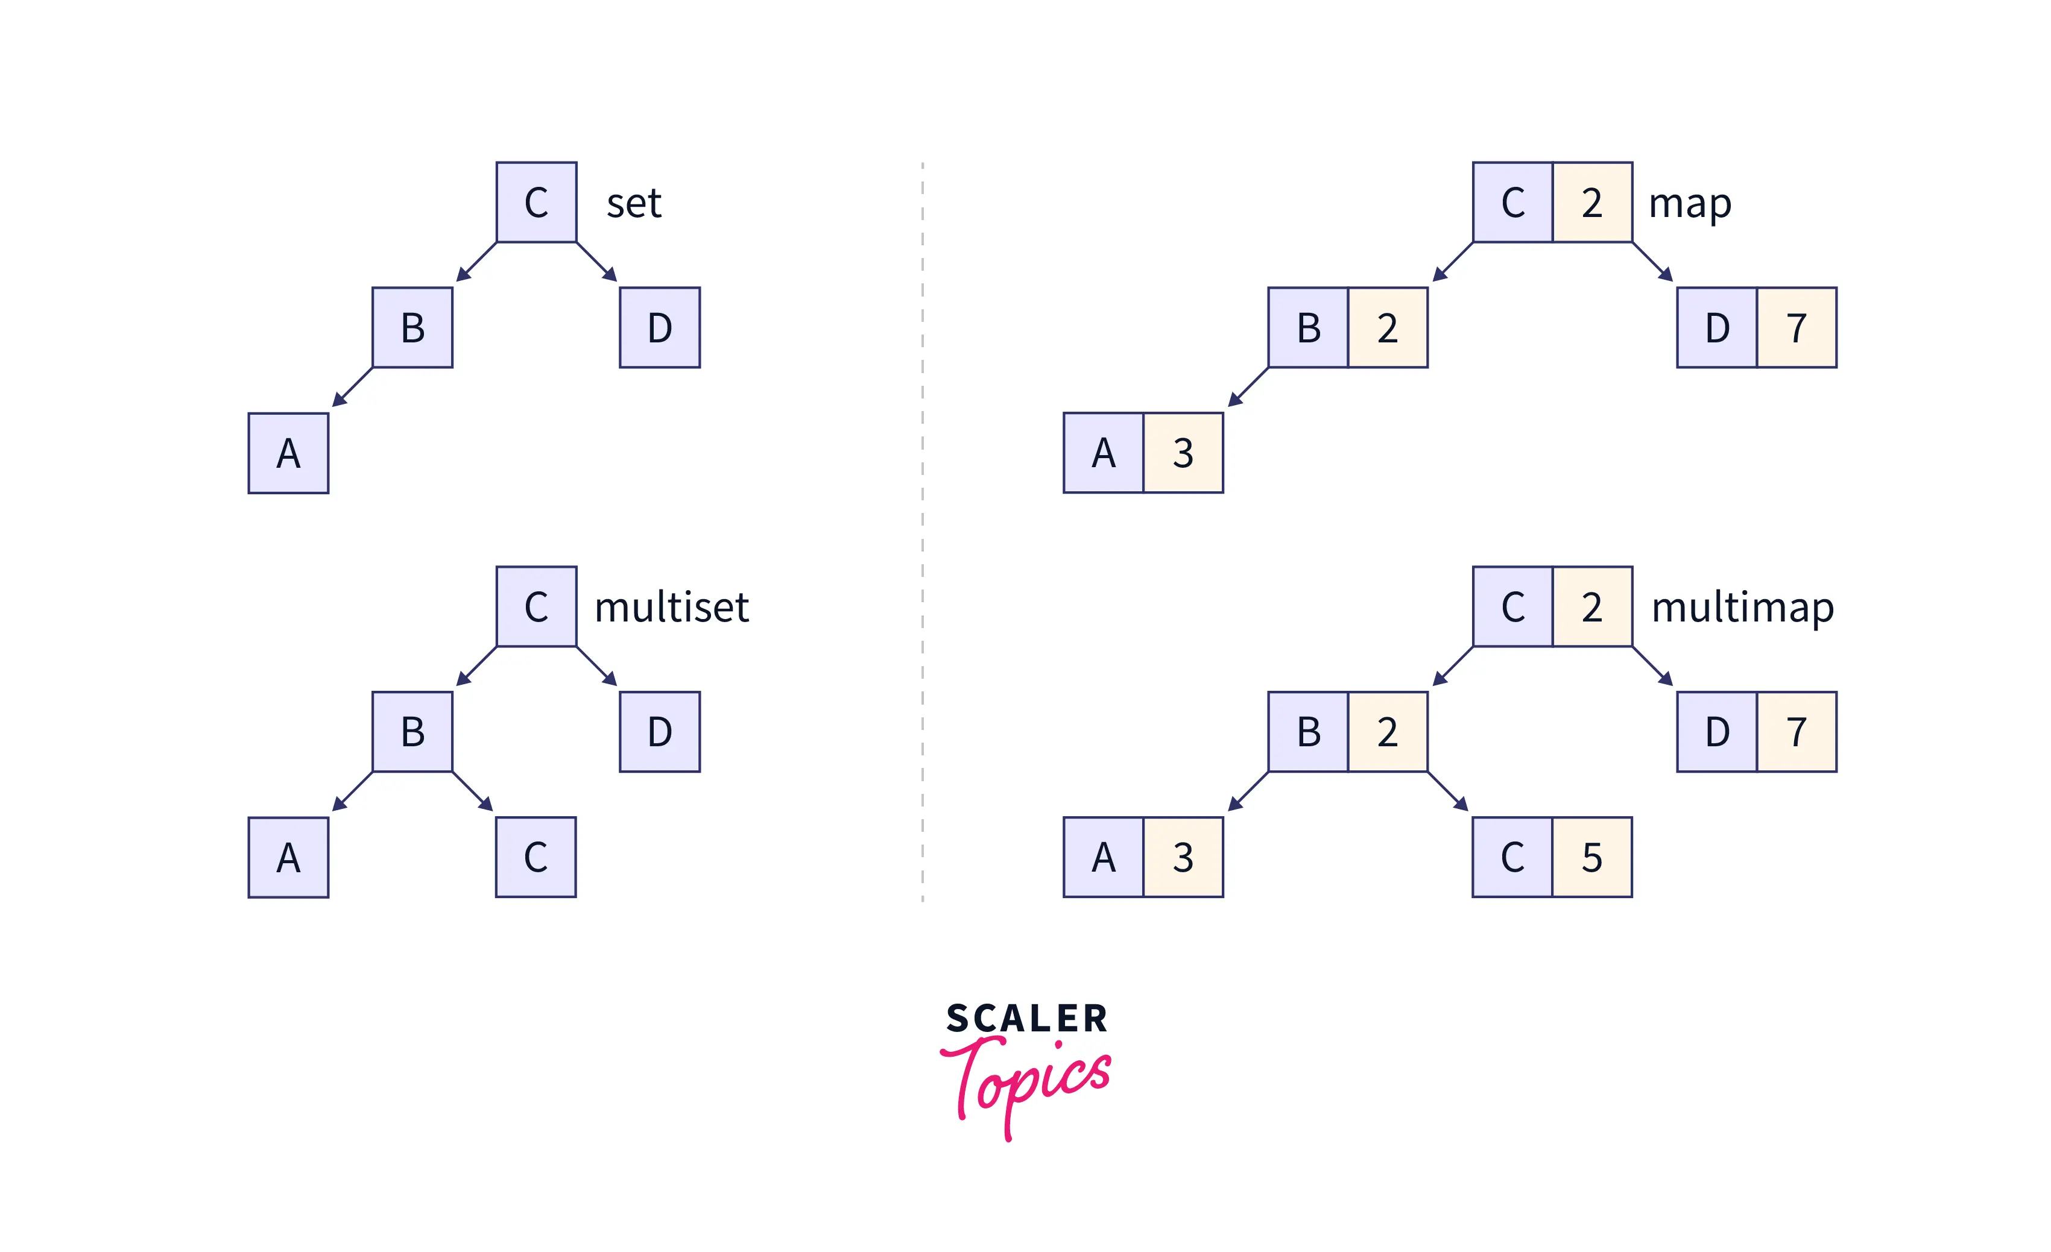
2. Associative Containers
Associative Containers:
Containers that store elements in a key-value relationship.
Provide efficient and fast access to elements based on their keys.
4 TYEPS :
Set:
A set is a container stores unique elements(keys) in sorted order.
No duplicate elements are allowed.
Map:
Container that stores key-value pairs in sorted order based on keys. No duplicate keys are allowed.
Multiset:
container that stores multiple occurrences of elements in sorted order. Allows duplicate elements.
Multimap:
container that stores multiple occurrences of key-value pairs in sorted order based on keys. Allows duplicate keys.

Slide 2
Set
Set:
A C++ STL container that stores unique elements in sorted order.
Characteristics
Ordered: Elements are stored in sorted order.
No Duplicates: Only unique elements are allowed
Advantages
Efficient Search
Unique Elements: Ensures uniqueness in the collection.
Sorted Order: Elements are maintained in sorted order for quick retrieval.
Declaration and initiliztion:
#include <set>
set<DataType> mySet;
Ex. set<int> mySet ;
mySet = {30, 10, 20, 30};
//Create a set of strings and display them in alphabetical order.
#include <iostream>
#include <set>
#include <string>
int main() {
// Declaration and initiation of a set of strings
set<string> stringSet = {"Apple", "Orange", "Banana", "Apple"};
// Displaying elements in sorted order
for (auto& element : stringSet) {
cout << element << " ";
}
return 0;
}

Slide 3
Set
insert():
Adds an element to the set.
Ensures that the set remains sorted and unique.
Syntax
set<DataType> mySet;
mySet.insert(value);
erase():
Removes elements from the set.
Can remove a specific element or a range of elements
mySet.erase(value);
// OR
mySet.erase(iteratorBegin, iteratorEnd);
count():
Returns the number of occurrences of a specific element in the set.
size_t occurrenceCount = mySet.count(value);
clear():
Removes all elements from the set.
mySet.clear();
//set operations
#include <iostream>
#include <set>
int main() {
set<int> mySet;
// insert()
mySet.insert(10);
mySet.insert(20);
mySet.insert(30);
// size()
cout << "Size: " << mySet.size() << std::endl;
// empty()
cout << "Is Empty: " << (mySet.empty() ? "Yes" : "No");
// erase()
mySet.erase(20);
// count()
cout << "Count of 20: " << mySet.count(20) << endl;
// clear()
mySet.clear();
return 0;
}

Slide 4
Set - Union and Intersection Operations
Union:
Combines elements from two sets into a new set.
The result contains all unique elements from both sets.
set<DataType> set1, set2, unionSet;
set_union(set1.begin(), set1.end(), set2.begin(), set2.end(), std::inserter(unionSet, unionSet.begin()));
Intersection:
Retrieves common elements from two sets into a new set.
The result contains only elements present in both sets.
set<DataType> set1, set2, intersectionSet;
set_intersection(set1.begin(), set1.end(), set2.begin(), set2.end(), sinserter(intersectionSet, intersectionSet.begin()));
#include <iostream> #include <set> #include <algorithm>
#include <iterator>
int main() {
set<int> set1 = {1, 2, 3, 4};
set<int> set2 = {3, 4, 5, 6};
set<int> unionSet;
set_union(set1.begin(), set1.end(), set2.begin(), set2.end(), inserter(unionSet, unionSet.begin()));
// Displaying the union set
cout << "Union Set: ";
for (const auto& element : unionSet) {
std::cout << element << " ";
set<int> intersectionSet;
set_intersection(set1.begin(), set1.end(), set2.begin(), set2.end(), inserter(intersectionSet, intersectionSet.begin()));
// Displaying the intersection set
cout << "Intersection Set: ";
for (const auto& element : intersectionSet) {
std::cout << element << " ";
}
return 0;
}

Slide 5
Set - subset and superset
subset:
A set A is a subset of set B if every element of A is also an element of B.
if (includes(set1.begin(), set1.end(), set2.begin(), set2.end()))
{
// set2 is a subset of set1
} else {
// set2 is not a subset of set1
}
superset:
A set A is a superset of set B if every element of B is also an element of A.
if (includes(set2.begin(), set2.end(), set1.begin(), set1.end())) {
// set1 is a superset of set2
} else {
// set1 is not a superset of set2
//Checking Subset and Superset
#include <iostream>
#include <set>
#include <algorithm>
using namespace std;
int main() {
set<int> set1 = {1, 2, 3, 4, 5};
set<int> set2 = {2, 4};
// Checking if set2 is a subset of set1
if (includes(set1.begin(), set1.end(), set2.begin(), set2.end())) {
cout << "set2 is a subset of set1." << endl;
} else {
cout << "set2 is not a subset of set1." << endl;
}
// Checking if set1 is a superset of set2
if (includes(set2.begin(), set2.end(), set1.begin(), set1.end())) {
cout << "set1 is a superset of set2." << endl;
} else {
cout << "set1 is not a superset of set2." << endl;
}
return 0;
}

Slide 6
Map
Map:
A C++ STL container that stores key-value pairs.
Maintains elements in sorted order based on keys.
Characteristics
Ordered Container: Elements are ordered by their keys.
Facilitates efficient search operations.
Unique Keys: Each key in the map is unique.
Ensures a one-to-one relationship between keys and values
Declaration
#include <map>
map<KeyType, ValueType> myMap;
Initialization
myMap = { {key1, value1}, {key2, value2}, ….};
//or
myMap[key1] = value1;
myMap[key2] = value2;
myMap[key3] = value3;
#include <iostream>
#include <map>
using namespace std;
int main() {
// Creating a map with int keys and int values
map<int, int> myMap;
// Inserting elements into the map
myMap[1] = 10;
myMap[2] = 20;
myMap[3] = 30;
// Displaying elements
for (const auto& pair : ageMap) {
cout << pair.first << ": " << pair.second << endl;
}
return 0;
}

Slide 7
Map
insert():
Adds a key-value pair to the map.
If the key already exists, the value is updated.
Syntax
map<KeyType, ValueType> myMap;
myMap.insert({key, value});
erase():
Removes an element by key or a range of elements.
map<KeyType, ValueType> myMap;
myMap.erase(key);
// OR
myMap.erase(iteratorBegin, iteratorEnd);
size()
Returns the number of key-value pairs in the map.
size_t mapSize = myMap.size();
clear():
Removes all elements from the set.
myMap.clear();
#include <iostream>#include <map>
int main() {
// Declaration and initialization
map<string, int> ageMap = { {"Aarav", 25}, {"Priya", 30}, {"Arjun", 22} };
ageMap.insert({"Anaya", 28}); // insert()
ageMap.erase("Priya"); // erase() the element
cout << "Size: " << ageMap.size() << endl; // size()
cout << "Is Empty: " << (ageMap.empty() ? "Yes" : "No") << endl;
auto it = ageMap.find("Arjun"); // find an element
if (it != ageMap.end()) {
cout << "Arjun's age: " << it->second << endl;
}
// clear()
ageMap.clear();
return 0;
}

Slide 8
Phone Book Application
Imagine you are developing a phone book application, and you want to use a map to store contact information.
Each contact has a name (a string) as the key and a phone number (an integer) as the value.
Implement the following operations:search, display, remvoe
INPUT & OUTPUT
Phone Book:
Amit: 123456789
Sunita: 987654321
Rahul: 555555555
Phone number for Sunita: 987654321
Updated Phone Book:
Amit: 123456789
Sunita: 987654321

Slide 9
//Phone Book Application
#include <iostream>
#include <map>
using namespace std;
int main()
{
map<string, int> pb;
// Add contacts to the phone book with Indian names
pb["Amit"] = 123456789;
pb["Sunita"] = 987654321;
pb["Rahul"] = 555555555;
// Display all contacts in the phone book
cout << "Phone Book:" << endl;
for (const auto& entry : pb)
{
cout << entry.first << ": " << entry.second << endl;
}
// Search for a contact by name
string searchName = "Sunita";
if (pb.find(searchName) != pb.end())
{
cout << "Ph no. for " << searchName << ": " << pb[searchName] ;
}
else
{
cout << "Contact not found." << endl;
}
// Remove a contact from the phone book
string removeName = "Rahul";
pb.erase(removeName);
// Display the updated phone book
cout << "Updated Phone Book:" << endl;
for (const auto& entry : pb)
{
cout << entry.first << ": " << entry.second << endl;
}
return 0;
}

Slide 10
Multiset:
Multiset:
A C++ STL container that stores multiple occurrences of elements in sorted order.
Similar to set, but allows duplicate elements.
Characteristics
Ordered Container:
Elements are stored in sorted order.
Facilitates efficient search operations.
Allows Duplicates:
Allows multiple occurrences of the same element.
Declaration and initialization:
#include <set>
multiset<int> myMultiset
myMultiset = {30, 10, 20, 30};
#include <iostream>
#include <set>
int main()
{
// Declaration and initialization
multiset<int> ms = {30, 10, 20, 30};
ms.insert(30); // insert()
ms.erase(20);
cout << "Size: " << ms.size();
cout << "Is Empty: " << (ms.empty() ? "Yes" : "No");
cout << "Count of 30: " << ms.count(30) ;
ms.clear();
return 0;
}
Aspect | set | multiset
Storage | Stores unique elements. | Stores multiple occurrences of elements.
Order | Maintains elements in sorted order. | Maintains elements in sorted order.
Duplication | Does not allow duplicate elements. | Allows duplicate elements.
Use Case | Suitable when uniqueness is crucial. | Suitable when duplicates are allowed

Slide 11
Multimap:
Multimap:
A C++ STL container that stores multiple occurrences of key-value pairs in sorted order.
Similar to map, but allows duplicate keys
Ordered Container:
Elements are stored in sorted order based on keys.
Facilitates efficient search operations.
Allows Duplicate Keys:
Allows multiple occurrences of the same key.
#include <map>
multimap<KeyType, ValueType> myMultimap;
multimap<KeyType, ValueType> myMultimap;
mao = { {"Alice", 25}, {"Bob", 30}, {"Alice", 22} };
#include <iostream>
#include <map>
int main()
{
// Declaration and initialization
multimap<string, int> mp = {
{"Alice", 25}, {"Bob", 30}, {"Alice", 22} };
mp.insert({"Alice", 28}); // insert()
mp.erase("Bob"); // erase()
cout << "Size: " << mp.size();
cout << "Is Empty: " << (mp.empty() ? "Yes" : "No");;
auto it = mp.find("Alice"); // find()
if (it != mp.end()) {
cout << "Alice's age: " << it->second ;
}
mp.clear();
return 0;
}

Slide 12
// student grading system using multimap
#include <iostream>
#include <map>
#include <string>
int main()
{
multimap<string, int> sg;
// Inserting values
sg.insert(make_pair("Alice", 85));
sg.insert(make_pair("Bob", 92));
sg.insert(make_pair("Alice", 90));
sg.insert(make_pair("Charlie", 78));
// Retrieving data for a specific student
string studentToFind = "Alice";
auto range = sg.equal_range(studentToFind);
cout << "Grades for student '" << studentToFind ;
for (auto it = range.first; it != range.second; ++it) {
cout << "- " << it->second << endl;
}
return 0;
}

