Slide 1
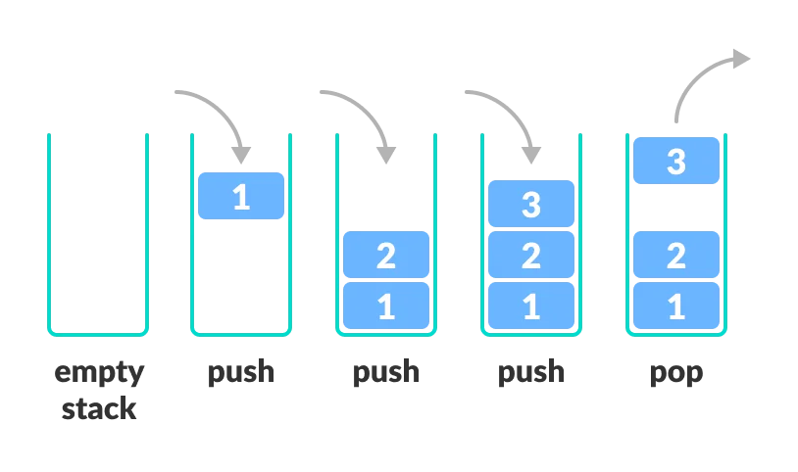
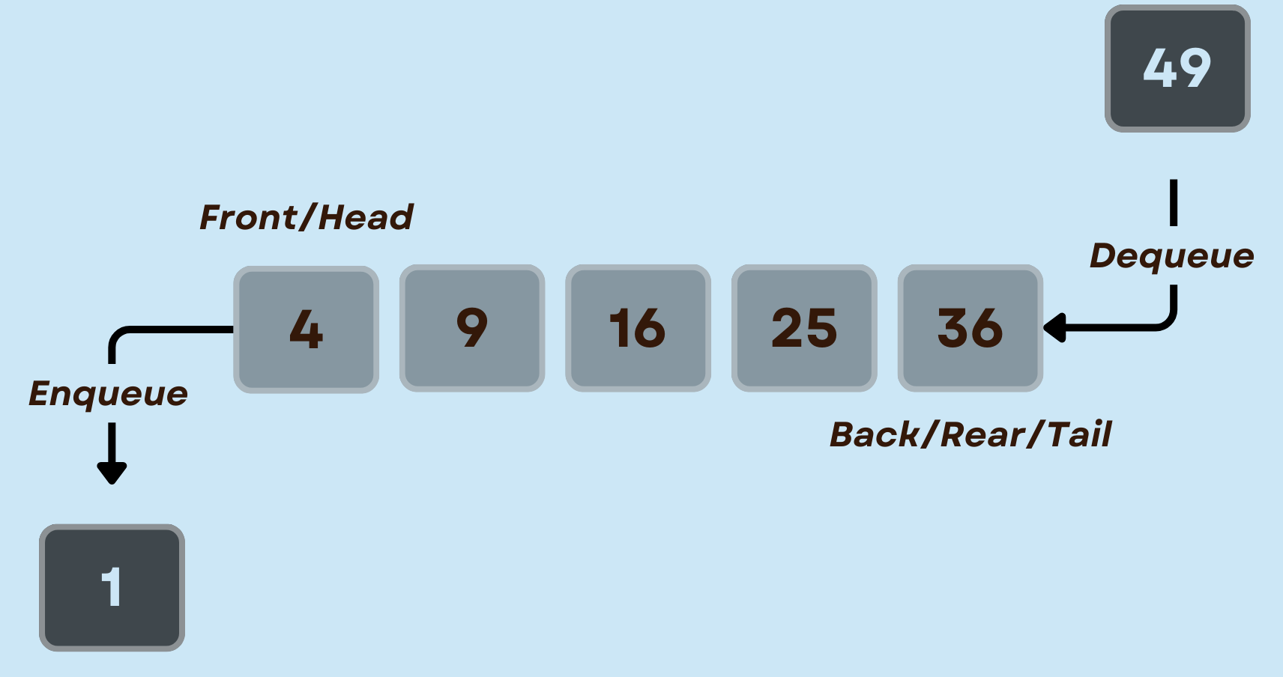
Derived containers/ Container Adapters
Container Adapters
Specialized interfaces built on top of existing containers.
A stack is a container adapter that uses the sequential container deque and provides a restricted interface to support push() and pop() operations only.
Types of Container Adapters
Stack
Adapter for LIFO (Last-In, First-Out) operations.
Uses a deque or a list as the underlying container
Queue
Adapter for FIFO (First-In, First-Out) operations.
Uses a deque or a list as the underlying container.
Priority Queue
Adapter for a priority queue.
Uses a vector as the underlying containe

Slide 2
stack
Stack Container Adapter:
Specialized interface for Last-In, First-Out (LIFO) operations.
LIFO Behavior:
Last element inserted is the first to be removed.
stack<DataType> myStack;
1. push()
Adds an element to the top of the stack.
myStack.push(value);
2. pop()
Removes the top element from the stack.
myStack.pop();
3. top()
Accesses the top element without removing it..
DataType topElement = myStack.top();
#include <iostream>
#include <stack>
int main() {
stack<int> myStack;
// push()
myStack.push(10);
myStack.push(20);
myStack.push(30);
// top()
cout << "Top element: " << myStack.top() << endl;
// pop()
myStack.pop();
// Display remaining elements
cout << "Remaining elements: ";
while (!myStack.empty()) {
cout << myStack.top() << " ";
myStack.pop();
}
return 0;
}

Slide 3
//creating stack with custom objects
#include <iostream>
#include <stack>
#include <string>
class Person {
public:
string name; int age;
Person(const string& n, int a) : name(n), age(a) {}
};
int main() {
stack<Person> ps;
ps.push(Person("Alice", 25)); // push()
ps.push(Person("Bob", 30));
ps.push(Person("Charlie", 22));
cout << "Top person: " << ps.top().name << " Age: " << ps.top().age << endl;
// pop()
personStack.pop();
// Display remaining persons
cout << "Remaining persons: ";
while (!ps.empty())
{
cout << ps.top().name << " ";
ps.pop();
}
return 0;
}

Slide 4
//Reversing a string using stack container adopter
#include <iostream>
#include <stack>
#include <string>
int main()
{
string str = "HELLO ";
stack<char> st;
// Push each character onto the stack
for (char c : str) {
st.push(c);
}
// Pop and print characters to reverse the string
cout << "Reversed String: ";
while (!st.empty()) {
cout << st.top();
st.pop();
}
return 0;
}

Slide 5
//DELETING MID ELEMENT OF THE STACK
#include <iostream>
#include <stack>
using namespace std;
void displayStack(const stack<int>& myStack) {
stack<int> tempStack = myStack;
cout << "Stack elements: ";
while (!tempStack.empty()) {
cout << tempStack.top() << " ";
tempStack.pop();
}
cout << endl; }
void deleteMiddle(stack<int>& myStack) {
if (myStack.empty()) {
return; // Nothing to delete in an empty stack
}
size_t size = myStack.size();
size_t middleIndex = size / 2;
stack<int> tempStack;
// Move elements to tempStack until middleIndex is reached
for (size_t i = 0; i < middleIndex; ++i) {
tempStack.push(myStack.top());
myStack.pop();
}
// Skip the middle element
myStack.pop();
// Move remaining elements back to myStack
while (!tempStack.empty()) {
myStack.push(tempStack.top());
tempStack.pop();
}
displayStack(myStack); // Display elements before deleting
}
int main() {
stack<int> myStack;
// Initialize stack
myStack.push(10); myStack.push(20);
myStack.push(30); myStack.push(40);
myStack.push(50);
displayStack(myStack); // Display elements before deleting
cout<<"After deleting mid element:";
deleteMiddle(myStack); // Delete middle element
return 0;
}

Slide 6
//Undo Mechanism using stack
#include <iostream>
#include <stack>
class TextEditor {
public:
string content;
stack<string> editHistory;
void insertText(string& text) {
content += text;
editHistory.push(content);
}
void undo() {
if (!editHistory.empty()) {
editHistory.pop();
if (!editHistory.empty()) {
content = editHistory.top();
} else {
content = "";
}
}
}
string getContent() const {
return content; }
};
int main() {
TextEditor editor;
editor.insertText("Hello, ");
cout << "Content: " << editor.getContent() << endl;
editor.insertText("World!");
cout << "Content: " << editor.getContent() << endl;
editor.undo();
cout << "Content after undo: " << editor.getContent();
return 0;
}

Slide 7
Derived container- queue
queue Container Adapter:
Specialized interface for First-In, First-Out (FIFO) operations.
Built on top of existing containers.
Characteristics
FIFO Behavior:
First element inserted is the first to be removed.
Container Choice:
Can use a deque or a list as the underlying container.
1. push()
Adds an element to the back of the queue.
myQueue.push(value);
2. pop()
Removes the front element from the queue.
myQueue.pop();
3. front()
Accesses the front element without removing it.
DataType frontElement = myQueue.front();
#include <iostream>
#include <queue>
int main() {
queue<int> q;
// push()
q.push(10);
q.push(20);
q.push(30);
// front()
cout << "Front element: " << q.front() << std::endl;
// pop()
q.pop();
// Display remaining elements
cout << "Remaining elements: ";
while (!q.empty()) {
cout << q.front() << " ";
q.pop();
}
return 0;
}

Slide 8
//Online Order Processing
#include <iostream>
#include <queue>
class Order {
public:
string item; int quantity;
Order(const std::string& i, int q) : item(i), quantity(q) {}
};
class OrderProcessor {
public: queue<Order> orderQueue;
void placeOrder(const Order& order) {
orderQueue.push(order);
cout << "Order placed: " << order.quantity << "x " << order.item << endl;
}
void processOrders() {
while (!orderQueue.empty()) {
Order currentOrder = orderQueue.front();
orderQueue.pop();
cout << "Processing order: " << currentOrder.quantity << "x " << currentOrder.item;
}
cout << "All orders processed." << endl;
} };
int main() {
OrderProcessor processor;
// Simulate online orders
processor.placeOrder(Order("T-shirt", 2));
processor.placeOrder(Order("Book", 1));
processor.placeOrder(Order("Headphones", 1));
// Process orders
cout << "Processing orders:" << endl;
processor.processOrders();
return 0;
}

Slide 9
Derived container- priority_queue
priority_queue
Specialized interface for a priority queue.
Built on top of an existing container (usually a vector).
Priority Queue:
Elements are dequeued based on priority.
Container Choice:
Uses a vector as the underlying container
1. push()
Adds an element to the priority queue
priority_queue<DataType> myPriorityQueue;
myPriorityQueue.push(value);
2. pop()
Removes the top element (element with the highest priority) from the priority queue
myPriorityQueue.pop();
3. top()
Accesses the top element (element with the highest priority) without removing it.
DataType topElement = myPriorityQueue.top();
#include <iostream>
#include <queue>
int main() {
priority_queue<int> myPriorityQueue;
// push()
myPriorityQueue.push(10);
myPriorityQueue.push(30);
myPriorityQueue.push(20);
// top()
cout << "Top element: " << myPriorityQueue.top() <<endl;
// pop()
myPriorityQueue.pop();
// Display remaining elements
cout << "Remaining elements: ";
while (!myPriorityQueue.empty()) {
cout << myPriorityQueue.top() << " ";
myPriorityQueue.pop();
}
return 0;
}

Slide 10
// priority queue of integers in ascending order
#include <iostream>
#include <queue>
using namespace std;
int main() {
// Create a priority queue of integers in ascending order
priority_queue<int, vector<int>, greater<int>> priorityQueue;
// Insert elements into the priority queue
priorityQueue.push(30);
priorityQueue.push(10);
priorityQueue.push(50);
priorityQueue.push(20);
// Display elements in ascending order
cout << "Elements in ascending order:" << endl;
while (!priorityQueue.empty()) {
cout << priorityQueue.top() << " ";
priorityQueue.pop();
}
return 0;
}

