Slide 1

1. What happens to your data after getting executed?
Notes:
data after getting executed - gets Deleted
The data displayed on the screen is stored in the memory for only a very short period of time. As the program terminates the data is lost. With the help of Files, we can avoid this. The data can be stored for any period of time without losing it i.e. permanent storage.

Slide 2
2. If you have large data, how would you handle it...?
Notes:
Consider the situation where the program handles a large quantity of data. Now the memory is limited to the amount that can be displayed on the screen. To overcome this limitation we make use of Files that allows us to handle a large quantity of data without any complexities.

Slide 3

3. How to transfer data from one system to another...?
Notes:
Title + Image + Text

Slide 4
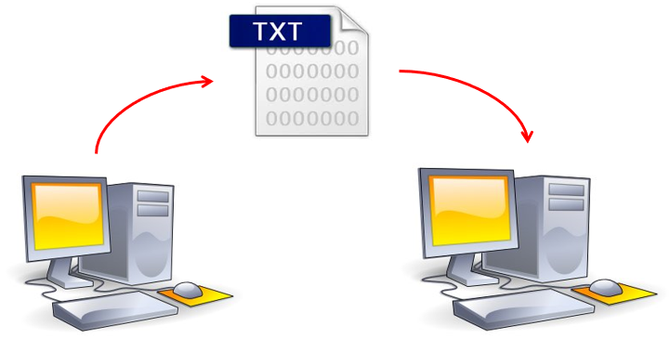

1. What happens to your data after getting executed?
2. If you have large data, how would you handle it...?
3. How to transfer data from one system to another...?
FILES
File Transfer
Notes:
Title + Image + Text

Slide 5
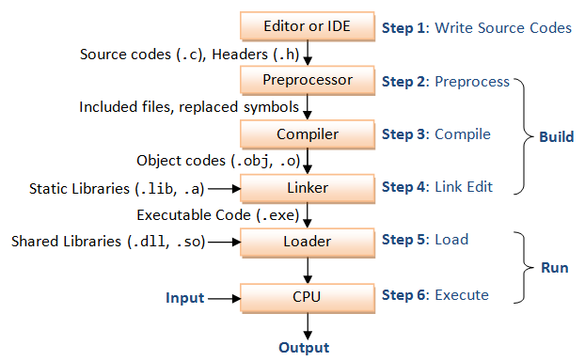
File Handling
Notes:
Title + Image + Text

Slide 6
FILE Types and FILE Operations:
1. Text FILES (.txt) - Human readable
2. Binary FILES(.bin) - 1's and 0's
FILE Operations
Creation of a new file
Opening or accessing an existing file
Reading from a file
Writing to a file
Seeking in a file or moving to a specific location
Closing a file
Notes:
Title + Image + Text

Slide 7
File Operations
Creating a FILE:
FILE *fp; // FILE POINTER
The FILE is the structure which stores the details and has been declared in the header file "stdio.h”
FILE *fp;
fp=fopen("E://FILES//Create.txt","w");
fopen() - to open/create a file
To create a new file, we use the file mode "w"
E://FILES// - File location (Can be choosen by the programmer)
Create.txt - File name to create
Notes:
Title + Image + Text

Slide 8
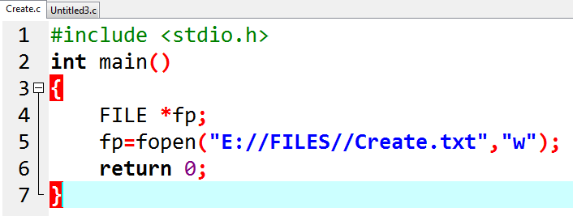
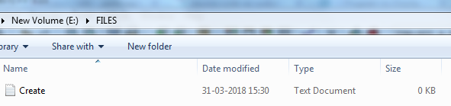
File Operations
Creating a FILE:
Notes:
Title + Image + Text

Slide 9
File Operations
Creating a FILE:
Notes:
Title + Image + Text

Slide 10
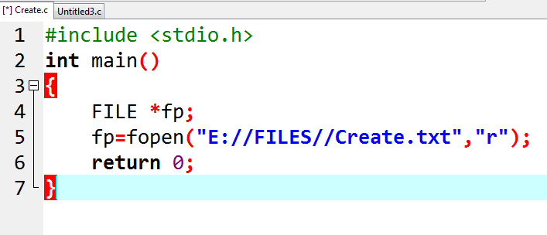
File Operations
Opening an existing FILE:
fp=fopen("E://FILES//Create.txt",“r");
Opens the file in the read mode "r"
Notes:
Title + Image + Text

Slide 11
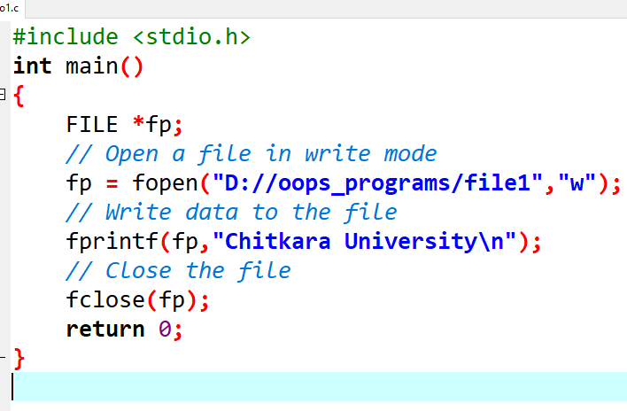
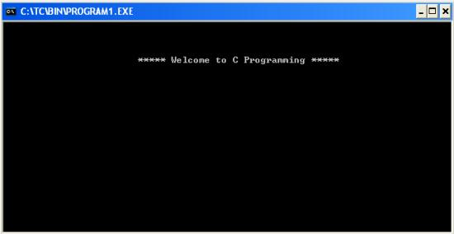
Writing to a FILE:
fp=fopen("E://FILES//Create.txt",“w");
Opens the file in the write mode “w"
fprintf():
This function will print the input in the particular file.
fprintf( fp,"\n\t Chitkara University ");
printf()
fprintf()
Notes:
Title + Image + Text

Slide 12
File Operations
fprintf() – Writing data to file
The fprintf() function is used to write mixed data type values into the file.
fprintf() function is used to write formatted data into a file
Syntax:
fprintf(FILE *fp,"format-string",var-list);
Example:
int age=20;
char name[20]=”ramu”;
fprintf (fp, “%s %d\n”, name, age); // ramu 20
Where, fp is file pointer to the data type “FILE”.

Slide 13
File Operations
//Program to open a file and write data to it
#include<stdio.h>
void main()
{
FILE *fp;
int rollno,n,i;
char name[25];
float percentage;
fp = fopen("student.txt","w"); //Statement 1
if(fp == NULL)
{
printf("\nCan't open file or file doesn't exist.");
exit(0);
}
Printf(“Enter n:\n”);
Scanf(“%d”,&n);
for(i=0;i<n;i++)
{
printf("\nEnter Roll, Name and Percentage :\n ");
scanf("%d%s%f",&rollno,name,&percentage);
fprintf(fp,"%d %s %f\n",rollno,name,percentage);
}
printf("\nData written successfully...");
fclose(fp);
}

Slide 14
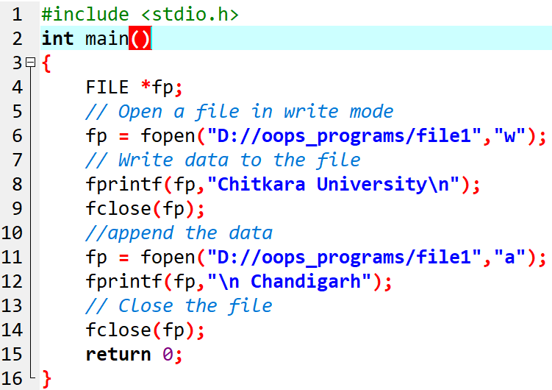
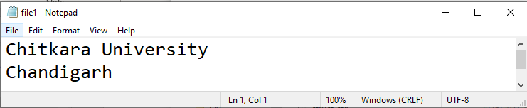
Append a File
"a" | opens a text file in append mode
Notes:
Title + Image + Text

Slide 15
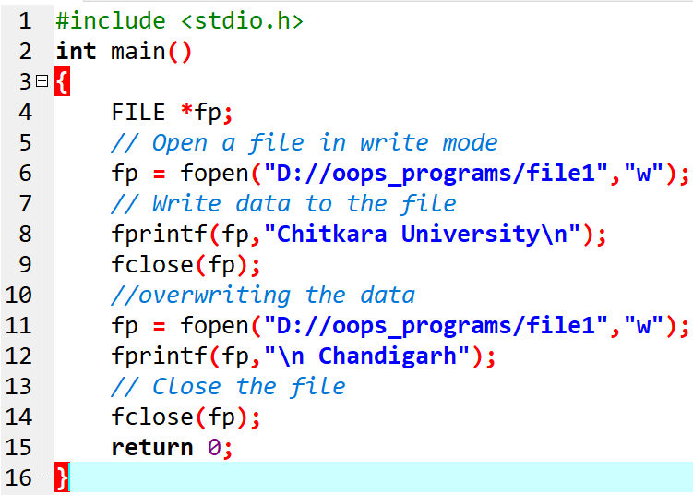
Overwriting a File
Notes:
Title + Image + Text

Slide 16
Difference between Write and Append Mode
Both are used to write in a file. New file is created if it doesn't exists already.
Write (w) mode
The file is reset - deletion of any data already present in the file.
Append (a) mode
Append mode is used to append or add data to the existing data of file(if any).
The cursor is positioned at the end of the present data in the file.
Notes:
Title + Image + Text

Slide 17
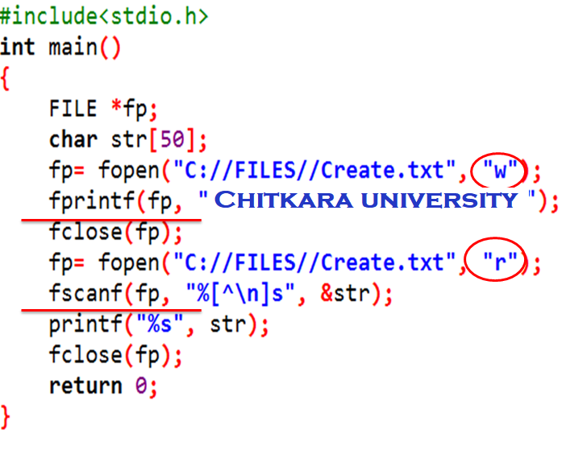
Reading a File
scanf()
fscanf()
Notes:
Title + Image + Text

Slide 18
File Operations
fscanf() – reads formatted data
fscanf() function is used to read formatted data from a file.
fscanf() function is used to read mixed type data values form the file.
Syntax:
fscanf(FILE *fp,"format-string",&var-list); //read input from the file
RAMU 20
SITA 16
SHEELA 23.
Example:
int age;
char name[20];
fscanf (fp, “%s%d”, name, &age); //name=Ramu age=20
Where, fp is file pointer to the data type “FILE”.
Note: The fscanf() function is similar to scanf() function except the first argument which is a file pointer that specifies the file to be read

Slide 19
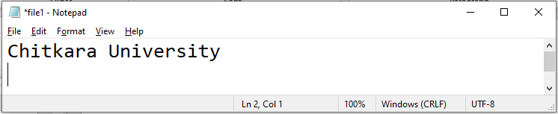

Output Screen Difference
File (Create.txt)
Stdout screen
Notes:
Title + Image + Text

Slide 20
File Operations
Program to illustrate fscanf() function
#include<stdio.h>
int main()
{
FILE *fp;
int rollno;
char name[25];
float percentage;
fp = fopen("student.txt","r");
if(fp == NULL)
{
printf("\nCan't open file or file doesn't exist.");
exit(0);
}
printf("\nReading Data from file...\n");
while((fscanf(fp,"%d%s%f",&rollno,name,&percentage))!=EOF)
printf("\n%d\t%s\t%f",rollno,name,percentage);
fclose(fp);
return 0;
}
o/p: 101 ramu 78.9
102 sita 89.7

Slide 21
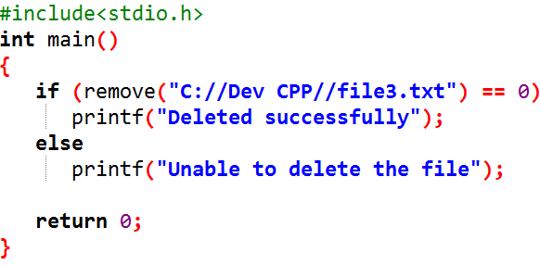
Program to Delete a File
remove()- returns 0, if file is deleted
Notes:
Title + Image + Text

Slide 22
File Operations/ File Handling Functions
fopen() Opens a file
fclose() Closes a file
fgetc() Reads a character from a file
fputc() Writes a character to a file
fgetw() Read an integer
fputw() Write an integer
fprintf() Prints formatted output to a file
fscanf() Reads formatted input from a file
fgets() Read string of characters from a file
fputs() Write string of characters to a file
feof() Detects end-of-file marker in a file
Notes:
Title + Image + Text

Slide 23
File Operations/ File Handling Functions
fseek() sets the file pointer to given position
ftell() returns current position
rewind() sets the file pointer to the beginning
of the file
Notes:
Title + Image + Text

Slide 24
File Operations
fseek()
fseek() sets the file pointer at a desired position in a file.
fseek() function sets the file position of the stream to the given offset.
This function returns (NULL) if successful, or else it returns a non-zero unsuccessful value.
Syntax:
int fseek(FILE *fp, long int offset, int whence);
Parameters
fp − This is the pointer to a FILE object that identifies the file.
offset − This is the number of bytes to (move) offset from whence POINT.
Offset= -ve backward move
+ve forward move
whence − This is the position from where offset is added. It is specified by one of the following constants
s.No | Whence | Constant value | Meaning
1 | SEEK_SET | 0 | Beginning of file
2 | SEEK_CUR | 1 | Current position
3 | SEEK_END | 2 | End of file

Slide 25
File Operations
Example:
fseek(fp,10,SEEK_SET) OR fseek(fp,7,0)
offset=10, whence=SEEK_SET / 0
sets the file position at 10th position from the beginning of the file.
fseek(fp,-5,SEEK_CUR) OR fseek(fp,-2,1)
offset=-5, whence= SEEK_CUR/1
The file position moved back to 5 bytes towards left from the current position of the file.
fseek(fp,-3,SEEK_END) or fseek(fp,-3,2)
The file position moved back to 3 bytes towards left from the End of the file.

Slide 26
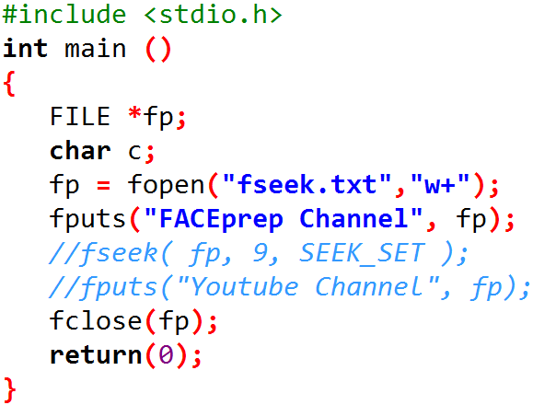
Program
Notes:
Title + Image + Text

Slide 27
File Operations
fgetc() – reading a file
It's used to read single character from a file that has been opened in read(r) mode by fopen() function.
getc() function returns next requested object from the file stream on success.
Syntax: int fgetc(filepointer); Hello
Example: FILE *fp;
fgetc(fp);
fputc() - writing to file
It is used to write a character to the file.
This function is used for writing a single character in a stream along with that it moves forward the indicator's position.
Syntax: int fputc( char ch, FILE *fp);
Example: FILE *fp;
char ch=’a’;
fputc(ch,fp); // value of ch is copied into file which is pointed by fp

Slide 28
File Operations
//Program to write single character to a file
#include <stdio.h>
main(){
FILE *fp;
fp = fopen("file1.txt", "w");//opening file
fputc('a',fp);//writing single character into file
fclose(fp);//closing file
}
Ouput: a
//program to read single character from a file
#include<stdio.h>
#include<conio.h>
int main(){
FILE *fp;
char c;
fp=fopen("myfile.txt","r");
while((c=fgetc(fp))!=EOF)
{
printf("%c",c);
}
fclose(fp);
return o
}
output;:
myfile.txt
this is simple text message

Slide 29

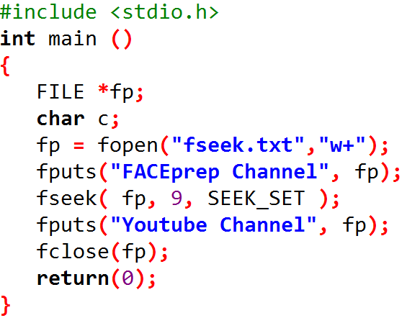

fputs()
Notes:
Title + Image + Text

Slide 30
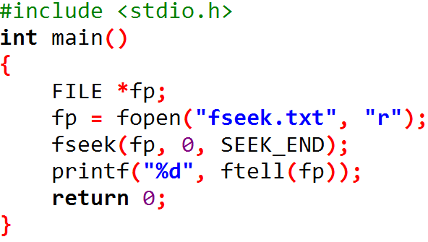

Program
Notes:
Title + Image + Text

Slide 31
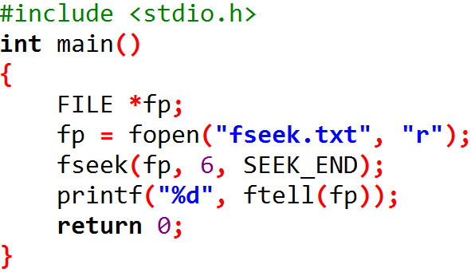
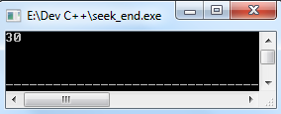
Program
SEEK_END - Brings the pointer to the end of the file and the offset 6 indictaes 6 positions after the end of the file.
Notes:
Title + Image + Text

Slide 32

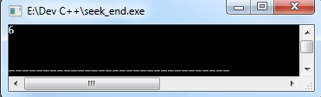
Program
SEEK_CUR - Takes the file pointer to the particular mentioned location.
Notes:
Title + Image + Text

Slide 33
File Operations
ftell()
ftell function is used to know current position of the file pointer.
Syntax: long int ftell(FILE *fp);
Example: ftell(fp);
rewind()
rewind function is used to move file pointer position to the beginning of the file where ever the cursor in the file..
Syntax: void rewind(FILE *fp)
Example: rewind(fp);

Slide 34
Modes on fopen function
r opens a text file in read mode
w opens a text file in write mode
a opens a text file in append mode
r+ opens a text file in read and write mode
w+ opens a text file in read and write mode
a+ opens a text file in read and write mode
rb opens a binary file in read mode
wb opens a binary file in write mode
ab opens a binary file in append mode
rb+ opens a binary file in read and write mode
wb+ opens a binary file in read and write mode
ab+ opens a binary file in read and write mode
Notes:
Title + Image + Text

