Slide 1
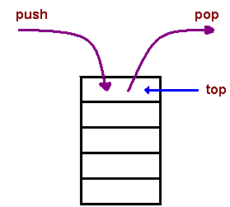
Stacks
Stack is a linear Data structure that stores and retrieves the elements by using a principle LIFO(Last-In First-Out ).
i.e. The elements in stack are inserted or removed according to Last-In First-Out (LIFO) principle.
LIFO Principle- Lastly Inserted elements will be removed first.
Ex. IN OUT
E4,E3,E2,E1 → STACK → E4,E3,E2,E1
Stack will have only one end, it is called as top of stack
Elements can be added and removed from the stack only at the top end.
push()→ inserting an element into stack is called as push.
pop()→ deleting an element into stack is called as pop
E4
E3
E2
E1
A stack

Slide 2
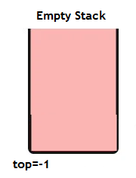
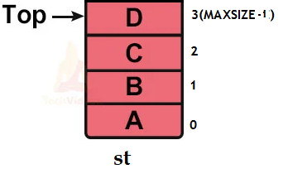
Stacks
An Empty stack: A stack with out any elements.
In Empty stack top points to -1
i.e. top=-1
If(top==-1)
{
printf(“stack is empty”);
}
Full Stack: A stack with full of elements.
In Full stack top points to MAXSIZE-1
i.e. top=MAXSIZE-1
if(top==MAXSIZE-1)
{
printf(“stack is FULL”);
}

Slide 3
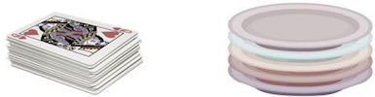
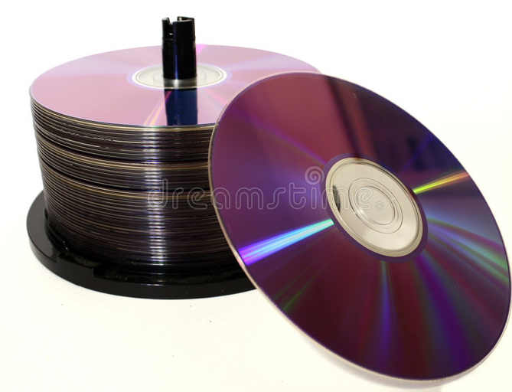

Stacks
Examples of a stack:
A deck of cards
a pile of plates
A CD case
A stack of books

Slide 4
Stack- Operations
Basic Operations:
push()→ inserting an element into stack is called as push.
pop()→ deleting an element into stack is called as pop
Other operations:
isEmpty(): It determines whether the stack is empty or not.
isFull(): It determines whether the stack is full or not.'
peek(): It returns the element at the given position.
count(): It returns the total number of elements available in a stack.
40
30
20
10
A stack

Slide 5
Stack-Operation – push()
push() – INSERTING ELEMENT
The process of inserting an element into stack is known as a push() Operation.
An element can be inserted into stack using push() operation.
-------------------------------------------------------------------------------
Push operation involves a series of steps −
Step 1 − Checks if the stack is full.
If the stack is full, produces an error and exit.
if(top==Maxsize-1)
print “Stack is overflow”
Step 2 − If the stack is not full, increments top to point next empty space.
top=top+1
Step 3 − Add data element to the stack location, where top is pointing.
stack[top]=item
Step 4: stop

Slide 6
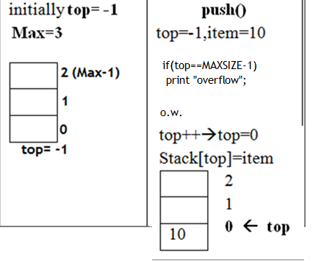
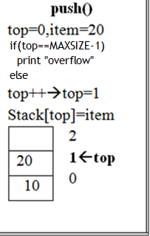
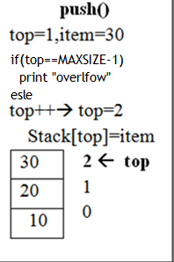
Stack-Operation push()

Slide 7
Stack-Operation – push(item)
//Implementation of push with item as a parameter
void push (int item) //push with item as a parameter
{
if (top == MAXSIZE-1 )
{
printf("\n Stack is full"); //checking for Overflow
}
else
{
top = top +1; //incremented top by 1
stack[top] = item; //insert the item at top position
}
}

Slide 8
Stack-Operation – pop()
pop() – REMOVING AN ELEMENT
The process of REMOVING an element from stack is known as a pop() operation.
An element can be removed from stack using pop operation.
Pop operation involves a series of steps −
Step 1 − Checks if the stack is empty.( underflow)
If the stack is empty, produces an error and exit.
if(top==--1)
print “Stack is empty”;
Step 2 − If the stack is not empty, access data element from the stack location, where top is pointing.
item= st[top] ;
Step 3 − top decrements top by 1
top=top-1
Step 4: return item;

Slide 9
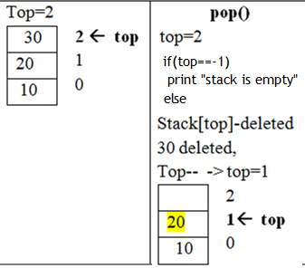
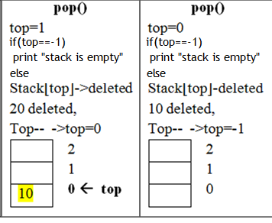
Stack-Operation pop()

Slide 10
Stack-Operation – pop()
int pop ()
{
if(top == -1) //check for underflow
{
printf(“Stack is empty");
return 0;
}
else
{
int item;
item = st[top]; //get the item i.e. removing an item from stack
top--;
return item;
}
}

Slide 11
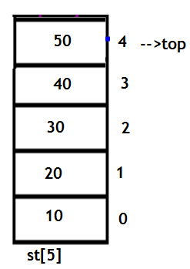
Implementation of Stack using Arrays
The stack is implemented by using the array.
All the operations regarding the stack are performed using arrays.
Declaration of stack:
datatype stackname[MAXSIZE];
EX> int st[5];
flaot st[15];
Operations performed:
push(item);
pop()

Slide 12
Implementation of Stack using Arrays
//stack implementation using array
#include<stdio.h>
#define MAXSIZE 10 //define the SIZE
void push(int item); //declaring push operation
int pop(); //declaring pop operation
void display();
int st[MAXSIZE ]; //declaring stack using array
int main()
{
push(10); //inserts 10
push(20); //inserts 20
push(30) //inserts 30
push(40); //inserts 40
printf(“After pushing the stack is \n”);
display();
pop(); //removes 40
pop(); //removes 30
pop(); //removes 10
printf(“After poping the stack is \n”);
display();
return 0;
}
//definition of push()
void push(int item)
{
if(top==MAX-1) //check for overflow
{
printf("STACK is full. Insertion not possible\n");
}
else
{
top=top+1;
stack[top]=item;
}
}

Slide 13
Implementation of Stack using Arrays
//implementation of pop()
int pop()
{
if(top==-1) //check for underflow
{
printf("Stack is empty\n");
return 0;
}
else
{
item=stack[top];
top--;
return(item);
}
}
void display()
{
int i;
if(top!=-1)
{
printf("The elements of STACK \n");
for(i=top; i>=0; i--)
printf("%d\n",stack[i]);
}
else
{
printf("The STACK is empty\n");
}
}
The elements of STACK
After pushing the stack is
40
30
20
10
After poping the stack is
10

Slide 14
Reverse string using stacks
//program for reversing a string
#include <stdio.h>
#include <string.h>
#define max 100
int top,stack[max];
void push(char x)
{
// Push(Inserting Element in stack) operation
if(top == max-1)
{
printf("stack overflow");
} else {
stack[++top]=x;
}
}
void pop(){
// Pop (Removing element from stack)
printf("%c",stack[top--]);
}
int main()
{
char str[50];
printf("Enter a string \n");
scanf("%s",str);
int len=strlen(str);
int i;
for(i=0;i<len;i++)
push(str[i]);
for(i=0;i<len;i++)
pop();
return 0;
}

Slide 15
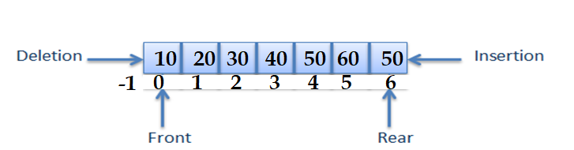
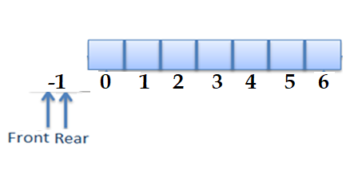
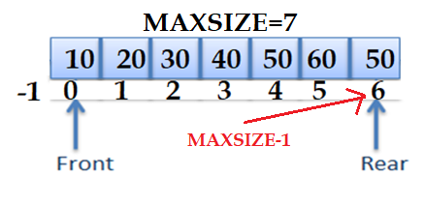
Queue
Queue is a Linear Data Structure which stores and retrieves the elements by following the principle First-In First-Out (FIFO). FIFO → The elements inserted first will be removed first.
Queue will have two ends, called as front-end and rear-end.
Elements can be added to queue at rear index and removed from the queue at the front index.
Q[7]
A full queue full when rear is at last array position i.e. (MAXSIZE -1)
Empty Queue
At the initial stage of queue front=-1 and rear=-1

Slide 16
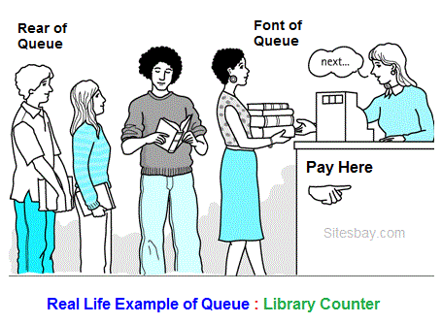

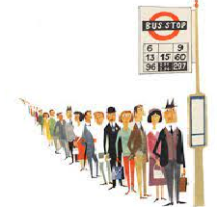
Queue

Slide 17
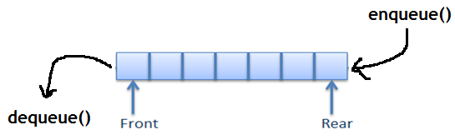
Queue operations
Basic operations :
enqueue()- An element can be inserted into queue using enqueue() operation.
dequeue() - An element is removed from queue using dequeue() operation.
Other Operations:
isEmpty(): The isEmpty() function is used to check if the Queue is empty or not.
isFull(): The isFull() function is used to check if the Queue is full or not.
peek() - This function helps to see the data at the front of the queue

Slide 18
Queue operations
Enqueue() - ALGORITHM
When rear points to MAXSIZE, queue is full, then it is said to be an OVERFLOW CONDITION
STEPS:
Step 1 − Check if the QUEUE IS FULL.
if(rear==MAXSIZE-1)
print “queue is full”;
Step 2 − If the QUEUE IS NOT FULL, increment rear
rear=rear+1;
Step 4 − Add data element to the queue at rear
queue[rear]=item;
Step 5 − return success.

Slide 19
Queue operations
//implementation of enqueue()
void enqueue(int item)
{
if(rear==MAXSIZE-1) //check for overflow
{
printf(“queue is full \n”);
}
else
{
if(front==-1) //if empty stack increment front
{
front++;
}
rear = rear + 1; //increment rear
queue[rear] = item; //insert item
}

Slide 20
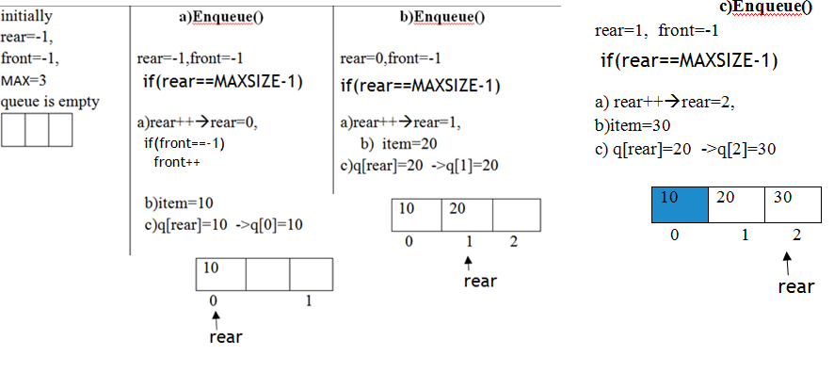
Queue operations

Slide 21
Queue operations
dequeue()
An element is removed from queue using dequeue() operation.
Front index is incremented by 1 in dequeue() operation.
Each dequeue() operation decreases the size of the queue by 1.
When rear==-1 or front >rear, the queue is empty, then it is said to be an Underflow condition
Algorithm ford equeue() to remove an element from queue.
Step 1. Check for underflow
if (rear==-1 || front>rear) or if(front==-1 || front>rear)
print “Queue is empty”; //underflow condition
Step 2: If the queue is not empty, access the data where front is pointing
itme=queue[front] ;
Step 3 : Increment front pointer to point to the next available data element.
front = front+ 1;
Step 4. stop

Slide 22
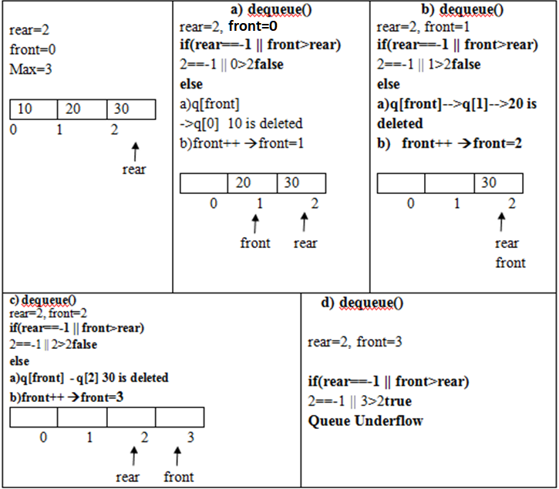
Queue operations

Slide 23
Queue operations
//implementation of dequeue()
void dequeue ()
{
if( rear==-1 || front>rear) //check for queue underflow
{
printf(" Deletion not possible QUEUE is empy"); }
else
{
int item;
item=queue[front]; //delete item
printf("The deleted element is %d\n“,item);
front++; //increment front
}
}

Slide 24
Implementation of Queue using Arrays
#define MAXSIZE 10
void enqueue(int item);
int dequeue();
void display();
int q[MAXSIZE ]; //declaring a queue
int main()
{
enqueue (10);
enqueue (20);
enqueue (30)
enqueue(40);
printf(“After inserting the queue is \n”);
display();
dequeue();
dequeue();
dequeue();
printf(“After removing the queue is \n”);
display();
return 0;
}
//implementation of enqueue
int enqueue(int item)
{
if(rear==MAXSIZE-1)
{
printf(“queue is full \n”);
return 0;
}
else
{
if(front==-1)
{
front++;
}
rear = rear + 1; //increment rear
queue[rear] = item; //insert item
return 1;
}

Slide 25
Implementation of Queue using Arrays
//implementation of dequeue()
void dequeue ()
{
if( rear==-1 || front>rear) //check for queue underflow
{
printf(" Deletion not possible QUEUE is empy"); }
else
{
int item;
item=queue[front]; //delete item
printf("The deleted element is %d\n“,item);
front++; //increment front
}
}
void display()
{
int i;
if( rear==-1 || front>rear)
printf("The QUEUE is empty\n");
else
{
printf("\n The elements of QUEUE\n");
for(i=front; i<=rear; i++)
printf("%d\n",queue[i]);
}
}
The elements of queue
After inserting the queue is
10
20
30
40
After deleting the queue is
40

Slide 26
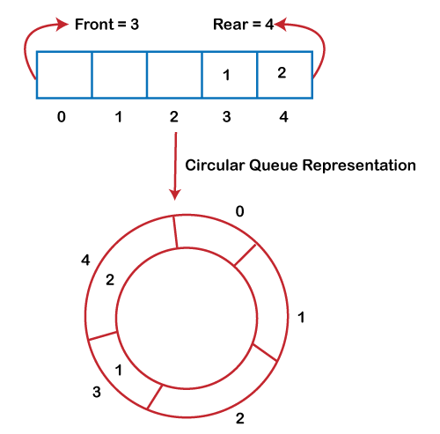
Circular Queue
Circular Queue
There was one limitation in the array implementation of Queue.
If the rear reaches to the end position of the Queue, then there might be possibility that some vacant spaces are left in the beginning which cannot be utilized.
So, to overcome such limitations, the concept of the circular queue was introduced.
A circular queue is like a linear queue as it is also based on the FIFO (First In First Out) principle except that the last position is connected to the first position in a circular queue that forms a circle.
It is also known as a Ring Buffer.

Slide 27
Circular Queue
Operations on Circular Queue
The following are the operations that can be performed on a circular queue:
enQueue(value): This function is used to insert the new value in the Queue. The new element is always inserted from the rear end.
deQueue(): This function deletes an element from the Queue. The deletion in a Queue always takes place from the front end.
Front: It is used to get the front element from the Queue.
Rear: It is used to get the rear element from the Queue.

Slide 28
Implementation of Circular Queue – enqueue()
#include <stdio.h>
#define max 6
int queue[max]; // array declaration
int front=-1;
int rear=-1;
// function to insert an element in a circular queue
void enqueue(int element)
{
if(front==-1 && rear==-1)
// condition to check queue is empty
{
front=0;
rear=0;
queue[rear]=element;
}
else if((rear+1)%max==front)
// condition to check queue is full
{
printf("Queue is overflow..");
}
else
{
rear=(rear+1)%max; // rear is incremented
queue[rear]=element;
// assigning a value to the queue at the rear position.
}
}

Slide 29
Implementation of Circular Queue- dequeue()
// function to delete the element from the queue
int dequeue()
{
if((front==-1) && (rear==-1))
// condition to check queue is empty
{
printf("\nQueue is underflow..");
}
else if(front==rear)
{
printf("\nThe dequeued element is %d", queue[front]);
front=-1;
rear=-1;
}
else
{
printf("\nThe dequeued element is %d", queue[front]);
front=(front+1)%max;
}
}

Slide 30
Implementation of Circular Queue
// function to display the elements of a queue
void display()
{
int i=front;
if(front==-1 && rear==-1)
{
printf("\n Queue is empty..");
}
else
{
printf("\nElements in a Queue are :");
while(i<=rear)
{
printf("%d,", queue[i]);
i=(i+1)%max;
}
}
}
int main()
{
int choice=1,x; // variables declaration
while(choice<4 && choice!=0) // while loop
{
printf("\n Press 1: Insert an element");
printf("\nPress 2: Delete an element");
printf("\nPress 3: Display the element");
printf("\nEnter your choice");
scanf("%d", &choice);
switch(choice)
{
case 1: printf("Enter the element which is to be inserted"); scanf("%d", &x); enqueue(x);
break;
case 2: dequeue(); break;
case 3: display();
}
}
return 0;
}

Slide 31
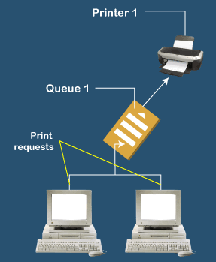
Applications of Queue
Queues are widely used as waiting lists for a single shared resource like printer, CPU, disk.
Queue are used to maintain the play list in media players in order to add or remove the songs from the play-list.
Queues are used in operating systems for handling interrupts.
Handling website traffic
Routers and switches in networking
Queues are used in asynchronous transfer of data (where data is not being transferred at the same rate between two processes) for eg. pipes, file IO, sockets.

Slide 32
Application of Stacks:
Stack is used for Evaluating expression with operands and operations.
Ex. A+B
Expression Conversion: An expression can be represented in infix prefix or postfix notation.
Infix to Postfix→ a+b → ab+
Infix to Prefix → a+b → +ab
Expressions
Infix ->a+b Prefix -> +ab Postfix -> ab+
Backtracking And Parenthesis Matching: Stacks are used for Stacks help in reversing any set of data or strings.
Function calls implementation →Used in Recursions;

Slide 33
Representation of Expressions and Evaluation
An Expression can have constants , variable and symbols that can be operators or parentheses.
Expression Evaluation: All the components of expression must be arranged according to a set of rules and must be parsed/evaluated according to grammar
Expression Representations:
3 notations :
1) Infix
2 ) Prefix and
3) Postfix
1) Infix Notation
Expressions are usually represented in Infix notation, in which each operator is written between two operands.
Operators are written in-between their operands
Syntax: <operand> <operator> <operand>
Ex. 2 + 3 → 2,3 are operands + operator
A – B
(P * 2)
(2+3) *4 An operand can also be an expression
(p+q) * (r + s) → (p+q) and (r+s) are the operands.
Note: we use only binary operators in expression evaluation

Slide 34
Representation of Expressions and Evaluation
Infix Expression Evaluation:
An expression in Infix form will be evaluated according to precedence and associativity of operators.
Operator Precedence(Order of operation ):
1.Paranthesis () {} []
2. Exponents ^ (right to left)
3. Multiplication and division (left to right)
4. Addition and subtraction (left to right)
Ex.
4 + 6 * 2 → 4 + 12 → 16
Precedence * then +
(4 + 6) * 2 → 10 * 2→ 20
Precedence () then *
2 * 6 / 2 -3 =?
Which operation Performed first?
* and / have same precedence
Here we need Operation Associativity.
2 * 6 / 2 -3 * has highest associativity
→ 12/2 -3 → 6 -3 →3 because * came first from left
100 / 10 * 10 → 10 * 10 → 100 / has highest
associativity because / came first from left
Operators Associativity
is used when two operators of same precedence appear in an expression.
Associativity can be either Left to Right (Left Associativity) or Right to Left(Right Associativity).

Slide 35
Expression Evaluation
2) Prefix Notation:
It is not easy to parse and evaluate an Infix expression with an ambiguity.
To reduce the ambiguity , mathematicians invented parenthesis free and can be parsed with out ambiguity.
→ In prefix notation operator can be placed before operands.
<operator> <operand> <operand>
Infix Prefix
A + B +AB
A+B*C +A*BC //Two operands are A,B and C
In infix notation operand B associated with two operators which makes ambiguity and needs operator precedence and associativity rules. or use parathesis.
Prefix does not require operator precedence and associativity rules

Slide 36
Representation of Expressions and Evaluation
3) Postfix Notation:
In Postfix notation operator can be placed after operands.
<operand> <operand> <operator>
Infix Prefix Postfix
A + B +AB AB+
A+B*C +A*BC ABC*+

Slide 37
Algorithms for conversions:
The conversion is done at the time of evaluating the expression by a compiler as one need not worry about the precedence or associativity of the operators.
1) Infix to Postfix Conversion 2) Infix to Prefix conversion
Infix to Postfix Conversion:
-----------------------------------------------------------------------------------------------------------------------
To convert infix expression to postfix expression, we will use the stack data structure.
ALG:
The following steps are required for conversion
Scan the infix expression from left to right,
When we will get any operand, simply add them to the postfix form(output)
For the operator and parenthesis, push them in the stack by maintaining the precedence of them.

Slide 38
Infix to Postfix Conversion:
Ex. Infix ➔ a + b * C
Postfix output→ abc*+
incoming char | stack | postfix form | observation
 |  | (output)
a | Empty | a | a is added to output
+ | + | a | + pushed to stack
b | + | ab | b is added to output
* | * + | ab | * has higher precedence than +
c | * + | abc | c is added to output
End of exp |  | abc*+ | Pop and add to output
STEPS:
Scan expression from left to right,
If(char== operand) → add to output
If(char ==operator) || char== parenthesis),
push in to stack by maintaining the precedence of them.

Slide 39
Infix to Postfix Conversion:
Rules for the conversion from infix to postfix expression
If (stack == empty or left parenthesis on top), then push(operator) on to the stack.
If incoming symbol is '(', push .
If the incoming symbol is ')', pop the stack and add the operators to output until the ‘)’ is found.
If( incoming operator > the top of the stack) then → push it on the stack.
If (incoming operator < the top of the stack) then → pop and print the top of the stack. Then test the incoming operator against the new top of the stack.
If ( incoming operator ==the top of the stack )→ use the associativity rules. If the associativity is from left to right then pop and print the top of the stack then push the incoming operator.
If the associativity is from right to left then push the incoming operator.
7. At the end of the expression, pop and print all the operators of the stack.

Slide 40
Convert infix expression to postfix notation: A + B * C - D / E
Step 1: Create an empty stack to hold operators temporarily.
Step 2: Process each element in the infix expression from left to right.
Step 3: For each element (operand or operator):
If it's an operand (letter), add it to the output.
If it's an operator, pop operators from the stack and add them to the output until you encounter an operator with lower precedence or equal precedence and left associativity, or until the stack is empty. Then push the current operator onto the stack.
Step 4: After processing all elements in the expression, pop any remaining operators from the stack and add them to the output.

Slide 41
Convert infix expression to postfix notation: A + B * C - D / E
Current Symbol | Stack | Output | Action
A | - | - | Output A
+ | + | A | Push +
B | + | A | Output B
* | +* | A B | Push *
C | +* | A B | Output C
- | + | A B C* | Pop * Output * Push -
D | - | A B C*+ | Output D
/ | -/ | A B C*+ D - | Push /
E | - | A B C*+ D - E / | Output E
- | - | A B C*+ D E / - | Pop / Output / Pop - Output -
The final postfix expression is "A B C*+ D E / -".

Slide 42
Convert infix expression to postfix notation:
( A + B ) * ( C - D )
LOGIC:
Step 1: Create an empty stack to hold operators temporarily.
Step 2: Process each element in the infix expression from left to right.
Step 3: For each element (operand, operator, or parenthesis):
If it's an operand (letter), add it to the output.
If it's an open parenthesis '(', push it onto the stack.
If it's a closing parenthesis ')', pop operators from the stack and add them to the output until an open parenthesis '(' is encountered. Pop and discard the open parenthesis from the stack.
Step 4: After processing all elements in the expression, pop any remaining operators from the stack and add them to the output.

Slide 43
( A + B ) * ( C - D )
Current Symbol | Stack | Output | Action
( | ( | - | Push (
A | ( | - | Output A
+ | (+ | A | Push +
B | (+ | A | Output B
) | - | A B + | Pop +<br>Output +<br>Pop (
* | * | A B + | Push *
( | *( | A B + | Push (
C | *( | A B + | Output C
- | *(- | A B + C | Push -
D | *(- | A B + C | Output D
) | * | A B + C D - | Pop -<br>Output -<br>Pop (
 |  | A B + C D - * | Pop *<br>Output *

Slide 44
Algorithms for conversion: Infix to Prefix
2.Infix to Prefix Conversion:
To convert infix expression to prefix expression, we will use the stack data structure.
ALG:
The following steps are required for conversion
First, reverse the infix expression
Scan the infix expression from left to right,
Whenever the operands arrives, simply add them to the postfix form(output).
For the operator and parenthesis, push them in the stack by maintaining the precedence of them.

Slide 45
Infix to Prefix Conversion:
incoming char | stack | prefix form (output) | observation
c | Empty | c | c is added to output
* | * | c | * pushed to stack
b | * | cb | b is added to output
+ | + | cb* | + has lower precedence than * then pop and print.
a | + | cb*a | a is added to output
End of exp |  | cb*a+ | Pop and add to output
 |  | +a*bc | Reverserof output
Ex. Infix➔ a + b * c
reverse→ c * b + a
→ output(prefix): + a * bc

Slide 46
Infix to Prefix Conversion:
Rules for the conversion from infix to prefix expression
If (stack == empty or contains a right parenthesis on top), then push the incoming operator on to the stack.
If the incoming symbol is '(', then pop all the operators from the stack till it finds ) opening bracket in the stack
If the operator is ')', then push it into the stack.
If( incoming operator > the top of the stack) then → push it on the stack.
If (incoming operator < the top of the stack) then → pop and print the top of the stack. Then test the incoming operator against the new top of the stack.
If ( incoming operator ==the top of the stack )→ push the incoming operator into the stack.
At the end of the expression, pop and print all the operators of the stack..

Slide 47
Q) Convert infix expression to prefix notation: ( A + B ) * ( C - D )
Step 1: Reverse the Infix Expression.
Step 2: Create an empty stack to hold operators temporarily.
Step 3: Process each element in the reversed infix expression from left to right.
For each element (operand, operator, or parenthesis):
If it's an operand (letter), add it to the output.
If it's an operator, pop operators from the stack and add them to the output until you encounter an operator with lower precedence or equal precedence and left associativity, or until the stack is empty. Then push the current operator onto the stack.
If it's an open parenthesis '(', push it onto the stack.
If it's a closing parenthesis ')', pop operators from the stack and add them to the output until an open parenthesis '(' is encountered. Pop and discard the open parenthesis.
Step 4: After processing all elements in the reversed expression, pop any remaining operators from the stack and add them to the output.
Step 5: Reverse the output to get the final prefix expression

Slide 48
Q) Convert infix expression to prefix notation: ( A + B ) * ( C - D )
Current Symbol | Stack | Output | Action
) | ) | - | Push )
D | )D | - | Output D
- | )D- | -D | Push -
C | )D- | -D | Output C
( | ) | -D C | Pop )<br>Output -DC
 |  | -D C | Push -
B | -B | -D C | Output B
+ | +(-B | -D C | Push +
A | +(-BA | -D C | Output A
) | +(-BA+ | -D C | Pop +<br>Output +
* | * | -D C +BA | Push *
( | *( | -D C +BA | Push (
 |  | -D C +BA | Pop (
 |  | -D C +BA * | Pop *<br>Output *
After reversing
Output is.
* + A B - C D

Slide 49
Postfix Expression Evaluation
ALG:
Step1: Read all the symbols one by one from left to right in the given Postfix Expression
Step 2: If (symbol==operand) then → push it on to the Stack.
Step 3: If (symbol== operator) then
a) pop top two contents from the stack
b) apply the operator on them ,
c) then push result back on to the Stack.
Step 4: Perform a pop operation and display the popped value as final result.
Ex. Evaluate the postfix expression: 4 5 + 3*
Element | Stack | Action
4 | 4 | Push 4
5 | 4 5 | Push 5
+ | 9 | Pop 5, Pop 4, Add, Push 9
3 | 9 3 | Push 3
* | 27 | Pop 3, Pop 9, Multiply, Push 27
Postfix 4 5 + 3* = 27
Infix (4 + 5) * 3 =27

Slide 50
Postfix Expression Evaluation: 5 3 + 8 2 - *
ALG:
Step1: Read all the symbols one by one from left to right in the given Postfix Expression
Step 2: If (symbol==operand) then → push it on to the Stack.
Step 3: If (symbol== operator) then
a) pop top two contents from the stack
b) apply the operator on them ,
c) then push result back on to the Stack.
Step 4: Perform a pop operation and display the popped value as final result.
Element | Stack | Action
5 | 5 | Push 5
3 | 5 3 | Push 3
+ | 8 | Pop 3, Pop 5, Add, Push 8
8 | 8 | Push 8
2 | 8 2 | Push 2
- | 6 | Pop 2, Pop 8, Subtract, Push 6
* | 48 | Pop 6, Pop 8, Multiply, Push 48

Slide 51
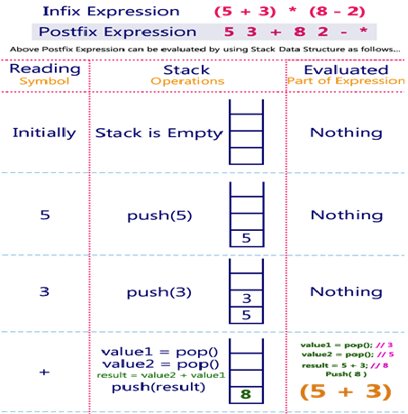
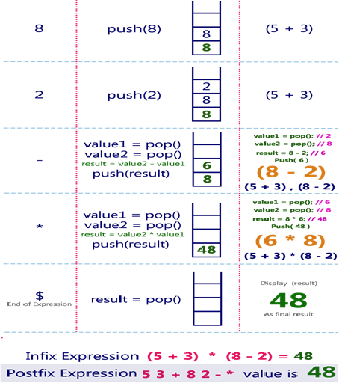
Example

Slide 52
//Impl. of postfix ex evaluation
#include<stdio.h>
#include<string.h>
#define size 10
int stack[size],top=-1;
void push(int e);
int pop();
int main()
{
char pe[30];
int i,v,op1,op2; //index,value, operand
printf("Enter postfix expression\n");
gets(pe);
for(i=0;pe[i]!='\0';i++) //read expression
{
if(isalpha(pe[i]))
{
printf("ener the vlaue of %c",pe[i]);
scanf("%d",&v);
push(v);
}
else if(isdigit(pe[i]))
{
push(pe[i]-'0’); //encoding scheme, ASCII, EX
//ASCII of 3 is 51 ascii of 0 is 48--> 51 - 48=3
}
else
{
op2=pop();
op1=pop();
switch(pe[i])
{
case '+': push(op1+op2);break;
case '-': push(op1-op2);break;
case '*': push(op1*op2);break;
case '/': push(op1/op2);break;
case '%': push(op1%op2);break;
case '^': push(op1^op2);break;
defaulat:
printf("\n invalid operation");
}
} //if close
} //for close
printf("the result is %d",stack[top]);
} //main close
void push(int e)
{
if(top==size-1)
printf("\n stack is full");
else
stack[++top]=e;
}
int pop()
{
if(top==-1)
printf("\n stack is empyt");
else
return stack[top--];
}

Slide 53
Parenthesis Checker (balanced brackets)
The parenthesis is represented by the brackets shown below:
( )
Where, ( → Opening bracket
) → Closing bracket
These parentheses are used to represent the mathematical representation.
THE BALANCED PARENTHESIS:
→ The opening parenthesis is equal to the closing parenthesis, then it is a balanced parenthesis.
Ex1.: ( 2+5 ) * 4
In the above expression, there is one opening and one closing parenthesis means that both opening and closing brackets are equal; therefore, the above expression is a balanced parenthesis.
Ex2: 2 * ( ( 4/2 ) + 5 )
The above expression has two opening and two closing brackets which means that the above expression is a balanced parenthesis.
Ex3: 2 * ( ( 4/2 ) + 5
The above expression has two opening brackets and one closing bracket, which means that both opening and closing brackets are not equal; therefore, the above expression is unbalanced.

Slide 54
Parenthesis Checker (balanced brackets)
Algorithm to check balanced parenthesis
check the balanced parenthesis by using a variable.
The variable is used to determine the balance factor.
Let's consider the variable 'x'. The algorithm to check the balanced parenthesis is given below:
ALG:
Step 1: Set x equal to 0.
Step 2: Scan the expression from left to right.
For each opening bracket "(", increment x by 1.
For each closing bracket ")", decrement x by 1.
This step will continue scanning until x<0.
Step 3: If x is equal to 0, then
"Expression is balanced.“
else
"Expression is unbalanced."
Expression→ (a+b)+(c-d)"
Character | x Value | Action
( | 1 | Increment x by 1
a | 1 | No change to x
+ | 1 | No change to x
b | 1 | No change to x
) | 0 | Decrement x by 1
( | 1 | Increment x by 1
c | 1 | No change to x
- | 1 | No change to x
d | 1 | No change to x
) | 0 | Decrement x by
After processing all characters, the value of x is 0, indicating that the expression "(a+b)+(c-d)" has balanced parentheses.

Slide 55
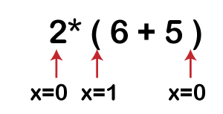
Parenthesis Checker (Balanced Brackets)
Let's understand the above algorithm through an example.
Suppose expression is 2 * ( 6 + 5 )
Solution: First, the x variable is initialized by 0.
The scanning starts from the variable '2', when it encounters '(' then the 'x' variable gets incremented by 1 and when the x reaches to the last symbol of the expression, i.e., ')' then the 'x' variable gets decremented by 1 and it's final value becomes 0.
if x is equal to 0 means the expression is balanced; therefore, the above expression is a balanced expression

Slide 56
// C program to check the balanced parenthesis.
#include<stdio.h>
int main()
{
char ex[50]; // declaration of char type array
int x=0, i=0; // declaration of two integer type variables
printf("\nEnter an expression");
scanf("%s", ex);
// Scanning the expression
while(ex[i]!= '\0')
{
// Condition to check the symbol is '('
if(ex[i]=='(')
{
x++; // incrementing 'x' variable
}
// condition to check the symbol is ')'
else if(ex[i]==')')
{
x--; // decrementing 'x' variable
if(x<0)
break;
}
i++; // incrementing 'i' variable.
}
// Condition to check whether x is equal to 0 or not.
if(x==0)
{
printf("Expression is balanced");
}
else
{
printf("Expression is unbalanced");
}
return 0;
}

Slide 57
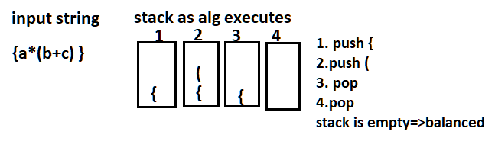
Parenthesis Checker using Stack
ALG:
Declare a character stack
Now traverse the string exp.
If( character == ( or { or [ ) → push it to stack.
If( character == ) or } or ] ) → pop from stack
if the popped character is the matching starting bracket, then fine else brackets are Not Balanced.
After complete traversal, if there is some starting bracket left in stack then Not balanced , else Balanced.

Slide 58
Check the bracket balancing using Stack {[(a+b)+(c-d)]}
Character | Stack | Action
{ | { | Push '{'
[ | { [ | Push '['
( | { [ ( | Push '('
a | { [ ( | No change to stack
+ | { [ ( | No change to stack
b | { [ ( | No change to stack
) | { [ | Pop '(' from stack
+ | { [ | No change to stack
( | { [ ( | Push '('
c | { [ ( | No change to stack
- | { [ ( | No change to stack
d | { [ ( | No change to stack
) | { [ | Pop '(' from stack
] | { | Pop '[' from stack
} |  | Pop '{' from stack
After processing all characters in the expression the stack is empty. "{[(a+b)+(c-d)]}",
This indicates that all opening and closing parentheses are matched correctly, and the expression has balanced parentheses.

Slide 59
//program parentheses checker using a stack:
#include <stdio.h>
#include <stdbool.h>
#define MAX_SIZE 100
// Stack implementation
char stack[MAX_SIZE];
int top = -1;
// Function to push
void push(char ch) {
if (top < MAX_SIZE - 1) {
stack[++top] = ch;
}
}
// Function to pop
char pop() {
if (top >= 0) {
return stack[top--];
}
return '\0';
}
// Function to check if parentheses are balanced
bool areBalanced(const char* exp)
{
for (int i = 0; exp[i] != '\0'; i++) {
if (exp[i] == '(' || exp[i] == '[' || exp[i] == '{‘)
{
push(expression[i]);
} else if (exp[i] == ')' || expr[i] == ']' || exp[i] == '}’)
{
char pe = pop();
if ((exp[i] == ')' && pe!= '(') ||
(ex[i] == ']' && pe!= '[') ||
(exp[i] == '}' && pop!= '{')) {
return false;
}
}
}
return top == -1;
}
int main() {
const char* expr = "{[()]()}";
if (areBalanced(exp))
{
printf("Parentheses are balanced.\n");
} else
{
printf("Parentheses are not balanced.\n");
}
return 0; }

