Slide 1
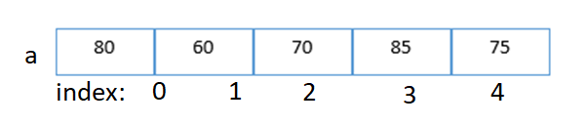
arrays
Array is a collection of similar data items or elements.
Elements are stored contiguously in memory under the same name.
Arrays are used to store multiple values in a single variable, instead of declaring separate variables for each value.
//multiple variables;
int a1,a2,a3,a4,a5;
int a[5];
a is array_name
size=5
Elements→ 80,60,70,85,75

Slide 2
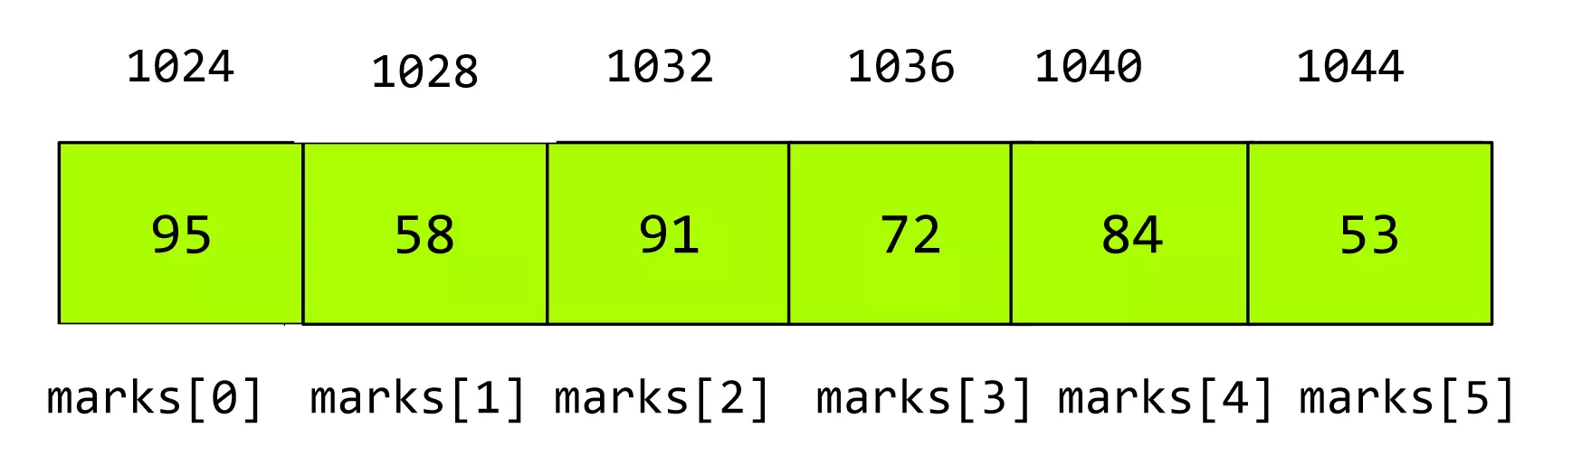
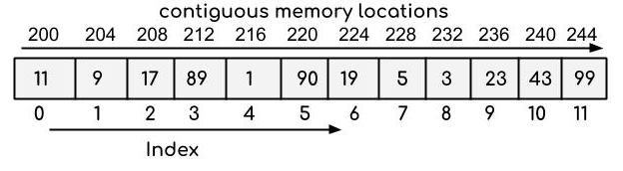
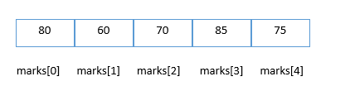
Properties of Array
Each element of an array is of same data type and carries the same size.
Elements of the array are stored at contiguous memory locations where the first element is stored at the smallest memory location.
int a[]={10,20,30,40}
ACCESSING OF ARRAY ELEMENTS:
Array elemlents can be accessed with index of that element
ex - a[5]
ex. int = 4 bytes.

Slide 3
Declaration and INITIALIZATION of C Array
DECLERATION OF AN ARRAY:
We can declare an array in the c language in the following way.
data_type array_name[array_size];
ex int marks[5];
Here, int is the data_type, marks are the array_name, and 5 is the array_size.
INITIALIZE AN ARRAY DURING DECLARATION.
For example,
int mark[] = {19, 10, 8, 17, 9};
Here, we haven't specified the size. However, the compiler knows its size is 5 as we are initializing it with 5 elements.
INITIALIZE USING INDEX.
marks[0]=19;//initialization of array
marks[1]=10;
marks[2]=8;
marks[3]=17;
marks[4]=9

Slide 4
Advantage of C++ Array
1) Code Optimization: Less code to the access the data.
2) Ease of traversing: By using the for loop, we can retrieve the elements of an array easily.
3) Ease of sorting: To sort the elements of the array, we need a few lines of code only.
4) Random Access: We can access any element randomly using the array.
Disadvantage:
1) Fixed Size: Whatever size, we define at the time of declaration of the array, we can't exceed the limit. So, it doesn't grow the size dynamically like LinkedList which we will learn later.

Slide 5
TYPES OF ARRAYS
Arrays are broadly classified into three categories
1. One dimensional arrays
2. Two dimensional arrays
3. Multi dimensional arrays

Slide 6
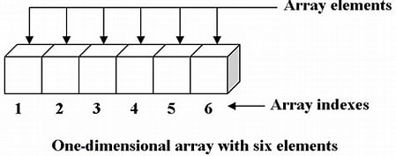
1. ONE DIMENSIONAL ARRAYS
An array of one dimension is known as a one-dimensional array
In one-dimensional array the elements are stored in a single row one after another.
Ex-
int a[10];
created an array of 10 integers
float x[5];
created an array of 5 floating point values
double z[8];
created an array of 8 double values.

Slide 7
Q) Write a c++ program to create an integer array of size 5 and display the elements of the array
int a[5] = {10,20,30,40,50};

Slide 8
1. ONE DIMENSIONAL ARRAYS
//PROGRAM FOR CREATING AN ARRAY
#include <iostream>
Using namespace std;
int main ( )
{
int a[5] = {10,20,30,40,50};
int i;
cout<<"elements of the array are";
for( i=0; i<5; i++)
cout<<a[i];
return 0;
}

Slide 9
1. ONE DIMENSIONAL ARRAYS
Write a C++ program to create an array of FLOAT TYPE , read and display elements using for loop
Input:
Enter 5 elements 22.55 44.6 66.4 76.4 55.6
Output:
Elements are 22.55 44.6 66.4 76.4 55.6

Slide 10
1. ONE DIMENSIONAL ARRAYS
#include <iostream>
int main() {
float a[5];
cout << "Enter 5 elements: ";
for (int i = 0; i < 5; i++)
{
cin >> a[i];
}
cout << "Elements of the array are: ";
for (int i = 0; i < 5; i++) {
cout << a[i] << " ";
}
return 0;
}

Slide 11
Write a C++ program to find the average of n numbers using arrays
Input:
Enter number of elements: 5
Output:
avg=?

Slide 12
//Program to find the average of n numbers using arrays
#include <iostream>
int main() {
int marks[10], n, sum = 0;
float avg;
cout << "Enter number of elements: ";
cin >> n;
for (int i = 0; i < n; ++i) {
cin >> marks[i];
sum += marks[i];
}
avg = static_cast<float>(sum) / n;
cout << "Average = " << avg <<endl;
return 0;
}

Slide 13
Q) This C++ Program finds the number of elements present in the given array.
Given array:
int arr[] = {1, 2, 3, 4, 5};
OUTPUT:
Number of elements present in given array: 5
HINT: int length = sizeof(arr)/sizeof(int);
LOGIC
1. Create an array along with the definition of all its elements. 2. Using the inbuilt function sizeof(), passing the name of the array whose size we need to calculate, returns the number of elements contained by array. 4. The returned value is stored in the variable created above.

Slide 14
Q)Write a C++ program to find the number of elements in an array
#include <stdio.h>
int main()
{
//Initialize array
int arr[] = {1, 2, 3, 4, 5};
//Number of elements present in an array can be calculated as follows
int length = sizeof(arr)/sizeof(int);
printf("Number of elements present in given array: %d", length);
return 0;
}

Slide 15
Write a C++ program to find largest element in an array
INPUT:
Enter no of elements (N = 5),
Enter the elements
12, 56, 34, 78 and 100
OUTPUT: The largest element present in the given array is: 100
LOGIC
1. Create an array of user-defined size. Int a[n] 2. Run the for loop till the user-defined size to insert the element at each location. 3. Considering the first element of the array to be the largest, compare all the remaining elements of the array.
max=a[0]
Compare with a[1], a[2]… if any element is larger that a[0] make it max
4. At last, the largest element will hold the actual largest value in the array. Thus, print it.

Slide 16
//C++ program to find largest element in an array
#include <iostream>
int main() {
int n, max;
cout<< "\nEnter the size of the array: ";
cin >> n;
int a[n]; // Declaring array
cout<< "\nEnter elements:\n";
for (int i = 0; i < n; i++) {
cin >> a[i];
}
// Make largest element as the first element
max = a[0];
for (int i = 1; i < n; i++) {
if (max < a[i])
{
max = a[i];
}
}
cout<< "\nLargest element is: " << max << endl;
return 0;
}

Slide 17
============================================================== write a c++ program to find second largest element in the given array ====================================================================
INPUT:
Enter the size of array:6
Enter the elements:
50
40
20
60
70
30
OUTPUT: The second largest element is: 60
LOGIC
Declare an array a[n]
make max1 = max2 = INT_MIN;
In loop compare max1 with a[i]
if(a[i] > max1)
max2 = max1;
max1 = a[i];
else if(a[i] > max2 && a[i] < max1)
{
max2 = a[i];
}

Slide 18
#include <iostream>
#include <limits> // For numeric_limits
int main() {
int n;
cout << "Enter size of the array: ";
cin >> n;
int a[n]; // Declare the array
cout<< "Enter elements in the array: ";
for (int i = 0; i < n; i++) {
cin >> a[i];
}
int max1, max2;
max1 = max2 = std::numeric_limits<int>::min();
for (int i = 0; i < n; i++) {
if (a[i] > max1) {
max2 = max1;
max1 = a[i];
} else if (a[i] > max2 && a[i] < max1)
{
max2 = a[i];
}
}
cout<< "First largest = " << max1 << endl;
cout<< "Second largest = " << max2;
return 0;
}
Enter size of the array: 6
Enter elements in the array: 5 8 3 9 6 7
First largest = 9
Second largest = 8

Slide 19
Write a C++ Program to insert an element in an Array in a given location
INPUT:
Enter no of elements: 5
Enter the elements
1 2 3 4 5
Enter the element to be inserted : 6
Enter the location : 1
1 6 2 3 4 5
LOGIC
1. Read the size of the array. 2. Read the elements
3. Enter the location where to insert
4.create space at the specified location
for (i = num; i >= location; i--)
{
a[i] = a[i - 1];
}
num++;
a[location - 1] = element;
5. print out the result of insertion

Slide 20
//C++ Program to insert an element in an Array
#include <iostream>
int main() {
int a[30], element, num, i, location;
cout << "\nEnter no of elements: ";
cin >> num;
for (i = 0; i < num; i++) {
cin >> a[i]
}
cout << "\nEnter the element to be inserted: ";
cin >> element;
cout << "\nEnter the location: ";
cin >> location;
// Create space at the specified location
for (i = num; i >= location; i--) {
a[i] = a[i - 1];
}
num++;
a[location - 1] = element;
// Print out the result of insertion
cout << "Array after insertion: ";
for (i = 0; i < num; i++) {
cout << a[i] << " ";
}
return 0;
}
Enter no of elements: 5
10 20 30 40 50
Enter the element to be inserted: 25
Enter the location: 3
Array after insertion: 10 20 25 30 40 50

Slide 21
Write a C++ Program to delete an element in an Array
Enter number of elements in array
5
Enter 5 elements
10
20
30
40
50
Enter the location where you wish to delete element
3
Resultant array is
10
20
40
50
LOGIC:
Step 1. Read the size of the array arr[]
Step 2. Read the elements
Step 3.Input the pos of element to delete from an array.
step 4: Compare the pos of an element (pos) from the total no. of elements (num+1).
if(pos>num+1)
{
deletion of the element is not possible
}
Step 5: Else remove the particular element and shift the rest elements' position to the left side in an array.
Step 6: Display the resultant array
Step 7: Terminate or exit from the program.

Slide 22
//C++ Program to delete an element in an Array
#include <iostream>
int main() {
int a[50], position, i, n;
cout<< "Enter number of elements in array: ";
cin >> n;
cout<< "Enter " << n << " elements: ";
for (i = 0; i < n; i++)
cin >> a[i];
cout<< "Enter the location to delete element: ";
cin >> position;
if (position >= n + 1)
cout<< "Deletion not possible." << endl;
else {
for (i = position - 1; i < n - 1; i++)
a[i] = a[i + 1];
cout<< "Resultant array is: " << endl;
for (i = 0; i < n - 1; i++)
cout<< a[i] << endl;
}
return 0;
}

Slide 23
============================================================== Write a C++ Program to REVERSE THE ARRAY ELEMENTS ====================================================================
Input array: [1,2,3,4] output: [4,3,2,1]
Input array: [3,2,1] Reversed array: [1,2,3]
LOGIC
1. Enter size of the array: . 2. Read the elements
3. Start point= first element; end points= last element.
4. while(start<end)
{
//Swapping elements
int temp=arr[start];
arr[start]=arr[end];
arr[end]=temp;
//Incrementing start and decrementing end
start++;
end - -;
}
5. Print reversed array

Slide 24
#include <iostream>
int main() {
int size, i;
cout<< "Enter size of the array: ";
cin >> size;
int arr[size];
cout<< "Enter Array Elements: ";
for (i = 0; i < size; i++)
cin >> arr[i];
cout<< "Entered Array is: ";
for (i = 0; i < size; i++)
cout<< arr[i] << " ";
int start = 0, end = size - 1;
while (start < end) {
// Swapping elements
int temp = arr[start];
arr[start] = arr[end];
arr[end] = temp;
// Incrementing start and decrementing end
start++;
end--;
}
// Printing reversed array
cout<< "\nReversed array is: ";
for (i = 0; i < size; i++)
cout<< arr[i] << " ";
return 0;
}

Slide 25
Write a program in C++ to separate odd and even integers in separate arrays
INPUT:
Input the number of elements to be stored in the array :5
Input 5 elements in the array :
element - 0 : 25
element - 1 : 47
element - 2 : 42
element - 3 : 56
element - 4 : 32
Expected Output :
The Even elements are :
42 56 32
The Odd elements are :
25 47
LOGIC
1. Enter size of the array: . 2. Read the elements
3. In loop
chck if (arr1[i]%2 == 0)
then
arr2[j] = arr1[i]; //store even numbers in arr2
else
arr3[k] = arr1[i]; //store odd numbers in arr3
4. print arr2 elements for even numbers
5. print arr3 elements for odd numbers

Slide 26
#include <iostream>
int main() {
int arr1[10], arr2[10], arr3[10];
int i, j = 0, k = 0, n;
cout<< "Input the number of elements: ";
cin >> n;
cout<< "Input " << n << " elements in the array:" << endl;
for (i = 0; i < n; i++) {
cin >> arr1[i];
}
for (i = 0; i < n; i++) {
if (arr1[i] % 2 == 0) {
arr2[j] = arr1[i];
j++;
} else {
arr3[k] = arr1[i];
k++;
}
}
cout<< "\nThe Even elements are: " << endl;
for (i = 0; i < j; i++) {
cout<< arr2[i] << " ";
}
cout<< "\nThe Odd elements are: " << endl;
for (i = 0; i < k; i++) {
cout<< arr3[i] << " ";
}
cout<< endl;
return 0;
}

Slide 27
Write a program in C++ to copy the elements of one array into another array.
INPUT:
Input the number of elements to be stored in the array :3
Input 3 elements in the array : element - 0 : 15 element - 1 : 10 element - 2 : 12
Expected Output : The elements stored in the first array are : 15 10 12
The elements copied into the second array are : 15 10 12
LOGIC
1. Enter size of the array1: . 2. Read the elements 1arra
3. Copy elements of first array into array2
4 for(i=0; i<n; i++)
{
arr2[i] = arr1[i];
}
5. Print the elements of first array
6. Print the elements of second array

Slide 28
//copy the elements of one array into another array.
#include <iostream>
using namespace std;
int main()
{
int a1[100], a2[100];
int i, n;
cout << "Input the number of elements for array1: ";
cin >> n;
cout << "Input " << n << " elements in the array1”;
for (i = 0; i < n; i++)
{
cout << "element - " << i << " : ";
cin >> a1[i];
}
// Copy elements of the first array into a2.
for (i = 0; i < n; i++) {
a2[i] = a1[i];
}
// Prints the elements of the first array.
cout << "\nThe elements stored in the first array are:" ;
for (i = 0; i < n; i++) {
cout << a1[i] << " ";
}
// Prints the elements copied into the second array.
cout << "\nCopied elements into the second array are:" ;
for (i = 0; i < n; i++) {
cout << a2[i] << " ";
}
cout << endl;
return 0;
}

Slide 29
Write a C++ program to find the most frequent element in an array of integers.
#include<iostream>
using namespace std;
void most_occurred_number(int nums[], int size)
{
int max_count = 0;
cout << "\nMost occurred number: ";
for (int i=0; i<size; i++)
{
int count=1;
for (int j=i+1;j<size;j++)
if (nums[i]==nums[j])
count++;
if (count>max_count)
max_count = count;
}
for (int i=0;i<size;i++)
{
int count=1;
for (int j=i+1;j<size;j++)
if (nums[i]==nums[j])
count++;
if (count==max_count)
cout << nums[i] << endl;
}
}
int main()
{
int nums[] = {4, 5, 9, 12, 9, 22, 45, 7};
int n = sizeof(nums)/sizeof(nums[0]);
cout << "Original array: ";
for (int i=0; i < n; i++)
cout << nums[i] <<" ";
most_occurred_number(nums, n);
}

Slide 30
Write a program in C to count a total number of duplicate elements in an array.
INPUT:
Enter the n:3
Input 3 elements in the array : element - 0 : 5 element - 1 : 1 element - 2 : 1
OUTPUT:
number of duplicate elements : 1
LOGIC
1. Enter size of the array: . 2. Read the elements arraY
3. Copy elements into array2
4 for(i=0; i<n; i++)
{
arr2[i] = arr1[i];
}
5. mark the elements are duplicate
for(i=0;i<n; i++)
{
for(j=0;j<n;j++)
{
if(a1[i]==a2[j])
{ a3[j]=mm;
mm++; }
}
mm=1;
}
6. Print the elements of first array
7. Print the elements of second array

Slide 31
#include <iostream>
using namespace std;
int main() {
int a1[100], a2[100], a3[100];
int n, mm = 1, count = 0;
int i, j;
cout << "Input the number of elements in the array: ";
cin >> n;
cout << "Input " << n << " elements in the array:" << endl;
for (i = 0; i < n; i++) {
cout << "element - " << i << " : ";
cin >> a1[i];
}
// Copy elements to another array and fill the third array with zeros
for (i = 0; i < n; i++) {
a2[i] = a1[i];
a3[i] = 0;
}
// Mark the elements as duplicate
for (i = 0; i < n; i++) {
for (j = 0; j < n; j++) {
if (a1[i] == a2[j]) {
a3[j] = mm;
mm++;
}
}
mm = 1;
}
// Count and print the number of duplicate elements
for (i = 0; i < n; i++) {
if (a3[i] == 2) {
count++;
}
}
cout << "Number of duplicate elements are " << count << endl;
cout << "\n\n";
return 0;
}

Slide 32
Write a C++ program to separate even and odd numbers in an array of integers. Put all even numbers first, and then odd numbers.
#include<iostream>
void swap(int *x, int *y)
{
int temp = *x; *x = *y; *y = temp;
}
void segregateEvenOdd(int nums[], int size)
{
int left_num = 0, right_num = size-1;
while (left_num < right_num)
{
while (nums[left_num]%2 == 0 && left_num < right_num)
left_num++;
while (nums[right_num]%2 == 1 && left_num < right_num)
right_num--;
if (left_num < right_num)
{
swap(&nums[left_num], &nums[right_num]);
left_num++;
right_num--; }
}
}
int main()
{
int nums[] = {0, 1, 3, 4, 5, 6, 7, 8, 10};
int n = sizeof(nums)/sizeof(nums[0]);
cout << "Original array: ";
for (int i=0; i < n; i++)
cout << nums[i] <<" ";
segregateEvenOdd(nums, n);
printf("\nArray after divided: ");
for (int i=0; i < n; i++)
cout << nums[i] <<" ";
return 0;
}

Slide 33
PROBLEM STATEMENT
Suppose you are working on a program to process a list of students' test scores. Each student's score is represented as an integer, and you want to separate the scores into two categories: "Pass" and "Fail." In this scenario, a "Pass" is defined as a score of 50 or higher, and a "Fail" is a score below 50.
Question:
Write a C++ program to take an array of students' test scores as input and separate the scores into two categories: "Pass" and "Fail." Ensure that all "Pass" scores come first in the array, followed by "Fail" scores. Implement the program using a function called separatePassFail that accepts the array and its size as parameters.
Input:
Enter the number of students: 5
Enter the test scores for each student: 65 45 78 32 56
Output:
Separated Scores (Pass first, Fail later): 65 78 56 45 32

Slide 34
#include <iostream>
void separatePassFail(int scores[], int size) {
int passIndex = 0;
int failIndex = size - 1;
while (passIndex < failIndex) {
// Find the next "Fail" score from the end of the array
while (scores[failIndex] >= 50 && passIndex < failIndex) {
failIndex--;
}
// Find the next "Pass" score from the beginning of the array
while (scores[passIndex] < 50 && passIndex < failIndex) {
passIndex++;
}
// Swap "Pass" and "Fail" scores
if (passIndex < failIndex) {
std::swap(scores[passIndex], scores[failIndex]);
passIndex++;
failIndex--;
}
}
}
int main() {
const int maxSize = 100; // Maximum number of students
int scores[maxSize];
int numStudents;
// Prompt the user for the number of students
std::cout << "Enter the number of students: ";
std::cin >> numStudents;
// Prompt the user for the test scores of each student
std::cout << "Enter the test scores for each student: ";
for (int i = 0; i < numStudents; i++) {
std::cin >> scores[i];
}
// Call the function to separate "Pass" and "Fail" scores
separatePassFail(scores, numStudents);
// Display the separated scores
std::cout << "Separated Scores (Pass first, Fail later): ";
for (int i = 0; i < numStudents; i++) {
std::cout << scores[i] << " ";
}
return 0;
}

Slide 35
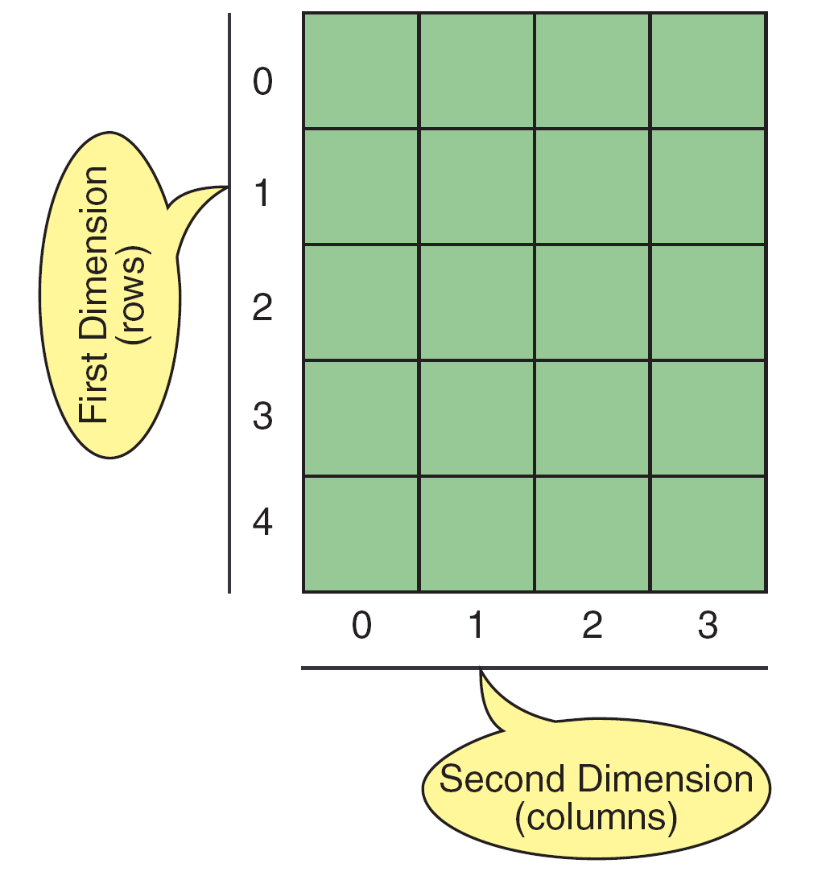
Two dimensional arrays
The 2D array is organizes the date in the form rows and columns
Ex.- store the student name, rollno, and attendance.
The data must be in rows and columns.- matrix
Declaration of two dimensional array
data type array_name[rows][columns];

Slide 36
Two dimensional arrays
2 D Array organizes the data in the form or ROWS and COLUMNS
Declaration of 2d array:
data_type array_name[rows][columns];
Ex>
int a[3][4];
int (dataType) → specifies type of element in each slot
a (array_name) →specifies name of the array
[3](rows) → specifies number of rows
[4](cols) → specifies number of columns
Initialization of two dimensional arrays
An array may be initialized at the time of declaration:
int a [3][4] = {{10,11,12,13}, {14,15,16,17}, {18,19,20,21}};
 | col0 | col1 | col2
Row0 | [0][0] | [0][1] | [0][2]
Row1 | [1][0] | [1][1] | [1][2]
Row2 | [2][0] | [2][1] | [2][2]

Slide 37
Two dimensional arrays
(i) Compile-time initialization of 2-D array:
Initialize and assign values to the arrays when we declare array variable is called compile time initialization.
int x[2][3] = {{1, 3, 0}, {4, 5, 9}};
int x[ ][3] = {{1, 3, 0}, {4, 5, 9}}; // column size is mandatory
int x[2][3] = {1, 3, 0, 4, 5, 9};
While initializing a 2-d array it is necessary to mention the column dimension. so that compiler automatically arrange the elements in rows and columns.
Row dimension is optional.

Slide 38
Accessing 2D array elements:
To access an element of a 2D array, you need to specify both the row and the column:
#include <iostream>
using namespace std;
int main() {
int arr[3][4] = { {1, 2, 3, 4}, {5, 6, 7, 8}, {9, 10, 11, 12} };
// Accessing elements using array indices
cout << "arr[0][0] = " << arr[0][0] << endl;
cout << "arr[0][1] = " << arr[0][1] << endl;
cout << "arr[0][2] = " << arr[0][2] << endl;
cout << "arr[0][3] = " << arr[0][3] << endl;
cout << "arr[1][0] = " << arr[1][0] << endl;
cout << "arr[1][1] = " << arr[1][1] << endl;
cout << "arr[1][2] = " << arr[1][2] << endl;
cout << "arr[1][3] = " << arr[1][3] << endl;
return 0;
}
nums[0][0] = 16;
Cout<< nums[1][2];

Slide 39
Q) write a c program to read a 2Darray and return the sum of all the elements in the 2d array.
INPUT
a[3][3] = {{1, 2, 3}, {4, 5, 6}, {7, 8, 9}}
OUTPUT:
sum= 45
LOGIC
Read the array with 3 rows and 3 cols
Read the elements
Let sum=0
loop for rows and colums
sum=sum+a[i][j];
5. Disp sum

Slide 40
Q) write a c program to return the sum of all the elements in the 2d array.
#include<stdio.h>
int main() {
int arr[3][3] = {{1, 2, 3}, {4, 5, 6}, {7, 8, 9}};
int rows = 3, cols = 3, total_sum = 0;
for (int i = 0; i < rows; i++) {
for (int j = 0; j < cols; j++) {
total_sum += arr[i][j];
}
}
printf("The sum of all the elements in the array is %d\n", total_sum);
return 0;
}

Slide 41
TWO DIMENSIONAL ARRAYS
ii) RUNTIME initialization of 2-D array:
Assigning array values during execution of the program is called runtime initialization
for(i=0; i<row_size; i++) // reads rows
{
for(j=0;j<columnsize;j++) //reads columns
{
scanf("%d", &x[i][j]);
}
}
//EX. Reading a 3 x 3 array
for(i=0; i<3; i++)
{
for(j=0;j<3;j++)
{
scanf("%d", &x[i][j]);
}
}

Slide 42
Write a program in C to read and display the elements of 2d array of 3 ROWS and 3 columns
Enter a[0][0]: 56
Enter a[0][1]: 10
Enter a[0][2]: 30
Enter a[1][0]: 34
Enter a[1][1]: 21
Enter a[1][2]: 34
Enter a[2][0]: 45
Enter a[2][1]: 56
Enter a[2][2]: 78
printing the elements ....
56 10 30
34 21 34
45 56 78
LOGIC
1. Declare a 2d array with 3 rows and 3 cols: . 2. Read the elements in corresponding row and column.
for(i=0;i<m;i++)
{
for(j=0;j<n;j++)
{
scanf("%d",&a[i][j]);
}
}
3. Print the elements of 2d array
for(j=0;i<m;i++)
{
for(j=0;j<n;j++)
{
printff("%d\t",a[i][j]);
}
}

Slide 43
//Program in C++ to read and display the elements of 2d array
#include <iostream>
int main() {
int a[3][3];
for (int i = 0; i < 3; i++) {
for (int j = 0; j < 3; j++) {
cout << "Enter a[" << i << "][" << j << "]: ";
cin >> a[i][j];
}
}
cout << "\nPrinting the elements....\n";
for (int i = 0; i < 3; i++) {
cout << "\n";
for (int j = 0; j < 3; j++) {
cout << a[i][j] << "\t";
}
}
return 0;
}
Enter a[0][0]:10
Enter a[0][1]:20
Enter a[0][2]:30
Enter a[1][0]:40
Enter a[1][1]:50
Enter a[1][2]:60
Enter a[2][0]:70
Enter a[2][1]:80
Enter a[2][2]:90
printing the element of a....
10 20 30
40 50 60
70 80 90

Slide 44
Q) Write a program in C++ to add TWO MATRICES using 2D arrays
Number of rows and columns of matrix
2 2
Enter the elements of a matrix
23 45
33 55
Enter the elements of b matrix
2 33
44 55
Sum of entered matrices:-
25 78
77 110
LOGIC
1. Declare 2 arrays a[ROWS][COLS] and b[ROWS][COLS] . 2. Read the size of matrix a and b
3. Read the elements of matrix a and b.
. for (i=0;i<m;i++)
for (j=0;j<n;j++)
scanf("%d", &a[i][j]); // similary matrix b
4.Perform addtion
for(i=0;i<m;i++)
for(j=0;j<n;j++)
c[i][j]=a[i][j]+b[i][j];
4. Print the elements c[i][j]

Slide 45
#include <iostream>
using namespace std;
int main() {
int m, n, i, j;
int a[10][10], b[10][10], c[10][10];
cout << "Enter the number of rows and columns: ";
cin >> m >> n;
cout << "Enter the elements of matrix A:" << endl;
for (i = 0; i < m; i++) {
for (j = 0; j < n; j++) {
cin >> a[i][j];
}
}
cout << "Enter the elements of matrix B:" << endl;
for (i = 0; i < m; i++) {
for (j = 0; j < n; j++) {
cin >> b[i][j];
}
}
cout << "Sum of entered matrices:" << endl;
for (i = 0; i < m; i++) {
for (j = 0; j < n; j++) {
c[i][j] = a[i][j] + b[i][j];
cout << c[i][j] << "\t";
}
cout << endl;
}
return 0;
}

Slide 46
Q) Write a C program to multiply TWO matrices
Enter dimensions of first matrix :
2 3
Enter dimensions of second matrix
3 2
Enter first matrix (2 rows x 3 columns):
1 2 3
4 5 6
Enter second matrix (3 rows x 2 columns):
7 8
9 10
11 12
Result matrix:
58 64
139 154
LOGIC
1. Declare 2 arrays a[ROWS][COLS] and b[ROWS][COLS] . 2. Read the size of matrix a and b
3. Read the elements of matrix a and b.
. for (i=0;i<m;i++)
for (j=0;j<n;j++)
scanf("%d", &a[i][j]); // similary matrix b
4.check the cols of matrix1 with rows of matrix2
if (cols1 != rows2) {
printf("cannot multiply.\n");
5. Perform multiplication
for (int i = 0; i < rows1; i++) {
for (int j = 0; j < cols2; j++) {
int sum = 0;
for (int k = 0; k < cols1; k++) {
sum += matrix1[i][k] * matrix2[k][j];
}
result[i][j] = sum;
}
6. Print the elements c[i][j]

Slide 47
#include <iostream>
using namespace std;
int main() {
int rows1, cols1, rows2, cols2;
cout << "Enter dimensions of first matrix: ";
cin >> rows1 >> cols1;
cout << "Enter dimensions of second matrix: ";
cin >> rows2 >> cols2;
if (cols1 != rows2) {
cout << "Cannot multiply matrices with these dimensions." << endl;
return 1;
}
int matrix1[rows1][cols1];
int matrix2[rows2][cols2];
int result[rows1][cols2];
// Read first matrix
cout << "Enter first matrix:" << endl;
for (int i = 0; i < rows1; i++)
for (int j = 0; j < cols1; j++)
cin >> matrix1[i][j];
// Read second matrix
cout << "Enter second matrix:" << endl;
for (int i = 0; i < rows2; i++)
for (int j = 0; j < cols2; j++)
cin >> matrix2[i][j];
// Multiply matrices
for (int i = 0; i < rows1; i++) {
for (int j = 0; j < cols2; j++) {
int sum = 0;
for (int k = 0; k < cols1; k++) {
sum += matrix1[i][k] * matrix2[k][j];
}
result[i][j] = sum;
}
}
// Print result matrix
cout << "Result matrix:" << endl;
for (int i = 0; i < rows1; i++) {
for (int j = 0; j < cols2; j++) {
cout << result[i][j] << " ";
}
cout << endl;
}
return 0;
}

Slide 48
Q) Write a C program to find the transpose of a matrix.
The Transpose of a matrix is found by interchanging its rows into columns or columns into rows
INPUT:
{{1, 2, 3}, {4, 5, 6}, {7, 8, 9}}
OUTPUT:
Original matrix:
1 2 3
4 5 6
7 8 9
Transpose of the matrix:
1 4 7
2 5 8
3 6 9
LOGIC
Declare a 2D arrays a[ROWS][COLS] and transpose[COLS][ROWS];
Read the size of matrix a and b
3. Read the elements of original matrix
. for (i=0;i<m;i++)
for (j=0;j<n;j++)
scanf("%d", &a[i][j]);
5. Find the transpose matrix as..
for(i = 0; i < ROWS; i++)
{
for(j = 0; j < COLS; j++)
{
transpose[j][i] = arr[i][j];
};
}
6. Print the elements transpose[j][i]

Slide 49
#include <iostream>
constexpr int ROWS = 3;
constexpr int COLS = 3;
int main() {
int arr[ROWS][COLS] = {{1, 2, 3}, {4, 5, 6}, {7, 8, 9}};
int transpose[COLS][ROWS];
int i, j;
cout<< "The original matrix is.." << endl;
for (i = 0; i < ROWS; i++) {
cout<< endl;
for (j = 0; j < COLS; j++) {
cout<< arr[i][j] << "\t";
}
}
for (i = 0; i < ROWS; i++) {
for (j = 0; j < COLS; j++) {
transpose[j][i] = arr[i][j];
}
}
cout<< "\nThe transpose of the matrix is.." << endl;
for (i = 0; i < COLS; i++) {
cout<< endl;
for (j = 0; j < ROWS; j++) {
cout<< transpose[i][j] << "\t";
}
}
return 0; }
OUTPUT:
The original matrix is..
1 2 3
4 5 6
7 8 9
Transpose of the matrix:
1 4 7
2 5 8
3 6 9

Slide 50
Q) Write a C program to compute the sum of elements in each row of a 2D array and print the result.
Input:
{{1, 2, 3}, {4, 5, 6}, {7, 8, 9}}
Output:
6
15
24
Input:
{{2, 4}, {6, 8}}
Output:
6
14
LOGIC
Declare a 2D arrays a[ROWS][COLS]
2. Read the elements of original matrix
3 Row sum can be calculated as..
for(i = 0; i < ROWS; i++) {
row_sum = 0;
for(j = 0; j < COLS; j++) {
row_sum += arr[i][j];
}
printf("%d\n", row_sum);
}
4. Print the sum

Slide 51
#include <iostream>
constexpr int ROWS = 3;
constexpr int COLS = 3;
int main() {
int arr[ROWS][COLS] = {{1, 2, 3}, {4, 5, 6}, {7, 8, 9}};
int i, j, row_sum;
cout<< "Row sums:" << endl;
for (i = 0; i < ROWS; i++) {
row_sum = 0;
for (j = 0; j < COLS; j++) {
row_sum += arr[i][j];
}
cout<< row_sum << endl;
}
return 0;
}

Slide 52
Q) Write a C program to compute the sum of elements in each column of a 2D array and print the result..
LOGIC
Declare a 2D arrays a[ROWS][COLS]
2. Read the elements of original matrix
3 Col sum can be calculated as..
for (j = 0; j < cols; j++) {
colSum[j] = 0;
for (i = 0; i < rows; i++) {
colSum[j] += matrix[i][j];
}
}
4. Print the sum
Input:
{{1, 2, 3}, {4, 5, 6}, {7, 8, 9}}
Output:
12 15 18
Input:
{{2, 4}, {6, 8}}
Output:
8 12

Slide 53
#include <iostream>
int main() {
int rows, cols, i, j;
int matrix[10][10], colSum[10];
cout << "Enter the number of rows (max 10):
cin >> rows;
cout << "Enter the number of columns (max 10): ";
cin >> cols;
cout << "Enter the elements of the matrix:" << endl;
// Read matrix elements
for (i = 0; i < rows; i++) {
for (j = 0; j < cols; j++) {
cin >> matrix[i][j];
}
}
// Calculate column sums
for (j = 0; j < cols; j++) {
colSum[j] = 0;
for (i = 0; i < rows; i++) {
colSum[j] += matrix[i][j];
}
}
// Print column sums
cout<< "Column sums:" << endl;
for (j = 0; j < cols; j++) {
cout<< colSum[j] << " ";
}
cout<< endl;
return 0;
}

Slide 54
Q) Write a C program that takes in a 2D array of integers and returns the sum of all the elements in the array.
Input:
arr = {{1, 2, 3},
{4, 5, 6},
{7, 8, 9}}
Output:
45
LOGIC
Declare a function sum_of_array
Declare a variable total_sum and initialize it to 0.
Iterate through each element of the array using nested for loops:
The outer loop iterates through each row of the array.
The inner loop iterates through each column of the current row.
At each element, add the element to total_sum.
Return total_sum.
In the main function, declare the arr 2D array
Declare variables rows and cols and set them to the appropriate values.
Call the sum_of_array function with arr, rows, and cols as parameters.
Store the returned value in a variable result.
Print out the result variable.

Slide 55
#include <iostream>
using namespace std;
int sum_of_array(int arr[][3], int rows, int cols) {
int total_sum = 0;
for(int i = 0; i < rows; i++) {
for(int j = 0; j < cols; j++) {
total_sum += arr[i][j];
}
}
return total_sum;
}
int main() {
int arr[3][3] = { {1, 2, 3}, {4, 5, 6}, {7, 8, 9} };
int rows = 3;
int cols = 3;
int result = sum_of_array(arr, rows, cols);
cout << "The sum of all the elements: " << result << endl;
return 0;
}

Slide 56
Q) Write a C program to compute the sum of elements above the diagonal of a square 2D array and print the result.
Input:
{{1, 2, 3}, {4, 5, 6}, {7, 8, 9}}
Output:
Sum of elements above the diagonal: 5
Input:
{{2, 4}, {6, 8}}
Output:
Sum of elements above the diagonal: 0

Slide 57
#include <iostream>
using namespace std;
constexpr int SIZE = 3;
int main() {
int arr[SIZE][SIZE] = {{1, 2, 3}, {4, 5, 6}, {7, 8, 9}};
int sum = 0;
for (int i = 0; i < SIZE; i++) {
for (int j = i + 1; j < SIZE; j++) {
sum += arr[i][j];
}
}
cout << "Sum of elements above the diagonal: " << sum << endl;
return 0;
}

Slide 58
Q) Write a C program to check if a given 2D array is symmetric or not.
A symmetric array is one that is equal to its transpose of a given matrix
1 2 3
2 4 5
3 5 6
its transpose:
1 2 3
2 4 5
3 5 6
Input:
{{1, 2, 3}, {2, 4, 5}, {3, 5, 6}}
Output:
The given 2D array is symmetric.
Input:
{{1, 2}, {3, 4}}
Output:
The given 2D array is not symmetric.

Slide 59
//PROGRAM TO CHECK IF A GIVEN 2D ARRAY IS SYMMETRIC OR NOT.
#include <stdio.h>
#define ROWS 3
#define COLS 3
int main() {
int arr[ROWS][COLS] = { {1, 2, 3}, {2, 4, 5}, {3, 5, 6} };
int i, j, flag = 1;
for(i = 0; i < ROWS; i++) {
for(j = 0; j < COLS; j++) {
if(arr[i][j] != arr[j][i]) {
flag = 0;
break;
}
}
if(flag == 0) {
break;
}
}
if(flag == 1) {
printf("The given 2D array is symmetric.");
} else
{
printf("The given 2D array is not symmetric.");
}
return 0;
}

Slide 60
Q) Program to sort the rows of a 2D array in ascending order:.
Input:
arr[3][3] = {{3, 2, 1}, {6, 5, 4}, {9, 8, 7}};
The sorted array is:
1 2 3
4 5 6
7 8 9

Slide 61
#include <iostream>
using namespace std;
int main() {
int arr[3][3] = {{3, 2, 1}, {6, 5, 4}, {9, 8, 7}};
int temp;
for (int i = 0; i < 3; i++) {
for (int j = 0; j < 2; j++) {
for (int k = j + 1; k < 3; k++) {
if (arr[i][j] > arr[i][k]) {
temp = arr[i][j];
arr[i][j] = arr[i][k];
arr[i][k] = temp;
}
}
}
}
cout << "The sorted array is:" << endl;
for (int i = 0; i < 3; i++) {
for (int j = 0; j < 3; j++) {
cout << arr[i][j] << " ";
}
cout << endl;
}
return 0;
}

Slide 62
Q) C program to arrange row elements in ascending order
Input:
int Matrix[ROW][COL] =
{ { 3, 2, 1 },
{ 5, 4, 6 },
{ 9, 8, 7 } };
OUTPUT:
Matrix:
3 2 1
5 4 6
9 8 7
Matrix after sorting row elements:
1 2 3
4 5 6
7 8 9

Slide 63
#include <iostream>
using namespace std;
const int ROW = 3;
const int COL = 3;
int main() {
int Matrix[ROW][COL] = {
{ 3, 2, 1 },
{ 5, 4, 6 },
{ 9, 8, 7 }
};
int i, j, k, temp;
cout << "Matrix:" << endl;
for (i = 0; i < ROW; ++i) {
for (j = 0; j < COL; ++j)
cout << " " << Matrix[i][j];
cout << endl;
}
// Arrange row elements in ascending order
for (i = 0; i < ROW; ++i) {
for (j = 0; j < COL; ++j) {
for (k = (j + 1); k < COL; ++k) {
if (Matrix[i][j] > Matrix[i][k]) {
temp = Matrix[i][j];
Matrix[i][j] = Matrix[i][k];
Matrix[i][k] = temp;
}
}
}
}
cout << "Matrix after sorting row elements:" << endl;
for (i = 0; i < ROW; ++i) {
for (j = 0; j < COL; ++j)
cout << " " << Matrix[i][j];
cout << endl;
}
return 0;
}

Slide 64
Q) Write a C program for spiral array
A spiral array is a two-dimensional array (i.e., a matrix) in which the elements are arranged in a spiral pattern.
The spiral pattern starts from the top left corner of the array and moves in a clockwise direction until all the elements in the array are filled.
1 2 3 4 5
16 17 18 19 6
15 24 25 20 7
14 23 22 21 8
13 12 11 10 9
5x5 spiral array

Slide 65
#include <iostream>
using namespace std;
const int N = 5;
int main() {
int a[N][N], i, j, k = 1, c1 = 0, c2 = N - 1, r1 = 0, r2 = N - 1;
while (k <= N * N) {
for (i = c1; i <= c2; i++) {
a[r1][i] = k++;
}
for (i = r1 + 1; i <= r2; i++) {
a[i][c2] = k++;
}
for (i = c2 - 1; i >= c1; i--) {
a[r2][i] = k++;
}
for (i = r2 - 1; i >= r1 + 1; i--) {
a[i][c1] = k++;
}
c1++;
c2--;
r1++;
r2--;
}
cout << "Spiral array:" << endl;
for (i = 0; i < N; i++) {
for (j = 0; j < N; j++) {
cout << a[i][j] << "\t";
}
cout << endl;
}
return 0;
}

Slide 66
Scenario:
You are tasked with creating a program to manage the seating chart for a movie theater. The theater has 10 rows and 20 seats in each row. Initially, all seats are available and marked as 'O' (for open). When a customer purchases a ticket for a seat, the seat is marked as 'X' (for occupied).
Write a C++ program that accomplishes the following:
Initializes the seating chart as a 2D array of characters with 'O' for open seats.
Displays the current seating chart to the user.
Allows customers to purchase tickets by specifying the row and seat number.
Marks the selected seat as 'X' to indicate it's occupied.
Continues to display the seating chart and allows ticket purchases until all seats are occupied.
Provides an option for the user to exit the program when the theater is full.

Slide 67
#include <iostream>
const int numRows = 10; const int numSeatsPerRow = 20;
// Function to display the seating chart
void displaySeatingChart(char chart[][numSeatsPerRow]) {
cout << "Seating Chart:\n";
for (int row = 0; row < numRows; row++) {
for (int seat = 0; seat < numSeatsPerRow; seat++) {
cout << chart[row][seat] << " ";
} cout << endl; }
cout << endl; }
int main() {
char seatingChart[numRows][numSeatsPerRow];
// Initialize the seating chart with 'O' for open seats
for (int row = 0; row < numRows; row++) {
for (int seat = 0; seat < numSeatsPerRow; seat++) {
seatingChart[row][seat] = 'O';
} }
while (true) {
displaySeatingChart(seatingChart);
// Check if all seats are occupied
bool allSeatsOccupied = true;
for (int row = 0; row < numRows; row++) {
for (int seat = 0; seat < numSeatsPerRow; seat++) {
if (seatingChart[row][seat] == 'O') {
allSeatsOccupied = false;
break;
}
}
if (!allSeatsOccupied) {
break;
}
}
if (allSeatsOccupied) {
cout << "All seats are occupied. The movie is sold out!" << endl;
break;
}
// Allow customers to purchase tickets
int selectedRow, selectedSeat;
cout << "Enter the row and seat number (e.g., 3 5) for your ticket (or enter -1 to exit): ";
cin >> selectedRow >> selectedSeat;
if (selectedRow == -1) {
cout << "Exiting the program." << endl;
break;
}
if (selectedRow >= 1 && selectedRow <= numRows && selectedSeat >= 1 && selectedSeat <= numSeatsPerRow) {
if (seatingChart[selectedRow - 1][selectedSeat - 1] == 'O') {
seatingChart[selectedRow - 1][selectedSeat - 1] = 'X';
cout << "Ticket purchased for Row " << selectedRow << ", Seat " << selectedSeat << ". Enjoy the movie!\n";
} else {
cout << "Sorry, that seat is already occupied. Please choose another seat.\n";
}
} else {
cout << "Invalid row or seat number. Please try again.\n";
} }
return 0; }

Slide 68
You are tasked with creating a program to manage the inventory of a small store. The store sells products, and you need to keep track of the available quantity for each product. The inventory system should allow the following operations:
Initialize the inventory with product names and their initial quantities.
Display the current inventory to the store owner.
Allow the owner to restock products by specifying the product name and the quantity to add.
Allow the owner to sell products by specifying the product name and the quantity to subtract.
Continuously display the inventory and allow the owner to perform restocking and selling operations until they decide to exit the program.

Slide 69
#include <iostream>
#include <string>
using namespace std;
const int numProducts = 5;
// Function to display the inventory
void displayInventory(string products[], int quantities[]) {
cout << "Inventory:\n";
for (int i = 0; i < numProducts; i++) {
cout << products[i] << ": " << quantities[i] << " in stock\n";
}
cout << endl;
}
int main() {
string products[numProducts] = {"Product A", "Product B", "Product C", "Product D", "Product E"};
int quantities[numProducts] = {10, 15, 20, 12, 8};
while (true) {
displayInventory(products, quantities);
int choice;
cout << "Menu:\n";
cout << "1. Restock a product\n";
cout << "2. Sell a product\n";
cout << "3. Exit\n";
cout << "Enter your choice: ";
cin >> choice;
if (choice == 1) {
// Restock a product
string productName;
int quantityToAdd;
cout << "Enter the product name and quantity to add: ";
cin >> productName >> quantityToAdd;
for (int i = 0; i < numProducts; i++) {
if (products[i] == productName) {
quantities[i] += quantityToAdd;
cout << "Restocked " << productName << " with " << quantityToAdd << " units.\n";
break;
}
}
} else if (choice == 2) {
// Sell a product
string productName;
int quantityToSell;
cout << "Enter the product name and quantity to sell: ";
cin >> productName >> quantityToSell;
for (int i = 0; i < numProducts; i++) {
if (products[i] == productName) {
if (quantities[i] >= quantityToSell) {
quantities[i] -= quantityToSell;
cout << "Sold " << quantityToSell << " units of " << productName << ".\n";
} else {
cout << "Not enough stock of " << productName << " to sell.\n";
}
break;
}
}
} else if (choice == 3) {
cout << "Exiting the program.\n";
break;
} else {
cout << "Invalid choice. Please try again.\n";
}
}
return 0;
}

Slide 70
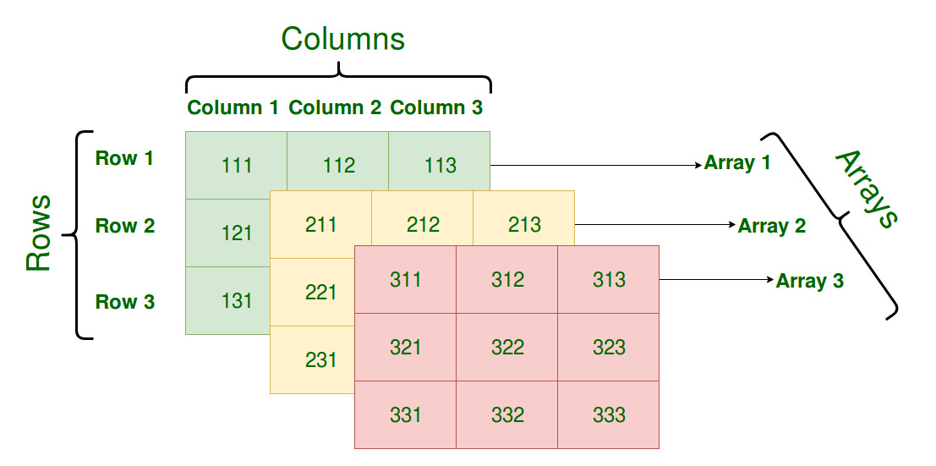
3. Multidimensional array
An array of three or more dimensions is called multidimensional array
Array declarations should understand from right-to-left
int a[10][3][2];
“an array of ten arrays of three arrays of two ints”
A Three-Dimensional Array
Syntax
data_type array_name[size1][size2]..[sizen];

Slide 71
int arr[3][3][3] ;
Declaration of Three-Dimensional Array
array of three Array of 3 rows and 3 columns arrays
Initializing Three-Dimensional Array
int x[3][3][3] = {
{{111,112,113}, {121,122,123}, {131,132,133}},
{{211,212,213}, {221,222,223}, {231,232,233}},
{{311,312,313}, {321,322,323}, {331,332,333}},
};
Initialization in a Three-Dimensional array is the same as that of Two-dimensional arrays.
The difference is as the number of dimensions increases so the number of nested braces will also increase.

Slide 72
Accessing 3D array elements:
{
{{ 1 2 3 } , { 4, 5, 6}, {7 ,8, 9}},
{{10,11,12} , {13,14,15}, {17,18,19}},
{{20,21,22} , {23,24,25},{26,27,28}},
}
a[0][0][0]=1 a[0][1][0]=4 a[0][2][0]=7
a[0][0][1]=2 a[0][1][1]=5 a[0][2][1]=8
a[0][0][2]=3 a[0][1][2]=5 a[0][2][2]=9
a[i][j][k] =➔ ith array jth row k th column
Array1 with 3 rows and 3 columns
Array2 with 3 rows and 3 columns
Array3 with 3 rows and 3 columns

Slide 73
Reading and displaying 3D Array elements
#include <iostream>
using namespace std;
int main() {
int a[2][3][3];
int i, j, k;
cout << "Enter the elements of the 3D array:" << endl;
for (i = 0; i < 2; i++) {
for (j = 0; j < 3; j++) {
for (k = 0; k < 3; k++) {
cin >> a[i][j][k];
}
}
}
cout << "The elements of the 3D array:" << endl;
for (i = 0; i < 2; i++) {
for (j = 0; j < 3; j++) {
for (k = 0; k < 3; k++) {
cout << a[i][j][k];
}
cout << endl;
}
cout << endl;
}
return 0;
}

Slide 74
Q) Write a C program to read and display the elements of 3D array
INPUT:
Enter 2 x 3 x 3 array elements:
1 2 3
4 5 6
7 8 9
10 11 12
13 14 15
16 17 18
OUTPUT:
Array elements are:
1 2 3
4 5 6
7 8 9
10 11 12
13 14 15
16 17 18

Slide 75
#include <iostream>
using namespace std;
const int ROWS = 3;
const int COLS = 3;
const int DEPTH = 2;
int main() {
int arr[DEPTH][ROWS][COLS];
int i, j, k;
cout << "Enter " << DEPTH << " x " << ROWS << " x " << COLS << " array elements:" << endl;
for (i = 0; i < DEPTH; i++) {
for (j = 0; j < ROWS; j++) {
for (k = 0; k < COLS; k++) {
cin >> arr[i][j][k];
}
}
}
cout << "Array elements are:" << endl;
for (i = 0; i < DEPTH; i++) {
for (j = 0; j < ROWS; j++) {
for (k = 0; k < COLS; k++) {
cout << arr[i][j][k] << " ";
}
cout << endl;
}
cout << endl;
}
return 0;
}

Slide 76
Q) Write a C program to find the sum of all the elements in a given 3D array.
Input:
{
{{1, 2, 3}, {4, 5, 6}, {7, 8, 9}},
{{10, 11, 12}, {13, 14, 15}, {16, 17, 18}},
{{19, 20, 21}, {22, 23, 24}, {25, 26, 27}}
}
Output:
The sum of all elements in the 3D array is: 378
Input:
{{{1, 2}, {3, 4}}, {{5, 6}, {7, 8}}}
Output:
The sum of all elements in the 3D array is: 36

Slide 77
#include <iostream>
using namespace std;
const int ROWS = 3;
const int COLS = 3;
const int DEPTH = 3;
int main() {
int arr[DEPTH][COLS][ROWS] = {
{{1, 2, 3}, {4, 5, 6}, {7, 8, 9}},
{{10, 11, 12}, {13, 14, 15}, {16, 17, 18}},
{{19, 20, 21}, {22, 23, 24}, {25, 26, 27}}
};
int sum = 0;
for (int i = 0; i < DEPTH; i++) {
for (int j = 0; j < ROWS; j++) {
for (int k = 0; k < COLS; k++) {
sum += arr[i][j][k];
}
}
}
cout << "The sum of all elements in the 3D array is: " << sum << endl;
return 0;
}

