Slide 1
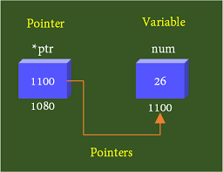
UNDERSTANDING POINTERS
Pointer is a variable which holds the address of another variable
int num = 26;
int* ptr = &num; // p is a pointer
ptr is pointer storing the address of variable num
i.e. 1100

Slide 2
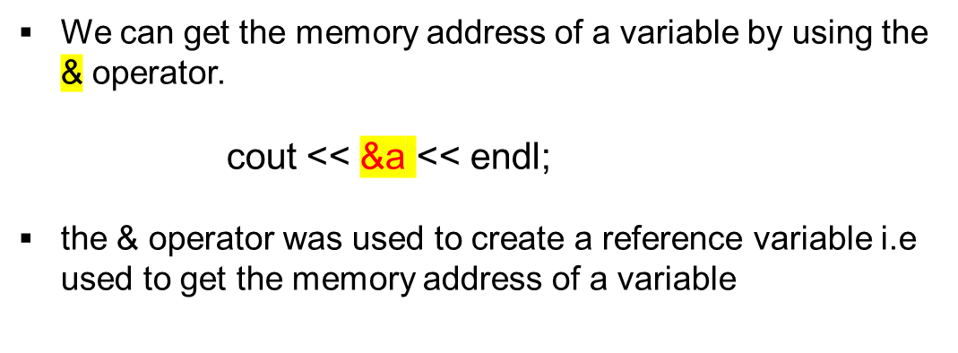
ACCESSING ADDRESS OF A VARIABLE
a
int a;
a=10
10
1000
4 bytes
b
int a = 26;
&a → accessing the address of a variable
int* p = &a; // p is a pointer
ptr is pointer storing the address of variable num
flaot b;
b = 10.456;
10.456
2000
4 bytes

Slide 3
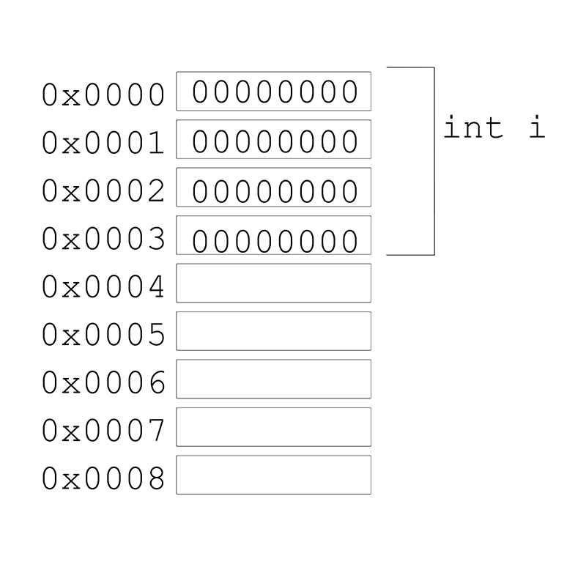
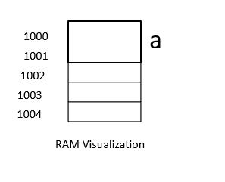
ACCESSING ADDRESS OF A VARIABLE
a
The memory address is in hexadecimal form (0x..).
0x6dfed4
int a;
a=10
1000
4 bytes
0x6dfed4

Slide 4
DECLARING & INITIALIZING POINTERS
Syntax: datatype *ptr-name;
Ex. int *p;
*→ used in declaration
To declare a pointer, we use the ( * ) dereference operator before its name
Ex. int *p;
p=&a;
&→ used in initialization
The address-of operator ( & ) operates on a variable, and returns the address of the variable
Type of Pointers:
int *ip; (integer pointer) -- > /* pointer to an integer */
float *fp; (float pointer) -- > /* pointer to a float */
double *dp; (double pointer) -- > /* pointer to a double */
char *ch (char pointer) -- > /* pointer to a character */

Slide 5
PROGRAM TO ILLUSTRATE A POINTER
#include <iostream>
int main() {
int *ptr, a;
cout << "Enter the value of a: ";
cin >> a;
ptr = &a; // Address of 'a' is assigned to 'ptr'
cout << "Value of a is: " << *ptr <<endl; // Show 'a's value using 'ptr'
return 0;
}

Slide 6
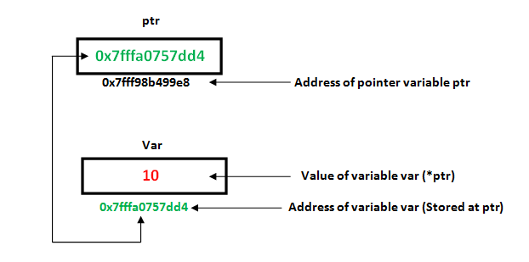
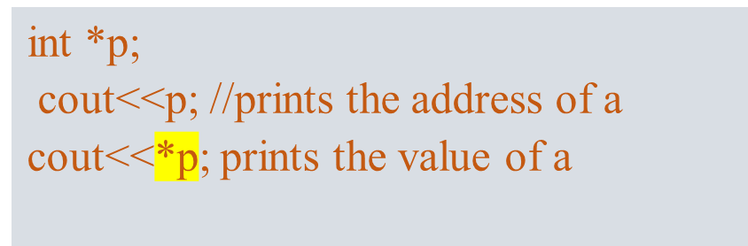
ACCESSING A VARIABLE THROUGH ITS POINTER
a
Access the value of the variable by using asterisk (*) - it is known as dereference operator
int a;
a=10
10
1000

Slide 7
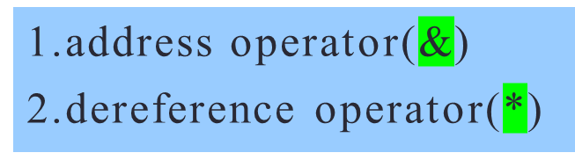
POINTER OPERATORS
1). & (address operator): initialize pointer variables
& - address operator can be used to find the address of any type of variable.
Syntax:
pointer=&variable-name (address of variable)
Ex: int a,*p;
p=&a // address of a
Every pointer variable must be initialized, then only it points to particular address
Initialization of pointervariable
pointervariable=&variblename;

Slide 8
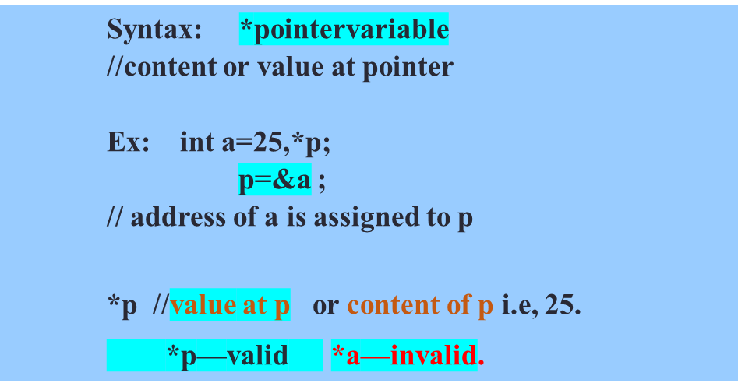
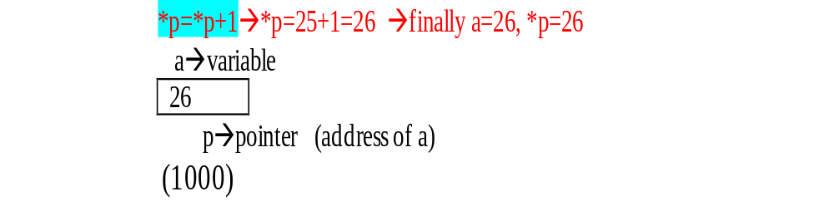
POINTER OPERATORS
* Dereference Operator
Access the value of the variable through its address/pointer.
modify the values of variables indirectly with pointers.
(*) can be used only before the pointer variable in the body of program
* can used at the declaration time to differentiate pointer variable and normal variable
Whereas in the body of the program it is used access the values at address.

Slide 9
Q)what will be the output of the following code?
#include <iostream>
int main() {
int x = 10;
int y = 20;
int* ptr1 = &x;
int* ptr2 = &y;
ptr1 = ptr2;
cout << *ptr1 << " " << *ptr2 << endl;
return 0;
}
a) 10 20
b) 20 20
c) 10 10
d) 20 10

Slide 10
Q)what will be the output of the following code?
#include <iostream>
int main() {
int x = 10;
int y = 20;
int* ptr1 = &x;
int* ptr2 = &y;
ptr1 = ptr2;
cout << *ptr1 << " " << *ptr2 << endl;
return 0;
}
a) 10 20
b) 20 20 *(Correct option)
c) 10 10
d) 20 10

Slide 11
Q)what will be the output of the following code?
#include <iostream>
int main() {
int a = 25, b;
int *ptr, *ptr1;
ptr = &a;
ptr1 = &b;
b = 36;
cout << *ptr << " " << *ptr1 << endl;
return 0;
}
A. 25 45632845
B. Run time error
C. Compilation Error
D. 25 36

Slide 12
Q)what will be the output of the following code?
#include <iostream>
int main() {
int a = 25, b;
int *ptr, *ptr1;
ptr = &a;
ptr1 = &b;
b = 36;
cout << *ptr << " " << *ptr1 << endl;
return 0;
}
A. 25 45632845
B. Run time error
C. Compilation Error
D. 25 36
Option: D
Explanation
ptr holds the address of a variable A and ptr1 holds the address of a variable B . The value of A is 25 and B is 36

Slide 13
BENEFITS OF USING POINTERS IN C++
Pointers used to access the address of the variable.
Pointers are more efficient in handling Arrays
It reduces length of the program and its execution time as well.
It allows C++ language to support Dynamic Memory management.
Pointers are dynamic variables.
A pointer enables us to access a variable that is defined outside the function.
Pointers are more efficient in handling the data tables.
Pointers are used in data structures in (linked organization of data)

Slide 14
POINTER ARITHMETIC IN C++
We can perform the following arithmetic operations on the pointers.
  Increment(++)
  Decrement(--)
  Addition(+)
  Subtraction(-)
  Comparison(==)

Slide 15
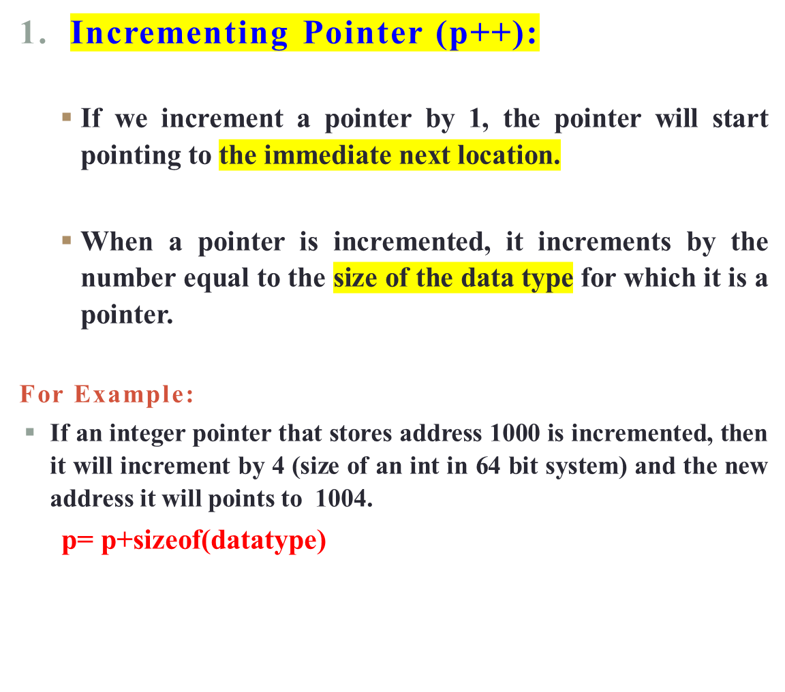
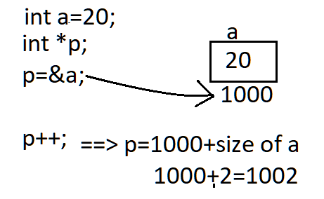

POINTER ARITHMETIC IN C++

Slide 16
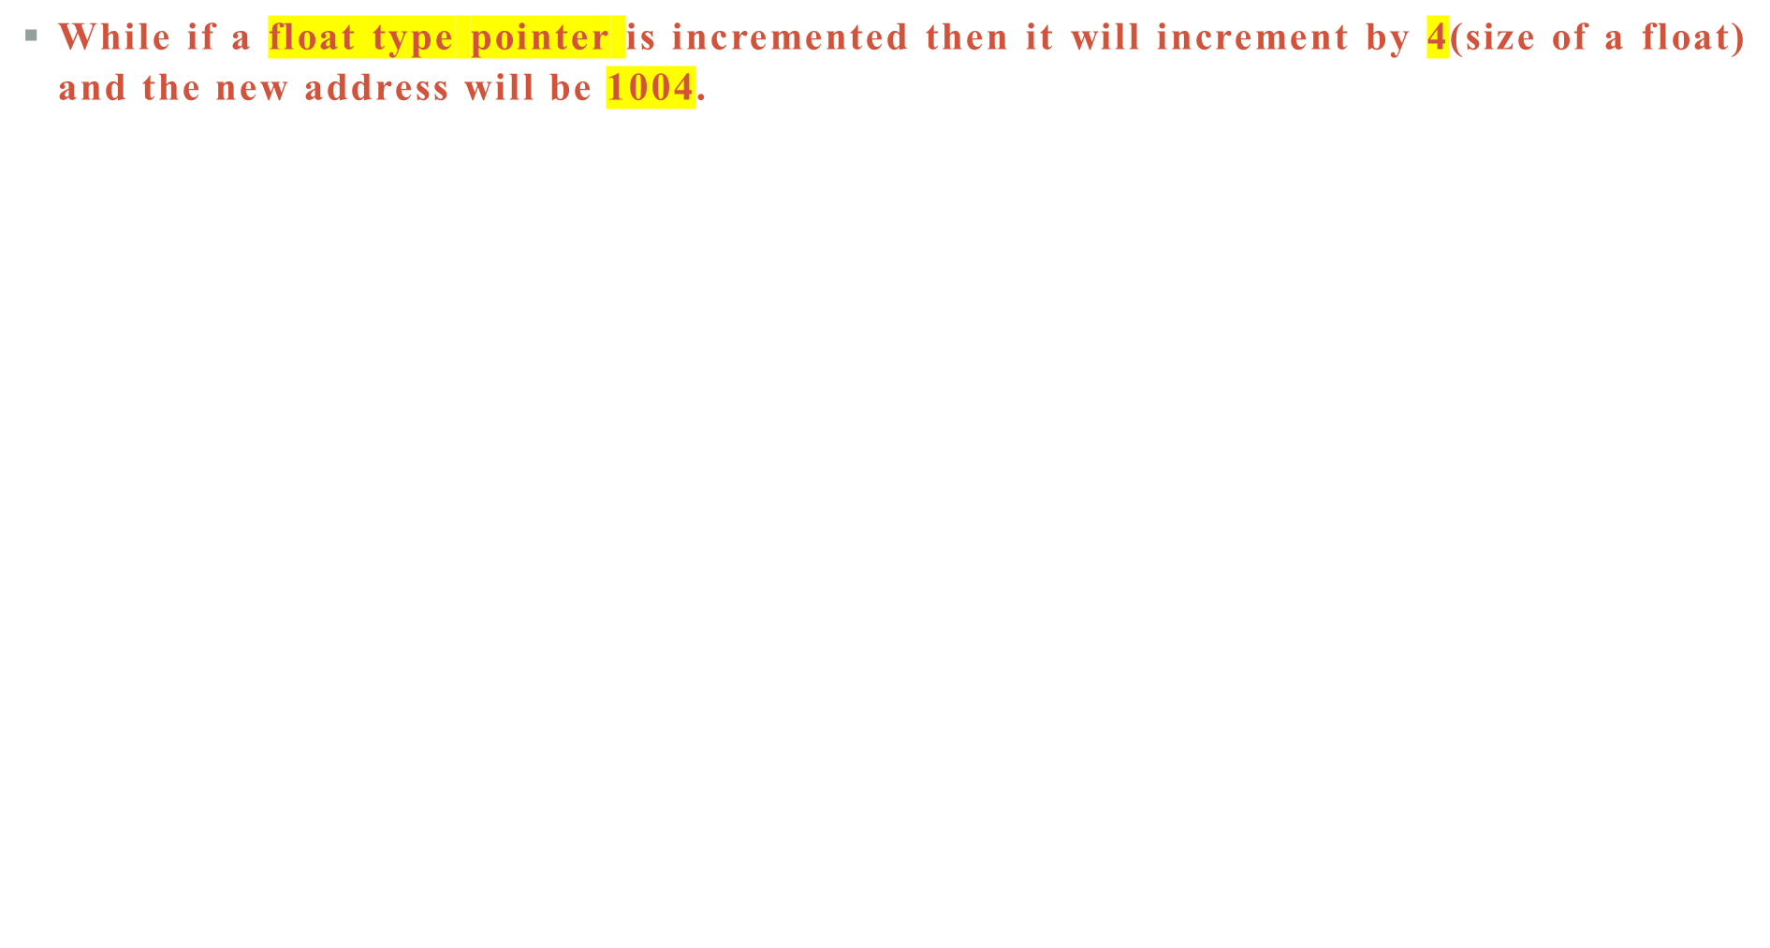
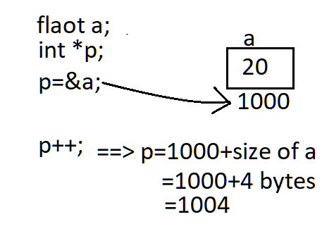
POINTER ARITHMETIC IN C++

Slide 17
POINTER ARITHMETIC IN C++
  #include <iostream>
  using namespace std;
  int main() {
  int a = 20;
  int *p; // Pointer to an integer
  p = &a; // Pointer stores the address of 'a'
  cout << "Pointer before Increment: " << p << endl;
  p++; // Incrementing pointer 'p'
  cout << "Pointer after increment: " << p << endl;
  return 0;
  }

Slide 18
Q.What will be the output of the following code?
#include <iostream>
int main() {
int x = 50;
int* ptr1 = &x;
int* ptr2 = &x;
int y = ++*ptr2;
cout << ++*ptr1 << " " << y << endl;
return 0;
}
a) 52 51
b) 50 50
c) 51 52
d) 51 50

Slide 19
Q.What will be the output of the following code?
#include <iostream>
int main() {
int x = 50;
int* ptr1 = &x;
int* ptr2 = &x;
int y = ++*ptr2;
cout << ++*ptr1 << " " << y << endl;
return 0;
a) 52 51 *(Correct option)
b) 50 50
c) 51 52
d) 51 50

Slide 20
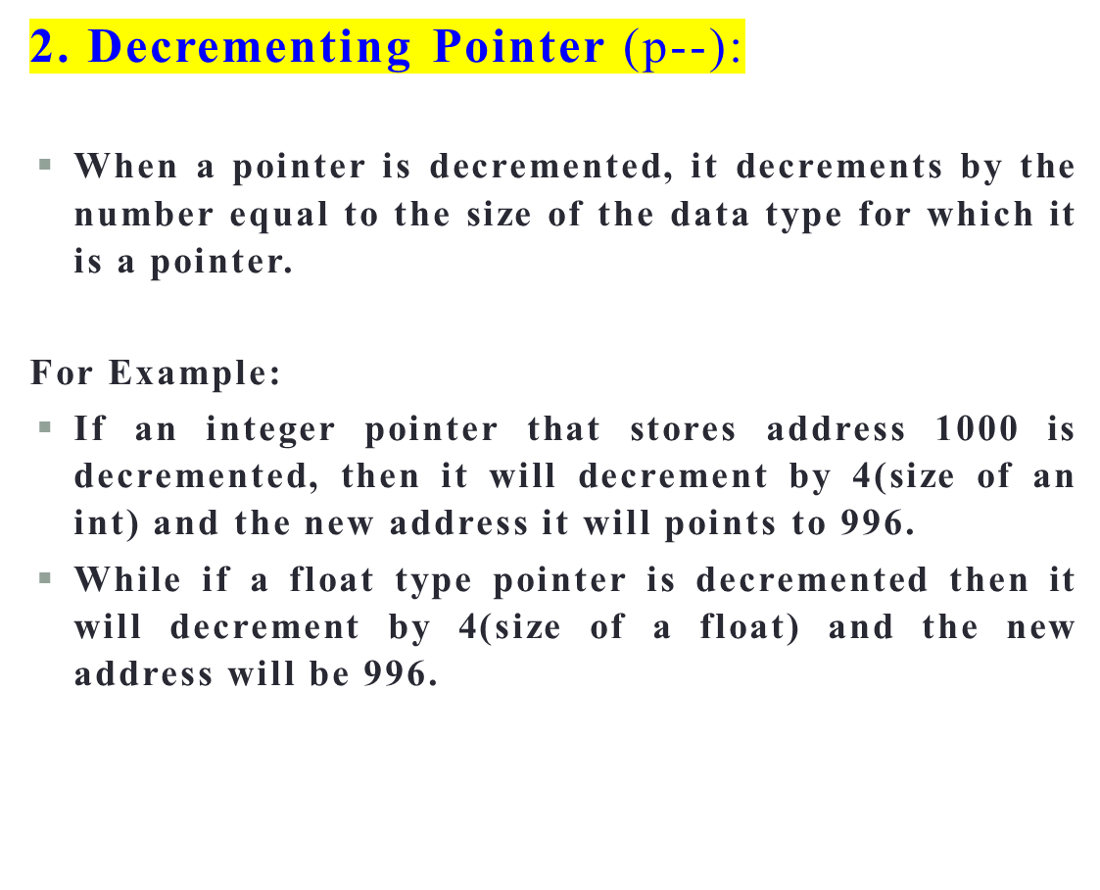
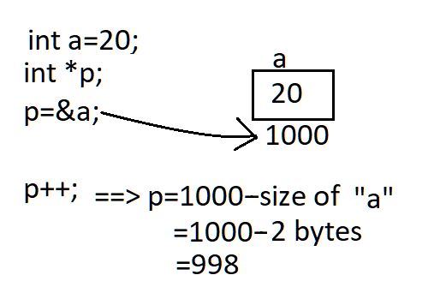
POINTER ARITHMETIC IN C++
=1000-4bytes=996

Slide 21
POINTER ARITHMETIC IN C++
#include <iostream>
using namespace std;
int main() {
int a = 20;
int *p; // Pointer to an integer
p = &a; // Pointer stores the address of 'a'
cout << "Pointer before decrement: " << p << endl;
p--; // Decrementing pointer 'p'
cout << "Pointer after decrement: " << p << endl;
return 0;
}

Slide 22
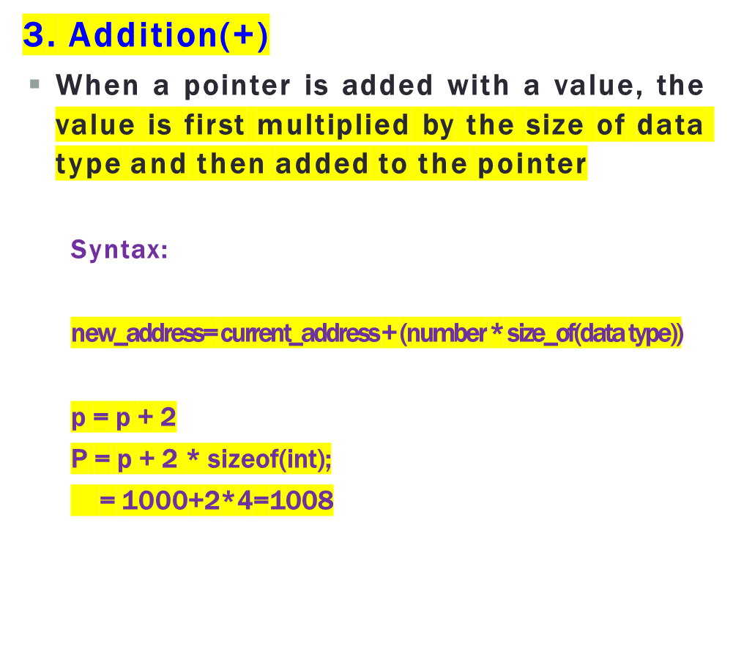
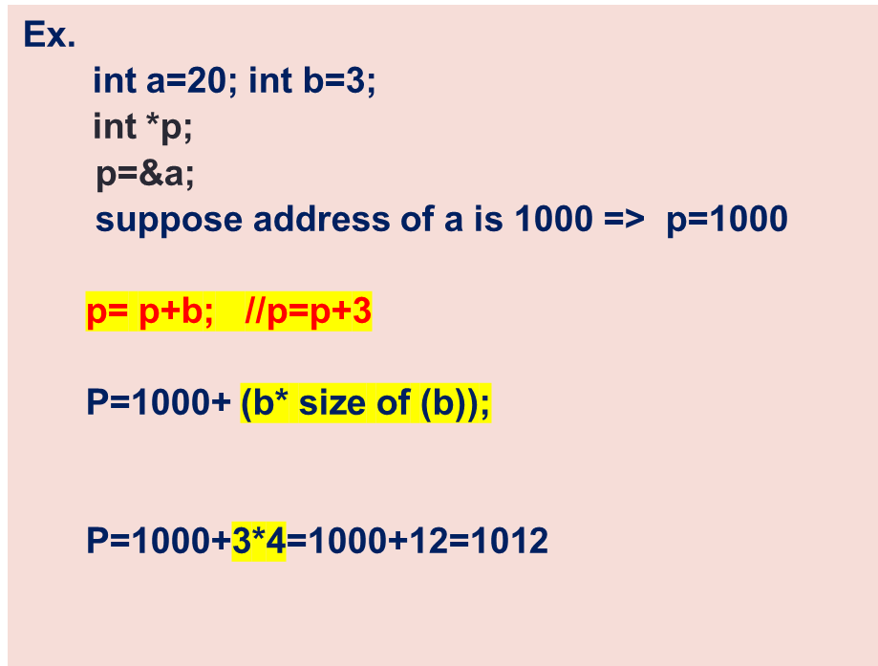
POINTER ARITHMETIC IN C++

Slide 23

POINTER ARITHMETIC IN C
  #include <iostream>
  using namespace std;
  int main() {
  int a = 50;
  int b = 3;
  int *p; // Pointer to int
  p = &b; // Stores the address of the 'b' variable
  cout << "Address of p variable is " << p << endl;
  p = p + b; // Adding 3 to the pointer variable
  cout << "After adding 3: Address of p variable is " << p << endl;
  return 0;
  }

Slide 24
POINTER ARITHMETIC IN C++
  Q) WAP program to add two numbers using pointers.
  Input
  Input num1: 10
  Input num2: 20
  Output
  Sum = 30

Slide 25
PROGRAM TO ADD TWO NUMBERS USING POINTERS.
#include <iostream>
int main() {
int num1, num2, sum;
int *ptr1, *ptr2;
ptr1 = &num1; // ptr1 stores the address of num1
ptr2 = &num2; // ptr2 stores the address of num2
cout << "Enter any two numbers: ";
cin >> *ptr1 >> *ptr2;
sum = *ptr1 + *ptr2;
cout << "Sum = " << sum << endl;
return 0;
}

Slide 26
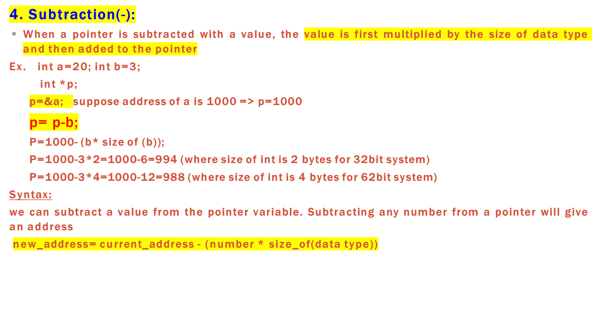
POINTER ARITHMETIC IN C

Slide 27
POINTER ARITHMETIC IN C++
  #include <iostream>
  using namespace std;
  int main() {
  int a = 50;
  int b = 3;
  int *p; // Pointer to int
  p = &a; // Stores the address of the 'a' variable
  cout << "Address of p variable is " << p << endl;
  p = p - b; // Subtracting 3 from the pointer variable
  cout << "After subtracting 3: Address of p variable is " << p << endl;
  return 0;
  }

Slide 28
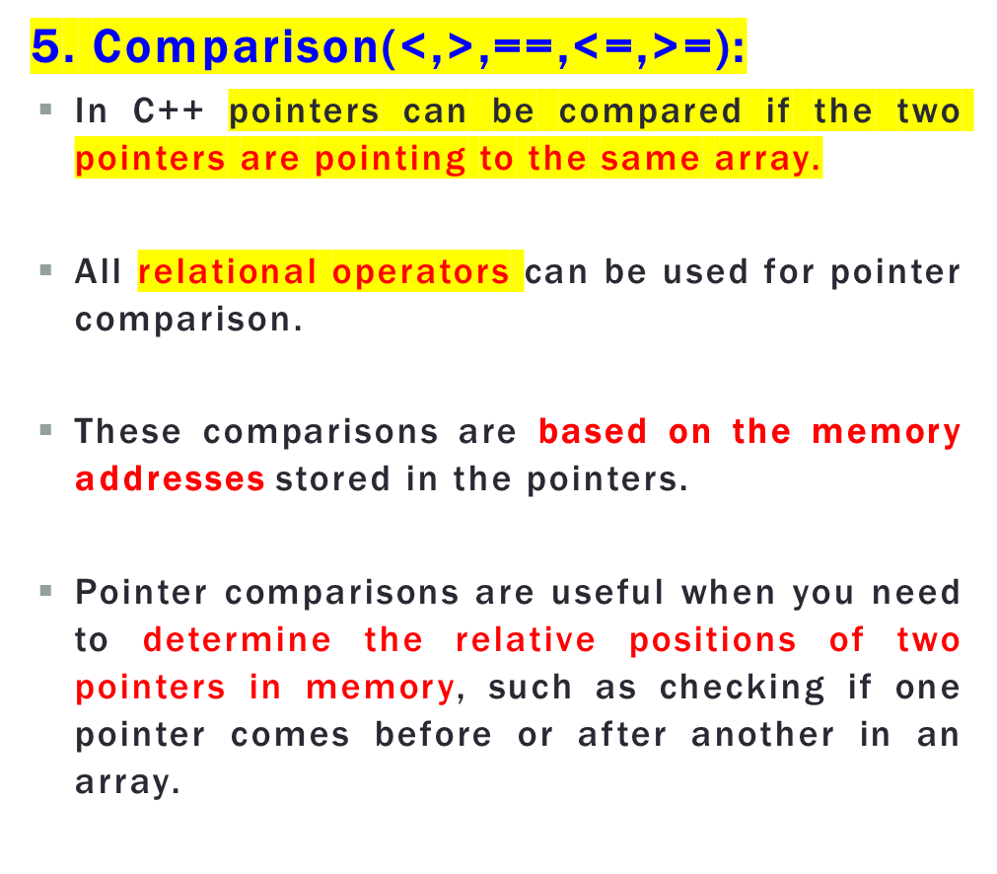
POINTER ARITHMETIC IN C++
ptr1 < ptr2:
  Checks if ptr1 points to an earlier memory location than ptr2.
ptr1 > ptr2:
  Checks if ptr1 points to a later memory location than ptr2.

Slide 29
POINTER ARITHMETIC IN C++
#include <iostream>
int main() {
int arr[] = {1, 2, 3, 4, 5};
int *ptr1 = &arr[0];
int *ptr2 = &arr[2];
cout << "Comparing pointers in an integer array:" << endl;
cout << "ptr1: " << ptr1 << endl;
cout << "ptr2: " << ptr2 << endl;
if (ptr1 < ptr2) {
cout << "ptr1 is pointing to an earlier memory location than ptr2." << endl;
} else if (ptr1 > ptr2) {
cout << "ptr1 is pointing to a later memory location than ptr2." << endl;
} else {
cout << "ptr1 and ptr2 are pointing to the same memory location." << endl;
}
return 0;
}

Slide 30
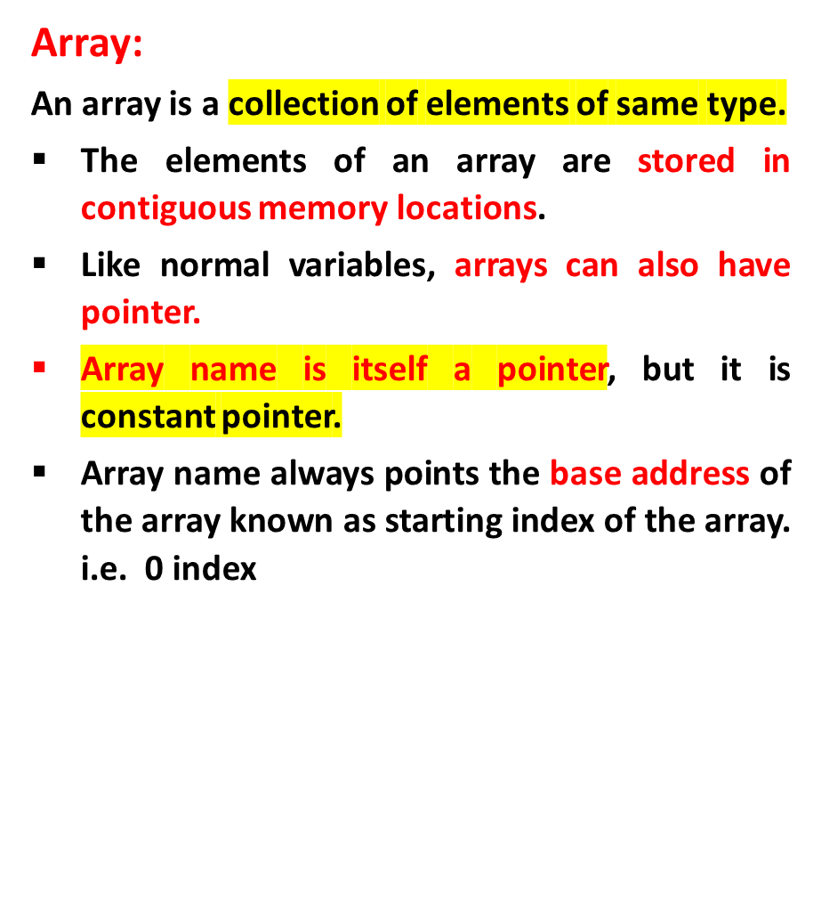
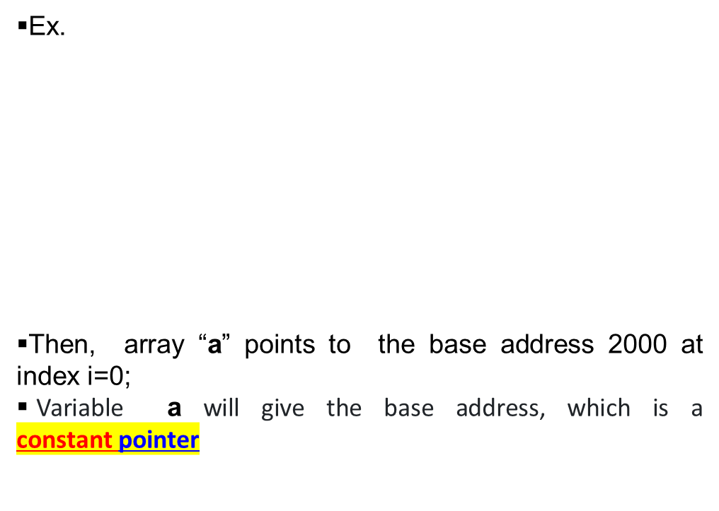
Pointer to Array
int a[5] = {10, 20, 30, 40, 50};
index i 0 1 2 3 4
address 2000 2004 2008 2012 2016

Slide 31
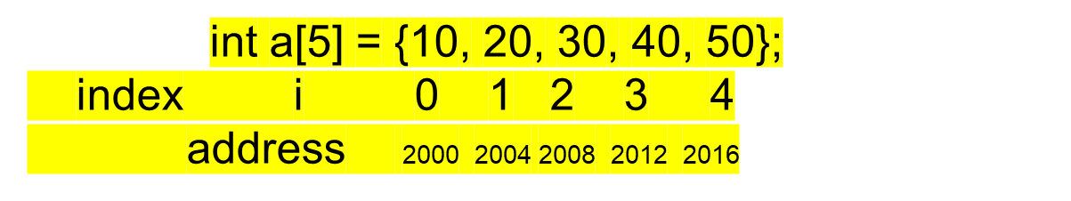
Accessing arrays using pointer
Accessing the addresses using array names:
a a+1 a+2 a+3 a+4
Array name ‘a’ is a constant pointer. It indicates the base address of the array a[0] address.
i.e &a[0]=(a+0) a[1]=(a+1) ……&a[i]=(a+i) //address of index i
Accessing the values using array addresses:
a[0]===*(a+0) ,a[1]====*(a+1) ….a[i]=====*(a+i) //value at index i

Slide 32
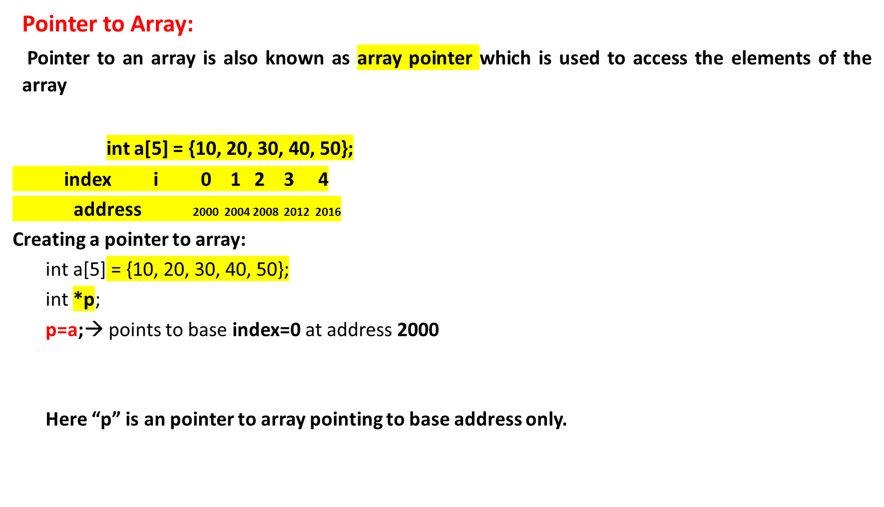
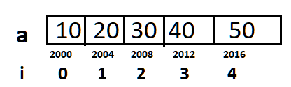
Accessing arrays using pointer

Slide 33

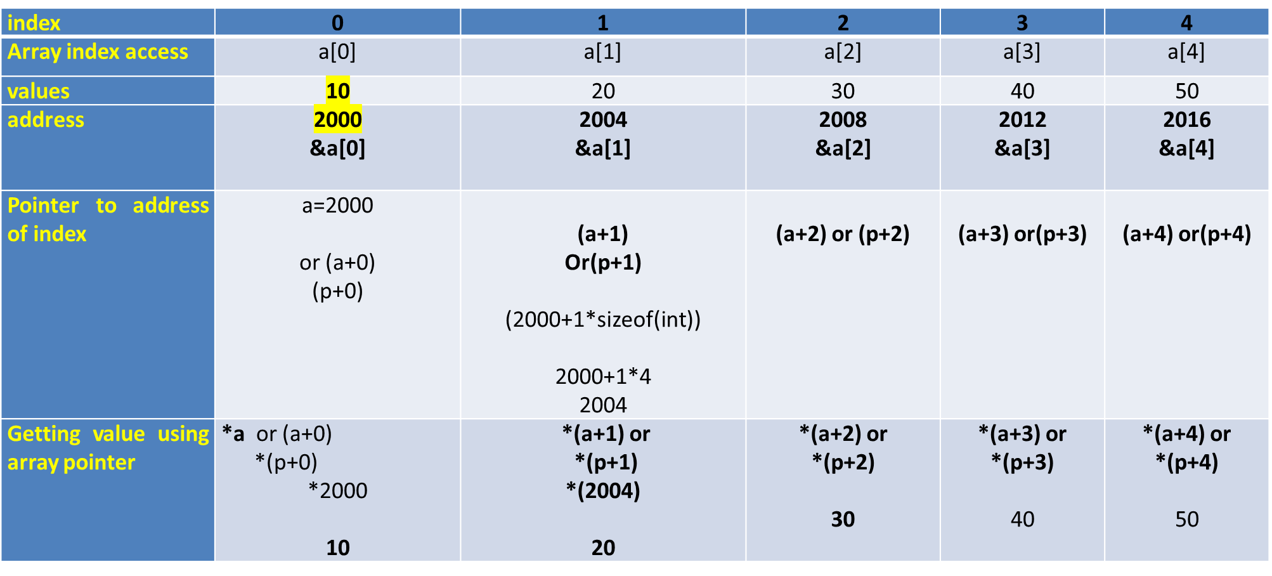
Pointers and Arrays

Slide 34
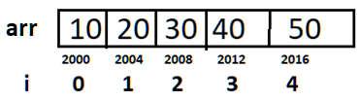
      INPUT:
      int arr[5] = {10,20,30,40,50};
      Output:
      Poiner address is 2000
      Value at pointer is 10
LOGIC:
Create an array.
2. ptr=a;
3. Print ptr //Prints 2000
4. Print *ptr ////Prints 10

Slide 35
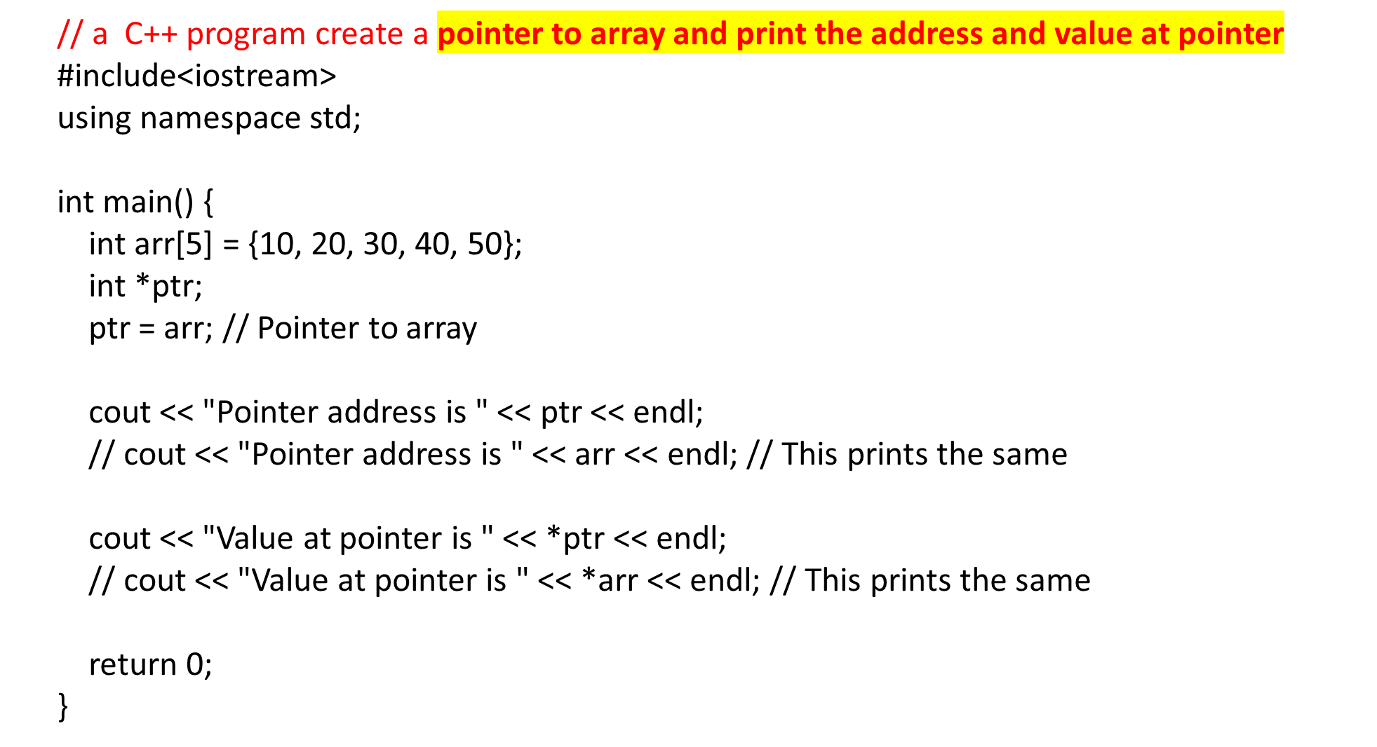
ptr=2000
Prints 2000
Prints 10

Slide 36
  Q) Write a C++ program for Reading and Printing an array elements using Pointers
Enter the size of array
4
enter array elemnts
10
20
30
40
the array elements are
10
20
30
40
LOGIC:
Create an array a[ ]
2. Create a pointer to the array a *ptr
ptr=a;
3. Read the size of array
4. Read the elements of array using pointer
    for(i=0;i<n;i++)
    cin>>ptr+I;
5. Print the elements of array using pointer
    for(i=0;i<n;i++)
    cout<<*(ptr+i));

Slide 37
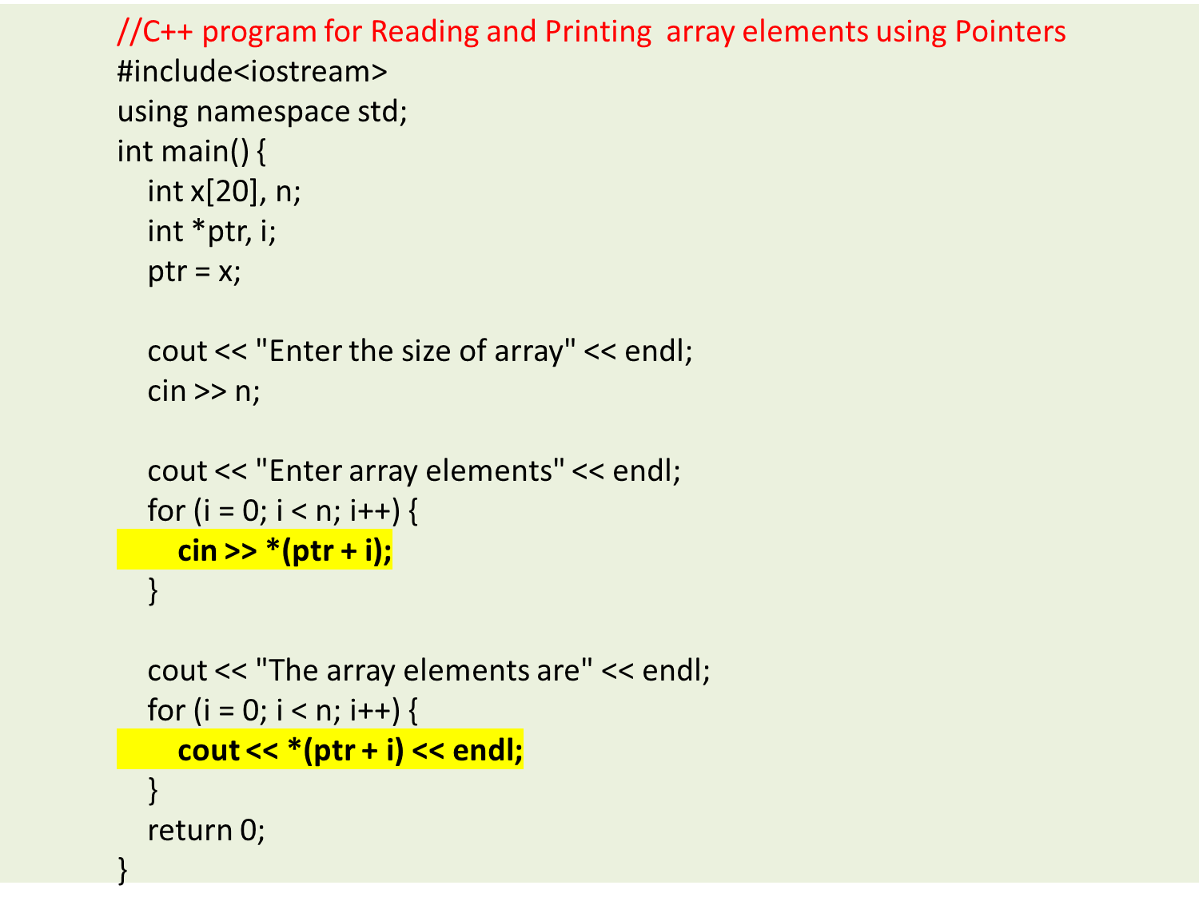

Slide 38
Q). What will be the output of the following C++ code?
#include<iostream>
using namespace std;
int main()
{
int a[3] = {1, 2, 3};
int *p = a;
cout << p << "\t" << a << endl;
return 0;
}
a) Same address is printed
b) Different address is printed
c) Compile time error
d) Nothing

Slide 39
Q). What will be the output of the following C++ code?
#include<iostream>
using namespace std;
int main()
{
int a[3] = {1, 2, 3};
int *p = a;
cout << p << "\t" << a << endl;
return 0;
}
a) Same address is printed
b) Different address is printed
c) Compile time error
d) Nothing

Slide 40
Q). What will be the output of the following C++ code?
#include<iostream>
using namespace std;
int main()
{
int ary[4] = {1, 2, 3, 4};
int *p = ary + 3;
cout << p[-2] << endl;
return 0;
}
a) 1
b) 2
c) Compile time error
d) Some garbage value

Slide 41
Q). What will be the output of the following C++ code?
#include<iostream>
using namespace std;
int main()
{
int ary[4] = {1, 2, 3, 4};
int *p = ary + 3;
cout << p[-2] << endl;
return 0;
}
a) 1
b) 2
c) Compile time error
d) Some garbage value

Slide 42
Scenario:
John is a software engineer working on optimizing code for a small game engine. In one part of the game code, there's an array of integers that represents the player's health points in different levels of the game. The team has decided that they want to double the health points for each level to make the game more challenging.
Question:
Imagine you are John, the software engineer. You have been assigned the task of doubling the health points for each level of the game by manipulating the array of integers using pointers in a C program. Here's your task:
Write a C program to double the value of each element in the array using pointers. Assume you have an array called healthPoints that contains the initial health points for each level, and it looks like thi
Input:
The input array healthPoints contains the initial health points for each level:
int healthPoints[] = {100, 120, 150, 80, 200};
Expected Output:
When you run the program, it will double the values in the healthPoints array and print both the original and updated health points:
Original Health Points: 100 120 150 80 200
Updated Health Points: 200 240 300 160 400

Slide 43
#include <stdio.h>
int main() {
int healthPoints[] = {100, 120, 150, 80, 200};
int length = sizeof(healthPoints) / sizeof(healthPoints[0]);
printf("Original Health Points: ");
for (int i = 0; i < length; i++) {
printf("%d ", healthPoints[i]);
}
printf("\n");
int *ptr = healthPoints; // Initialize a pointer to the first element of the array
// Double the values of the elements using a loop and pointers
for (int i = 0; i < length; i++) {
*ptr = (*ptr) * 2; // Double the value at the current pointer location
ptr++; // Move the pointer to the next element
}
printf("Updated Health Points: ");
for (int i = 0; i < length; i++) {
printf("%d ", healthPoints[i]);
}
printf("\n");
return 0;
}

Slide 44
Scenario:
Sarah is a programmer working on a weather monitoring application. She has an array that contains the temperatures recorded for the past five days in Celsius. Sarah wants to convert these temperatures to Fahrenheit and store them in a new array using pointers.
Question:
You are Sarah, the programmer, and you need to accomplish this task. Here's your task:
Write a C program to convert the temperatures from Celsius to Fahrenheit using pointers. You have an array called celsiusTemperatures that contains the temperatures for the past five days:
Input:
The input array celsiusTemperatures contains the temperatures in Celsius:
double celsiusTemperatures[] = {23.5, 18.2, 30.0, 15.7, 27.3};
Expected Output:
When you run the program, it should calculate the temperatures in Fahrenheit and store them in the fahrenheitTemperatures array. Here's the expected output:
Celsius Temperatures: 23.5 18.2 30.0 15.7 27.3
Fahrenheit Temperatures: 74.3 64.76 86.0 60.26 81.14

Slide 45
#include <stdio.h>
int main() {
double celsiusTemperatures[] = {23.5, 18.2, 30.0, 15.7, 27.3};
int length = sizeof(celsiusTemperatures) / sizeof(celsiusTemperatures[0]);
printf("Celsius Temperatures: ");
for (int i = 0; i < length; i++) {
printf("%.2f ", celsiusTemperatures[i]);
}
printf("\n");
// Create an array to store the Fahrenheit temperatures
double fahrenheitTemperatures[length];
double *celsiusPtr = celsiusTemperatures;
double *fahrenheitPtr = fahrenheitTemperatures;
// Convert Celsius to Fahrenheit using pointers
for (int i = 0; i < length; i++) {
*fahrenheitPtr = (*celsiusPtr * 9.0 / 5.0) + 32.0;
celsiusPtr++;
fahrenheitPtr++;
}
printf("Fahrenheit Temperatures: ");
for (int i = 0; i < length; i++) {
printf("%.2f ", fahrenheitTemperatures[i]);
}
printf("\n");
return 0;
}

Slide 46
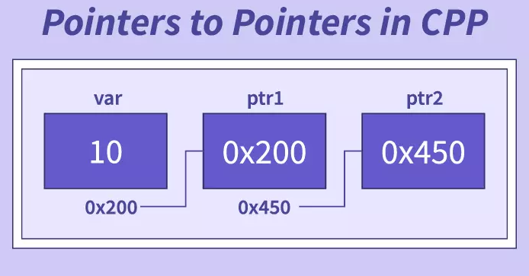
Pointer to Pointer(double pointer):**
*→single pointer(pointer)
** →double pointer(pointer to pointer)
A pointer to pointer holds the address of pointer of same type is known as pointer-to-pointer or double pointer.
Declaration of a Pointer to Pointer
Syantax:
datatype **ptrtoptr;
int **q ;
Here q is a pointer to pointer. There must be two *’s in the declaration of pointer to pointer.
Ex:
int a = 10, *p, **q;
//p is pointer, q is pointer to pointer
Initialization of pointer to pointer:
ptrtoptr_var=&ptr_var;
p = &a; //pointer initialization consider
address of a=1000
q=&p ;
// Pointer to pointer initialization
consider address of p=2000

Slide 47
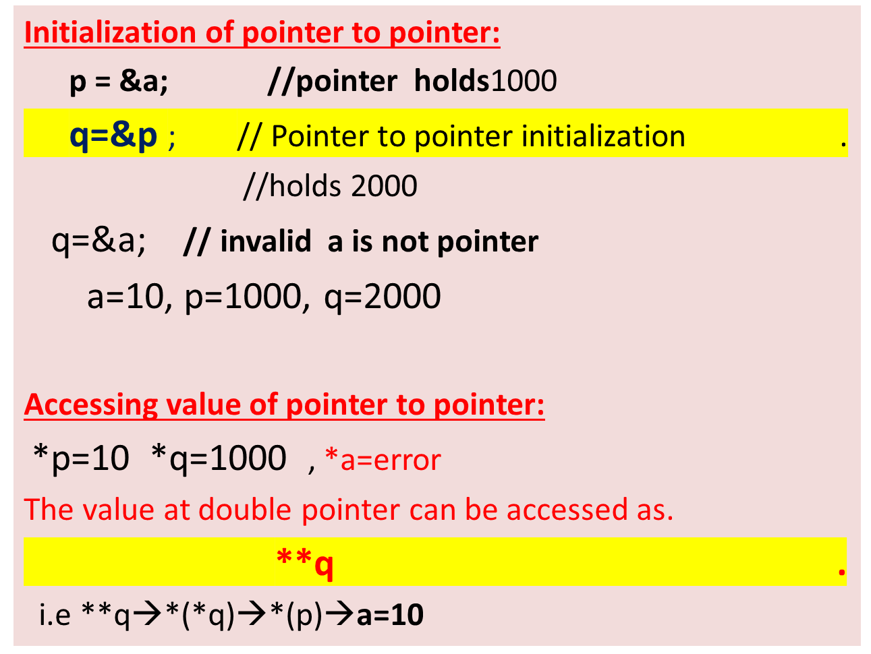
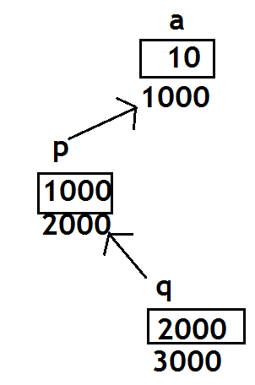
Pointer to Pointer(double pointer):**
(p is a pointer)
(q is a Double pointer)

Slide 48
Q) Write a C++ program to create a pointer to pointer(double pointer)
INPUT:
Enter a
789
OUTPUT:
Value of a = 789
Value of a using single pointer = 789
Value of a using double pointer = 789

Slide 49
Pointer to Pointer(double pointer):**
// C++ program to create a pointer to pointer(double pointer)
#include <stdio.h>
int main()
{
int a , *p, **q;
printf(“Enter a\n”);
scanf(“%d”,&a);
p = &a; //initializing pointer
q = &p; //initializing ptr to ptr
printf("Value of a= %d\n", a );
printf("Value of a using single pointer = %d\n", *p);
printf("Value of a using pointer to pointer = %d\n", **q);
return 0;
}

Slide 50
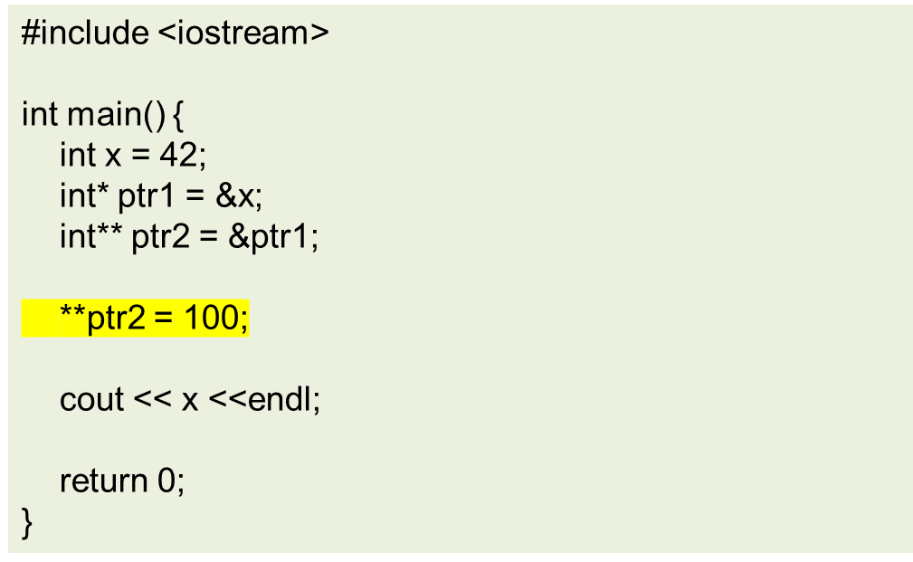
Q) What will be the output of the below code?
a. 42
b. 100
c. Compilation error
d. Runtime error

Slide 51
Q) What will be the output of the below code?
Explanation:
In the code, ptr1 is a pointer to an integer x, and ptr2 is a double pointer (pointer to a pointer) that points to ptr1.
When **ptr2 is used to modify the value pointed to by ptr1, it indirectly modifies the value of x, setting it to 100.
Therefore, the output of the code will be 100.
a. 42
b. 100
c. Compilation error
d. Runtime error

Slide 52
Q) What will be the output of the below code?
#include <iostream>
int main() {
int a = 42;
int b = 87;
int* ptr1 = &a;
int* ptr2 = &b;
int** ptr_double = &ptr1;
*ptr_double = ptr2;
cout << **ptr_double << endl;
return 0;
}
a. 42
b. 87
c. Compilation error
d. Runtime error

Slide 53
Q) What will be the output of the below code?
#include <iostream>
int main() {
int a = 42;
int b = 87;
int* ptr1 = &a;
int* ptr2 = &b;
int** ptr_double = &ptr1;
*ptr_double = ptr2;
cout << **ptr_double << endl;
return 0;
}
Explanation:
In the code, initially, ptr1 points to the integer a, and ptr2 points to the integer b.
Then, the double pointer ptr_double is set to point to ptr1. However, the line *ptr_double = ptr2; changes the target of ptr_double to point to ptr2, effectively making it point to b.
Therefore, when **ptr_double is used to access the value, it retrieves the value of b, which is 87.
a. 42
b. 87
c. Compilation error
d. Runtime error

Slide 54
Scenario:
Emily is working on a program that generates summaries of articles in various languages. She needs to count the number of sentences in each article, which is represented as an array of strings.
Develop a function, countSentences, that uses a pointer to pointer to process the articles and count the sentences give me story based question on this
Input:
char *articles[] = {
"The quick brown fox. Jumped over the lazy dog.",
"Le renard brun rapide. A sauté par-dessus le chien paresseux.",
"El zorro marrón rápido. Saltó sobre el perro perezoso.",
"Der schnelle braune Fuchs. Sprang über den faulen Hund.",
NULL // Null-terminated to mark the end of the array
};
Expected Output:
Article 1 (English): "The quick brown fox. Jumped over the lazy dog."
  Expected Sentence Count: 2
Article 2 (French): "Le renard brun rapide. A sauté par-dessus le chien paresseux."
  Expected Sentence Count: 2

Slide 55
#include <stdio.h>
#include <string.h>
int countSentences(char **articles) {
// Initialize a variable to keep track of the sentence count
int sentenceCount = 0;
// Iterate through the array of strings
for (int i = 0; articles[i] != NULL; i++) {
char *article = articles[i];
int articleLength = strlen(article);
// Iterate through each character in the article
for (int j = 0; j < articleLength; j++) {
// Check if the character is a sentence-ending punctuation (., !, ?)
if (article[j] == '.' || article[j] == '!' || article[j] == '?') {
// Increment the sentence count
sentenceCount++;
}
}
}
return sentenceCount;
}
int main() {
// Sample array of articles
char *articles[] = {
"This is a sample sentence. It has multiple sentences within it.",
"Another article! With more than one sentence?",
"One more article.",
NULL // Null-terminated to mark the end of the array
};
int totalSentences = countSentences(articles);
printf("Total Sentences in the articles: %d\n", totalSentences);
return 0;
}

