Slide 1
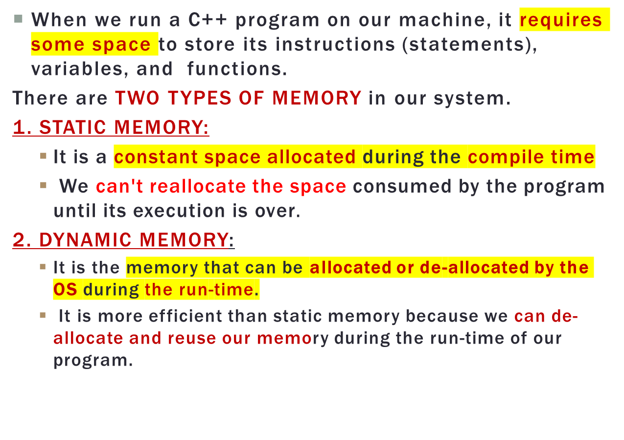
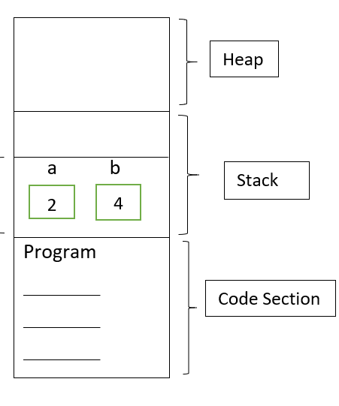
C++ PROGRAM MEMORY MANAGEMENT

Slide 2
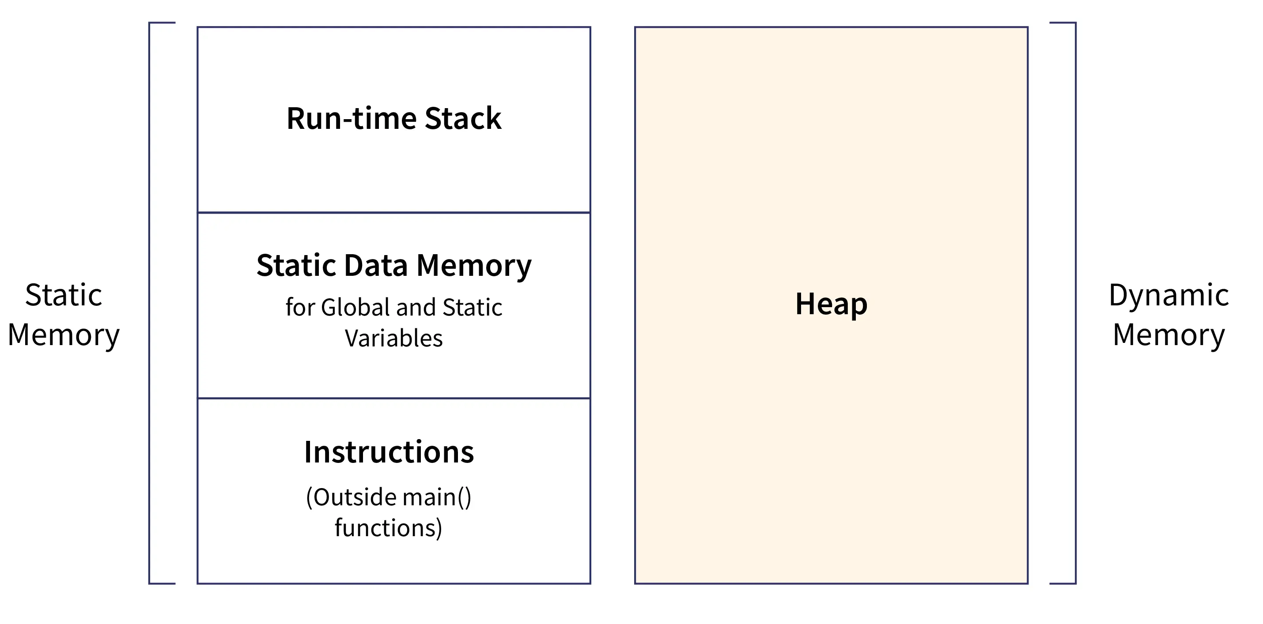
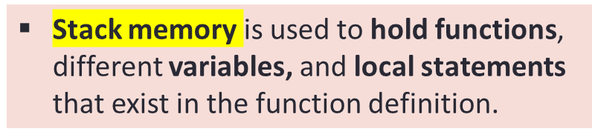
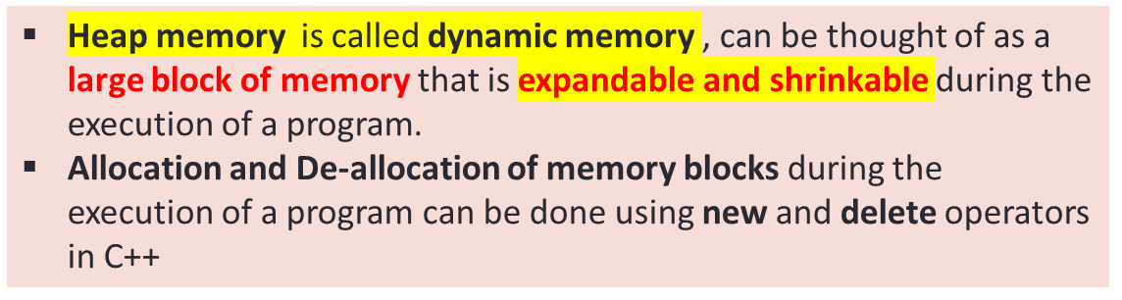
C++ PROGRAM MEMORY MANAGEMENT
The memory used by a C++ program can be divided further into four parts:
Run-time Stack (Static Memory)
Static Data Memory (for Global and Static Variables)
Instructions / Statements (Static Memory)
Heap (Dynamic Memory)

Slide 3
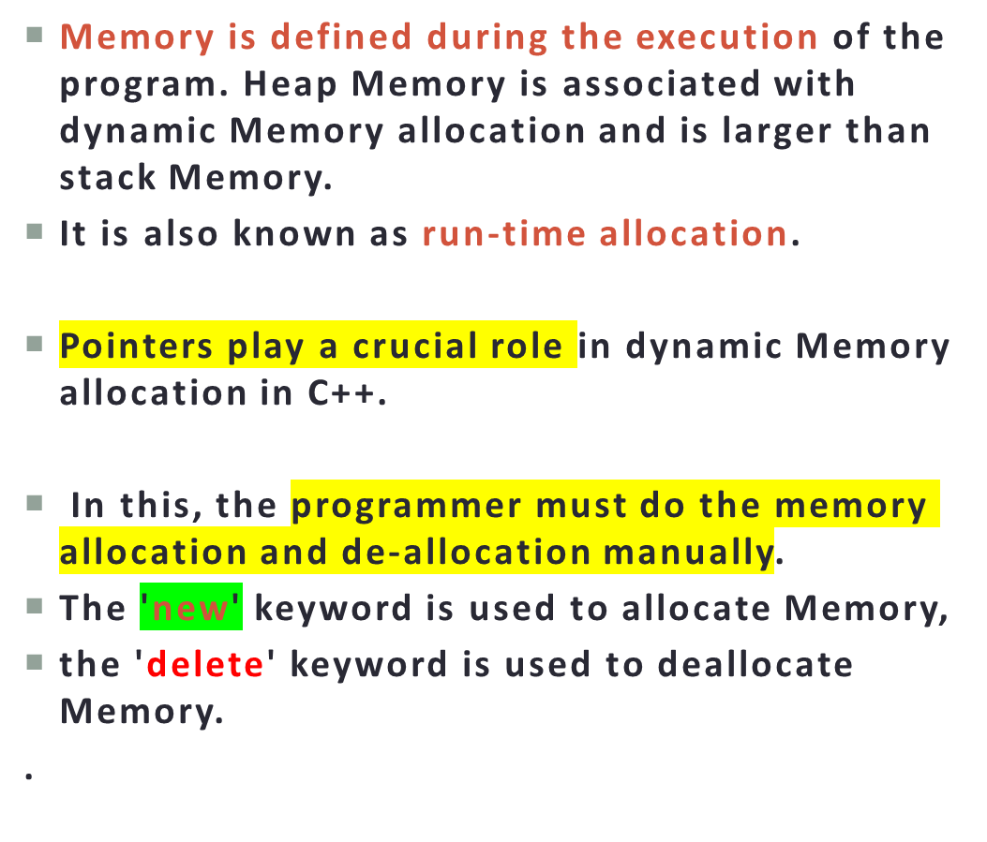
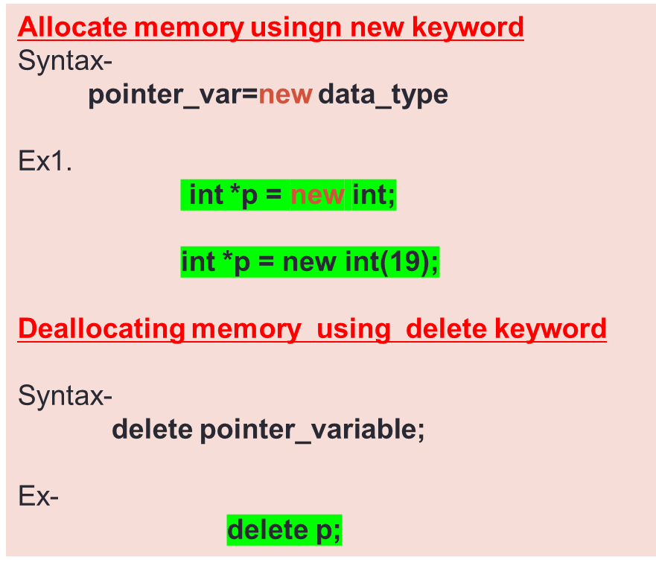
DYNAMIC MEMORY ALLOCATION

Slide 4
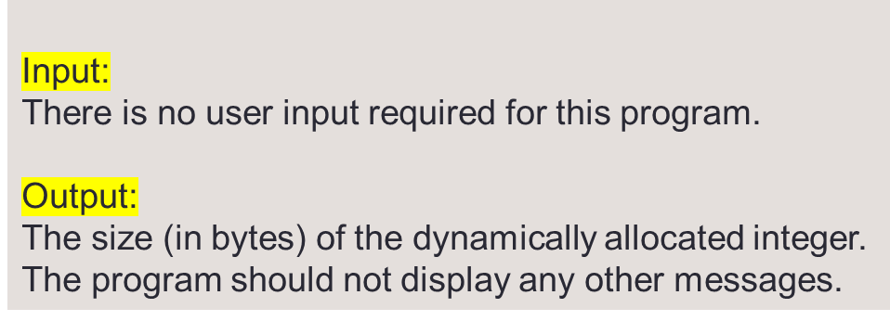
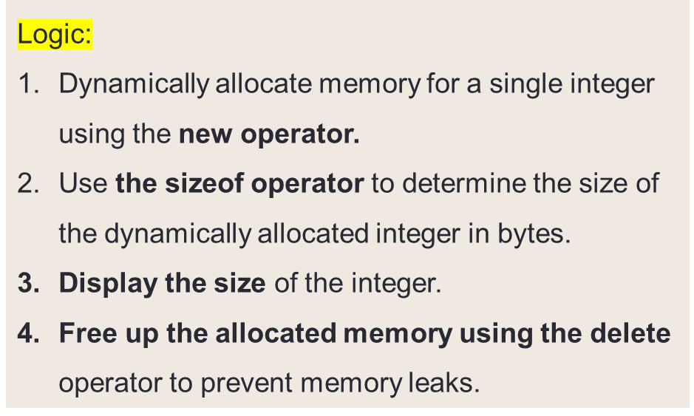
DYNAMIC MEMORY ALLOCATION
Question:
Write a C++ program that dynamically allocates memory for a single integer, displays the size (in bytes) of the allocated integer, and then frees the allocated memory.

Slide 5
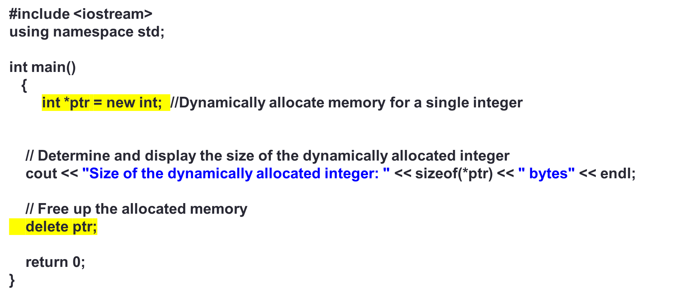
DYNAMIC MEMORY ALLOCATION

Slide 6
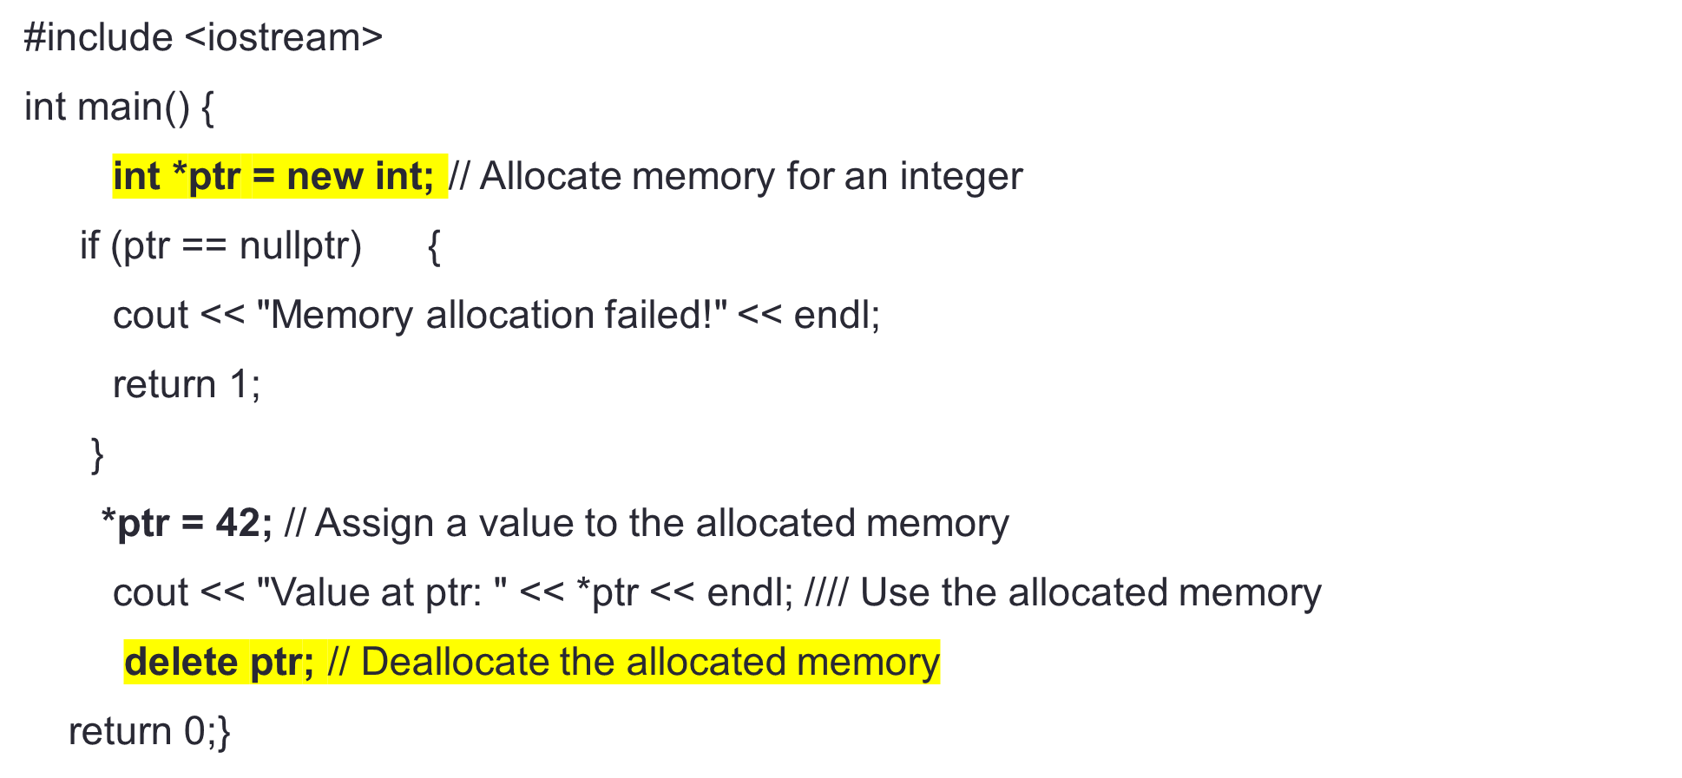
DYNAMIC MEMORY ALLOCATION

Slide 7
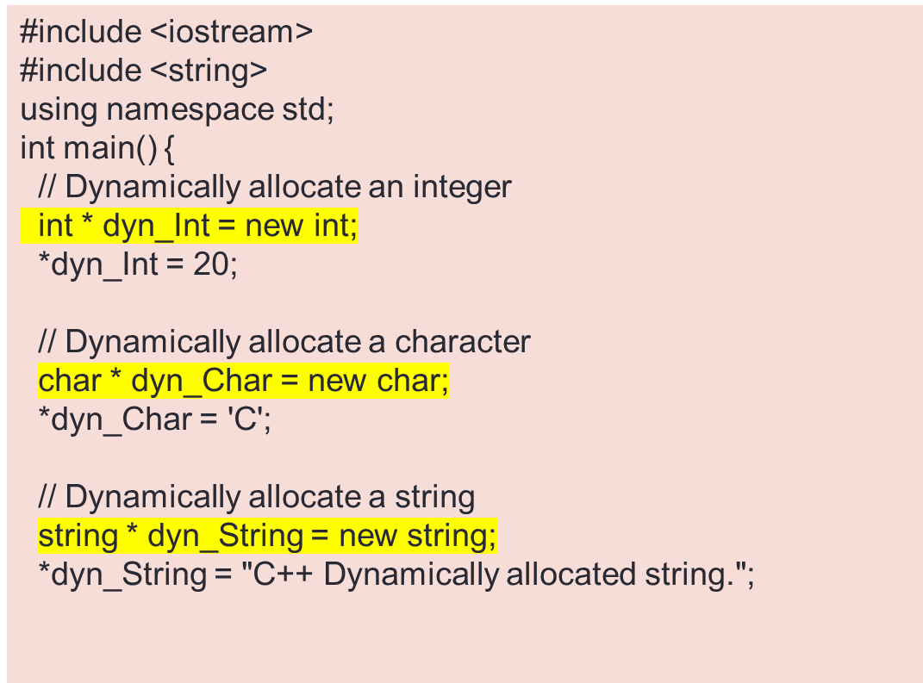
WRITE A C++ PROGRAM TO DYNAMICALLY ALLOCATE AN INTEGER, A CHARACTER AND A STRING AND ASSIGN A VALUE TO THEM.
// Display the values
cout << "Dynamically allocated integer: " << *dyn_Int << endl;
cout << "Dynamically allocated character: " << *dyn_Char << endl;
cout << "Dynamically allocated string: " << *dyn_String << endl;
// Deallocate the memory
delete dyn_Int;
delete dyn_Char;
delete dyn_String;
return 0;
}

Slide 8
WRITE A C++ PROGRAM TO DYNAMICALLY ALLOCATE AN ARRAY OF INTEGERS AND STRINGS AND INITIALIZE ITS ELEMENTS.
#include <iostream>
#include <string>
int main()
{
// Dynamically allocate an array of integers
int size = 7; // Size of the array
int * dynamicIntArray = new int[size];
// Initialize the elements of the array
for (int i = 0; i < size; i++) {
dynamicIntArray[i] = i + 1;
}
// Dynamically allocate an array of strings
std::string * dynamicStringArray = new std::string[size];
// Initialize the elements of the array
for (int i = 0; i < size; i++) {
dynamicStringArray[i] = "Element-" + std::to_string(i + 1);
}
// Display the elements of the integer array
std::cout << "Dynamically allocated integer array:" << std::endl;
for (int i = 0; i < size; i++) {
std::cout << dynamicIntArray[i] << " ";
}
std::cout << std::endl;
// Display the elements of the string array
std::cout << "\nDynamically allocated string array:" << std::endl;
for (int i = 0; i < size; i++) {
std::cout << dynamicStringArray[i] << std::endl;
}
// Deallocate the memory
delete[] dynamicIntArray;
delete[] dynamicStringArray;
return 0;
}

Slide 9
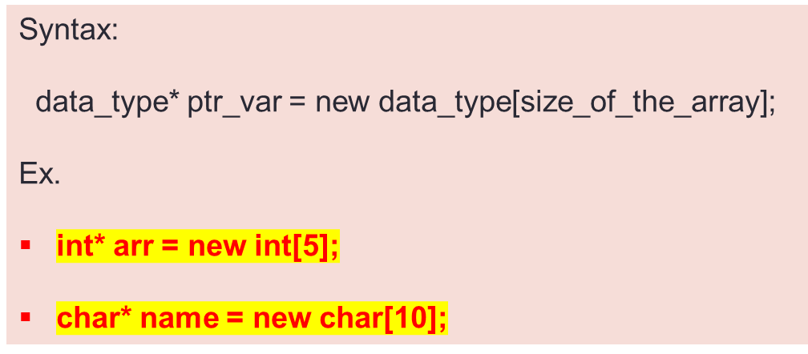
DYNAMIC MEMORY ALLOCATION IN C++ FOR ARRAYS
The new operator can also be used to allocate a block of memory for an array of any data_type.
Dynamic vs. Static Arrays:
Dynamic arrays are allocated on the heap at runtime, and their size can be determined during program execution.
Static arrays, on the other hand, have a fixed size determined at compile-time.
Check whether the memory allocation was successful by comparing the pointer to nullptr.
If the allocation fails, the new operator will return nullptr, indicating a failure to allocate memory.
if (arr == nullptr) {
// Handle memory allocation failure
}

Slide 10
DYNAMIC MEMORY ALLOCATION
Question:
Write a C++ program that dynamically allocates an array of integers and then frees the allocated memory.
The program should also display the size of the dynamically allocated array.
Input:
5
10
20
30
40
50
.
Output
8

Slide 11
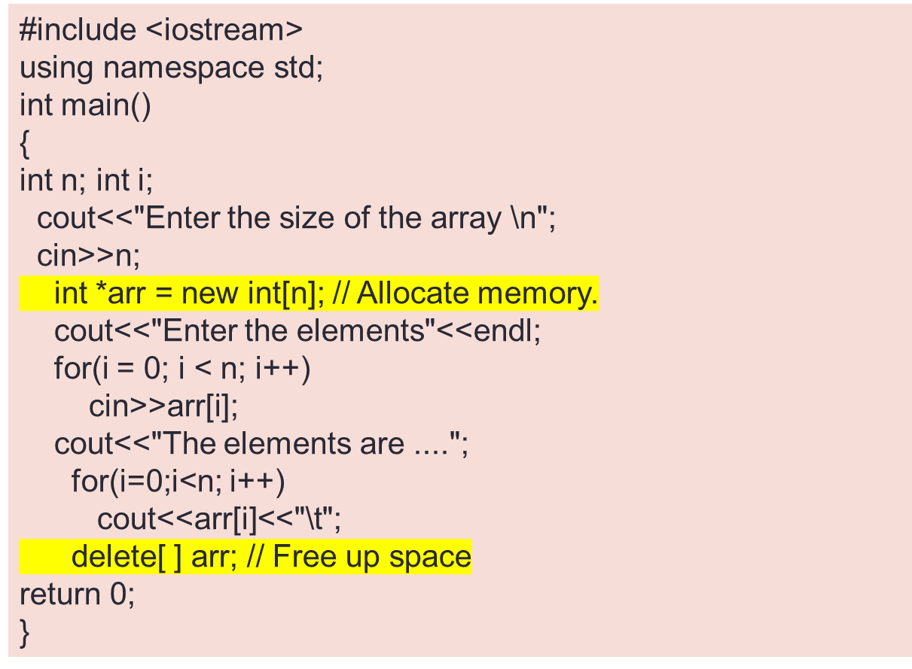
// DYNAMIC MEMORY ALLOCATION AN ARRAY OF INTEGERS

Slide 12
DYNAMIC MEMORY ALLOCATION
Problem statement:
You are writing a program that needs to read an unknown number of integers from the user until they enter a sentinel value, like -1. How would you dynamically allocate memory to store these integers, and how would you ensure you don't run out of memory?
Implement code you would take to dynamically allocate memory to store these integers, and how you would handle memory allocation errors.
Input:
Enter integers (enter -1 to stop):
1 2 3 4 5 -1
Output
Entered numbers: 1 2 3 4 5

Slide 13
#include <iostream>
int main() {
const int sentinel = -1;
int* numbers = nullptr; // Initialize the dynamic array pointer
int size = 0; // Current size of the array
int capacity = 1; // Initial capacity of the array
std::cout << "Enter integers (enter -1 to stop):\n";
while (true) {
int num;
std::cin >> num;
if (num == sentinel) {
break; // Exit the loop if the sentinel value is entered
}
// Check if we need to resize the array
if (size == capacity) {
// Create a new larger array
capacity *= 2;
int* newNumbers = new int[capacity];
// Copy existing elements to the new array
for (int i = 0; i < size; ++i) {
newNumbers[i] = numbers[i];
}
// Deallocate the old array
delete[] numbers;
// Update the pointer to the new array
numbers = newNumbers;
}
// Store the entered number in the array
numbers[size] = num;
size++;
}
// Output the entered numbers
std::cout << "Entered numbers: ";
for (int i = 0; i < size; ++i) {
std::cout << numbers[i] << " ";
}
// Deallocate the dynamically allocated memory
delete[] numbers;
return 0;
}

Slide 14
PROBLEM STATEMENT:
You are developing software for a scientific research project that involves the analysis of experimental data. The data consists of two types: floating-point values and corresponding descriptions represented as strings. These data sets are dynamic and vary in size, making it necessary to efficiently allocate memory.
Question: How would you design a C++ program to dynamically allocate two two-dimensional arrays – one for floating-point values and another for strings – and initialize their elements? Provide input values and the resulting output to illustrate the program's functionality.
Input:
The user is prompted to enter the dimensions (rows and columns) of the two arrays.
The user then enters the elements of both arrays, starting with the floating-point values and followed by the corresponding strings.
Output:
The program displays the initialized arrays for both floating-point values and strings.

Slide 15
#include <iostream>
#include <string>
int main() {
int rows, cols;
// Input: Dimensions of the arrays
std::cout << "Enter the number of rows: ";
std::cin >> rows;
std::cout << "Enter the number of columns: ";
std::cin >> cols;
// Dynamic memory allocation for the floating-point array
float** floatArray = new float*[rows];
for (int i = 0; i < rows; ++i) {
floatArray[i] = new float[cols];
}
// Dynamic memory allocation for the string array
std::string** stringArray = new std::string*[rows];
for (int i = 0; i < rows; ++i) {
stringArray[i] = new std::string[cols];
}
// Input: Initialize the floating-point array
std::cout << "Enter " << rows * cols << " floating-point values:" << std::endl;
for (int i = 0; i < rows; ++i) {
for (int j = 0; j < cols; ++j) {
std::cin >> floatArray[i][j];
}
}
// Input: Initialize the string array
std::cin.ignore(); // Clear newline character
std::cout << "Enter " << rows * cols << " strings:" << std::endl;
for (int i = 0; i < rows; ++i) {
for (int j = 0; j < cols; ++j) {
std::getline(std::cin, stringArray[i][j]);
}
}
// Output: Display the initialized arrays
std::cout << "\nInitialized Floating-Point Array:" << std::endl;
for (int i = 0; i < rows; ++i) {
for (int j = 0; j < cols; ++j) {
std::cout << floatArray[i][j] << " ";
}
std::cout << std::endl;
}
std::cout << "\nInitialized String Array:" << std::endl;
for (int i = 0; i < rows; ++i) {
for (int j = 0; j < cols; ++j) {
std::cout << stringArray[i][j] << " ";
}
std::cout << std::endl;
}
// Deallocate memory
for (int i = 0; i < rows; ++i) {
delete[] floatArray[i];
delete[] stringArray[i];
}
delete[] floatArray;
delete[] stringArray;
return 0;
}

Slide 16
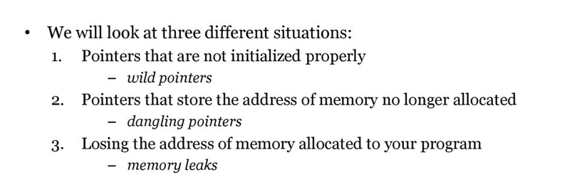
POSSIBLE PROBLEMS WITH THE USE OF POINTERS

Slide 17
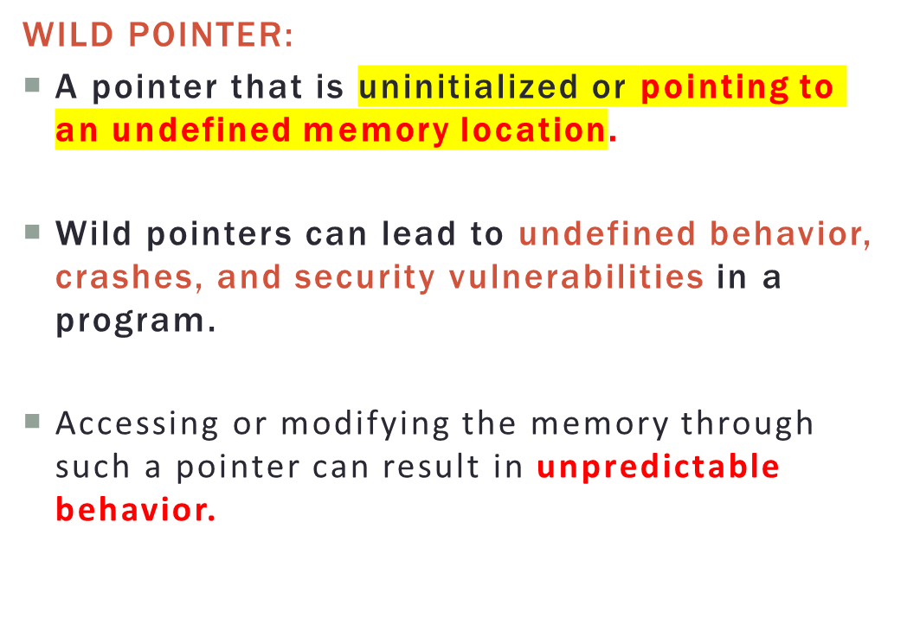
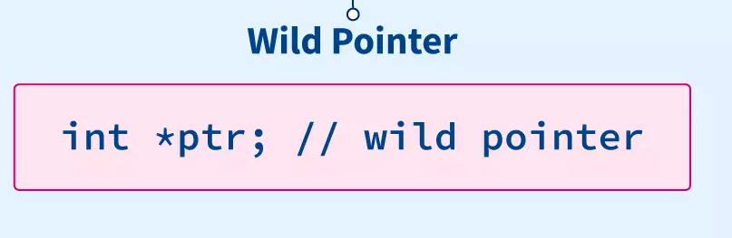
WILD POINTER
Int *wP; // This is a wild pointer

Slide 18
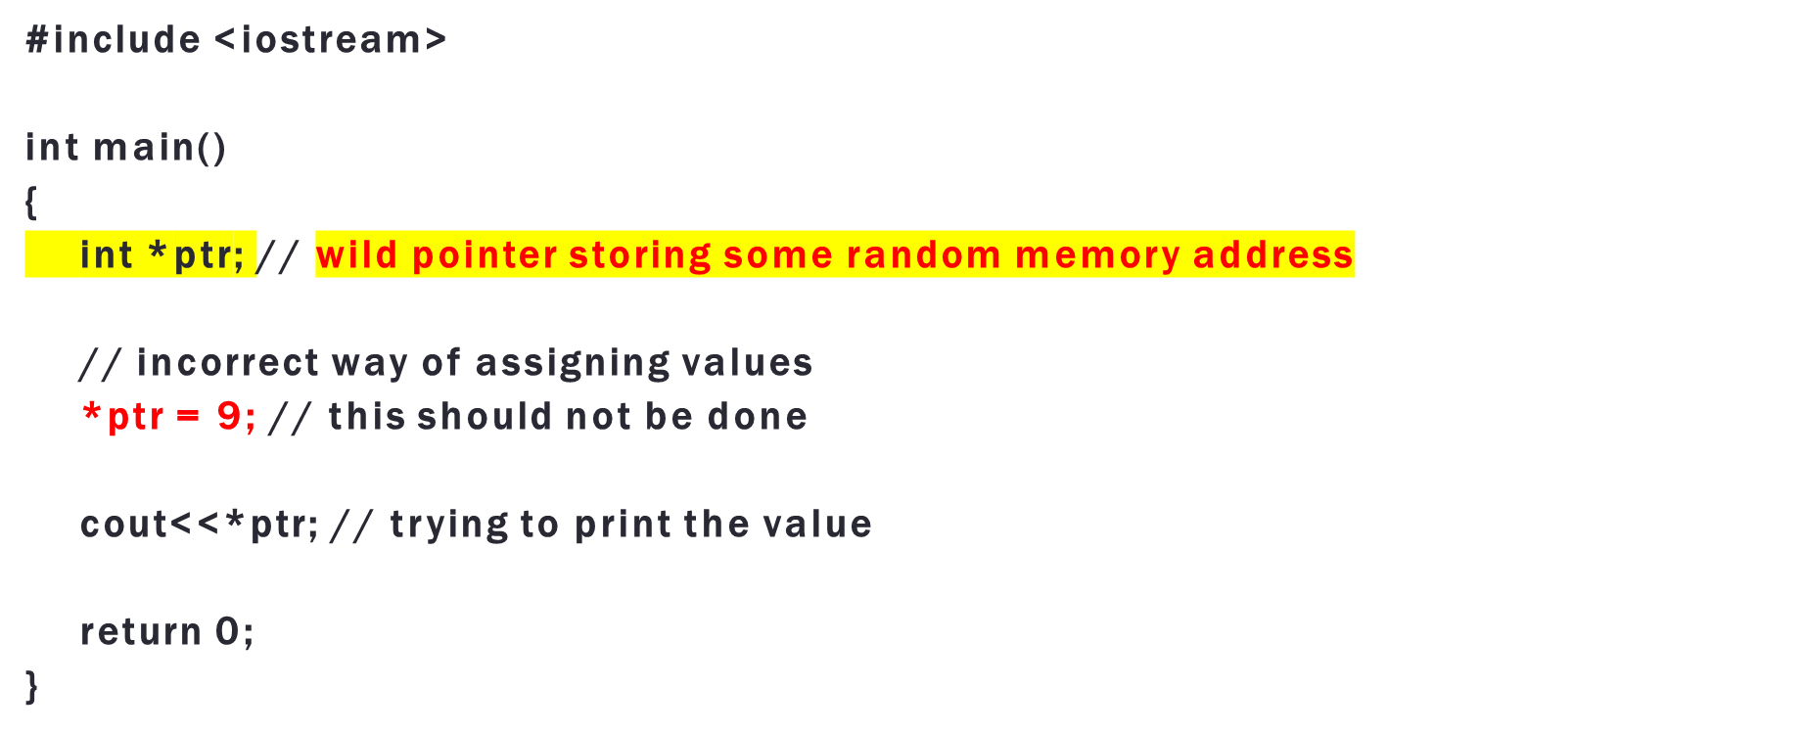
WILD POINTER

Slide 19
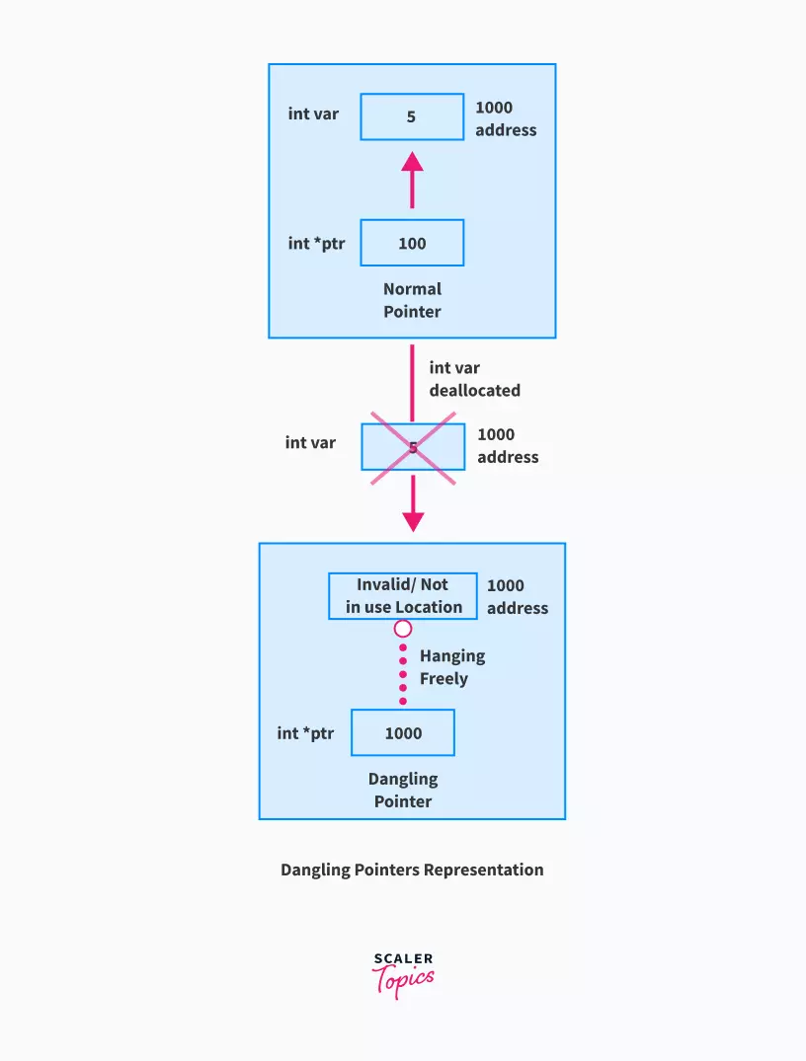

DANGLING POINTER
A "dangling pointer" is a pointer that points to a memory location that has been deallocated or is no longer valid.
Dereferencing a dangling pointer can lead to undefined behavior, crashes, and hard-to-diagnose bugs in your program
Deallocated Memory: The pointer was valid at some point but now points to memory that has been explicitly deallocated using the delete or delete[] operator.
int* ptr = new int;
delete ptr;
*ptr = 42; // Dangling pointer

Slide 20
PROGRAM FOR DANGLING POINTER
//c++ program for dynamic memory allocation
#include<iostream>
using namespace std;
int main()
{
int *p=new int;
cout<<"Enter the value to store \n";
cin>>*p;
cout<<"The address of memory allocated is "<<p<<endl;
cout<<"The value at the address is "<<*p<<endl;
delete p;
cout<<"After deleting memory the value at the address is "<<*p<<endl;
return 0;
}

Slide 21
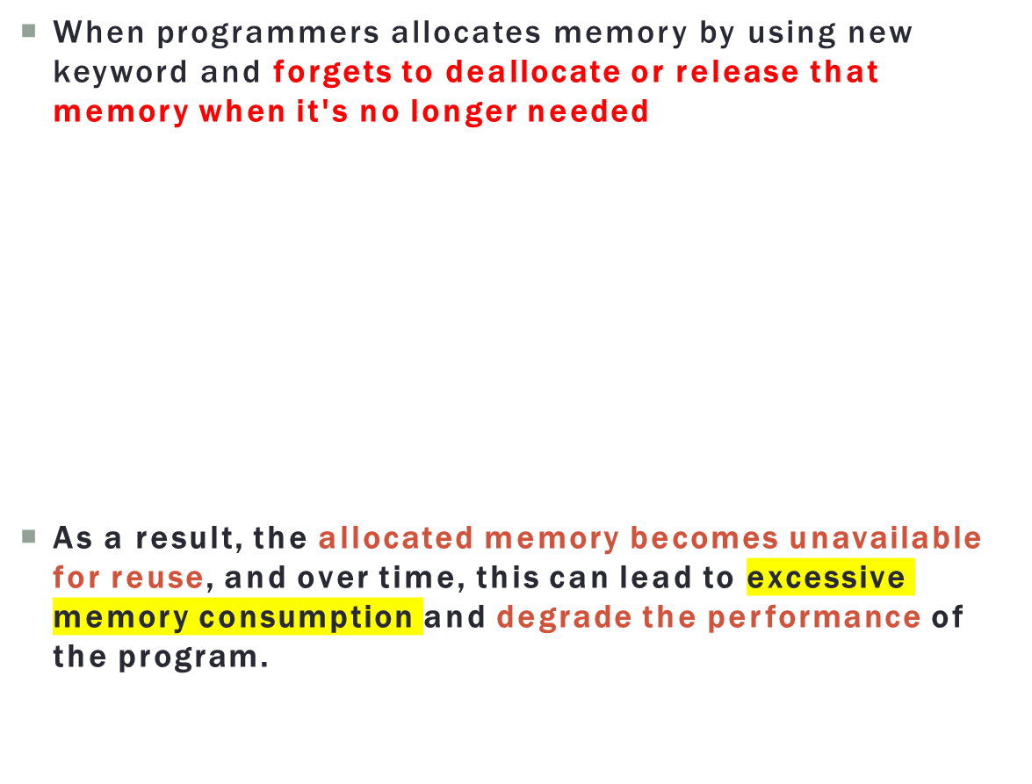
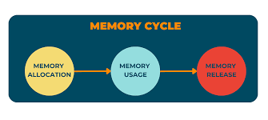
MEMORY LEAK
int main()
{
int* ptr = new int[10];
ptr[0] = 1;
ptr[1] = 2;
// forgot to delete ptr, causing a memory leak
return 0;
}

Slide 22
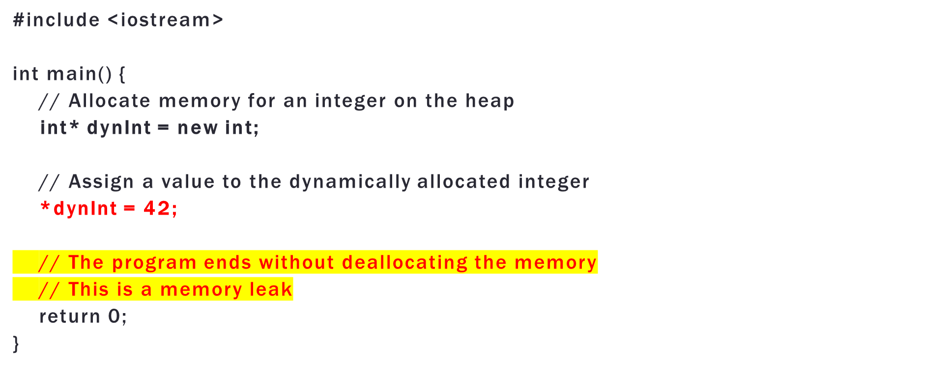
MEMORY LEAK

Slide 23
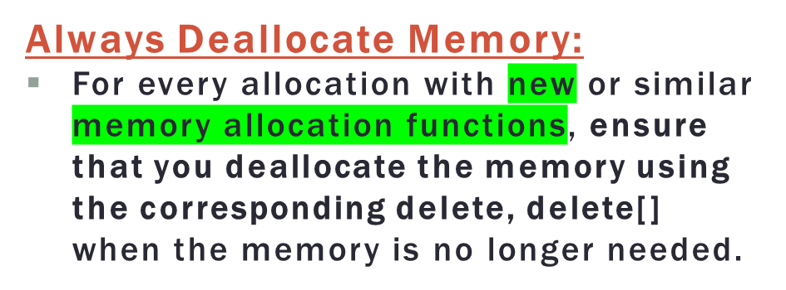
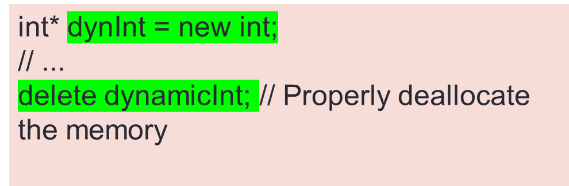
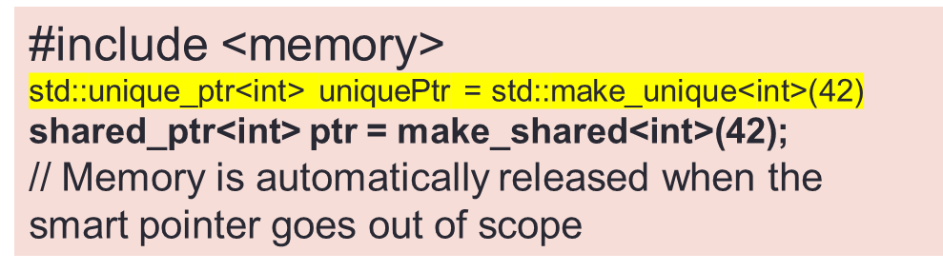
AVOIDING MEMORY LEAKS IN C++
Use Smart Pointers:
Consider using smart pointers like std::shared_ptr and std::unique_ptr that manage memory automatically and release it when it's no longer in use

Slide 24
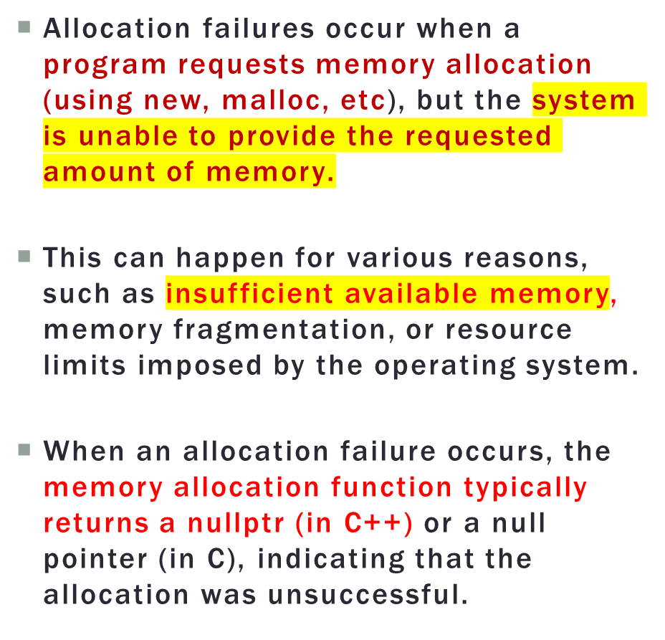
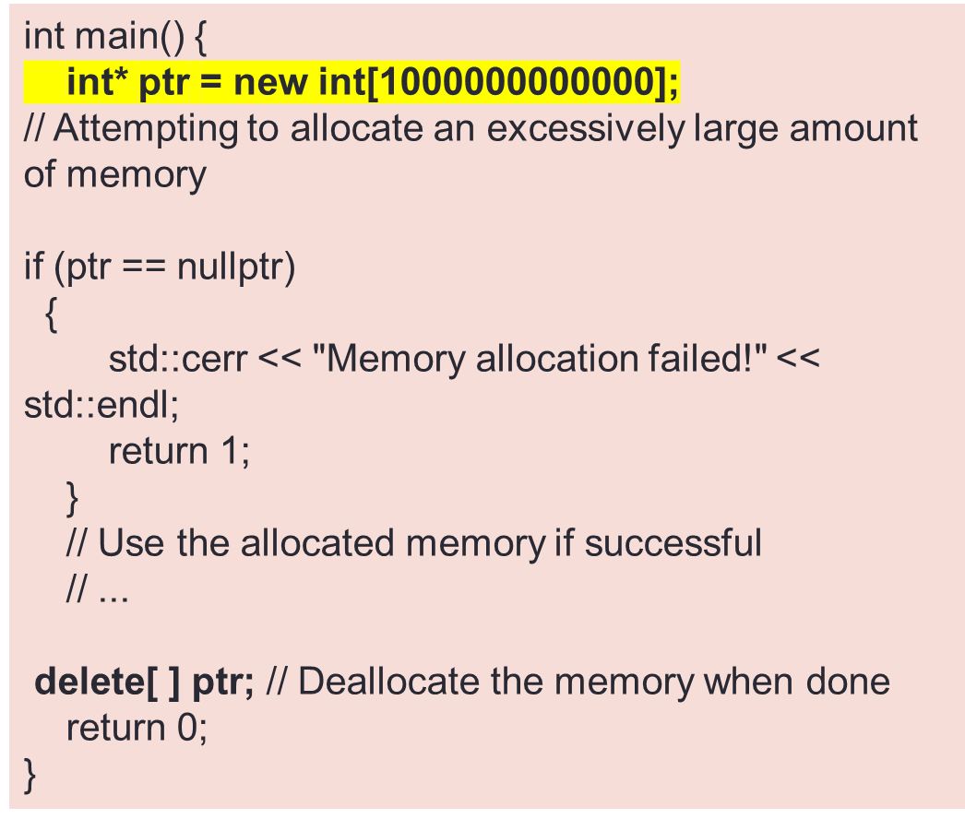
MEMORY LEAK AND ALLOCATION FAILURE

Slide 25
Scenario: You are developing software for a multimedia application that allows users to create playlists containing various media types, including audio and video files. Users can dynamically add and remove items from their playlists.
Question: Explain how you would use dynamic memory allocation to create and manage playlists efficiently.
What memory management techniques would you employ to ensure optimal resource usage and prevent memory leaks, especially when users frequently add and remove media items from their playlists?
Options:
1. Add media item to playlist
2. Remove media item from playlist
3. Display playlist
4. Exit
1
Enter title: Song A
Enter file type: MP3
Added to playlist.
Options:
1. Add media item to playlist
2. Remove media item from playlist
3. Display playlist
4. Exit
1
Enter title: Video 1
Enter file type: MP4
Added to playlist.

Slide 26
#include <iostream>
#include <string>
// Structure to represent a multimedia item
struct MultimediaItem {
std::string title;
std::string fileType;
MultimediaItem(const std::string& t, const std::string& ft) : title(t), fileType(ft) {}
};
void addToPlaylist(MultimediaItem** playlist, int& playlistSize, const MultimediaItem& item) {
// Create a new playlist with increased size
MultimediaItem** newPlaylist = new MultimediaItem*[playlistSize + 1];
// Copy existing items to the new playlist
for (int i = 0; i < playlistSize; ++i) {
newPlaylist[i] = playlist[i];
}
// Add the new item to the playlist
newPlaylist[playlistSize] = new MultimediaItem(item);
// Deallocate the old playlist memory
delete[] playlist;
// Update the playlist reference and size
playlist = newPlaylist;
++playlistSize;
}
// Function to remove a media item from the playlist
void removeFromPlaylist(MultimediaItem** playlist, int& playlistSize, int index) {
if (index >= 0 && index < playlistSize) {
// Deallocate the memory of the removed item
delete playlist[index];
// Shift the remaining items to fill the gap
for (int i = index; i < playlistSize - 1; ++i) {
playlist[i] = playlist[i + 1];
}
--playlistSize;
}
}
// Function to display the current playlist
void displayPlaylist(const MultimediaItem* const* playlist, int playlistSize) {
std::cout << "Current Playlist:" << std::endl;
for (int i = 0; i < playlistSize; ++i) {
std::cout << i + 1 << ". " << playlist[i]->title << " (" << playlist[i]->fileType << ")" << std::endl;
}
}
int main() {
MultimediaItem** playlist = nullptr;
int playlistSize = 0;
while (true) {
std::cout << "\nOptions:\n1. Add media item to playlist\n2. Remove media item from playlist\n3. Display playlist\n4. Exit\n";
int choice;
std::cin >> choice;
if (choice == 1) {
std::string title, fileType;
std::cout << "Enter title: ";
std::cin.ignore();
std::getline(std::cin, title);
std::cout << "Enter file type: ";
std::cin >> fileType;
MultimediaItem item(title, fileType);
addToPlaylist(playlist, playlistSize, item);
std::cout << "Added to playlist." << std::endl;
} else if (choice == 2) {
int index;
std::cout << "Enter the index to remove: ";
std::cin >> index;
removeFromPlaylist(playlist, playlistSize, index - 1);
std::cout << "Removed from playlist." << std::endl;
} else if (choice == 3) {
displayPlaylist(playlist, playlistSize);
} else if (choice == 4) {
// Deallocate memory and exit
for (int i = 0; i < playlistSize; ++i) {
delete playlist[i];
}
delete[] playlist;
break;
} else {
std::cout << "Invalid choice. Try again." << std::endl;
}
}
return 0;
}

Slide 27
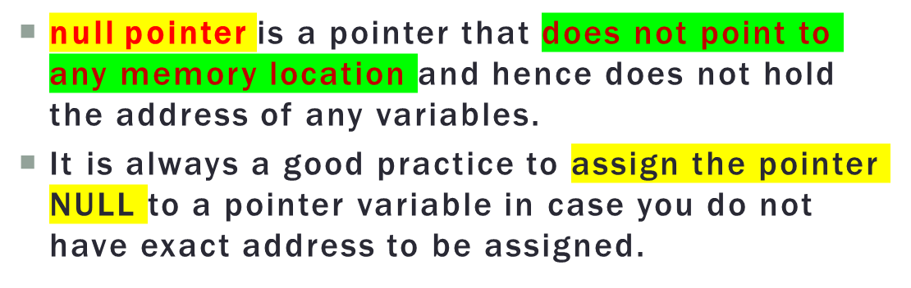
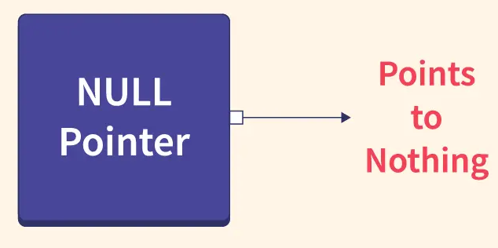
NULL POINTER
#include <iostream>
using namespace std;
int main () {
int *ptr = NULL;
cout << "The value of ptr is " << ptr ;
return 0;
}
int* ptr = nullptr; // C++11 and later
int* oldPtr = NULL; // C and older C++

Slide 28
PROBLEM STATEMENT:
Scenario: You are developing software for a personnel management system for a large organization. The system needs to store detailed information about each employee, including their name, age, department, and job title. Since the organization has a varying number of employees, you must efficiently allocate memory for each employee's information.
Question: In the context of the personnel management system, how would you design a C++ program to dynamically allocate memory for a structure representing employee information and input the details from the user? Provide a scenario where this program would be beneficial, and explain the importance of dynamic memory allocation in managing employee records efficiently
Enter the number of employees: 2
Employee #1 details:
Name: John Doe
Age: 30
Department: Sales
Job Title: Sales Manager
Employee #2 details:
Name: Jane Smith
Age: 25
Department: HR
Job Title: HR Specialist

Slide 29
#include <iostream>
#include <string>
struct Employee {
std::string name;
int age;
std::string department;
std::string jobTitle;
};
int main() {
int numEmployees;
// Input: Number of employees in the organization
std::cout << "Enter the number of employees: ";
std::cin >> numEmployees;
// Dynamic memory allocation for an array of Employee structures
Employee* employees = new Employee[numEmployees];
// Input: Initialize employee information
for (int i = 0; i < numEmployees; ++i) {
std::cin.ignore(); // Clear newline character
std::cout << "Employee #" << i + 1 << " details:" << std::endl;
std::cout << "Name: ";
std::getline(std::cin, employees[i].name);
std::cout << "Age: ";
std::cin >> employees[i].age;
std::cin.ignore(); // Clear newline character
std::cout << "Department: ";
std::getline(std::cin, employees[i].department);
std::cout << "Job Title: ";
std::getline(std::cin, employees[i].jobTitle);
}
// Output: Display employee information
std::cout << "\nEmployee Information:\n";
for (int i = 0; i < numEmployees; ++i) {
std::cout << "Employee #" << i + 1 << ":\n";
std::cout << "Name: " << employees[i].name << std::endl;
std::cout << "Age: " << employees[i].age << std::endl;
std::cout << "Department: " << employees[i].department << std::endl;
std::cout << "Job Title: " << employees[i].jobTitle << std::endl;
std::cout << std::endl;
}
// Deallocate memory
delete[] employees;
return 0;
}

Slide 30
PROBLEM STATEMENT:
You are developing an application for a robotics project that requires managing a stack of tasks.
Each task represents a specific action for the robot to perform, and these tasks are generated dynamically as the project progresses.
To efficiently manage the tasks, you need to implement a stack data structure with push and pop operations.
Question: In the context of the robotics project, how would you design a C++ program to dynamically allocate memory for a stack data structure? Explain how you would implement the push and pop operations on this stack. Provide a scenario where this program would be beneficial for managing the robot's tasks efficiently.
Input:
Push three tasks onto the stack with values 1, 2, and 3.
Output:
Executing task: 3
Executing task: 2
Executing task: 1
Stack is empty. No tasks to pop.

Slide 31
struct Task {
int type;
Task* next; // Pointer to the next task
};
class TaskQueue {
private:
Task* front; Task* rear;
public:
TaskQueue() {
front = rear = nullptr;
}
~TaskQueue() {
while (!isEmpty()) {
pop();
}
}
bool isEmpty() {
return front == nullptr;
}
void push(const Task& task) {
Task* newTask = new Task(task);
newTask->next = nullptr;
if (isEmpty()) {
front = rear = newTask;
} else {
rear->next = newTask;
rear = newTask;
}
}
Task pop() {
if (isEmpty()) {
// Handle queue underflow
Task emptyTask;
return emptyTask;
}
Task* temp = front;
front = front->next;
Task poppedTask = *temp;
delete temp;
if (front == nullptr) {
rear = nullptr;
}
return poppedTask;
}
};
int main() {
TaskQueue taskQueue; // Generate and add tasks to the queue
Task task1 = {1}; Task task2 = {2}; Task task3 = {3}; taskQueue.push(task1);
taskQueue.push(task2); taskQueue.push(task3);
while (!taskQueue.isEmpty()) {
Task currentTask = taskQueue.pop();
if (currentTask.isValid()) {
std::cout << "Executing task of type " << currentTask.type << std::endl;
// Simulate task execution (replace with actual robot code)
// robot.executeTask(currentTask);
} else {
std::cout << "No tasks left in the queue." << std::endl;
}
}
return 0;
}

