Slide 1
ECE 3430 Introduction to Embedded Computer Systems
Debugging with UART

Slide 2
Project Requirements
Control LEDs on the board by sending commands through a terminal.

Slide 3
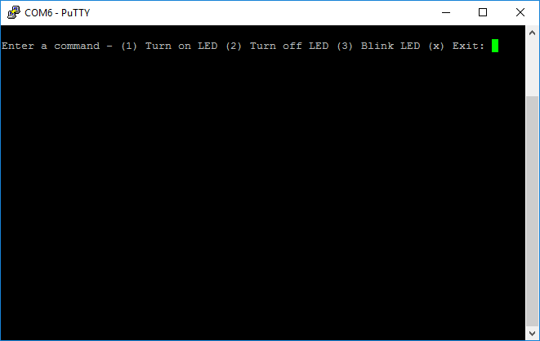
Project Objective: PuTTY Demonstration

Slide 4
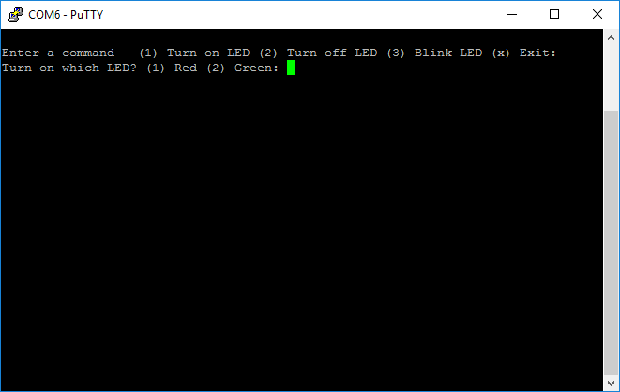
Project Objective: PuTTY Demonstration

Slide 5
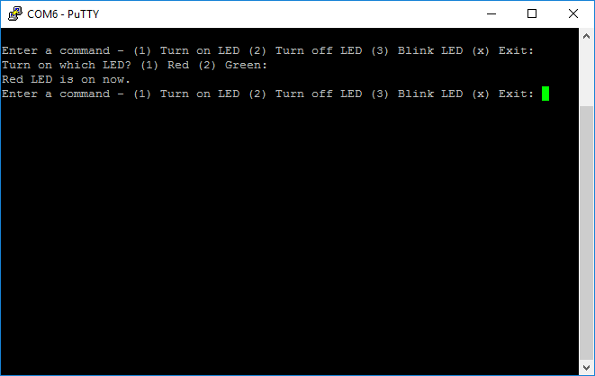
Project Objective: PuTTY Demonstration

Slide 6
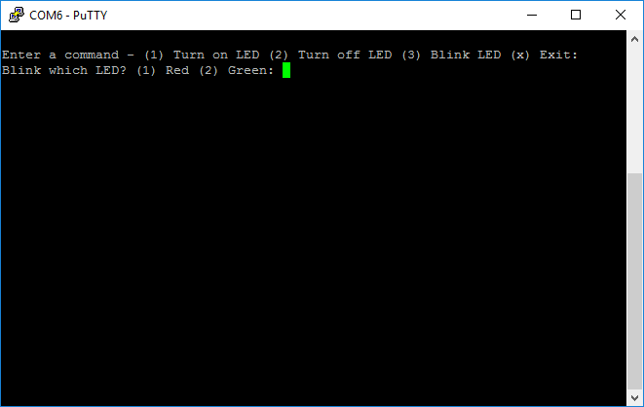
Project Objective: PuTTY Demonstration

Slide 7
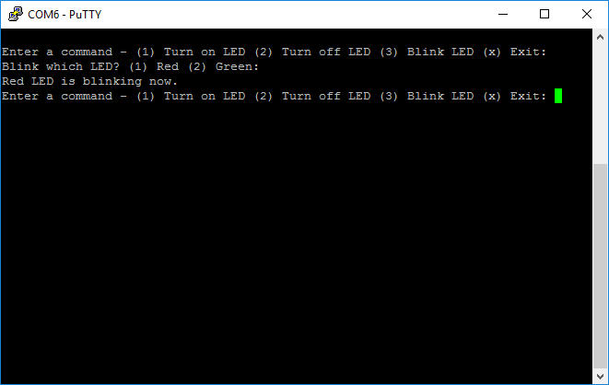
Project Objective: PuTTY Demonstration

Slide 8
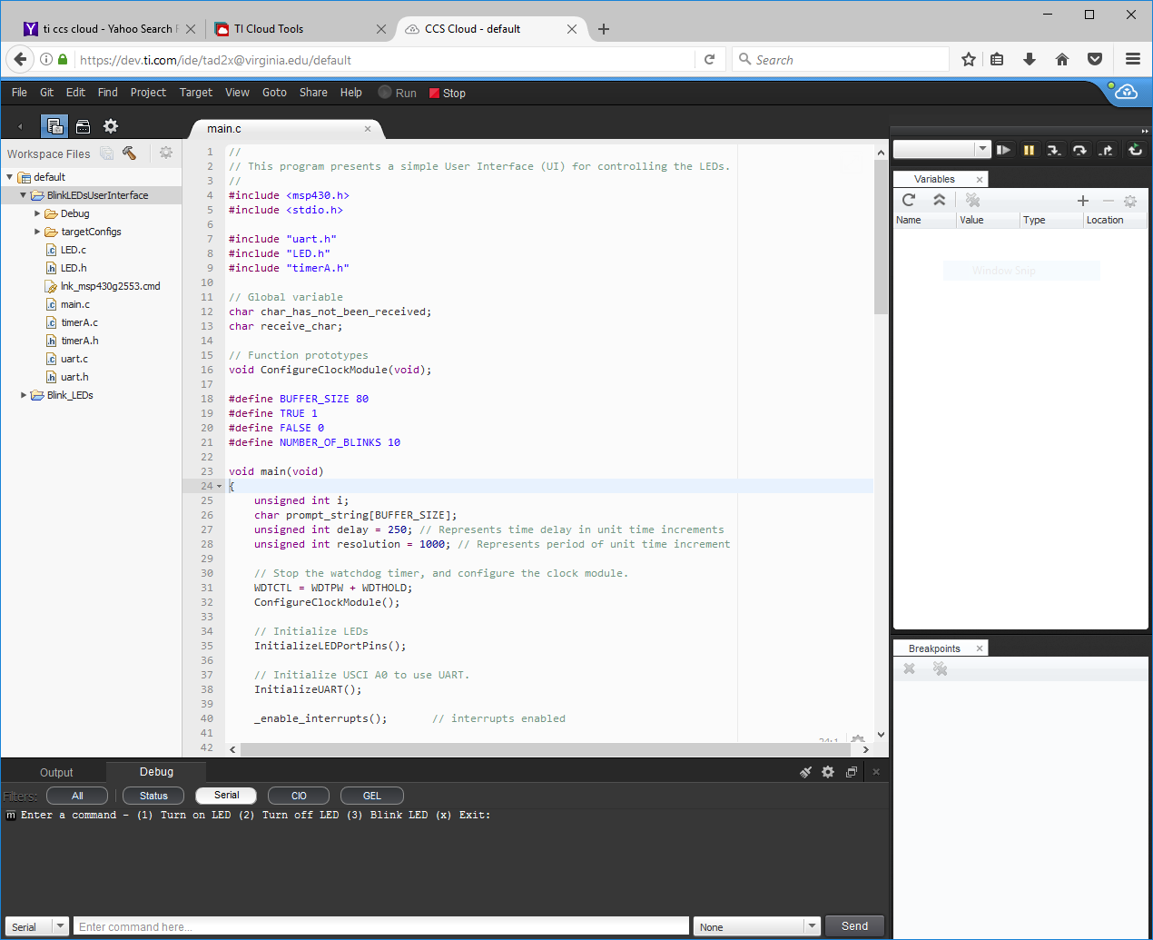
Project Objective: CCS Cloud Demonstration

Slide 9

Project Objective: CCS Cloud Demonstration

Slide 10

Project Objective: CCS Cloud Demonstration

Slide 11
Why Debug in UART?
Not the only way to debug
VirtualBench
Stepping through code
UART allows user to interface through terminal
Code is not paused, computations can still be performed in background
Programs can be divided into options, can run one at a time or several times without rebooting

Slide 12
Serial Communication
Sending bits, one by one, in series (hence, serially)
Several protocols, each with their own pros/cons
Serial Peripheral Interface (SPI)
Inter-Integrated Circuit (I²C)
Universal Asynchronous Receiver/Transmitter
Universal: Any purpose
Asynchronous: any time
Receiver/Transmitter: full duplex

Slide 13
UART via the USCI module
Universal Serial Communication Interface (boxed in red)
Block Diagram of MSP430 with all its major functions

Slide 14
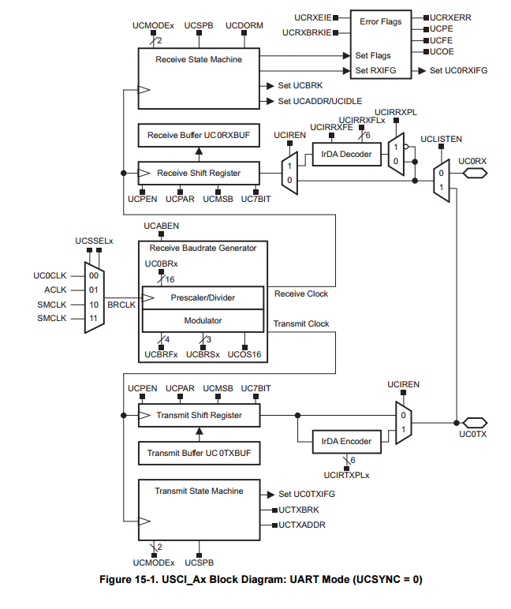
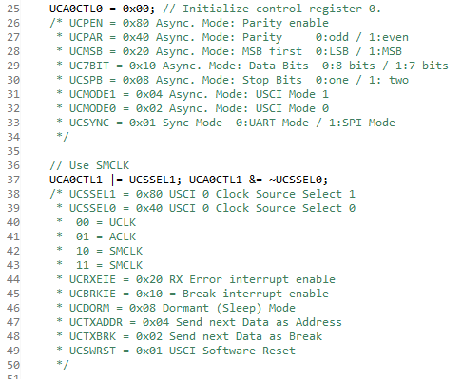
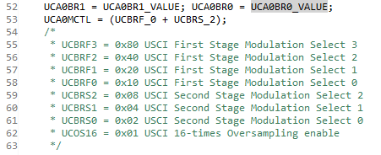
Schematic
Snippet from uart.c

Slide 15
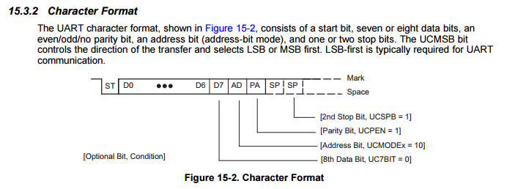
Sending Characters Serially
Page 413 in MSP430 User’s Guide
Different uses for different bits:
Start bit (pull data bus low to indicate “request to send”)
Data bits (8 in our case because 1 char = 8 bits = 1 byte)
Parity bits (not used for this project)
Address bit (not used for this project)
Stop bits (assigned by hardware)

Slide 16
Baud Rate
≠ bit rate
Bit rate: number of ones and zeros per second
Baud rate: number of signal changes per second
Think of it this way:
“Bit rate” relates to information
“Baud rate” relates to hardware
9600 is generally accepted
Read more here

Slide 17
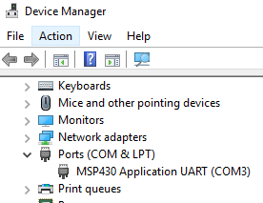
COM Ports
Short for “COMmunication port”
Legacy from IBM computers
Identifies devices plugged into computer
Windows:
Open Device Manager
Mac OS:
Use Terminal, see this post

Slide 18

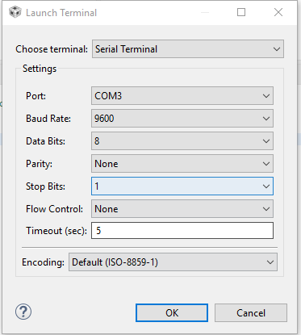
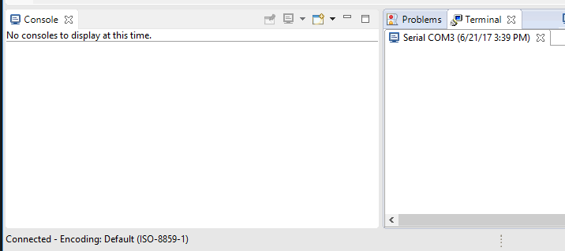
Opening a Serial Terminal: CCS
Window > Show View > Other > Terminal
Click “Open a Terminal”
Use these settings, then OK

Slide 19
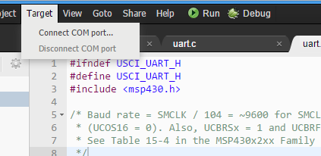
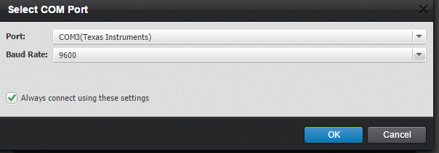
Opening a Serial Terminal: CCS Cloud
First, ensure MSP is selected as target
(use Device Manager in Windows to find COM port)

Slide 20
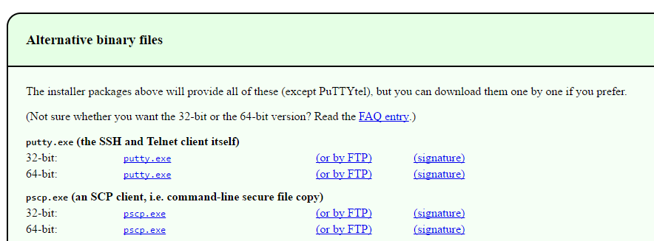
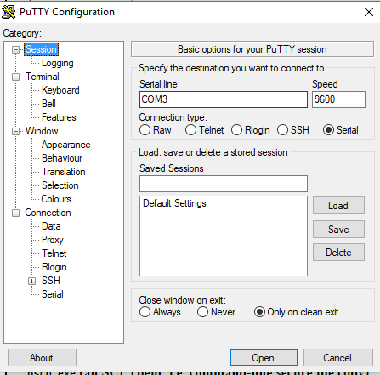
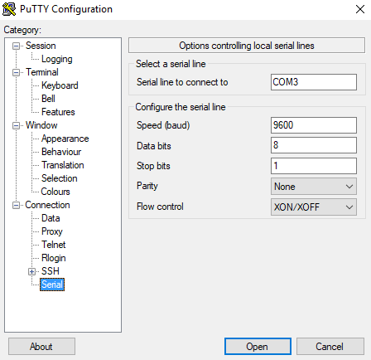
Opening a Serial Terminal: PuTTY
Download just the PuTTY executable here
Use these settings, then Open

Slide 21
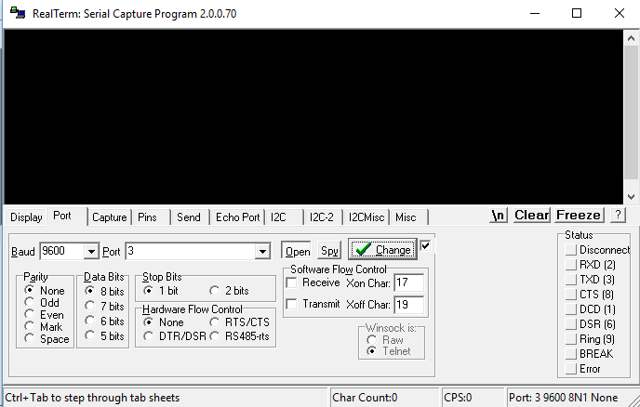
Opening a Serial Terminal: RealTerm
Install RealTerm here Run, use these settings, then Change
Note: Port should match COM port

