Slide 1
Exploratory Data Analysis
Summer Olympics 1896 - 2012

Slide 2

Summer Olympics Games

Slide 3
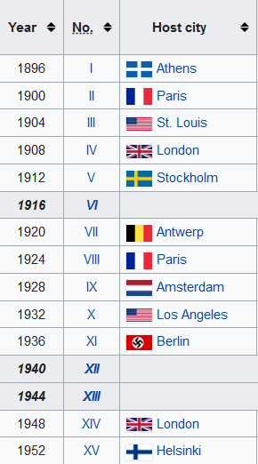

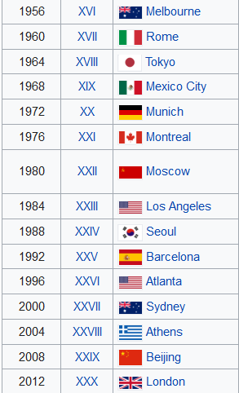
Cities Hosted Olympics from 1896 - 2012

Slide 4
References
I have referred the below sites to complete this report
INSAID Github Site to download the data
https://github.com/nkraja33/Term-1/tree/master/Data/Projects
Kaggle site to understand the data(Columns)
https://www.kaggle.com/heesoo37/120-years-of-olympic-history-athletes-and-results
w3school & stackoverflow site to get help with Python Coding
https://www.w3schools.com/python/
https://stackoverflow.com/questions/tagged/python
data-to-viz.com to select the correct chart
https://www.data-to-viz.com/

Slide 5
EDA Process
Problem Statement
Exploratory Data Analysis (EDA)
Conclusion

Slide 6
Problem Statement
The Summer Olympic Games or the Games of the Olympiad, first held in 1896, is a major international multi-sport event held once every four years.
We will find out which country won more medals, which sport has more medals, who were most awarded Athletes in this details analysis.
This Data set has data of summer Olympics held between 1896 to 2012. It has the details of year, hosted city, sport and it's discipline, Athlete, Country, Gender, Event and Medal.
From these data we will try to find the below details:
Overall Contribution of medals through out the games
Sport Counts by Year
Which are all the cities that were hosted Olympic Games more than once.
Medal counts by countries and plot the top 10 countries.
Countries list by each medal counts and plot top 5 of them
Medal counts by Gender
List of Athletes who has more medals and plot Top 5
List of Sport Disciplines which won more medals by Gender and plot Top 5

Slide 7
Exploratory Data Analysis (EDA)

Slide 8
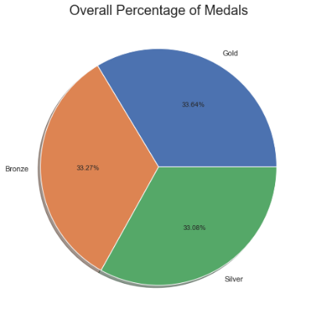
Exploratory Data Analysis (EDA)
Overall Contribution of medals through out the games
Medal | Count
Gold | 10484
Bronze | 10369
Silver | 10310

Slide 9
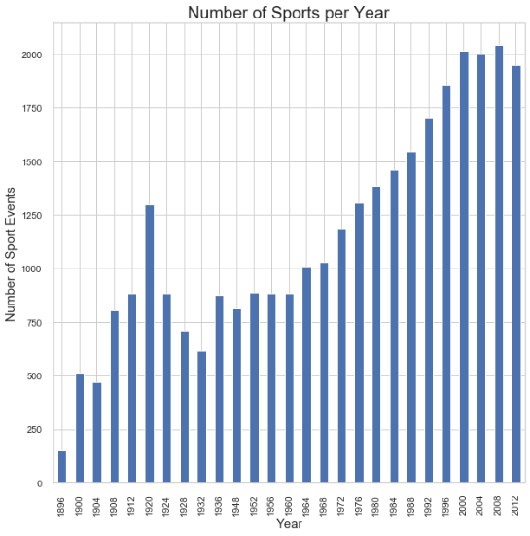
Exploratory Data Analysis (EDA) Cont’d…
Sport Counts by Year
Missing Years:
1916
Cancelled Due to World War I
1940 & 1944
Cancelled Due to World War II

Slide 10
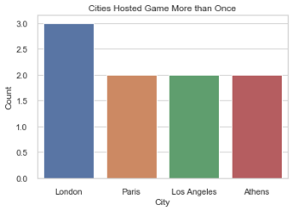
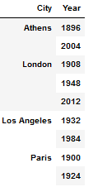
Exploratory Data Analysis (EDA) Cont’d…
Cities Hosted More than Once

Slide 11
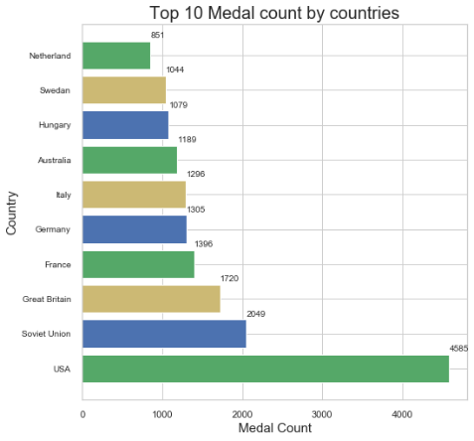
Exploratory Data Analysis (EDA) Cont’d…
Medal counts by countries
Country IOC | Count
USA | 4585
URS | 2049
GBR | 1720
FRA | 1396
GER | 1305
ITA | 1296
AUS | 1189
HUN | 1079
SWE | 1044
NED | 851

Slide 12
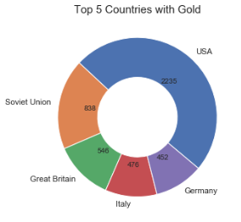
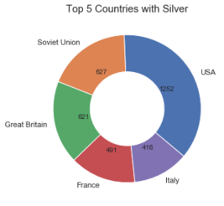
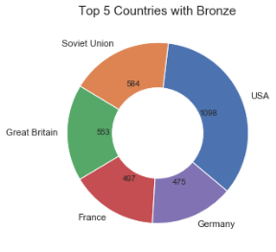
Exploratory Data Analysis (EDA) Cont’d…
Countries by each medal counts

Slide 13
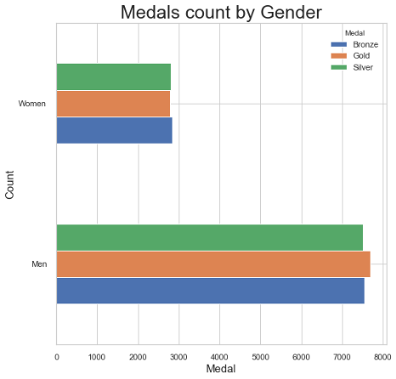
Exploratory Data Analysis (EDA) Cont’d…
Medal counts by Gender
Medal | Bronze | Gold | Silver
Men | 7539 | 7697 | 7509
Women | 2830 | 2787 | 2801

Slide 14
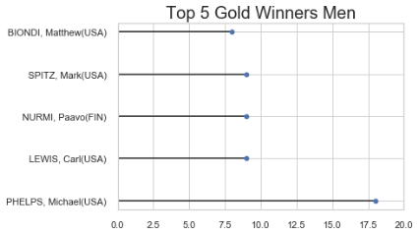
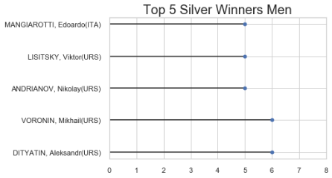
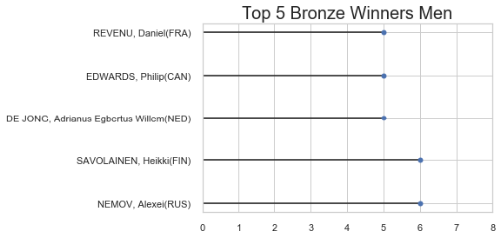
Exploratory Data Analysis (EDA) Cont’d…
Top 5 Athletes By Medal: (Men)

Slide 15
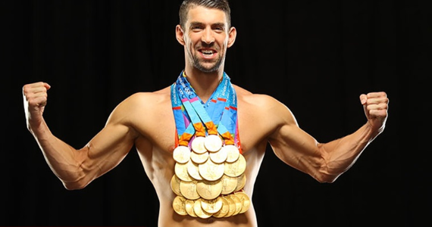
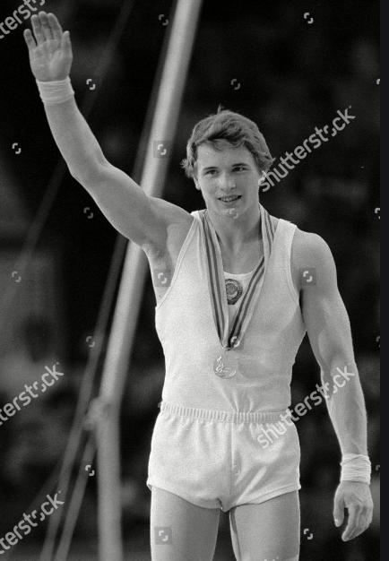

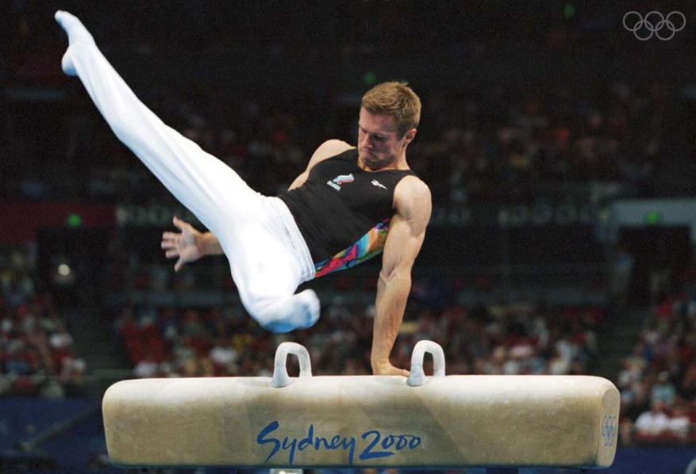
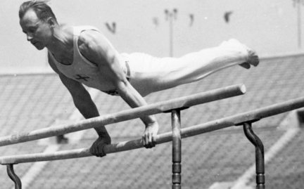
Exploratory Data Analysis (EDA) Cont’d…
Top 5 Athletes By Medal: (Men)
Gold: Silver: Bronze:
Michael PHELPS (USA)
Alexander Dityatin (URS)
VORONIN, Mikhail (URS)
Alexei Nemov (Rus)
SAVOLAINEN, Heikki (Fin)

Slide 16
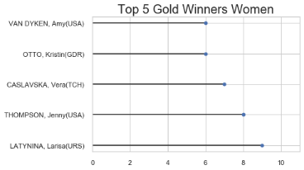
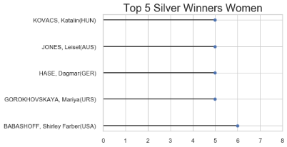
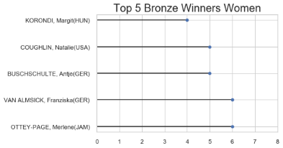
Exploratory Data Analysis (EDA) Cont’d…
Top 5 Athletes By Medal: (Women)

Slide 17
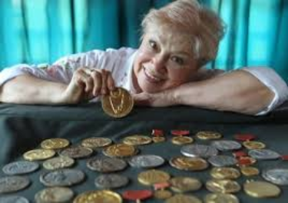

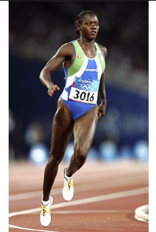
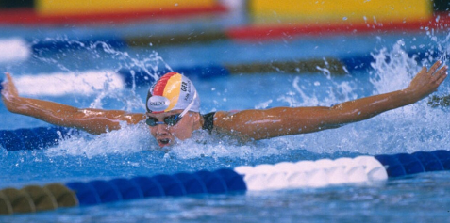
Exploratory Data Analysis (EDA) Cont’d…
Top 5 Athletes By Medal: (Women)
Gold: Silver: Bronze:
LATYNINA, Larisa (URS)
Shirley Farber BABASHOFF (USA)
Merlene Ottey (JAM)
Franziska VAN ALMSICK (GER)

Slide 18
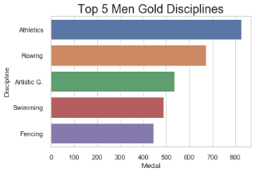
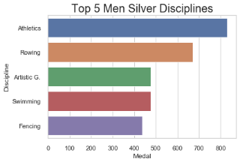
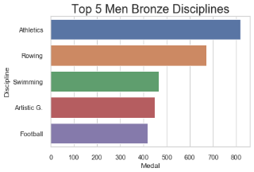
Exploratory Data Analysis (EDA) Cont’d…
Medals by Disciplines (Men):

Slide 19
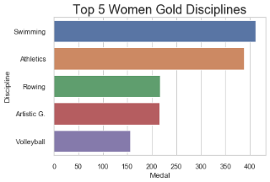
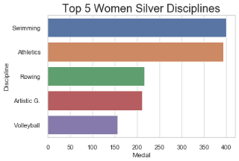
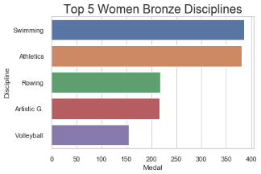
Exploratory Data Analysis (EDA) Cont’d…
Medals by Disciplines (Women):

Slide 20
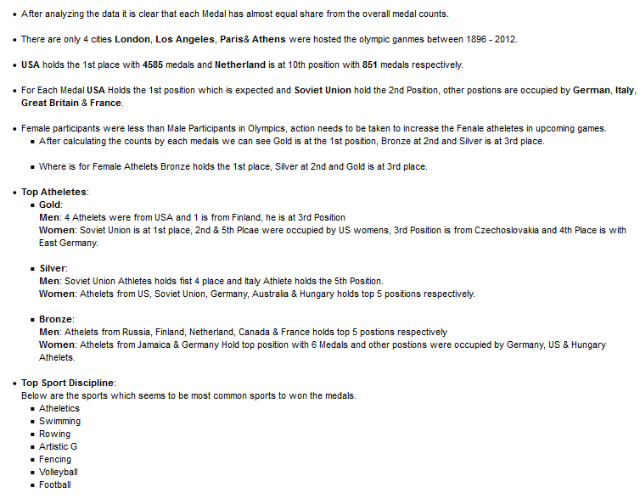
Conclusion

Slide 21
Thank You

