Slide 1
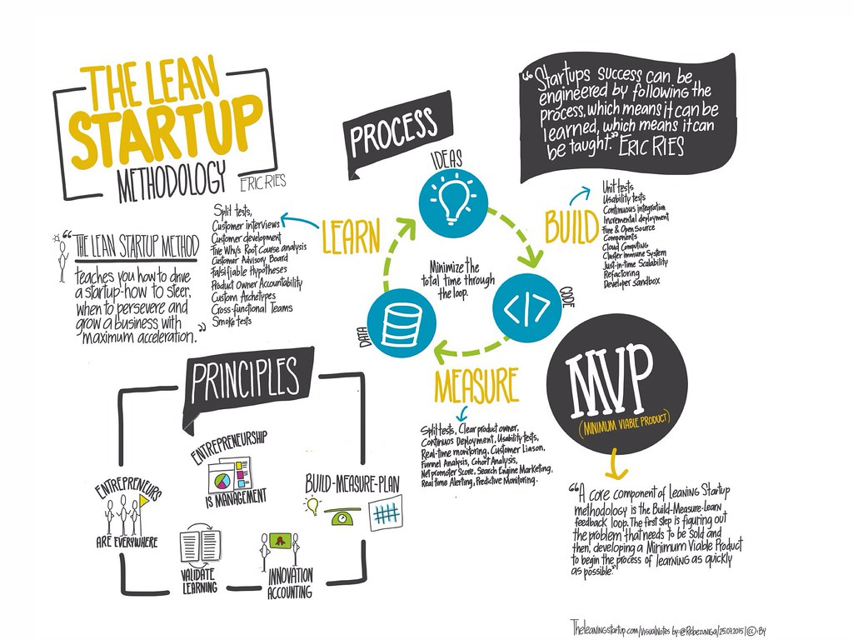
MVP
What’s in IT FOR YOU?

Slide 2
What DOES MVP in the AGILE WORLD STAND FOR?
Most Valuable Player
Most Vulnerable Person
Maximum Valet Parking
Minimum Viable Product

Slide 3

Some history to this..
A minimum viable product is that version of a new product which allows a team to collect the maximum amount of validated learning about customers with the least effort.
Back in 2011, Eric Ries who is an American entrepreneur, blogger, and author, released his bestselling book The Lean Startup about his experience in building startups.
This book not only impacted the whole startup industry, but also introduced concepts including MVP, A/B testing, Agile principles, and continuous software deployment.
3

Slide 4
What does MVP represent?
Minimum
Viable
Rudimentary and isolated functions that cannot be consumed
Well-thought of functions that can be consumed by early adopters
A stable and tangible product with the right features that users need and can consume

Slide 5
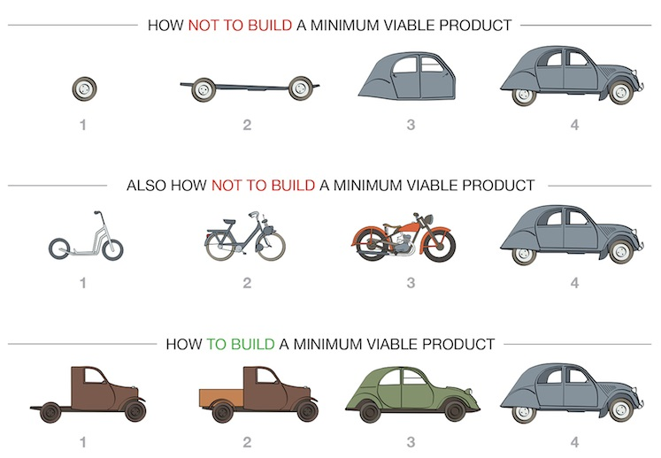
To put it all together..
Minimum Viable Product or MVP is a
Development technique in which a new product is introduced in the market with basic features, but enough to get the attention of the consumers.
The final product is released in the market only after getting feedback from the product's initial users.
MVPs can help you avoid failures and large capital losses.

Slide 6
Key attributes of MVP
Must Sell
MVP must work such that it sells
It must carry enough value to the users
Build Core Features
It’s not about the volume but the actual consumption
Has core features sufficient to implement an idea and retain early adopters
Iterative Process
Based on the lean startup philosophy
Iterative process of the building-> measuring-> learning loop until the product meets the market need completely
Avoids huge development efforts
Aims to avoid building unconsumable, unnecessary products
Gain insight about the market first

Slide 7
Process steps involved
Market study
Analysis of potential competitors
Key Features
Defining and prioritizing features
Uniqueness
How different is your solution from the rest
Minimum +Viable
Define the scope
Stakeholders
Review
Product vision
Identify the people involved
Get constant feedback

Slide 8
“We must learn what customers really want, not what they say they want or what we think they should want.”
ERIC RIES

Slide 9
Build. Measure. Learn
The key contributor is the iterative loop of improving the product continuously.
Once you have your first version, it is important to understand that users give you feedback.
With this review, you can start improving your product, by following the process iteratively; test, measure and learn the quality; test again, and the process goes on until it is finalized.
Measure
Learn
Build

Slide 10
Key benefits of mvp
Possibility to attract investors early
Reduction of potentially wasted engineering hours
Gaining and expanding the user base
Learning and Education
Checking real-life market tendencies
Avoidance of the bigger failures and fund expense

Slide 11
“As you consider building your own minimum viable product, let this simple rule suffice: remove any feature, process, or effort that does not contribute directly to the learning you seek.”
Eric Ries

Slide 12





What does this mean for technical writers?
Right use of terminology for your product
Tutorials or demos
Interactive guided tours using storyboarding
Convincing user stories
Videos of anticipated behavior

Slide 13
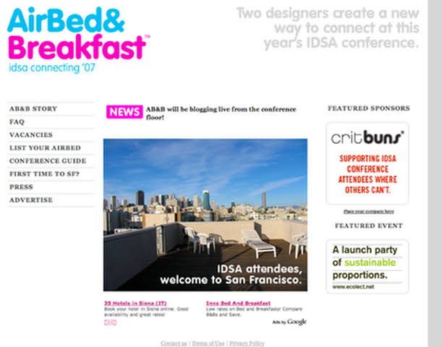
POPULAR MVP STORIES
Users: In the late 2007, two product designers, Brian Chesky and Joe Gebbia had recently moved to San Francisco
Problem: They needed help in paying their rent.
Situation: They had some extra space in their apartment’s living room — at least enough to fit a few air mattresses.
Idea: They thought maybe a few people would be willing to pay to stay with them.
Solution: They didn’t rent out space or build new beds. They leveraged their existing assets in order to test their assumption as quickly as possible.
Final MVP: STRANGERS, AIR BEDS, FREE WIFI, AND BREAKFAST

Slide 14









Some of the biggies that used the MVP process

Slide 15
SUMMARY
What is a Minimum Viable Product (MVP)?
1
Key attributes and benefits
2
Process steps to consider
3
What does this mean for technical communicators?
4
Some examples of companies that used this methodology
5

Slide 16
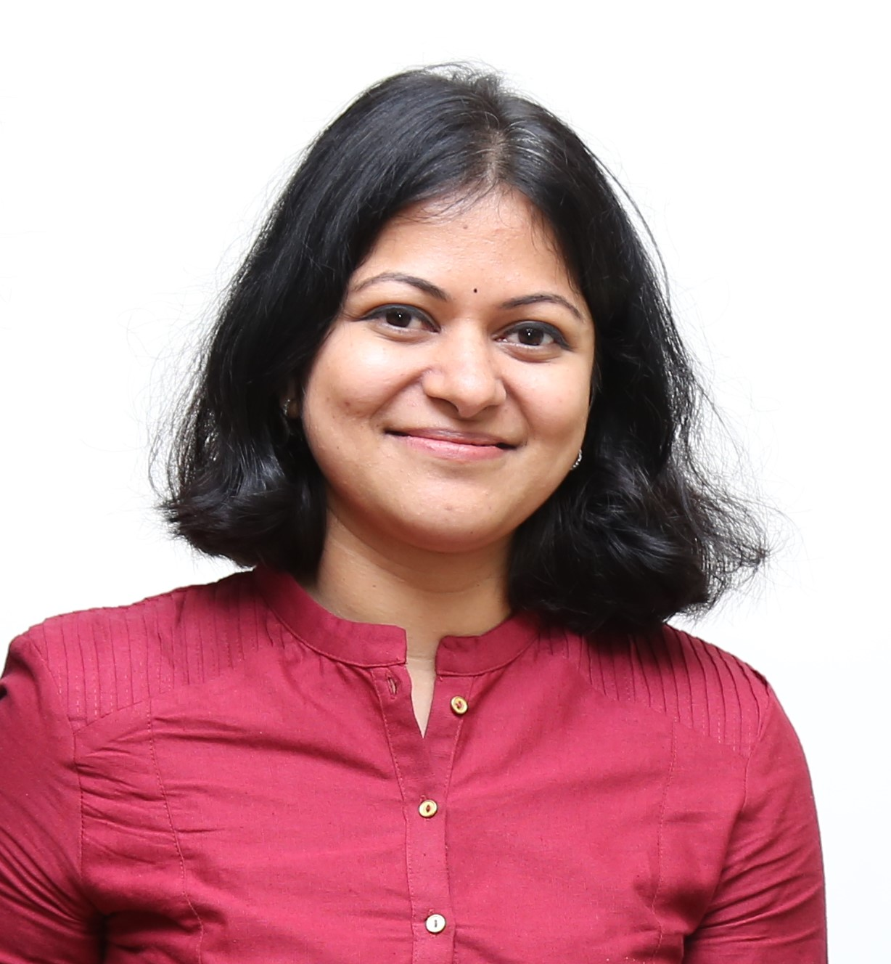
THANK YOU!
With 13 years of experience in technical communications, I enjoy creating a collaborative space for all roles within a team.
The best ideas come from sharing and learning. Let me know what you thought of the session, whether it helped you in any way, if you already knew about it or have a story to share.
Contact Information:
Nithya Krishnan
https://www.linkedin.com/in/nithyakrishnan/

