Slide 2
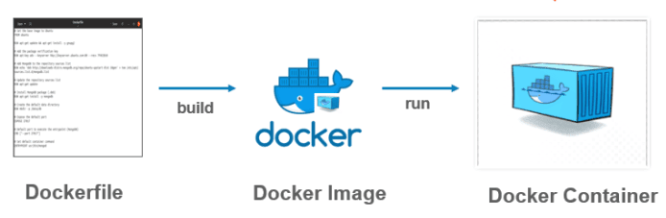
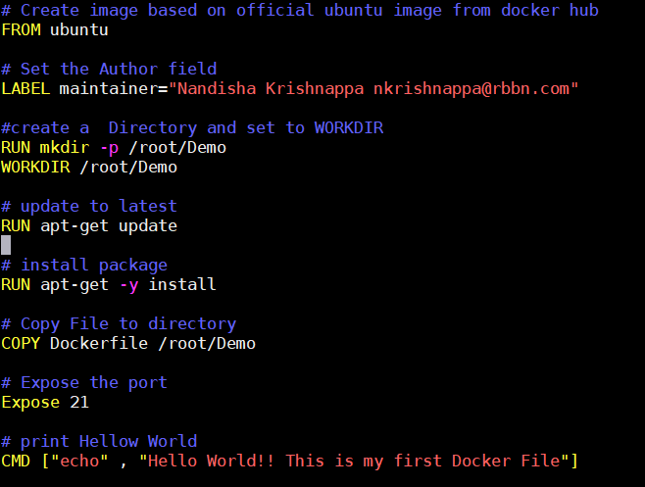

Dockerfile

Slide 3
Dockerfile

Slide 4
Each Dockerfile Command Creates a Layer
…
EXPOSE
COPY
WORKDIR
RUN
FROM
Kernel

