Slide 1
Docker Networking
Krishnappa, Nandisha

Slide 2

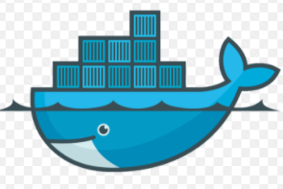
The evolving architecture of application networking
Services, application components are 1:1 with network addresses and architecture.
Often flat or simplistic networks defined by physical network ports or VLANs used to segregate the application from the network.
High availability is provided by clustering software or DNS/load balancer across multiple deployments/sites.

Slide 3
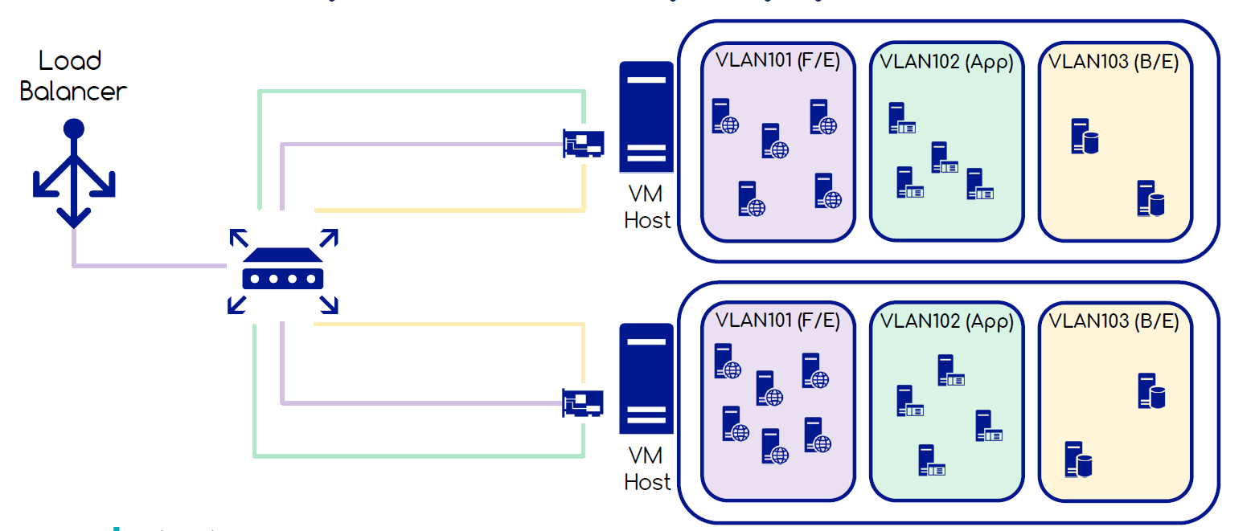
The evolving architecture of application networking
Virtual (Machine) applications
Services and Applications are broken down into smaller VM allocations resulting in an explosion of network resources
The tight-packing of numerous VMs per host has resulted in numerous networks being provisioned to every host.
Virtual LANs are used as the method for providing segregation between applications and application tiers.

Slide 4
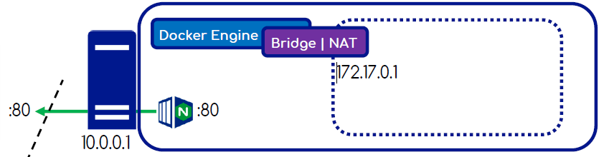
Docker Networking
host
The host flag will start the container in the same namespace as the host itself allowing a container to use the hosts networking stack directly.
that container’s network stack is not isolated from the Docker host (the container shares the host’s networking namespace
the container does not get its own IP-address allocated.
Provides near metal speed, however, can result in port conflicts.

Slide 5
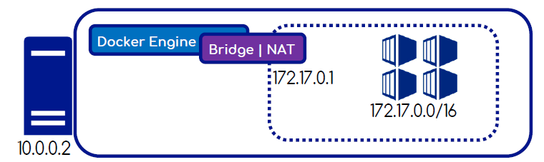
Docker Networking
bridge
Containers are started and connected by default to the internal bridge network.
These containers won't expose any network connectivity to the outside world by design, however, can speak to one another on the same host.
The Docker bridge driver automatically installs rules in the host machine so that containers on different bridge networks cannot communicate directly with each other.
User-defined bridge networks are superior to the default bridge network.

Slide 6
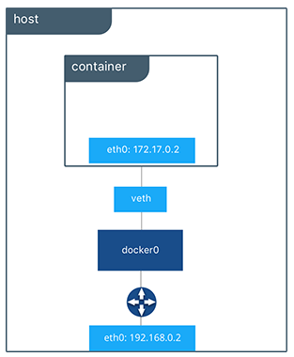
Docker Networking – Demo

Slide 7
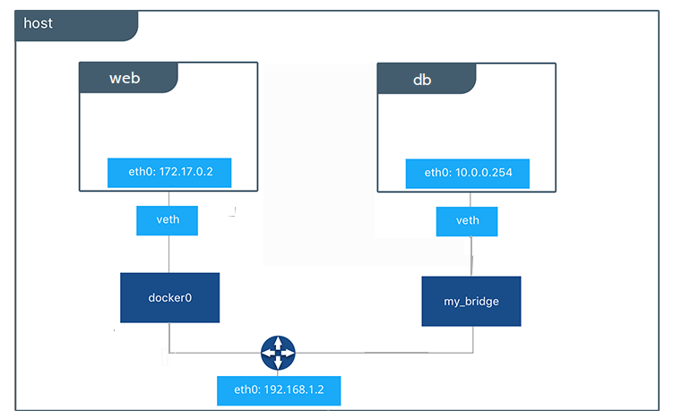
Docker Networking - Demo

Slide 8
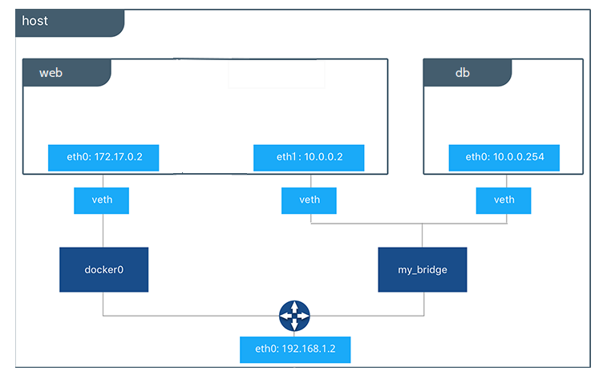
Docker Networking - Demo

