Slide 1
Docker Storage and Volumes
Krishnappa, Nandisha

Slide 2
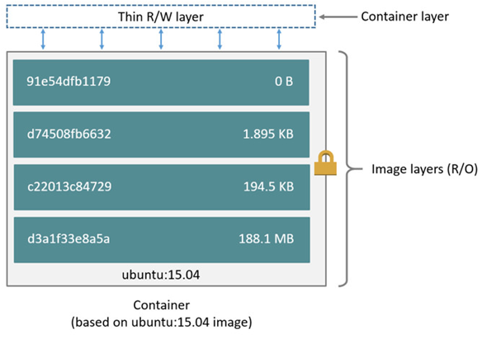
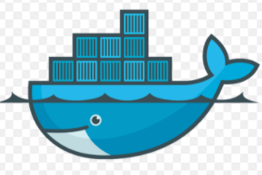
Image and Container

Slide 3
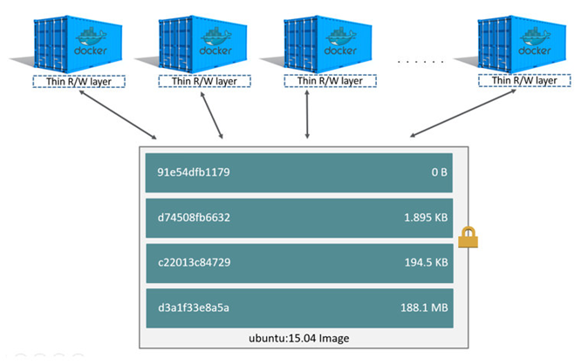
Multiple Containers using same image

Slide 4
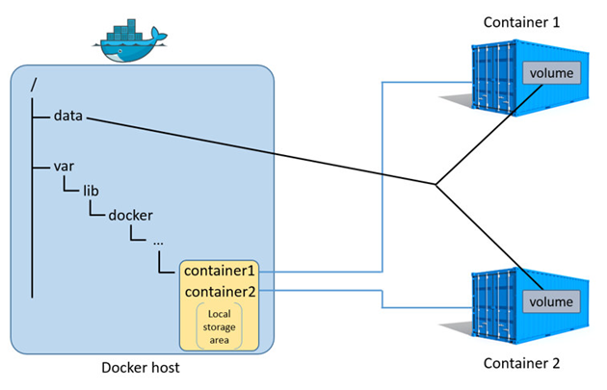
Sharing Storage Space

Slide 5
Why Volumes ?
By default, all files created inside a container are stored on a writable container layer.
The data doesn’t persist when that container is no longer running, and it can be difficult to get the data out of the container if another process needs it.
A container’s writable layer is tightly coupled to the host machine where the container is running. You can’t easily move the data somewhere else.
Writing into a container’s writable layer requires a storage driver to manage the filesystem.

Slide 6
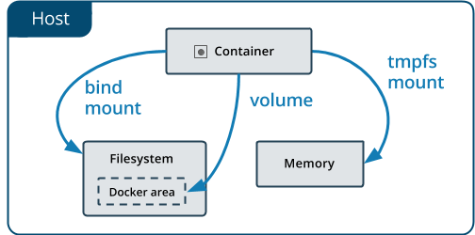
Choose the right type of mount

Slide 7
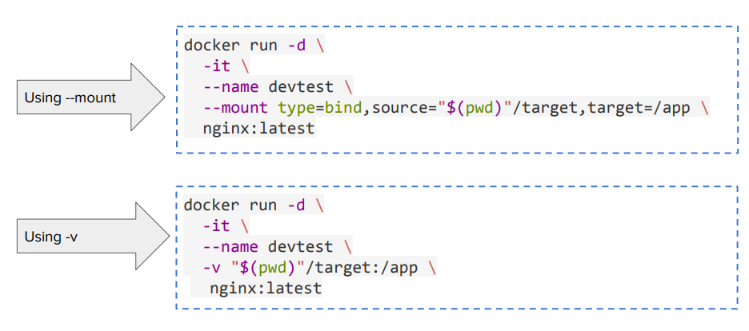
Bind Mount
Bind mounts stored anywhere on the host system.
They may even be important system files or directories.
Non-Docker processes on the Docker host or a Docker container can modify them at any time.

Slide 8
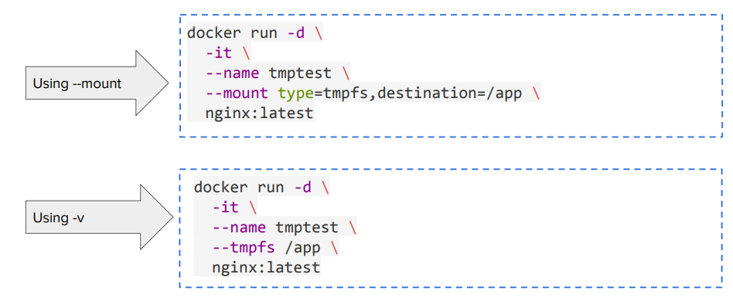
tmpfs
tmpfs mount is temporary and only persisted in the host memory.
When the container stops, the tmpfs mount is removed, and files written there won’t be persisted.
Limitations:
Unlike volumes and bind mounts, you can’t share tmpfs mounts between containers.
This functionality is only available if you’re running Docker on Linux.

Slide 9
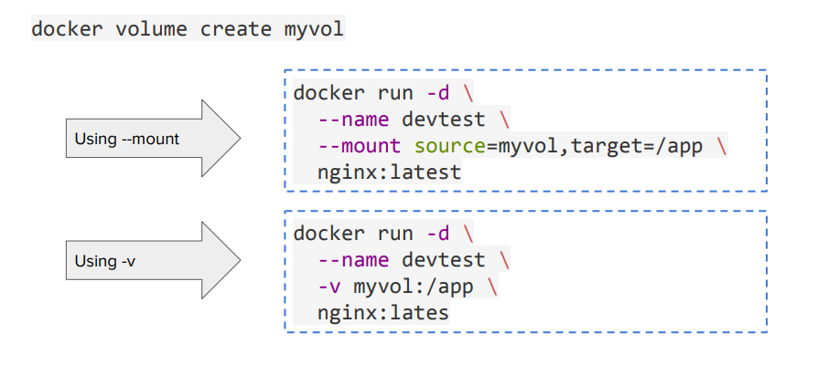
Volumes
Volumes are stored in a part of the host filesystem which is managed by Docker(/var/lib/docker/volumes/ on Linux).
Non-Docker processes should not modify this part of the filesystem.
Volumes are the best way to persist data in Docker.

