Slide 1



Chatbot Evaluation

Slide 2

Overview
This framework provides an automated and objective approach for evaluating RAG-based chatbots using LLM-as-a-Judge with RAGAS.
Instead of manual testing or predefined datasets, the system automatically generates test data, executes real chatbot interactions, and evaluates chatbot quality using standardized RAG evaluation metrics.
Key Objectives
Ensure chatbot answers are accurate, relevant, and grounded in documentation
Detect hallucinations and retrieval failures
Replace subjective manual validation with measurable metrics
Enable scalable testing across releases

Slide 3
Solution Architecture
Phase 1: Data Generation
Raw documents (PDFs, articles, chunks, knowledge base content) are ingested.
An LLM generates a Synthetic Dataset automatically:
Questions
Reference Context (ground truth)
Phase 2: Inference
Generated questions are sent to the Chatbot API
The chatbot responds blindly, without access to reference answers
Output includes:
Chatbot answer
Retrieved chunks / article links
Phase 3: Data Preparation
All evaluation inputs are structured into a unified dataset:
Question
Reference context (expected chunks)
Chatbot answer
Retrieved context (chunks used by chatbot)
Phase 4: RAGAS Evaluation
RAGAS evaluates chatbot performance using:
Context Precision→ Are retrieved chunks relevant?
Context Recall→ Is required information successfully retrieved?
Faithfulness→ Is the answer supported by retrieved context?
Answer Correctness→ Does the answer correctly address the question?

Slide 4
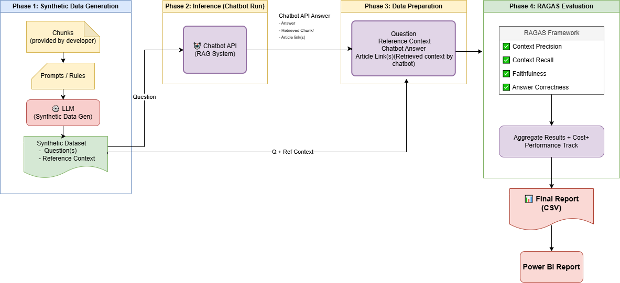

Slide 5
Cost Analysis
Category | Details
Model Used | GPT-4o-mini
Scenario | Processing 1 Standard Article
Article Size | ~1,000 words (~1,300 Tokens)
Operations | Generate 5 Q&A pairs + Evaluate
Token Breakdown | Input: ~3,500 tokens (Reading docs, Context, System Prompts) Output: ~700 tokens (JSON generation, Scores, Reasoning)
Pricing Model | Input: $0.15 per 1M tokens Output: $0.60 per 1M tokens
Cost Per Article | ~$0.001
Total Impact | Fully audit 1,000 documents for approximately $1.00 USD

Slide 6
Performance Tracker
Feature | Manual Human QA | Automated Pipeline
Speed per Query | ~15 Minutes (Read doc, verify answer) | ~3 Seconds
Volume | ~30 Queries | ~10,000+ Queries
Consistency | Low (Varies by person) | High (Algorithmic)
Data Points | Pass/Fail only | Detailed Semantic Scores
Feedback Loop | Days/Weeks | Instant (Power BI)

Slide 7
Thank You!

Slide 8
Metrics – DeepEval
DeepEval provides a comprehensive, unit-test style evaluation for LLM outputs. We utilize standard metrics plus custom security protocols.
Core Metrics:
FaithfulnessMetric:
  Measures if the answer is derived solely from the retrieved context. This is our primary defense against hallucinations.
AnswerRelevancyMetric:
  Analyzes whether the generated response actually answers the specific question asked, or if the model is rambling/evading.
ContextualPrecisionMetric:
  Evaluates the retrieval system: Does the most relevant information appear at the top of the context window? High scores here ensure the LLM isn't distracted by noise.
GEval (General Evaluation):
  A flexible framework that uses Chain-of-Thought (CoT) reasoning to grade complex criteria (like factual correctness) on a continuous scale (0–1).
Custom & Security Metrics (Extensible):
Beyond standard scoring, we can define custom logic:
  Security & PII: specific checks to ensure no sensitive data (emails, phone numbers) is leaked.
  Toxicity & Bias: Ensuring the model remains polite and neutral.
  Tone Consistency: Verifying the persona matches the brand voice (Professional vs. Casual).

