Slide 1
Summary of Chapters 1-8

Slide 2
3. Defining a Class
Class definition
  Tells compiler what member functions and data members belong to the class
  Keyword class followed by the class’s name
  Class body is enclosed in braces ({})
    Specifies data members and member functions
    Access-specifier public:
      Indicates that a member function or data member is accessible to other functions and member functions of other classes

Slide 3
3. Example of Class Definition
class GradeBook
{
public:
GradeBook( string );
void setCourseName( string );
string getCourseName();
void displayMessage();
void determineClassAverage();
private:
string courseName;
};

Slide 4
3. Defining a Class (Cont.)
Member function definition
  Return type of a function
    Indicates the type of value returned by the function when it completes its task
    void indicates it does not return any value
  Function name must be a valid identifier
  Parentheses after function name indicate that it is a function
  Function body contains statements that perform the function’s task
    Delimited by braces ({})

Slide 5
3. Defining a Class (Cont.)
Using a class
  A class is a user-defined type (or programmer-defined type)
    Can be used to create objects
      Variables of the class type
    C++ is an extensible language
  Dot operator (.)
    Used to access an object’s data members and member functions
    Example
      myGradeBook.displayMessage()
        Call member function displayMessage of GradeBook object myGradeBook

Slide 6
3. Defining a Member Function with a Parameter (Cont.)
Parameter Lists
  Additional information needed by a function
  Located in parentheses following the function name
  A function may have any number of parameters
    Parameters are separated by commas
  The number, order and types of arguments in a function call must match the number, order and types of parameters in the called function’s parameter list

Slide 7
3. Data Members, set Functions and get Functions
Local variables
  Variables declared in a function definition’s body
    Cannot be used outside of that function body
  When a function terminates
    The values of its local variables are lost
Attributes
  Exist throughout the life of the object
  Represented as data members
    Variables in a class definition
  Each object of class maintains its own copy of attributes

Slide 8
3. Data Members, set Functions and get Functions (Cont.)
Access-specifier private
  Makes a data member or member function accessible only to member functions of the class
  private is the default access for class members
  Data hiding
Returning a value from a function
  A function that specifies a return type other than void
    Must return a value to its calling function

Slide 9
3. Initializing Objects with Constructors
Constructors
  Functions used to initialize an object’s data when it is created
    Call made implicitly when object is created
    Must be defined with the same name as the class
    Cannot return values
      Not even void
  Default constructor has no parameters
    The compiler will provide one when a class does not explicitly include a constructor
      Compiler’s default constructor only calls constructors of data members that are objects of classes

Slide 10
3. Placing a Class in a Separate File for Reusability
.cpp file is known as a source-code file
Header files
  Separate files in which class definitions are placed
    Allow compiler to recognize the classes when used elsewhere
  Generally have .h filename extensions
Driver files
  Program used to test software (such as classes)
  Contains a main function so it can be executed

Slide 11
3. Placing a Class in a Separate File for Reusability (Cont.)
#include preprocessor directive
  Used to include header files
    Instructs C++ preprocessor to replace directive with a copy of the contents of the specified file
  Quotes indicate user-defined header files
    Preprocessor first looks in current directory
      If the file is not found, looks in C++ Standard Library directory
  Angle brackets indicate C++ Standard Library
    Preprocessor looks only in C++ Standard Library directory

Slide 12
3. Placing a Class in a Separate File for Reusability (Cont.)
Creating objects
  Compiler must know size of object
    C++ objects typically contain only data members
    Compiler creates one copy of class’s member functions
      This copy is shared among all the class’s objects

Slide 13
3. Separating Interface from Implementation
Interface
  Describes what services a class’s clients can use and how to request those services
    But does not reveal how the class performs them
    A class definition that lists only member function names, return types and parameter types
      Function prototypes
  A class’s interface consists of the class’s public member functions (services)
Separating interface from implementation
  Client code should not break if the implementation changes, as long as the interface stays the same

Slide 14
3. Separating Interface from Implementation (Cont.)
Separating interface from implementation (Cont.)
  Define member functions outside the class definition, in a separate source-code file
    In source-code file for a class
      Use binary scope resolution operator (::) to “tie” each member function to the class definition
    Implementation details are hidden
      Client code does not need to know the implementation
  In the header file for a class
    Function prototypes describe the class’s public interface

Slide 15
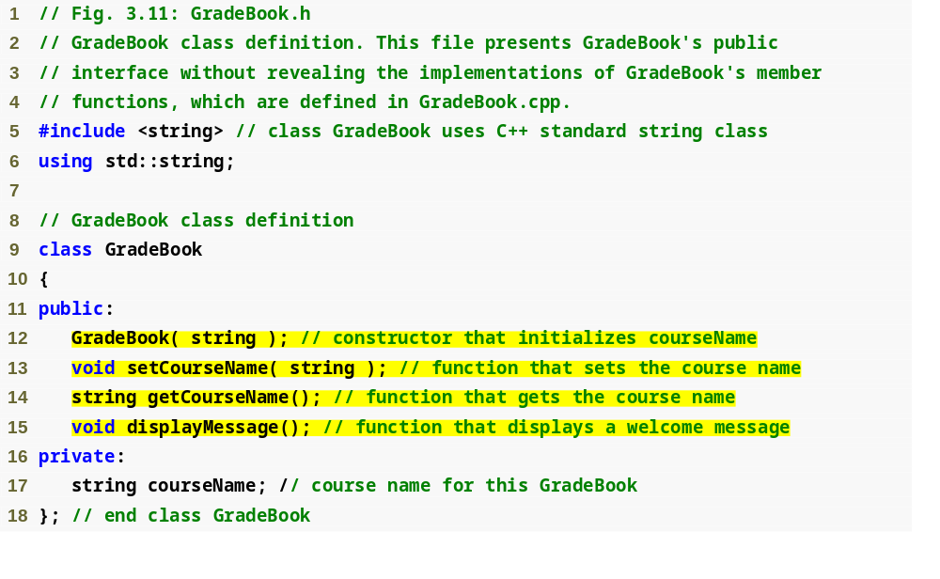
Outline
fig03_11.cpp
(1 of 1)
Interface contains data members and member function prototypes

Slide 16
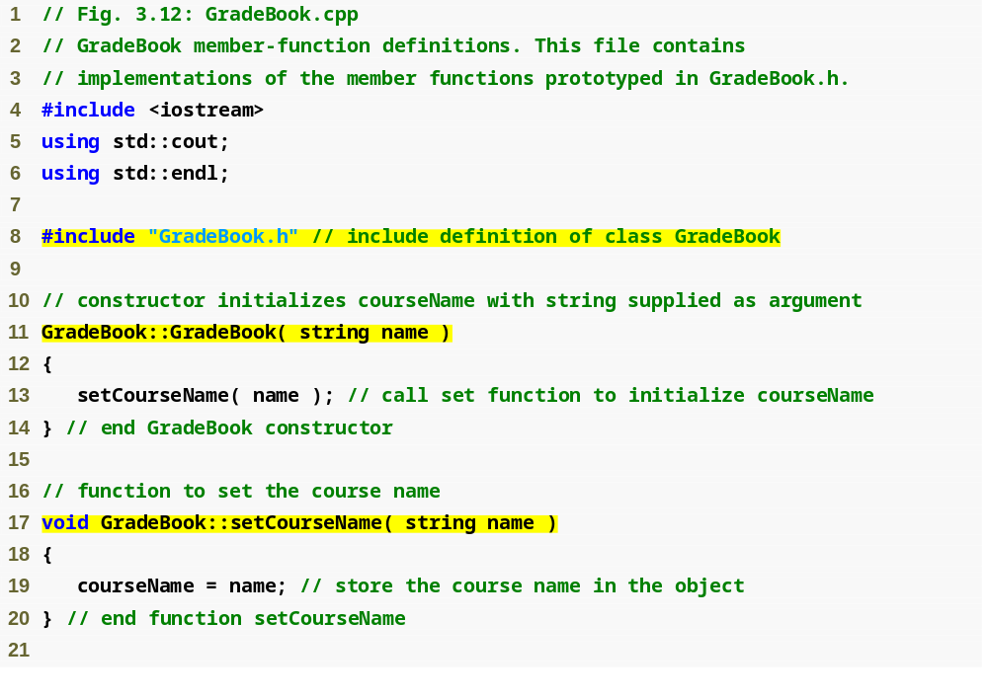
Outline
GradeBook implementation is placed in a separate source-code file
fig03_12.cpp
(1 of 2)
Include the header file to access the class name GradeBook
Binary scope resolution operator “ties” a function to its class

Slide 17
4-5. Control Statements
Sequence structure
  “built-in” to C++
Selection structure
  if, if…else and switch
Repetition structure
  while, do…while and for

Slide 18
6. Functions
  Called methods or procedures in other languages
  Allow programmers to modularize a program by separating its tasks into self-contained units
    Statements in function bodies are written only once
        Reused from several locations in a program
        Hidden from other functions
        Avoid repeating code
    Enable the divide-and-conquer approach
    Reusable in other programs
    User-defined or programmer-defined functions

Slide 19
6. Functions (cont.)
A function is invoked by a function call
    Called function either returns a result or simply returns to the caller
    Function calls form hierarchical relationships

Slide 20
7. Arrays
Consecutive group of memory locations
  All of which have the same type
Index
  Position number used to refer to a specific location/element
  Also called subscript
  Placed in square brackets
  Must be nonnegative integer or integer expression
  First element has index zero
  Example (assume a = 5 and b = 6)
  c[ a + b ] += 2;
    Adds 2 to array element c[ 11 ]

Slide 21
8. Pointers
Pointer variables: Contain memory addresses as values
Example of pointer declarations:
    int *myPtr;
address operator (&)
indirection operator or dereferencing operator (*)
* and & are inverses of each other
int y = 5;
int *yPtr;
yPtr = &y;
  *yPtr = 9;

Slide 22
8. Passing arguments to functions by reference with pointers
Pass-by-reference with pointer arguments
  Simulates pass-by-reference
    Use pointers and indirection operator
  Pass address of argument using & operator
  Arrays not passed with & because array name is already a pointer
  * operator used as alias/nickname for variable inside of function

Slide 23
8. Using const with Pointers
Four ways to pass pointer to function
  1. Nonconstant pointer to nonconstant data
    int * ptr;
  2. Nonconstant pointer to constant data
    const int * ptr;
  3. Constant pointer to nonconstant data
    int * const ptr = &x;
  4. Constant pointer to constant data
    const int *const ptr = &x;

