Slide 1

C++ How to Program, 9/e

Slide 2

In this chapter you’ll learn:
Use class templates to create a group of related types.
Distinguish between class templates and class-template specializations.
Learn about nontype template parameters
Learn about default template arguments
Learn about overloading function templates.

Slide 3

Function templates (chap. 6) and class templates
  Enable programmers to specify an entire range of related functions and related classes
    Called function-template specializations and class-template specializations, respectively
  Generic programming
  Analogy: templates are like stencils, template specializations are like separate tracings
    All tracings have the same shape, but they could have different colors and textures

Slide 4

It’s possible to understand the concept of a stack independent of the type of the items being placed in the stack.
However, to instantiate a stack a data type must be specified.
Nice opportunity for software reusability.
Here, we define a stack generically then use type-specific versions of this generic stack class.

Slide 5

Class templates (called parameterized types)
require one or more type parameters to specify how to customize a generic class template to form a class-template specialization.
When a particular specialization is needed, you use a concise, simple notation, and the compiler writes the specialization source code.

Slide 6
Creating Class Template Stack< T >
Class-template definitions are preceded by a header
    template< typename T >
    // or, template< class T >
  Type parameter T can be used as a data type in member functions and data members
Multiple type parameters can be specified using a comma-separated list
    template< typename T1, typename T2 >
The names of type parameters must be unique inside a template definition.

Slide 7
Any valid identifier can be used as a type parameter name.
The type parameter becomes associated with a specific type when you create an object using the class template—at that point, the compiler generates a copy of the class template in which all occurrences of the type parameter are replaced with the specified type.
Another key difference is that we did not separate the class template’s interface from its implementation.

Slide 8
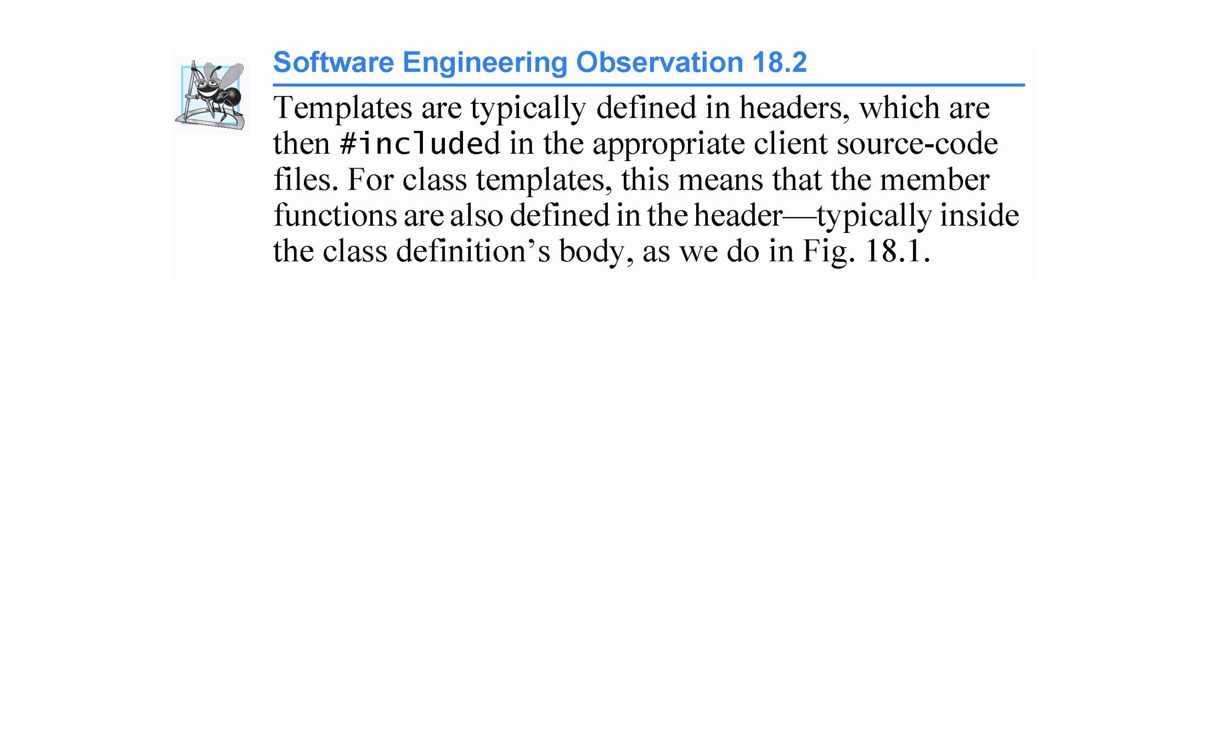

Slide 9
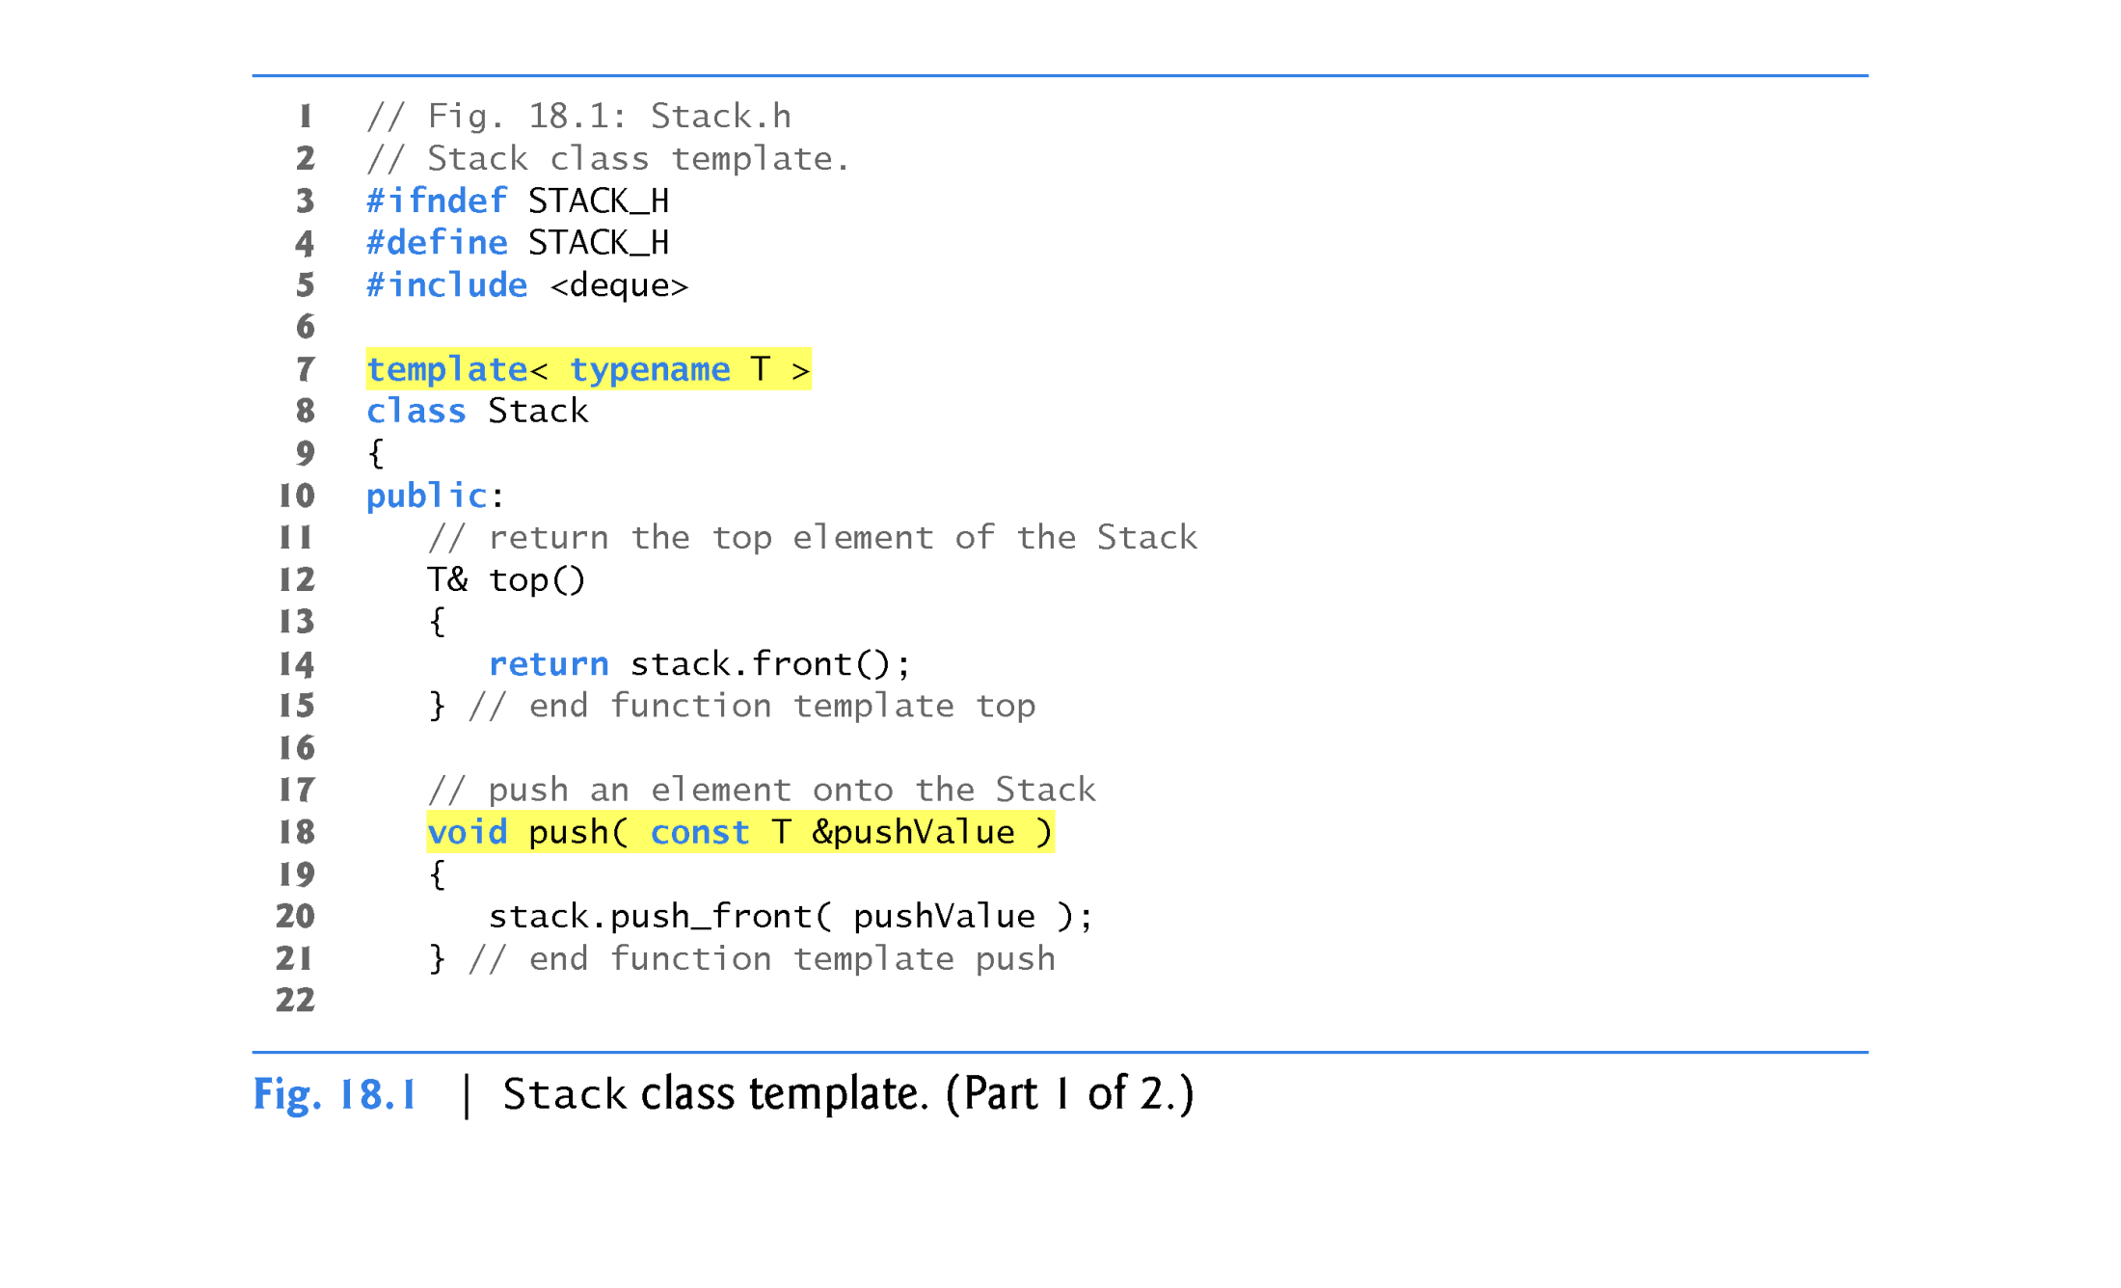

Slide 10
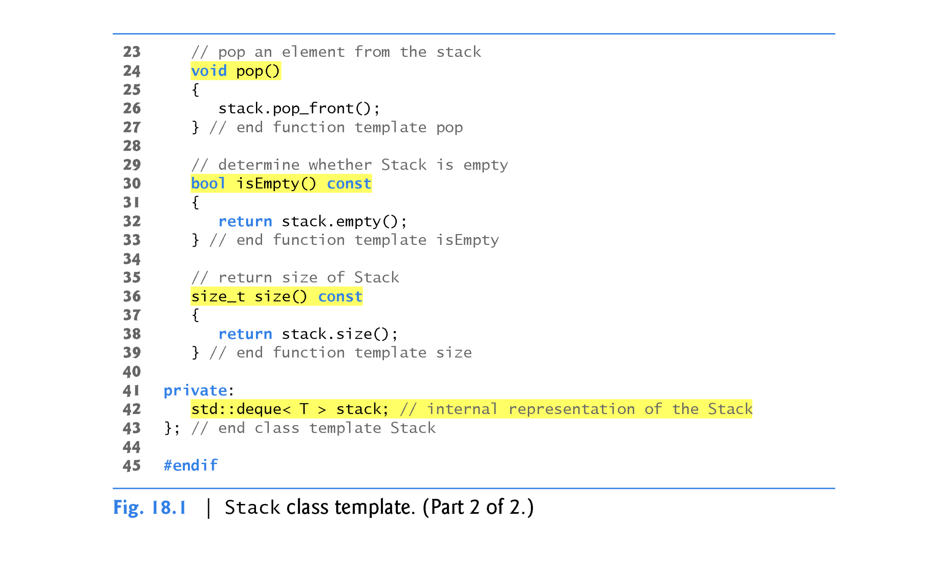

Slide 11
Class Template Stack<T>’s Data Representation
A stack requires insertions and deletions only at its top.
So, a vector or a deque could be used to store the stack’s elements.
A vector supports fast insertions and deletions at its back.
A deque supports fast insertions and deletions at its front and its back.
A deque is the default representation for the Standard Library’s stack adapter because a deque grows more efficiently than a vector.

Slide 12
vector
Maintained as a contiguous block of memory
When a new element is added to a full block, the vector allocates a larger contiguous memory block and copies the old elements into the new block.
deque
Typically implemented as list of fixed-size, built-in arrays
New fixed-size built-in arrays are added as necessary and none of the existing elements are copied when new items are added to the front or back.
For these reasons, we use a deque (line 42) as the underlying container for our Stack class.

Slide 13
Class Template Stack<T>’s Member Functions
The member-function definitions of a class template are function templates, but are not preceded with the template keyword and template parameters in angle brackets (< and >) when they’re defined within the class template’s body.
As you can see, however, they do use the class template’s template parameter T to represent the element type.
Our Stack class template does not define it’s own constructors—the default constructor provided by the compiler will invoke the deque’s default constructor.

Slide 14
member functions in Fig. 18.1:
  top (lines 12–15) returns a reference to the Stack’s top element.
  push (lines 18–21) places a new element on the top of the Stack.
  pop (lines 24–27) removes the Stack’s top element.
  isEmpty (lines 30–33) returns a bool value—true if the Stack is empty and false otherwise.
  size (lines 36–39) returns the number if elements in the Stack.
Each of these member functions delegates its responsibility to the appropriate member function of class template deque.

Slide 15
Member-function definitions can appear outside a class template definition.
In this case, each must begin with the template keyword followed by the same set of template parameters as the class template.
In addition, the member functions must be qualified with the class name and scope resolution operator.
    template< typename T >
    inline void Stack<T>::pop()
    {
    stack.pop_front();
    } // end function template pop

Slide 16
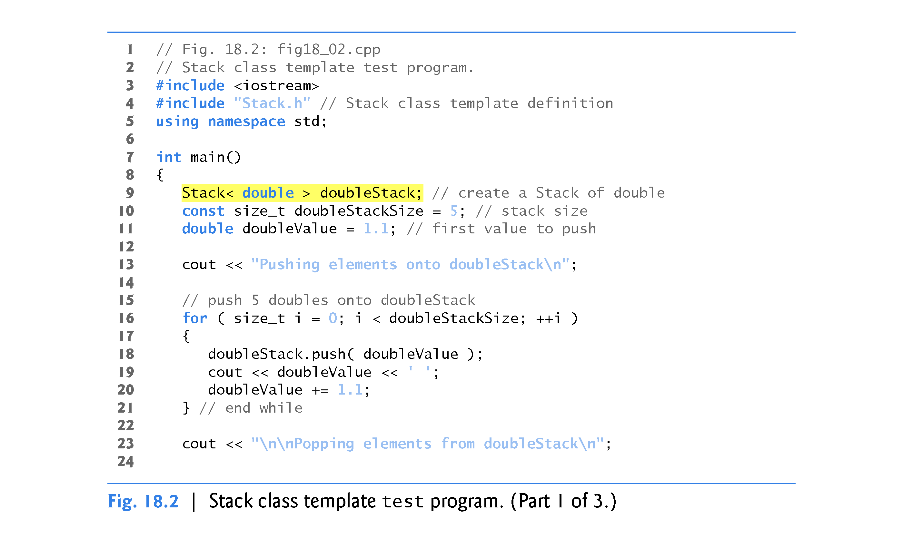

Slide 17
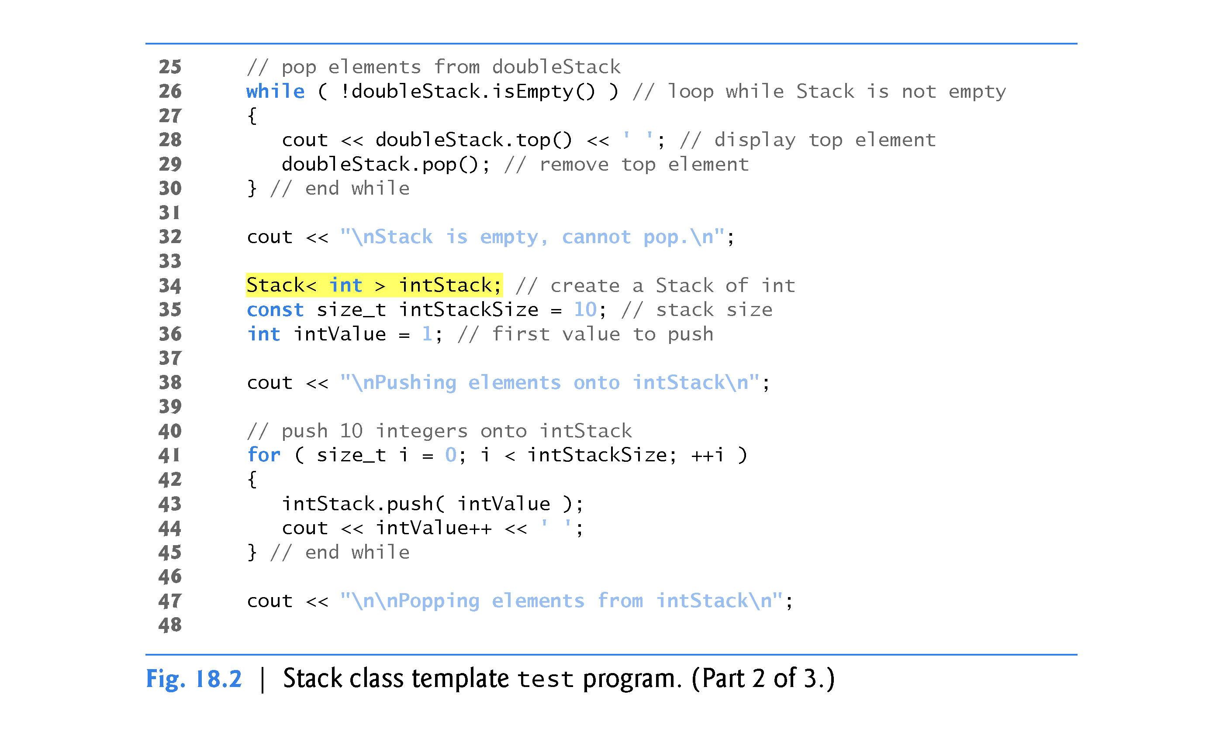

Slide 18
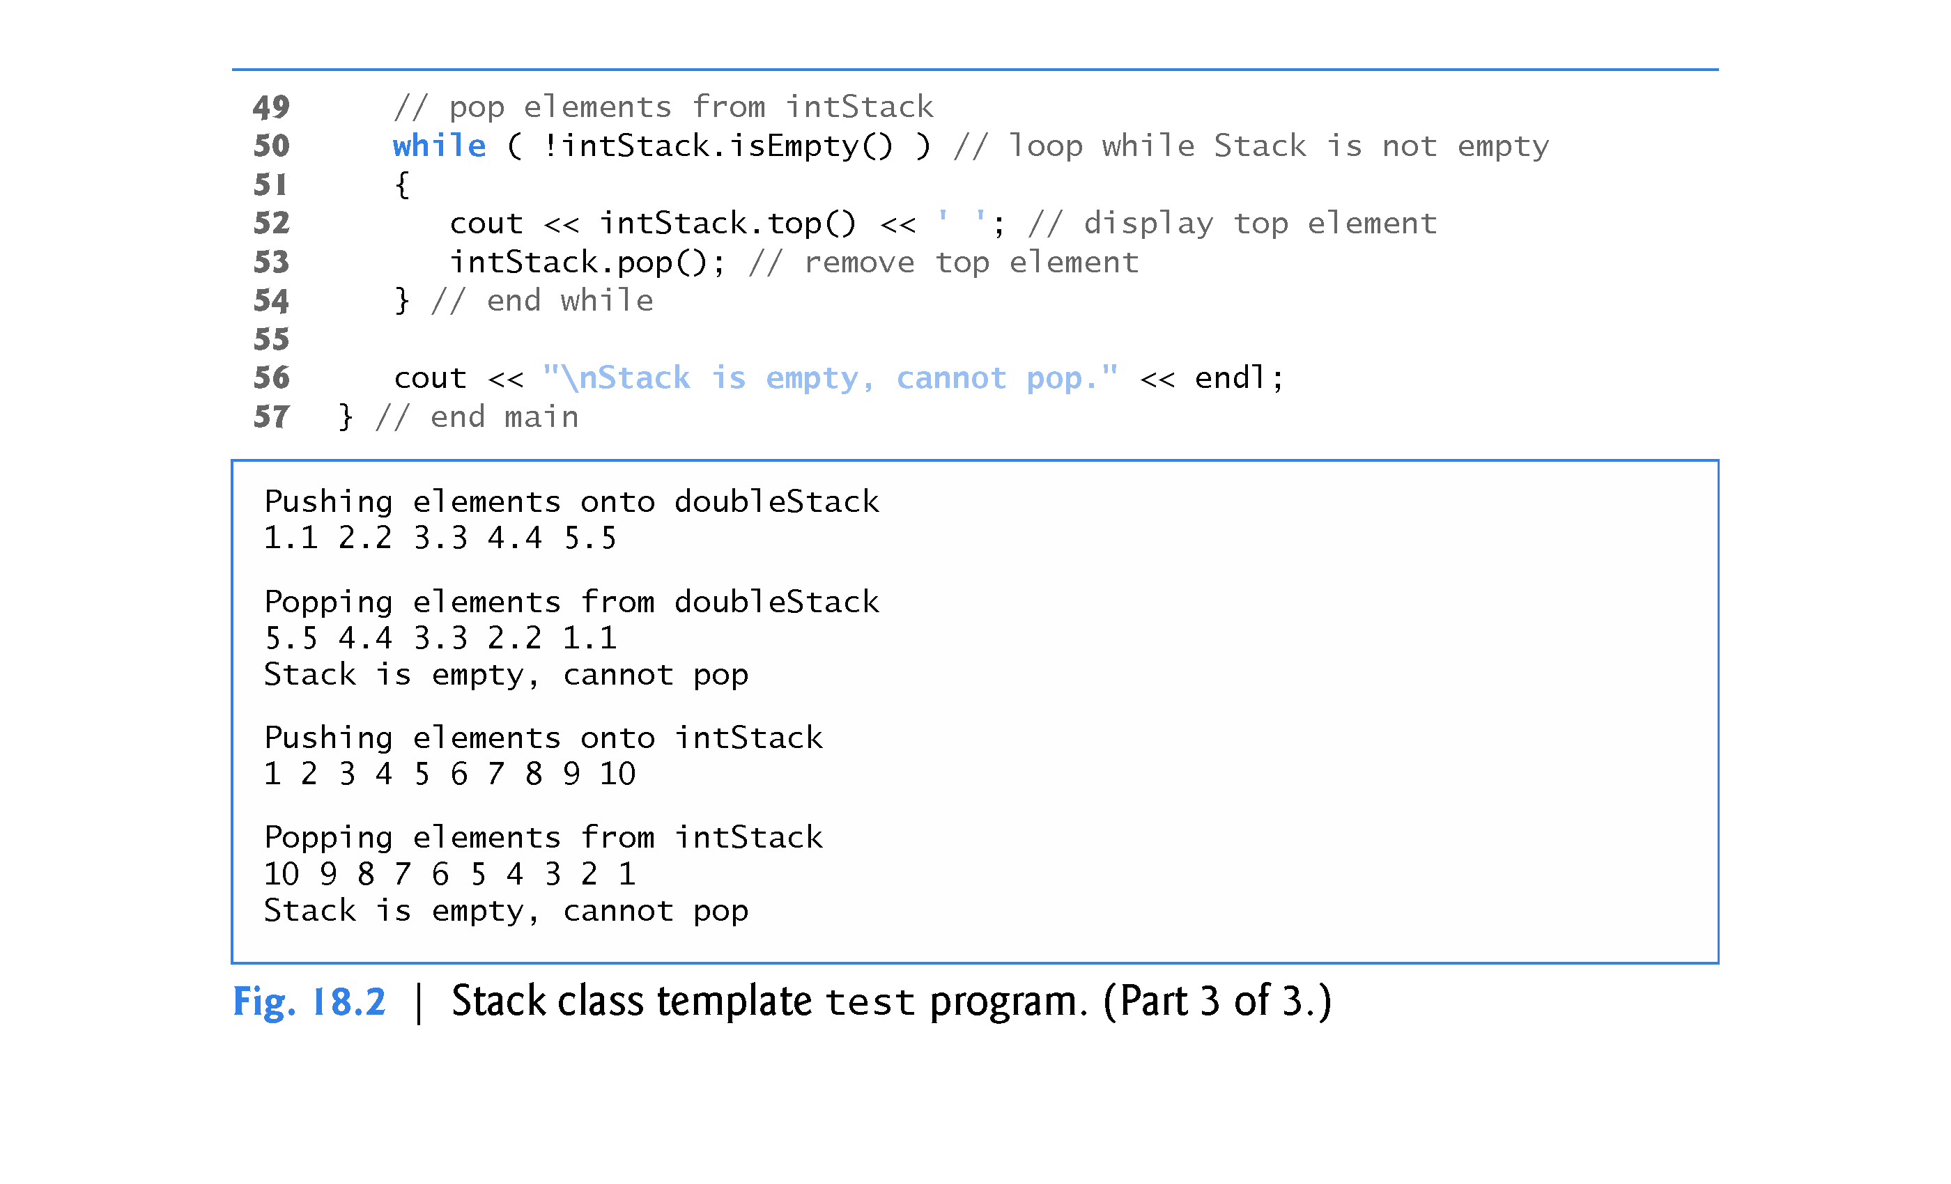

Slide 19

Notice that the code in function main of Fig. 18.2 is almost identical for both the doubleStack manipulations and the intStack manipulations.
This presents another opportunity to use a function template.
Figure 18.3 defines function template testStack to perform the same tasks as main in Fig. 18.2—push a series of values onto a Stack<T> and pop the values off a Stack<T>.

Slide 20
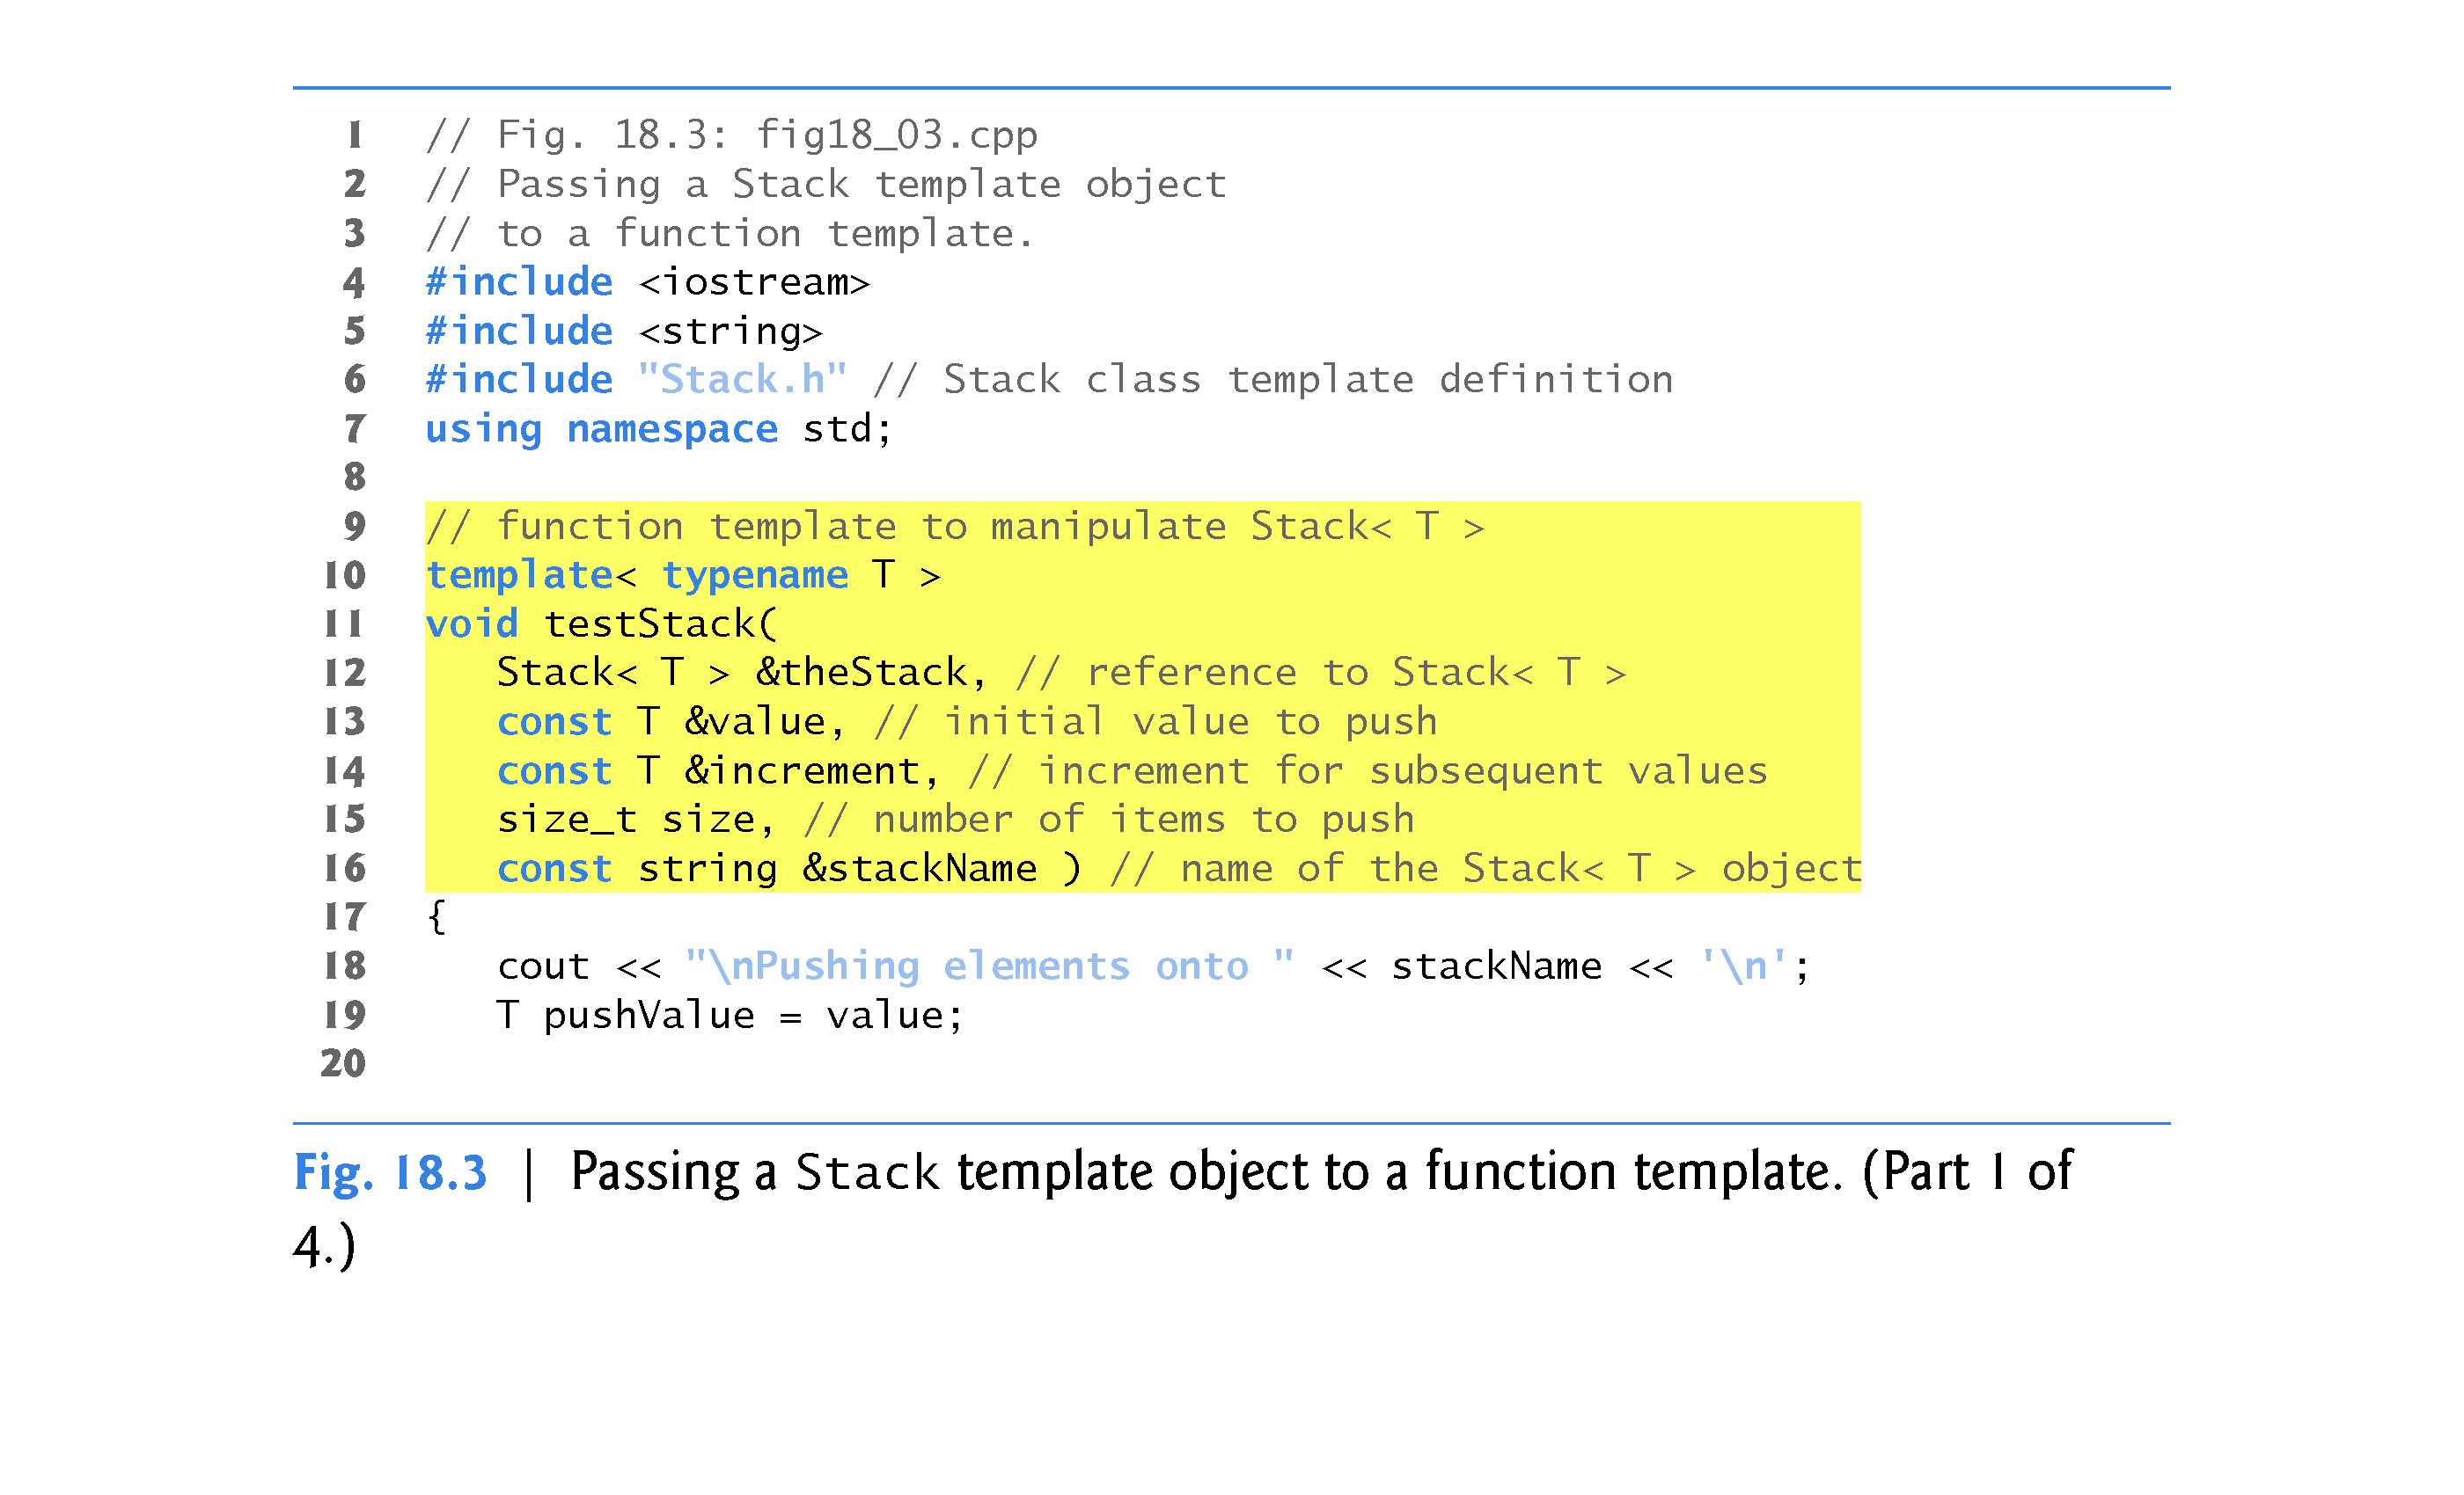

Slide 21
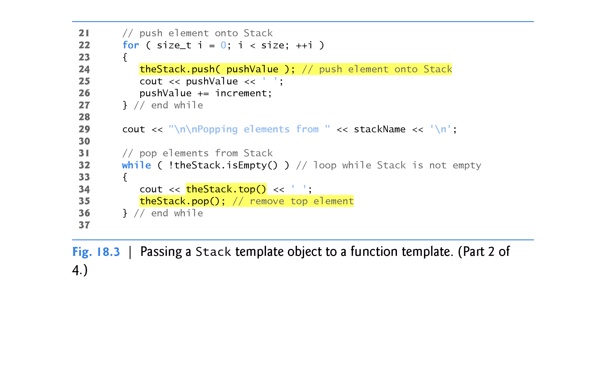

Slide 22
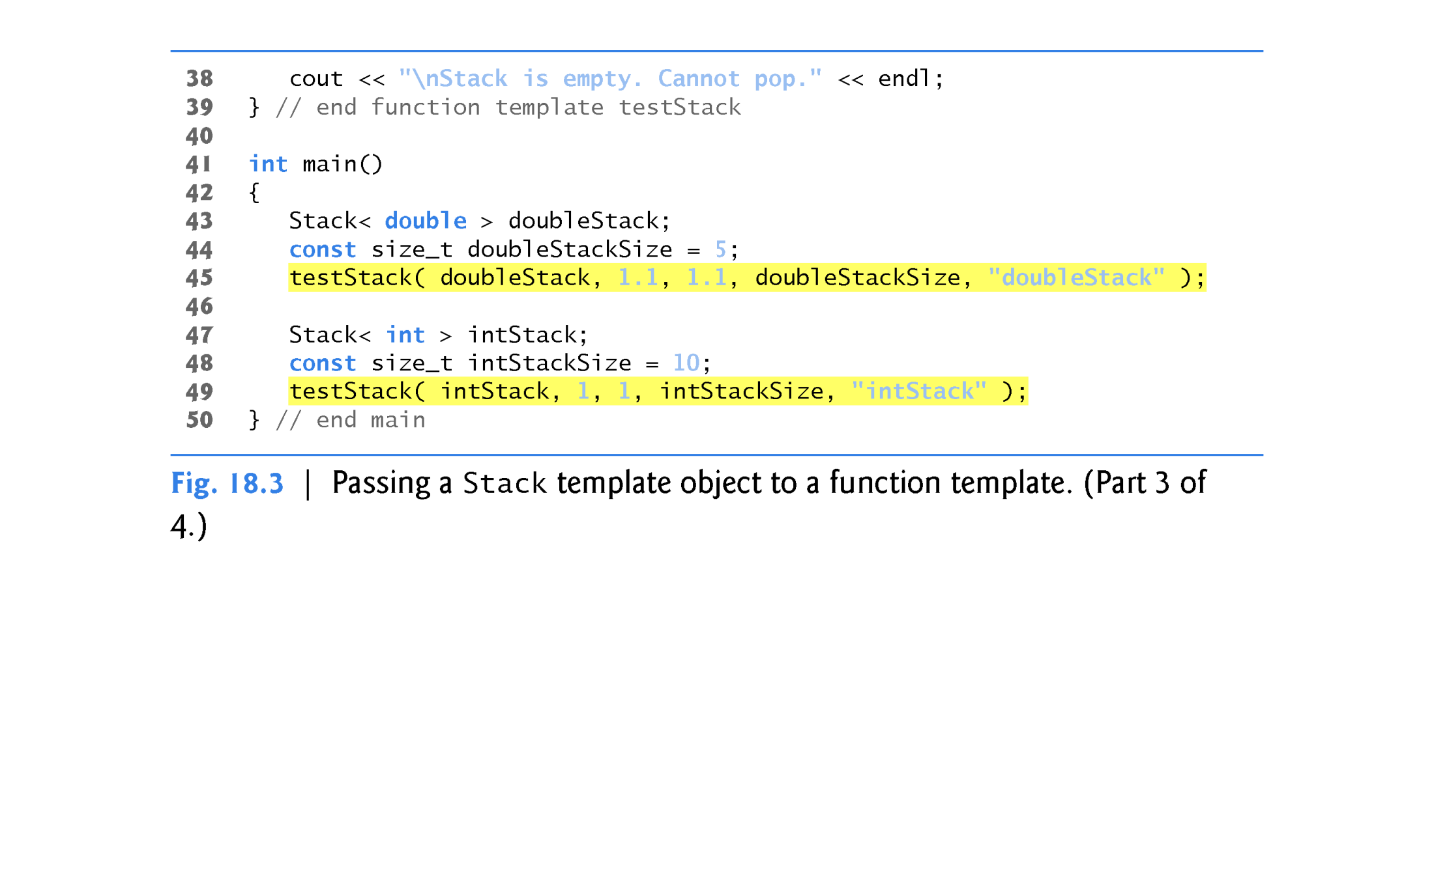

Slide 23
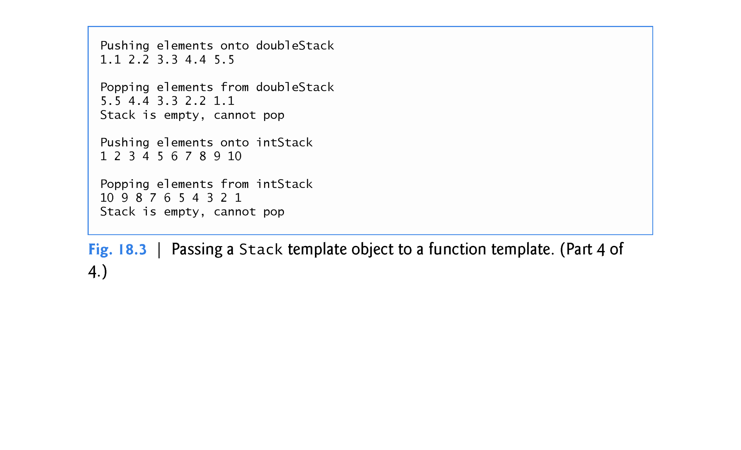

Slide 24

Class template Stack of Section 18.2 used only a type parameter (Fig. 18.1, line 7) in its template declaration.
It’s also possible to use nontype template parameters, which can have default arguments and are treated as constants.
For example, the C++ standard’s array class template begins with the template declaration:
  template < class T, size_t N >
(Recall that keywords class and typename are interchangeable in template declarations.)

Slide 25

So, a declaration such as
    array< double, 100 > salesFigures;
creates a 100-element array of doubles class-template specialization, then uses it to instantiate the object salesFigures.
The array class template encapsulates a built-in array.
When you create an array class-template specialization, the array’s built-in array data member has the type and size specified in the declaration—in the preceding example, it would be a built-in array of double values with 100 elements.

Slide 26
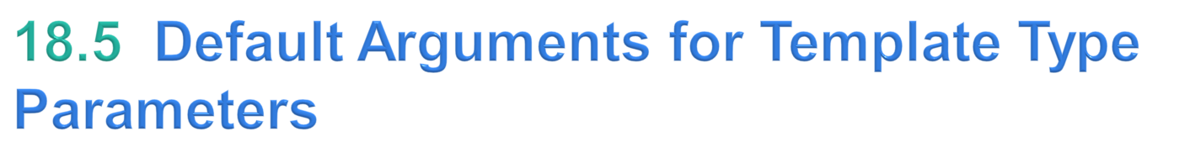
A type parameter can also specify a default type argument.
For example, the C++ standard’s stack container adapter class template begins with:
    template < class T, class Container = deque< T > >
which specifies that a stack uses a deque by default to store the stack’s elements of type T.

Slide 27

Function templates and overloading are intimately related.
In Chapter 6, you learned that when overloaded functions perform identical operations on different types of data, they can be expressed more compactly and conveniently using function templates.
You can then write function calls with different types of arguments and let the compiler generate separate function-template specializations to handle each function call appropriately.
The function-template specializations generated from a given function template all have the same name, so the compiler uses overload resolution to invoke the proper function.

Slide 28
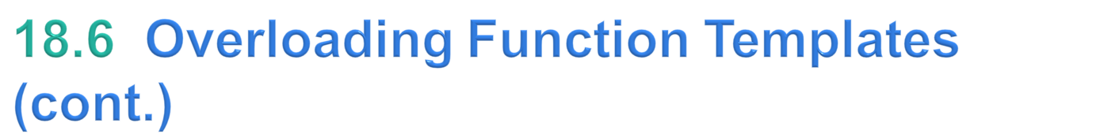
You may also overload function templates.
For example, you can provide other function templates that specify the same function name but different function parameters.
A function template also can be overloaded by providing nontemplate functions with the same function name but different function parameters.

Slide 29
Matching Process for Overloaded Functions
It looks at both nontemplate functions and function templates.
If there are no matches, the compiler issues an error message.
If there are multiple matches for the function call, the compiler attempts to determine the best match.
If there’s more than one best match, the call is ambiguous and the compiler issues an error message.

