Slide 1



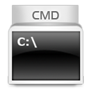


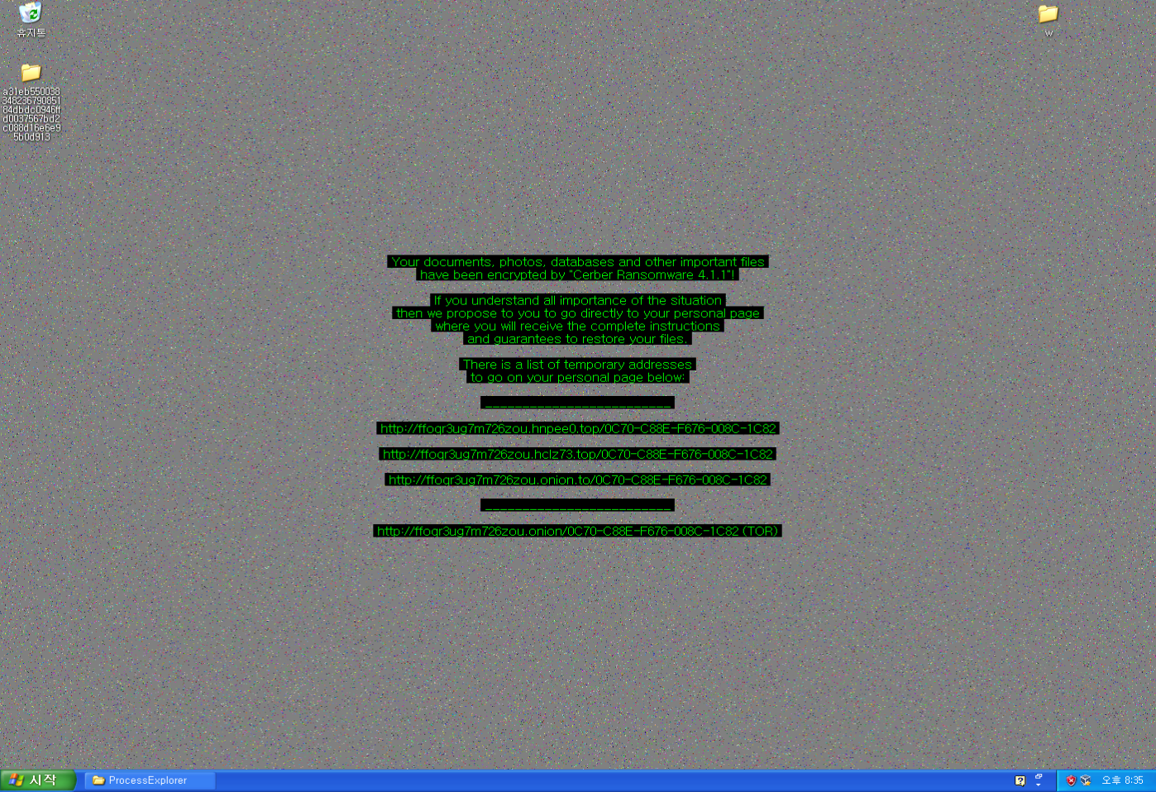
SSED
Thiophene.sed
CreateFile
Encrypt File
ReadFile
CreateFile
CreateProcess()
CreateProcess()
Cerber.exe
BgWorker.dll
Cerber.exe
wmic.exe shadowcopy delete
CreateFile
LoadLibrary
SystemParameterInfo
socket_sendto()
System.dll

