Slide 1
LLM-Based
Query Rewriting
Conversational passage retrieval on TREC CAsT 2020
Raw queries, pseudo-relevance feedback, and contextual rewriting
Notes:
Sources: README.md; notebooks/colab_benchmark.ipynb; cast2020_results/aggregate_metrics.csv; cast2020_results/ollama_rewrites.csv. Local project snapshot inspected on 2026-09-23.
This project evaluates passage retrieval, not generated answer quality.

Slide 2
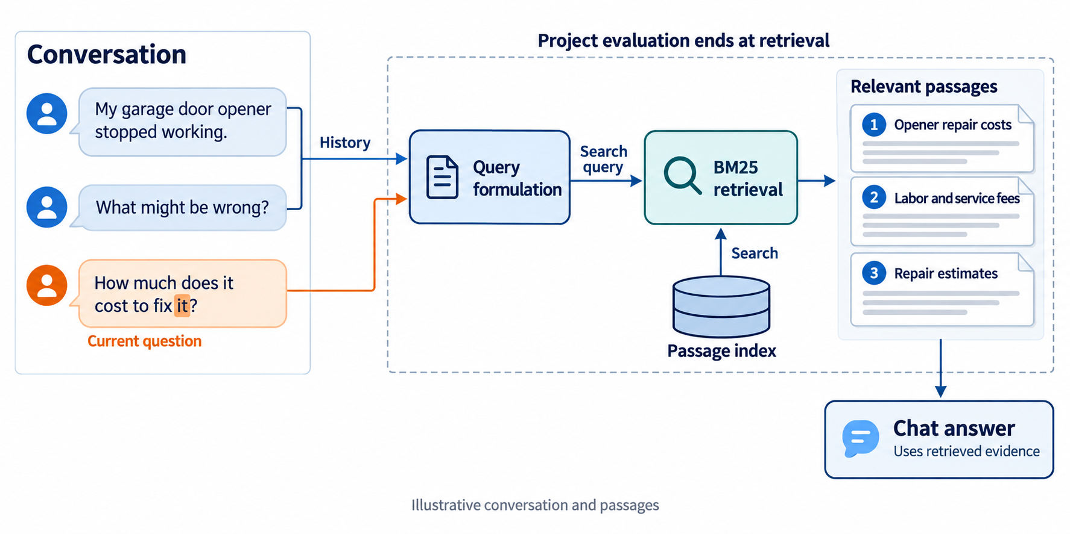
Conversational search: the retrieval workflow
Notes:
Sources: README.md; notebooks/colab_benchmark.ipynb; cast2020_results/aggregate_metrics.csv; cast2020_results/ollama_rewrites.csv. Local project snapshot inspected on 2026-09-23.
Illustrative conversation and passage topics. History and current query feed query formulation. Search uses a passage index. Project evaluation ends at ranked passages; downstream answer generation is a usage scenario, not an evaluated component.
Visual generated with the built-in ImageGen tool. Diagram text is rasterized.

Slide 3
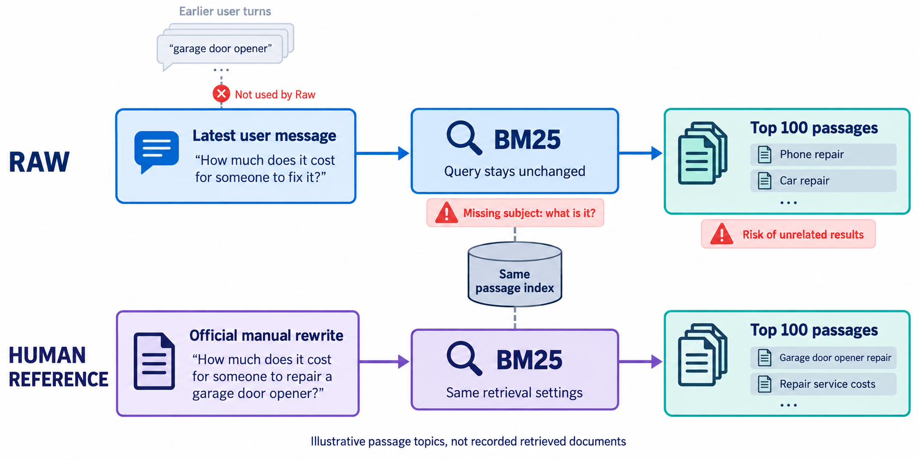
Raw queries and the Human reference
Notes:
Sources: README.md; notebooks/colab_benchmark.ipynb; cast2020_results/aggregate_metrics.csv; cast2020_results/ollama_rewrites.csv. Local project snapshot inspected on 2026-09-23.
Raw uses the latest user utterance only. The official CAsT manual rewrite provides the Human reference input. Both use the same BM25 setup. Query quotations correspond to CAsT 2020 turn 81_3. Passage titles are illustrative, not actual recorded results, and do not imply guaranteed Human relevance.
Visual generated with the built-in ImageGen tool. Diagram text is rasterized.

Slide 4
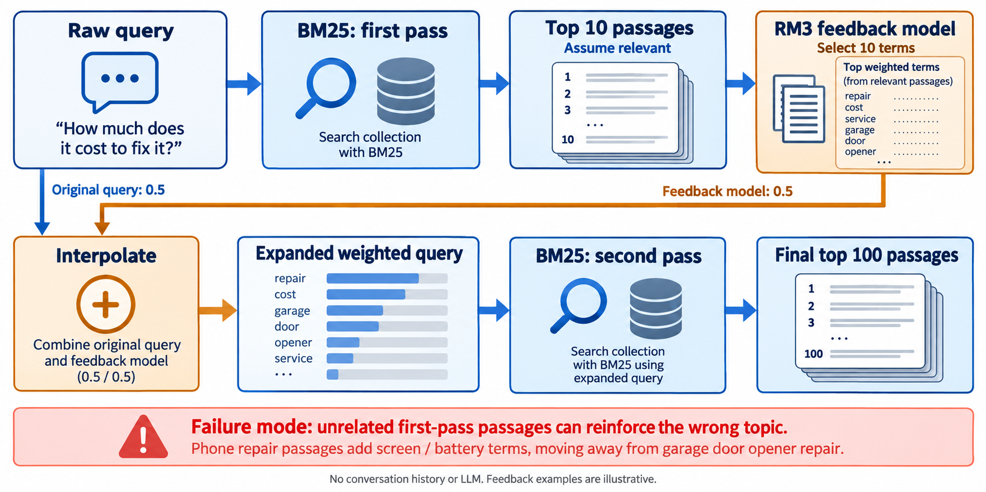
PRF: two retrieval passes with RM3
Notes:
Sources: README.md; notebooks/colab_benchmark.ipynb; cast2020_results/aggregate_metrics.csv; cast2020_results/ollama_rewrites.csv. Local project snapshot inspected on 2026-09-23.
Implementation: first retrieval on the raw query; use top 10 passages as pseudo-relevant feedback; build feedback model and select 10 terms; interpolate original query and feedback model with original_query_weight=0.5; search again and return top 100 passages. Same index and BM25 parameters for both passes. Feedback passages are assumed relevant, not verified. Query wording, feedback terms and weights depicted as bars are illustrative. No history, LLM or qrels enters expansion.
Visual generated with the built-in ImageGen tool. Diagram text is rasterized.

Slide 5
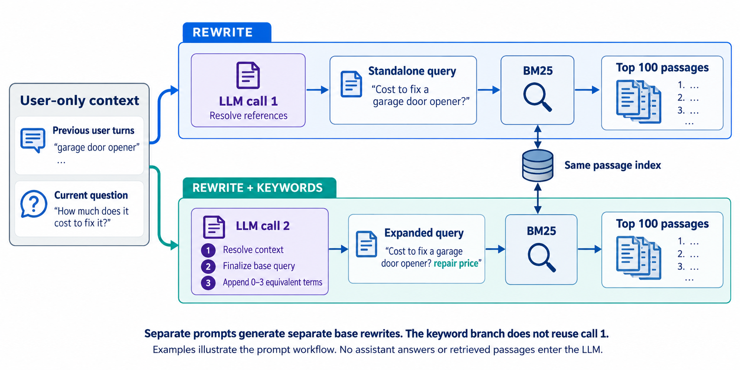
LLM rewriting: two independent prompt workflows
Notes:
Sources: README.md; notebooks/colab_benchmark.ipynb; cast2020_results/aggregate_metrics.csv; cast2020_results/ollama_rewrites.csv. Local project snapshot inspected on 2026-09-23.
Both methods take the current user query and preceding user utterances, including unjudged turns. No assistant answers or retrieved passages enter the LLM. Model gemma4:31b via Ollama Cloud; temperature 0; num_predict 128; think false. Rewriter 1 produces a standalone query. In a separate call, Rewriter 2 finalizes its own base and appends zero to three equivalent terms within that same call. It does not reuse Rewriter 1 output. Examples are illustrative. The prompts request preservation of intent, constraints and supported entities, without speculative facts. Prompt compliance is not guaranteed.
Visual generated with the built-in ImageGen tool. Diagram text is rasterized.

Slide 6
TREC CAsT 2020: what the dataset contains
25
216
208
conversations
total turns
turns with judgments
Conversation data
Retrieval and evaluation data
Ordered user utterances
Manual standalone rewrites
Canonical response passages
MS MARCO + Wikipedia CAR passages
Query–passage relevance judgments
40,451 judgments in the project setup
History uses all preceding user turns. Evaluation uses only the 208 judged turns.
06
Notes:
Sources: README.md; notebooks/colab_benchmark.ipynb; cast2020_results/aggregate_metrics.csv; cast2020_results/ollama_rewrites.csv. Local project snapshot inspected on 2026-09-23.
External source: Dalton, Xiong, and Callan, CAsT 2020: The Conversational Assistance Track Overview, https://trec.nist.gov/pubs/trec29/papers/OVERVIEW.C.pdf . Official task: rank passages for each conversational turn. Dataset has 25 topics and 216 turns. Project README and notebook document 208 judged turns and 40,451 judgments. Corpus comprises MS MARCO and Wikipedia TREC CAR passages. The dataset also provides canonical responses, which this project does not feed to the rewriter. Manual rewrites are a reference, not a guaranteed theoretical upper bound.

Slide 7
Benchmark: five methods on CAsT 2020
Shared setup: BM25 (k₁ = 0.9, b = 0.4), cast2019 index, top 100, 208 turns
Method | nDCG@10 | Recall@100 | RR@10
Raw | 0.0780 | 0.1251 | 0.1720
PRF (RM3) | 0.0905 | 0.1415 | 0.1784
Rewrite | 0.2311 | 0.3688 | 0.5097
Rewrite + Keywords | 0.2364 | 0.3812 | 0.5105
Human | 0.2558 | 0.4273 | 0.5430
Rewrite + Keywords has the highest automatic scores. Human remains the strongest reference.
Higher is better. Saved project results, rounded to 4 decimals. No statistical significance test.
07
Notes:
Sources: README.md; notebooks/colab_benchmark.ipynb; cast2020_results/aggregate_metrics.csv; cast2020_results/ollama_rewrites.csv. Local project snapshot inspected on 2026-09-23.
Method mapping: Raw=raw, PRF (RM3)=raw_rm3, Rewrite=rewriter 1, Rewrite + Keywords=rewriter 2, Human=human. Exact values are read from aggregate_metrics.csv and rounded to four decimals for display. Each run CSV has 208 distinct query IDs and 20,800 result rows. No new benchmark was run for this deck. nDCG@10 measures ranking quality with graded relevance; Recall@100 measures the fraction of relevant passages retrieved; RR@10 measures the reciprocal rank of the first relevant result in the top ten. Higher is better. Relative nDCG improvement of Rewrite + Keywords over Rewrite is 2.287%; difference is 0.0052856291. Statistical significance has not been tested.

Slide 8
Limitations
Incomplete context
User-only history omits previous answers that some CAsT turns depend on.
Rewrite errors
The LLM can alter intent or add unsupported terms. The keyword branch worsens 28 of 208 turns versus Raw on nDCG@10.
Limited experimental scope
One dataset, one recorded model, and BM25. No significance tests or latency and cost measurements.
Keywords are not isolated
The two prompts generate different base rewrites. Their score difference cannot be attributed only to added keywords.
08
Notes:
Sources: README.md; notebooks/colab_benchmark.ipynb; cast2020_results/aggregate_metrics.csv; cast2020_results/ollama_rewrites.csv. Local project snapshot inspected on 2026-09-23.
Per-query evidence: llm_minus_raw_per_query.csv contains 140 improved, 40 tied, and 28 degraded queries for Rewriter 2 versus Raw on nDCG@10. The rewriters use different full prompts and independently generated bases, so the comparison is not a controlled keywords-only ablation. Cloud provider, latency, cost, and model-version reproducibility require further measurement. CAsT 2020 can contain references to previous response passages; user-only history omits that information.

Slide 9
Thank you
Questions & discussion
Notes:
End of presentation.

