Slide 1
DISTRIBUTED MULTI-MODEL ANALYTICS
for E-Commerce Data
MongoDB · HBase · Apache Spark
Dany NKURUNZIZA
Student ID: 101283
MSc Big Data Analytics | MSDA9113 | June 2026

Slide 2
Presentation Outline
01
System Architecture & Technology Selection
04
Integrated Analytics — Customer Lifetime Value
02
Data Modeling — MongoDB & HBase Schema Design
05
Visualizations & Business Insights
03
Apache Spark — Batch Processing & SQL Analytics
06
Scalability Considerations & Conclusions

Slide 3
01
System Architecture
Three-store distributed pipeline — each technology doing what it does best

Slide 4
Architecture: Data Gravity Principle
MongoDB
HBase
Apache Spark
Document Store
Wide-Column Store
Computation Layer
Product catalog + price history
User profiles + geo data
Transactions + embedded items
Aggregation pipelines
User session clickstream
Reverse-timestamp row keys
Product daily metrics
Append-only event writes
Cross-store joins on user_id
Distributed ML algorithms
Spark SQL window functions
Cohort & CLV analytics
→
→

Slide 5
02
Data Modeling
MongoDB schema design · HBase row-key strategy · Technology trade-offs

Slide 6
MongoDB — Schema Design Decisions
Collection | Key Design Decision | Rationale
products | Embed price_history array | Always accessed with parent product — avoids JOIN on every catalog read
products | Denormalise category_name | Read-heavy display field; category renames are rare
transactions | Embed items array | Transaction + line items always retrieved together — single document read
transactions | Index: user_id, timestamp, status | Covers all primary query axes: user history, date range, fulfilment
users | Embed geo_data sub-document | Country/state filters use compound index — zero-lookup geographic segmentation
users | No embedded transaction history | Transaction volume is unbounded — would breach 16 MB document limit
Design principle: structure follows access pattern, not normalisation rules.

Slide 7
HBase — Row Key Strategy & Column Families
TABLE: user_sessions
TABLE: product_performance
Row Key: user_id # reverse_timestamp
Row Key: product_id # YYYYMMDD
reverse_ts = Long.MAX_VALUE − epoch_ms
Forward scan → most recent sessions first
Avoids full table scan + sort for user history
meta: start/end time, device, referrer, status
geo: city, state, country, IP address
cart: product_ids, total_value (sparse)
VERSIONS=1, SNAPPY compression
Date-bucketed: 1 row per product per day
30-day range scan = single contiguous read
O(date range) not O(table size)
views: count, unique_users, avg_dur_sec
cart: add_count, total_value_added
sales: units_sold, revenue, order_count
Write-optimised — no updates, only appends

Slide 8
03
Apache Spark Processing
Data cleaning · Co-purchase recommendations · Cohort analysis · Spark SQL

Slide 9
Spark Pipeline — Four Processing Stages
1
Data Cleaning
2
Co-Purchase Recommendations
Timestamp → TimestampType
Null discount → 0.0
Suspicious records flagged (total ≤ 0)
Derived: year_month, tenure_days
Self-join on transaction_id
Jaccard similarity normalisation
Minimum support threshold = 2
Scales to 500K+ transactions
3
Cohort Analysis
4
Spark SQL Analytics
Cohort = registration month
Track spend in subsequent months
ARPU per cohort × month cell
Detects early retention signals
7-day rolling revenue average
Funnel by referrer channel
Device × OS revenue breakdown
Customer LTV segmentation (CTE)

Slide 10
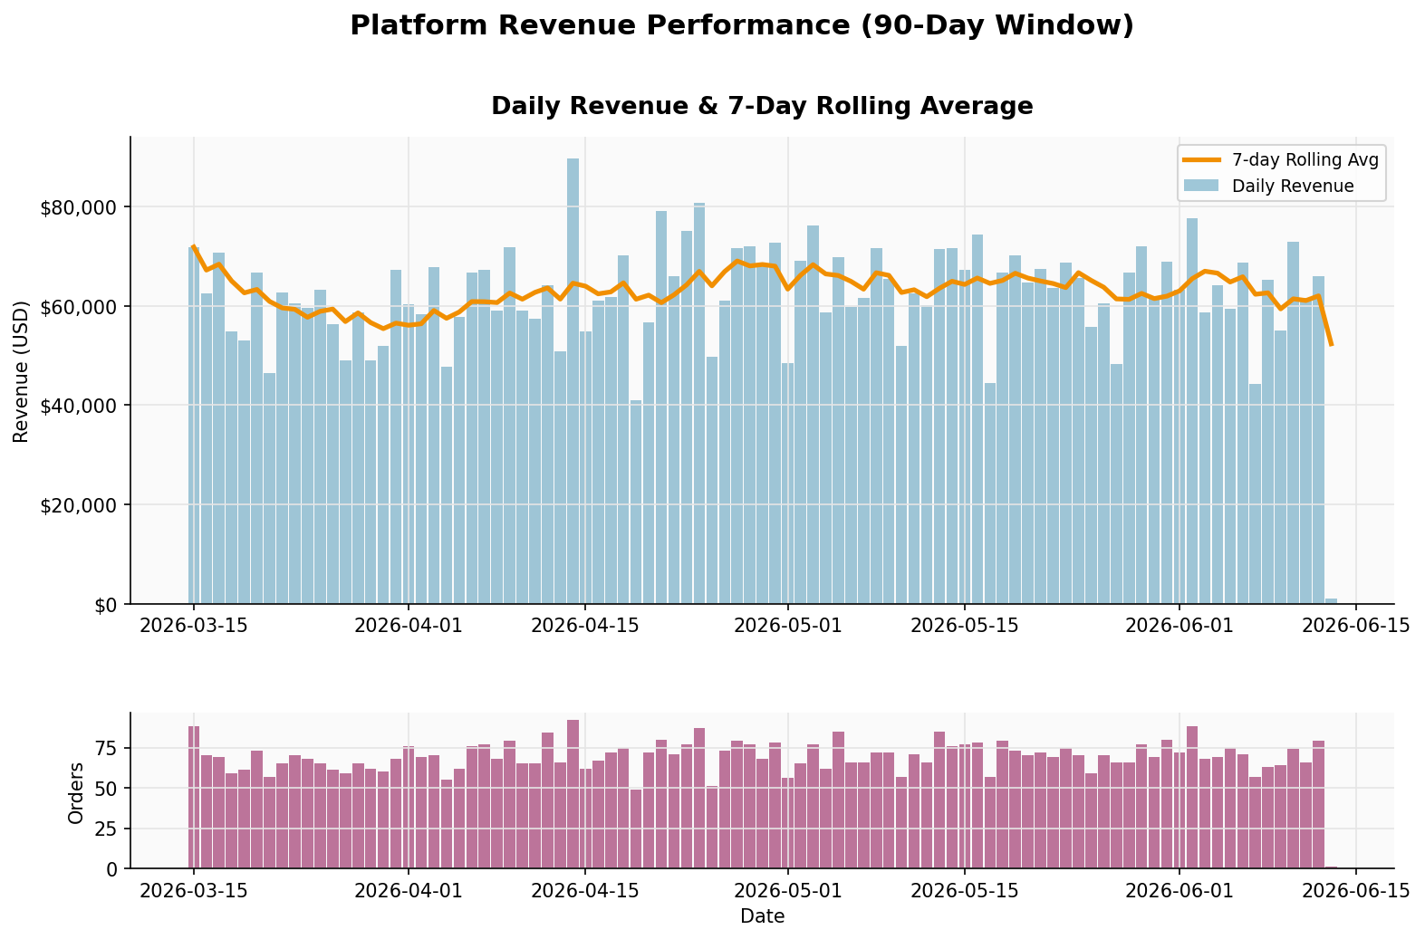
Spark SQL — Key Query Results
$5.66M
$900
21.1%
Total revenue
(90-day window)
Average
order value
Peak session
conversion (email)

Slide 11
04
Integrated Analytics
Customer Lifetime Value: combining MongoDB transactions + HBase sessions via Spark

Slide 12
CLV Integration — Cross-Store Join Architecture
MongoDB
Apache Spark
HBase
Transactions
Integration Layer
Sessions
CLV features:
total spend, order count,
avg order value, discount rate
Join on user_id
Left join — preserves all
CLV records; nulls for
non-session users
Engagement features:
no. sessions, avg duration,
conversion rate, device,
referrer channel
→ Unified user profile: CLV tier (High / Mid / Low) + engagement behaviour per segment

Slide 13
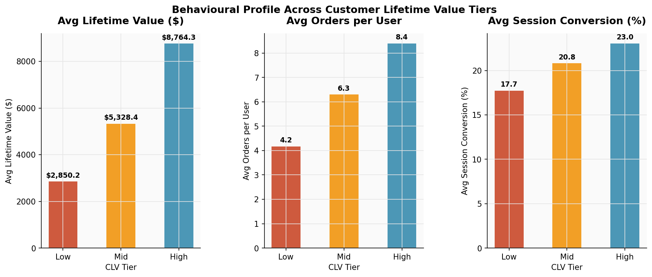
CLV Results — Segment Behavioural Profiles
Key Findings
High-CLV users convert 23% of sessions vs 17.7% for Low
Conversion rate is a leading indicator — visible early in user lifecycle
High-CLV users place 2× more orders than Low-CLV
Email channel: highest avg CLV ($5,739) despite fewer users
Session volume barely differs across tiers (48–51 sessions)
CLV Tier | Avg LTV | Avg Orders | Session Conv.
High | $8,764 | 8.4 | 23.0%
Mid | $5,328 | 6.3 | 20.8%
Low | $2,850 | 4.2 | 17.7%

Slide 14
05
Visualizations & Insights
Five business analytics charts from the integrated dataset

Slide 15
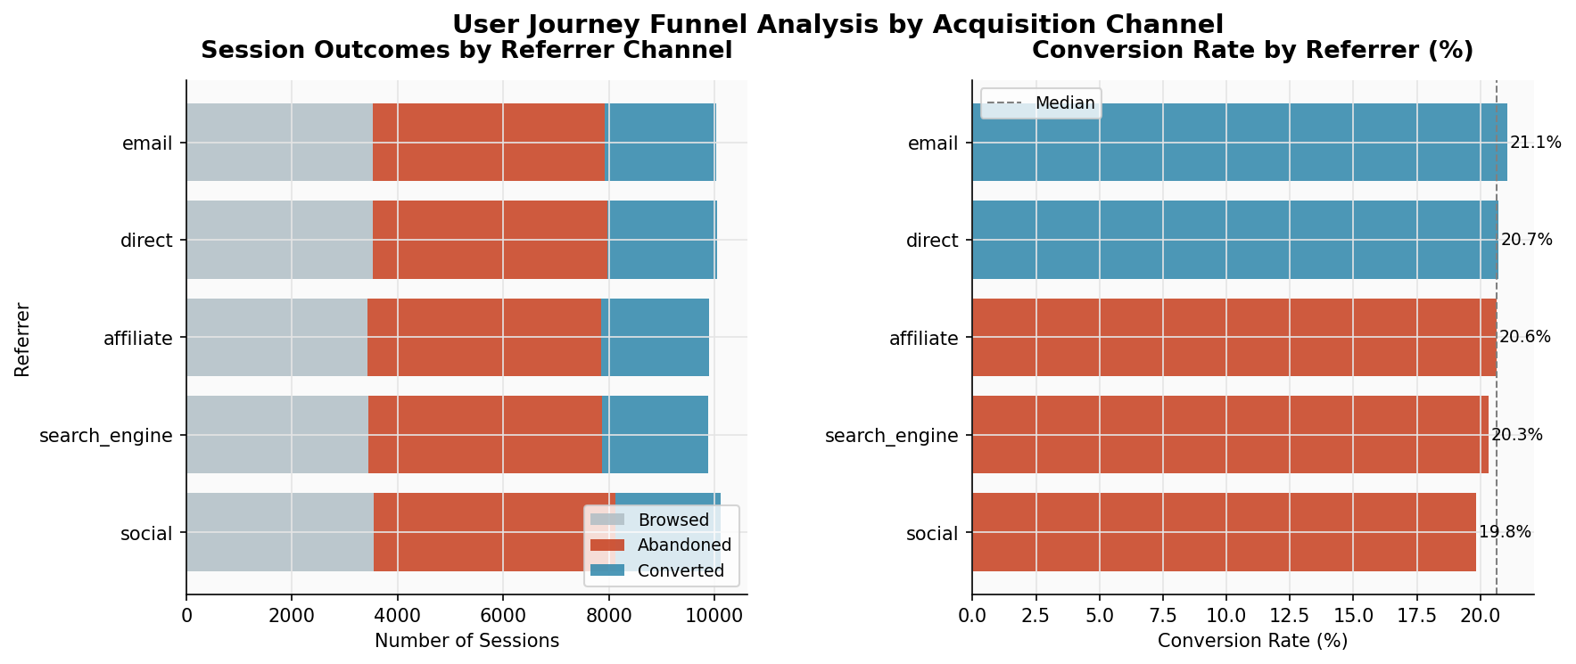
Session Conversion by Acquisition Channel
Insight
Email drives highest intent-based conversion
Social media = high volume, low conversion → needs re-targeting strategy
Direct traffic shows consistent mid-range performance
Affiliate channel delivers strong conversion despite lower volume

Slide 16
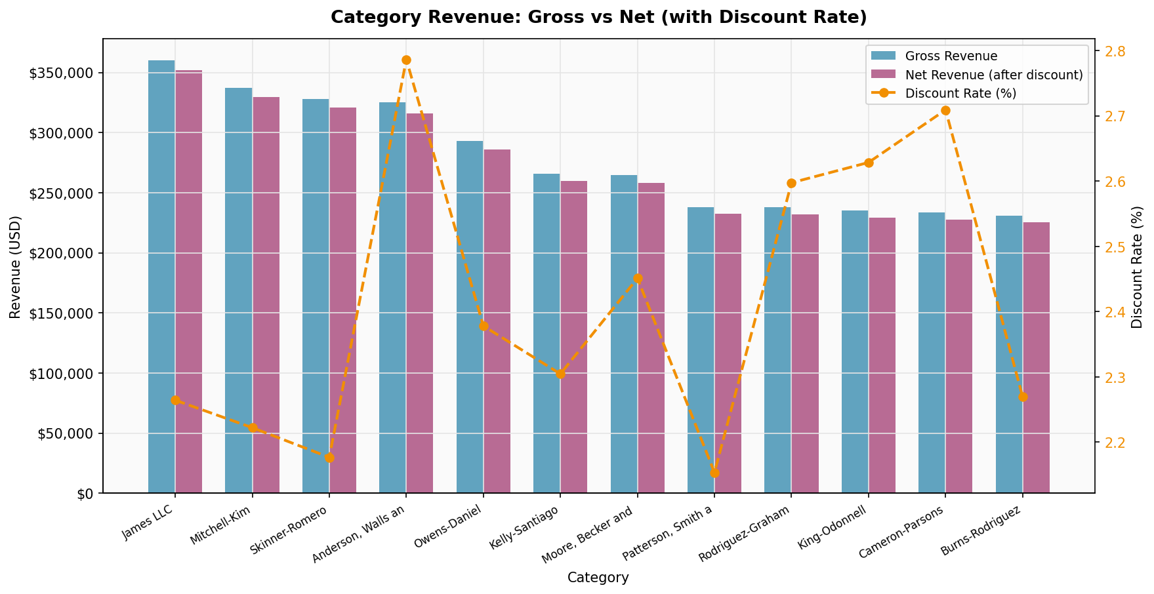
Category Revenue: Gross vs Net with Discount Impact
Some mid-revenue categories carry higher discount rates than top categories — warrants margin review
Discounts in high-volume categories may be necessary for competitiveness; in niche categories they are often unnecessary

Slide 17
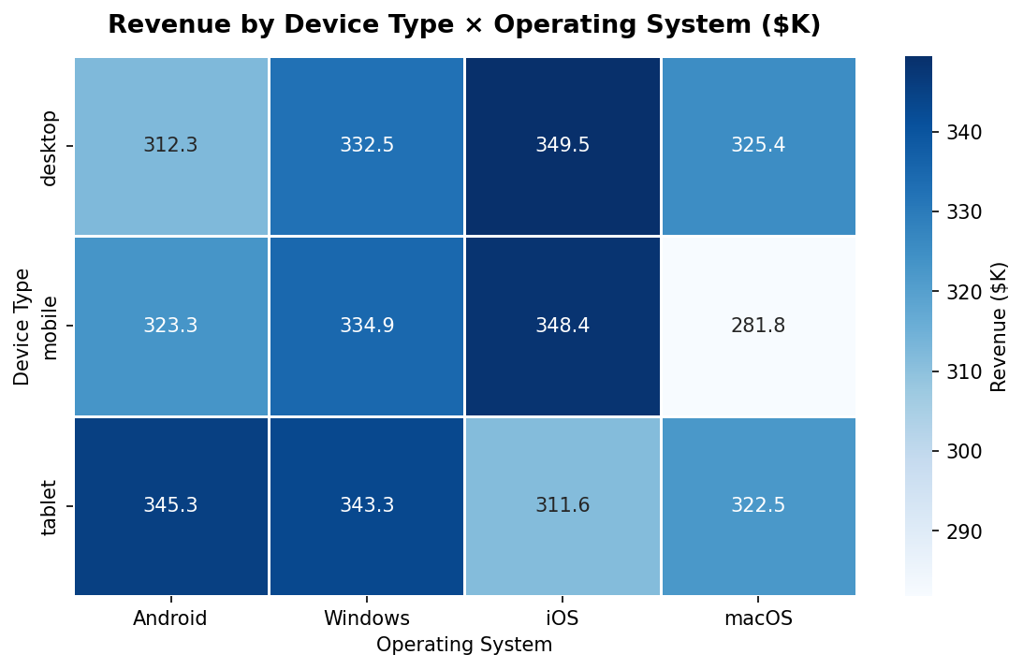
Revenue by Device Type × Operating System
Device Insights
Mobile-iOS and Desktop-Windows are the dominant revenue combinations
Tablet-iOS performs above expectation — UX investment opportunity
Android mobile lags iOS disproportionately vs market share
Suggests a checkout UX gap on Android worth investigating

Slide 18
06
Conclusions & Scalability
Design justifications · Production path · Limitations

Slide 19
Technology Selection — Why Three Systems?
Concern | MongoDB | HBase | Spark
Query model | Document + aggregation pipelines | Key-range scans + server filters | Distributed SQL + DataFrames
Best for | Catalog, transactions, orders | Clickstream, time-series events | Cross-store joins, ML, analytics
Scale mechanism | Horizontal sharding | Auto region-splitting | Executors on YARN/Kubernetes
Transactions | Multi-doc ACID (v4.0+) | Single-row atomic only | N/A — read/transform only
Write pattern | Mixed read/write, rich updates | Append-only, high throughput | Batch computation
The core principle: use each technology for the workload it was designed for, not the workload it can tolerate.

Slide 20
Scalability & Production Path
MongoDB
HBase
Apache Spark
Range shard on timestamp → older data to cheap storage
Product catalog: range shard on category_id
Working set <1TB: single high-memory node; beyond that: 3-shard cluster
2M sessions × 50KB ≈ 100GB — comfortable on 3-node cluster
SNAPPY compression reduces on-disk size ~60%
Reverse-key design enables automatic region splits as data grows
Local[*] → YARN/Kubernetes — single config change
User DataFrame fits in broadcast variable → eliminates shuffle
Structured Streaming extension for real-time session events
Limitations: HBase runs in simulation mode (production: Docker harisekhon/hbase or Google Bigtable). Real-time streaming (Spark Structured Streaming → Kafka) and ALS collaborative filtering are natural next steps.

Slide 21
Summary
MongoDB handles document-oriented catalog and transactional data with expressive aggregation pipelines
HBase is optimised for the append-only, time-series session clickstream with reverse-timestamp row keys
Spark joins both stores to answer business questions neither system can answer alone
Session conversion rate is a leading indicator of lifetime value — enabling early CRM intervention
Email channel delivers the highest CLV per user despite not being the highest-volume source
Dany NKURUNZIZA · MSc Big Data Analytics · AUCA · June 2026

