Slide 1
Learn Apache Spark “checkpoint” from source code
Nikolay
Join us in telegram t.me/apache_spark
Feb 2021

Slide 2
Example
The directory must be a HDFS path if running on a cluster.
spark.sparkContext.setCheckpointDir( path)
val ds1 =spark.spark.range(1,1000000).checkpoint()
ds1.collect()

Slide 3
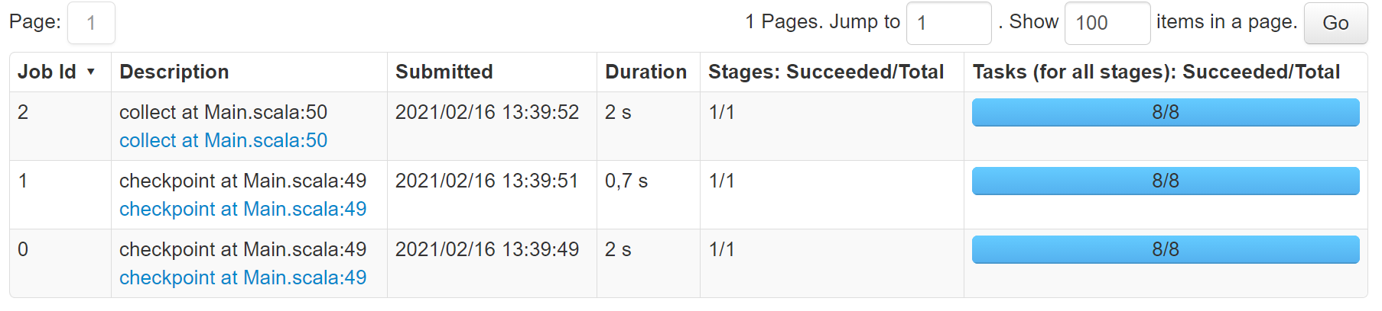
Ask youself
Why do we have 3 jobs?

Slide 4
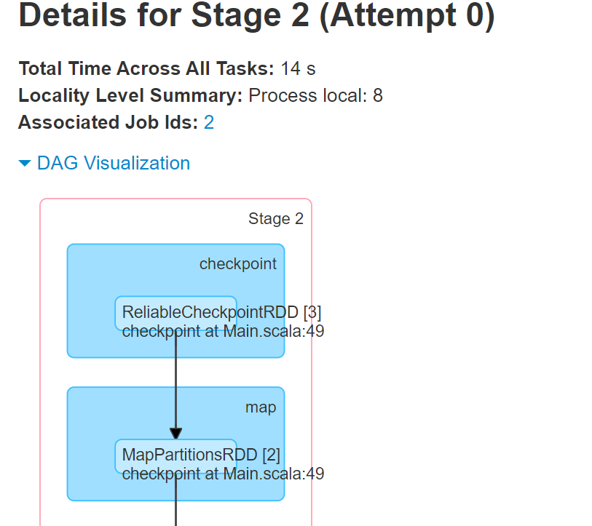

Slide 5
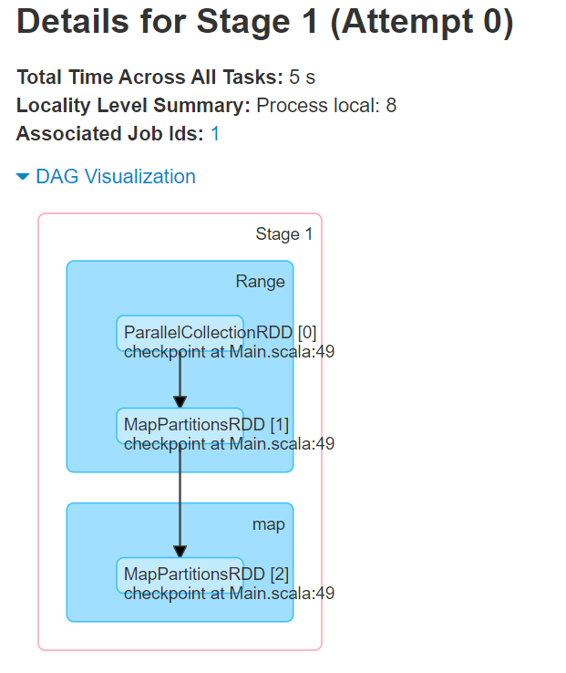

Slide 6
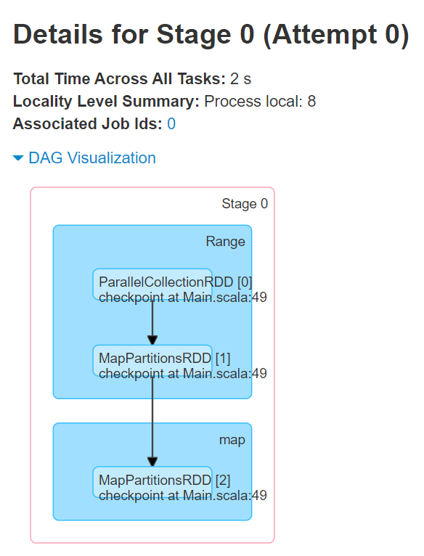

Slide 7
Intuition
OriginalRDD
Iterator00
Iterator1
Iterator2
HDFS
rdd-id
Part-00000
Part-00001
Part-00002
ReliableCheckpointRDD
Iterator00
Iterator1
Iterator2

Slide 8
Class Dataset
/**
Eagerly checkpoint a Dataset and return the new Dataset. Checkpointing can be used to truncate the logical plan of this Dataset, which is especially useful in iterative algorithms where the plan may grow exponentially. It will be saved to files inside the checkpoint
* directory set with `SparkContext#setCheckpointDir`.
*
* @group basic
* @since 2.1.0
*/
def checkpoint(): Dataset[T] = checkpoint(eager = true, reliableCheckpoint = true)

Slide 9
/**
* Returns a checkpointed version of this Dataset.
*
* @param eager Whether to checkpoint this dataframe immediately
* @param reliableCheckpoint Whether to create a reliable checkpoint saved to files inside the
* checkpoint directory. If false creates a local checkpoint using
* the caching subsystem
*/
private def checkpoint(eager: Boolean, reliableCheckpoint: Boolean): Dataset[T] = {
val actionName = if (reliableCheckpoint) "checkpoint" else "localCheckpoint"
withAction(actionName, queryExecution) { physicalPlan =>
val internalRdd = physicalPlan.execute().map(_.copy())
if (reliableCheckpoint) {
internalRdd.checkpoint()
} else {
internalRdd.localCheckpoint()
}
if (eager) {
internalRdd.count()
}

Slide 10
Class Dataset
// Takes the first leaf partitioning whenever we see a `PartitioningCollection`. Otherwise the
// size of `PartitioningCollection` may grow exponentially for queries involving deep inner
// joins.
def firstLeafPartitioning(partitioning: Partitioning): Partitioning = {
partitioning match {
case p: PartitioningCollection => firstLeafPartitioning(p.partitionings.head)
case p => p
}
}
val outputPartitioning = firstLeafPartitioning(physicalPlan.outputPartitioning)
Dataset.ofRows(
sparkSession,
LogicalRDD(
logicalPlan.output,
internalRdd,
outputPartitioning,
physicalPlan.outputOrdering,
isStreaming
)(sparkSession)).as[T]
}

Slide 11
Class RDD
/** Mark this RDD for checkpointing. It will be saved to a file inside the checkpoint directory set with `SparkContext#setCheckpointDir` and all references to its parent RDDs will be removed. This function must be called before any job has been executed on this RDD. It is strongly recommended that this RDD is persisted in memory, otherwise saving it on a file will require recomputation. */ def checkpoint(): Unit = RDDCheckpointData.synchronized { // NOTE: we use a global lock here due to complexities downstream with ensuring // children RDD partitions point to the correct parent partitions. In the future // we should revisit this consideration. if (context.checkpointDir.isEmpty) { throw new SparkException("Checkpoint directory has not been set in the SparkContext") } else if (checkpointData.isEmpty) { checkpointData = Some(new ReliableRDDCheckpointData(this)) } // ReliableRDDCheckpointData is subclass of RDDCheckpointData }

Slide 12
Class RDD
/**
* Performs the checkpointing of this RDD by saving this. It is called after a job using this RDD
* has completed (therefore the RDD has been materialized and potentially stored in memory).
* doCheckpoint() is called recursively on the parent RDDs.
*/
private[spark] def doCheckpoint(): Unit = {
RDDOperationScope.withScope(sc, "checkpoint", allowNesting = false, ignoreParent = true) {
if (!doCheckpointCalled) {
doCheckpointCalled = true
if (checkpointData.isDefined) {
if (checkpointAllMarkedAncestors) {
// TODO We can collect all the RDDs that needs to be checkpointed, and then checkpoint
// them in parallel.
// Checkpoint parents first because our lineage will be truncated after we
// checkpoint ourselves
dependencies.foreach(_.rdd.doCheckpoint())
}
checkpointData.get.checkpoint()
} else {
dependencies.foreach(_.rdd.doCheckpoint())

Slide 13
Class SparkContext
def runJob[T, U: ClassTag](
rdd: RDD[T],
func: (TaskContext, Iterator[T]) => U,
partitions: Seq[Int],
resultHandler: (Int, U) => Unit): Unit = {
if (stopped.get()) {
throw new IllegalStateException("SparkContext has been shutdown")
}
val callSite = getCallSite
val cleanedFunc = clean(func)
logInfo("Starting job: " + callSite.shortForm)
if (conf.getBoolean("spark.logLineage", false)) {
logInfo("RDD's recursive dependencies:\n" + rdd.toDebugString)
}
dagScheduler.runJob(rdd, cleanedFunc, partitions, callSite, resultHandler, localProperties.get)
progressBar.foreach(_.finishAll())
rdd.doCheckpoint()
}

Slide 14
Class RDD
private[spark] def doCheckpoint(): Unit = {
RDDOperationScope.withScope(sc, "checkpoint", allowNesting = false, ignoreParent = true) {
if (!doCheckpointCalled) {
doCheckpointCalled = true
if (checkpointData.isDefined) {
if (checkpointAllMarkedAncestors) {
// TODO We can collect all the RDDs that needs to be checkpointed, and then checkpoint
// them in parallel.
// Checkpoint parents first because our lineage will be truncated after we
// checkpoint ourselves
dependencies.foreach(_.rdd.doCheckpoint())
}
checkpointData.get.checkpoint()
} else {
dependencies.foreach(_.rdd.doCheckpoint())
}
}
}
}

Slide 15
Class RDDCheckpointData
/**
* Materialize this RDD and persist its content.
* This is called immediately after the first action invoked on this RDD has completed.
*/
final def checkpoint(): Unit = {
// Guard against multiple threads checkpointing the same RDD by
// atomically flipping the state of this RDDCheckpointData
RDDCheckpointData.synchronized {
if (cpState == Initialized) {
cpState = CheckpointingInProgress
} else {
return
}
}
val newRDD = doCheckpoint()
// Update our state and truncate the RDD lineage
RDDCheckpointData.synchronized {
cpRDD = Some(newRDD)
cpState = Checkpointed
rdd.markCheckpointed()
}
}

Slide 16
ReliableRDDCheckpointData
/**
* Materialize this RDD and write its content to a reliable DFS.
* This is called immediately after the first action invoked on this RDD has completed.
*/
protected override def doCheckpoint(): CheckpointRDD[T] = {
val newRDD = ReliableCheckpointRDD.writeRDDToCheckpointDirectory(rdd, cpDir)
// Optionally clean our checkpoint files if the reference is out of scope
if (rdd.conf.get(CLEANER_REFERENCE_TRACKING_CLEAN_CHECKPOINTS)) {
rdd.context.cleaner.foreach { cleaner =>
cleaner.registerRDDCheckpointDataForCleanup(newRDD, rdd.id)
}
}
logInfo(s"Done checkpointing RDD ${rdd.id} to $cpDir, new parent is RDD ${newRDD.id}")
newRDD
}
}

Slide 17
object ReliableCheckpointRDD
/**
* Write RDD to checkpoint files and return a ReliableCheckpointRDD representing the RDD.
*/
def writeRDDToCheckpointDirectory[T: ClassTag](
originalRDD: RDD[T],
checkpointDir: String,
blockSize: Int = -1): ReliableCheckpointRDD[T] = {
val checkpointStartTimeNs = System.nanoTime()
val sc = originalRDD.sparkContext
// Create the output path for the checkpoint
val checkpointDirPath = new Path(checkpointDir)
val fs = checkpointDirPath.getFileSystem(sc.hadoopConfiguration)
if (!fs.mkdirs(checkpointDirPath)) {
throw new SparkException(s"Failed to create checkpoint path $checkpointDirPath")
}

Slide 18
Class ReliableCheckpointRDD
// Save to file, and reload it as an RDD
val broadcastedConf = sc.broadcast(
new SerializableConfiguration(sc.hadoopConfiguration))
// TODO: This is expensive because it computes the RDD again unnecessarily (SPARK-8582)
sc.runJob(originalRDD,
writePartitionToCheckpointFile[T](checkpointDirPath.toString, broadcastedConf) _)
if (originalRDD.partitioner.nonEmpty) {
writePartitionerToCheckpointDir(sc, originalRDD.partitioner.get, checkpointDirPath)
}
val checkpointDurationMs =
TimeUnit.NANOSECONDS.toMillis(System.nanoTime() - checkpointStartTimeNs)
logInfo(s"Checkpointing took $checkpointDurationMs ms.")

Slide 19
Class ReliableCheckpointRDD
val newRDD = new ReliableCheckpointRDD[T](
sc, checkpointDirPath.toString, originalRDD.partitioner)
if (newRDD.partitions.length != originalRDD.partitions.length) {
throw new SparkException(
"Checkpoint RDD has a different number of partitions from original RDD. Original " +
s"RDD [ID: ${originalRDD.id}, num of partitions: ${originalRDD.partitions.length}]; " +
s"Checkpoint RDD [ID: ${newRDD.id}, num of partitions: " +
s"${newRDD.partitions.length}].")
}
newRDD
}

Slide 20
Class ReliableCheckpointRDD
def writePartitionToCheckpointFile[T: ClassTag](
path: String,
broadcastedConf: Broadcast[SerializableConfiguration],
blockSize: Int = -1)(ctx: TaskContext, iterator: Iterator[T]): Unit = {
val env = SparkEnv.get
val outputDir = new Path(path)
val fs = outputDir.getFileSystem(broadcastedConf.value.value)
val finalOutputName = ReliableCheckpointRDD.checkpointFileName(ctx.partitionId())
val finalOutputPath = new Path(outputDir, finalOutputName)
val tempOutputPath =
new Path(outputDir, s".$finalOutputName-attempt-${ctx.attemptNumber()}")
val bufferSize = env.conf.get(BUFFER_SIZE)

Slide 21
Class ReliableCheckpointRDD
val fileOutputStream = if (blockSize < 0) {
val fileStream = fs.create(tempOutputPath, false, bufferSize)
if (env.conf.get(CHECKPOINT_COMPRESS)) {
CompressionCodec.createCodec(env.conf).compressedOutputStream(fileStream)
} else {
fileStream
}
} else {
// This is mainly for testing purpose
fs.create(tempOutputPath, false, bufferSize,
fs.getDefaultReplication(fs.getWorkingDirectory), blockSize)
}
val serializer = env.serializer.newInstance()
val serializeStream = serializer.serializeStream(fileOutputStream)
Utils.tryWithSafeFinally {
serializeStream.writeAll(iterator)
} {
serializeStream.close()
}

Slide 22
Class ReliableCheckpointRDD
if (!fs.rename(tempOutputPath, finalOutputPath)) {
if (!fs.exists(finalOutputPath)) {
logInfo(s"Deleting tempOutputPath $tempOutputPath")
fs.delete(tempOutputPath, false)
throw new IOException("Checkpoint failed: failed to save output of task: " +
s"${ctx.attemptNumber()} and final output path does not exist: $finalOutputPath")
} else {
// Some other copy of this task must've finished before us and renamed it
logInfo(s"Final output path $finalOutputPath already exists; not overwriting it")
if (!fs.delete(tempOutputPath, false)) {
logWarning(s"Error deleting ${tempOutputPath}")
}
}
}
}

Slide 23
Class ReliableCheckpointRDD
/**
* Read the content of the checkpoint file associated with the given partition.
*/
override def compute(split: Partition, context: TaskContext): Iterator[T] = {
val file = new Path(checkpointPath, ReliableCheckpointRDD.checkpointFileName(split.index))
ReliableCheckpointRDD.readCheckpointFile(file, broadcastedConf, context)
}

Slide 24
Class ReliableCheckpointRDD
/**
* Read the content of the specified checkpoint file.
*/
def readCheckpointFile[T](
path: Path,
broadcastedConf: Broadcast[SerializableConfiguration],
context: TaskContext): Iterator[T] = {
val env = SparkEnv.get
val fs = path.getFileSystem(broadcastedConf.value.value)
val bufferSize = env.conf.get(BUFFER_SIZE)

Slide 25
Class ReliableCheckpointRDD
val fileInputStream = {
val fileStream = fs.open(path, bufferSize)
if (env.conf.get(CHECKPOINT_COMPRESS)) {
CompressionCodec.createCodec(env.conf).compressedInputStream(fileStream)
} else {
fileStream
}
}
val serializer = env.serializer.newInstance()
val deserializeStream = serializer.deserializeStream(fileInputStream)
// Register an on-task-completion callback to close the input stream.
context.addTaskCompletionListener[Unit](context => deserializeStream.close())
deserializeStream.asIterator.asInstanceOf[Iterator[T]]

Slide 26
Intuition
OriginalRDD
Iterator00
Iterator1
Iterator2
HDFS
rdd-id
Part-00000
Part-00001
Part-00002
ReliableCheckpointRDD
Iterator00
Iterator1
Iterator2

Slide 27
Summary
2 jobs
ReliableRDDCheckpointData
ReliableCheckpointRDD
override def compute(split: Partition, context: TaskContext): Iterator[T] = {
val file = new Path(checkpointPath, ReliableCheckpointRDD.checkpointFileName(split.index))
ReliableCheckpointRDD.readCheckpointFile(file, broadcastedConf, context)
}

