Slide 1
Learn Apache Spark “coalesce” from source code Part1 (when no locality available)
Nikolay
Join us in telegram t.me/apache_spark
Jan 2021

Slide 2
Example
val df1 = spark.range(1,1000000).coalesce(2)

Slide 3
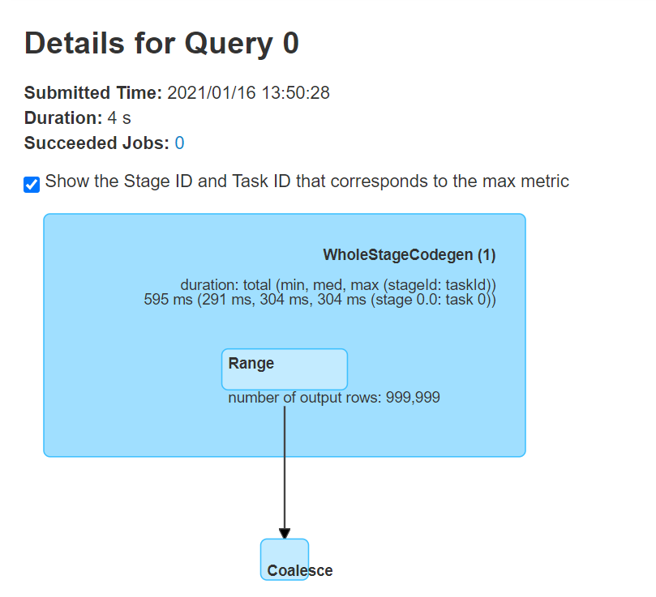

Slide 4
== Parsed Logical Plan ==
Repartition 2, false
+- Range (1, 1000000, step=1, splits=Some(8))
== Analyzed Logical Plan ==
id: bigint
Repartition 2, false
+- Range (1, 1000000, step=1, splits=Some(8))
== Optimized Logical Plan ==
Repartition 2, false
+- Range (1, 1000000, step=1, splits=Some(8))
== Physical Plan ==
Coalesce 2
+- *(1) Range (1, 1000000, step=1, splits=8)

Slide 5
/*
* Returns a new Dataset that has exactly `numPartitions` partitions, when the fewer partitions
* are requested. If a larger number of partitions is requested, it will stay at the current
* number of partitions. Similar to coalesce defined on an `RDD`, this operation results in
* a narrow dependency, e.g. if you go from 1000 partitions to 100 partitions, there will not
* be a shuffle, instead each of the 100 new partitions will claim 10 of the current partitions.
*
* However, if you're doing a drastic coalesce, e.g. to numPartitions = 1,
* this may result in your computation taking place on fewer nodes than
* you like (e.g. one node in the case of numPartitions = 1). To avoid this,
* you can call repartition. This will add a shuffle step, but means the
* current upstream partitions will be executed in parallel (per whatever
* the current partitioning is).
*/
def coalesce(numPartitions: Int): Dataset[T] = withTypedPlan {
Repartition(numPartitions, shuffle = false, logicalPlan)
}

Slide 6
/**
* Returns a new RDD that has exactly `numPartitions` partitions. Differs from
* [[RepartitionByExpression]] as this method is called directly by DataFrame's, because the user
* asked for `coalesce` or `repartition`. [[RepartitionByExpression]] is used when the consumer
* of the output requires some specific ordering or distribution of the data.
*/
case class Repartition(numPartitions: Int, shuffle: Boolean, child: LogicalPlan)
extends RepartitionOperation {
require(numPartitions > 0, s"Number of partitions ($numPartitions) must be positive.")
}

Slide 7
Object BasicOperators (This is a part of Catalyst)
case logical.Repartition(numPartitions, shuffle, child) => if (shuffle) { ShuffleExchangeExec(RoundRobinPartitioning(numPartitions), planLater(child), canChangeNumPartitions = false) :: Nil } else { execution.CoalesceExec(numPartitions, planLater(child)) :: Nil }

Slide 8
Class CoalesceExec
protected override def doExecute(): RDD[InternalRow] = {
if (numPartitions == 1 && child.execute().getNumPartitions < 1) {
// Make sure we don't output an RDD with 0 partitions, when claiming that we have a
// `SinglePartition`.
new CoalesceExec.EmptyRDDWithPartitions(sparkContext, numPartitions)
} else {
child.execute().coalesce(numPartitions, shuffle = false)
}
}

Slide 9
Abstract class RDD
def coalesce(numPartitions: Int, shuffle: Boolean = false,
partitionCoalescer: Option[PartitionCoalescer] = Option.empty)
(implicit ord: Ordering[T] = null)
: RDD[T] = withScope {
require(numPartitions > 0, s"Number of partitions ($numPartitions) must be positive.")
if (shuffle) {
……
} else {
new CoalescedRDD(this, numPartitions, partitionCoalescer)
}
}

Slide 10
Class CoalescedRDDPartition
private[spark] case class CoalescedRDDPartition( index: Int, @transient rdd: RDD[_], parentsIndices: Array[Int], @transient preferredLocation: Option[String] = None) extends Partition {
var parents: Seq[Partition] = parentsIndices.map(rdd.partitions(_)) … }

Slide 11
Class CoalescedRDD
override def compute(partition: Partition, context: TaskContext): Iterator[T] = {
partition.asInstanceOf[CoalescedRDDPartition].parents.iterator.flatMap { parentPartition =>
firstParent[T].iterator(parentPartition, context)
}
}

Slide 12
Class CoalescedRDD
override def getPartitions: Array[Partition] = {
val pc = partitionCoalescer.getOrElse(new DefaultPartitionCoalescer())
pc.coalesce(maxPartitions, prev).zipWithIndex.map {
case (pg, i) =>
val ids = pg.partitions.map(_.index).toArray
CoalescedRDDPartition(i, prev, ids, pg.prefLoc)
}
}

Slide 13
Class DefaultPartitionCoalescer
def coalesce(maxPartitions: Int, prev: RDD[_]): Array[PartitionGroup] = { val partitionLocs = new PartitionLocations(prev) // setup the groups (bins) setupGroups(math.min(prev.partitions.length, maxPartitions), partitionLocs) // assign partitions (balls) to each group (bins) throwBalls(maxPartitions, prev, balanceSlack, partitionLocs) getPartitions }

Slide 14
Bin packing problem
In the bin packing problem, items of different volumes must be packed into a finite number of bins or containers each of a fixed given volume in a way that minimizes the number of bins used. In computational complexity theory, it is a combinatorial NP-hard problem.[1] The decision problem (deciding if items will fit into a specified number of bins) is NP-complete.[2]
There are many variations of this problem, such as 2D packing, linear packing, packing by weight, packing by cost, and so on. They have many applications, such as filling up containers, loading trucks with weight capacity constraints, creating file backups in media and technology mapping in field-programmable gate array semiconductor chip design.
The bin packing problem can also be seen as a special case of the cutting stock problem. When the number of bins is restricted to 1 and each item is characterised by both a volume and a value, the problem of maximising the value of items that can fit in the bin is known as the knapsack problem.
Despite the fact that the bin packing problem has an NP-hard computational complexity, optimal solutions to very large instances of the problem can be produced with sophisticated algorithms.
https://en.wikipedia.org/wiki/Bin_packing_problem

Slide 15
Class DefaultPartitionCoalescer
/** * Initializes targetLen partition groups. If there are preferred locations,
* each group is assigned a preferredLocation. This uses coupon collector to
* estimate how many preferredLocations it must rotate through until it has
* seen most of the preferred locations (2 * n log(n)) * @param targetLen The number of desired partition groups */ def setupGroups(targetLen: Int, partitionLocs: PartitionLocations): Unit = { // deal with empty case, just create targetLen partition groups with
//no preferred location if (partitionLocs.partsWithLocs.isEmpty) { (1 to targetLen).foreach(_ => groupArr += new PartitionGroup()) return }

Slide 16
def throwBalls(
maxPartitions: Int,
prev: RDD[_],
balanceSlack: Double, partitionLocs: PartitionLocations): Unit = {
if (noLocality) { // no preferredLocations in parent RDD, no randomization needed
if (maxPartitions > groupArr.size) { // just return prev.partitions
for ((p, i) <- prev.partitions.zipWithIndex) {
groupArr(i).partitions += p
}
} else { // no locality available, then simply split partitions based on positions in array
for (i <- 0 until maxPartitions) {
val rangeStart = ((i.toLong * prev.partitions.length) / maxPartitions).toInt
val rangeEnd = (((i.toLong + 1) * prev.partitions.length) / maxPartitions).toInt
(rangeStart until rangeEnd).foreach{ j => groupArr(i).partitions += prev.partitions(j) }
}
}
} else {

Slide 17
Example
P0
P1
P2
P3
P4
P5
P6
P7
P8
P9
P0
P1
0*10/2 = 0
1*10/2 = 5
[0,5)
1*10/2 = 5
2*10/2 = 10
[5,10)

Slide 18
def getPartitions: Array[PartitionGroup] = groupArr.filter( pg => pg.numPartitions > 0).toArray

Slide 19
Class CoalescedRDD
override def getPartitions: Array[Partition] = {
val pc = partitionCoalescer.getOrElse(new DefaultPartitionCoalescer())
pc.coalesce(maxPartitions, prev).zipWithIndex.map {
case (pg, i) =>
val ids = pg.partitions.map(_.index).toArray
CoalescedRDDPartition(i, prev, ids, pg.prefLoc)
}
}

Slide 20
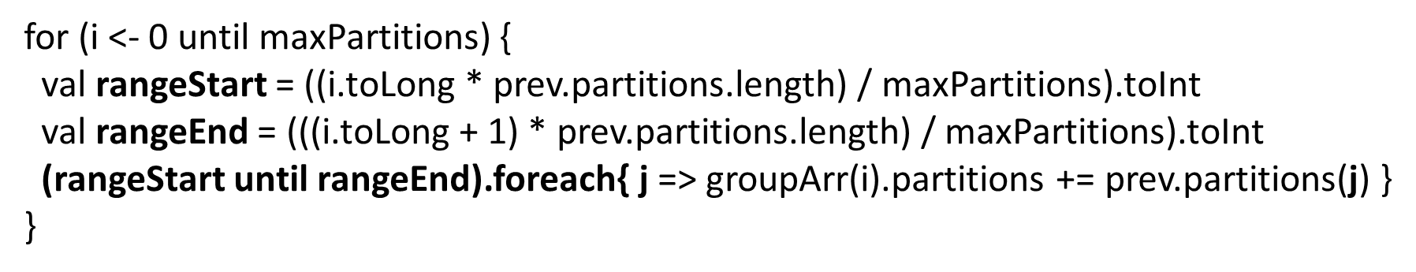
Summary
CoalescedRDD
If no locality available, then simply split partitions based on positions in array

